Slide 1

Macroeconomics II
Lecture 01 (13 Feb 2022)
Introduction
Concepts
Growth
Convergence and divergence
1
Notes:
1

Slide 2
Macro 2
Objectives
Macroeconomics II is a course that aims to study modern economic growth by providing the conceptual elements, as well as the main theories and basic analytical tools for the research on the factors of economic growth, and to introduce students to discussion on choices for economic development.
Concepts
Theories / analytical tools
Reality
Strategies for development
Macroeconomics of Growth
2
Notes:
2

Slide 3
Syllabus
Part I – Economic growth: concepts and models
1. Introduction. Economic growth: data and facts. Computation of growth rates. Crises.
2 A map of theories of growth. Smith, Marx and the classics.
3. Economic growth: stylised facts.
4. The cases of the US, South Korea and China.
5. The macroeconomic production function. Growth accounting.
6. The Harrod-Domar model. Criticism by Solow.
7. The Solow model.
8. Endogenous growth models. The Romer approach.
Part II – Limits to growth
9. Limits to growth and sustainability.
10. Climate change, its causes and impacts.
11. Inequality, distribution and growth.
12. Welfare and social security.
13. Debt and financialization.
14. Innovation, crises and cycles.
Part III – Development strategies
15. Growth policies and growth regimes.
16. Industrialisation and economic growth.
17. Industrial policy and investment choices.
18. Economic development in a global economy.
3
Notes:
3

Slide 4
A successful student of Macro 2
What is required (for a continual assessment over the semester):
1. Attend all the lectures;
2. Attend all the tutorials (practical classes), do the exercises, read the required texts in advance and participate in the discussions (worth 15% of the grade)
3. Read the recommended readings (indicated in the slides for each class and made available in the Macro 2 Fenix page). The main reference books are:
    (in English) Jones, C. & Vollrath, D. (2013), Introduction to Economic Growth. Norton. 3rd edition. (ISEG library: HD75.J65 201)
    (in Portuguese only) Louçã, F. and Mortágua, M. (2021), Manual de Economia Política. Bertrand.
4. Take and submit the mid-term test (on the week of 27 March) (worth 15% of the final grade)
5. Write and submit an essay on a topic to be indicated (worth 20% of the final grade)
6. Take the final exam (worth 50% of the final grade)
Alternatively, (or in case of failing in the Época Normal), you have the Época de Recurso.
4
Notes:
4

Slide 5
Lecture 01
Economic Growth: data and facts
what is economic growth?
why is it important to study economic growth?
which questions are relevant?
Reading
Louçã e Mortágua (2021), Chapter 2
Jones & Vallrath (2013), cap. 1, pp. 1 – 19 “Introduction: the facts of economic growth”+ Appendix A - Mathematical Review(pp. 261-274)
5
Notes:
5

Slide 6
what is economic growth?
change over time of the magnitude of an economically relevant variable
relevance: GDP, as a measure of the value of all of the goods and services produced in
a country in a year
indicator of differences in economic status among countries
indicator of the trend of living standards of population in a country
indicator of abundance and of the productivity of the production factors (differences among
countries and time trend for each country)
        y (t)
what is y? it depends of the focus of the analysis
Notes:
6
FIGURE 3.5 CONVERGENCE IN THE OECD, 1960–2008
SOURCE: Penn World Tables Mark 7.0 and Summers and Heston (1991)

Slide 7
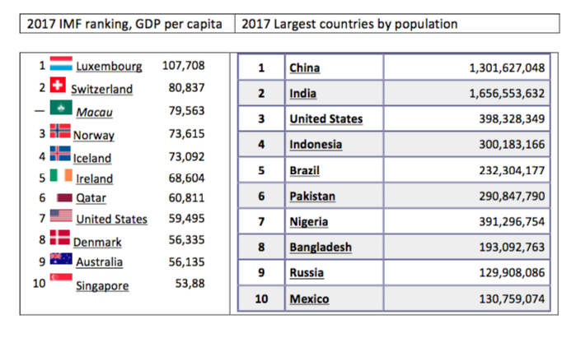
Top Ten Countries in 2017 According to Two Different Measures
China 1.409.517
India 1.339.188
USA 324.459
Indonesia 263.991
Brazil 209.288
Pakistan 197.016
Nigeria 190.886
Bangladesh 164.670
Russia 143.990
Mexico 129.163
Notes:
7

Slide 8
Use the graph: https://www.gapminder.org/tools/#_chart-type=linechart
economic growth is a long-term economic trend. A quite recent divergence among regions?
Notes:
8

Slide 9
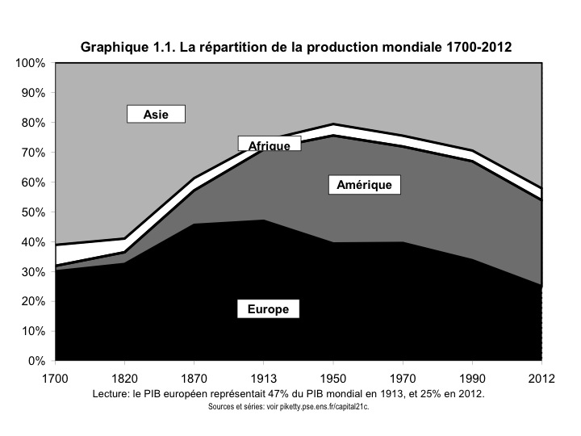
World production (1700-2012)
9
Notes:
9

Slide 10
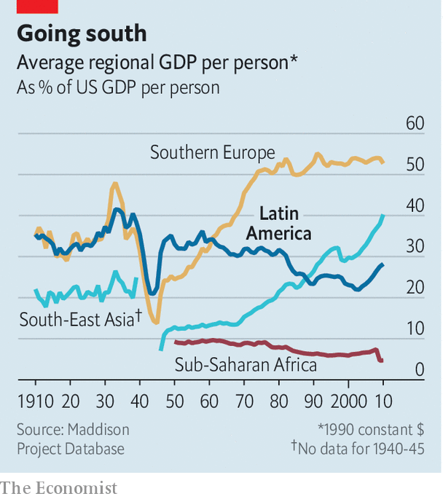
But growth is very unequal
Notes:
10

Slide 11
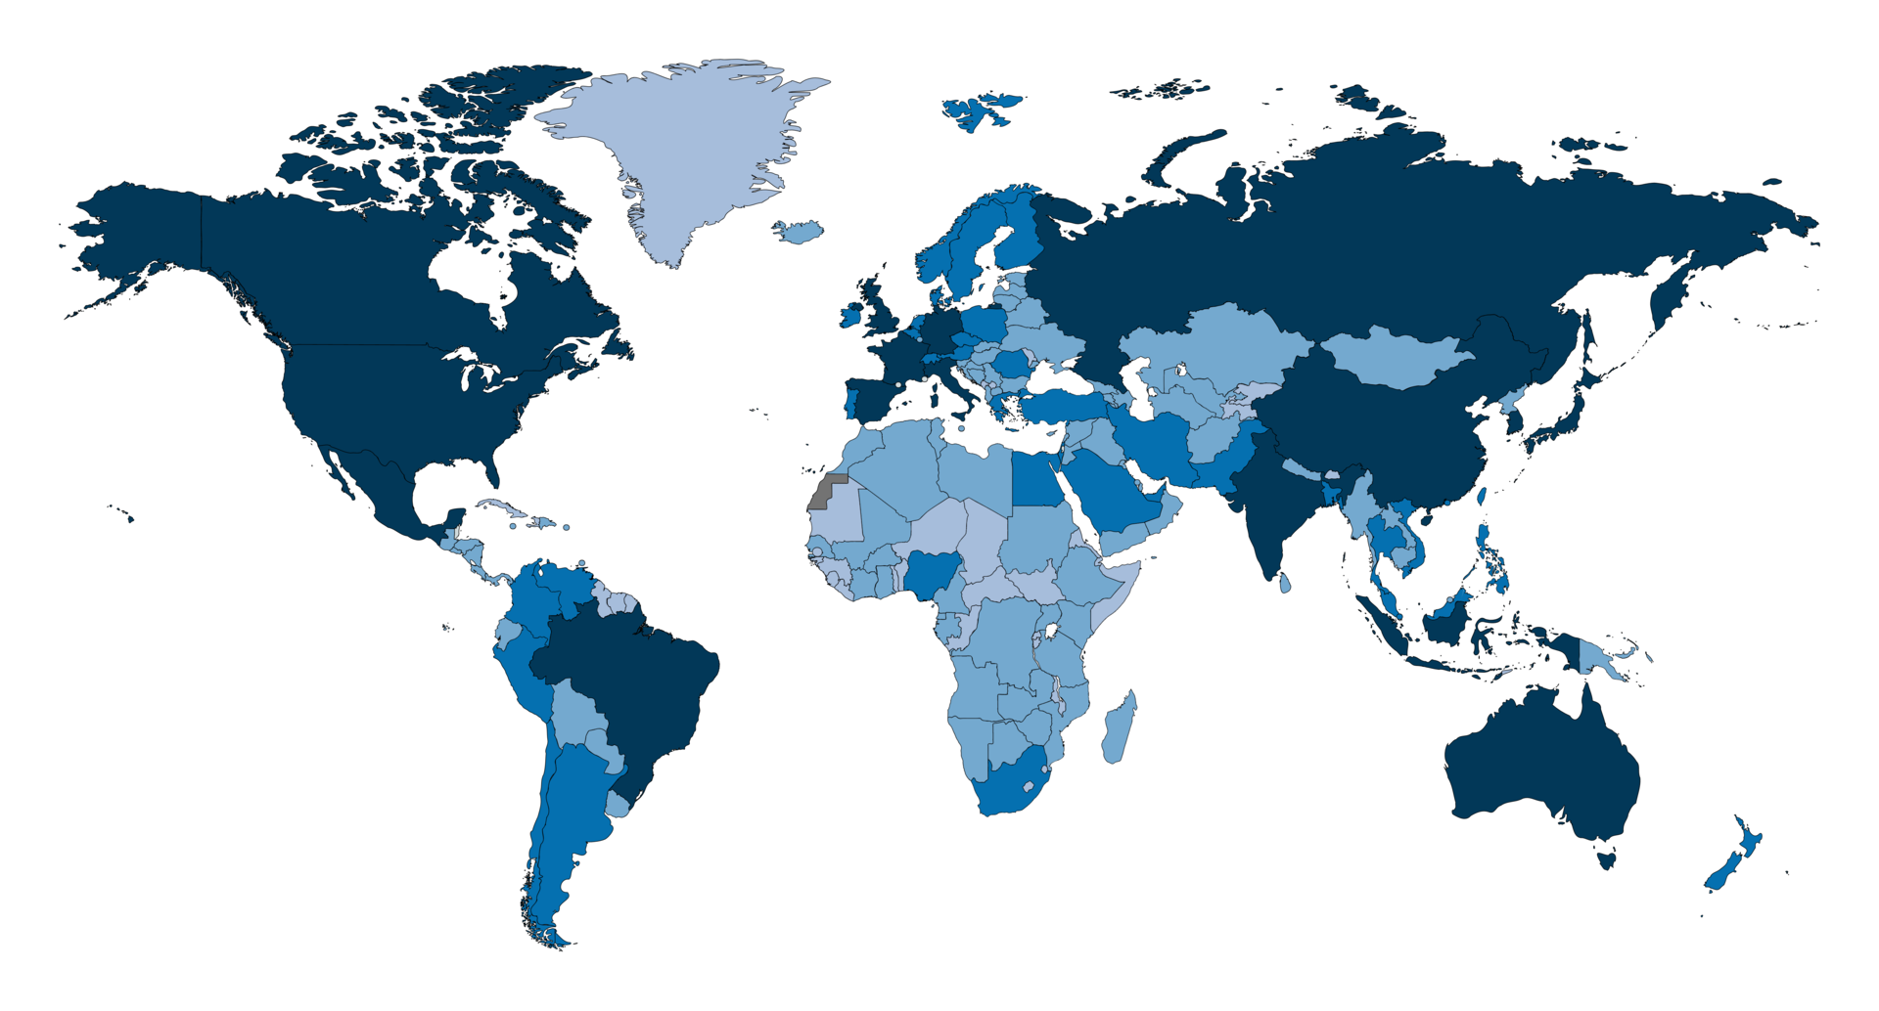
World GDP (2017)
The darker, the larger the GDP

Slide 12
y is GDP … which one?
GDP -> economic size
GDP per capita -> living standard
GDP per worker -> labour productivity
GDP currrent prices
GDP constant prices using national currency
GDP constant prices using market exchange rates (dollars)
GDP constant prices using PPP exchange rates (dollars)
Notes:
12
FIGURE 3.5 CONVERGENCE IN THE OECD, 1960–2008
SOURCE: Penn World Tables Mark 7.0 and Summers and Heston (1991)

Slide 13
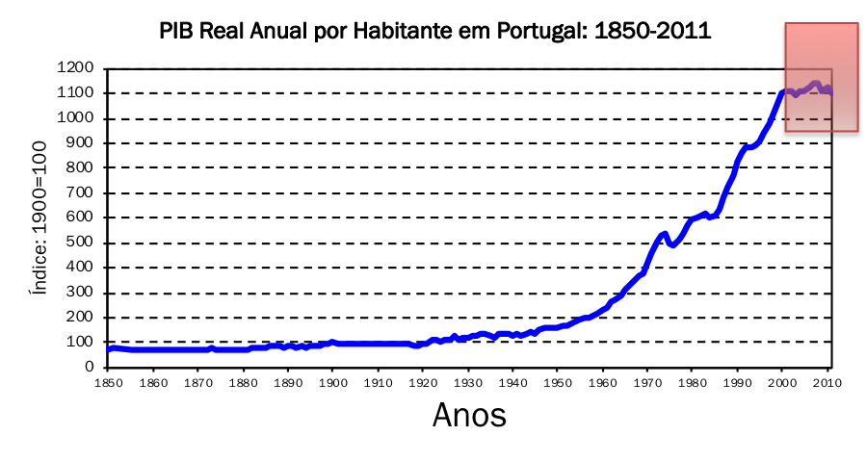
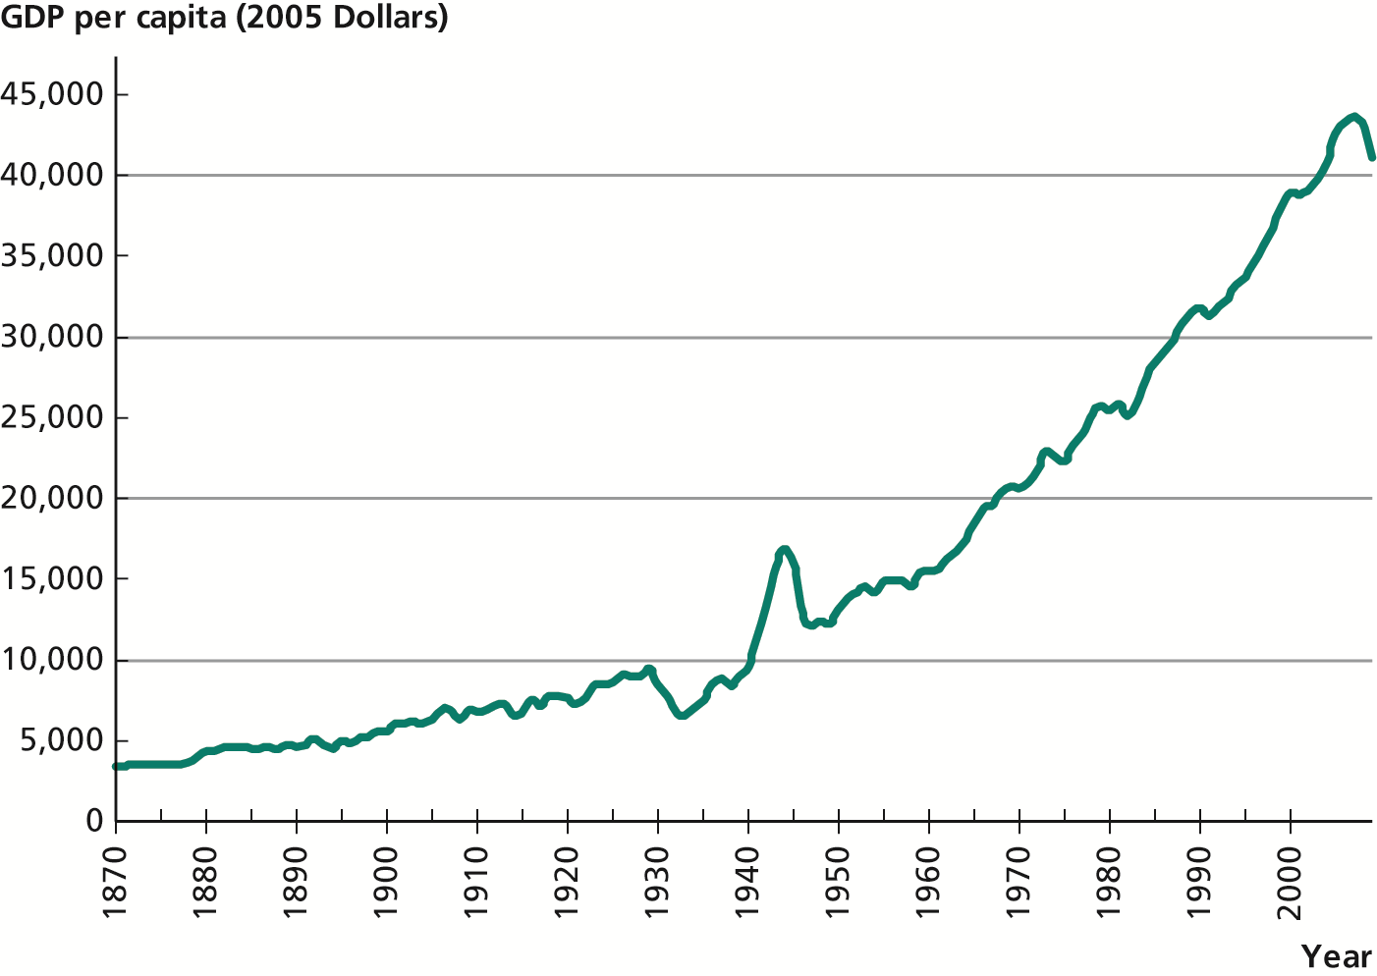
look at the growth of USA GDP per capita 1870 – 2009
Notes:
13
FIGURE 3.5 CONVERGENCE IN THE OECD, 1960–2008
SOURCE: Penn World Tables Mark 7.0 and Summers and Heston (1991)

Slide 14
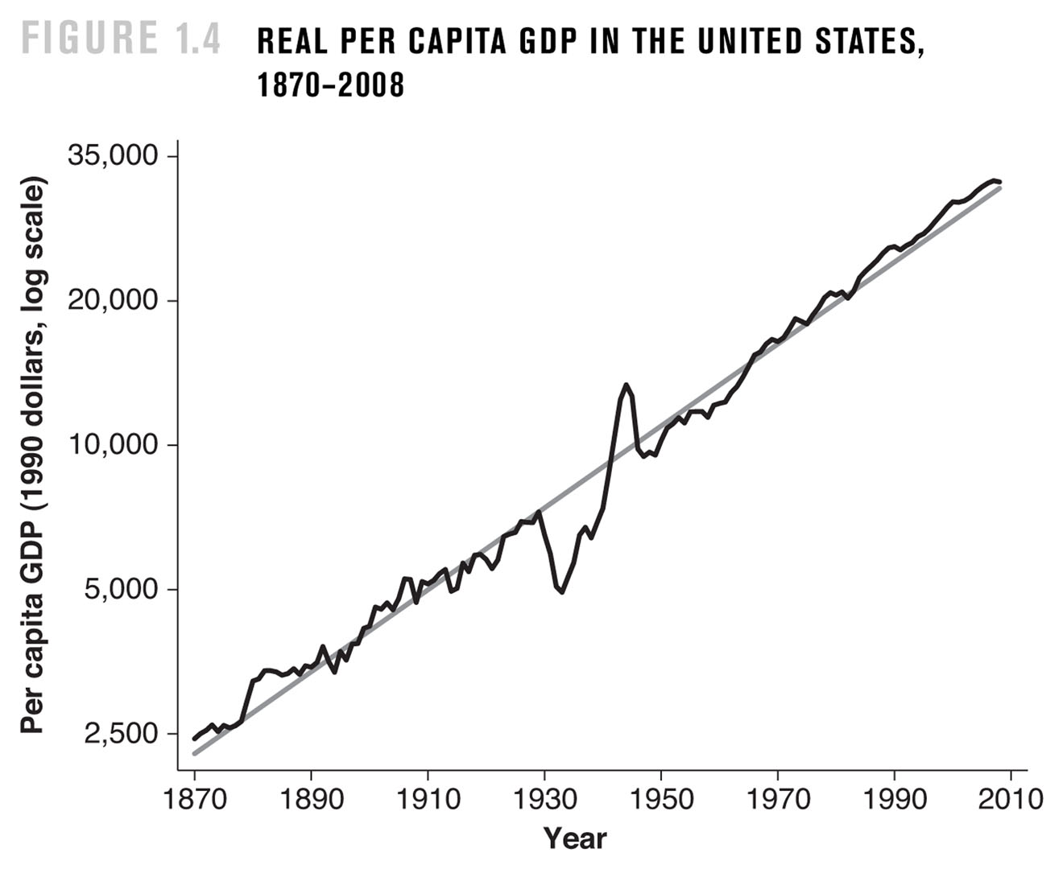
the trend
14
Notes:
14

Slide 15
and what is means – a simple mathematical formulation
ln y (t)
the slope of ln y(t) is the average
growth rate of y(t)
g is the average growth rate of y
the slope of ln y(t)
15
Notes:
15

Slide 16
GDP per capita in the present (y_{t}) depends on the GDP in the past (y₀) and the growth rate of GDP per capita till the present (g)
this is the theoretical formulation
16
Notes:
16

Slide 17
we should distinguish long-term trend from short term
fluctuations around the trend
the procedures:
(the relevance of looking at the data)
1. look at the growth of USA GDP per capita 1870 – 2009
2. find out the trend
3. look at the fluctuations around the trend
4. make an interpretation of what you see (and ask what it means)
5. what else is relevant for observation?
Notes:
17
FIGURE 3.5 CONVERGENCE IN THE OECD, 1960–2008
SOURCE: Penn World Tables Mark 7.0 and Summers and Heston (1991)

Slide 18
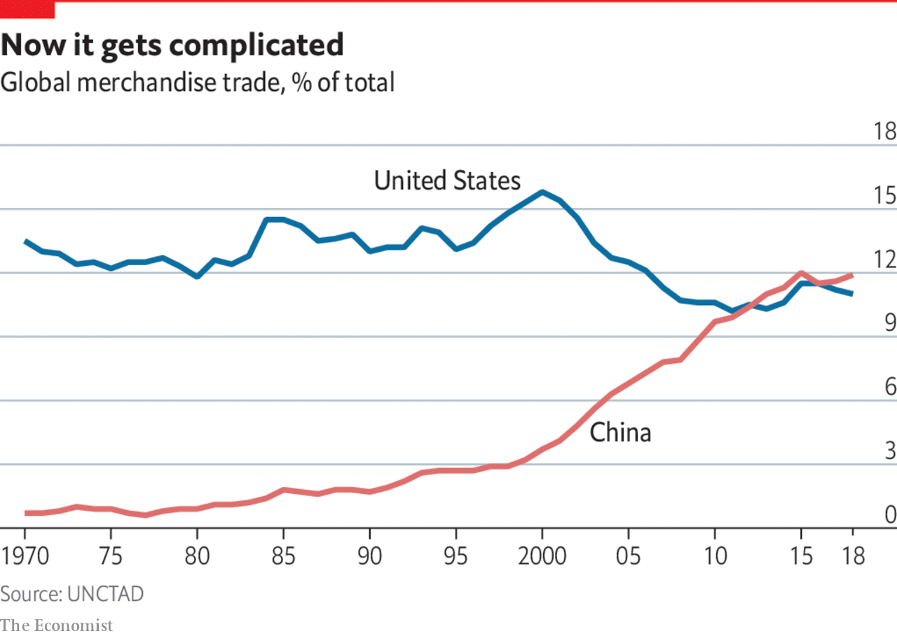
Another look at inequality of growth: USA and China in the world trade (1970 – 2019)
Notes:
18

Slide 19
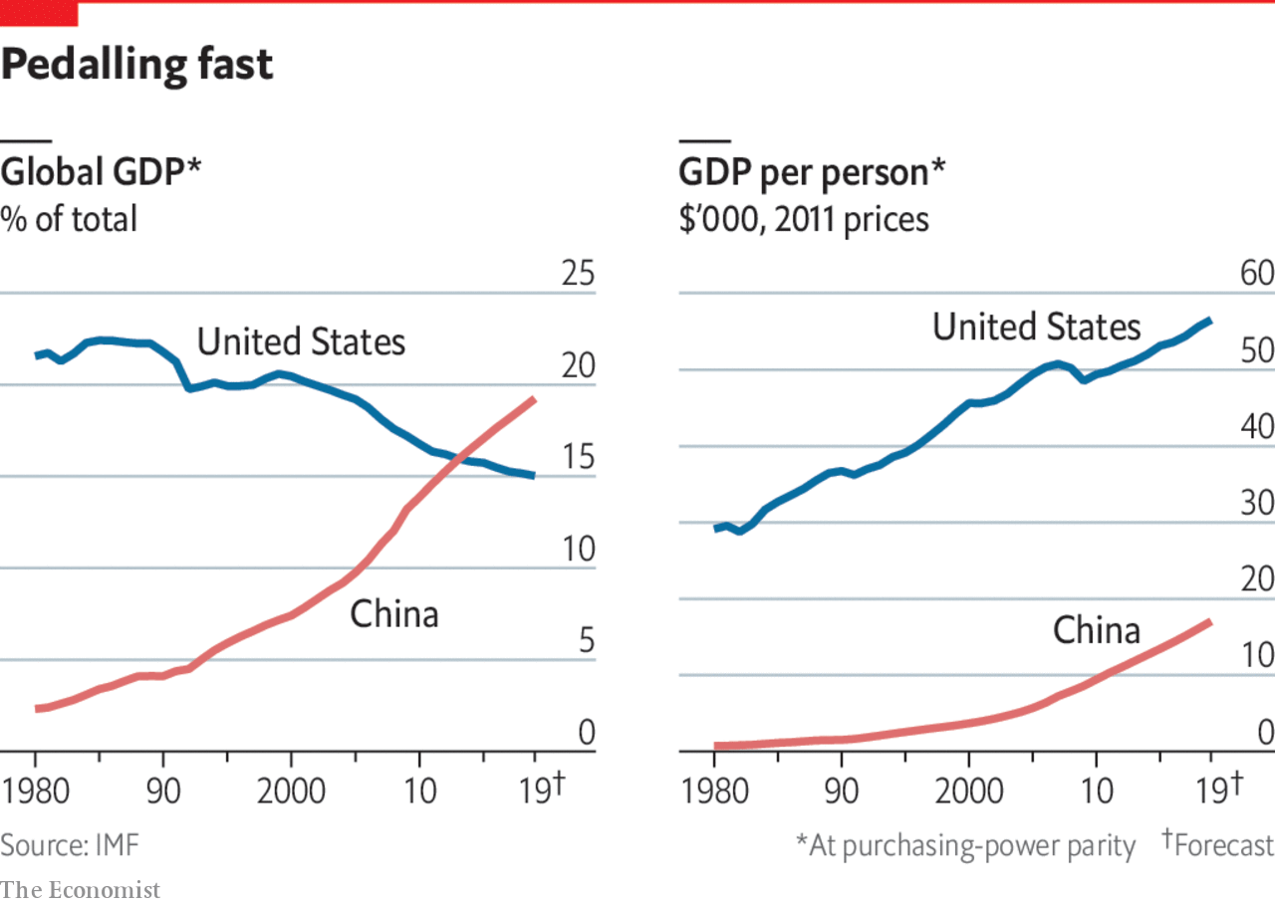
Are USA and China converging or diverging?
Notes:
19

Slide 20
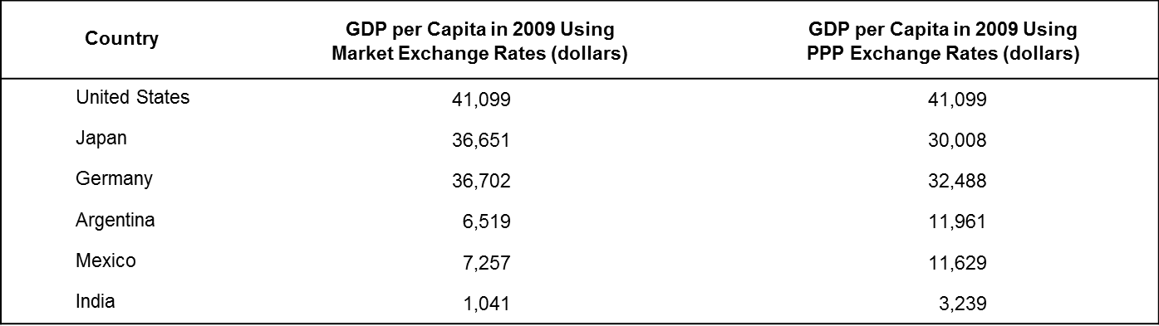
PPP Exchange Rates
exchange rates based on the prices of a standardized basket of goods and services.
Notes:
20
FIGURE 3.5 CONVERGENCE IN THE OECD, 1960–2008
SOURCE: Penn World Tables Mark 7.0 and Summers and Heston (1991)

Slide 21
major questions for research in modern growth theory
why some countries grow faster than others? (level)
are the various nations converging? (convergence)
what are the prospects (the future) of economic growth? (factors of growth)
What type of growth is sustainable?
Notes:
21
FIGURE 3.5 CONVERGENCE IN THE OECD, 1960–2008
SOURCE: Penn World Tables Mark 7.0 and Summers and Heston (1991)

Slide 22
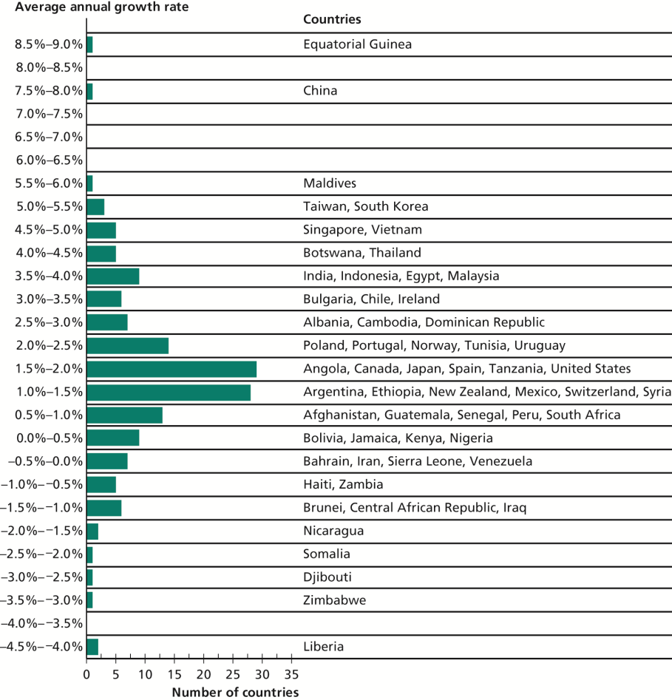
… and wide differences (too) in the growth rate of GDP per capita …
The Distribution of Growth Rates,
1975–2009, until the last recession
Source: Heston, Summers, and
Aten (2011).
22
Notes:
22

Slide 23
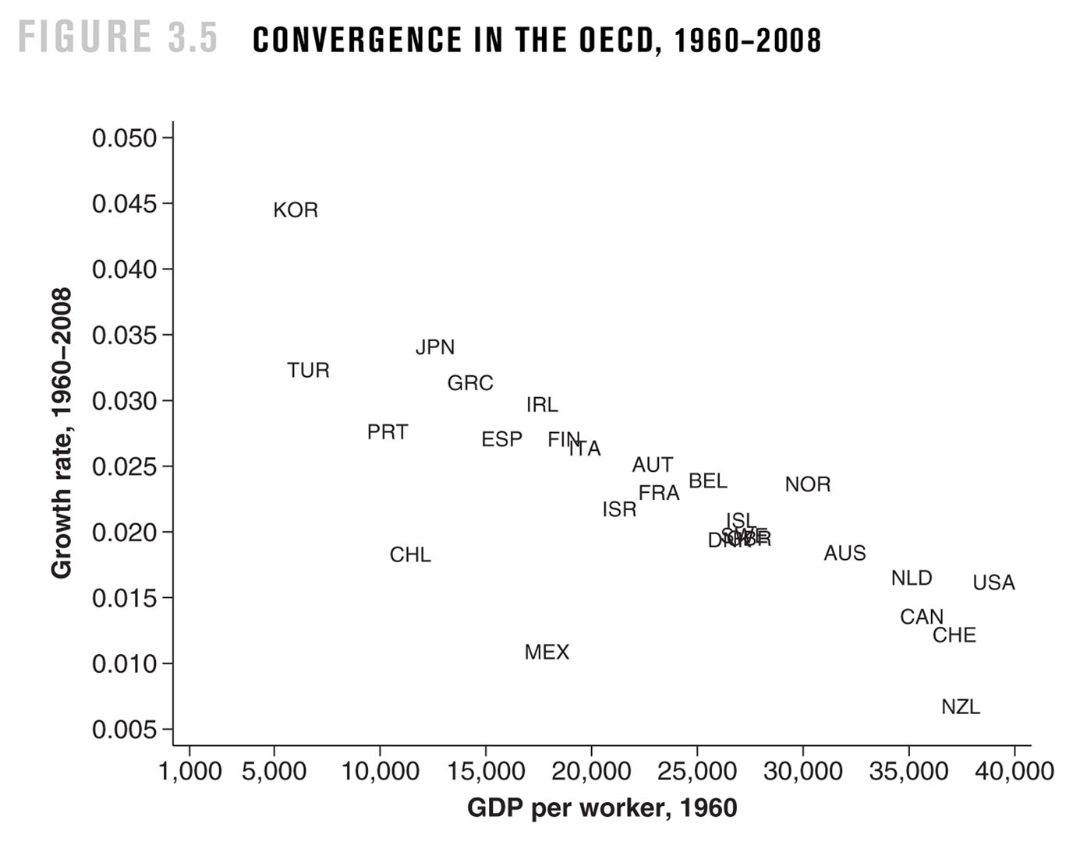
Introduction to Economic Growth, 3rd Edition
Copyright © 2013, W.W. Norton & Company
Notes:
23
FIGURE 3.5 CONVERGENCE IN THE OECD, 1960–2008
SOURCE: Penn World Tables Mark 7.0 and Summers and Heston (1991)

Slide 24
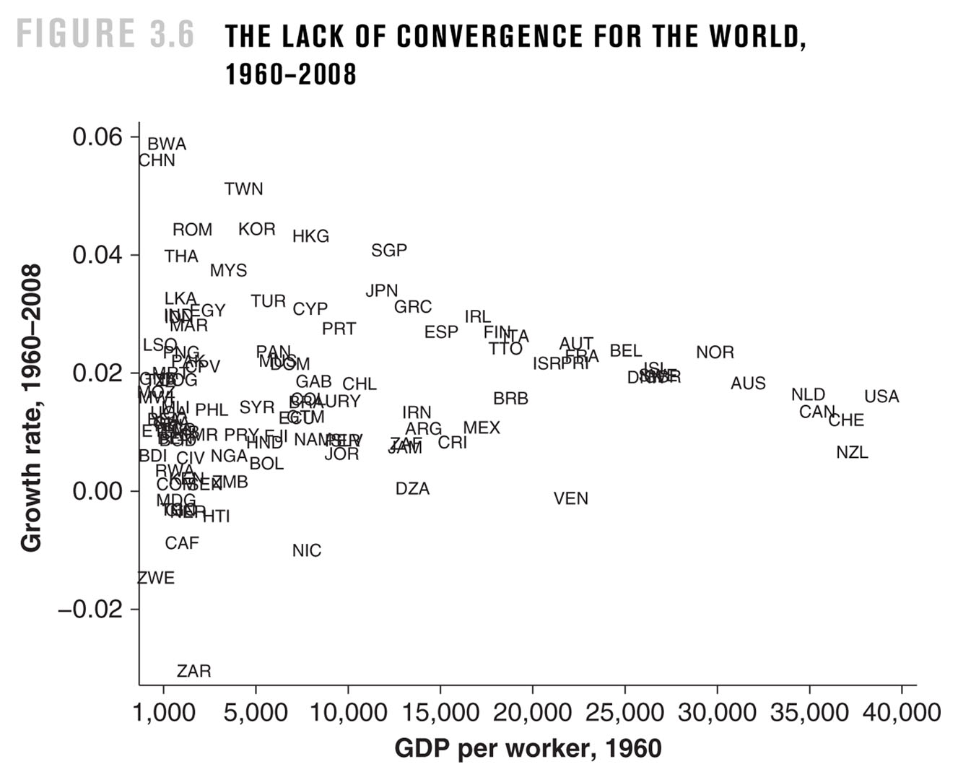
Introduction to Economic Growth, 3rd Edition
Copyright © 2013, W.W. Norton & Company
Notes:
24
FIGURE 3.6 THE LACK OF CONVERGENCE FOR THE WORLD, 1960–2008
SOURCE: Penn World Tables Mark 7.0 and Summers and Heston (1991)

Slide 25
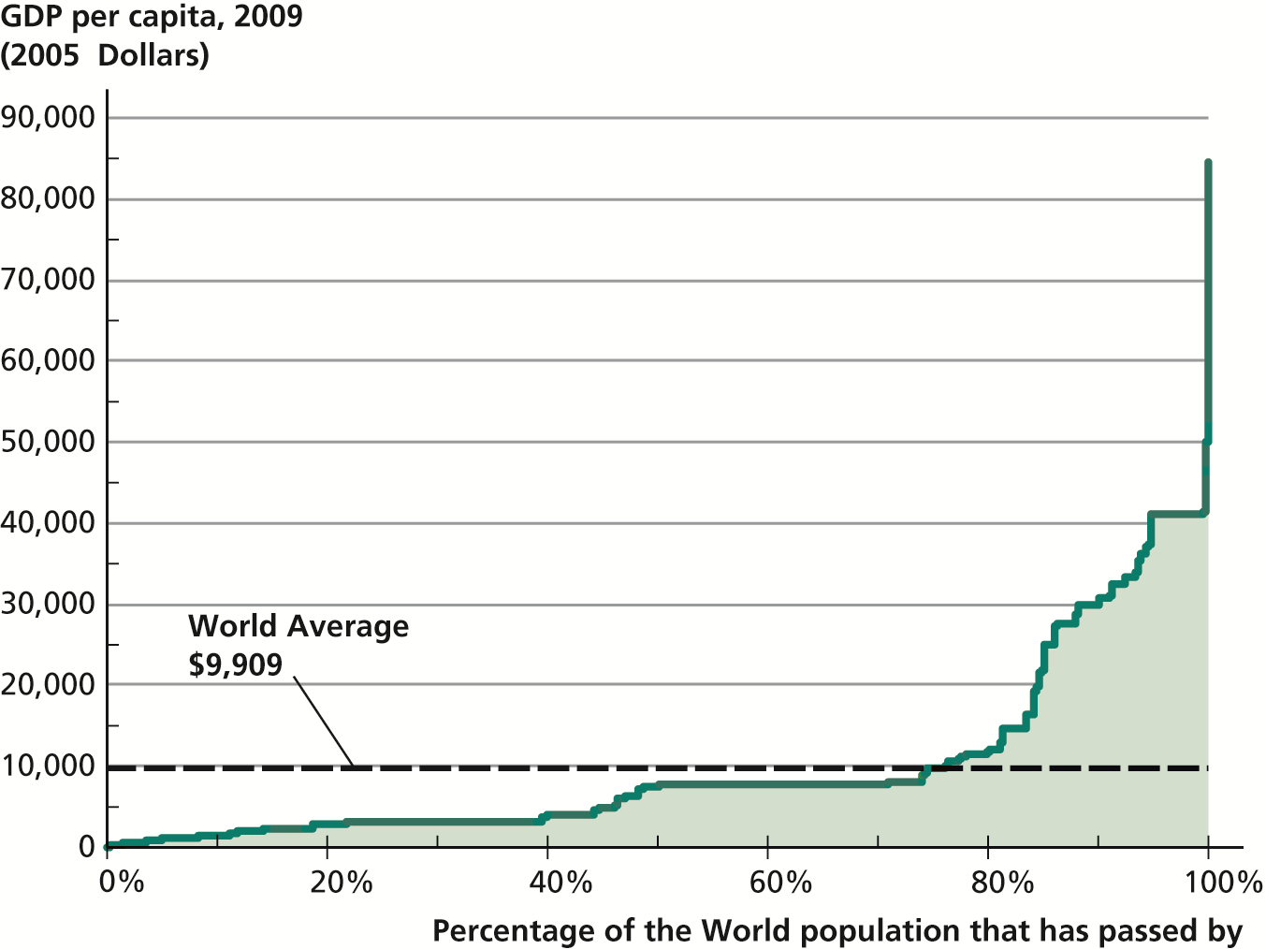
wide differences in the world on the level
of GDP per capita …
Source: Heston, Summers, and Aten (2011).
Notes:
25

Slide 26
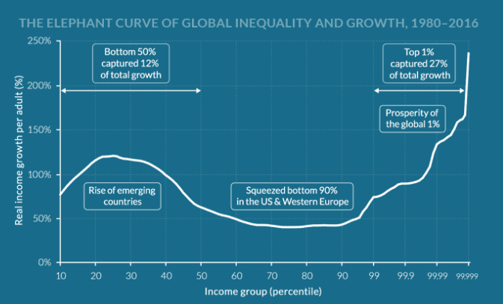
World Inequality
26
Notes:
26

Slide 27
Developmentalist theories of economic growth
(20th Century)
after WW II (1940s, 1950s); in the context of economic reconstruction of Europe, Marshall Plan (economists participated as experts in the UN, WBank, etc);
major characteristics of such “school”(?) of thought (developmentalist theories)
Study less developed economies
industrialization as the driving force of economic growth;
influence of Keynesian thought;
advocate large-scale, short-term governmental intervention into the economy.
main authors: Rosenstein-Rodan, Ragnar Nurske, Hirschman, Arthur Lewis, Walt Rostow, etc
27

Slide 28

Old interpretations of growth
Walt Rostow (1916-2003)
participated as economist in the Economic Commission for Europe, in the implementation of the Marshall Plan.
was professor at MIT (1951-1961)
He wrote “The Stages of Economic Growth”, The Economic History Review (new series), vol 12, nº 1, 1959, pp. 1-16.
28

Slide 29
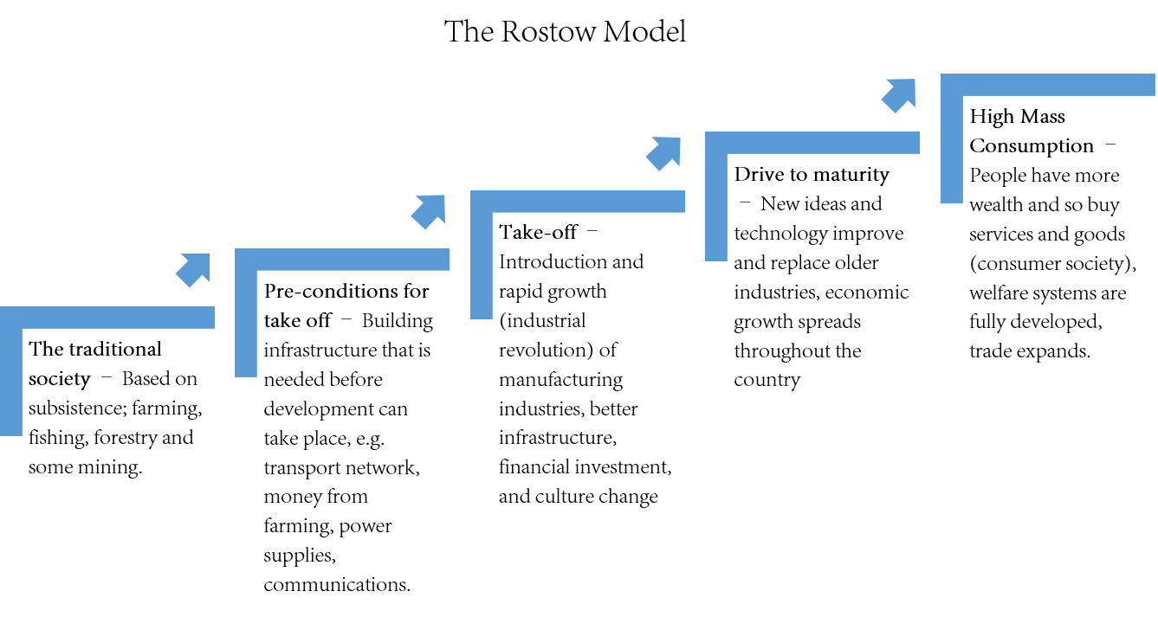

Slide 30
Recent questions
for economic development debates:
Inequality: causes, tendencies (national and global), implications for growth
Industrial policies and trade relations: theoretical debates; the return of industrial policy; trade wars, protectionism, “reshoring”,…
Climate change and its implications
Financialisation, debt and crises

