Slide 1
Intermediate Microeconomics: An Intuitive Approach with Calculus, 1e
Chapter 21 –
Externalities in Competitive Markets

Slide 2
Externalities
Externalities arise when either costs or benefits are imposed on non-market participants.
Market participants – i.e. producers and consumers – have no incentive to take such costs and benefits into account.
In the absence of such “external costs and benefits”, private marginal benefits (as expressed in demand curves) and private marginal costs (as expressed in supply curves) are equivalent to social marginal benefits and social marginal costs.
But in the presence of external costs and benefits, social marginal costs and social marginal benefits deviate from what we measure in demand and supply curves.
As a result, the competitive equilibrium ceases to be efficient unless something happens to bring private and social incentives in line with one another.
That “something” can involve government policy, markets and/or civil society.

Slide 3
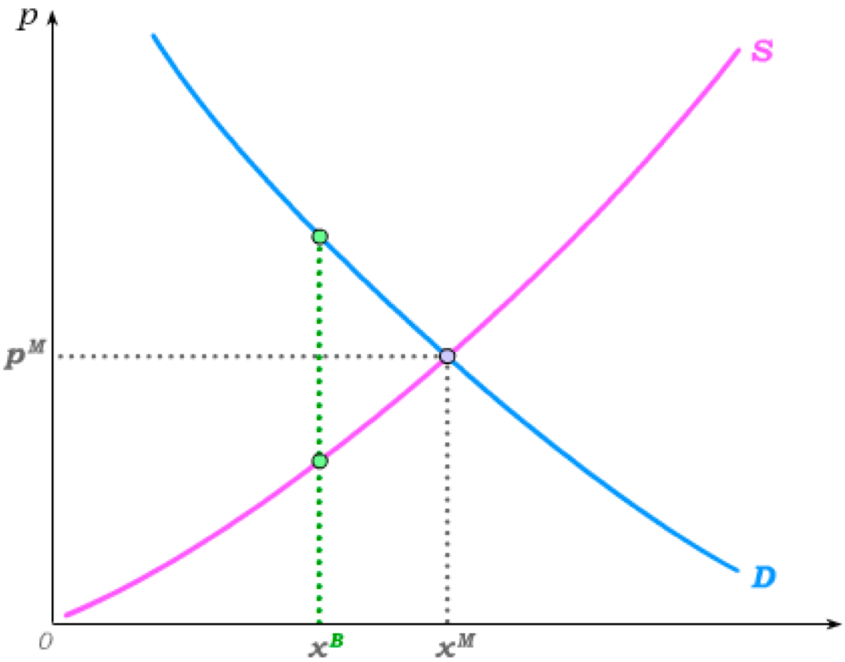
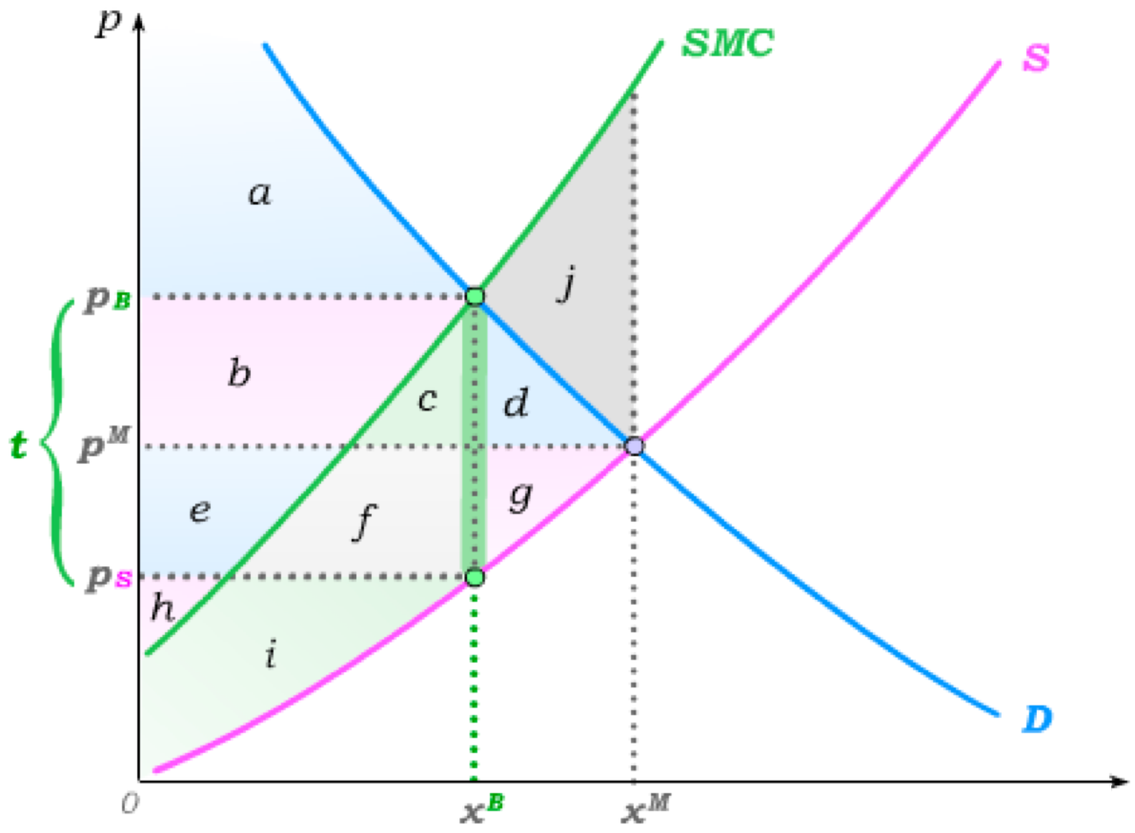
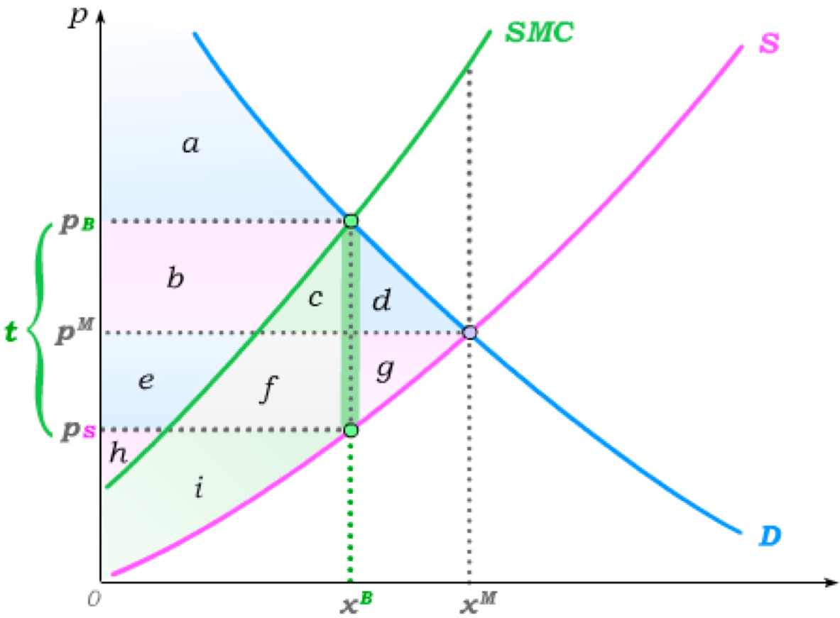
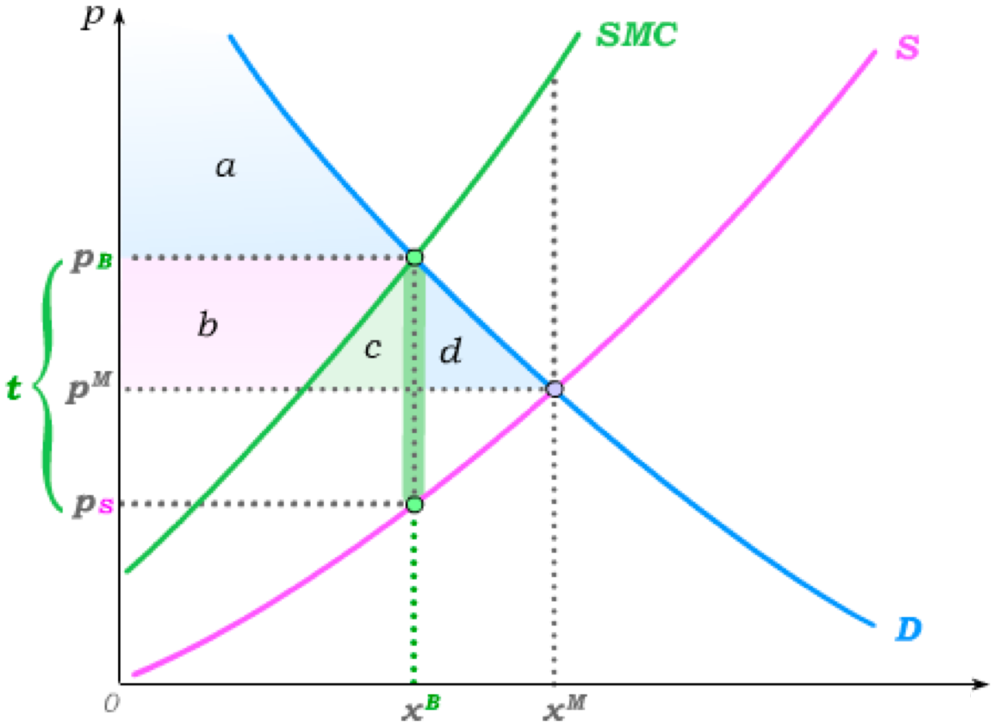
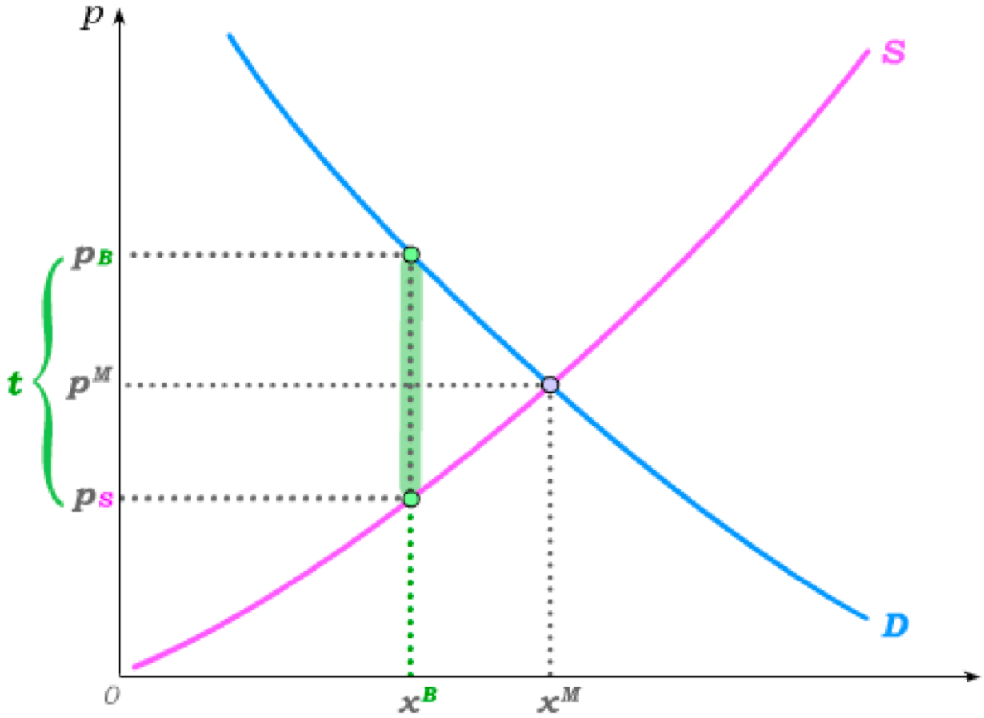
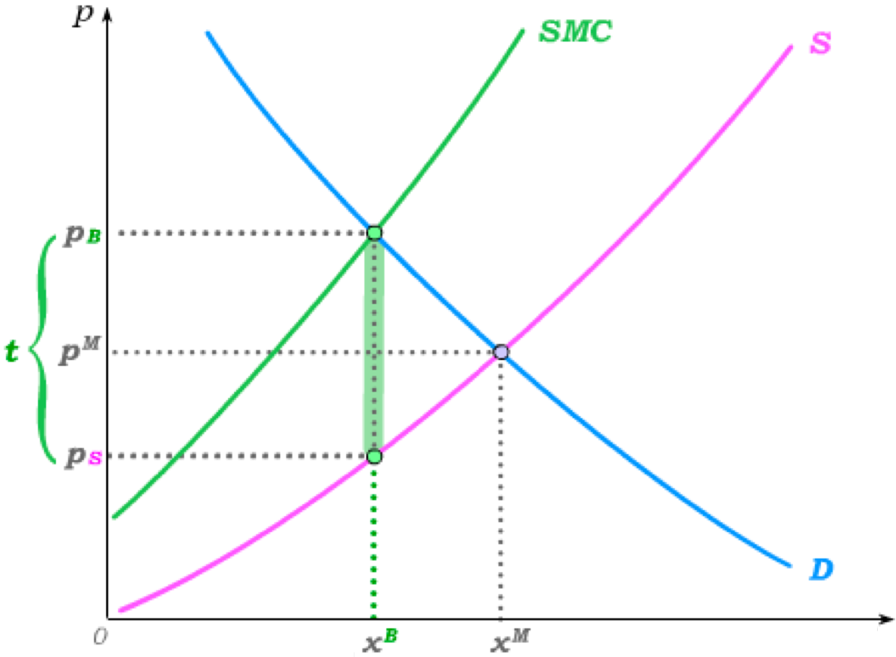
Pigouvian Taxes
We know from our work on taxes that market output can be reduced through the imposition of a per-unit tax.
A per-unit tax t that is set equal to the difference between SMC and producer MC as evaluated at at the efficient output level x^{B}
is called a Pigouvian Tax.
without tax with tax
Consumer Surplus
a+b+c+d
a+b+c+d
a
a
Producer Surplus
e+f+g+h+i
e+f+g+h+i
h+i
h+i
Pollution Damage
– (c+d+f+g+i+j)
– (c+d+f+g+i+j)
– (c+f+i)
– (c+f+i)
b+c+e+f
Tax Revenue
None
b+c+e+f
Total Surplus
a+b+e+h – j
a+b+e+h
By reducing the market quantity to the efficient quantity, a Pigouvian tax eliminates the DWL from the pollution externality.

Slide 4
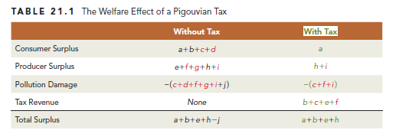
The Welfare Effect of a Pigouvian Tax

Slide 5
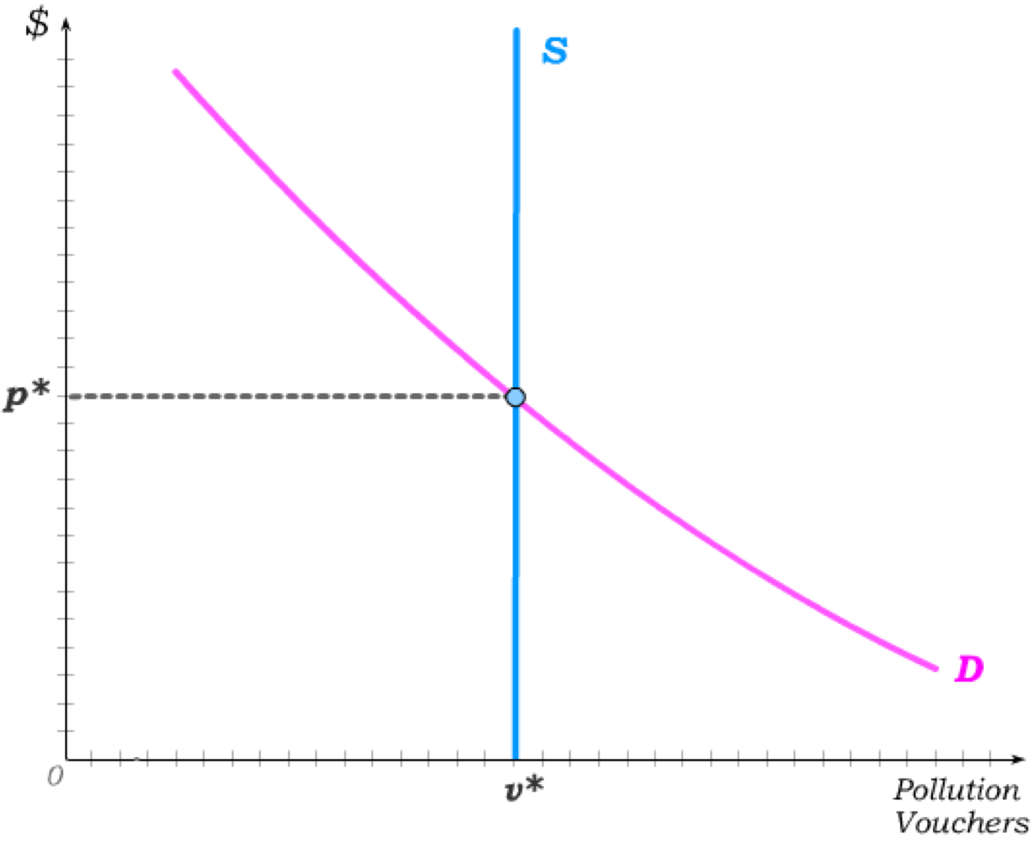
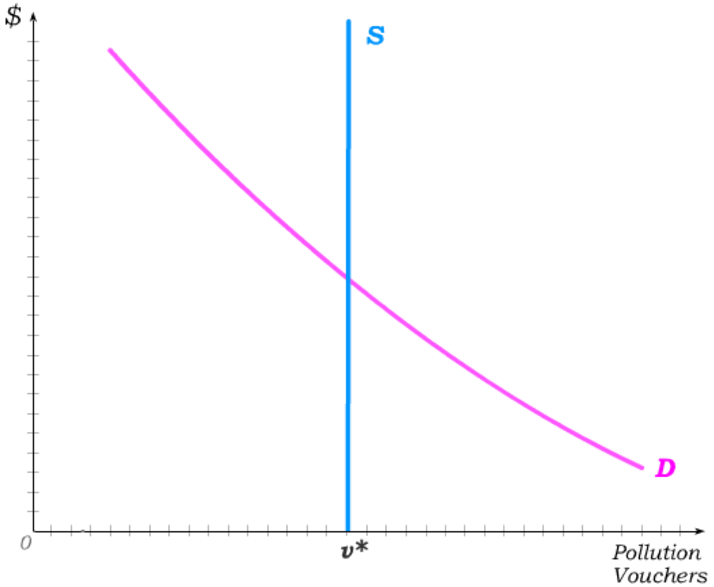
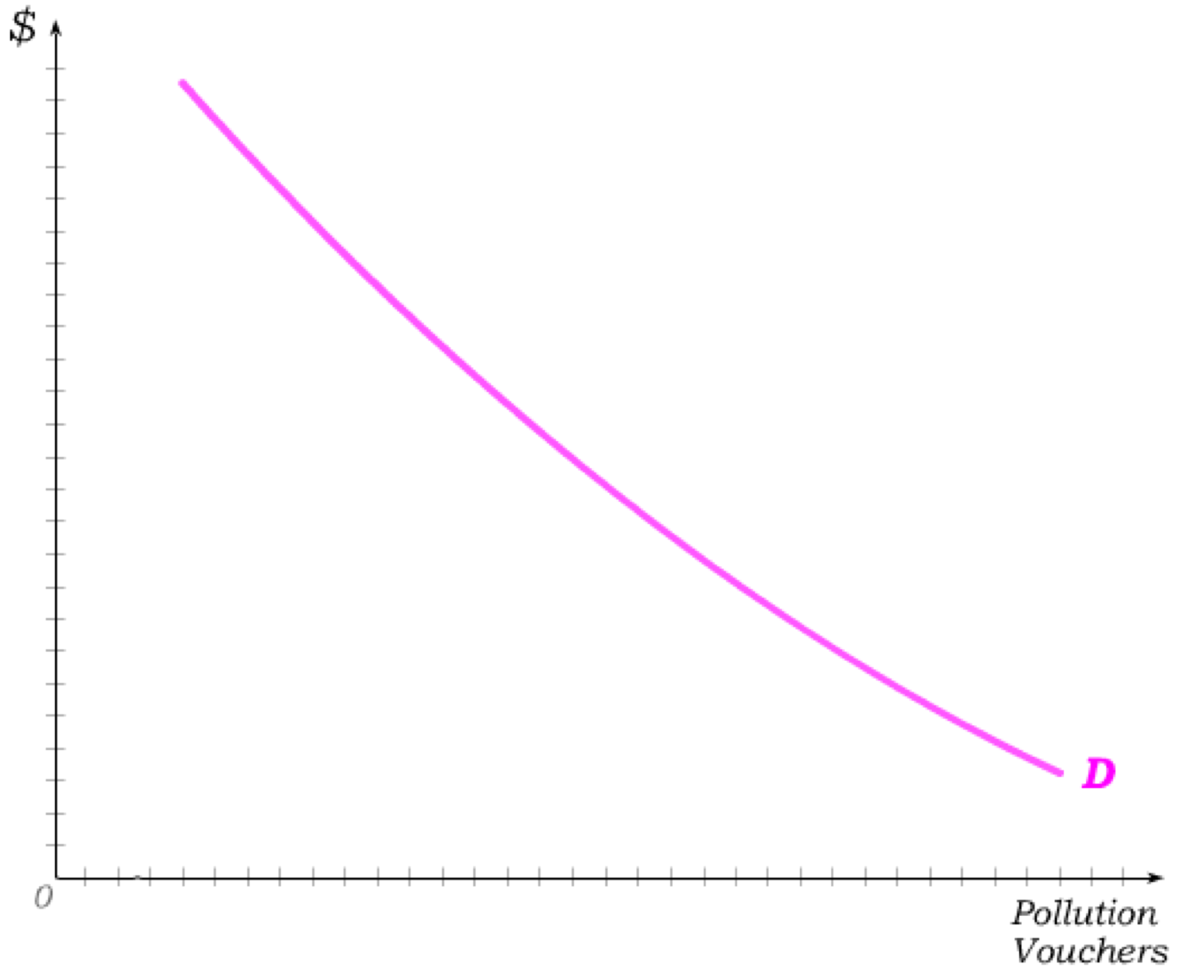
Cap-and-Trade and Pollution Permits
Another policy to address pollution externalities is known as Cap-and-Trade.
A cap on
overall pollution is set, and pollution permits (or pollution vouchers) that sum to the cap are printed and then traded in a market for such permits.
Pollution permits then become an input into production for polluting firms, with market demand for vouchers summing all polluting firms’ demands.
€
The supply of vouchers is set by the government as it sets the cap …
… and a market price p* permits are traded.
High
demand firms
High demand firms find it difficult to reduce pollution and thus buy the vouchers …
… while low demand firms find it cheaper to just reduce pollution and thus don’t buy vouchers.
Low
demand firms
Overall pollution is then reduced in the least costly way (without the government having to know firm costs.)

Slide 6
Pollution Taxes vs. Cap-and-Trade
A Pigouvian Tax is a per-unit tax on output in industries that emit pollution.
A Pollution Tax is a per-unit tax on pollution in industries that emit pollution.
It therefore sets a price for polluting directly so that firms that employ pollution-abating technologies reduce their tax burden.
Once a price for polluting is set under a pollution tax, the overall level of pollution is determined in the market.
Under cap-and-trade, the government instead sets an overall level of pollution and then allows the price for polluting to be set in the market for pollution permits.
Once a level of pollution is set under cap-and trade, the price of polluting is determined in the market.
If the equilibrium level of pollution that emerges under a pollution tax is instead set as the cap on pollution under a cap-and-trade system, the equilibrium price of pollution that emerges under cap-and-trade is equal to the pollution tax.
Whether a pollution tax or a cap-and-trade system is “better” then largely depends on political feasibility and administrative costs of the two systems.

Slide 7
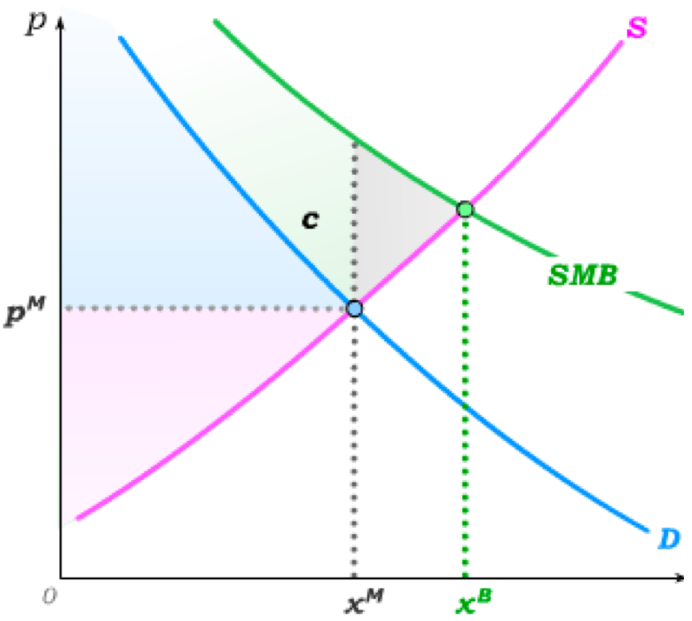
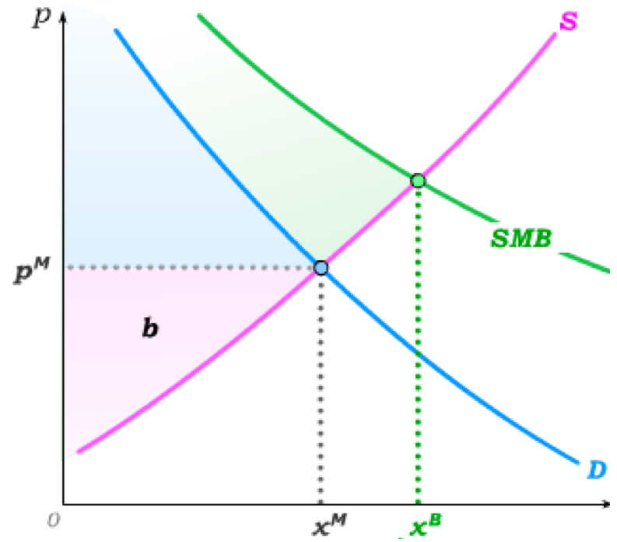
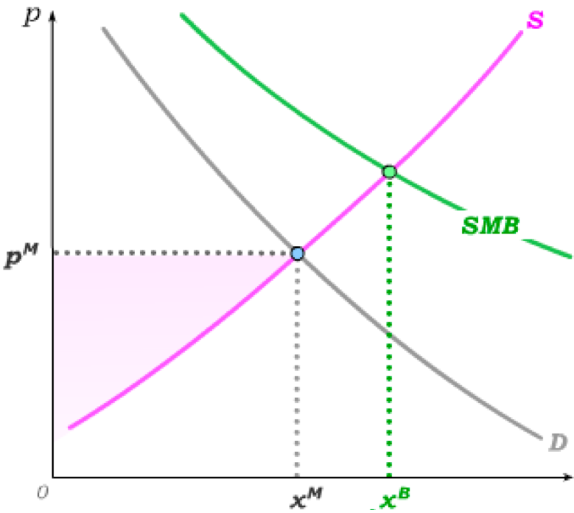
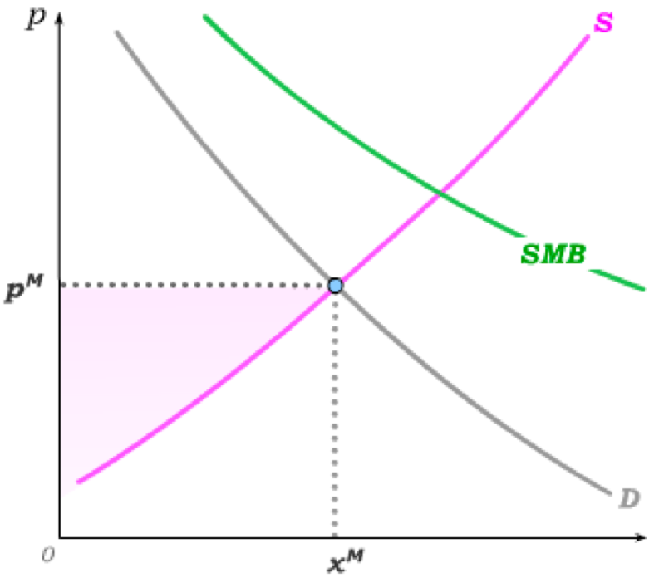
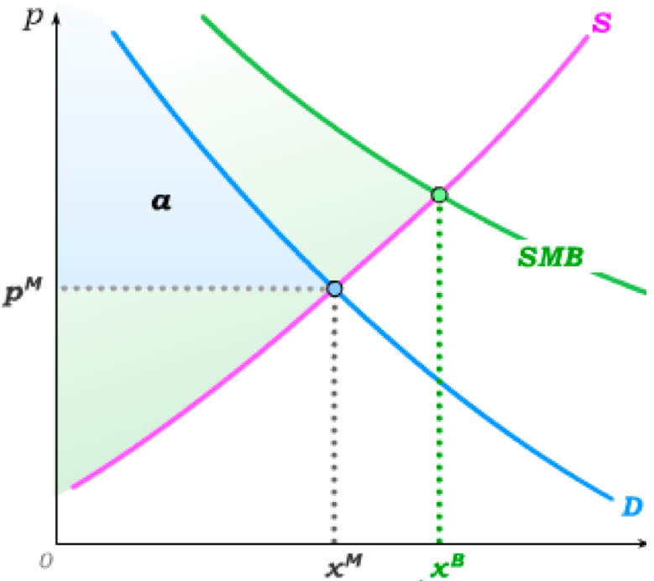

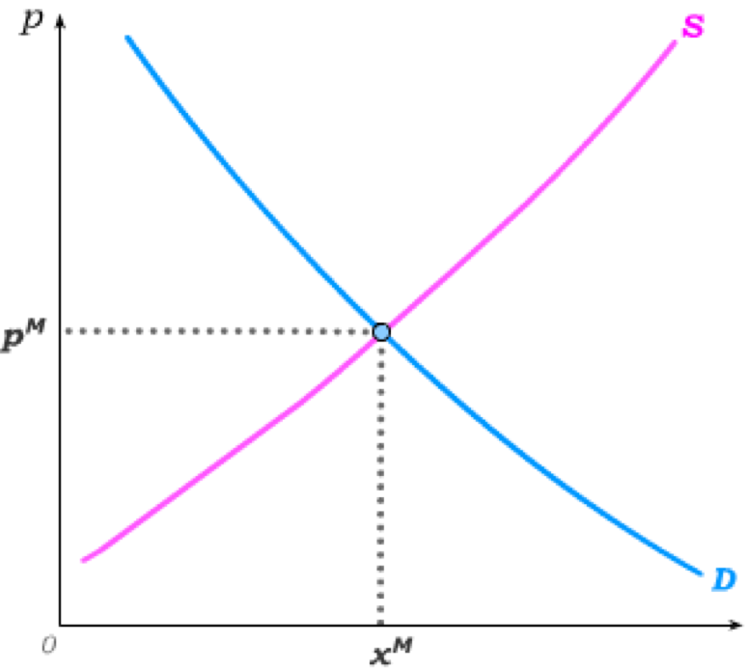
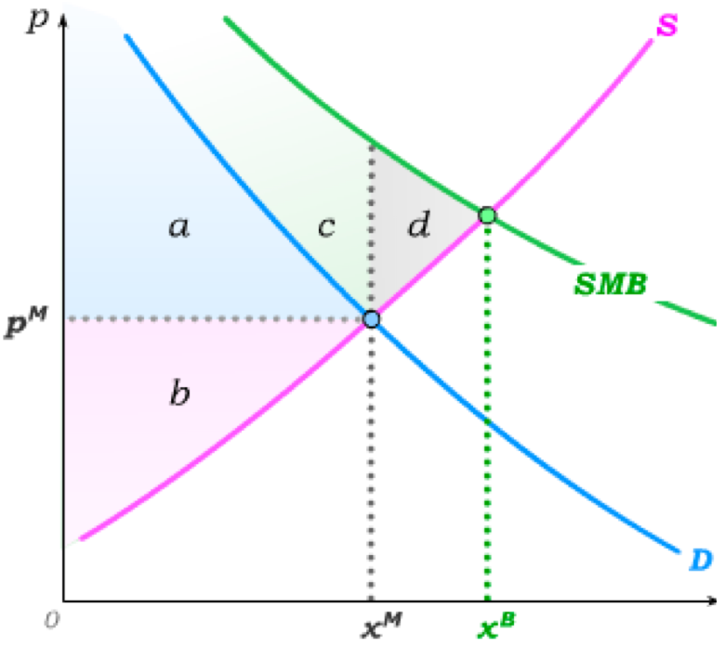
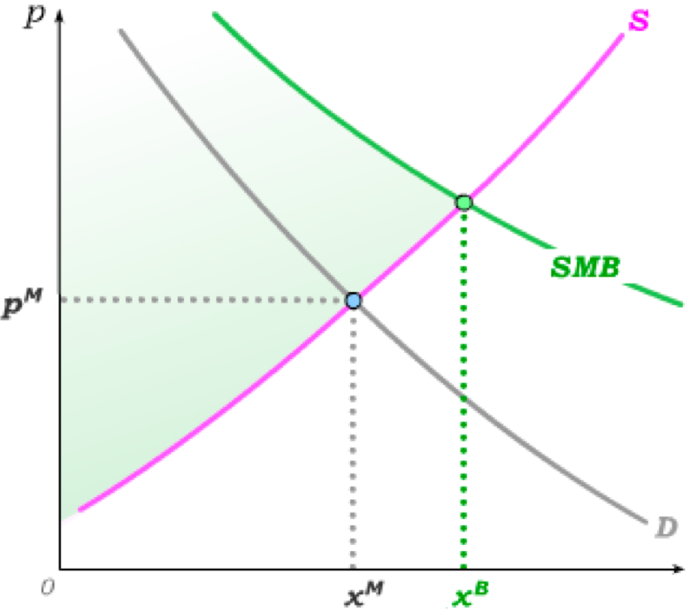
Positive Consumption Externalities
Regardless of externalities, competitive markets produce where Demand crosses Supply.
Under a positive (consumption) externality, social marginal benefit (SMB) is higher than private marginal benefit –
implying an efficient level of output x^{B}.
This is the quantity at which total surplus is maximized.
Consumer surplus is a;
producer surplus is b,
and externality benefits of c are generated.
Additional surplus of d is possible but NOT attained when the market produces x^{M}.
Overall surplus from market production is then (a+b+c), but the total possible surplus is (a+b+c+d) – implying a DWL of d under market production.
Under positive externalities, competitive markets under-produce relative to the efficient output level.

Slide 8
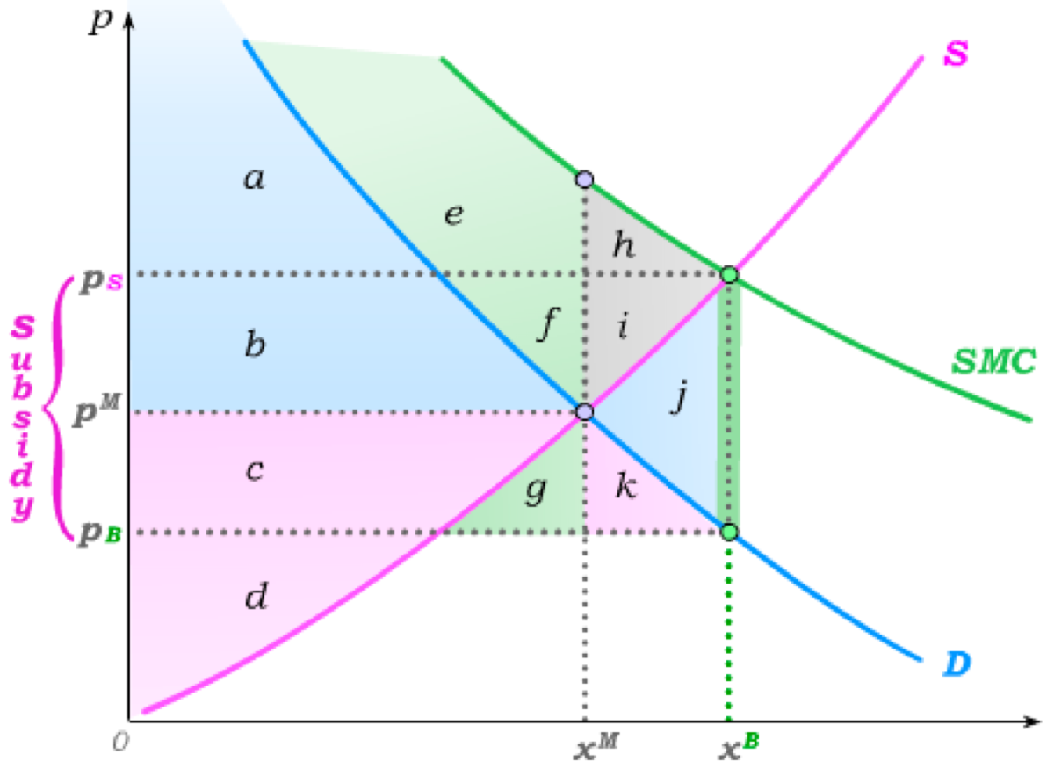
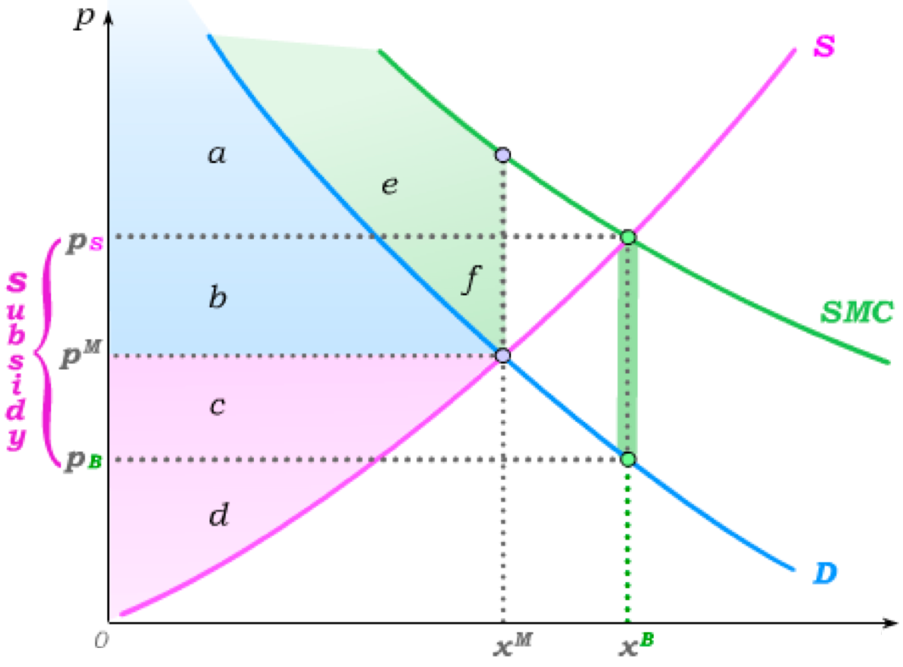
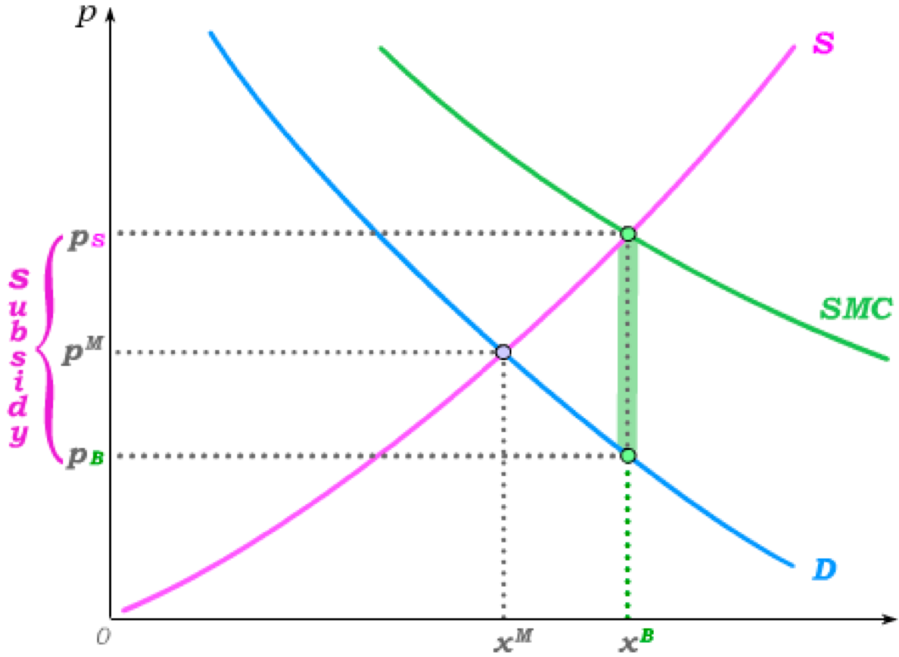
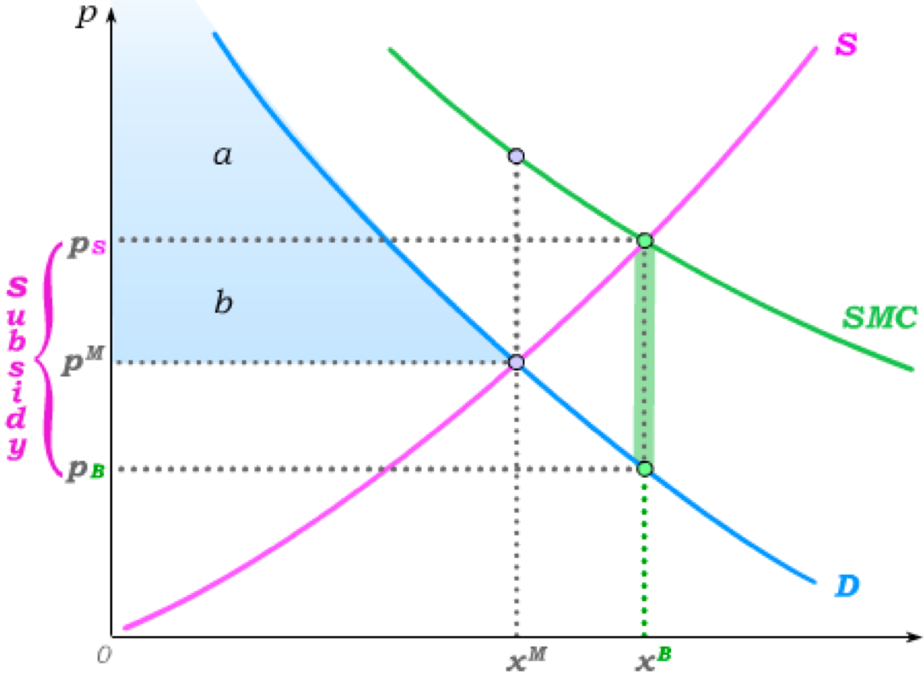
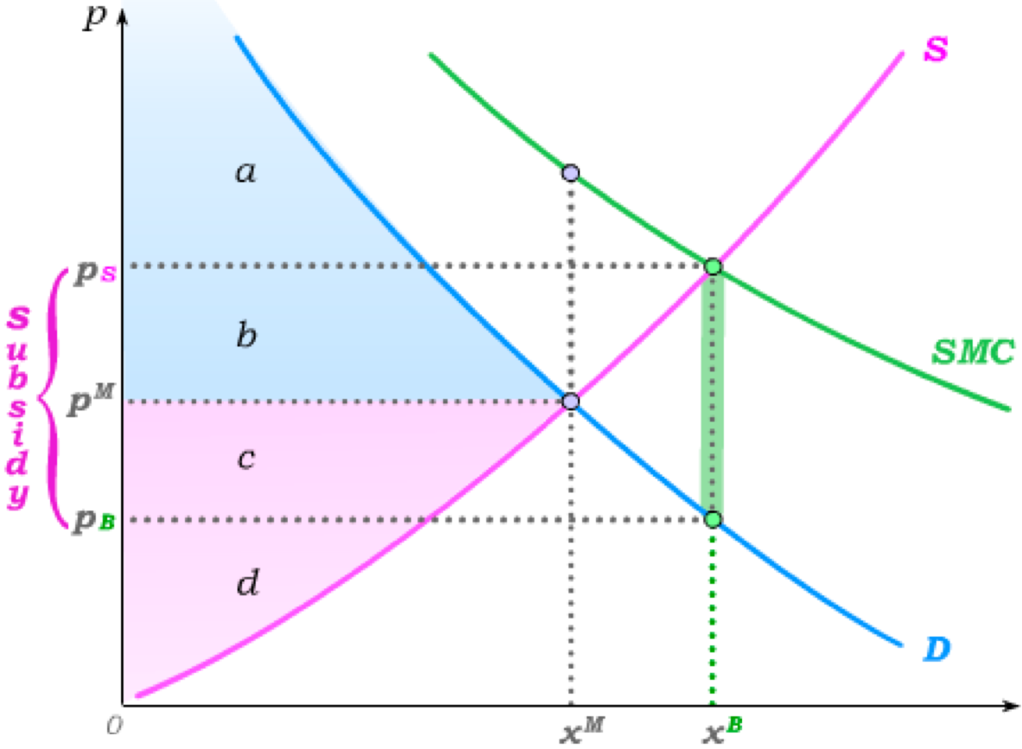
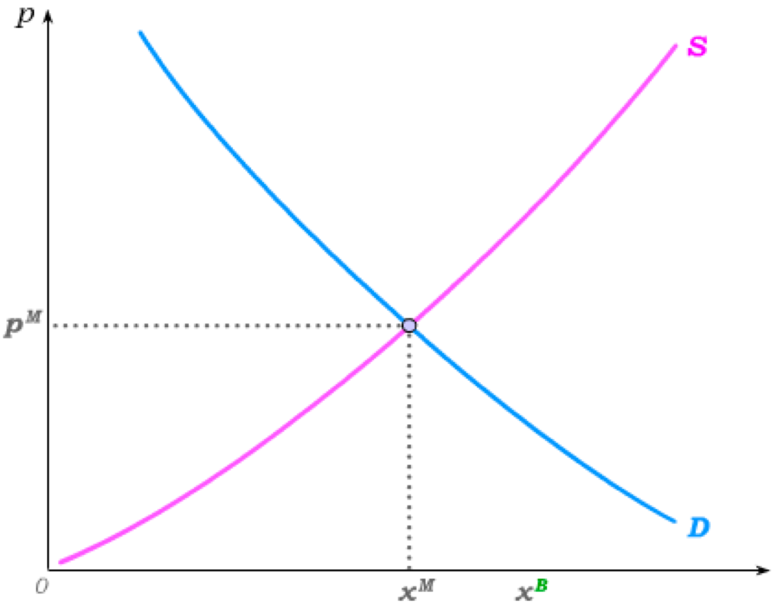
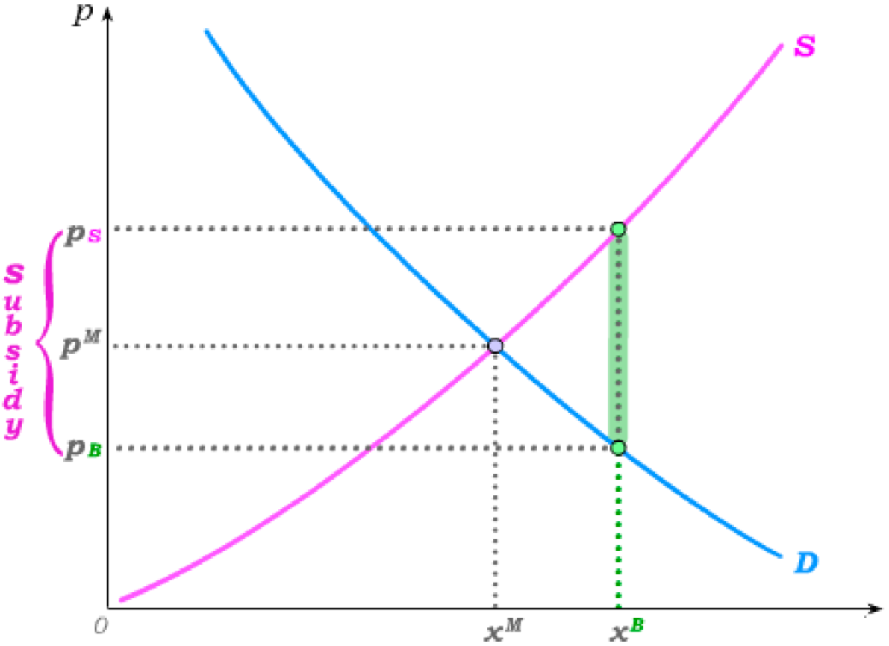
Pigouvian Subsidies
We know from our work on subsidies that market output can be increased through a per-unit subsidy.
A per-unit subsidy that is set equal to the difference between SMB and consumer MB as evaluated at at the efficient output level x^{B}
is called a Pigouvian Subsidy.
without subsidy with subsidy
Consumer Surplus
a+b
a+b+c+g+k
a+b+c+g+k
Producer Surplus
c+d
b+c+d+f+i
b+c+d+f+i
Externality Benefit
e+f
e+f+h+i+j
e+f+h+i+j
–(b+c+f+g+i+j+k)
Subsidy Cost
None
–(b+c+f+g+i+j+k)
Total Surplus
a+b+c+d+e+f
a+b+c+d+e+f+h+i
SMB
By raising the market quantity to the efficient quantity, a Pigouvian subsidy eliminates the DWL from the externality-induced underproduction.

Slide 9
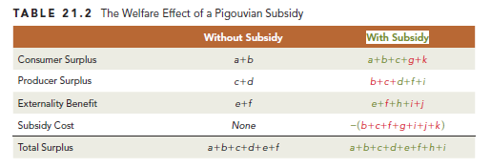
The Welfare Effect of a Pigouvian Subsidy

Slide 10
Market Failure or Failure of Markets to Exist?
When a firm pollutes, it is essentially using another input – “clean air” – that it is not paying for.
If a market existed for this input – as it does for labour and capital, the input would be priced in the market; i.e. the owners of “clean air” would have to agree to sell just as the owners of “labour” agree to sell.
Similarly, a positive externality is a “product” that is produced but for which no market exists – and so it is consumed “for free”.
In both cases, there exists an externality because of the non-existence of a market that prices either inputs or outputs appropriately.
Fundamentally, the externality problem is therefore a problem of missing markets.
Assigning property rights and allowing competitive trades would in principle eliminate the externality – but this is only sometimes a practical option.

Slide 11
The Tragedy of the Commons
Another way of viewing the externality problem is as a problem of common ownership rather than private property.
When “common ownership” means that anyone can take resources for free, we have a missing market due to a lack of property rights having been assigned.
Examples: Air, water, plants and animals on un-owned land,
public roads
The Tragedy of the Commons is the “tragedy” of the social losses that occur from such common ownership in the form of the inefficiently excessive use of un-priced resources.
In cases where the establishment of property rights is not practical, a variety of policies may lead to efficiency improvements:
Examples: Pigouvian Taxes, Pollution Taxes, Cap-and-Trade
Congestion pricing
But a significant portion of government activity in fact involves guaranteeing property rights – and thus taking resources “out of the commons”.

Slide 12
The Coase Theorem
An appreciation of externalities as a “missing markets” problem has also led to a better understanding of “small externalities” (where establishing property rights would not lead to a competitive market).
Such “small” externalities typically happen in communities – with disputes that arise often ending up in courtrooms in front of judges.
It is then in the area of Law and Economics that Ronald Coase derived what has become known as the Coase Theorem.
Coase Theorem: From an efficiency perspective, so long as transactions
costs are low, it does not matter how judges “assign property
rights”– i.e. it does not matter in whose favor they rule.

Slide 13
The Case of The Shadowy Swimming Pool
Suppose you and I are neighbours, and you currently enjoy a swimming pool in your backyard.
One day you find out that I have made plans to build a third story to my home. The problem (from your perspective) is that this will cast a shadow on your pool – significantly reducing its value to you.
Neither of us knows who has the “property rights” in this case – whether I have the right to build or whether you have the right to have sun on your pool.
So you go to a local zoning board or homeowner’s association or courtroom to force me to abandon my building plans.
Suppose the judge cares only that the efficient outcome is reached.
Should I build my addition on another part of my house so that there is no shadow?
Should I be forced to not build at all?
Should I be allowed to build my addition as planned?
The efficient outcome depends on how much you value the sun on your pool and how much I value building the addition as is (as opposed to going to the next best alternative).

Slide 14
The Case of The Shadowy Swimming Pool
For use with Nechyba, Intermediate Microeconomics © 2018 Cengage EMEA, ISBN: 9781473759008
Suppose I value the currently planned addition €5,000 more than the next best alternative; and you value the sunshine at €10,000.
Ruling 1: You win in court
Ruling 2: I win in court
You now have an incentive to visit me and offer me an amount between €5,000 and €10,000 to abandon my building plans.
Result: My currently planned addition is not built.
Efficient Outcome
No matter which way the judge rules, the efficient outcome arises so long as transactions costs are below €5,000.

Slide 15
The Case of The Shadowy Swimming Pool
Suppose instead I value the currently planned addition €10,000 more than the next best alternative; and you value the sunshine at €5,000.
Ruling 1: You win in court
Ruling 2: I win in court
I now have an incentive to visit you and offer you an amount between €5,000 and €10,000 to waive your rights and allow me to build.
Result: My currently planned addition is built.
Efficient Outcome
No matter which way the judge rules, the efficient outcome arises so long as transactions costs are below €5,000.

Slide 16
The Case of The Shadowy Swimming Pool
As long as transactions costs are low, an efficiency-driven judge therefore does not need to worry about what is actually efficient – he just needs to assign property rights in some way.
You and I would still prefer to win rather than loose – because that determines which way cash changes hands, but the efficient outcome happens regardless.
The reason this does not apply to large externalities is because there the transactions costs are high.
Coase rejects any inherent moral argument for ruling one way or another – pointing out that it takes both of us for there to be an externality:
If you did not live next door with your swimming pool, my shadow would be not be a problem.
And if I built my addition a different way, there would be no shadow.
Both parties are, in this sense, “responsible” for the externality.

Slide 17
Tutorial exercises
Within-chapter exercises:
  21A.3, 21.A7, 21.A8, 21.A15, 21.A18, 21.A20
End-of-chapter exercises:
  21.1, 21.2, 21.4A, 21.6A

Slide 18
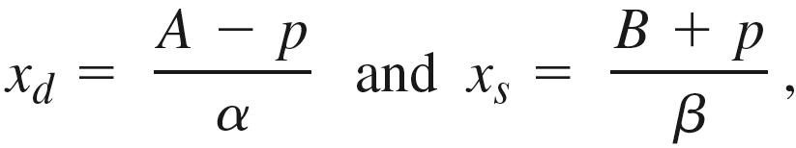
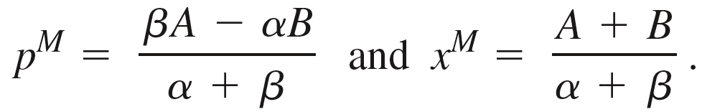


Negative Production Externalities
Suppose that demand and supply functions are given by
from which we can calculate the market price and output as
Next, suppose each unit of x produces δ units of CO₂, with an externality cost of
The marginal externality cost is then
and the private marginal
cost is the inverse supply function; i.e.
The social marginal cost curve is then the sum of these two marginal costs; i.e.

Slide 19
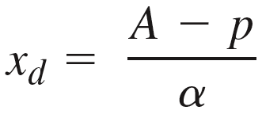




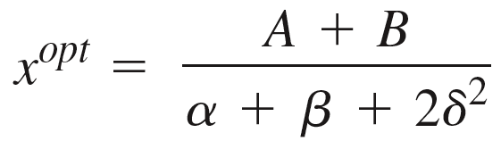
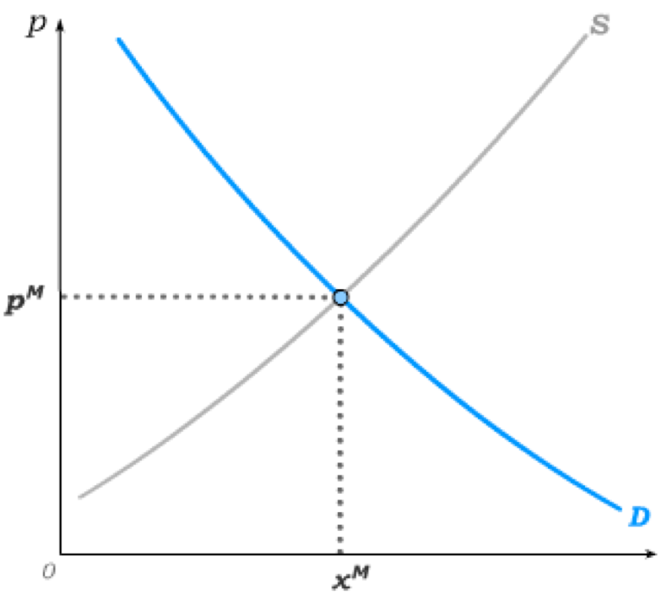
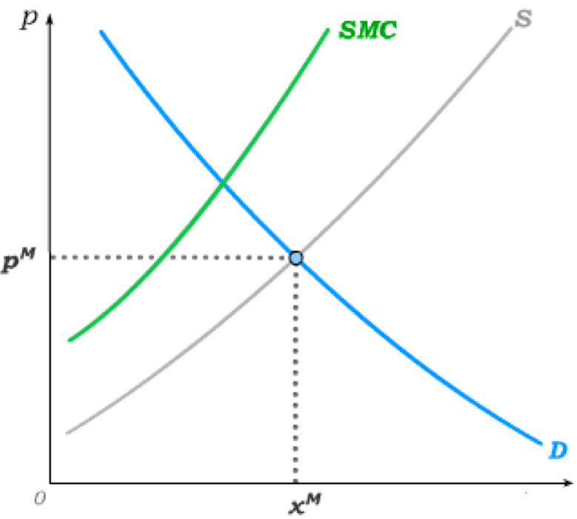

Efficient Production with Negative Externality
For use with Nechyba, Intermediate Microeconomics © 2018 Cengage EMEA, ISBN: 9781473759008
Demand Curve
To solve for the optimum:
=
Note that
i.e. the market over-produces from an efficiency perspective.

Slide 20
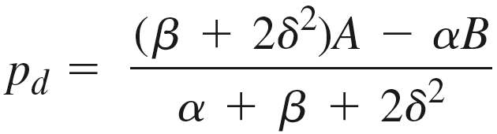


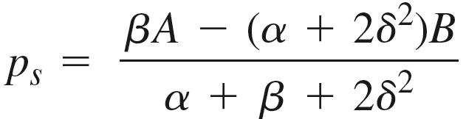
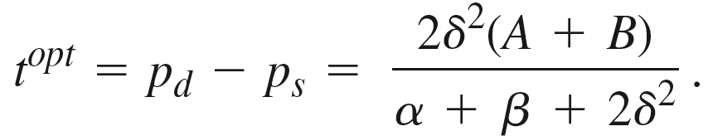


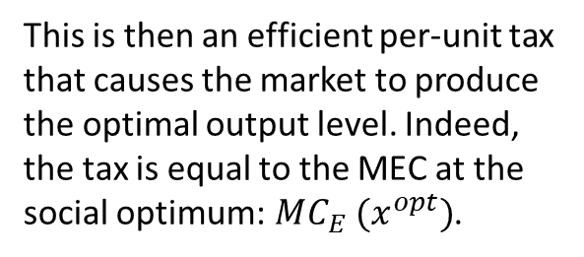
Optimal Pigouvian Tax
The optimal Pigouvian tax t^{opt} is then a tax that results in a consumer price p_{d} and supplier price p_{s} such that the optimal quantity is demanded and supplied; i.e.
This then implies
This is then an efficient per-unit tax that causes the market to produce the optimal output level. Indeed, the tax is equal to the MEC at the social optimum:$MC_{E} (x^{opt})$.

Slide 21


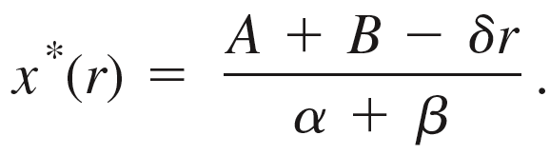

Cap-and-Trade
For use with Nechyba, Intermediate Microeconomics © 2018 Cengage EMEA, ISBN: 9781473759008
Suppose instead that a pollution permit is required for every CO₂ unit emitted in production.
Since δ units of CO₂ are emitted for every unit of x that is produced, a firm has to purchase δ permits per output unit.
If permits trade for a price r, this means the pollution permits add δr to the pre-permit industry marginal cost of to give
The industry produces until MC=p, where is the demand curve (derived from our original demand function);
i.e. equilibrium output under a permit price r occurs when
Solving for output, we get the equilibrium industry output as a function of r:
Note that, so long as r>0,

Slide 22
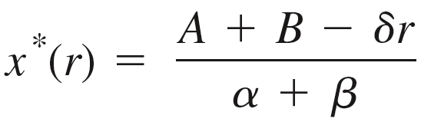
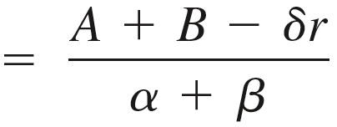

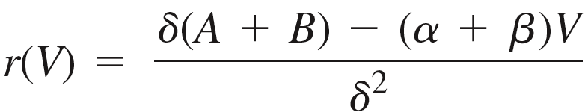
Permit Price under Cap-and-Trade
But the price of permits is determined in a market in which the government sets supply equal to V.
Since δ units of CO₂ are emitted for every unit of x that is produced, the “cap” V implies market output is reduced to (in the absence of pollution abating technologies).
Demand curve for pollution permits
Note that r(V)=0 when
– i.e. when there is a sufficient number
of permits to produce the undisturbed market quantity
Pollution permits therefore become valuable as the “cap” is set to limit production below the market quantity.

Slide 23
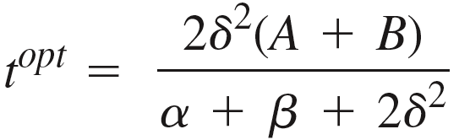
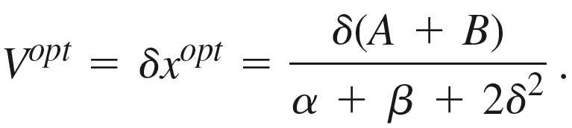
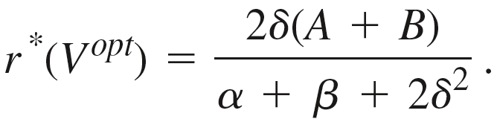
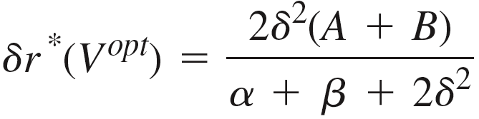

Implementing the Efficient Output with Permits
To achieve the efficient output level the “cap” V has to be set so that the optimal output level can be produced given that it takes δ permits per output unit; i.e.
This then implies an equilibrium price for permits of
Since it takes δ permits to produce 1 output, the marginal cost of production then goes up by
which is exactly the optimal Pigouvian tax we calculated earlier.
Taxes set a price for pollution and let the market determine quantity, whereas pollution permits set the quantity and let the market determine price.

