Slide 1




Sociology of Work
Quality of working life and dignified work
Adam Standring, PhD.

Slide 2
New demands, new forms of production and organization
Rapidly changing markets → new consumer demands → limits to mass production
Quality
Diversity/variety, innovation, individualization/customization, on-time delivery
Quality-related
Quality inspection: separate from the assembly line (final inspection/at random sample)
A lot of faults were not detected … Rectification was very expensive + waste/scrap
Inflexibility/slow response to market demands
Model changes required long development
No variations in the model were possible

Slide 3
‘New’ workforce, new forms of labour regulations
Labour problems/ a new wave of industrial conflicts:
Motivation doesn’t only result from maximum earnings for effort
Psychological and social needs were ignored
Homo economicus+homo socius
Ignored the workers’ tacit skills, their creativity and full potential
Ignored the worker as a human being
Ignored the hidden costs associated with absenteeism, sloppiness and sabotage

Slide 4
New forms of work organization
Anthropocentric / Humanist (inspired in the Nordic countries) focusing on the human factor and including qualitative flexibility (Socio-Technical school, quality of work life).
Objective: Improving performance and quality of work life.
High Route of Organizational Renovation
Efficiency-centred (inspired in the Japanese and American examples) focusing on increased competiveness and (mostly) quantitative flexibility.
Objective: Increasing flexibility and cost-reduction.
Low Route of Organizational Renovation
(Oeij e Wieser, 2002)

Slide 5
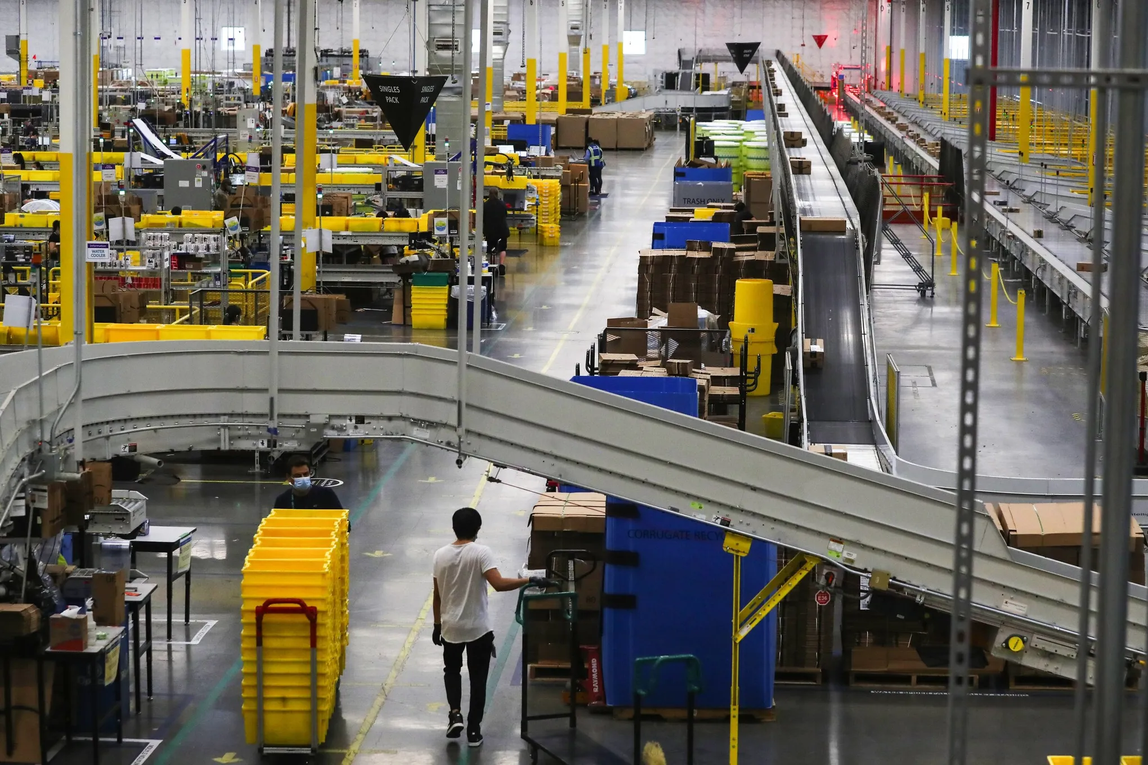
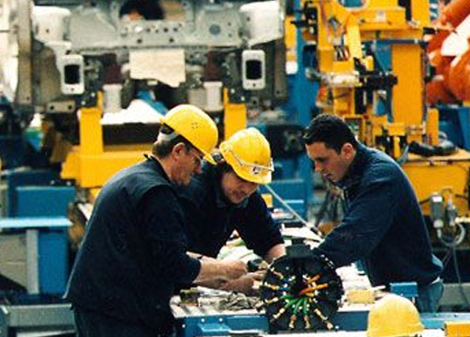
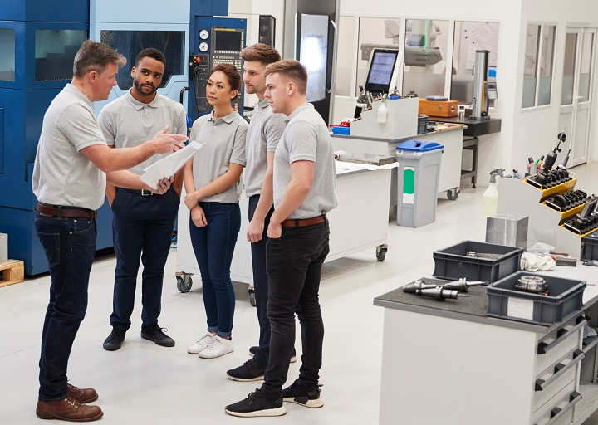
New forms of work organization – different views on flexibility
Each is inspired by different forms of (early) work organization models
Neo- Taylorism
Lean Magement/Production
Humanist

Slide 6
New forms of work organization – different views on flexibility
Watch-pair-think (main elements and differences between the two settings) :
https://www.youtube.com/watch?v=3Rdbo8WZauk (7:38)
https://www.youtube.com/watch?v=aI7ornrCKnM (6:24)

Slide 7
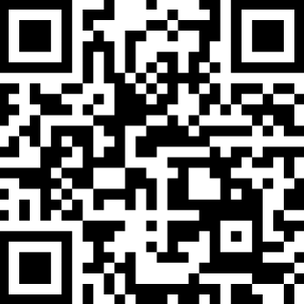
New forms of work organization – different views on flexibility
Watch-pair-think (main elements and differences between the two settings) :
https://tinyurl.com/SW25-work-org

Slide 8
Elements in new forms of work organization
Multi-tasking
This new form of work organization is found in the efficiency-centred approaches, in which simple and monotonous tasks that did not require varied qualifications are expanded. Quantitative flexibility.
Task enrichment
In the anthropocentric approaches, such task expansion is going to be related to task enrichment: not only do tasks require multiple qualifications and continuous trainingm but they involve greater autonomy and development of new skills that are transferable to other contexts (e.g. management of teams, leadership). This allows also for better quality of work life (through professional fullfilment). Qualitative flexibility.

Slide 9
Elements in new forms of work organization
Task rotation
Task rotation can occur between tasks that are part of the same function (multi-tasking) or span different tasks that are part of different functions (task enrichment), often within autonomous teams.

Slide 10
Elements in new forms of work organization
Task enrichment
Autonomy
Complex, challenging and qualified tasks
Opportunities for continuous training and up-skill, professional growth and satisfaction
Only found in humanist or anthropocentric approaches to new forms of work organization

Slide 11
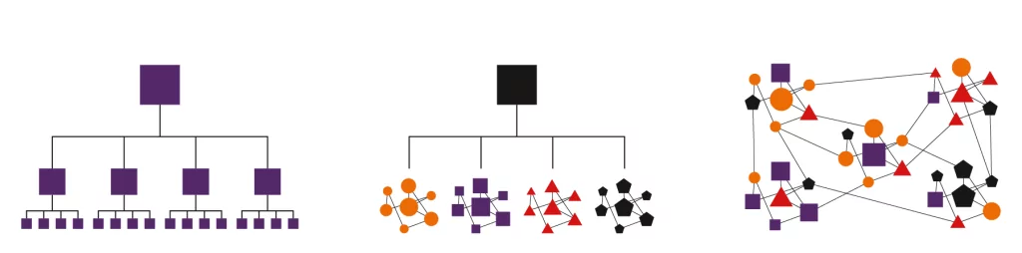
Elements in new forms of work organization
Team-work
Supervised/directed teams – tasks are interdependent (in a simple way or along an assembly line), but still in an hierarchical way (there is subordination and no or very limited autonomy)
Semi-autonomous teams
Self-directed teams (in practice it is exceptional and only found in some contexts – such as cooperatives, etc)

Slide 12
Multi-tasking and supervised teams
Main differences from semi-autonomous teams:
No autonomy in conception, coordination and control
There is task rotation and multi-tasking and some degree of internal coordination and some control taks may be delegated to the group
Even these tasks that are delegated are very limited and the group follows the instructions/commands from the leader/hierarchy
More responsibilities (from different tasks) and not necessarily greater empowerment: multi-tasking and not multi-qualifications
Quantitative flexibility

Slide 13
Semi-autonomous teams
This teams may:
Define and divide tasks among team members
Define the working methods,
Coordinate and control their own activities,
Hire team members (internal job market),
Have access to the necessary information to be autonomous in their planing and control,
Members take part in the definition of production objectives,
Members aquire different skills (task enrichment) through adequate training and emphasis on qualitative flexibility
Notes:
Forma mais desenvolvida entre as NFOT, que:
inclui as outras formas menos desenvolvidas,
implica uma rutura total com os princípios tayloristas.

Slide 14
New forms of work organization
Involvement
Operational tasks/issues
Ideas and suggestions (decision-making and implementation not included)
Participation
Strategic decisions
Direct
Indirect
Iinformation and consultation
Negotiation
Co-decision

Slide 15
An important distinction
Involvement (Lean Production) | Participation (Anthropocentric)
Encorages suggestions and ideas to eliminate waste and optimize production | Enorages colective results. Suggestions to optimize production and strategic aspects (training, work organization) Direct and indirect participation
Multi-tasking | Task enrichment
Flat organization, but with defined positions/hierarchies | Flat organization Semi-autonomous teams
Management of corporate culture Firm/workers have a common interest Individual negotiations | Social dialogue and collective bargaining Democratic working relations
Source: Adapted from HYMAN, J. & MASON, B. (1995), Managing Employee Involvement and Participation, Sage: London, p.25.

Slide 16
New forms of work organization and labour relations
Unitary perspective
Associated with involvement and not participation. Workers and management are understood as having the same interests. Sharing a common corporate culture. Management by peer pressure and through company culture.
Pluralist perspective
Recognizes that there are conflicting interest between workers and management and these are seen as natural.
Focus on negotiation and compromise, using participation as a way to develop it (will come back to this in point 4)

Slide 17
Arguments presented by Grote & Guest (2017)
Calls for an integrated approach to achieve ‘quality of work life’: set of policies and practices that aim to achieve improved autonomy and well-being among workers
The focus on quality of working life started in the Nordic countries in the 1960s and 1970s. If focused on improving organizational performance and workers’ wellbing (reinforcing each other and not as opposites) and saw the company/organization as an ‘open system’. Changing socio-economic conditions led to a diminishing of its relevance after the 1980s.
They call for a renewed emphasis on the quality of working life, understood as an approach focusing on autonomy, collective negotiation and individual agency.
Refuses technical determinism: technoloy is adapted to the worker7production and not the other way around.

Slide 18
Anthropocentric / Humanist – why is it not widespread?
(also dubbed “discretionary models”) Mostly present in innovative sectors, Nordic countries
Obstacles (in industrialized countries):
R&D focus on technological development
Management techniques focusing on rationalization of processes/workforce (downsizing), using quantitative flexibility (including working hours) as determined by the companies
Organizations are rigid: payment (incentive) schemes, qualifications
Degree of social dialogue (low)

Slide 19
Anthropocentric / Humanist
Obstacles in Portugal:
Competitive advantage/specialization based on low-wages/costs
Low education/qualification, especially in the industrial sector
Capital and labour: bargaining process centred around quantitative aspects (e.g. wages) instead of qualitative aspects (qualification, work organization)
Confrontational labour relations
Limited innovation & diversification/technocentric perspectives → traditional management methods, hierarchic structures
‘Individual commitment to the company’ seem as the gold-standard and poor understanding of productivity, leading to long working hours
New forms of work organization and participatory management are not widespread (limited worker involvement in change processes)

Slide 20
To recapitulate...
Characteristics | Neo-Taylorism | Lean production | Anthropocentric
Organizational structure | Vertical integration. Rigid hierarchy, centralized control Direct supervision. | Operational decentralization. Flat organization, low status differences Subcontracting based on power | Decentralization of decisions Flat organization, low status differences Subcontracting based on partnership
Principles of work organization | Strong division of labour. Individual, simple and fragmented tasks Multi-tasks (limited task rotation) (eventually) | Team work organized around a team leader; Task enlargement, simple multitasks. | Semi-autonomous workgroups, task enrichment, complex tasks, organized according to socio-technical criteria Multi-skilling
Communication, Participation and Labour Relations | Centralized communication. Top-down. Low/no participation. Adversarial Labour relations | Decentralized communication Bottom-up Mechanisms of involvement. Marginalization of trade unions Labour relations based on compliance/consensus | Decentralized communication Bottom to up. Mechanisms of participation (direct and indirect). Labour relations based on cooperation.
Human resources | Lower education Quantitative flexibility | High education Quantitative flexibility and partial qualitative flexibility | High education Training for polyvalent functions Qualitative flexibility
Production volume | High volume/large scale production | High volume, just in time and flexible production | Production in small batches and prototypes

Slide 21
To recapitulate: examples and elements of the new forms of work organization
New forms of work organization
Task enlargement / multi-tasking
Multi-skilling
Task enrichment
Team work
Semi-autonomous workgroups

Slide 22
Organisational Modes
Percent of employees by organisational type/class, per country (2000)
 | Discretionary learning organisation | Lean production | Taylorist organisation
Belgium | 38,9 | 25,1 | 13,9
Denmark | 60,0 | 21,9 | 6,8
Germany | 44,3 | 19,6 | 14,3
Greece | 18,7 | 25,6 | 28,0
Italy | 30,0 | 23,6 | 20,9
Spain | 20,1 | 38,8 | 18,5
France | 38,0 | 33,3 | 11,1
Ireland | 24,0 | 37,8 | 20,7
Luxembourg | 42,8 | 25,4 | 11,9
Netherlands | 64,0 | 17,2 | 5,3
Portugal | 26,1 | 28,1 | 23,0
United Kingdom | 34,8 | 40,6 | 10,9
Finland | 47,8 | 27,6 | 12,5
Sweden | 52,6 | 18,5 | 7,1
Austria | 47,5 | 21,5 | 13,1
EU-15 | 39,1 | 28,2 | 13,6
Source: EUROFOUND, 3rd European Working Condition Survey in OECD (2010) Innovative Workplaces, OECD, Paris, p.40

Slide 23
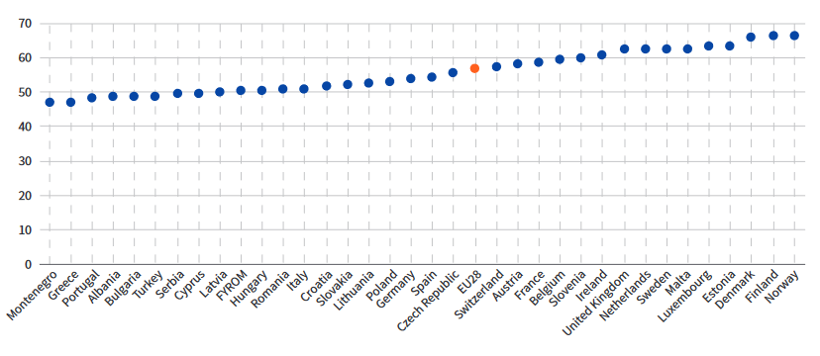
European Working Conditions Survey 2015
Skills and discretion index, by country (2015)
Source: EUROFOUND (2017), 6th European Working Condition Survey, Figure 66

Slide 24
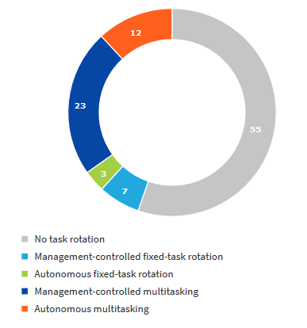
European Working Conditions Survey 2015
Task rotation types, EU28 (2015)
High percentage of task rotation: DK (77%), SI (72%) and NL (64%)
Low percentage of task rotation: LV (32%), IT (28%) and HU (26%)
Younger workers, services and sales and healthcare → higher task rotation
Source: EUROFOUND (2017), 6th European Working Condition Survey, Figure 78

Slide 25
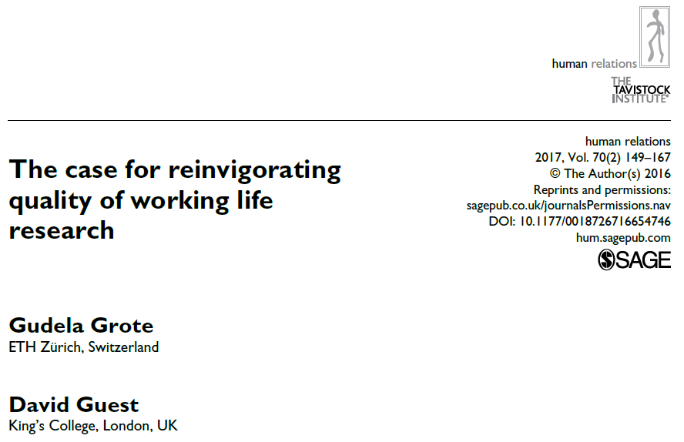
Essential reading:
The CORE team (2017): The Economy: Economics for a Changing World, UNITs 3.9 and 3.10: http://www.core-econ.org/the-economy/book/text/0-3-contents.html#contents
Grote, G. & Guest, D. (2017) The case for reinvigorating quality of working life research, Human Relations, 70(2) 149–167.

Slide 26
Sociology of Work
Inclusive forms of work organization
Ricardo Rodrigues, PhD, MSc

Slide 27
Inclusive models – organizational constraints
Management techniques focusing on rationalization of processes/workforce (downsizing), using quantitative flexibility (including working hours) as determined by the companies
‘Individual commitment to the company’ seem as the gold-standard and poor understanding of productivity, leading to long working hours
Corporate culture and work schedules geared towards ‘company-first’ approaches and thus also leading to long working hours and forfeiting social benefits (see mandatory paternity leave example in Portugal)
Lack of awareness about public policies on work-life balance
Source: Casaca, Sara Falcão (2014) “A conciliação trabalho-família como uma dimensão fundamental da qualidade de vida”, Kovács, Ilona (coord), Temas atuais em Sociologia do Trabalho, Fundação Económicas/Almedina, p. 359.

Slide 28
Inclusive models – organizational constraints
‘Traditional’ management and corporate culture, whose values and practices influence recruitment practices, assessment of performance, payments, which are based on a ‘traditional standard’ worker and on a strict separation of work and family spheres.
Predominance of stereotypes regarding workers with family responsibilities, disability and within certain age groups and self-selection mechanisms to leadership positions.
Low social dialogue and marginalization of unions, lack of participatory mechanisms
Source: Casaca, Sara Falcão (2014) “A conciliação trabalho-família como uma dimensão fundamental da qualidade de vida”, Kovács, Ilona (coord), Temas atuais em Sociologia do Trabalho, Fundação Económicas/Almedina, p. 359.

Slide 29
What companies stand to gain from diversity?
Improved organizational climate
Greater worker satisfaction, motivation and quality of work life, improved worker retention, low turnover and absenteeism
Greater pool of talent/human resources from which to recruit
Improved internal and external image (reputational gains)
Better able to adapt to the needs and understand the functioning of markets
Better performance and innovation and improved competitiveness
In Portugal:
Law 4/2019: from February 2024 onwards, companies with at least 75 workers must include 1% of people with disabilities, if they are medium companies, and 2% if they are considered large companies.
Law 62/2017: from January 2018 onwards, public companies must have at least 33.3% of women in their management or regulatory boards; and the same for private companies listed in the Lisbon Stock Exchange from January 2020.
If you want to know more for Portugal: https://womenonboards.pt/en/

Slide 30
Diversity and ageism
Jacob Mincer’s theory of human capital: inverted U-shaped curve for earnings (confirmed… only for earnings) related to investment in human capital
However, evidence indicates that:
There is no decline in productivity with age...
... Except in routine or less-demanding tasks, in less heterogeneous environments or expressed in higher abseentism
In fact, older workers perform better in more complex tasks, those requiring verbalization or in more heterogeneous environments
Discrimination based on age is not permited in the EU (Directive 2000/78)
Wages
Age

Slide 31
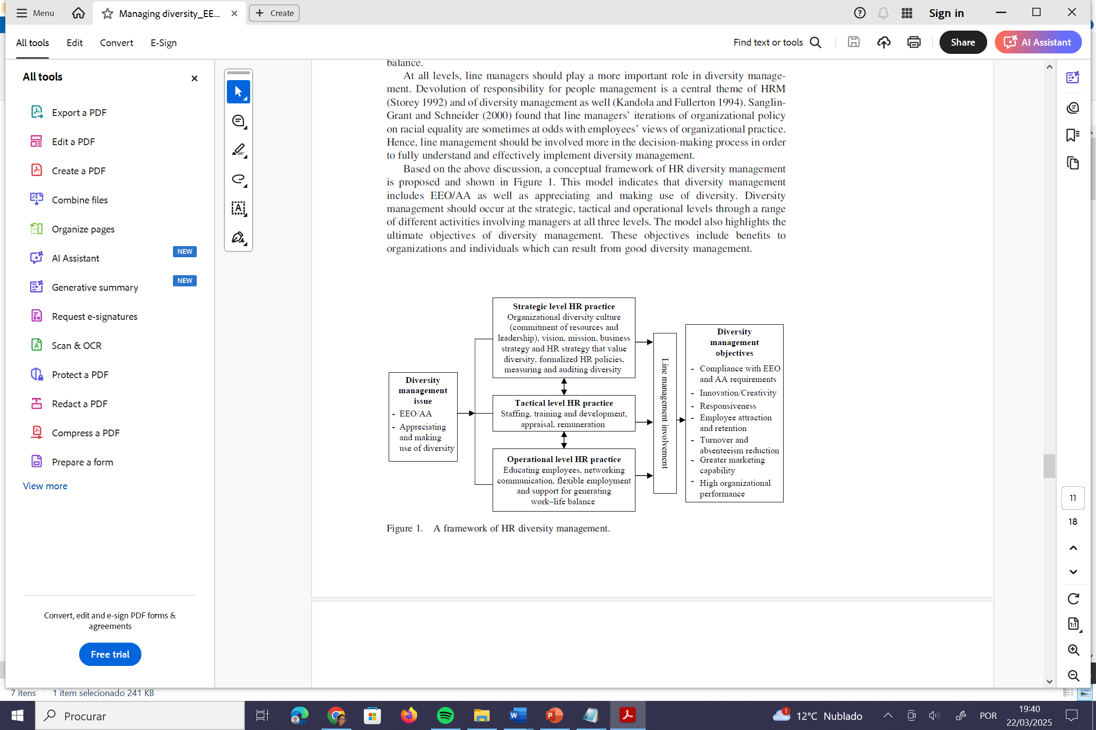
Diversity must be aligned with the organizational strategy and business objectives
Diversity management models – different levels
Management practices that are adapted to support inclusion by recruiting and assessing based on diversity
Equal Employment Opportunity(EEO) and Affirmative Action (AA)
To create an organizational culture that fosters and values diversity
Source: Shen et al. 2009: 245

Slide 32


www.iseg.ulisboa.pt

