Slide 1
NET PRESENT VALUE AND OTHER INVESTMENT CRITERIA
5
McGraw-Hill/Irwin
Copyright © 2014 by The McGraw-Hill Companies, Inc. All rights reserved.

Slide 2
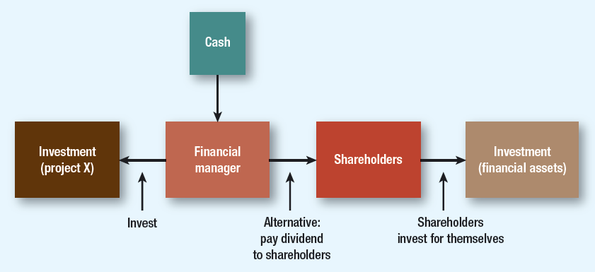
Figure 5.1 NPV and cash transfers
Notes:
This diagram reinforces the idea discussed in Chapter 2 that financial market opportunity (financial asset) is a benchmark against which real asset investment opportunities are compared.

Slide 3
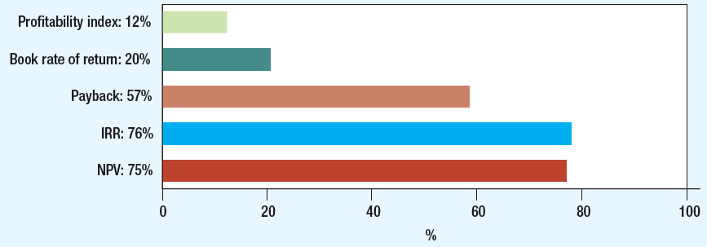
Figure 5.2 cfo decision tools
Notes:
Here the survey results from the Graham and Harvey paper are provided.
Students should read this article that is available at:
http://faculty.fuqua.duke.edu/~charvey/Research/Published_Papers/P67_The_theory_and.pdf

Slide 4
5-1 review of basics
Book Rate of Return
Average income divided by average book value over project life
Also called accounting rate of return
Components reflect tax and accounting figures, not market values or cash flows
Notes:
Book rate of return is discussed briefly. Note that only 20% of the CFOs use this method.
There is no need to provide a numerical example. The choice of acceptable book rate of return is also arbitrary. This method ignores the time value of money and also does not use market values. Cash flows and book income are generally very different.

Slide 5
5-2 payback
Payback Period
Number of years before cumulative cash flow equals initial outlay
Payback Rule
Only accept projects that pay back within desired time frame
Ignores later year cash flows and present value of future cash flows
Notes:
The standard payback period chosen is arbitrary. Note that 57% of CFOs surveyed use this method. The payback period is easy to understand and calculate. Its disadvantages are that it does not consider the time value of money and ignores all cash flows after the payback period.

Slide 6
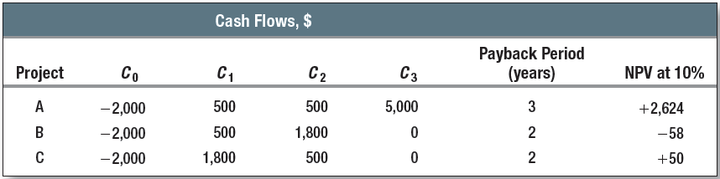
5-2 payback
Example
Find disadvantage of only taking projects with payback period of two years or less
Notes:
Here the payback period is compared with NPV.
Project A, which should have been accepted (based on the NPV), is rejected and Project B, which should have been rejected, was accepted. The payback period method does not promote value maximization.

Slide 7
5-3 internal rate of return
Example
Tool A costs $4,000. Investment will generate $2,000 and $4,000 in cash flows for two years. What is IRR?
Notes:
The internal rate of return method is a discounted cash flow method. It considers the time value of money. Calculating the IRR is similar to calculating the yield to maturity on a bond.
IRR is defined as the discount rate that makes NPV equal to zero.
0 1 2
|---------------|----------------|
– 4000 2000 4000
Using a financial calculator: C₀ = – 4,000; C₁ = 2,000, C₂ = 4,000, Compute IRR = 28.08%.
Alternative example:
0 1 2
|-------------------|-------------------|
– 2000 1500 2250
Using a financial calculator: C₀ = – 2,000; C₁ = 1,500, C₂ = 2,250, Compute IRR = 50%.
There are three ways to calculate the IRR: graphical method, trial and error method, and using financial calculators. You accept a project if IRR > opportunity cost of capital. Both the graphical method and the trial and error method are time consuming. Make sure to explain how IRR can be calculated using financial calculators.

Slide 8
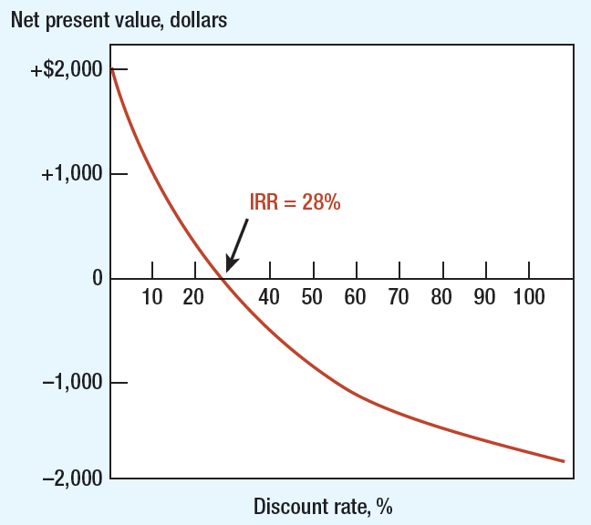
Figure 5.3 internal rate of return
Notes:
The graphical method can be used to calculate the IRR, but it is time consuming.

Slide 9
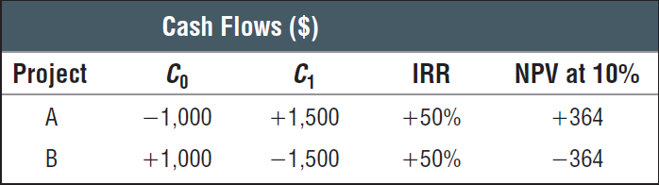
5-3 internal rate of return
Pitfall 1: Lending or Borrowing?
NPV of project increases as discount rate increases for some cash flows
Notes:
The IRR method cannot distinguish between investing and borrowing. In the case of borrowing, you accept the project if IRR < opportunity cost of capital. But NPV automatically gives the right answer. Project B is borrowing at 50%. The NPV of the loan is positive only if the cost of capital is > 50%.

Slide 10
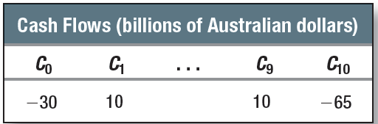
5-3 internal rate of return
Pitfall 2: Multiple Rates of Return
Certain cash flows generate NPV = 0 at two different discount rates
Following cash flow generates NPV = $A253 million at IRR% of 3.5% and 19.54%
Notes:
For cash flows with more than one change in sign, there will be more than one IRR or multiple IRRs. This problem can be overcome using the modified IRR method. By discounting the later cash flows at the cost of capital until there remains only one change in the sign of cash flows, a modified internal rate of return can be calculated using the modified set of cash flows.
Alternative example:
0 1 2
|-------------------|-------------------|
– 4,000 25,000 – 25,000
This project has two IRRs: IRR = 25% and IRR = 400%.

Slide 11
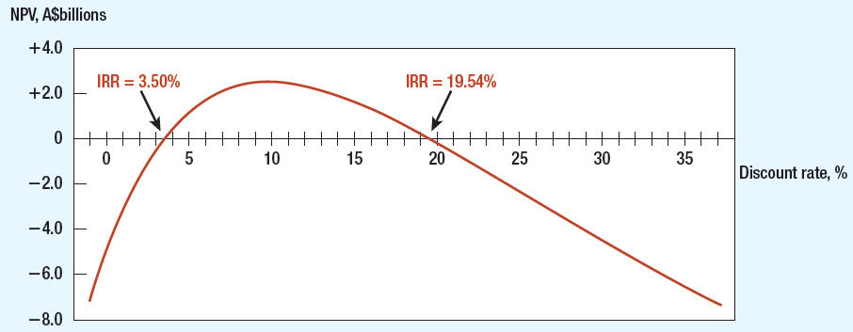
Figure 5.4 Multiple rates of return
Notes:
The project (Slide 10) has positive NPV for discount rates between 3.5% and +19.54%.
It is easier to use the NPV method.

Slide 12
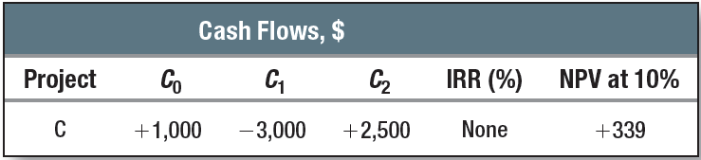
5-3 internal rate of return
Pitfall 2: Multiple Rates of Return
Project can have 0 IRR and positive NPV
Notes:
It is possible to have a positive NPV and no IRR.

Slide 13
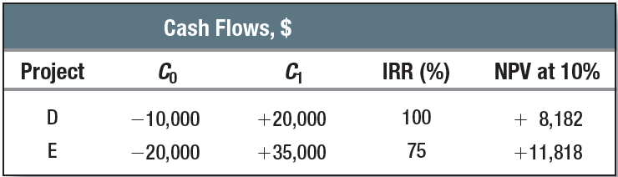
5-3 internal rate of return
Pitfall 3: Mutually Exclusive Projects
IRR sometimes ignores magnitude of project
Notes:
For mutually exclusive projects, accept the project with the higher NPV. A project with higher NPV need not be the one with a higher IRR. Again using the NPV method is easier. IRR does not have the value-additive property.
Project D has an IRR of 100% and NPV of + 8,182 at 10%.
Project E has an IRR of 75% and NPV of +11,818 at 10%.
Alternate example:
Project C₀ C₁ IRR NPV at 25%
A – 1 +2 100% +0.6
B – 1 +4 300% +2.2
(A + B) – 2 +6 200% +2.8
Adding the two NPVs gives the NPV of the combined project. This is called the value-adding property. Adding the two IRRs does not give the IRR of the combined project.

Slide 14
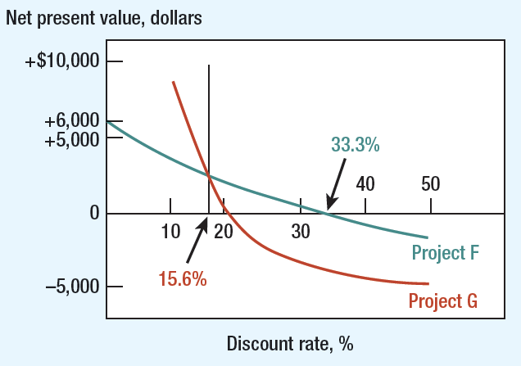
Figure 5.5 irr of various projects
Pitfall 3: Mutually Exclusive Projects
Notes:
The project with higher IRR need not be a better project. This is because of the reinvestment rate assumption. In case of the NPV method and the MIRR method, the reinvestment rate is the cost of capital. This is a more reasonable assumption than investing at the IRR, particularly for projects with high IRRs.
Alternate example:
Project C₀ C₁ IRR NPV at 25%
F – 20,000 +35,000 75% +8,000
E – 10,000 +20,000 100% +6,000
——————————————————————
F – E – 10,000 +15,000 50% +2,000
(Project F is preferred to project E).
IRR method cannot be applied to mutually exclusive projects. You can only compare two projects at a time as shown above. It is much easier to use the NPV method and choose the project with the higher (highest if there are more than two projects) NPV.

Slide 15
5-3 internal rate of return
Pitfall 4: More than One Opportunity Cost of Capital
Term Structure Assumption
Assume discount rates stable during term of project
Implies all funds reinvested at IRR
False assumption
Notes:
IRR method implicitly assumes that the project cash flows are reinvested at the IRR. This is not a realistic assumption. It also assumes that the discount rates are stable during the term of the project.

Slide 16
5-4 choosing capital investments when resources are limited
Profitability Index (PI)
Tool for selecting between project combinations and alternatives
Set of limited resources and projects can yield various combinations
Highest weighted average PI indicates optimal project
Notes:
Profitability index (PI) provides a tool for selecting among various projects when the firm is faced with capital constraint.

Slide 17
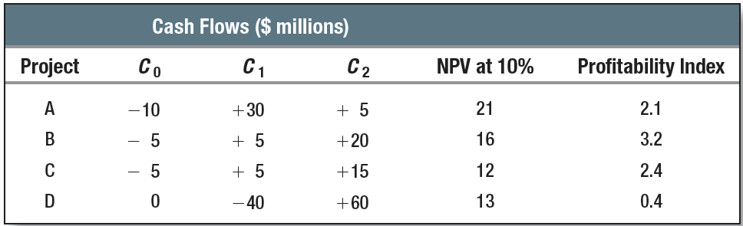
5-4 choosing capital investments when resources are limited
Notes:
Profitability index (PI) provides a tool for selecting among various projects when the firm is faced with capital constraint. PI = NPV/(investment).
The combination B + C gives the highest NPV, given the resource constraint. Choose the combination with the highest weighted average PI.

Slide 18
5-4 choosing capital investments when resources are limited
Example
Select best projects for $300,000
Project | NPV | Investment | PI
A | 230,000 | 200,000 | 1.15
B | 141,250 | 125,000 | 1.13
C | 194,250 | 175,000 | 1.11
D | 162,000 | 150,000 | 1.08
Notes:
Here is another example. Choose the combination with the highest weighted average PI.
PI method indicates that B and C combination is better. It also has the highest NPV.

Slide 19
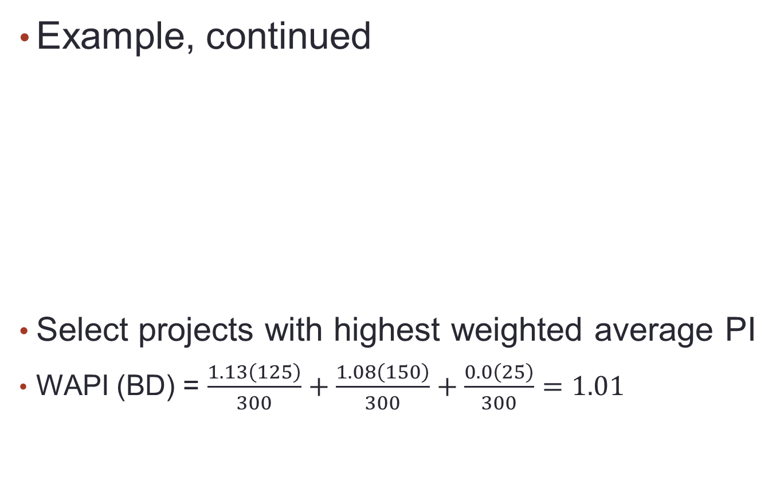
5-4 choosing capital investments when resources are limited
Project | NPV | Investment | PI
A | 230,000 | 200,000 | 1.15
B | 141,250 | 125,000 | 1.13
C | 194,250 | 175,000 | 1.11
D | 162,000 | 150,000 | 1.08
Notes:
There is capital constraint for the firm.
Project: A B C D PI 1.15 1.13 1.11 1.08
Investment 200 125 175 150
WAPI(BD) = [1.13 × (125/300)] + [1.08 × (150/300)] + [0.0 × (25/300)] = 1.01.
($25,000 is invested in the financial market and therefore has zero NPV.)

Slide 20
5-4 choosing capital investments when resources are limited
Example, continued
Select projects with highest weighted average PI
WAPI (BD) = 1.01
WAPI (A) = 0.77
WAPI (BC) = 1.12
Project | NPV | Investment | PI
A | 230,000 | 200,000 | 1.15
B | 141,250 | 125,000 | 1.13
C | 194,250 | 175,000 | 1.11
D | 162,000 | 150,000 | 1.08
Notes:
Weighted average PI for B and C = (125/300) x 1.13 + (175/300) x (1.11) = 1.12
Weighted average PI (BD) = 1.01
WAPI (A) = 0.77
WAPI(BC) = 1.12
Therefore, accept B and C combination.

Slide 21
5-4 choosing capital investments when resources are limited
Capital Rationing
Limit set on amount of funds available for investment
Soft Rationing
Imposed by management
Hard Rationing
Imposed by unavailability of funds in capital market
Notes:
Point out that companies desire all projects that create positive NPVs. Unfortunately, firms do not have access to endless sources of capital. The credit crisis of 2008 and 2009 provides a good example.

