Slide 1
MAKING INVESTMENT DECISIONS WITH THE NET PRESENT VALUE RULE
6
McGraw-Hill/Irwin
Copyright © 2014 by The McGraw-Hill Companies, Inc. All rights reserved.

Slide 2
6-1 applying net present value rule
Rule 1: Only Cash Flow Is Relevant
Capital Expenses
Record capital expenditures when they occur
To determine cash flow from income, add back depreciation and subtract capital expenditure
Working Capital
Difference between company’s short-term assets and liabilities
Notes:
Remember that only cash flows are relevant. Use incremental, after-tax cash flows to calculate NPVs. Remind students to be very careful when using accounting data.

Slide 3
6-1 applying net present value rule
Rule 2: Estimate Cash Flows on an Incremental Basis
Include taxes, salvage value, incidental effects, and opportunity costs
Do not confuse average with incremental payoffs
Forecast sales today, recognize after-sales cash flow to come later
Forget sunk costs
Beware of allocated overhead costs
Notes:
These are all important points. Incremental cash flows are cash flows generated by the project. It may be difficult to figure out all incidental effects. In addition to investing in machinery, plant, etc., investing in working capital is required to produce goods or services. Sunk costs should not be considered. Opportunity costs should be included on an after-tax basis. Include only appropriate overhead costs.

Slide 4
6-1 applying net present value rule
Rule 3: Treat Inflation Consistently
Use nominal interest rates to discount nominal cash flows
Use real interest rates to discount real cash flows
Same results from real and nominal figures
Notes:
If the discount rate and the cash flows are estimated consistently, this should not give any trouble. The general rule to remember is that after-tax nominal cash flows are discounted using after-tax nominal discount rates. After-tax real cash flows are discounted using after-tax real discount rates.

Slide 5
6-1 applying net present value rule
Inflation
Example
Project produces real cash flows of -$100 in year zero and then $35, $50, and $30 in three following years. Nominal discount rate is 15% and inflation rate is 10%. What is NPV?
Notes:
Here is an example to show how inflation can distort cash flows.
This slide represents the introduction that flows through the next two slides. It also calculates the real interest rate, as it will be used in an upcoming slide.

Slide 6
6-1 applying net present value rule
Inflation
Example—Nominal figures
Notes:
Nominal cash flows are discounted using an inflation rate of 10%. Nominal cash flows include inflation.

Slide 7
6-1 applying net present value rule
Inflation
Example—Real figures
Notes:
Real cash flows do not include inflation and should be discounted using real discount rates. The PV is the same as above. Conclusion: You get the same answer as long as you treat inflation consistently.

Slide 8
6-1 applying net present value rule
Separate Investment and Financing Decisions
Regardless of financing, treat cash outflows required for project as coming from investors
Regardless of financing, treat cash inflows as going to investors
Notes:
This slide covers the importance of separating investment and financing decisions.

Slide 9
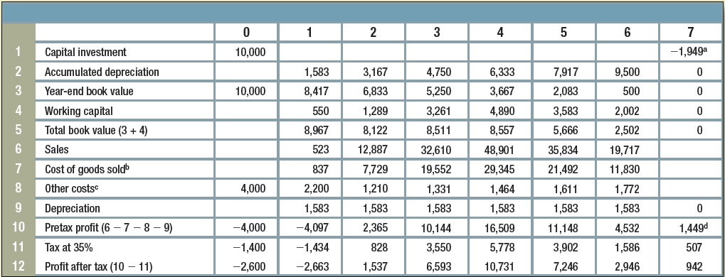
TABLE 6.1 IM&C’S FERTILIZER PROJECT, REVISED PROJECTIONS ($1,000S) REFLECTING INFLATION
Notes:
Go over this table step by step. Remember that this example uses straight-line depreciation. Here working capital required is 10% of the sales. Many times working capital is invested in year zero and taken out at the end of the project. In other words, the same working capital is invested throughout the project, which simplifies the estimation. This estimation assumes straight-line depreciation, which also simplifies the estimation.

Slide 10
6-2 IM&C’s fertilizer project
NPV Using Nominal Cash Flows
Notes:
This can be covered via a formula calculation, spreadsheet, or financial calculator. The complexity of the example lends itself well to a spreadsheet.

Slide 11
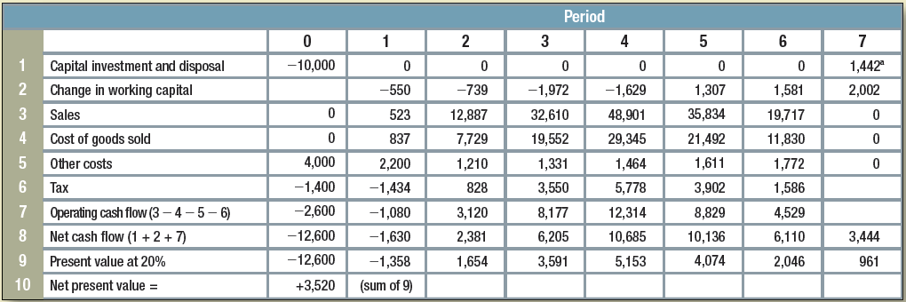
Table 6.2 im&c’s fertilizer project, cash flow analysis ($1,000s)
Notes:
Go over this table carefully to show how cash flows are estimated.

Slide 12
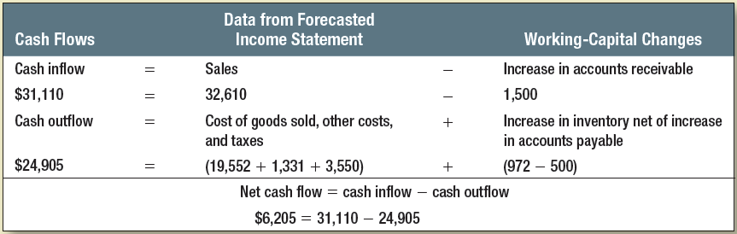
TABLE 6.3 IM&C’S FERTILIZER PROJECT, DETAILS OF CASH FLOW FORECAST IN YEAR 3 ($1,000S)
Notes:
This provides an analysis of cash inflows and cash outflows for year three. This should be worked out for each year.

Slide 13
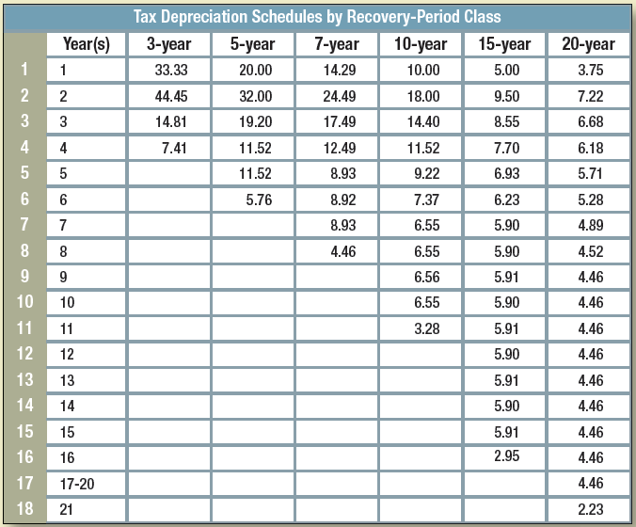
Table 6.4 im&c’s fertilizer project, tax depreciation
Notes:
Generally, there are two ways to depreciate an asset: the straight-line method and MACRS. This table is provided by IRS. Make sure to point out the terminology inconsistency between the self-described method and the actual years used.

Slide 14
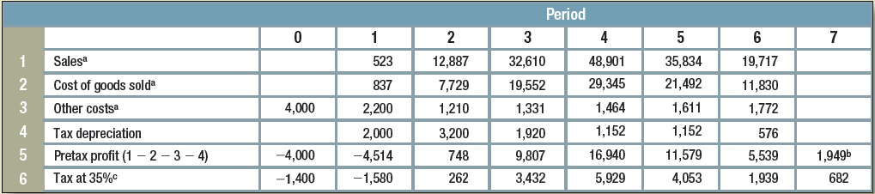
Table 6.5 im&c’s fertilizer project, tax payments ($1,000s)
Notes:
Note how taxes are different when MACRS is used for depreciation.

Slide 15
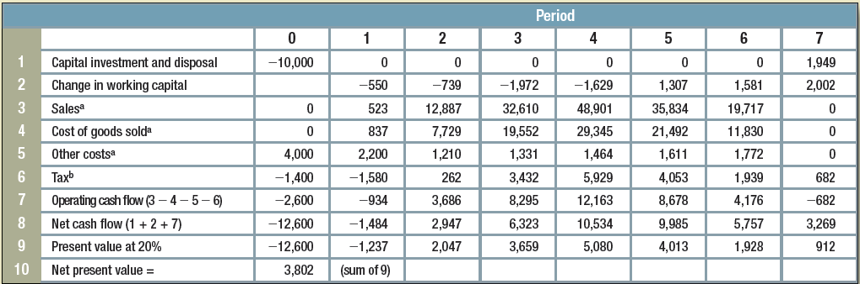
Table 6.6 im&c’s fertilizer project, revised cash flow analysis, ($1,000s)
Notes:
The NPV is also different (higher) when MACRS is used. NPV = +3,802, which is slightly higher than that for straight-line depreciation. This is because of the tax advantage associated with accelerated depreciation.

Slide 16
6-3 using the npv rule to choose projects
Problem 1: Investment Timing Decision
Some projects are more valuable if undertaken in the future
Examine start dates (t) for investment and calculate net future value for each date
Discount net values back to present
Notes:
It is important to explain that NPVs can be calculated at any point in time. Students are most familiar with time = 0. This kind of case shows how we must be flexible in our calculations. It is an “outside the box” concept and hard for students to grasp.

Slide 17
6-3 using the npv rule to choose projects
Problem 2: Choice between Long- and Short-Term Equipment
Example
Given the following cash flows from operating two machines and a 6% cost of capital, which machine has the higher value using the equivalent annual annuity method?
 | Year
Machine | 0 | 1 | 2 | 3 | PV@6% | E.A.A.
A | +15 | +5 | +5 | +5 | 28.37 | 10.61
B | +10 | +6 | +6 |  | 21.00 | 11.45
Notes:
These are present value costs. There is no need to consider the revenue side. (The years should be changed to 0, 1, 2, 3). EAC (A) = 28.37 / 2.673 = 10.61; EAC (B) = 21/ 1.8333 = 11.45. Therefore it is best to select machine A. (Here we are comparing only costs.)

Slide 18
6-3 using the npv rule to choose projects
Equivalent Annual Cash Flow, Inflation, and Technological Change
Inflation increases nominal costs of operating equipment, but real costs remain unchanged
Real cash flows are not always constant
Notes:
Equivalent annual cash flows are useful when comparing machines with different lives. In many cases you do not need to consider the revenue side, as the machines would be producing the same output. This method has a number of practical applications as managers and engineers routinely face these types of problems. In more robust examples, both positive and negative cash flows may occur. In both, the technique is useful.

Slide 19
6-3 using the npv rule to choose projects
Equivalent Annual Cash Flow and Taxes
Lifetime costs should be calculated after tax
Operating costs are tax-deductible
Capital investment generates depreciation tax shields
Notes:
This slide explains the importance of factoring taxes into lifetime costs.

Slide 20
6-3 using the npv rule to choose projects
Problem 3: When to Replace an Old Machine
Example
A machine is expected to produce a net inflow of $4,000 this year and $4,000 next year before breaking. You can replace it now with a machine that costs $15,000 and will produce an inflow of $8,000 per year for three years. Should you replace now or wait a year?
Notes:
In practice, the point at which equipment is replaced reflects economics, not physical collapse. We must decide when to replace.

Slide 21
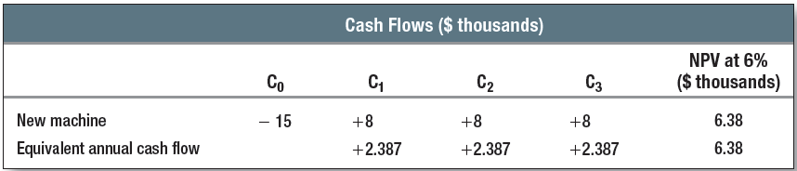
6-3 using the npv rule to choose projects
Problem 3: When to Replace an Old Machine
Example, continued
Notes:
The cash flows of the new machine are equivalent to an annuity of $2,387 per year.

Slide 22
6-3 using the npv rule to choose projects
Problem 4: Cost of Excess Capacity
Example
A computer system costs $500,000 to buy and operate at a discount rate of 6% and lasts five years
Equivalent annual cost of $118,700
Undertaking project in year 4 has a present value of 118,700/(1.06)⁴, or about $94,000
Notes:
When recognized, the NPV of the project may prove to be negative. If so, we still need to check whether it is worthwhile undertaking the project now and abandoning it later, when the excess capacity of the present system disappears.

