Slide 1
Intermediate Microeconomics: An Intuitive Approach with Calculus, 1e
Chapter 27– Public Goods

Slide 2
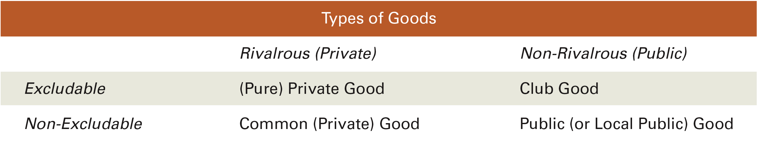
Types of Goods
Rivalrous: If the good cannot be consumed by more than one individual at a time.
Excludable: If non-paying consumers can be excluded from consumption.
Of the many types of goods in the world, our primary focus so far has been on private goods – goods that are both rivalrous and excludable.
Common goods arise when rivalrous goods are made non-excludable through common ownership (from Tragedy of the Commons, Chapter 21).
Public goods are both non-rivalrous and non-excludable; e.g. national defense.
Club goods are non-rivalrous but excludable; e.g. public swimming pools.

Slide 3
Public Goods, Externalities and Markets
The non-rivalry of public goods arises from the presence of (positive) externalities – because consumption of the good by one individual makes consumption by others possible.
With public goods this consumption is also non-excludable, and so the externality cannot easily be priced.
Public goods are therefore the least likely to be produced in the market.
Excludable public goods – or club goods – can be produced in the market because firms can exclude non-paying consumers.
While we have characterized goods as discretely falling into one of four categories, real world goods often fall along a continuum of rivalry and non-rivalry as well as excludability and non-excludability.

Slide 4
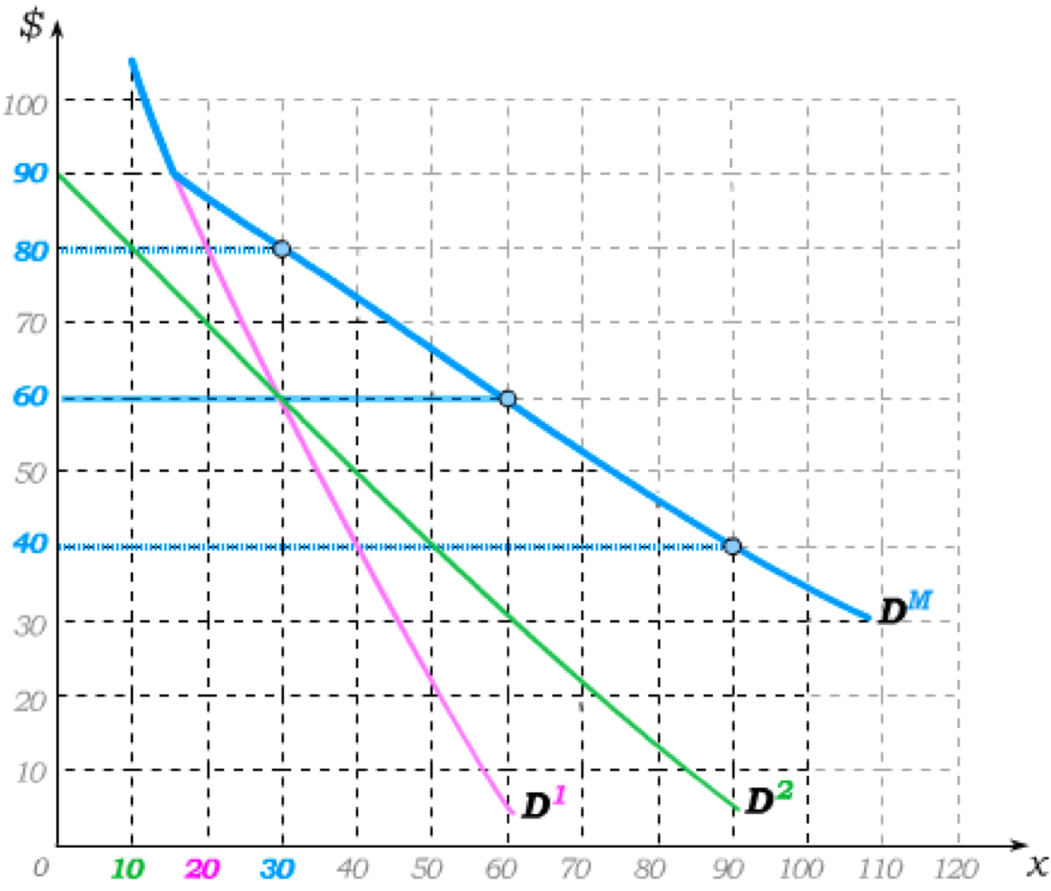
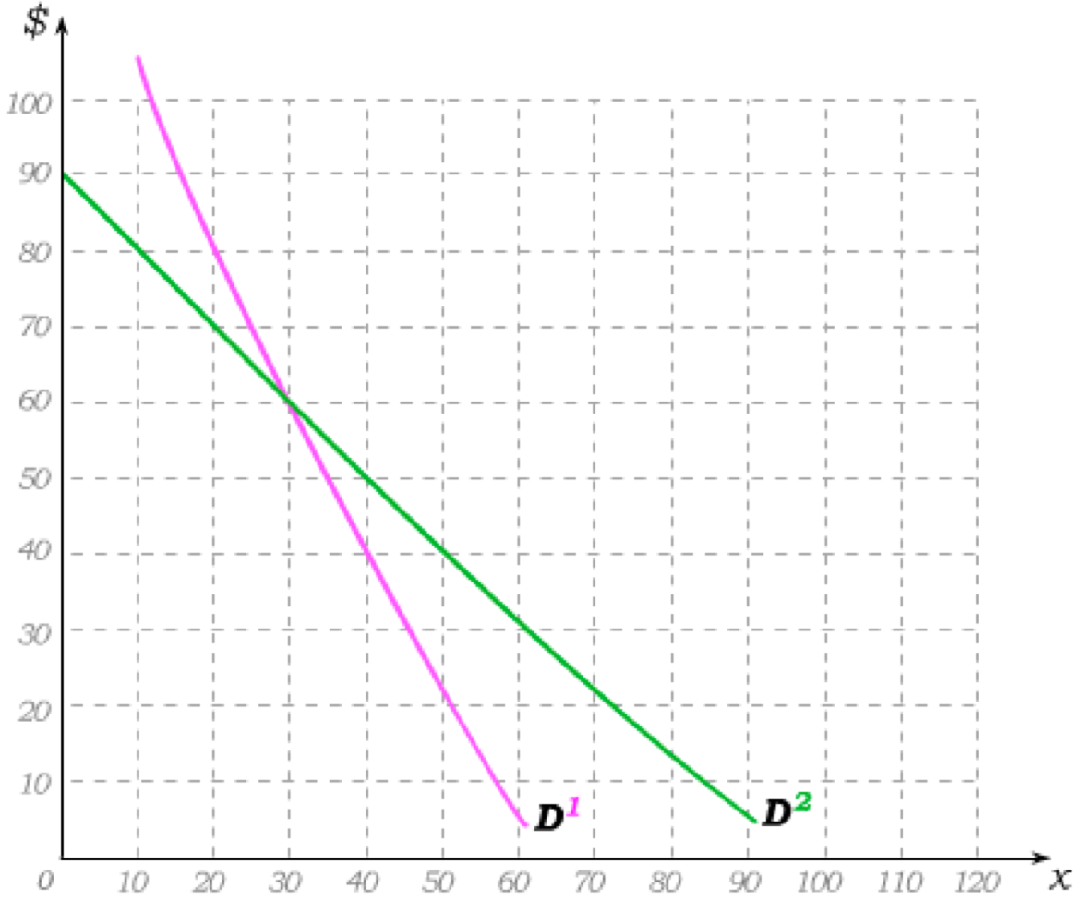
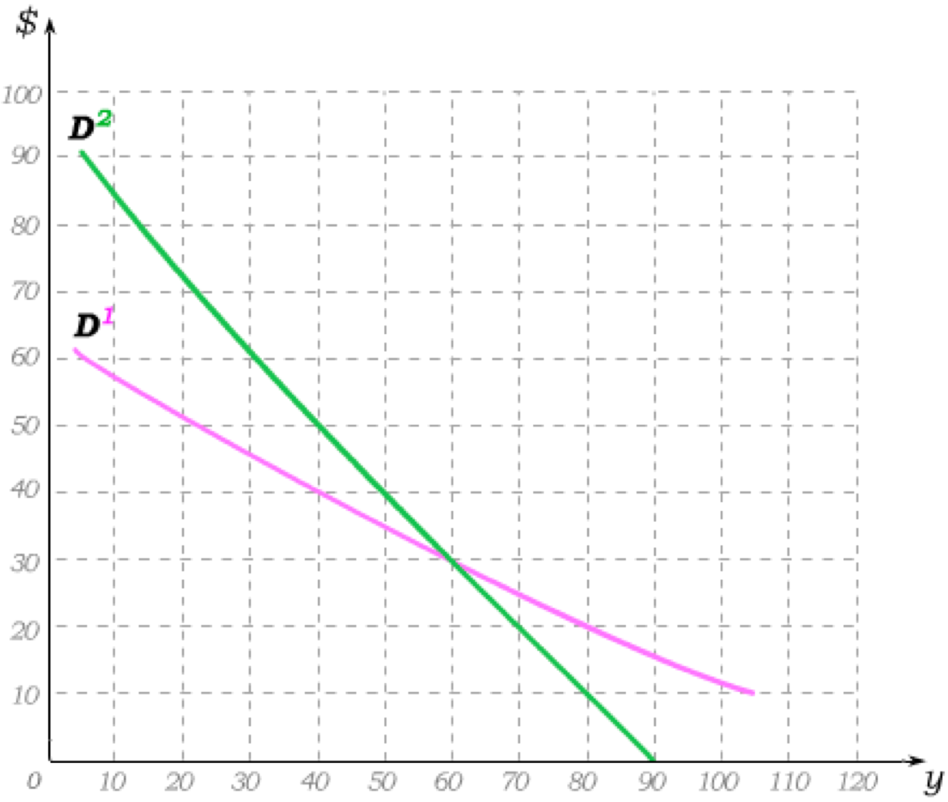
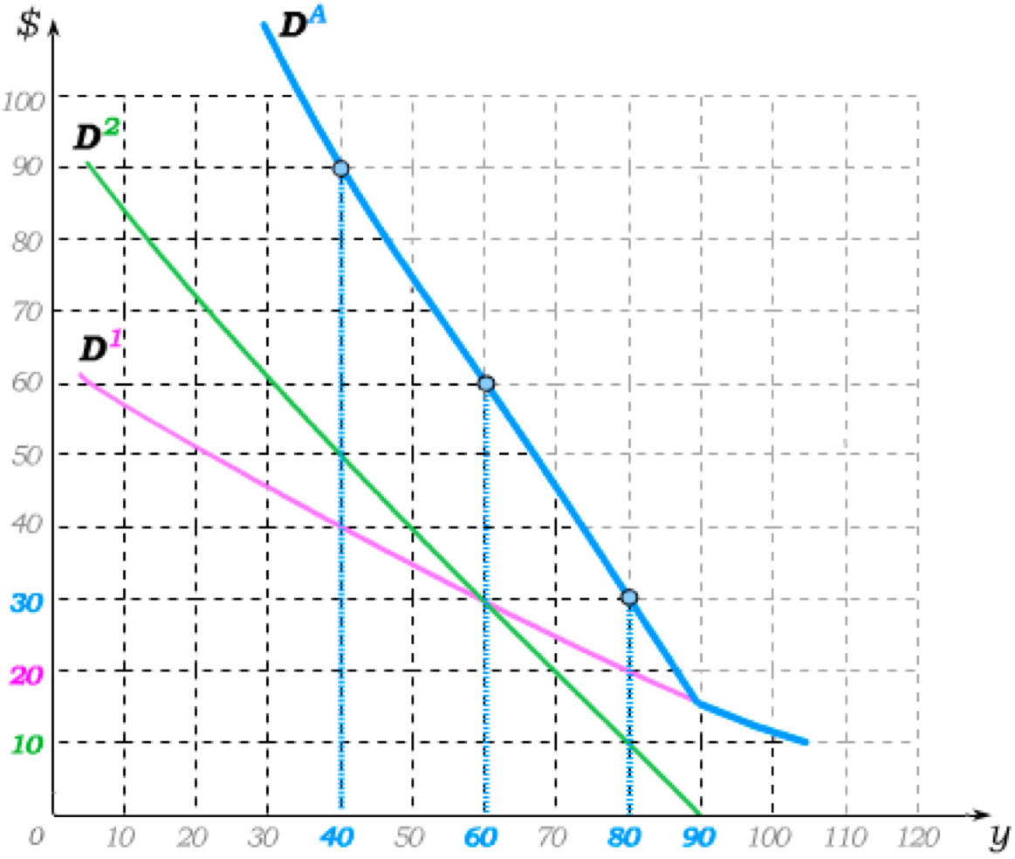
Demand, or MWTP, for Public Goods
In deriving market demand for pure private goods, we began with demands for 2 individuals.
To find total demand for pure public goods, we similarly begin with two initial demand curves.
But now each quantity can be consumed by both individuals – and so we add demand curves “vertically” to determine the total willingness to pay for that quantity.
At each price level, we then add the demand curves “horizontally” to get total demand.
€
€

Slide 5
Efficient Output Level: Private vs. Public
For a given marginal cost of production, the efficient private good output level occurs where MC=D^{M}.
For a given marginal cost of production, the efficient public good output level occurs where MC=D^{M}.
Consumer 1 consumes where MC=D¹ and consumer 2 consumes where MC=D².
At this efficient quantity, D¹ + D² = MC.
Efficiency implies the sum of private marginal benefits is equal to MC.
€
Efficiency implies private marginal benefits are equal to MC.
€
MC
MC
MB¹
MB²

Slide 6
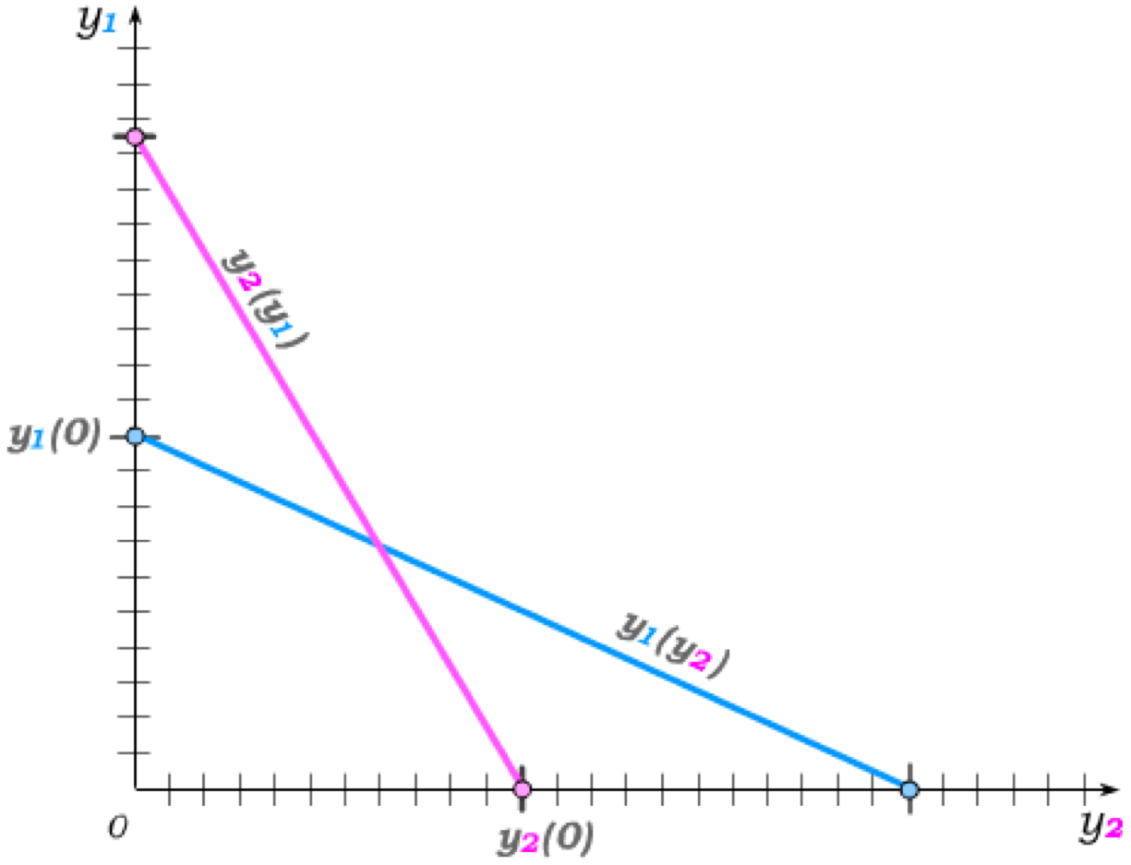
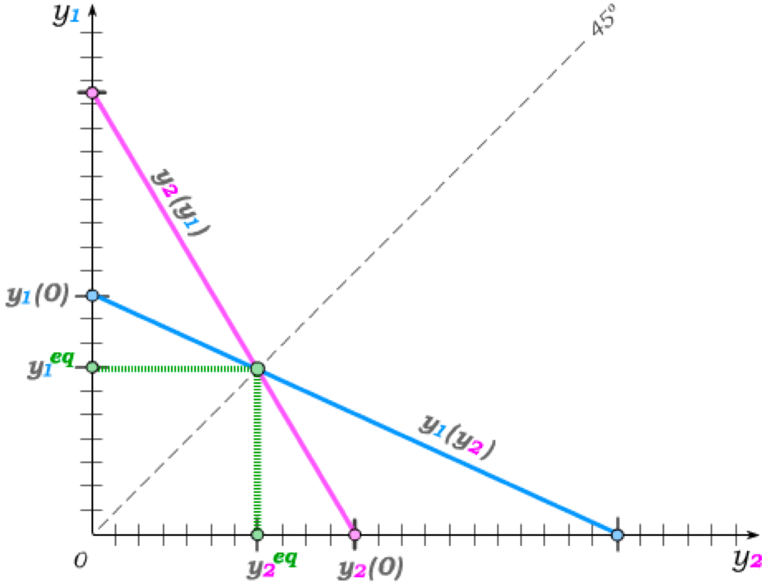
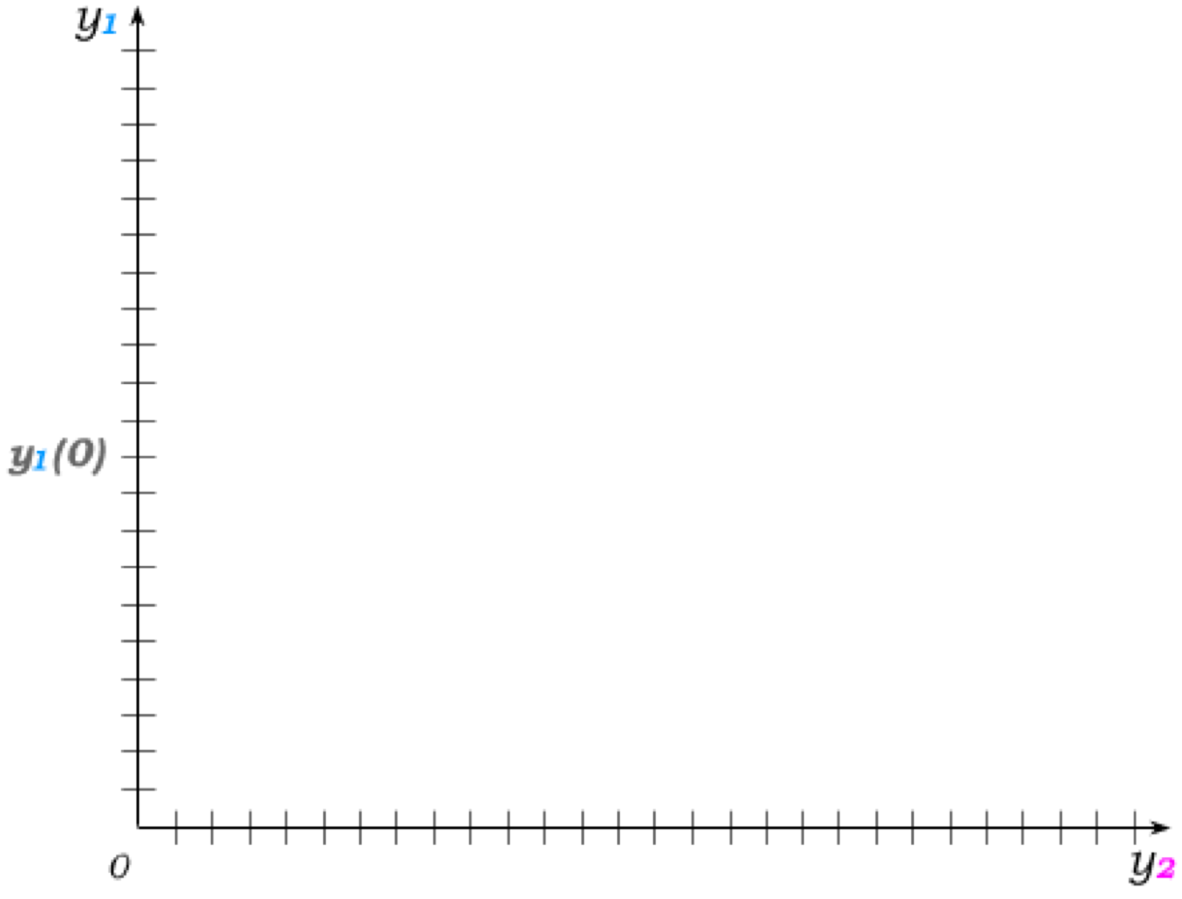
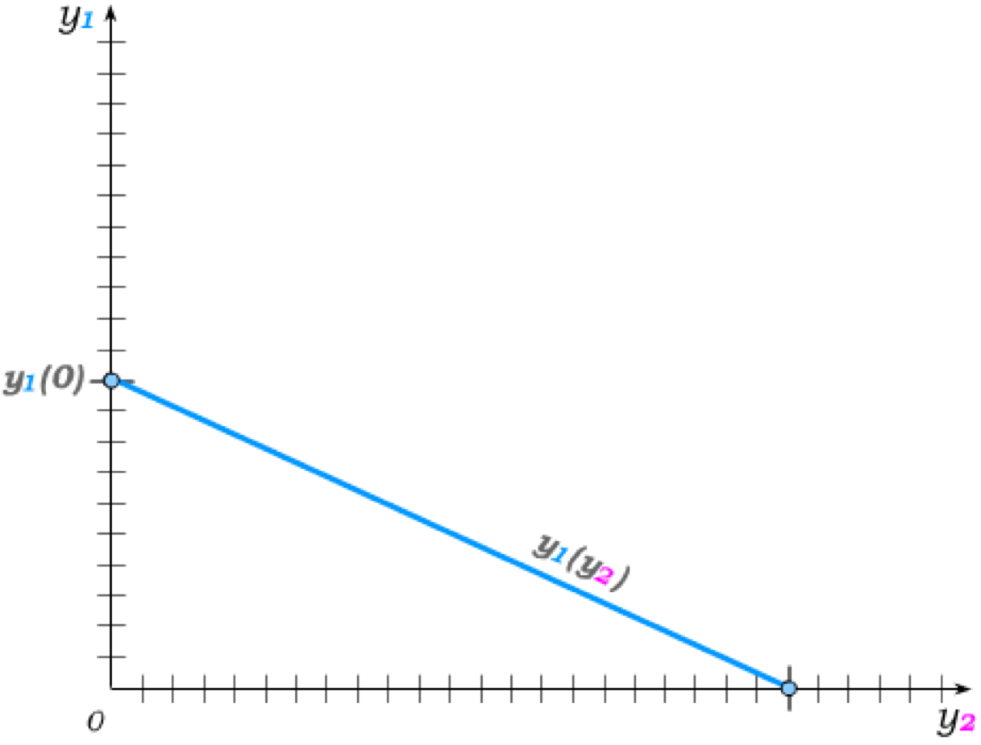
Decentralized Public Good Provision
Suppose two people individually contribute to a public good.
If ind 1 believes ind 2 contributes y₂ = 0, his best response is to contribute and amount y₁(0) such that the marginal benefit of the last euro contribution is equal to €1.
As ind 2 contributes y₂ > 0, ind 1 best-responds by contributing y₁(y₂) < y₁(0), due to dimi- nishing returns, where the marginal benefit of last euro contribution is again equal to €1.
The symmetric is true for individual 2’s best response to individual 1’s contribution.
The Nash equilibrium contributions then occur where the best response functions cross.
Because, in best responding to the other, each individual contributes until his own marginal benefit equals €1,
Too little —relative to the efficient level— of the public good is therefore provided.

Slide 7
Free-Riding and the Prisoners’ Dilemma
The public goods problem is, in essence, a prisoners’ dilemma problem.
Each individual has an incentive to give too little – regardless of what others do (i.e., a dominant strategy). This is often referred to as the free-riding problem.
And the prisoners’ dilemma incentives get worse the more individuals benefit (and potentially contribute) to the public good.
We have seen that individuals who are caught in a prisoners’ dilemma would prefer to hire an enforcer to force them to the efficient solution.
That is, in essence, what we are doing when we hire the government as an enforcer who forces us to pay taxes to fund public goods.
Such government funding can come in essentially three ways:
– The government can subsidize private giving to public goods, as it does by allowing for tax deductions or tax credits for charitable giving.
– The government can directly contribute to the public good, as it does for national television.
– The government can simply provide the public good as it does for national defense.

Slide 8
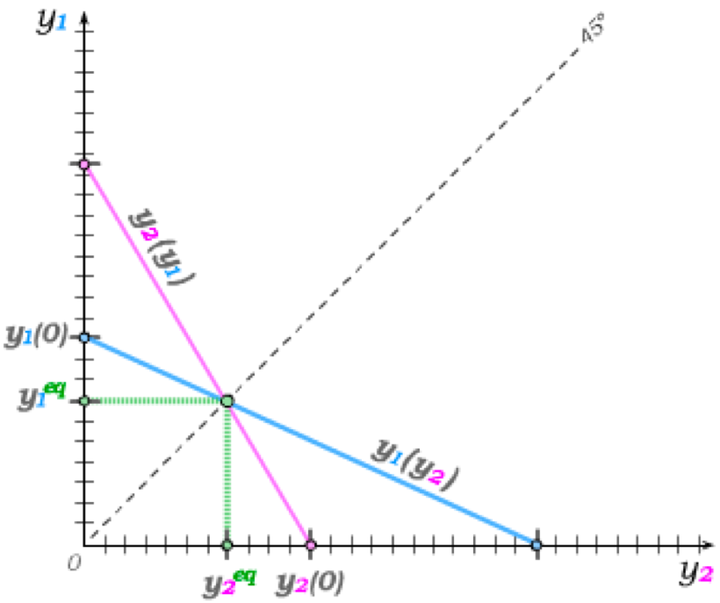
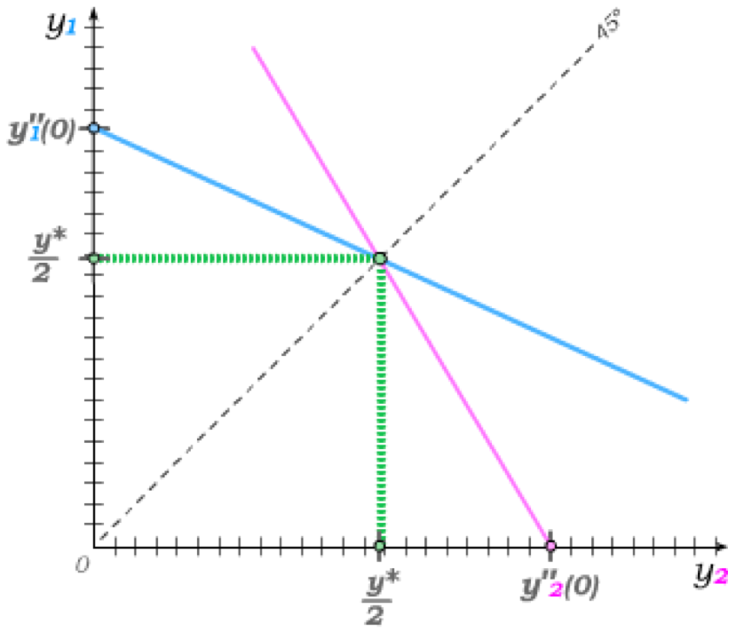
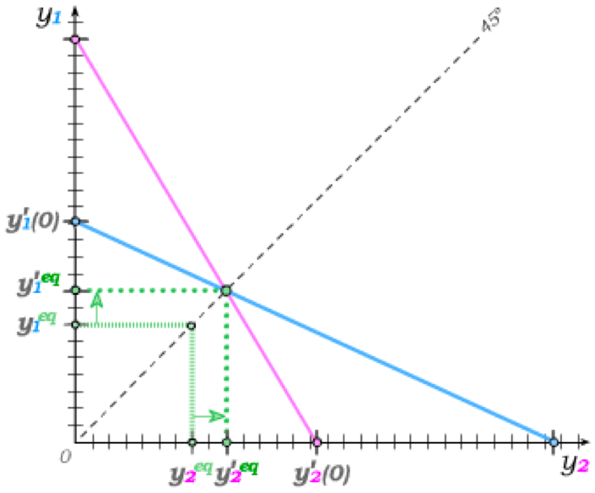
Nash Equilibrium with Subsidies
We can see the impact of subsidizing the individual contributions made to the public good within the graph of best response functions.
Any subsidy that make it cheaper for individuals to contribute will raise each person’s best response function – and thus the equilibrium contributions.
If the two individuals are identical, the efficient level of the subsidy is an amount such that each individual contributes half the efficient level of the public good.
Since the inefficiently low level of contributions without subsidies arises from the fact that there is a positive externality that is not internalized, the subsidy is an example of a Pigouvian subsidy.

Slide 9
Government Provision and “Crowd Out”
If the government does not subsidize private giving by making such giving cheaper, the alternative is for the government to contribute to the public good directly – or to simply outright provide it.
Government Contributions:
If the government simply becomes another contributor to a public good to which individuals are already contributing, the government contributions can “crowd out” private contributions.
The private giving Nash equilibrium thus results in less private giving as the government increases its contribution.
This holds so long as individuals are in fact still giving to the public good and the public good is not fully provided by the government.
Government Provision:
When individuals are not voluntarily giving to a public good, the government can simply address the underlying prisoner’s dilemma by funding such goods through taxation.

Slide 10
Establishing “Markets” to Provide Public Goods
So long as public goods are excludable, we can imagine market-based provision. But in this case, we are basically talking about club goods.
In some cases, it may be possible to simply exclude non-payers at the “gate” – as, for instance in movie theaters (i.e., club goods).
In such cases, firms and “clubs” can compete for paying customers.
In other instances, the public good is geographically confined, and individuals must pay some “price” to live in the community that provides the public good.
In such cases, geographically based institutions like homeowners’ associations and local governments emerge.
None of this is easily envisioned for pure public goods, like national defense, that are not excludable.

Slide 11
Lindahl Price Discrimination
When institutions provide (local) public goods – such as public gardens and pools – consumers consume the same quantity but have different willingness to pay.
In private goods markets, efficiency arises from the fact that all individuals pay the same price and then choose different quantities as they optimize.
In public good markets, the reverse is true:
€
Everyone chooses the same quantity – but in order for this to happen efficiently, individuals must optimize using individualized prices related to their marginal willingness to pay.
These individualized prices are called Lindahl prices, and an equilibrium in which efficient Lindahl price discrimination arises is called a
Lindahl Equilibrium.
MC
p¹
p²

Slide 12
Lindahl Equilibrium and the Incentive to Lie
We can conceptually see how prices can be individualized as Lindahl prices in such a way as to get individuals to choose the same level of the public good.
The practical problem, however, is that setting such individualized prices requires knowledge of individual tastes.
If firms (or clubs) rely on individuals to give indications of their individual tastes, they are relying on information provided by consumers who know that the price they will be charged depends on how much they say they like the public good.
But individuals then clearly have an incentive to under-report their true taste for the public good (i.e., an incentive to lie).
As the number of individuals increases, the incentive to lie about tastes grows – because
– a single individual’s tastes have increasingly little connection to how much of the public good will be produced, while
– the individualized price depends entirely on an individual’s (reported) tastes.
This has led to interest in preference revelation mechanisms – i.e. the structuring of incentives to get people to report their true preferences for public goods.

Slide 13
The “Lighthouse” Example
Even when some public goods are not excludable, we can think of examples where market mechanisms can provide them – if the public good can be tied to a private good.
The most famous example is that of the 18th century lighthouse that guided ships into harbours and around treacherous waters.
Such lighthouses were in some cases provided by owners of harbours who bundled the public good with private docking rights that were excludable.
We can think of similar examples of bundling in modern homeowners’ associations that provide such public goods as swimming pools and street lights bundled with condominiums that include homeowners’ association fees.
Such bundling can effectively provide only certain types of public goods – i.e. those that are at least somewhat local.

Slide 14
Public Goods Provided by Civil Society
We have seen how the public goods problem can be addressed through government policy and, in some instances, through market-like mechanisms.
But many public goods are provided in the civil society – i.e., in the sphere of society where exchange is governed neither by government compulsion nor by market prices.
Examples include local public goods provided in families, by churches and by charitable organizations.
The essential problem that civil society organizations must overcome is the free-rider problem – i.e., the tendency of individuals to free-ride on the contributions of others.
In cases involving few individuals and low transaction costs, the Coase Theorem may apply (recall Externalities from Chapter 21) .
In cases involving many individuals, civil society often relies on social norms and tipping points.

Slide 15
Social Norms and “Warm Glow”
Social norms impact individual preferences in ways that may allow civil society institutions to in part overcome the free rider problem.
In our framework of private giving to a public good, we assumed that individuals only derive “utility” from the public good itself.
Under a social norm that emphasizes private giving, individuals also derive utility from the act of giving.
This is often referred to as the warm glow effect.
Individuals that get a “warm glow” from giving will give more because they are in essence buying the private good of the warm glow as they are contributing to the public good.
There is much evidence that private giving must in fact be accompanied by something like a “warm glow” – and that marketing by charitable organizations can increase this “warm glow” and thus capitalize on the private benefits of giving.
For instance: Our model of private giving in the absence of a warm glow effect cannot explain why individuals give to multiple large charities.
The model similarly cannot explain why government contributions to groups like the Red Cross or NPR don’t more fully crowd out private contributions.

Slide 16
Tipping Points
In some instances, it seems difficult to provide large public goods in the civil society until a sufficiently large number of people are engaged.
Consider, for instance, private giving for building a new church.
Individuals may consider their private benefit from a new church, and they may get a “warm glow” from knowing that their contribution has helped.
But the “warm glow” may increase the more an individual sees others as giving – creating a snowball effect as more people give.
In many such situations, it is initially difficult to get individuals involved in giving – but, once a sufficiently large fraction of people are involved, a tipping point is reached.
Raising funds after the tipping point then becomes much easier as individuals get utility from being seen as giving and disutility from being viewed as “shirking”.
This tipping point mechanism can also explain how some social movements never quite catch on – while others, including those that involve considerable personal risk on the part of individuals that get involved, tip into successful movements.
Successful social entrepreneurs often combine use of the “warm glow effect” with tipping point dynamics of social movements to provide public goods through the civil society.

Slide 17
Tutorial exercises
Within-chapter exercises:
27A.1, 27A.10, 27A.11, 27A.12, 27A.14, 27A.16, 27A.17, 27A.18, 27A.19, 27A.20
End-of-chapter exercises:
N/A

Slide 18

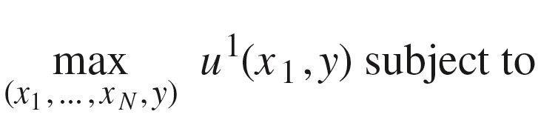
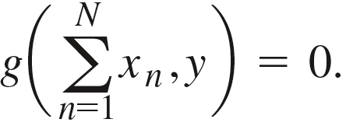
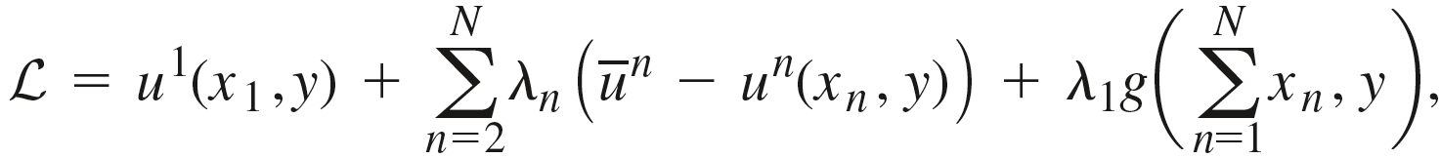
Solving for the Efficient Public Good Level
Letting the constraint be written as
we can then find an efficient allocation by solving
The Lagrange function for this problem is
from which we can then derive the first order conditions.

Slide 19

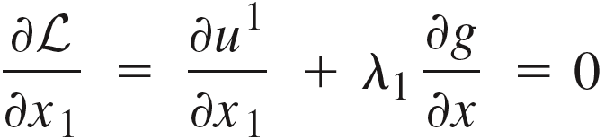

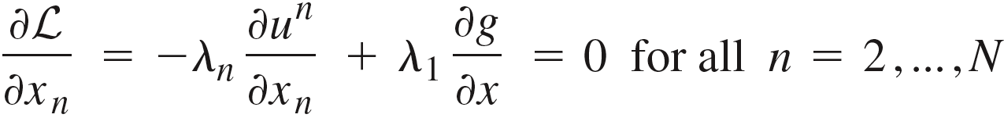
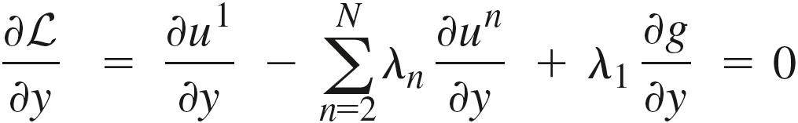
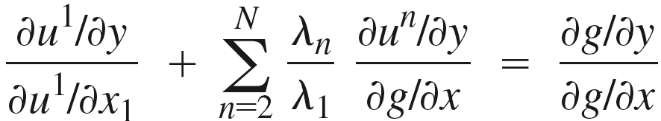
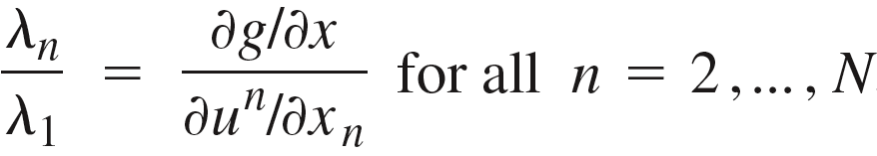
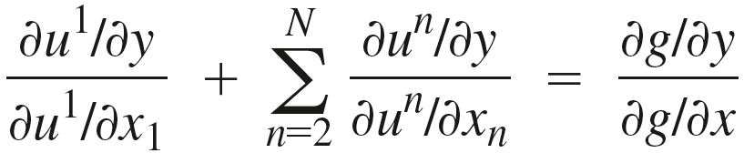
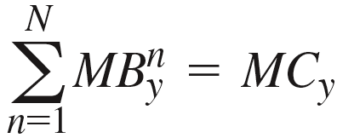
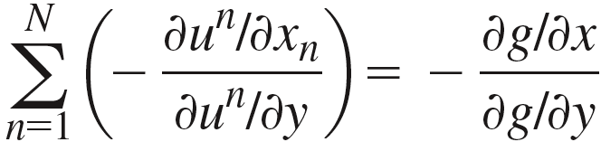
Solving for the Efficient Public Good Level

Slide 20





An Example
Suppose there are 2 consumers with (private good) incomes I₁ and I₂ and identical tastes represented by
And suppose the public good production technology is .
We can find an efficient allocation by maximizing one individual’s utility subject to the resource and production constraint and holding the utility of the other fixed:
Solving the first order conditions, we get
which implies

Slide 21


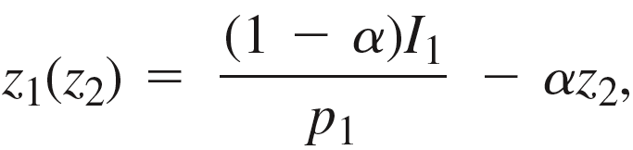
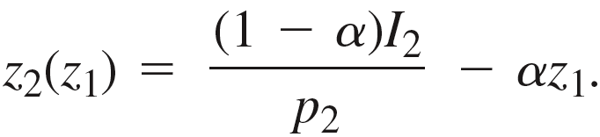
Decentralized Provision of Public Goods
Continuing with our example, suppose that the public good is funded through private contributions z₁ and z₂, and thus
Suppose further that it costs individual n an amount p_{n} to contribute €1, with p_{n}=1 when there is no subsidy for private giving to public goods.
Individual 1 then takes z₂ as given when solving
Writing the Cobb-Douglas utility function in log form and substituting in the constraints, this becomes
with the first derivative set to zero giving us the first order condition. Solving this, we get individual 1’s best response function
and, since individual 2’s situation is symmetric,

Slide 22
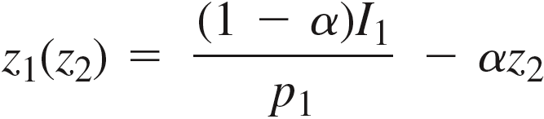
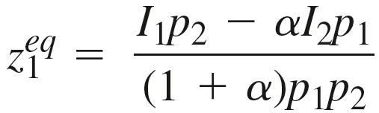
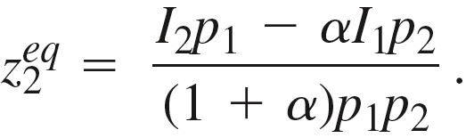
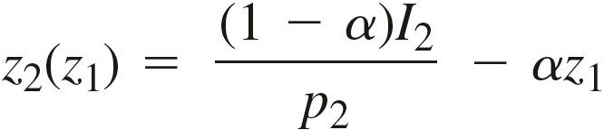
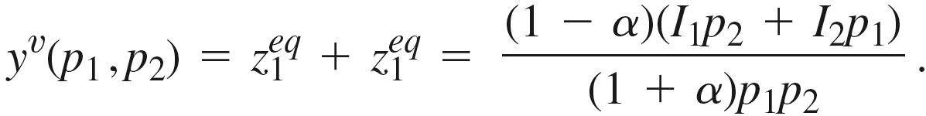
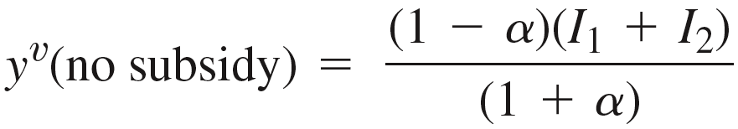
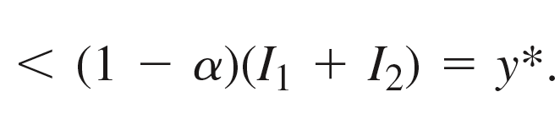
Decentralized Equilibrium
In Nash equilibrium, the two must best-respond to one another. We therefore substitute one best response function into the other to get the equilibrium contributions
and
The public good level under voluntary contributions is then
And without subsidies, p₁=p₂=1, implying
decentralized public
good level
efficient public good level

Slide 23
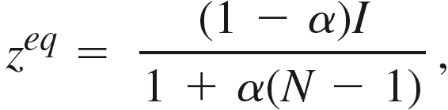

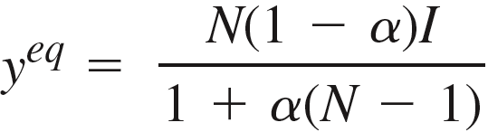
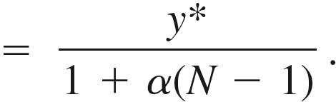
Decentralization with N > 2
Next, suppose there are N individuals contributing to a public good without subsidies (i.e. p_{n}=1).
To simplify the problem further, everyone has identical income I.
Each individual then takes the (N – 1) contributions by everyone else as given, and, since everyone is identical, everyone will contribute the same amount z in equilibrium.
In equilibrium, everyone is furthermore best-responding, which implies
Solving for z, we get
implying an equilibrium level of public good of
As N increases, the equilibrium deviates further from the optimum.

Slide 24
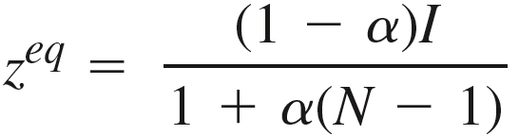

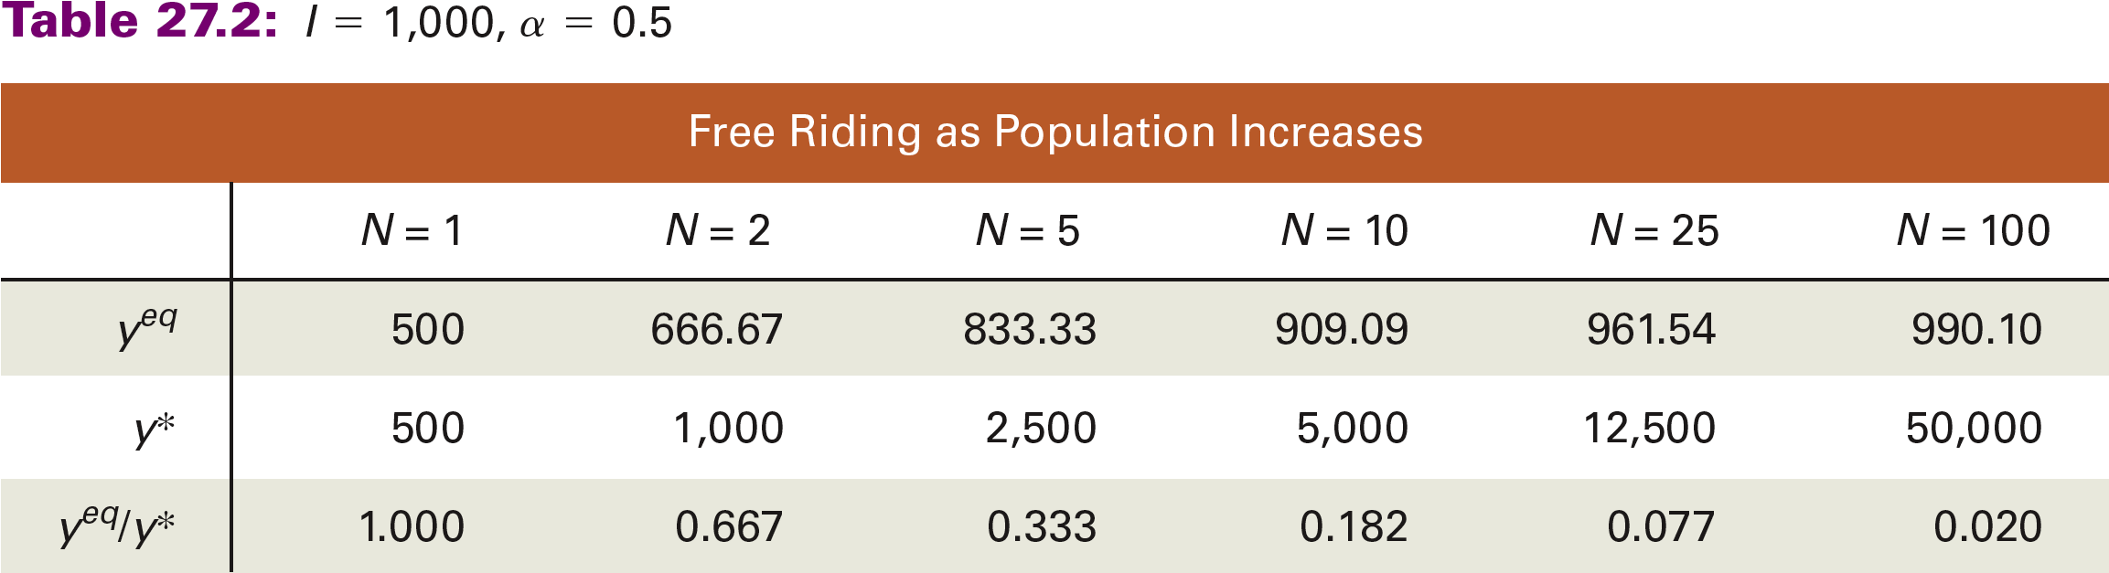
Decentralization as N Increases
Suppose, for instance, that I = 1,000 and the Cobb-Douglas preference parameter on the utility function
is α = 0.5.
We can then use the functions we derived to calculate how the equilibrium changes as N increases.

Slide 25
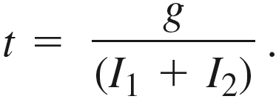
Government Provision
Going back to our 2-person example where the individuals have identical tastes described by but potentially different incomes I₁ and I₂, suppose next that the government provides an amount g to the public good.
To fund its contribution, the government taxes the (lump sum) income of the individuals at a rate t sufficient to pay for g; i.e. t(I₁ + I₂) = g, which implies the tax rate has to be
Individual 1 then takes as given both z₂ and g as well as the tax rate t when solving
where we have written the Cobb-Douglas utility function in log form and where p₁=1 in the absence of any subsidy for private giving.
Substituting in for the tax rate t that is necessary to fund g, this can be written as

Slide 26
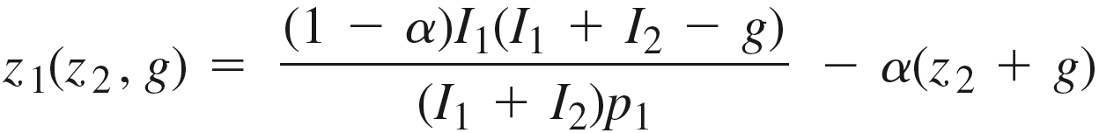
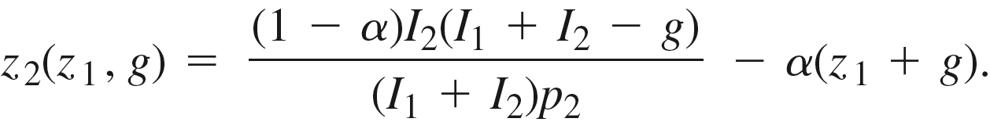
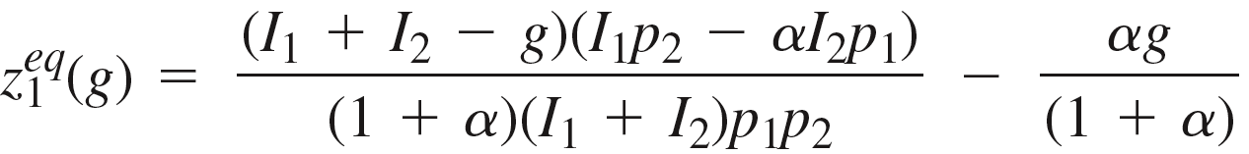
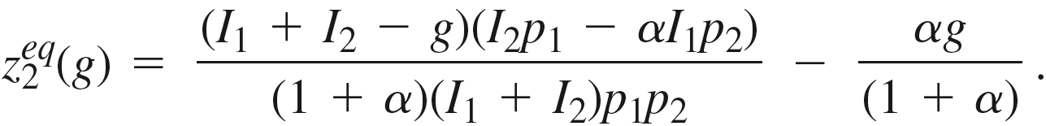
Best Response Functions
Solving the first order condition for both individuals, we get the best response functions
and
And substituting one into the other, we find the Nash equilibrium contributions of
and

Slide 27
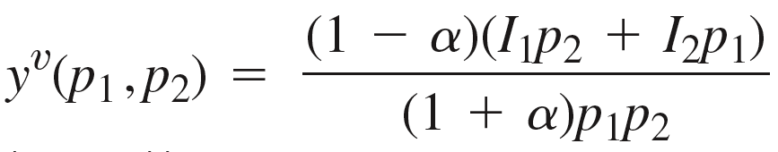

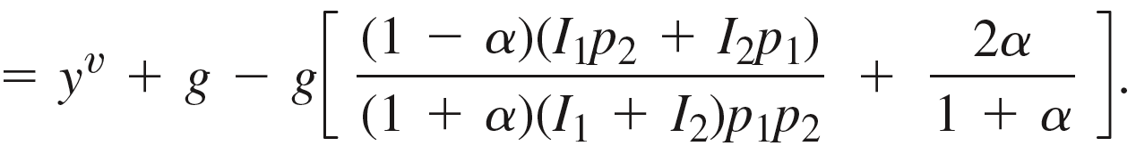

Crowd-Out under Government Provision
We previously calculated the voluntary contributions equilibrium in the absence of government provision as
The equilibrium level of the public good when the government provides g is then
crowd-out of private contributions
When private giving is not subsidized and thus p₁=p₂=1, this crowd-out term becomes
which implies and the government contribution fully crowds out private contributions – so long as individuals are not driven to corner solutions.

Slide 28
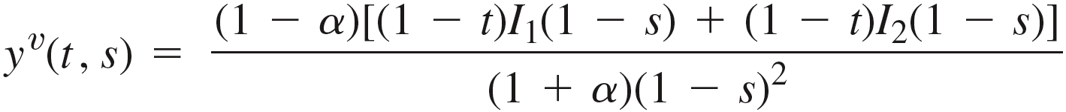
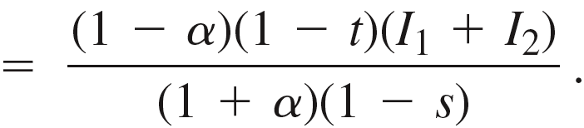



Subsidies for Voluntary Giving
Next, suppose the government does not provide any of the public good but instead subsidizes private contributions.
Such a policy can be characterized by (t , s) – a subsidy s that lowers the price of giving €1 to the public good from 1 to (1 – s), and a tax rate t on (lump sum) income in order to cover to cost of the subsidy.
Multiplying the income terms in our voluntary contributions public good equilibrium y^{v}(p₁,p₂) by (1 – t) and replacing the price terms by (1 – s), we then get
If the government aims to implement the efficient public good level
the cost of the subsidy is – implying a necessary tax rate that satisfies which in turn simplifies to

Slide 29


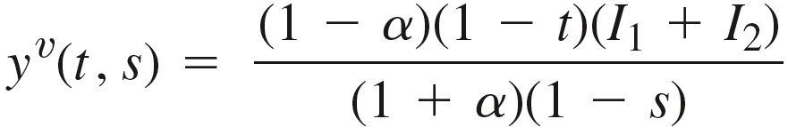
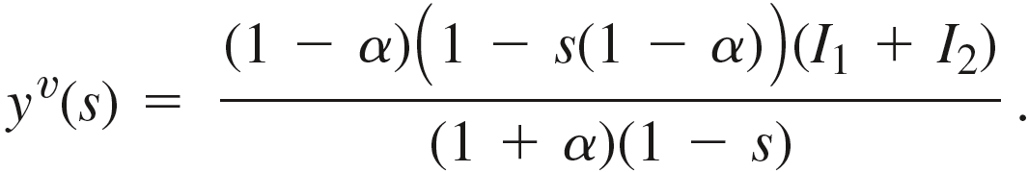

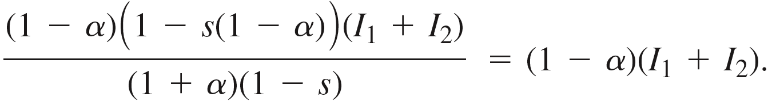
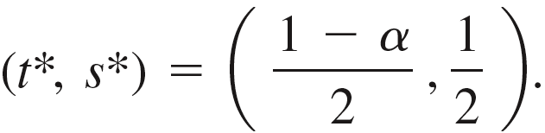

Subsidies for Voluntary Giving
Substituting into , we then get
And for this to be efficient, the subsidy needs to be set such that i.e. such that
Solving for s, we get the efficient subsidy level s*=1/2, and, given , the full efficient tax/subsidy combination is
When the number of individuals is N (rather than 2), the optimal subsidy rate increases to
Since the free-rider problem increases with N, the optimal subsidy for private contributions must also rise.

Slide 30




Lindahl Prices
Lindahl prices are individualized prices for public goods such that all individuals will choose the optimal quantity of the public good at their individualized prices.
Suppose again that the production process is which implies that the public good is produced at constant marginal cost c = 1.
Suppose further that we again have two consumers with identical tastes described by
but potentially different incomes I₁ and I₂.
The Lindahl prices p₁ and p₂ must then sum to 1 (to cover costs) and be such that both consumers will actually choose efficient public good quantity.
Cobb-Douglas demands imply consumers allocate a fraction of their income to each good – with consumer n’s demand for the public good
To induce the efficient quantity y*, the individualized price p_{n} must then solve
which gives the Lindahl price

Slide 31

Civil Society and Free Riding
The “purely rational” model of voluntary giving has difficulty explaining some behaviors we observe and may need to be supplemented if it is to explain certain empirical regularities.
It is, for instance, difficult to explain why people give to multiple charities.
Suppose there are 3 charities: a, b and c.
Before an individual considers a gift to one or more of these charities, they have already received gifts of Y_{a} , Y_{b} and Y_{c} .
Let the individual’s assessment of the value that is added by these charities be given by the function F(Y_{a} , Y_{b} , Y_{c} ).
In deciding where to donate some amount D, the individual then solves
where y_{a} , y_{b} and y_{c} are the individual’s contributions to charities a, b and c.
When D is small relative to each Y_{i} , the only way that an individual would optimize by giving to all 3 charities is if
There is no particular reason to expect this to hold.
Suggests something is missing from the model.

Slide 32

Warm Glow
One common addition to the “purely rational” model of public goods giving introduce a “warm glow” from giving and, perhaps, a larger “warm glow” from giving to multiple causes.
In essence, this results in an individual n’s contribution z_{n} entering his utility function twice, once as part of the public good, and once as a separate private good:
public good
Consider N identical individuals with this utility function, and suppose they also have identical incomes I.
In equilibrium, everyone else will then contribute an identical amount z, with individual 1’s best response z₁ determined from the problem
where the Cobb-Douglas utility is written in log form and the budget constraint substituted in for private good consumption.

Slide 33


Equilibrium Giving with Warm Glow
The first order condition, after rearranging some terms, is
And in equilibrium, everyone is best-responding – which implies z₁= z. We can therefore replace z₁ with z in the first order condition and then solve for z to get the equilibrium private contribution
The equilibrium contribution converges to the efficient contribution as β converges to 0 …
If we set up a social planner problem and solved for the efficient level of private contribution under the constraint that everyone contributes equally, we would get
… because, as β converges to 0, the public good ceases to matter and only the warm glow matters.

Slide 34

Inefficiency Ameliorated by Warm Glow
We can then calculate how a “warm glow” from giving to public goods ameliorates but does not eliminate the free rider problem.
Suppose, for instance, that the Cobb-Douglas parameter on private and public good consumption remains equal (as in previous tables) – but now there is also a “warm glow”.
We can then see that, while the equilibrium public good level under private giving deviates from the efficient level as N increases, it deviates less as private giving no longer converges to zero as N increases.

Slide 35

Marketing Public Goods in the Civil Society
The recognition of “warm glow” effects in private giving then has implications for social entrepreneurs who market public goods in the civil society.
Suppose there are 10,000 individuals with €1,000 and with tastes described by the utility function above where α = 0.4 and β + γ = 0.6.
Now suppose that marketing can alter the relative size of β and γ.
We can then calculate how a marketing campaign aimed at increasing “warm glow” can significantly increase how much is given to the public good.
€
€
€
€
€
€
€
€
€
€
€
€
€
€

Slide 36


Tipping Points
Now consider one more modification to the model: Suppose the size of the “warm glow” depends on how many others also contribute to the public good; for instance, suppose
We can then solve for the equilibrium contribution just as we did before – but now we would find that the problem yields two solutions: An equilibrium with high giving and an equilibrium with low giving.
When social entrepreneurs coordinate individuals to end up in the high equilibrium, we say that we have crossed a tipping point from little giving to a lot of giving.
€
€
€
€
€
€
€
€
€
€
€
€

Slide 37





Mechanism Design
A mechanism is a way of eliciting information from individuals and using this information to choose the social outcome that one would have wanted to choose had all relevant information been available to begin with.
Suppose, for instance, that N individuals each have tastes drawn from the set of all possible tastes .
If we knew individual tastes, we would, for
instance, want to use criteria like “efficiency”
captured by a function f to choose a combination of
public goods and taxes from the set of possible outcomes A.
Instead we design a message game in which we allow individuals
to send information using a message from a set of messages M that are accepted.
A mechanism represented by the function g then uses the messages sent to choose a social outcome from A.
A mechanism (M, g) implements a function f if the messages that are sent cause the function g to choose the same outcome as the one f would have chosen if tastes had been known.

Slide 38













The Groves-Clarke Mechanism
Suppose we want to produce the efficient level of a public good y and charge consumers of y enough to cover constant MC.
The Groves-Clarke mechanism implements this as follows:
1. Individuals are asked to let us know their demand curve for y, with individual i’s “revealed demand” labeled RD_{i} .
M is thus the set of all possible downward sloping curves.
2. For each individual i, we then calculate .
3. The public good level is then set such that
€
4. Prior to the message game, a “price” p_{i} is assigned to each individual, with .
5. Each individual is then assessed a total charge P_{i} composed of a fixed fee and
a variable fee for a total

Slide 39



Truth Telling vs. Under-Reporting
The first result we demonstrate is that, under this mechanism, it is a dominant strategy for individuals to reveal their public goods demands truthfully.
Let D_{i} be individual i’s true demand which, if revealed as such, would lead the mechanism to implement the public good level y^{t}.
If the individual instead under-reports her true demand, the public good level y^{U} is implemented instead.
€
The charge assessed for individual i then falls by (b+c) – from (b+c+d+e+f) to (d+e+f).
But the true value individual i places on the public good quantity (y^{t} – y^{U}) that is no longer produced is (a+b+c).
By under-reporting her true demand, she therefore gains (b+c) but loses (a+b+c).
Truth-telling therefore dominates under-reporting.

Slide 40



Truth Telling vs. Over-Reporting
Next, suppose the individual instead considers over-reporting her true demand.
This results in the public good level increasing from y^{t} to y^{O}.
The charge assessed to individual i then increases by (g+h) – from (i+j+k) to (g+h+i+j+k).
But the true value individual i places on the additional public good quantity (y^{O} – y^{t}) that is now produced is only (h).
€
By over-reporting her true demand, she therefore gains (h) but loses (g+h).
Truth-telling therefore dominates over-reporting.
Since truth-telling dominates both over- and under-reporting,
Truth-telling is a dominant strategy in the Groves-Clarke mechanism.

Slide 41







Revenues Raised
A second result we demonstrate is that sufficient funds are raised to pay for the cost of y*.
Recall that the “prices” p_{i} are set such that Thus, if at least p_{i} y* is raised from each individual, the cost y* times MC is raised.
For some individuals, p_{i} is set below the intersection of RD_{i} and ,
implying p_{i} y* = a+b+c is raised
plus an additional amount d.
€
For others, p_{i} might be set exactly at this intersection – implying she will pay exactly p_{i} y*.
And for yet others, p_{i} will be set above this intersection –
implying she will
pay p_{i} y* = e+f+g
plus an additional
amount h.
The Groves-Clarke mechanism therefore raises at least as much as is necessary to cover the marginal cost of the efficient level of the public good.

Slide 42
The Gibbard-Satterthwaite Theorem
The fact that the Groves-Clarke Mechanism almost always raises more revenue than necessary actually poses a problem: not doing anything with the excess is not efficient, but returning the excess generally creates income effects that would alter the efficient public good level.
Strictly speaking, the Groves-Clarke Mechanism can therefore only implement an efficient public goods solution if tastes are quasilinear (and revenues can therefore be returned without altering demands for public goods.)
This is a more general issue in mechanism design where the Gibbard-Satterthwaite Theorem has shown the following: A function f is implementable in dominant strategies only if we restrict preferences, but it can be implemented with Nash equilibrium (truth-telling) strategies without restricting tastes.
Since the formulation of the Groves-Clarke mechanism, mechanisms with simpler message requirements have been developed – and some have been implemented in small settings.

