Slide 1
Intermediate Microeconomics: An Intuitive Approach with Calculus, 1e
Chapter 17 –
Choice and Markets in the Presence of Risk

Slide 2
Choice with Risk
Risky choice is often modelled as a choice over different gambles.
Each gamble has at least two possible outcomes – with some probability associated with each outcome.
How much we are willing to pay to reduce the risk we face depends on our degree of risk aversion – which is a feature of tastes that we have so far not modelled.
Tastes will now be defined over outcome pairs – not over consumption bundles.
Markets like insurance markets sell contracts that offer consumers the opportunity to alter the gambles they face – effectively allowing them to transfer resources from the good state to the bad state.

Slide 3
Two Types of Tastes with Risk
Anytime we model risky choices, we have the possibility of at least two “states of the world” arising.
Typically, the “good state” comes with more consumption than the “bad state”.
When the only thing that matters about a “state” is the level of consumption associated with it, we will say that “only money matters” and tastes are state-independent.
When something else about the “state” matters – and when that causes us to evaluate consumption differently in the two states, we will say that tastes are state-dependent.
Investment choices in risky environments, for instance, are typically state-independent: the only thing that matters to the investor about “good” versus “bad” outcomes is how much money the investment yields.
But my evaluation of consumption may differ depending on whether my loved ones are around or not – so the “good state” (in which they are around) differs from the “bad state” (where they are not around) in a more fundamental way.

Slide 4
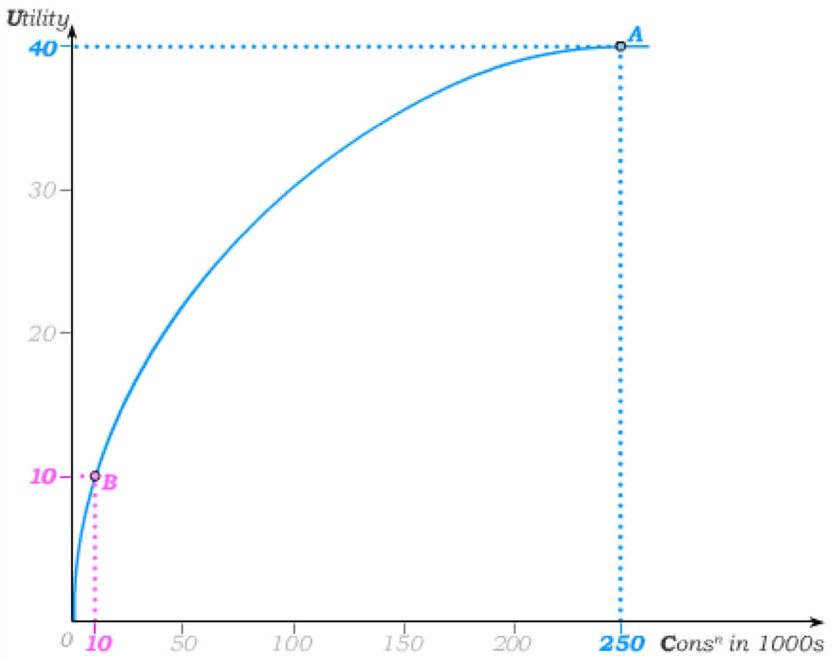
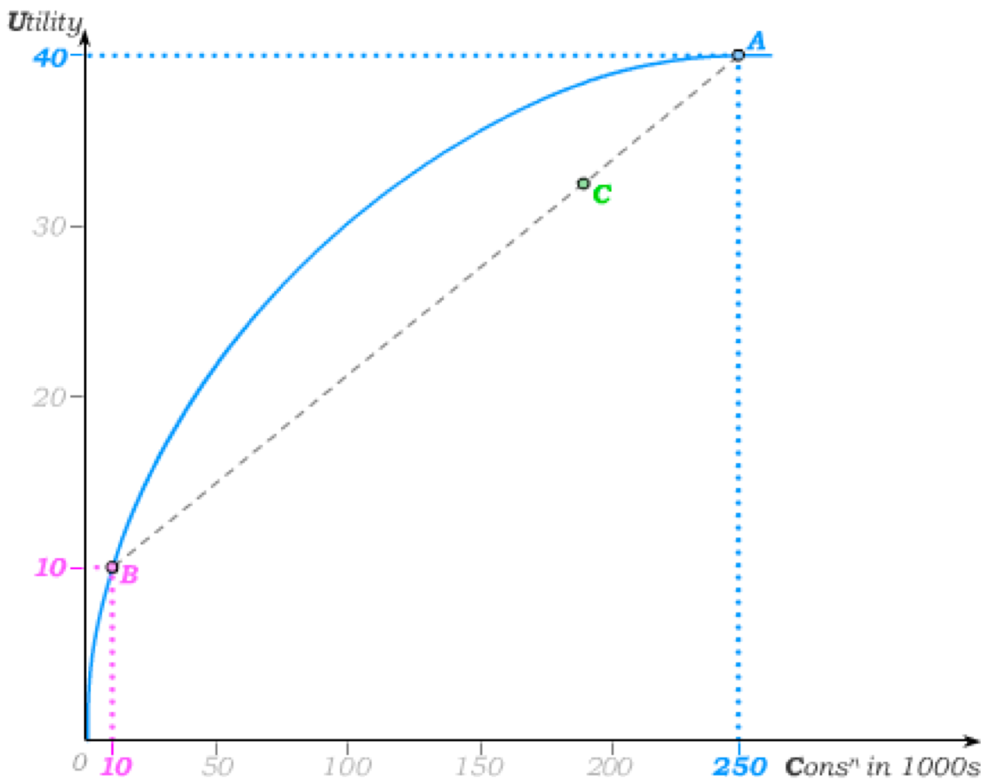
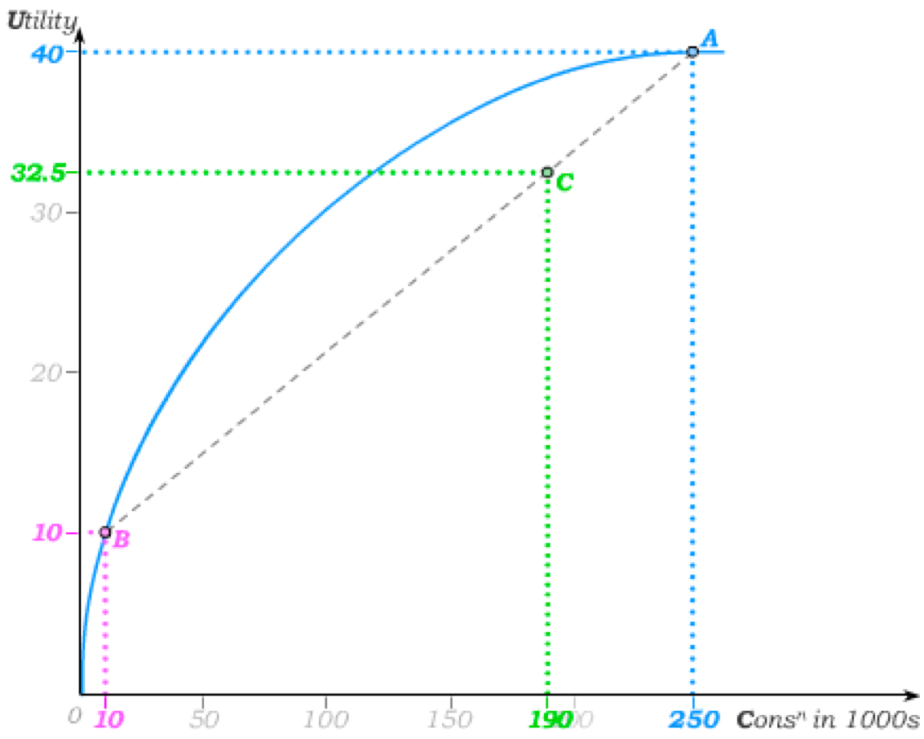
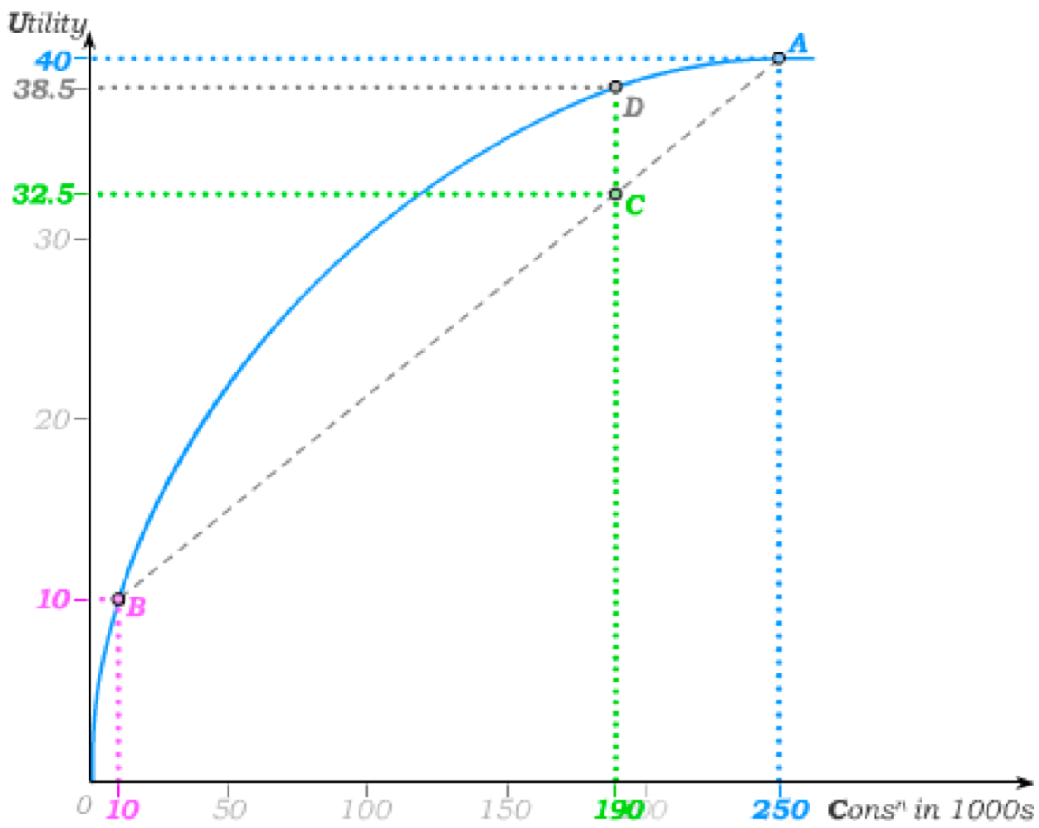
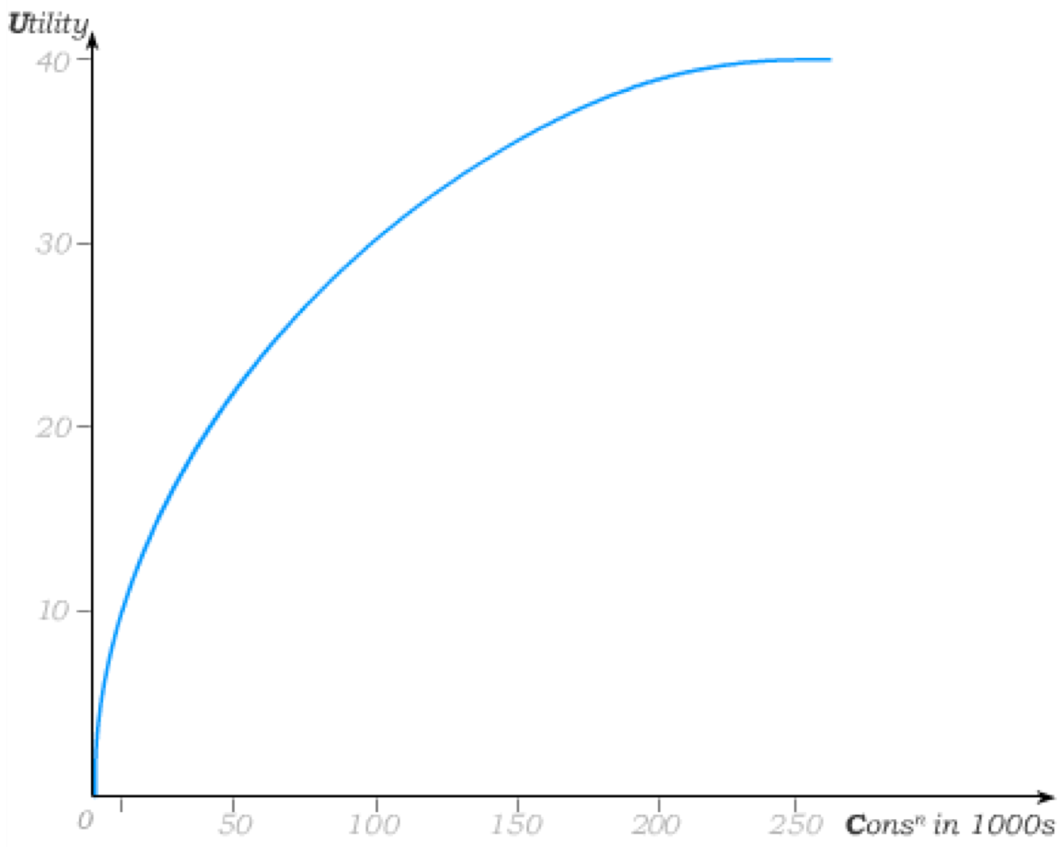
Expected Value and Expected Utility
For now, we assume “only money matters” (state independence).
We begin by hypothesizing a concave utility/consumption relationship.
There is a 75%
chance of €250 in consumption (A) and a 25% chance of €10 in consumption (B).
The expected utility of this gamble is then read off the line connecting A and B – three
quarters of the way toward A.
The expected value of the gamble then lies three quarters of the distance between 10 and 240 on the horizontal axis; i.e.
0.25(10) + 0.75(250) = 190
and the expected utility lies three quarters of the way between the utilities 10 and 40 on the vertical axis; i.e.
0.25(10) + 0.75(40) = 32.5.
The utility of the expected value, on the other hand, is read off D.

Slide 5
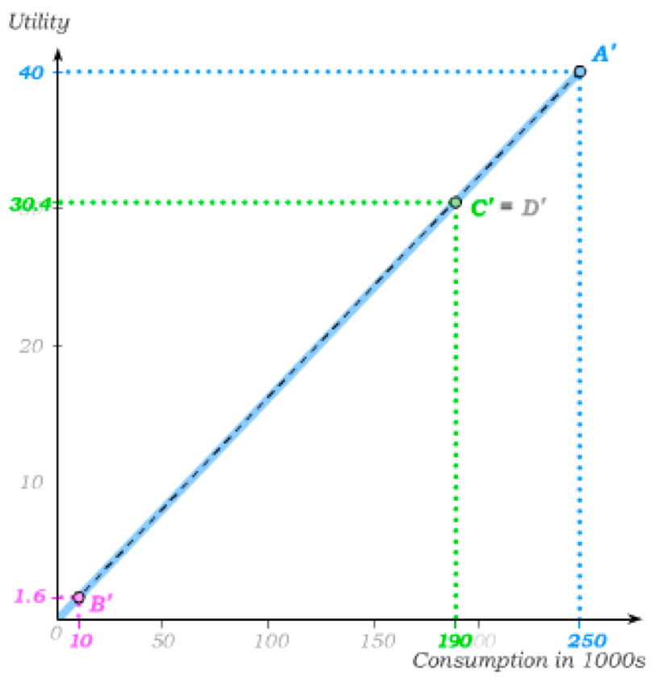
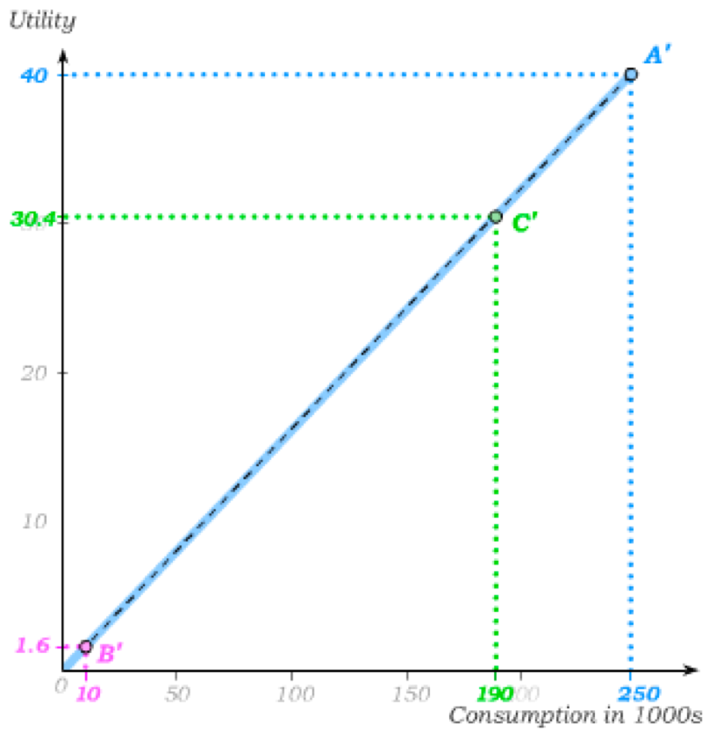
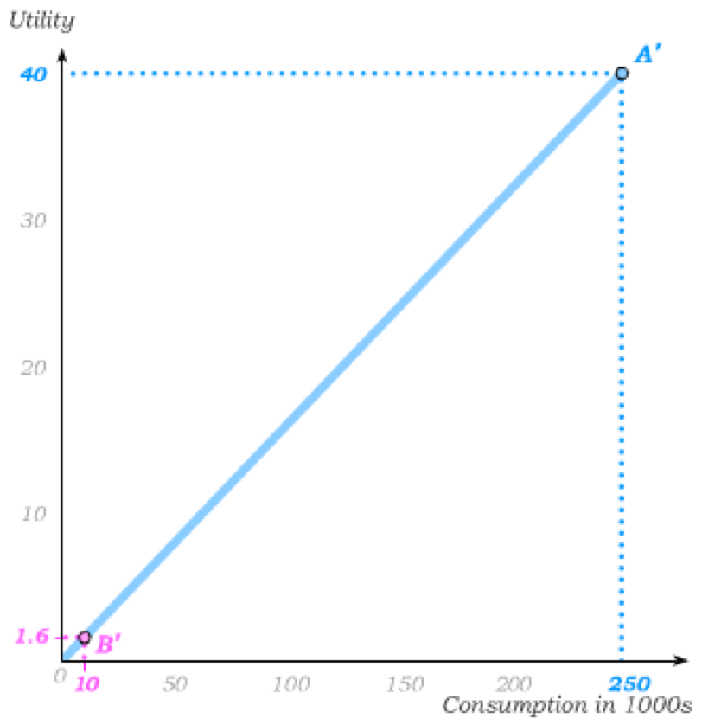
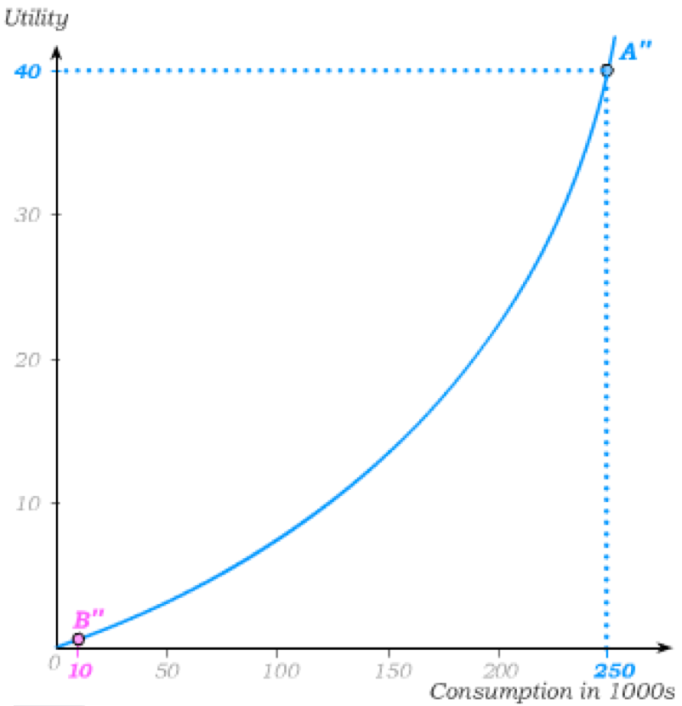
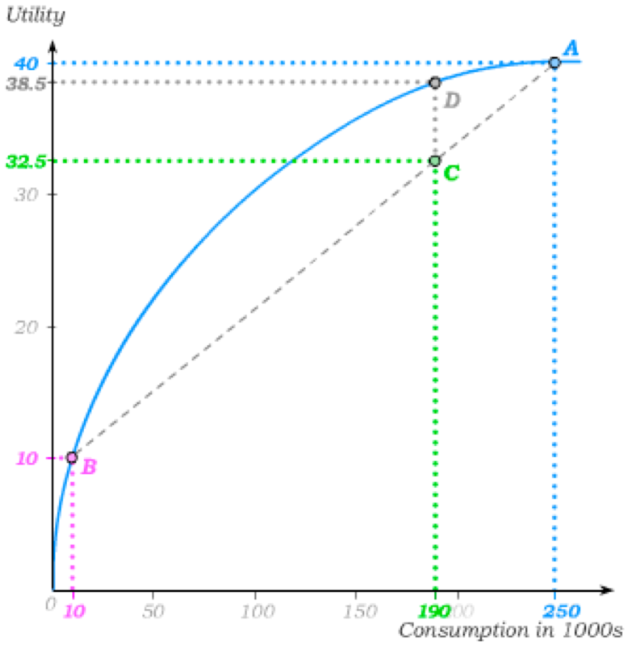
Attitudes toward Risk
When the utility of the expected value of the gamble is bigger than the expected utility of the gamble, we say the person is risk averse.
This risk aversion arises here from the concavity of the utility/consumption relationship.
When this relationship becomes linear, we say that the person is risk neutral.
This is because the utility of the expected value of the gamble is now equal to the expected utility of the gamble.
Finally, a convex utility/consumption relationship leads to risk loving tastes. This is because the utility of the expected value of the gamble is now smaller than the expected utility of the gamble

Slide 6
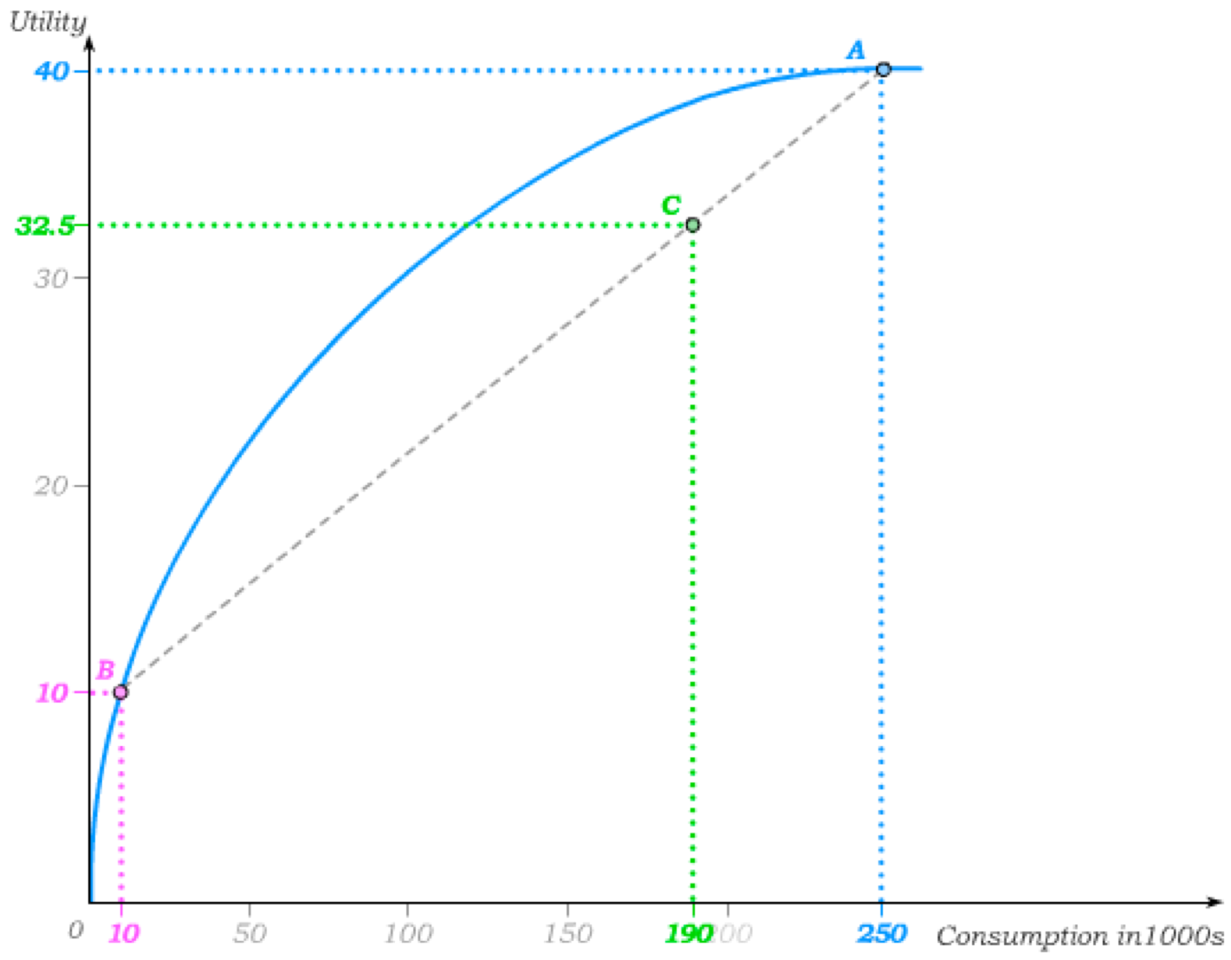
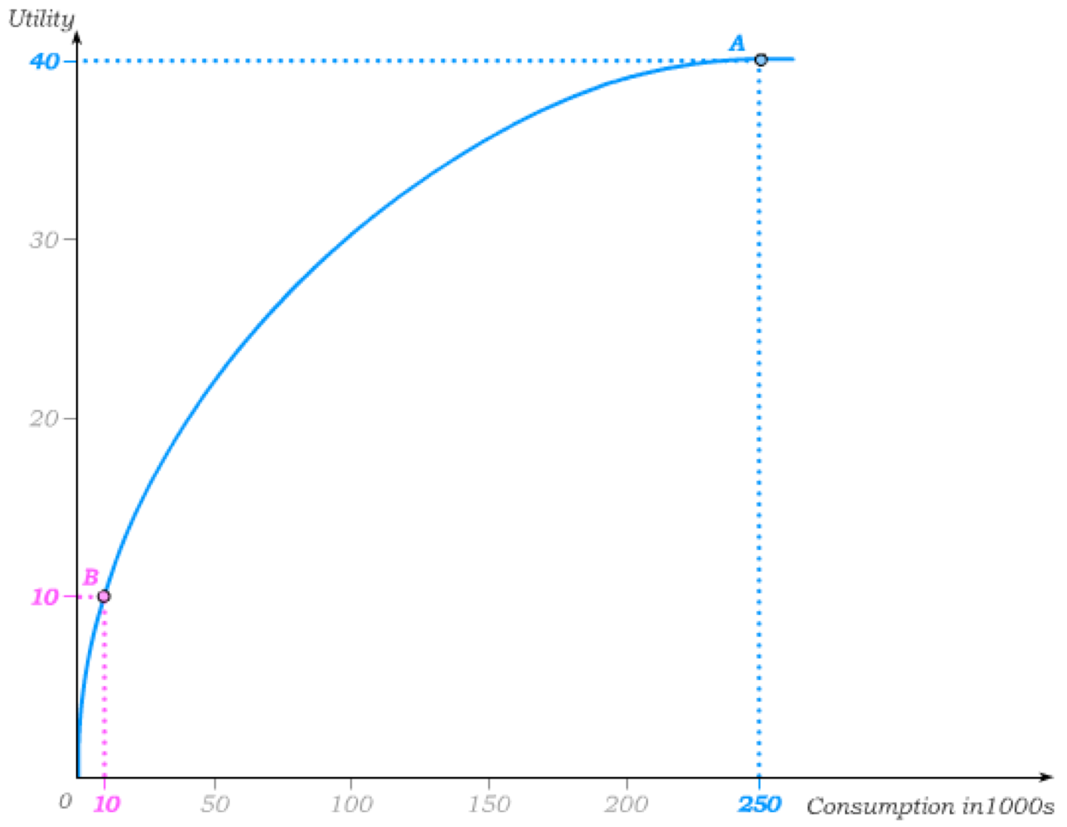
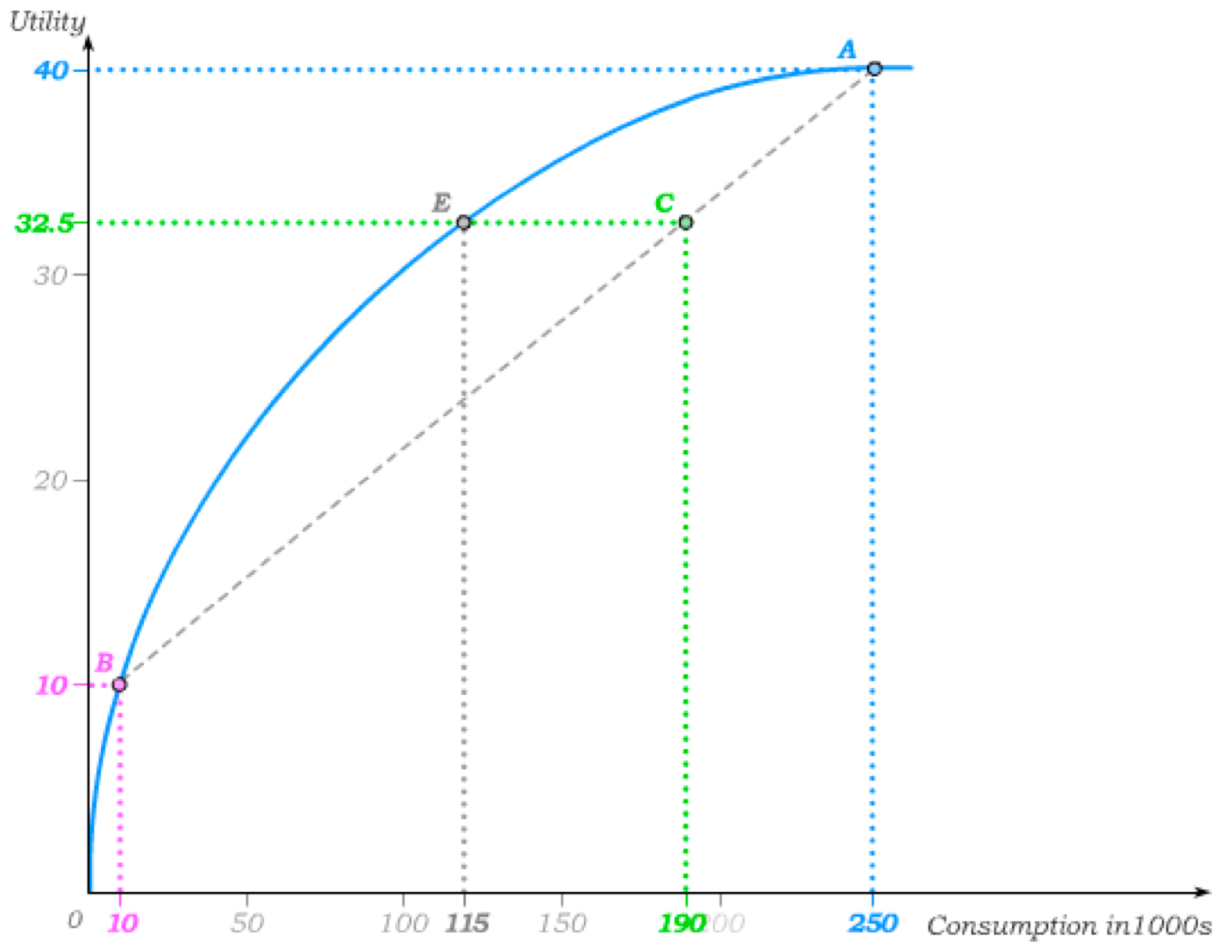
Certainty Equivalent and Risk Premium
The certainty equivalent of a gamble is the amount an individual would be willing to accept without risk in exchange for participating in the gamble.
We know that the expected utility of this gamble is 32.5.
The certainty equivalent of the gamble for this individual is then the amount 115 that results in the same utility level.
The risk premium of a gamble is the difference between the expected value of the gamble and the certainty equivalent.
It is positive for risk averse tastes, zero for risk neutral tastes and negative for risk loving tastes.
risk premium

Slide 7
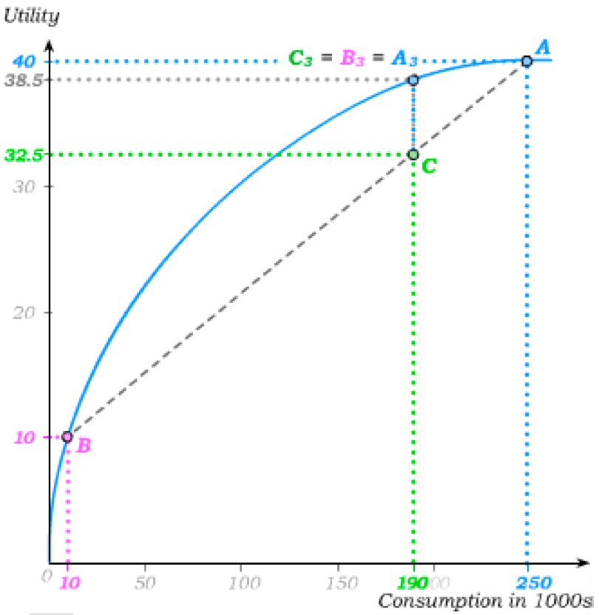
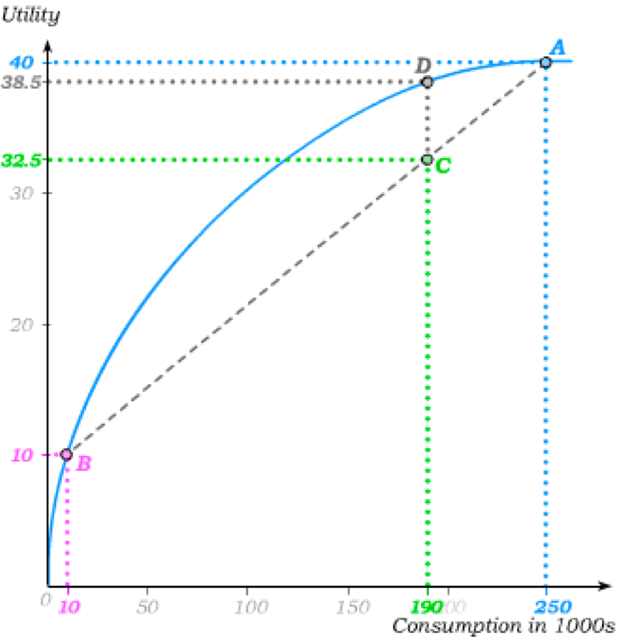
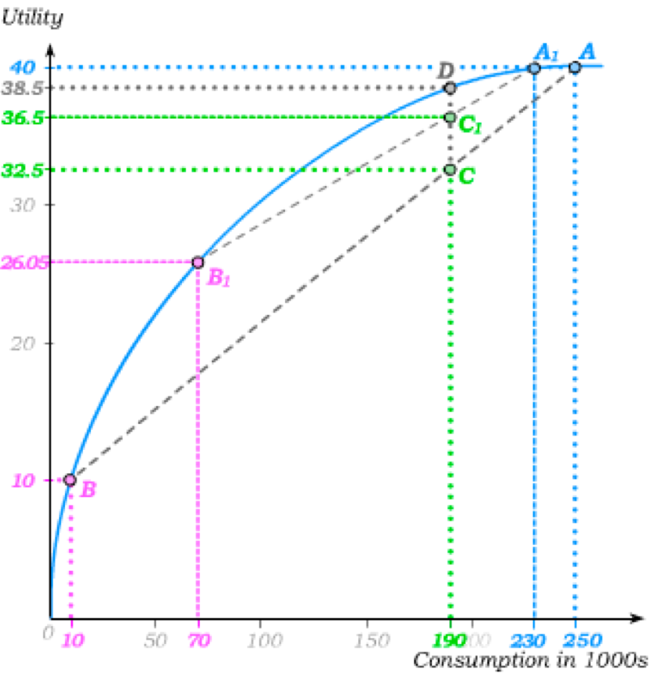
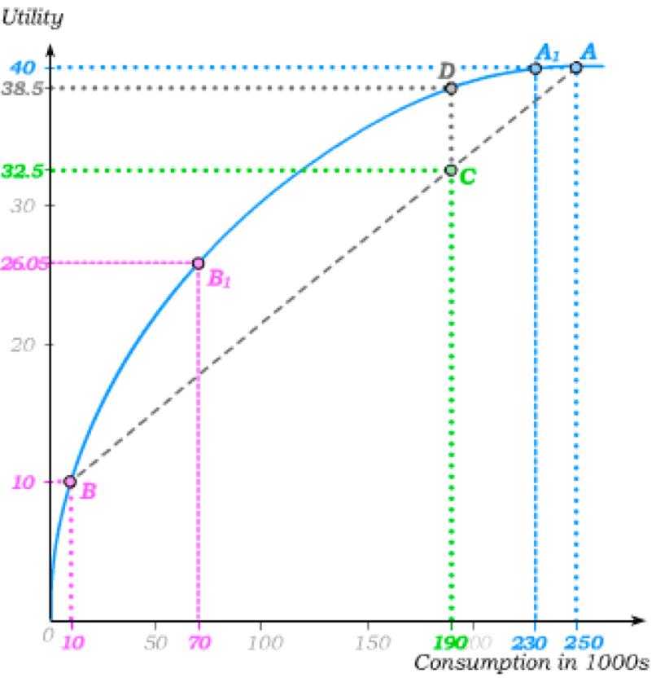
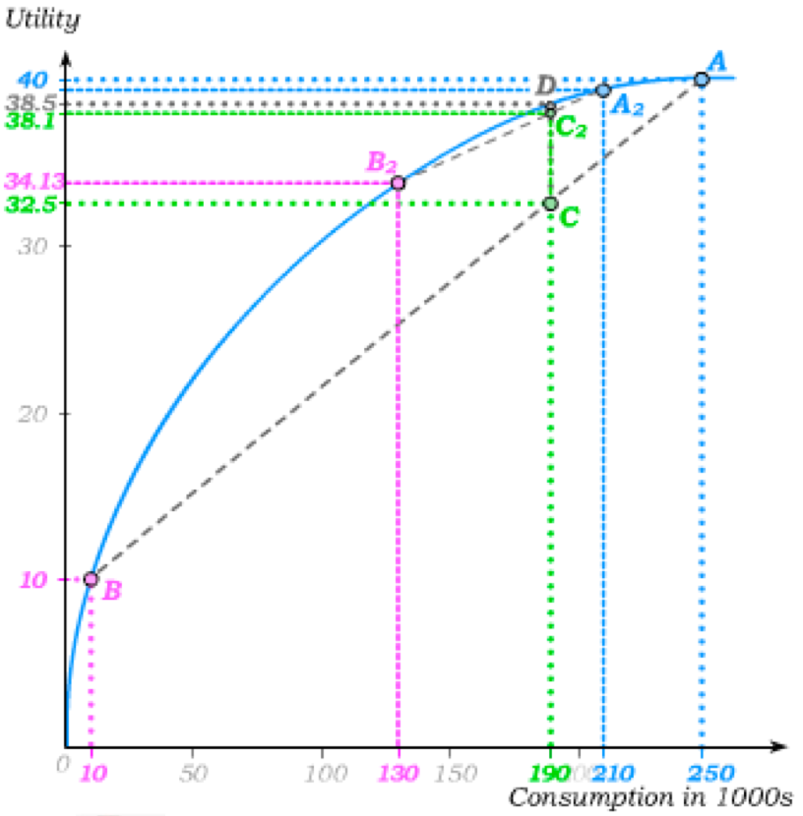
Actuarially Fair Insurance
Under any insurance contract, an individual agrees to give up something if all goes well in order to be paid something in the event that things go badly.
An insurance contract is actuarially fair if the premium matches the expected value of the gamble. In other words, the insurance company makes no profits.
When tastes are risk averse, such an insurance contract results in higher expected utility.
Insuring further thus results in further increases in expected utility …
… until the individual is fully insured, and obtains the expected value of the gamble with certainty
With state-independent utility and insurance is actuarially fair,
Risk Aversion implies Full Insurance.

Slide 8
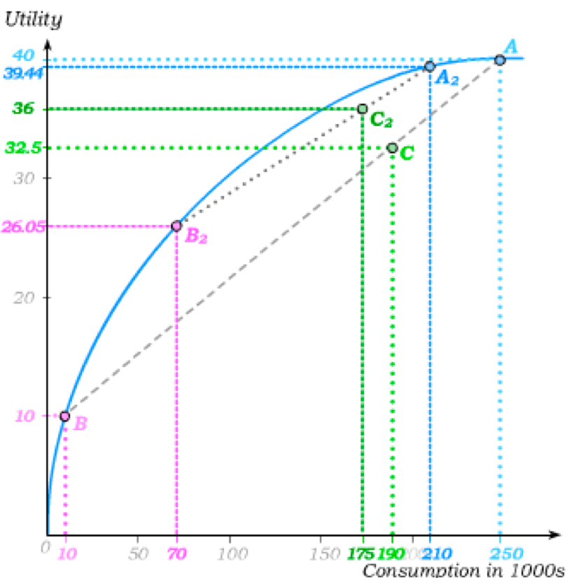
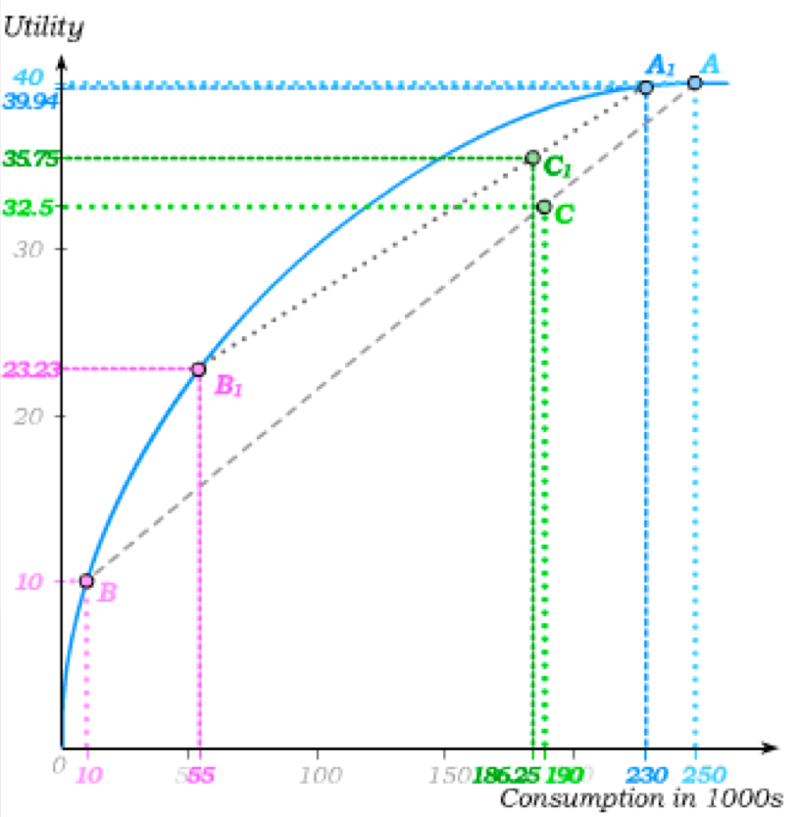
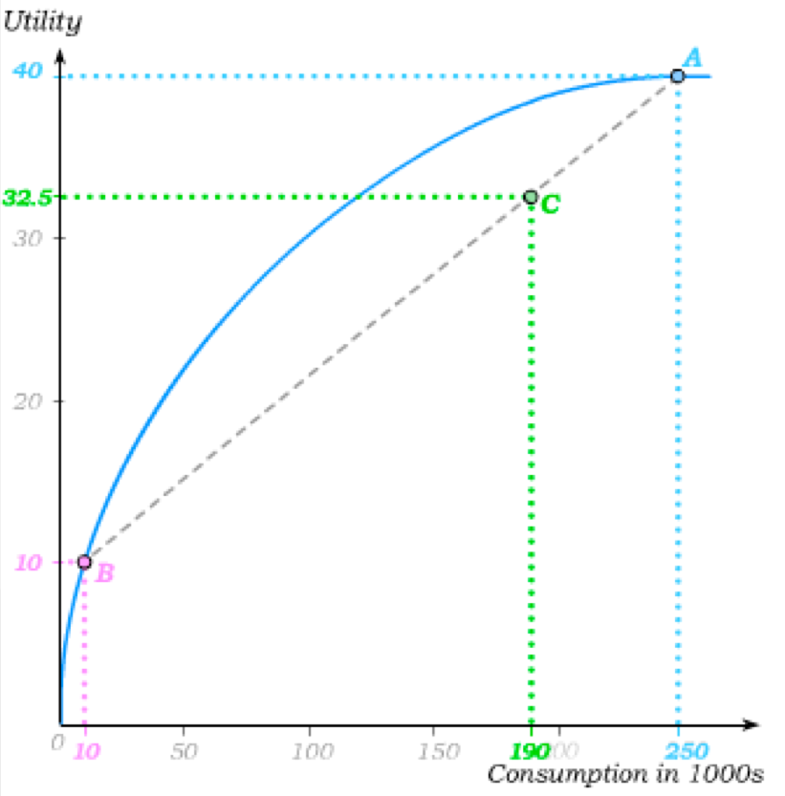
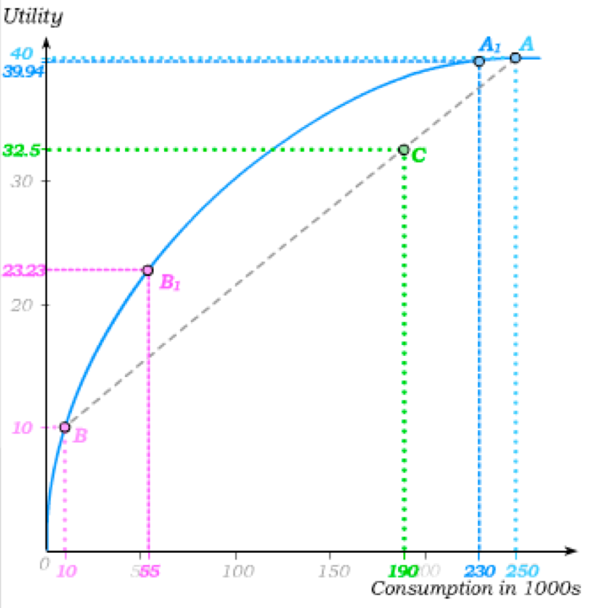
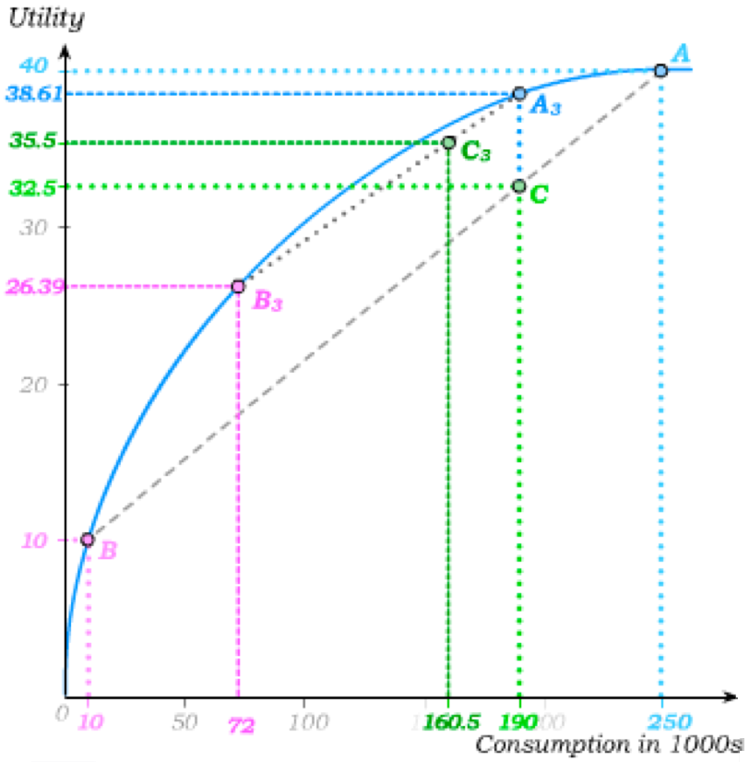
Actuarially Unfair Insurance
An insurance contract is actuarially unfair if the premium is larger than the actuarially fair premium. In other words, the insurance company makes positive profits.
That does not mean that a risk averse individual will be worse off under the insurance contract …
… and that more insurance might not improve welfare.
But it is no longer the case that a risk averse individual will fully insure when insurance contracts are actuarially unfair.

Slide 9
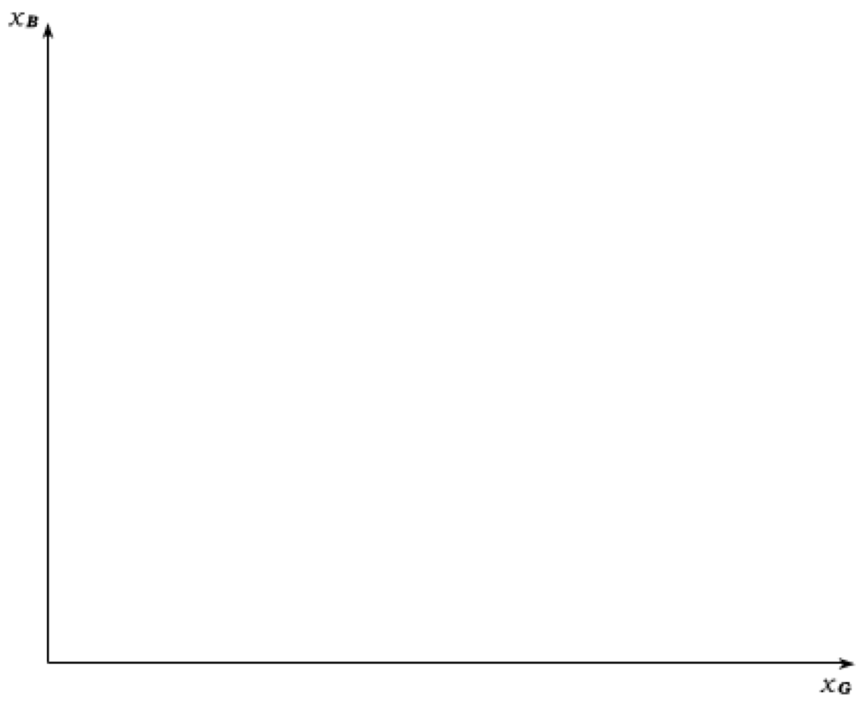
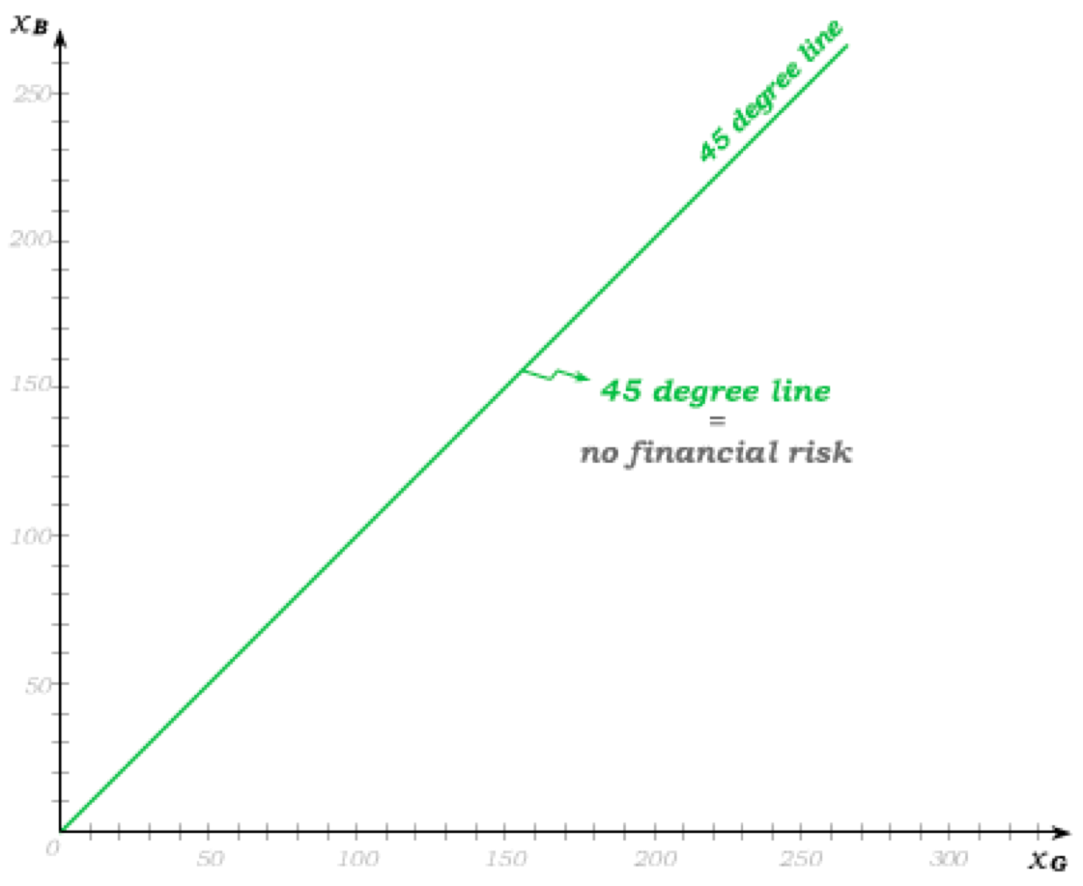
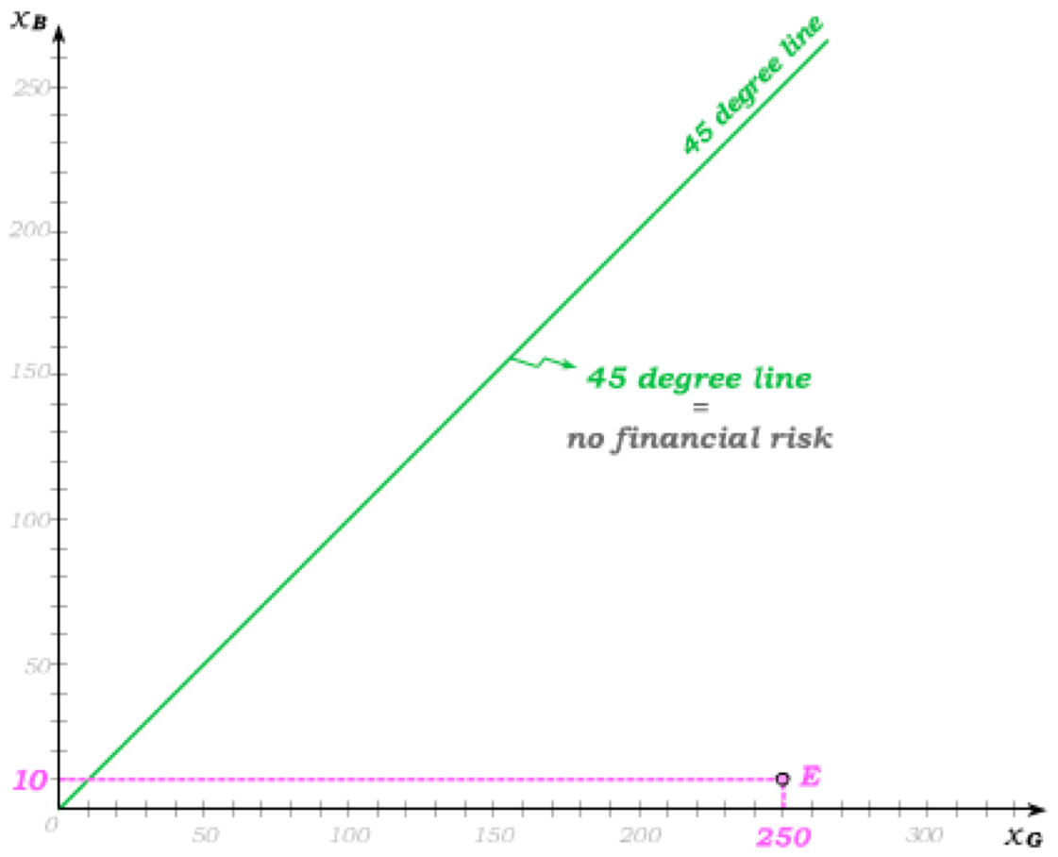
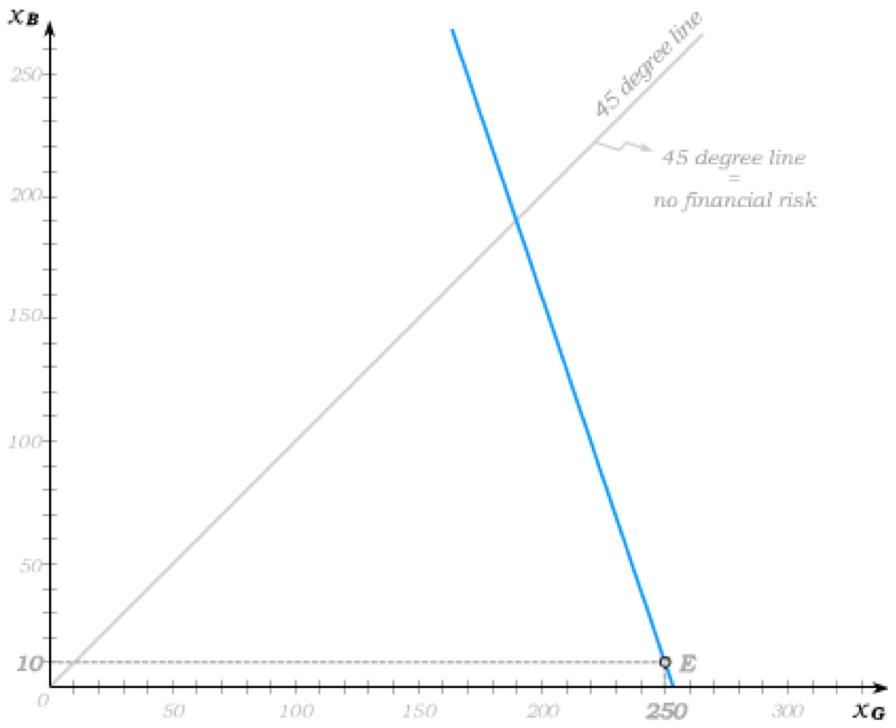
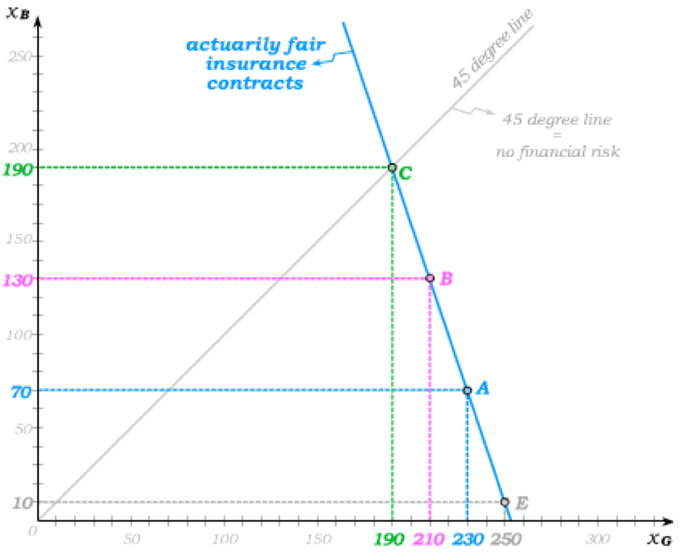
Full Menu of Actuarially Fair Insurance Contracts
Another way to depict actuarially fair insurance contracts is in a graph of outcome pairs.
Along the 45-degree line, the individual faces no financial risk because the “good” consumption outcome is equal to the “bad” consumption outcome.
The uninsured outcome pair is like an endowment bundle E in this graph.
The actuarially fair insurance contracts then lie on a “budget line” along which the expected value of the gamble remains constant. (Here the probability of the “bad” outcome is 0.25.)
Since the “good” outcome is three times as likely as the “bad” outcome, the slope is – 3.

Slide 10
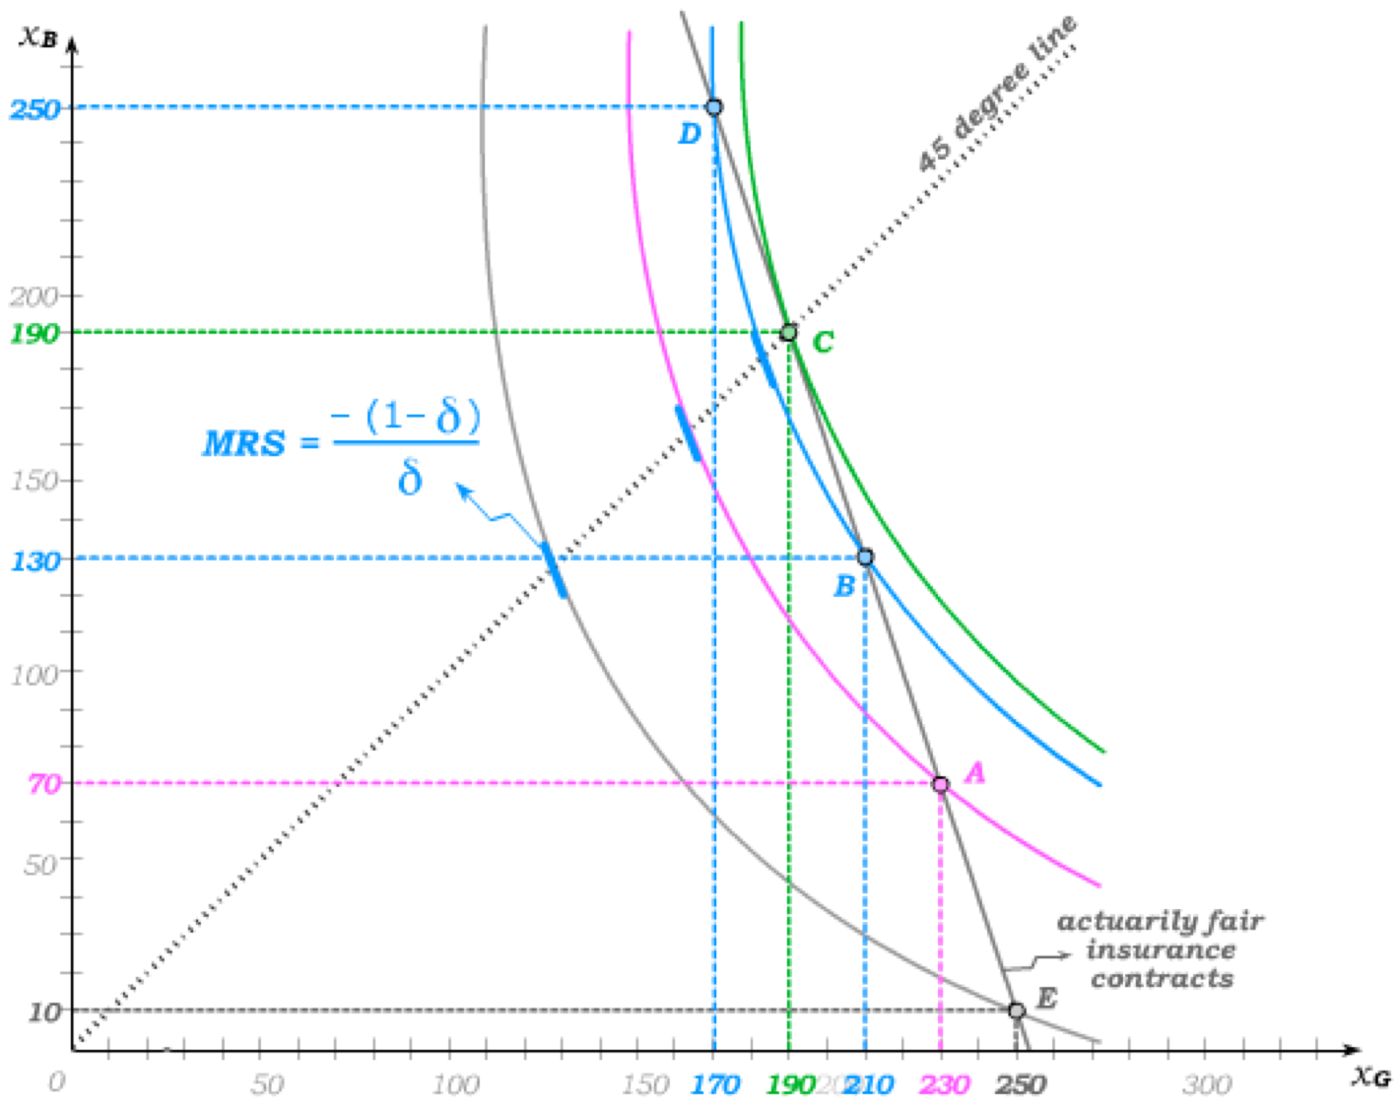
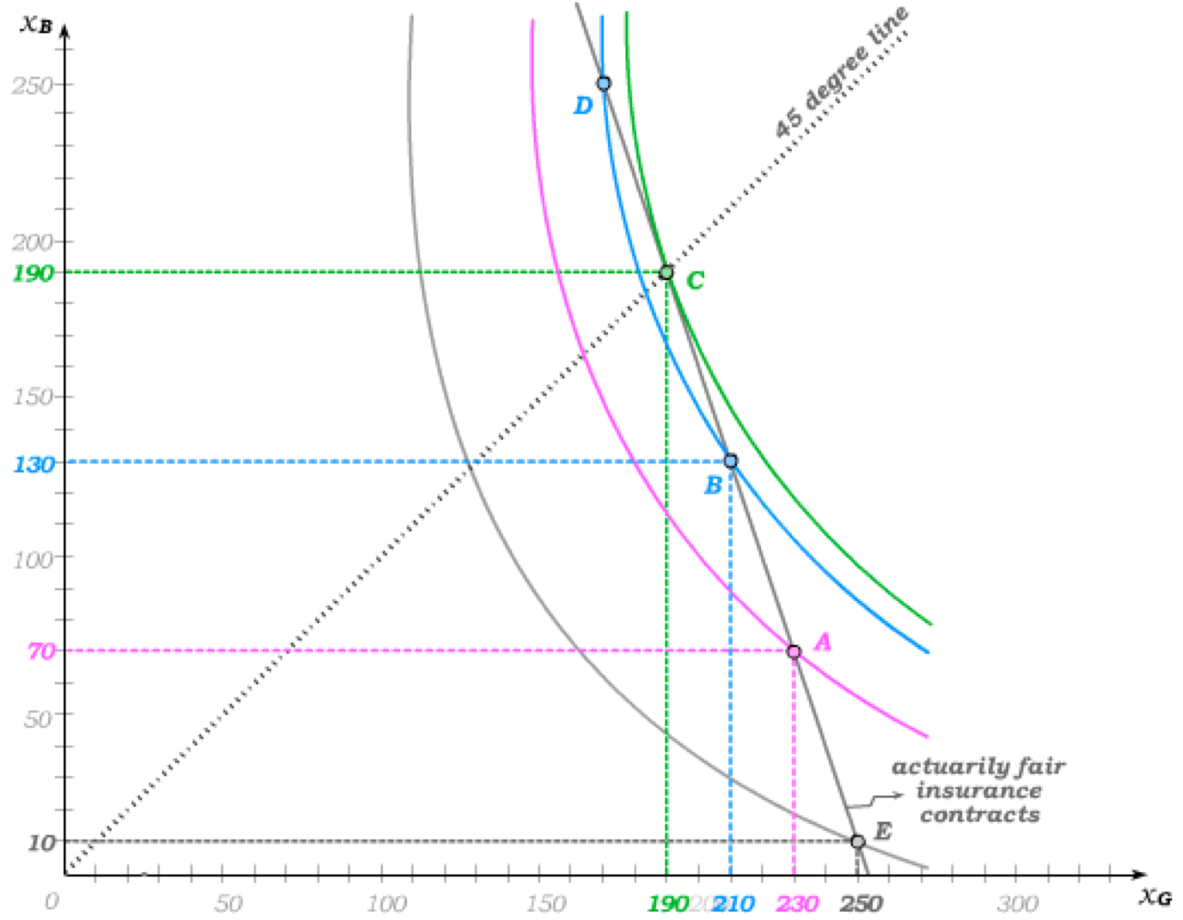
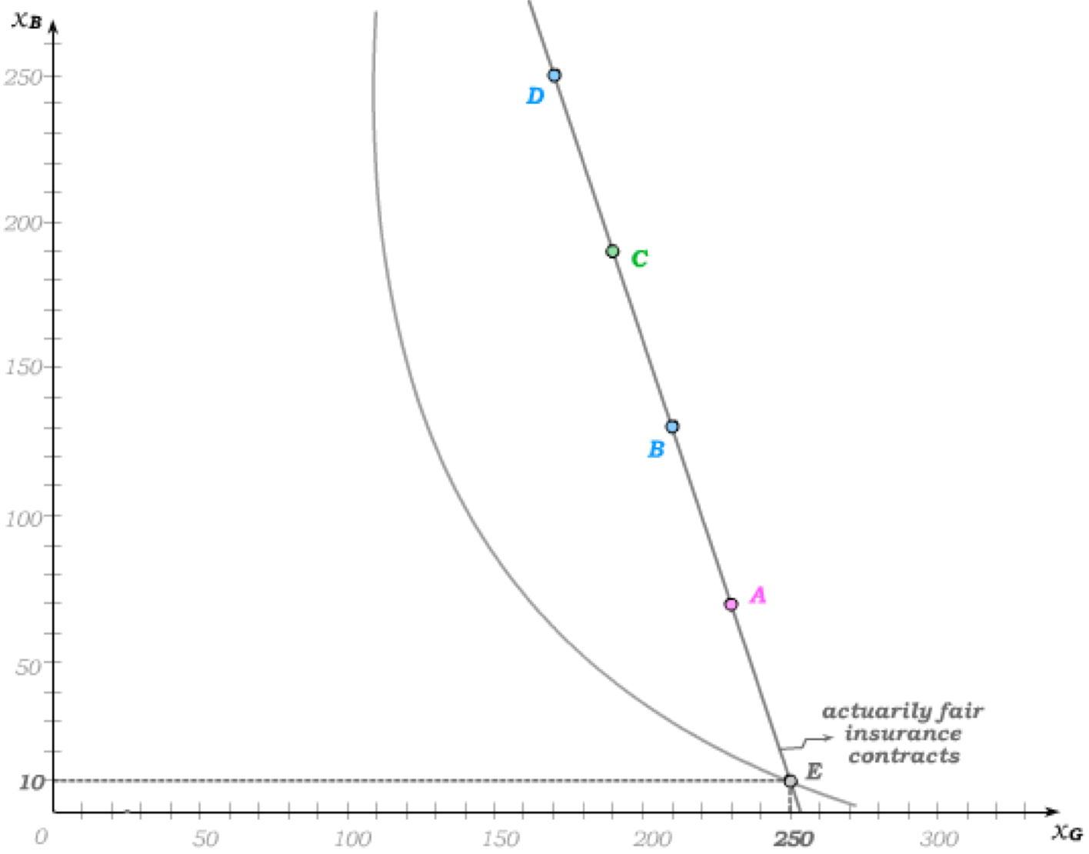
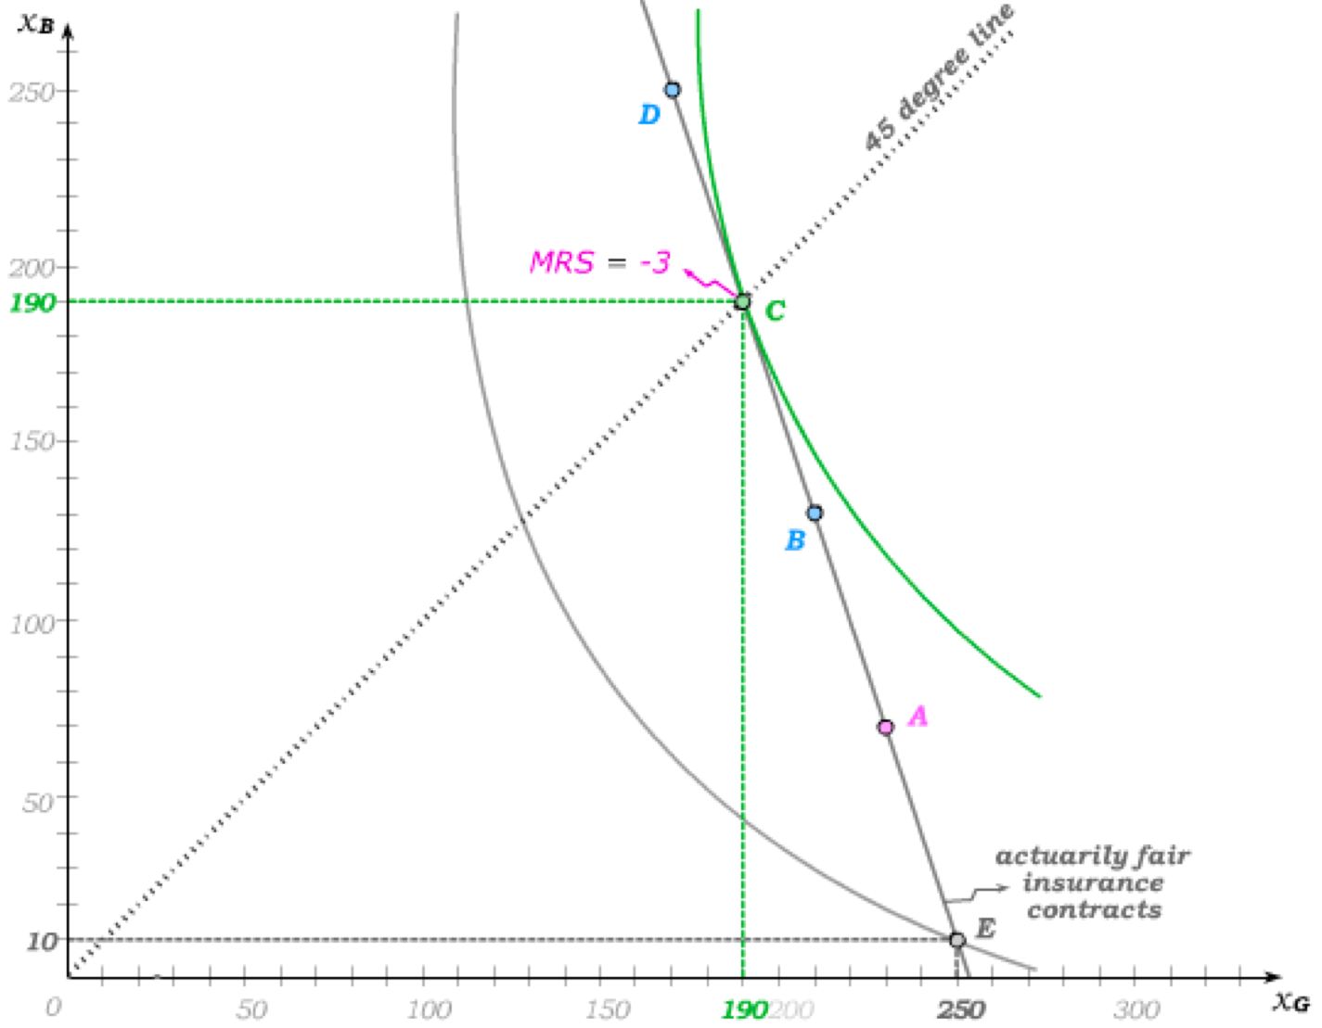
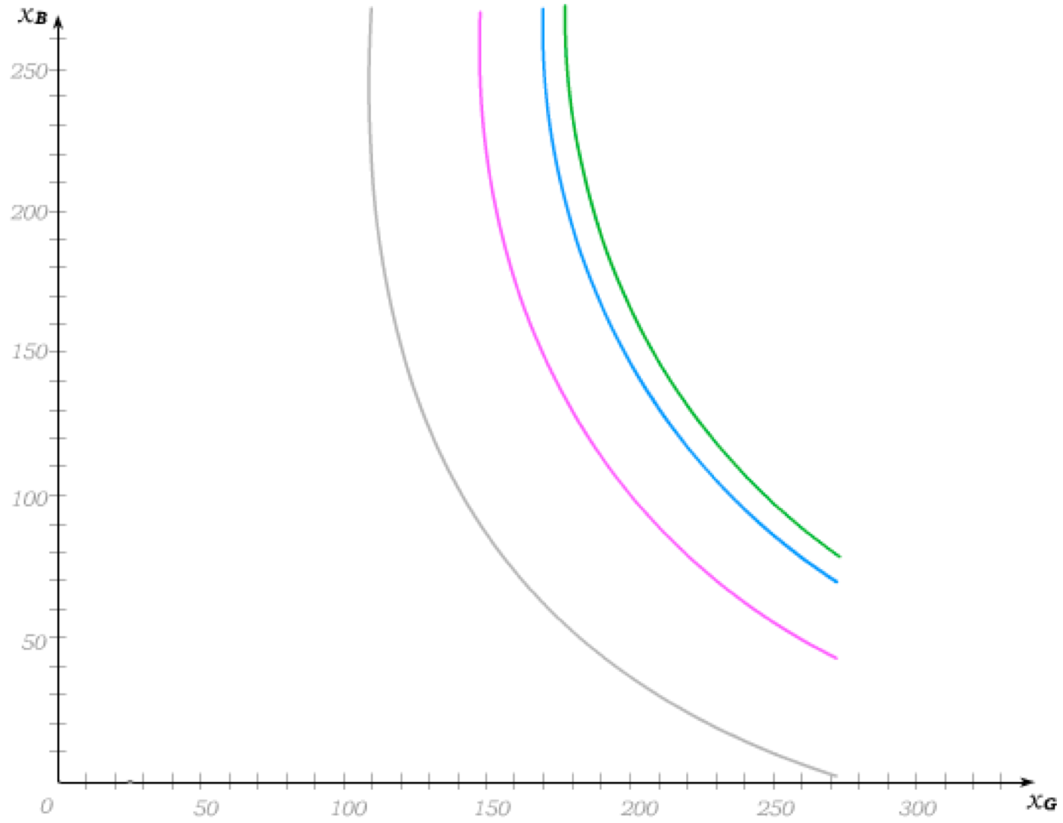
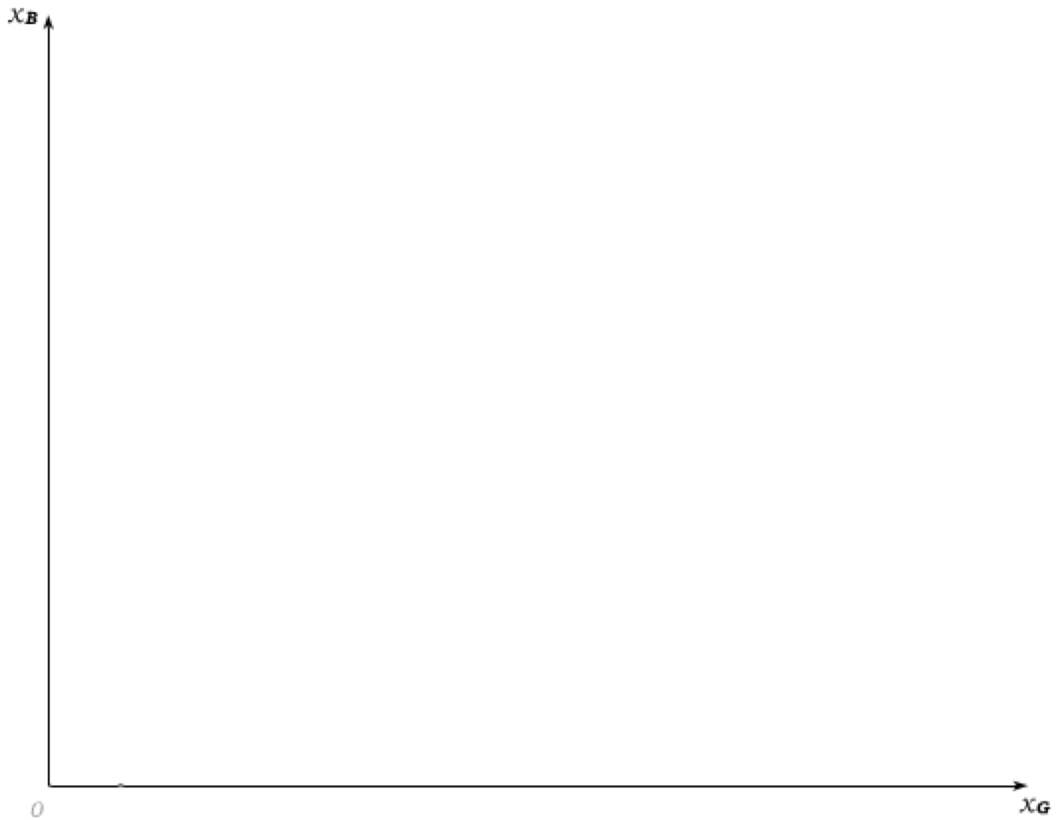
Optimizing when Only Money Matters
Tastes over outcome pairs can again be captured by maps of indifference curves.
The uninsured outcome pair E puts the individual on an initial indifference curve – but she can do better by choosing an outcome pair “above” this indifference curve.
A risk averse individual will choose to fully insure on the 45-degree line when insurance contracts are actuarially fair (and utility is state independent).
And for this to always be the case, the slope of the indifference curve (MRS) along the “no risk” 45-degree line must be the same everywhere – i.e. equal to slope of the actuarially fair contract line.

Slide 11
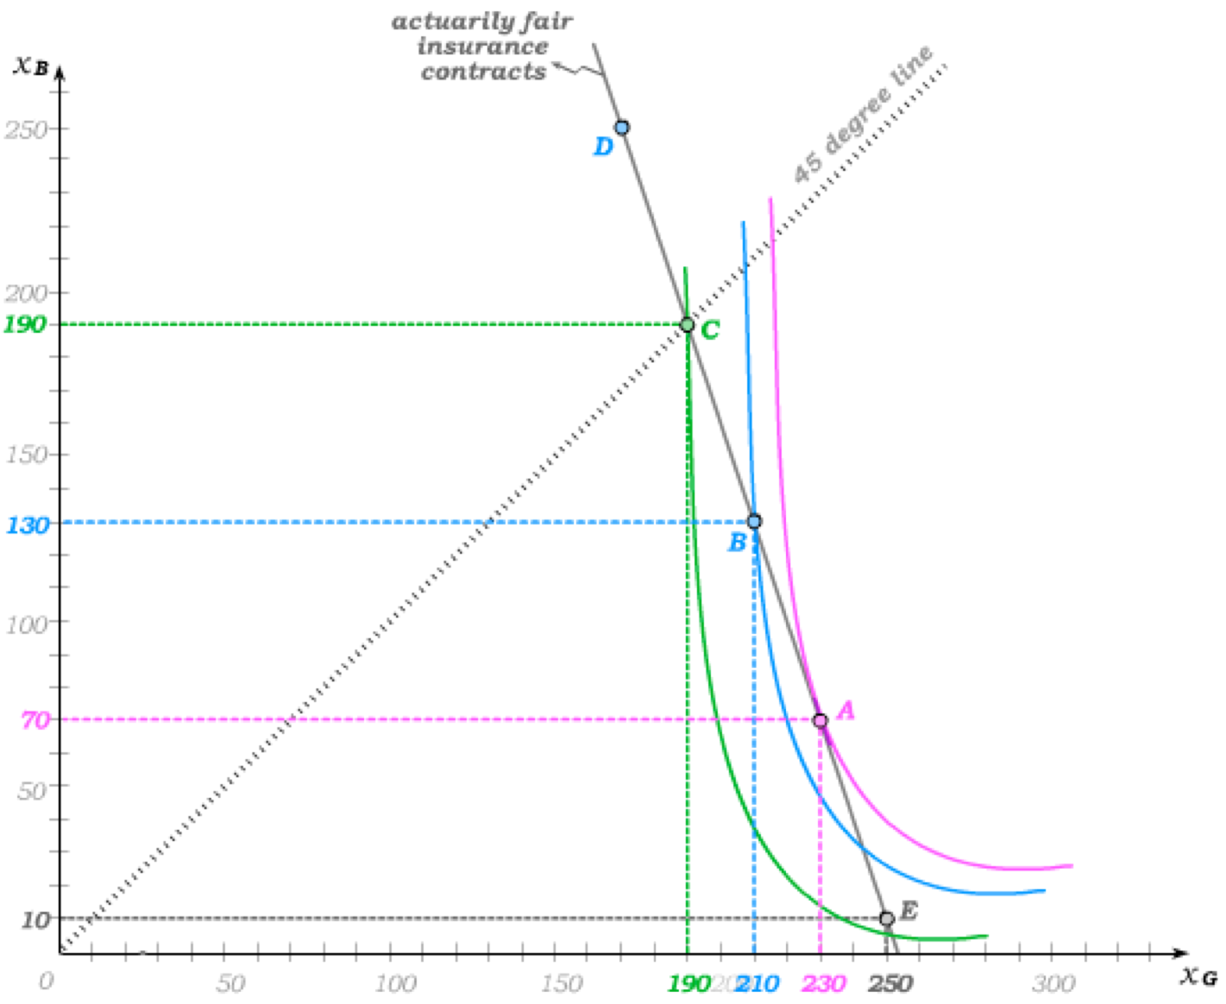
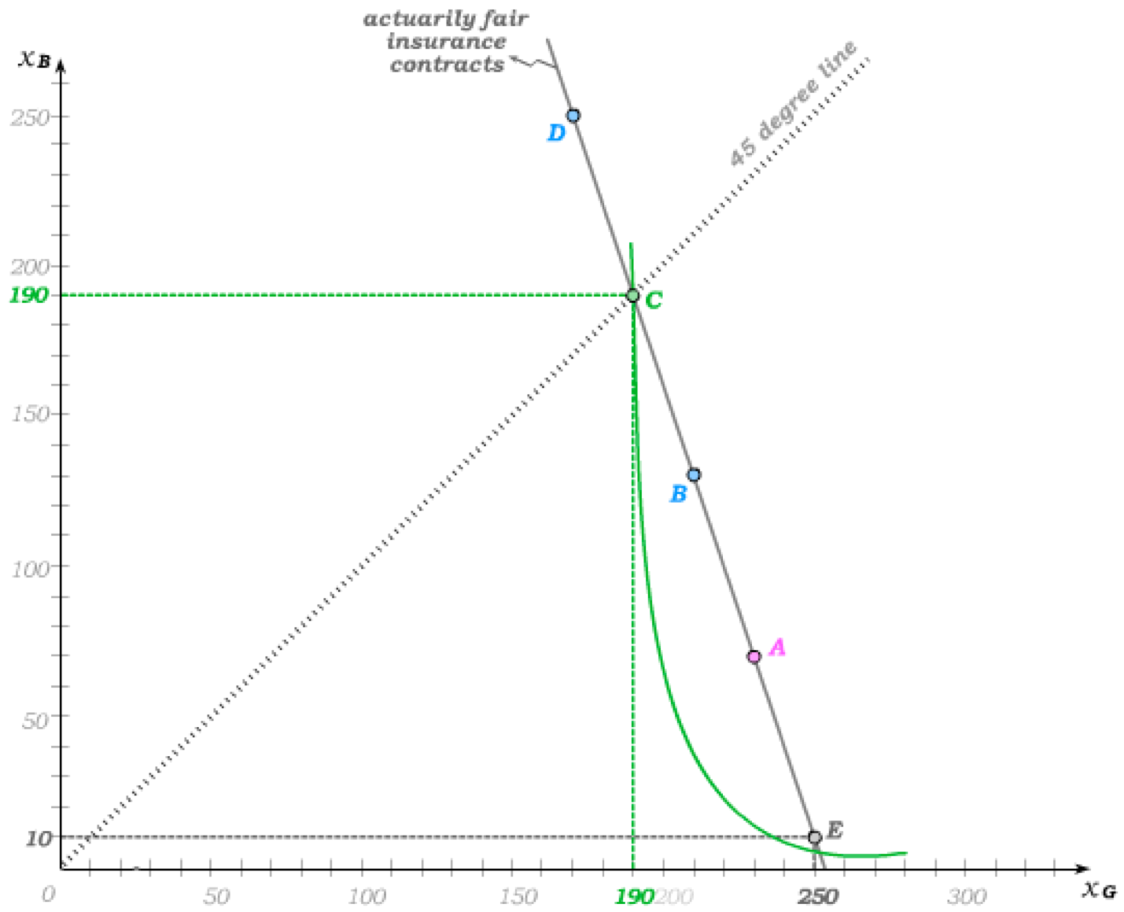
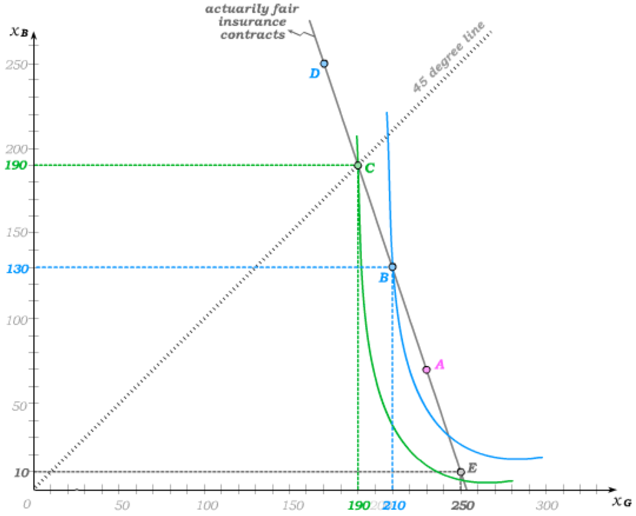
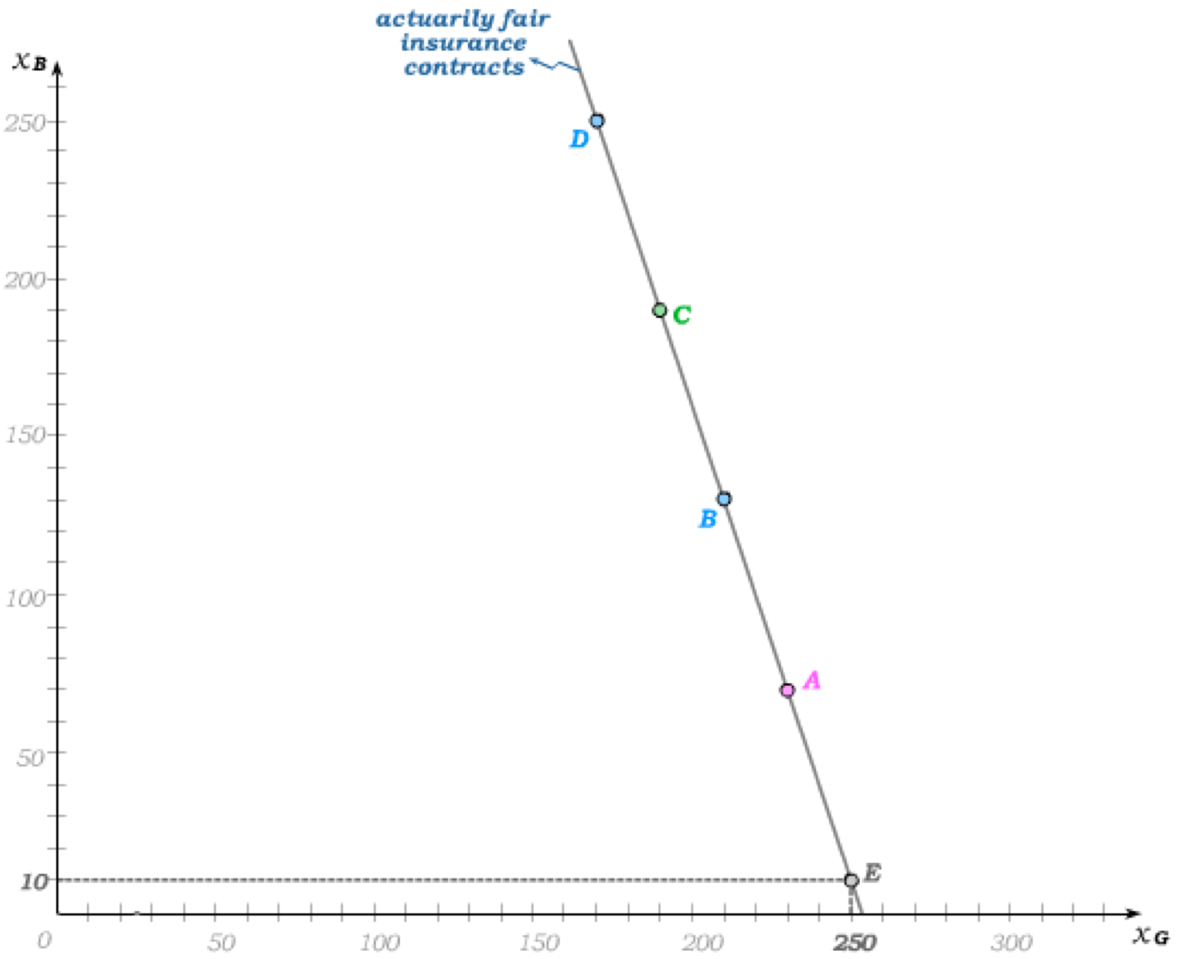
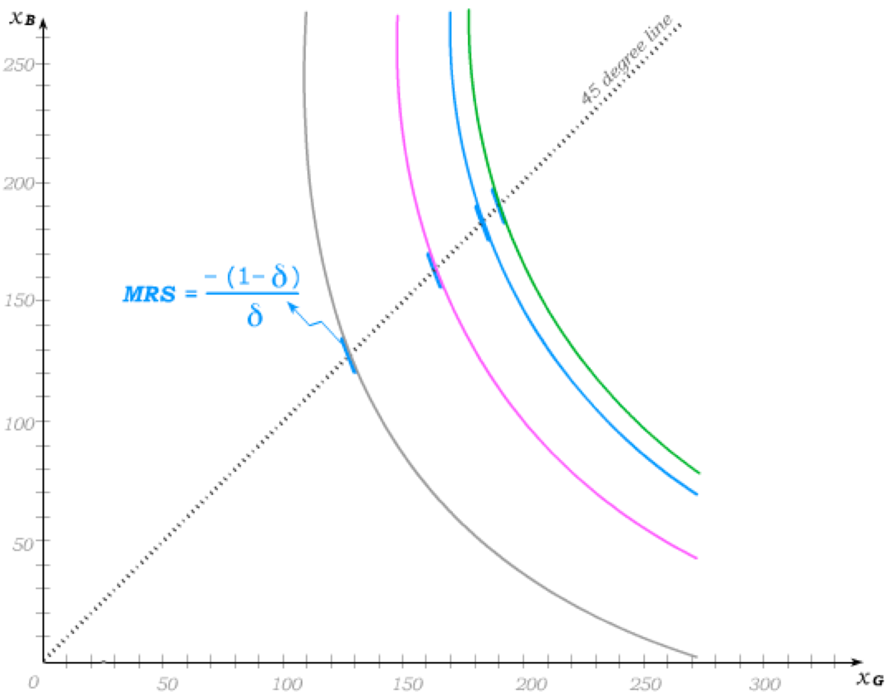
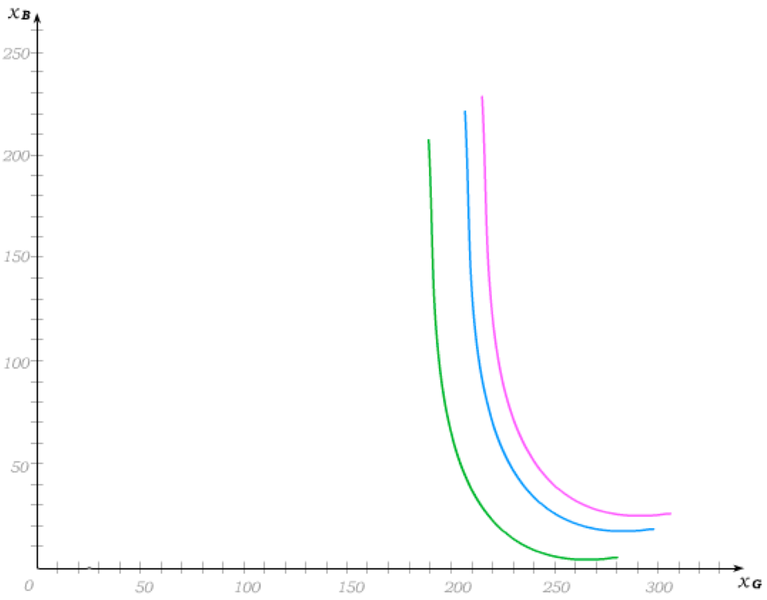
State-Dependent Tastes
When “only money matters”, the only thing that matters about the “good” versus the “bad” state is how much consumption we have in both. Tastes are then state-independent, and for this reason we know the MRS along the 45 degree line.
When tastes are instead state-dependent, indifference maps might assume very different shapes.
Full actuarially fair insurance may then be worse than no insurance …
… and partial insurance becomes optimal even when insurance contracts are actuarially fair.

Slide 12
Tutorial exercises
Within-chapter exercises:
17A.3, 17A.6, 17A.8, 17A.14, 17.A17
End-of-chapter exercises:
17.1, 17.2

Slide 13
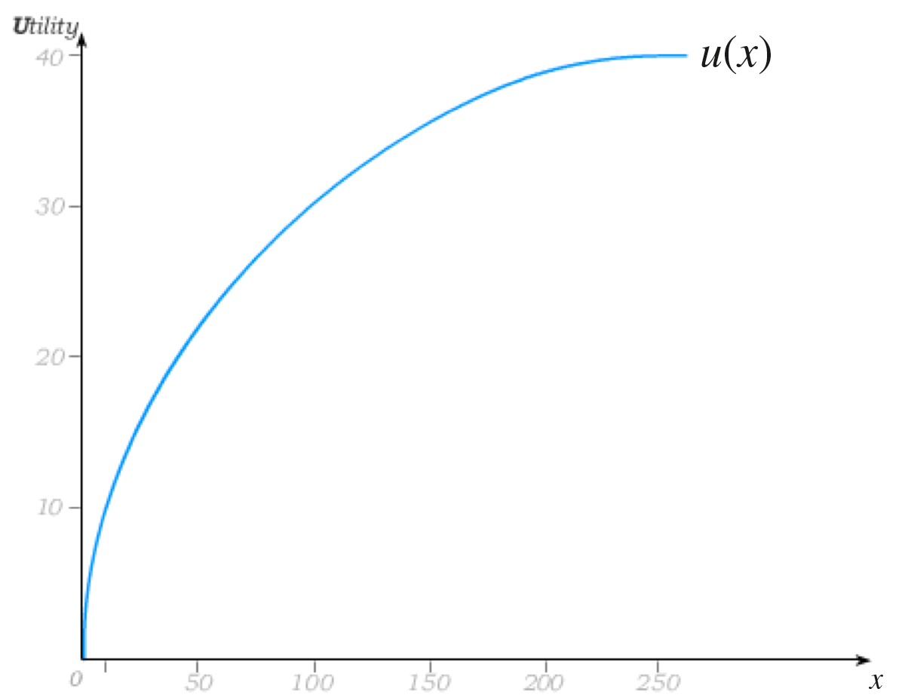
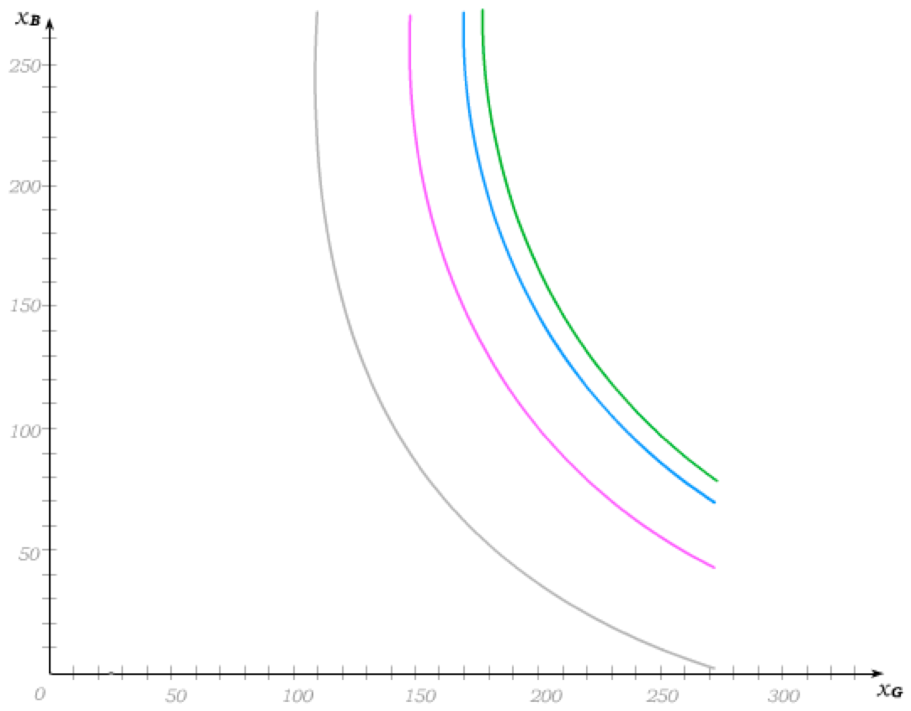
“Utility” and Expected Utility
When we model a “utility/consumption” relationship that we then use to derive the expected utility from facing a gamble, we are modeling a “utility function” u(x).
This is not meant to be a utility function that represents someone’s “utility over consumption” – rather it is a tool used to construct the expected utility function.
The expected utility function is simply a utility function that represents tastes over outcome bundles -- tastes that can be modeled using indifference maps.

Slide 14

Expected Utility Theorem
Let x_{B} and x_{G} represent the outcomes in the “bad state” and “good” state, and let δ be the probability of the “bad state” (leaving (1-δ) as the probability of the “good state”.)
(von Neumann-Morgenstern) Expected Utility Theorem: If tastes over gambles satisfy the Independence Axiom, then there exists a function u(x) such that the tastes over the gambles can be represented by a function U that takes the form
This function is said to “take the expected utility form” and is called the (von Neumann-Morgenstern) expected utility function.
Go to Independence Axiom
The function u(x)
is therefore a tool we use to construct
which in turn represents tastes over outcome pairs.

Slide 15


Expected Outcomes and Expected Utility
Suppose x_{B} = 10, x_{G} = 250, δ = 0.25 and a function that allows us to represent the consumer’s tastes using the expected utility form is Then …
u(250) = 0.5 ln (250) = 40
u(10) = 0.5 ln (10) = 10
The expected utility of the gamble is
E(u) = U(10, 250) = 0.25 u(10) + 0.75 u(250)
= 0.25(10) + 0.75(40)
= 32.5
while the expected value of the gamble is
E(x) = 0.25(10) + 0.75(250) = 190.
This compares to the Utility of the Expected Value
U(190, 190) = u(190) =
= 0.5 ln (190) = 38.50

Slide 16


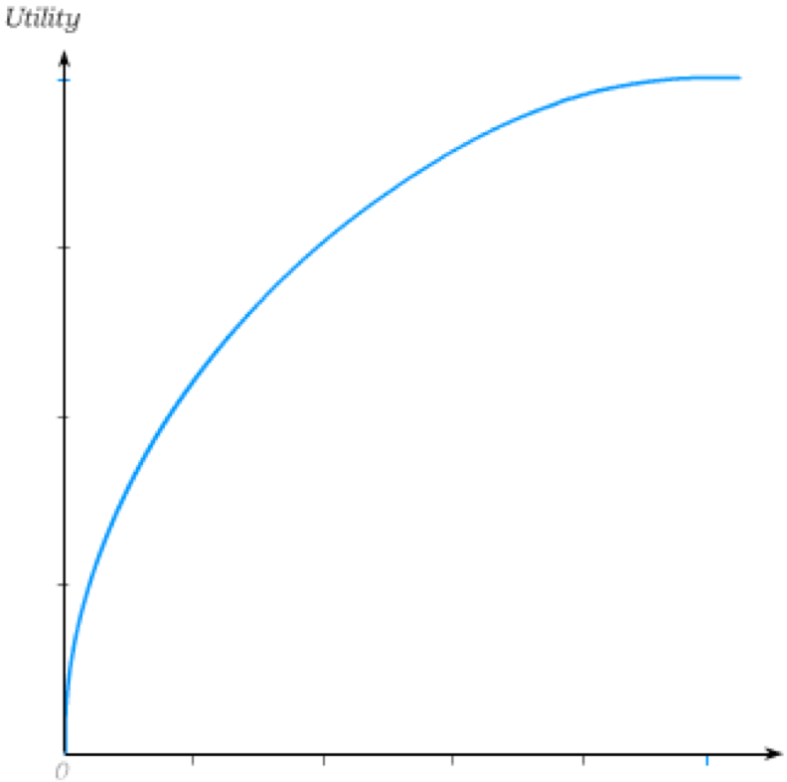
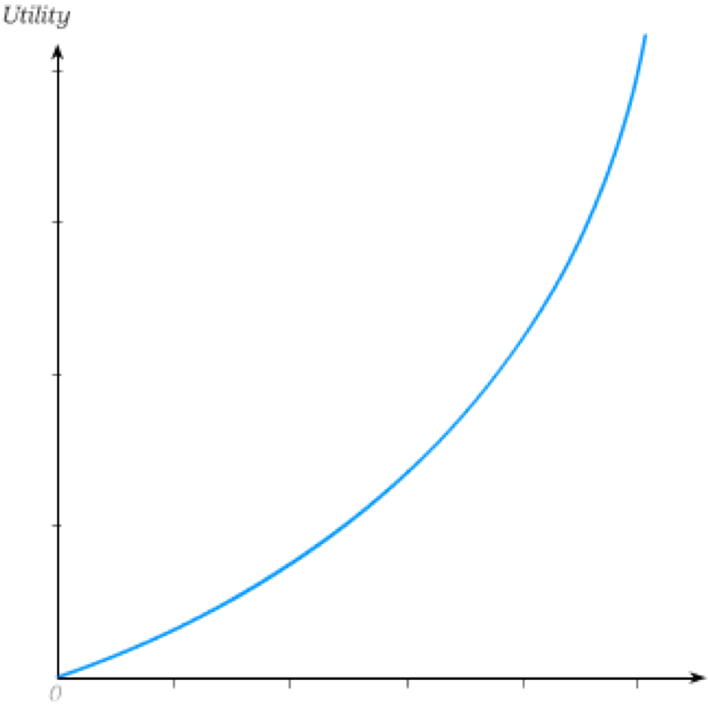

Risk Aversion
An individual is risk averse if and only if the utility of the expected value is greater than the expected utility of the gamble; i.e. if and only if
This can also be written as
Recall that a function f is concave if and only if
for all and all δ between zero and 1.
This then implies that risk averse tastes can be represented in the expected utility form only with “utility/consumption” relationships u(x) that are concave …
… and risk loving tastes can be represented in this form only with u(x) that is convex.

Slide 17
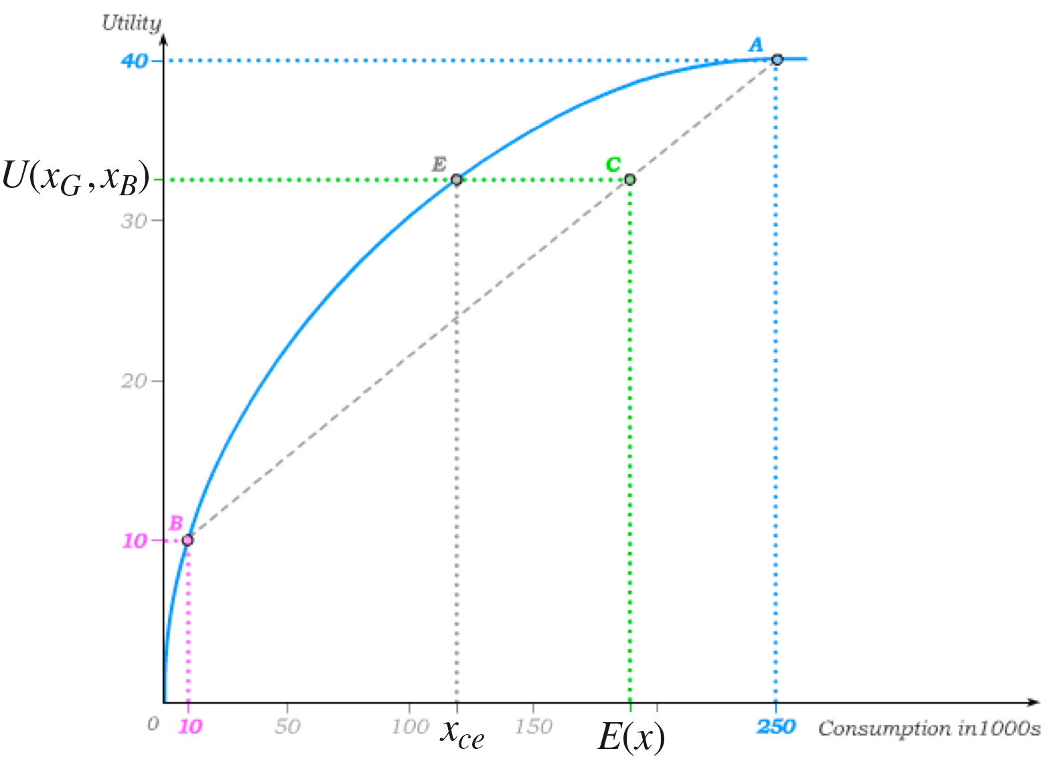
Certainty Equivalent and Risk Premium
The certainty equivalent x_{ce} of a gamble is the minimum amount an individual would accept to not participate in the gamble; i.e.
for the gamble (x_{B} , x_{G} , δ), x_{ce} solves
The risk premium of a gamble is then defined as the difference between the expected value of the gamble and its certainty equivalent; i.e.
risk premium

Slide 18


Actuarially Fair Insurance
An insurance contract is a pair (b, p) where b is the insurance benefit that is paid in the bad state and p is the insurance premium that is paid regardless of the state.
Consumption in good state:
Consumption in bad state:
The insurance company therefore receives the premium p with certainty – and pays the benefit b with probability δ.
This implies the expected cost is equal to the expected revenue if and only if δb = p.
Any insurance contract (b, p) that satisfies this condition is called actuarially fair – i.e.
The menu of actuarially fair insurance contracts is defined by the equation

Slide 19
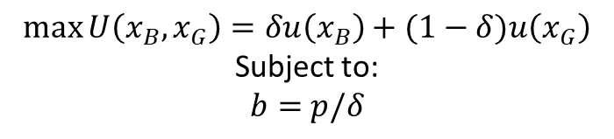
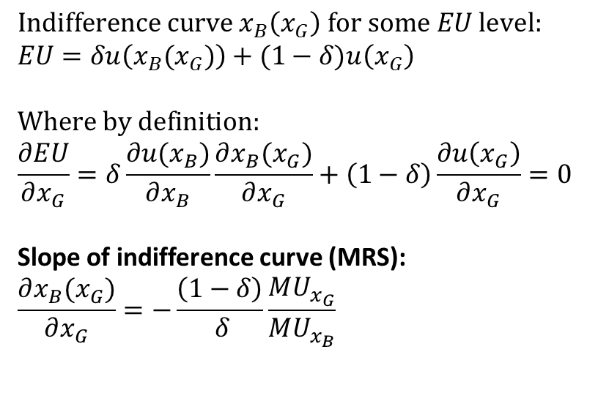
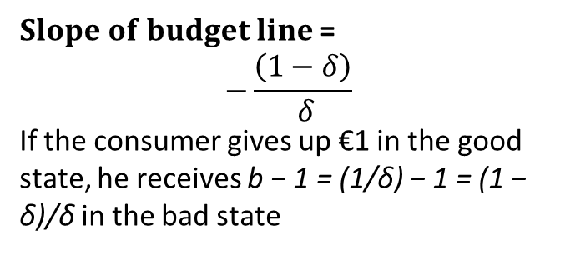
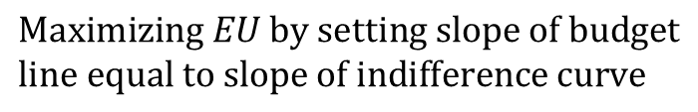
Maximizing EU with Risk Aversion & Fair Ins
$$\max{U\left(x_{B},x_{G}\right)}=δu\left(x_{B}\right)+(1−δ)u\left(x_{G}\right)$$
Subject to:
$b=$ $p/δ$
$Slope of budget line$ =
$$−\frac{\left(1−δ\right)}{ δ}$$
If the consumer gives up €1 in the good state, he receives b − 1 = (1/δ) − 1 = (1 − δ)/δ in the bad state
$$Maximizing EU by setting slope of budget$$
$$line equal to slope of indifference curve$$
$$Indifference curve x_{B}\left(x_{G}\right) for some EU level:$$
$$EU=δu\left(x_{B}(x_{G})\right)+(1−δ)u\left(x_{G}\right)$$
$$Where by definition:$$
$$\frac{∂EU}{∂x_{G}}=δ\frac{∂u(x_{B})}{∂x_{B}}\frac{∂x_{B}(x_{G})}{∂x_{G}}+\left(1−δ\right)\frac{∂u\left(x_{G}\right)}{∂x_{G}}=0$$
Slope of indifference curve (MRS):
$$\frac{∂x_{B}(x_{G})}{∂x_{G}}=−\frac{\left(1−δ\right)}{ δ}\frac{MU_{x_{G}}}{MU_{x_{B}}}$$

Slide 20

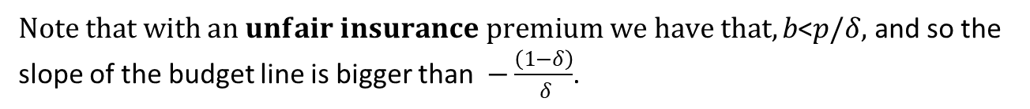

Maximizing EU with Risk Aversion & Fair Ins
$$Maximize EU if slope of budget line is equal to slope of indifference curve:$$
$$−\frac{\left(1−δ\right)}{ δ}=−\frac{\left(1−δ\right)}{ δ}\frac{MU_{x_{G}}}{MU_{x_{B}}}$$
$$MU_{x_{G}}=MU_{x_{B}}$$
$$A risk averse individual with a fair insurance premium fully insures and$$
$consumes an$equal amount in the good and bad state.
$Note that with an unfair insurance premium we have that,b\text{<}p/δ,$ and so the slope of the budget line is bigger than $−\frac{\left(1−δ\right)}{ δ}$.
$$In turn, for a risk averse individual with an unfair insurance,we need that$$
$$MU_{x_{G}}<MU_{x_{B}} for the slopes of the budget line and the indifference curve$$
to be equal. This implies more consumption$in the good than in the bad state$
and less than full insurance.

