Slide 1
Intermediate Microeconomics: An Intuitive Approach with Calculus, 1e
Chapter 22 –
Asymmetric Information in Competitive Markets

Slide 2
Asymmetric Information
So far, we have assumed that both sides of a market know what product is being traded – i.e. they have the same information about the product.
Asymmetric information arises when one side of the market has more information about the product that is being traded than the other.
Used car owners know more about their cars than potential buyers; workers know more about their commitment to a job than potential employers; and corporate CEO’s know more about a firm’s balance sheet than potential investors.
This asymmetric information can then lead to adverse selection of low quality products and high cost consumers selecting into markets in order to free-ride on the high quality or low costs of others.
The adverse selection imposes a negative externality on high quality producers and low-cost consumers – which in turn gives rise to inefficiencies in competitive markets.
In some cases, such markets are just distorted – in others they cease to exist entirely.

Slide 3
A Grade Insurance
Consider the following insurance product marketed to students:
If you buy A-insurance, you are guaranteed to receive an A in this course.
Suppose that the A-insurance market is perfectly competitive, and the only costs incurred by insurance firms is the bribe necessary to convince professors to raise grades that would otherwise fall below an A.
The cost of bribes is c per letter grade – i.e. it costs c to raise a B to an A, 2c to raise a C to an A, etc.
And in the absence of insurance, grades in the course are curve such that
10% receive an A
25% receive a B
30% receive a C
25% receive a D
10% receive an F
Finally, suppose students work as hard regardless of whether they own insurance.

Slide 4
Equilibrium in the A-Insurance Market
The long-run equilibrium price must result in zero expected profit (perfectly competitive market); i.e. if all students buy insurance,
10% receive an A
25% receive a B
30% receive a C
25% receive a D
10% receive an F
p_{A} = 0.1(4c)
+ 0.25(3c)
+ 0.3(2c)
+ 0.25(c)
= 2c
Cost of F-Students
Cost of D-Students
Cost of C-Students
Cost of B-Students
But if students know what type they are, then A-students will not buy insurance.
As A-students adversely select out of the insurance pool, the zero-profit price rises to
Now suppose that students value a 1 letter grade increase at 2c and each additional letter grade at an addition 0.5c. Then B-students will not be willing to buy the A-insurance at a price of 2.22c.
As B-students adversely select out of the insurance pool, the zero-profit price then rises to

Slide 5
Equilibrium in the A-Insurance Market
But C-students value an increase from a C to an A at only 2.5c – and thus are not willing to buy A-insurance at a price 2.69c.
10% receive an A
25% receive a B
30% receive a C
25% receive a D
10% receive an F
As C-students adversely select out of the insurance pool, the zero-profit price then rises to
But now D-students (who value an increase from a D to an A at 3c) will no longer buy the insurance. As they adversely select out of the insurance pool, the zero profit price rises to
which implies even F-students will no longer buy the insurance.
The asymmetric information in the A-insurance market has unraveled the market – it no longer exists due to
the negative externality created through adverse selection.

Slide 6
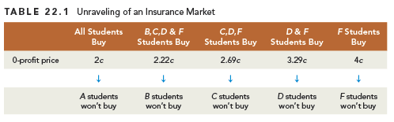
Unraveling of an Insurance Market
Adverse selection is the potential unraveling of the market due to hidden characteristics.

Slide 7
Removing the Asymmetry of Information
Suppose that firms have access to transcript data and can learn what type each student is (and suppose students also know their own type).
Competitive insurance companies would then provide A-insurance at different prices to different student types:
Value of A-insurance
For B-students:
All students other than
F-students would buy
A-insurance.
For B-students: 2c
For C-students:
For C-students: 2.5c
For D-students:
For D-students: 3c
For F-students:
For F-students: 3.5c
Students value a 1-letter grade increase at 2c and each additional letter increase at 0.5c.
The market for A-insurance has been re-established through the removal of asymmetric information.
And with it, efficiency has been restored because only students who value the insurance more than it costs to implement will carry A-insurance.

Slide 8
Introducing Uncertainty
The result remains if transcript data leaves some uncertainty about what grade a student will earn in the absence of holding insurance – so long as students are equally uncertain.
Suppose students identified as A-students will make an A with probability 0.75 and a B with probability 0.25, and F-students will make an F with probability 0.75 and a D with probability 0.25.
Suppose further that all B, C and D-students will make their usual grade with probability 0.5, a grade above their usual grade with probability 0.25 and a grade below their usual grade with probability 0.25.
Value of A-insurance
For A-students:
For A-students: 0.5c
For B-students:
All students other than
F-students would buy
A-insurance.
For B-students: 2c
For C-students:
For C-students: 2.5c
For D-students:
For D-students: 3c
For F-students:
For F-students: 3.5c
Students value a 1-letter grade increase above their usual grade at 2c and each additional letter increase at 0.5c, and suppose A-students value the insurance that they will get their usual grade at 0.5c.

Slide 9
Statistical Discrimination
Uncertainty about student types therefore does not change the fact that removal of asymmetric information re-establishes the A-insurance market and results in efficient provision of A-insurance – so long as the uncertainty itself is not asymmetric.
This is because the insurance industry will statistically price discriminate – inferring student type from the statistical distribution of grades likely to be obtained by students with different transcripts.
Statistical Discrimination is the use of statistical information about a group to infer something about an individual that belongs to the group.
Such statistical discrimination can then re-establish markets that would unravel due to adverse selection in the absence of such discrimination.
While potentially efficiency enhancing, we will see less innocuous applications of this to gender and racial discrimination later on.

Slide 10
Moral Hazard
Another problem arising from information asymmetry in our grade insurance example arises from moral hazard.
Moral Hazard is the change in hidden behavior by someone that enters a contract as a result of having entered the contract.
In our grade insurance example, moral hazard arises from the fact that insured students no longer have an incentive to work as hard as they otherwise would.
If such moral hazard is observable for insurance companies – such that there is no information asymmetry on behavior – the zero-profit price would simply increase.
BUT – some students may be more likely to reduce effort when insured than others, and this difference in student type may not be observable – such that there is information asymmetry on behavior – which may worsen the adverse selection problem.
Thus, when asymmetric information also generates moral hazard,
it aggravates the adverse selection problem.

Slide 11
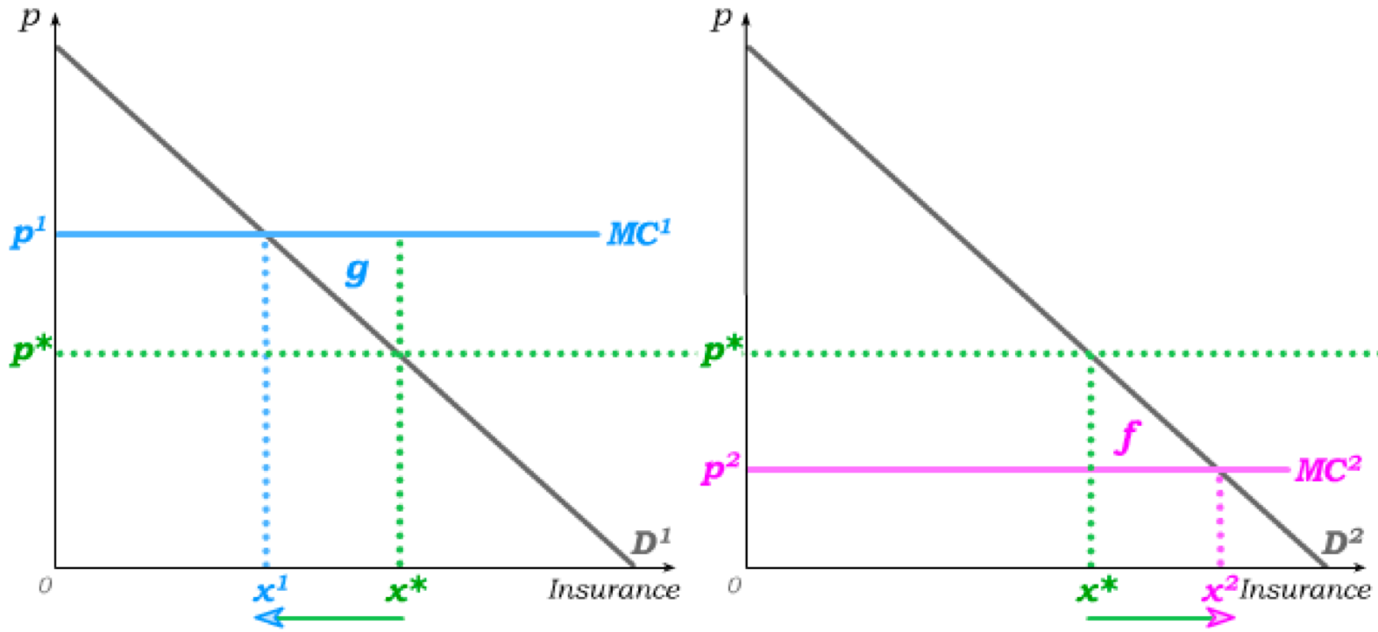
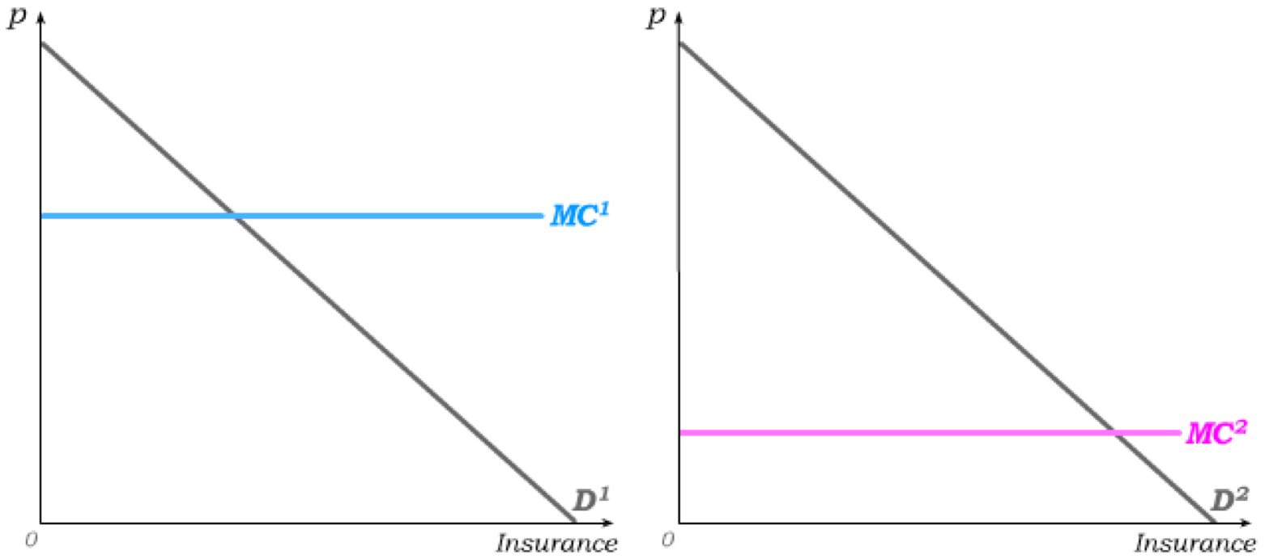
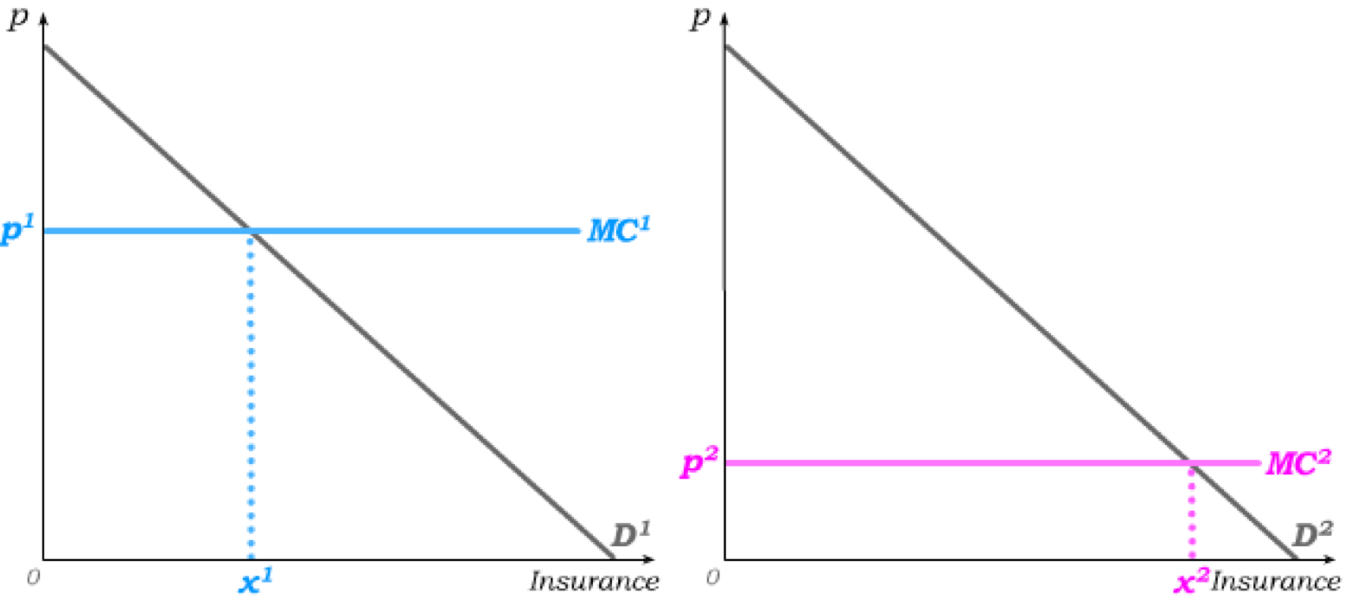
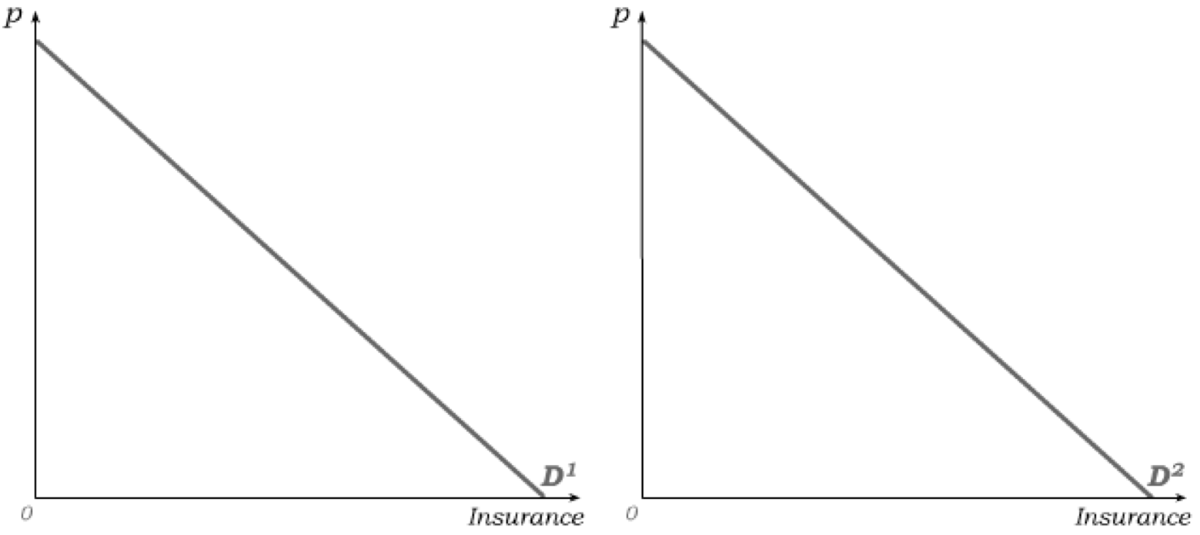
Adverse Selection in Car Insurance
Consider the amount of car insurance bought by consumers and suppose there are two types of drivers, represented in the population in equal numbers, with the same demand for insurance:
Unsafe Type 1 drivers have expected MC of MC ¹ for insurance firms.
Safe Type 2 drivers have expected MC of MC ² for insurance firms.
If competitive insurance firms can tell who is who, they will charge p¹ to type 1 and p¹ to type 1.
But if they cannot tell, the zero-profit price p* will fall halfway between p¹ and p¹.
This results in DWL from over-provision of insurance to unsafe drivers …
… and a DWL from
under-provision of insurance to safe drivers.

Slide 12

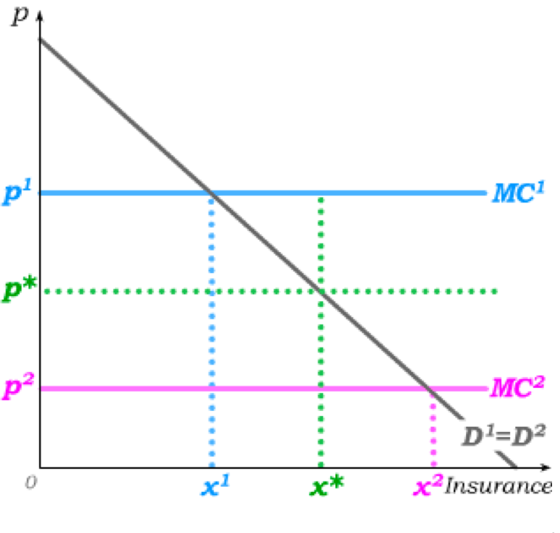
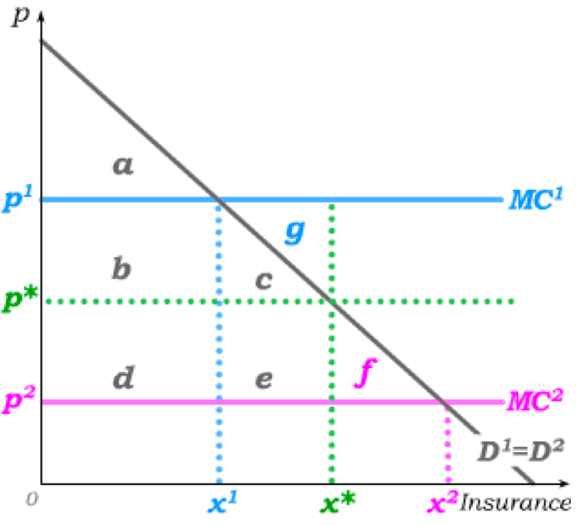
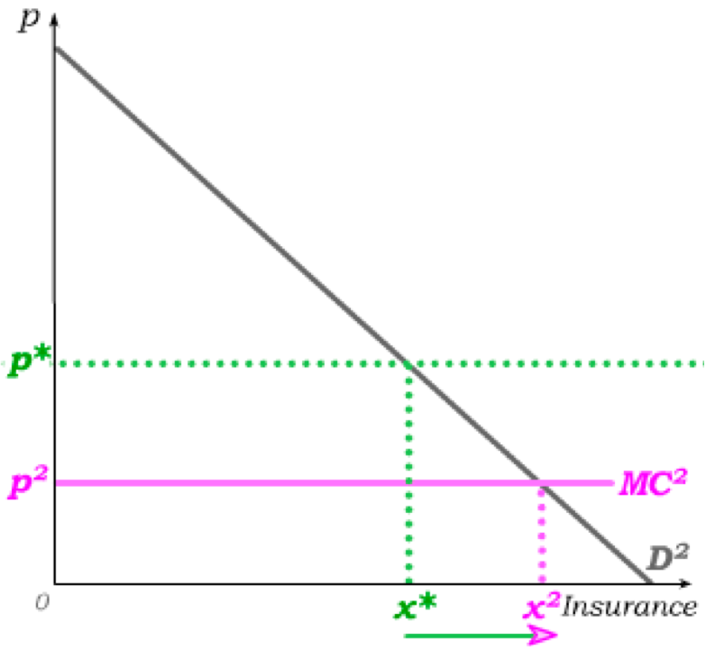
Another Way to See DWL
no asymmetric information
We can also overlay these …
asymmetric information
… and derive DWL in a single graph.
Type 1 Surplus
a
a+b+c
Type 2 Surplus
a+b+c+d+e+f
a+b+c
Total Surplus
2a+b+c+d+e+f
2a+b+c+d+e+f
2a+2b+2c
=
2a+2b+c+e+f
2a+2b+c+e+f
=
2a+2b+2c+0.5e+f
2a+2b+2c+0.5e+f
=
2a+2b+2c+g+f
2a+2b+2c+g+f
The DWL from asymmetric information is therefore g+f.

Slide 13
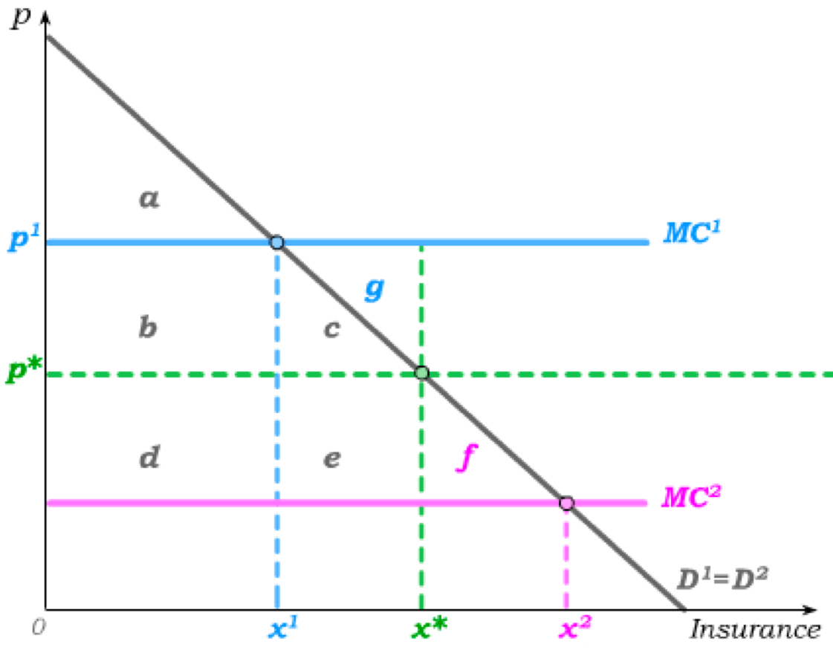
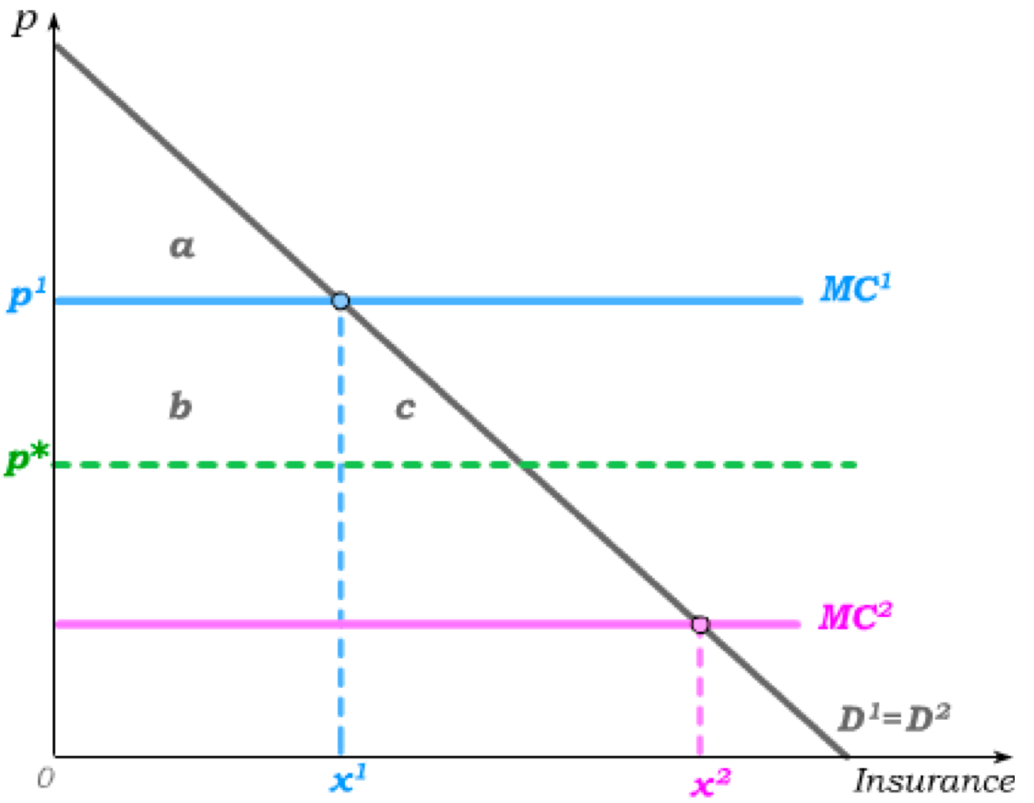
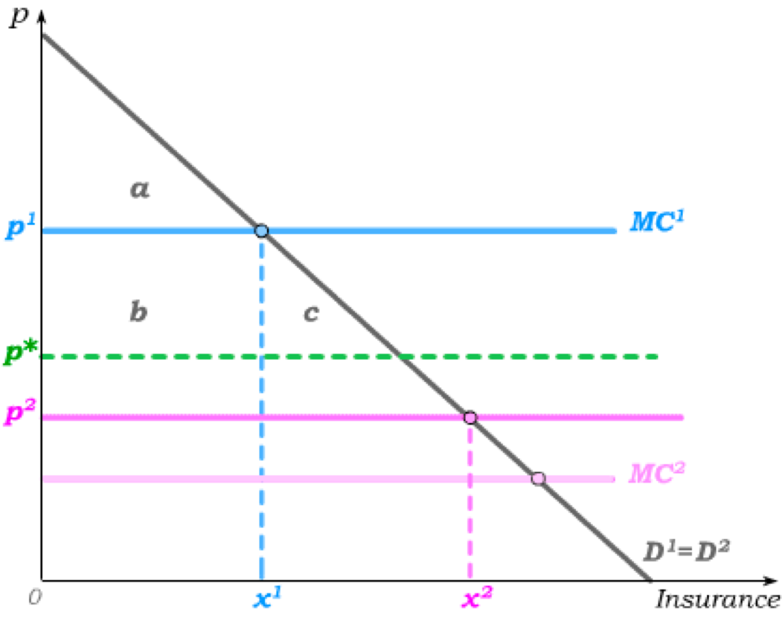
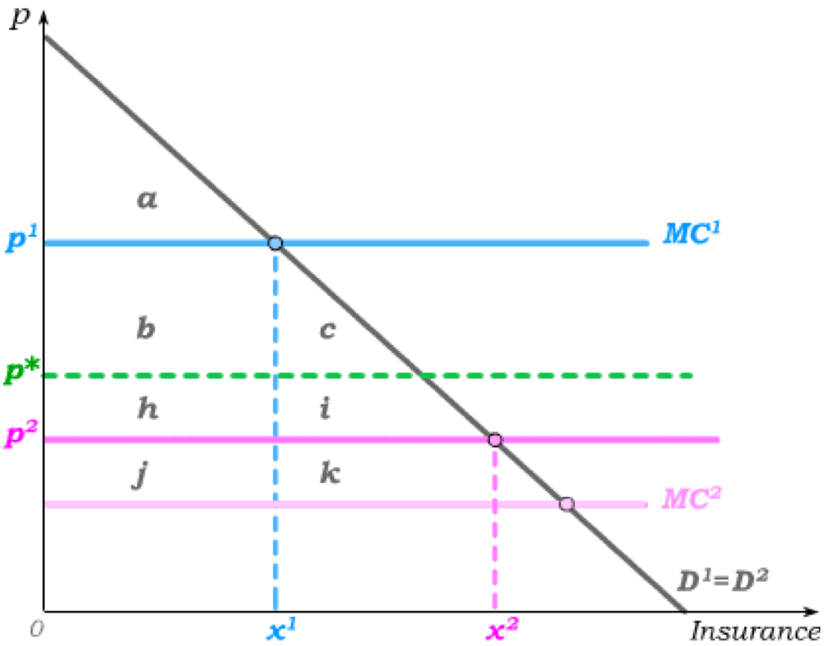
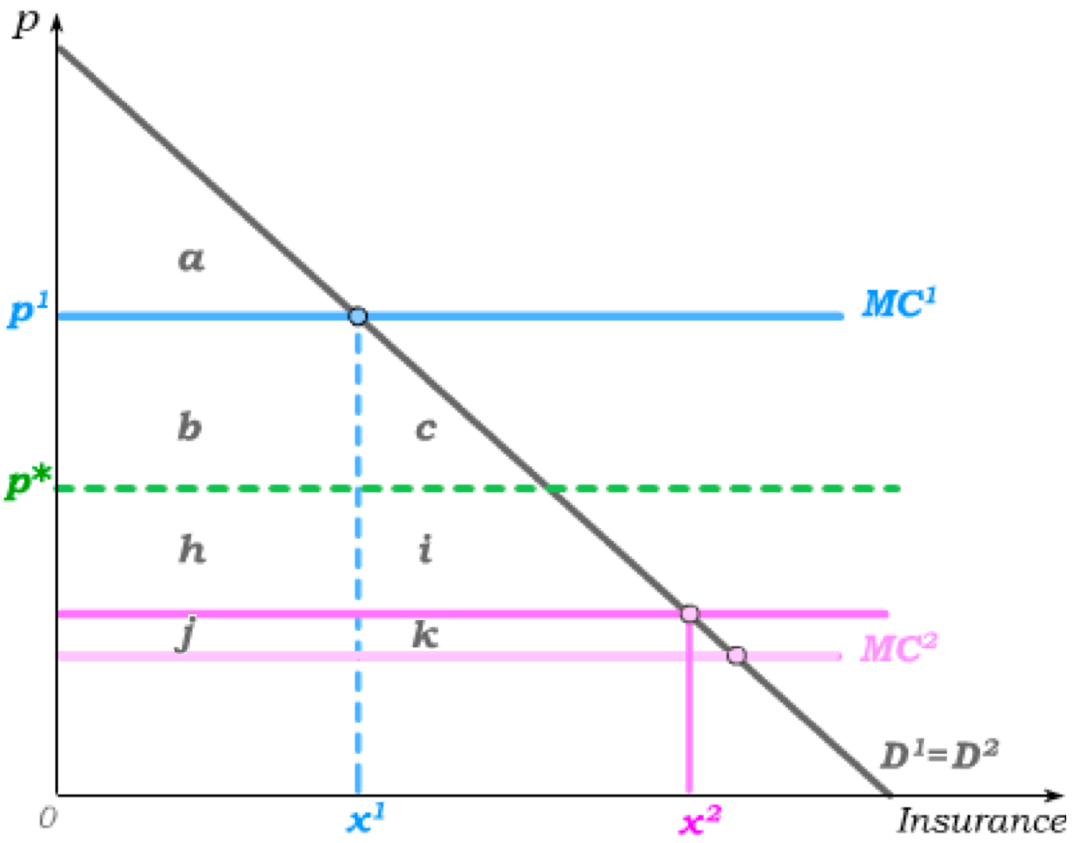
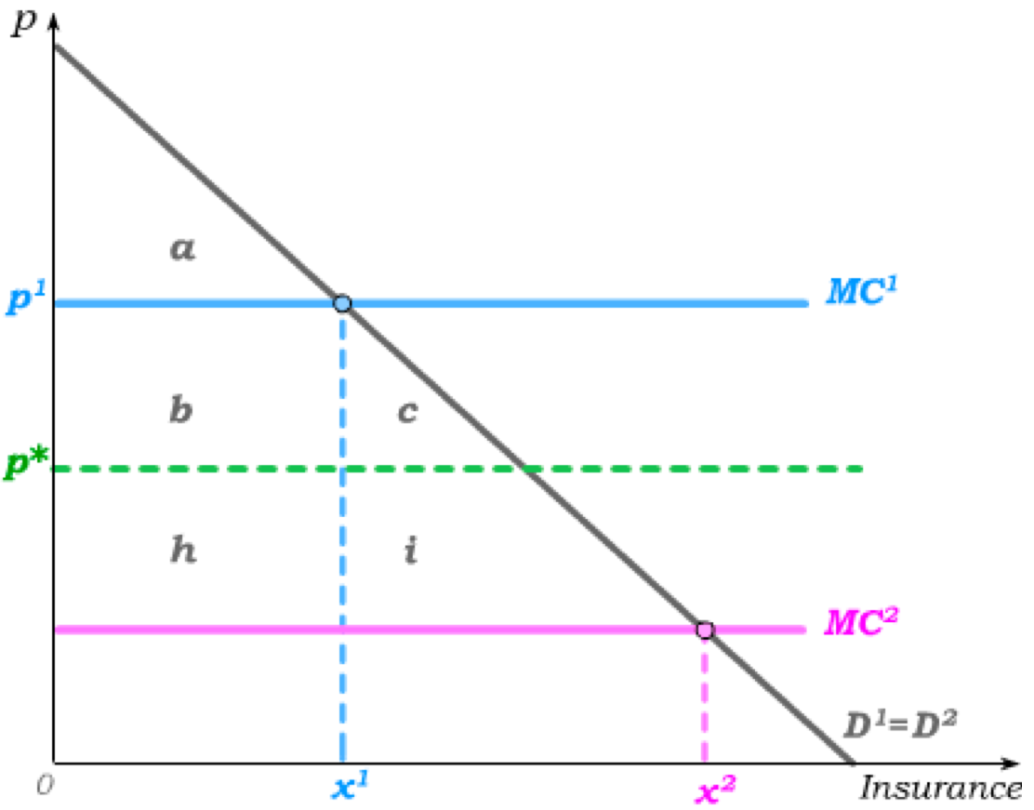
Revealing Information through Screening
If information is revealed through screens, type 1’s price has to be p¹ (and cannot be higher or else another firm will offer insurance at p¹.)
without screening
with screening
Type 1 Surplus
a+b+c
a
The screening cost is thus passed to type 2
by setting p² >MC², where p² -MC² are the screening cost.
Type 2 Surplus
a+b+c
a+b+c+h+i
Because information is costly, it is not always efficient to gather information.
2a+2b+2c
2a+b+c+h+i
Total Surplus
By screening, we gain surplus of (h+i) and lose surplus of (b+c) …
… which may result in greater DWL when information is sufficiently costly (high p²),
but will reduce DWL when information is sufficiently cheap (low p²) …
… and eliminate DWL when information is free (p² =MC²),.

Slide 14
Revealing Information through Signals
Next, suppose that it is too costly for firms to screen and we find our selves in a pooling equilibrium where both types pay the same price p*, where p* < MC ¹ and p* > MC ².
Safe drivers (of type 2) then have an incentive to find a way to credibly signal that they are safe – and then getting insurance at p² = MC ².
But the problem is that unsafe
drivers also have an incentive to mimic that signal if it result in a lower price.
In order for signaling to result in a separating equilibrium where safe drivers are charged p² = MC ² and unsafe drivers are charged p¹ = MC ¹, it must be sufficiently cheap for safe drivers to signal and sufficiently expensive for unsafe drivers to not signal.
Let δ be the cost for safe drivers to truthfully signal they are safe, and let γ be the cost for unsafe drivers to falsely signal that they are safe.
A separating equilibrium will then emerge if two conditions hold simultaneously:
1. MC ² + δ < p*
Safe drivers pay δ to send the signal and pay p² = MC ².
2. MC ² + γ > MC ¹
Unsafe drivers do NOT send the signal and pay p¹ = MC ¹.
But, just as we found in the case of firm screening, the revelation of information through signaling is only efficiency enhancing if it is not too costly to reveal true information.

Slide 15
Some Real World Applications
Signals
Screens
Other
Other Insurance Markets
statistical discrimination
( based on age, gender…)
Life Insurance
non-smoker
health exam
Unemployment Insurance
government provision
pre-existing condition health exam
statistical discrimination
compulsory mandates
Health Insurance
medical history
Output Markets
3rd-party certification
warranties
check with mechanic
reputation of used car dealer
Used cars
Consumer electronics
brand names
warranties
word-of-mouth
consumer reports
required disclosures

Slide 16
Some More Real World Applications
Signals
Screens
Other
Labour Markets
Workers have hidden information about their productivity
education
work history
references
job interviews
probationary hiring
skill tests
statistical discrimination
Financial Markets
Borrowers have hidden information about their ability to pay back loans
credit history
financial statements
statistical discrimination
Firms have hidden information about their balance sheets – hidden from investors
financial advisors
disclosure requirements
regulations
deposit insurance
Bond ratings

Slide 17
The Special Case of Health Insurance
Age and health status are excellent predictors of how much health care we will use in any given year; unregulated competitive health insurance markets will therefore charge substantially higher premiums to older and sicker people – so high, that health insurance becomes unaffordable for those who need it most.
The typical efficiency argument (i.e., higher premiums to older and sicker people) becomes problematic when we think of buying health insurance across the life cycle , rather than annually, since we start as a low-cost consumer, but as we age, we become higher cost consumers.
While pooling everyone into a single insurance pool implies the young and healthy subsidize the old and sick in any given year, it also implies today’s young are pooled with their future selves likely to get old and sick over their live cycles.
If health insurance contracts were lifetime and not annual, and people behaved rationally, the young would rationally choose to pool with their future selves. The adverse selection problem therefore arises from individuals making (short-run) choices in real time, rather than (long-run) choices for the whole life cycle.
If insurers may not price-discriminate, the young and healthy will adversely select out, causing escalating premiums for those who most need health care.

Slide 18
Discrimination
There are two kinds of discrimination: statistical discrimination and taste discrimination.
Statistical Discrimination is the use of statistical information about a group to infer something about an individual that belongs to the group – and then to base treatment of individuals on statistical group differences.
Examples: Life insurance companies charge a higher premium to smokers.
Life insurance is sold at cheaper rates to women than to men.
Car insurance is sold at higher prices to young drivers.
Taste Discrimination is the use of taste-based arguments in determining how members of different groups are treated.
Example: men on corporate boards feeling uncomfortable about allowing women more economic opportunities.
Statistical discrimination arises from asymmetric information, while taste discrimination is based on prejudice that prefers one group over another.

Slide 19
Discrimination and Markets
Consider 4 different firms and their employment practices:
Firm A
Firm B
Firm C
Firm D
Taste-based discriminates (e.g., women)
No taste-based discrimination
No taste-based discrimination, but statistically discriminates
No taste-based discrimination, but has inexpensive screening tool
Firm B has access to a wider qualified labour pool and can thus hire more qualified individuals
Firm C takes advantage of some information that firm B does not consider – and thus hires better on average
Firm D has found a way to extract individual rather than statistical information about potential employees
Firm B will make higher profits for shareholders
Firm C will make higher profits because it partially addresses asymmetric information
Firm D will make higher profits because it fully addresses asymmetric information

Slide 20
Discrimination and Markets
Markets therefore tend to punish taste-based discrimination while they tend to reward statistical discrimination.
But there are exceptions:
Suppose that the employees of our firms are visible to customers, and suppose customers are prejudiced against certain groups.
Then demand may be higher for firms that taste-discriminate against certain groups – and markets may then reward taste-based discrimination (e.g., consider a restaurant in a small prejudiced village).
As prejudice diminishes in the population in general, markets will be more likely to punish taste-based discrimination …
… but statistical discrimination is likely to persist (absent organized efforts against it) so long as statistical group differences allow inferences that hold on average even if they do not hold in particular individual cases.
Understanding the source of discrimination can then help formulate appropriate policy responses.

Slide 21
Tutorial exercises
Within-chapter exercises:
22A.5, 22A.10, 22A.11, 22.A15, 22A.17, 22A.25, 22A.26, 22A.28, 22A.31
End-of-chapter exercises:
22.1A, 22.2A, 22.3A (challenging)
Extra exercises (see Fenix)
Open Q.5 and Q.9

Slide 22
Tastes over Insurance Contracts
An insurance contract is the combination of a benefit level b that is paid if a “bad” outcome occurs and a price or premium p that is paid regardless of the outcome.
Suppose the “bad outcome” is x₁ and the “good” outcome is x₂.
An insurance contract (b,p) then results in consumption of
x₁ + b – p in the “bad state” and
x₂ – p in the “good state”.
Suppose further that the “bad” outcome occurs with probability δ.
If tastes over risky gambles are state-independent and satisfy the independence axiom, we know from Chapter 17 that there exists a function u(x) that allows us to represent tastes over insurance contracts with the expected utility function
When u(x) is concave, tastes are risk averse (which we will assume throughout).

Slide 23

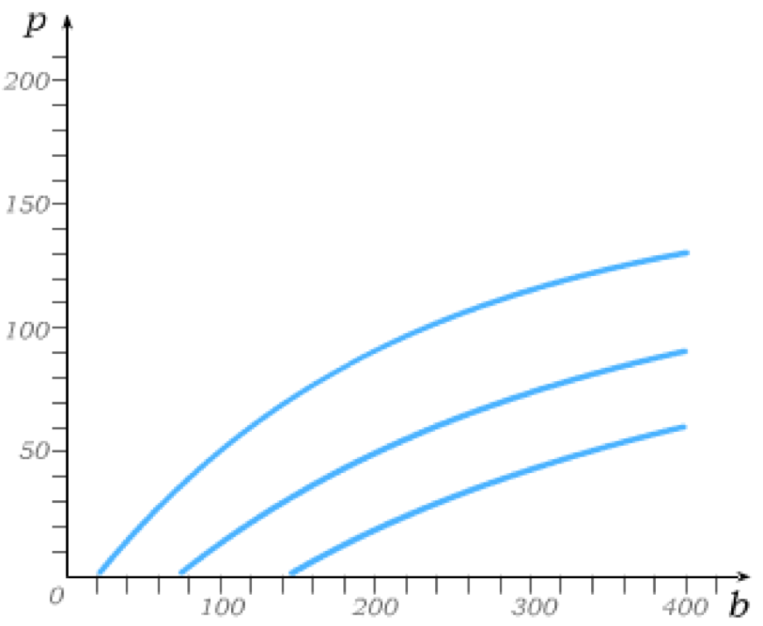
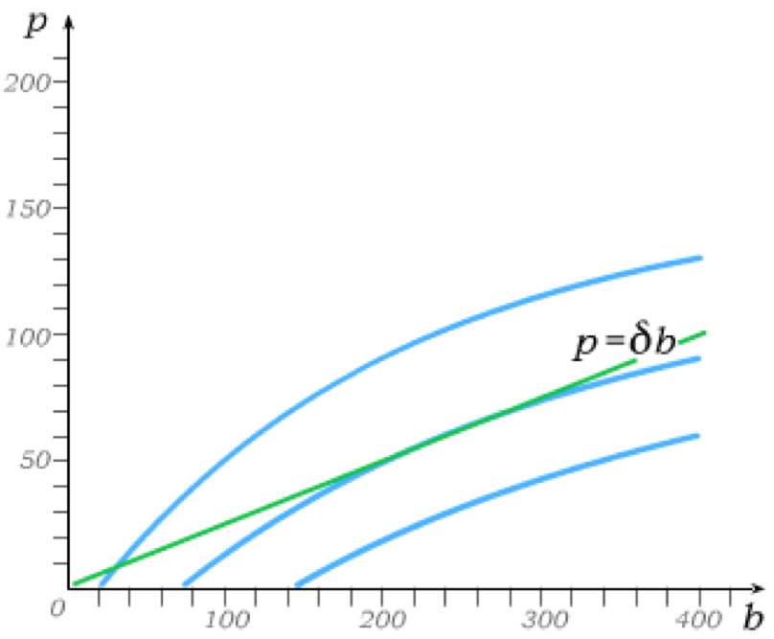
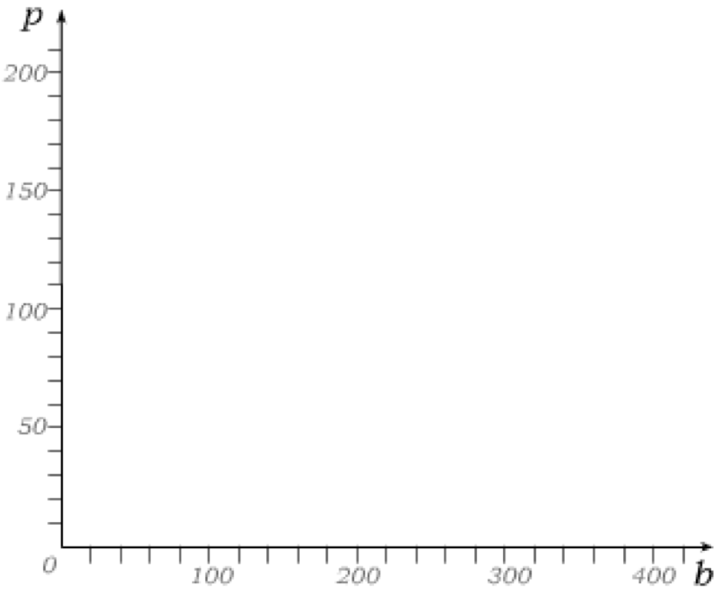
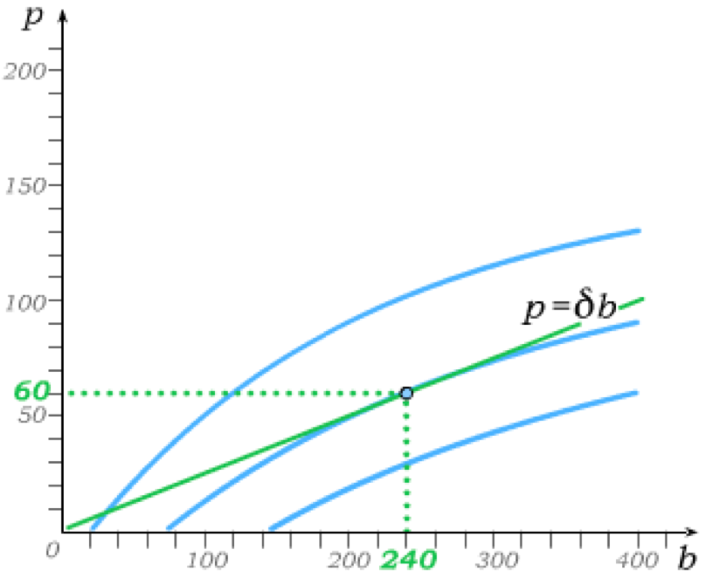

Insurance Contracts with 2 Risk Types
The set of all possible insurance contracts can then be illustrated with b and p on the axes.
From the expected utility function U(b, p), we can further derive indifference curves over this set of all possible insurance contracts.
The indifference curves here are derived assuming , and assuming (which is concave).
The set of actuarially fair – zero-profit – insurance contracts has to satisfy the equation
because the benefit is paid with probability δ while the premium is collected with probability 1.
An expected-utility-maximizing consumer will then choose the policy
(b, p) = (240,60).

Slide 24
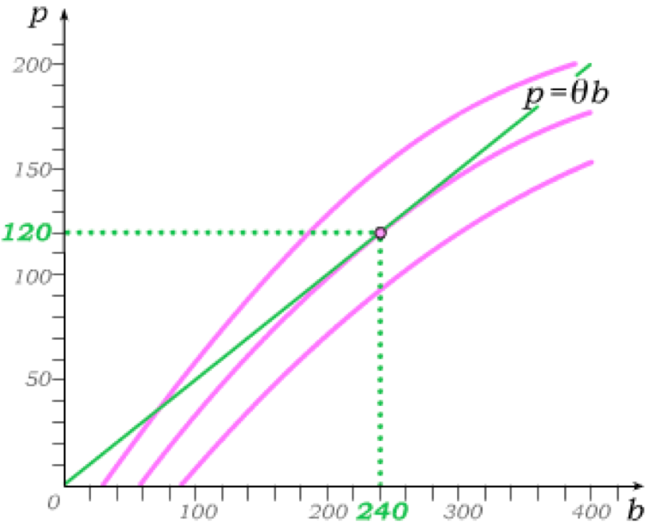
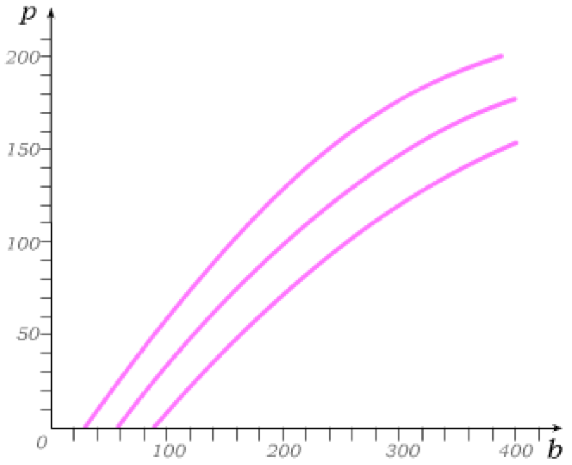
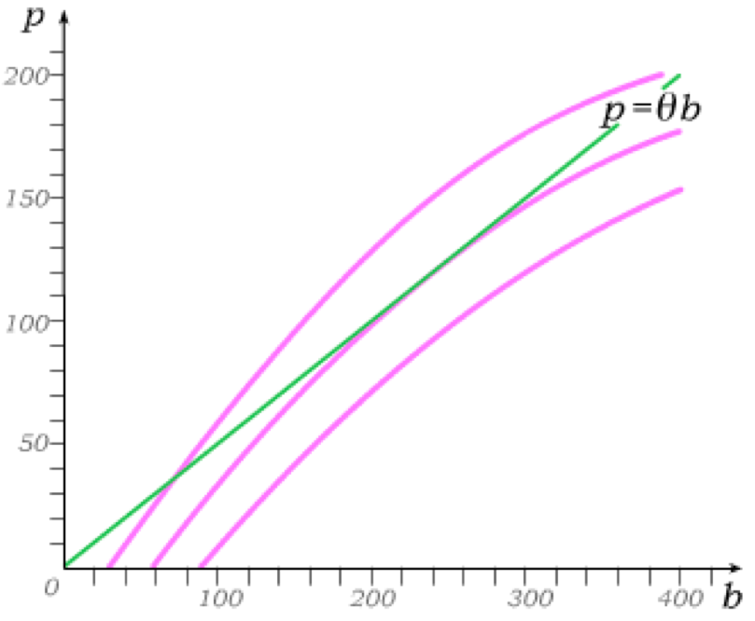
Insurance Contracts with 2 Risk Types
Now suppose there exists a second type of consumer who faces more risk than the first.
In particular, suppose the second consumer faces a probability θ of the “bad” outcome, where θ > δ.
This then changes the expected utility function to
which implies an indifference map with steeper indifference curves.
Actuarially fair insurance must now satisfy p = θb,
leading to the choice (b, p) = (240,120).

Slide 25
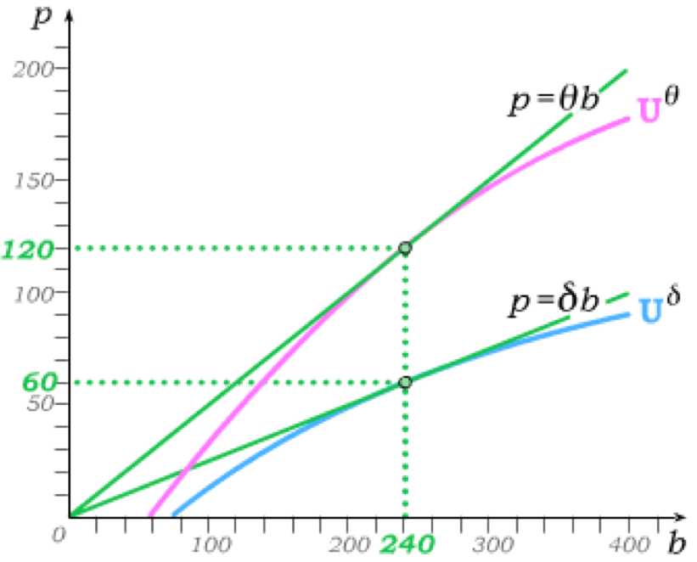

Equilibrium without Asymmetric Information
If competitive insurance firms can tell how is a low-risk δ-type and who is a high risk θ-type, a separate set of actuarially fair insurance contracts is offered in equilibrium to each type.
Given our assumption of risk aversion and state-independence of tastes, each type will then fully insure at insurance prices that are actuarially fair given the consumer’s type.
This is then a depiction of an efficient equilibrium in the absence of asymmetric information.
It is an equilibrium because high risk θ-types cannot choose from actuarially fair policies aimed at low-risk δ-types …
… which is possible only because insurance firms can tell the two consumer types apart.

Slide 26
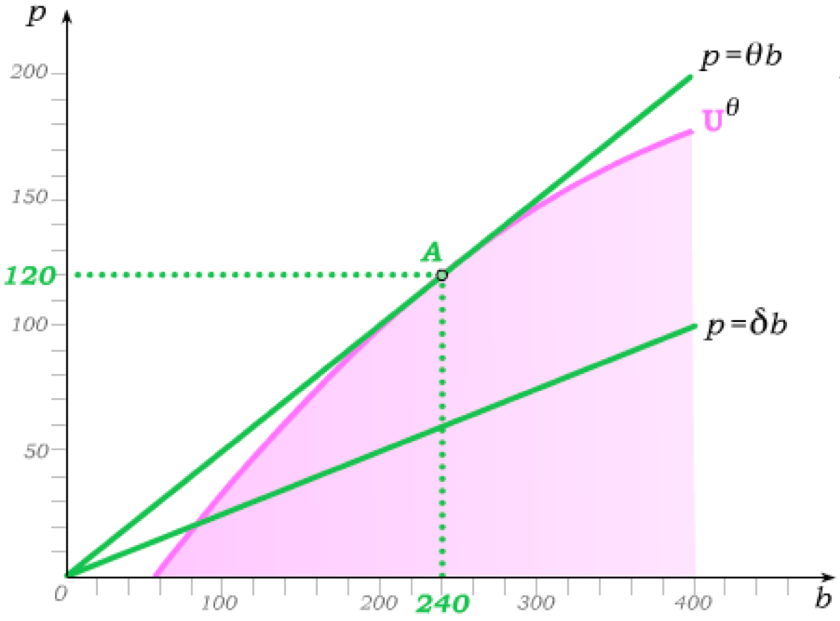
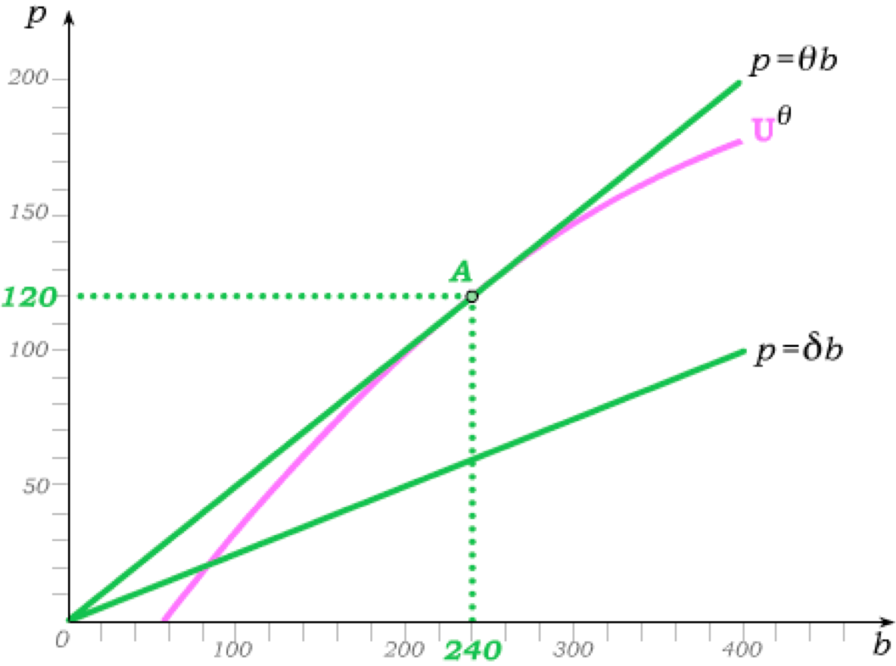
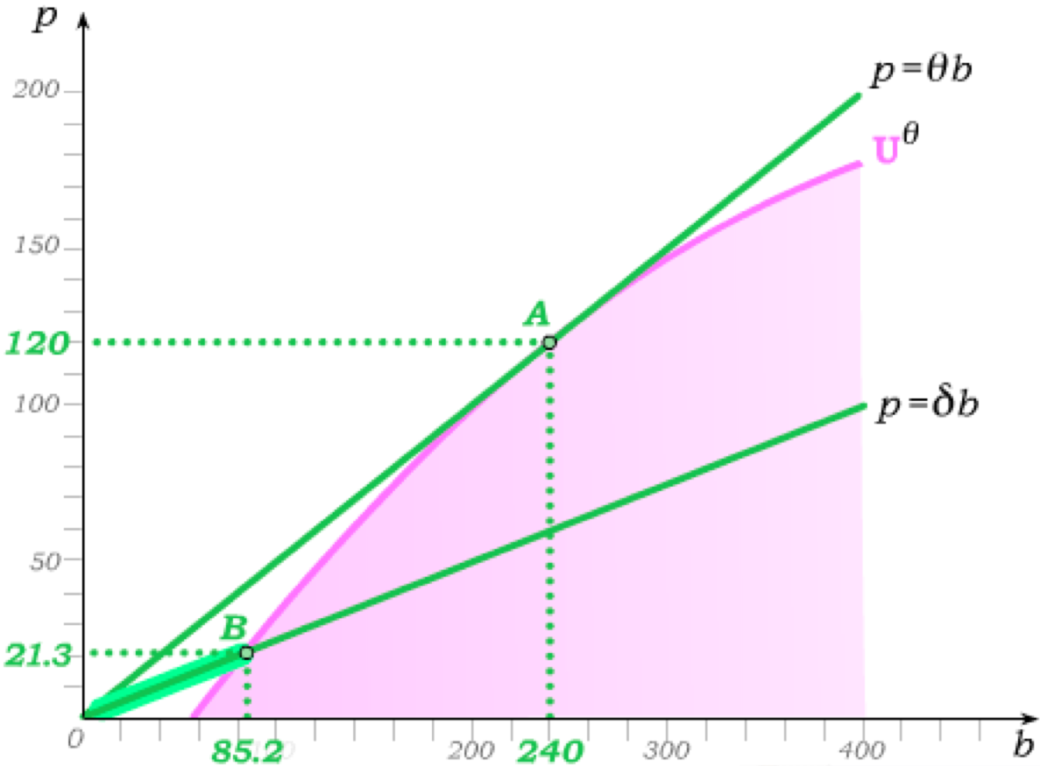
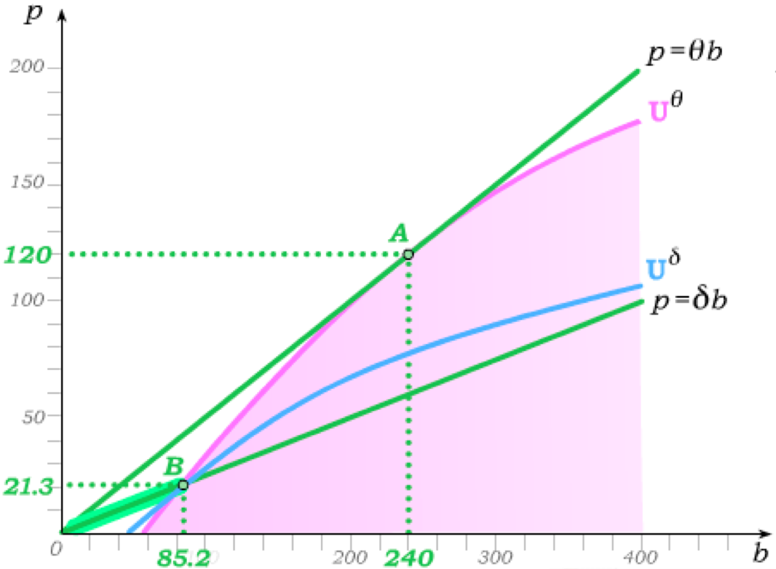
Separating Equilibrium with Asymmetric Information
In any separating equilibrium, consumer types are revealed and thus only actuarially fair insurance specific to each risk type will be offered.
Since no insurance company can loose anything from offering all actuarially fair policies aimed at high risk θ-types, such policies will always be offered …
… and high risk θ-types can always choose to fully insure at A.
Inefficiency arises even when all information is revealed.
But if the full set of actuarially fair contracts aimed at low-risk δ-types is offered, high risk θ-types will not choose from “their” actuarially fair line …
… which implies only those low risk actuarially fair contracts that high risk θ-types will not choose can be offered in a separating equilibrium.

Slide 27

Calculating the Separating Equilibrium
We have shown that high risk θ-types fully insure while low-risk δ-types only partially insure in a separating equilibrium (because only partial insurance is offered in the market).
Full insurance (under actuarially fair terms) for high risk θ-types implies
bad state consumption
good state
consumption
actuarial
fairness
Solving for the full insurance contract terms, we get implying consumption of
regardless of whether or not the good state occurs.
Given the function we are using to derive expected utility, the utility level attained by high risk θ-types in a separating equilibrium (under full insurance) is

Slide 28

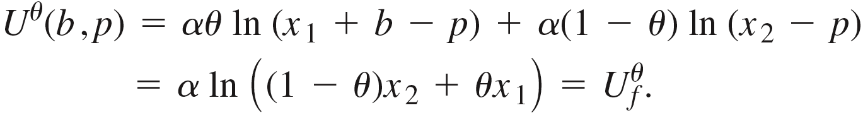
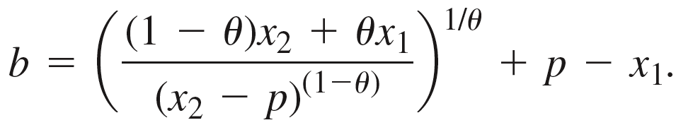
Calculating the Separating Equilibrium
This is then the highest utility a high risk θ-type can attain purchasing a policy aimed at low-risk δ-types,
because in a separating equilibrium, high risk θ-types fully insure under their actuarially fair terms, choosing such full insurance over policies that are actuarially fair for low-risk δ-types.
The “best” contract (b, p) offered to low-risk δ-types must then satisfy
Cancelling α and using the rules of logarithms, we can re-write this as
and solve for
This is then then an equation for the indifference curve that a high risk θ-type attains at full actuarially fair insurance.

Slide 29
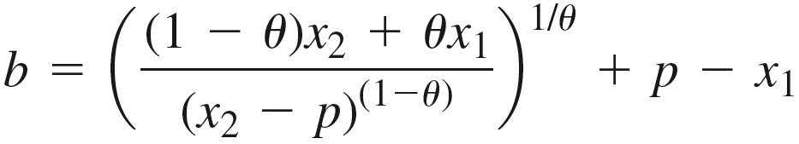
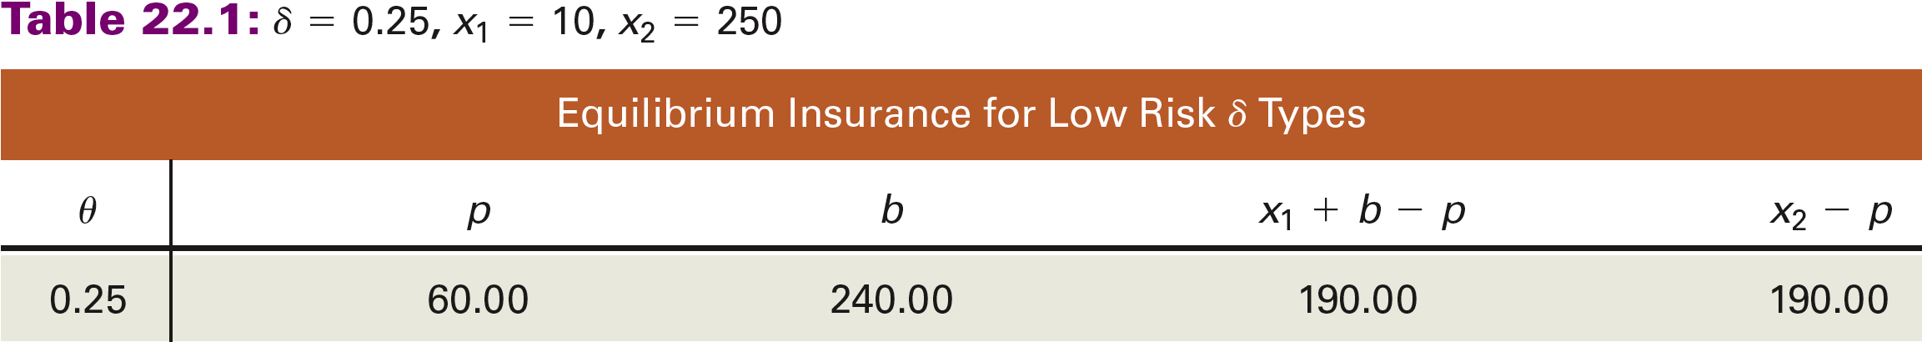
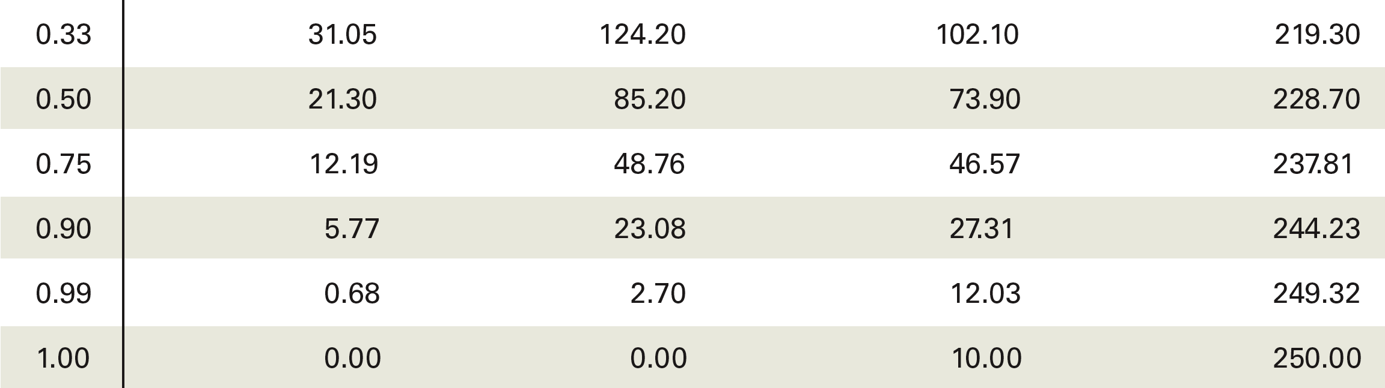
Calculating the Separating Equilibrium
The “best” insurance contract a low-risk δ-type can then obtain lies at the intersection of this “full insurance” θ-indifference curve and the actuarially fair contract line p = δb.

Slide 30
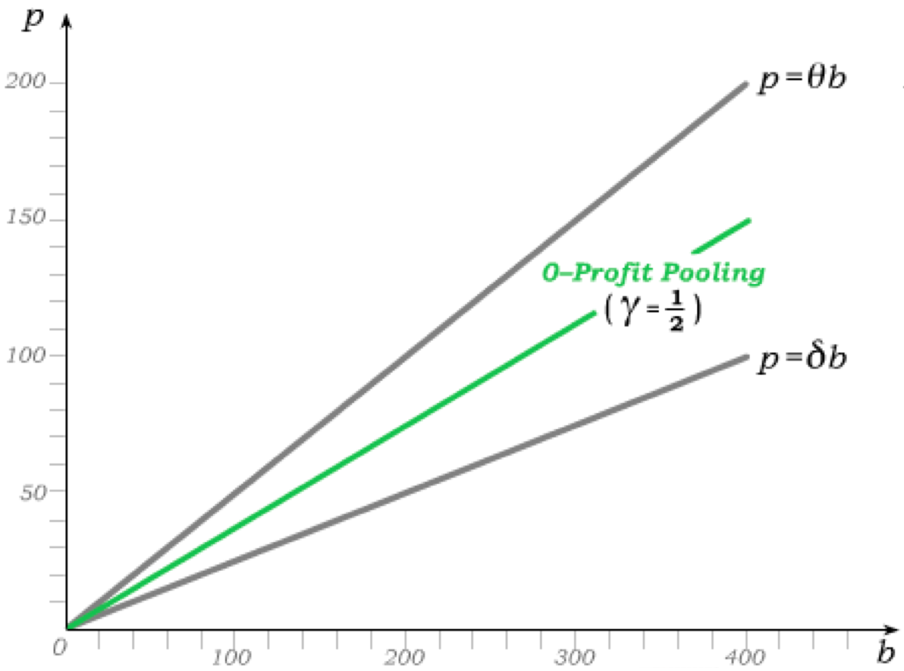
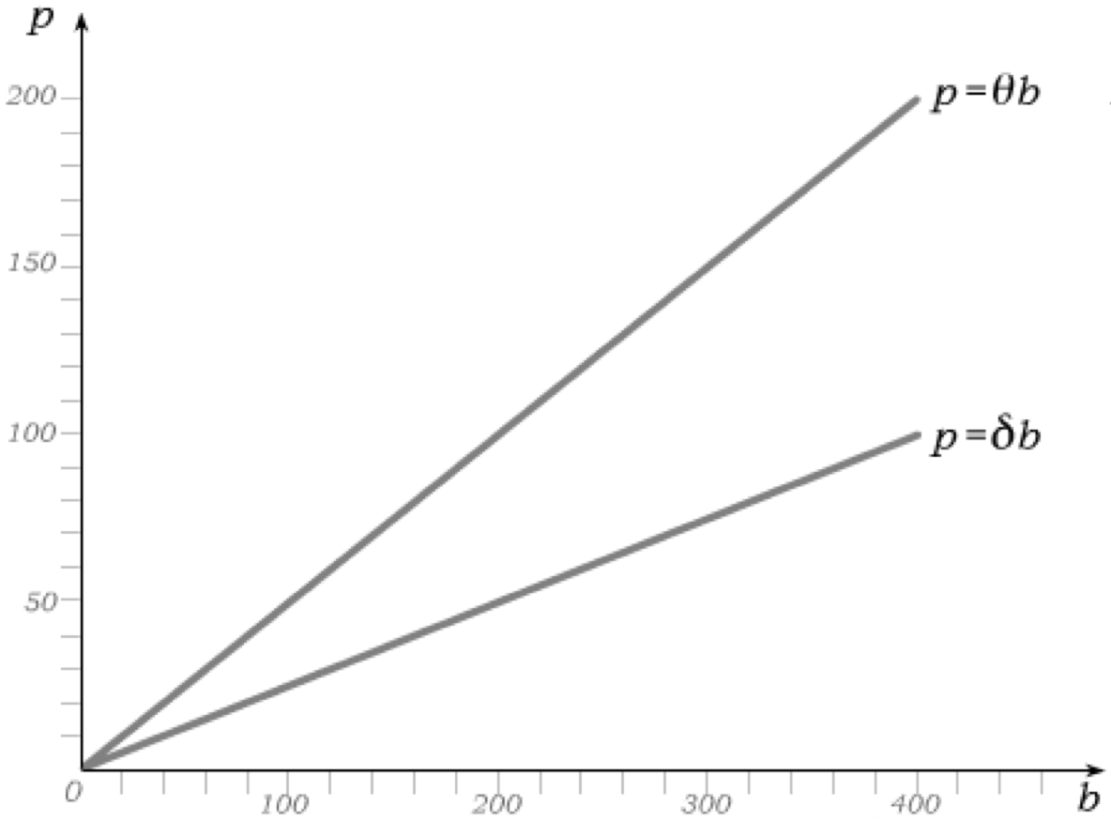


Pooling Contracts
In any pooling equilibrium, consumer types are not revealed and thus both types pay the same price for insurance.
Zero profit implies that equilibrium pooling contracts must lie in between the actuarially fair contract lines aimed at the two risk types under complete information.
Exactly where the 0-profit pooling line lies depends on the fraction γ of the population that is low risk.
Expected benefits to low-risk types
Expected benefits to high-risk types
If γ = ½, the 0-profit pooling lies exactly halfway in between the two actuarially fair contract lines.

Slide 31
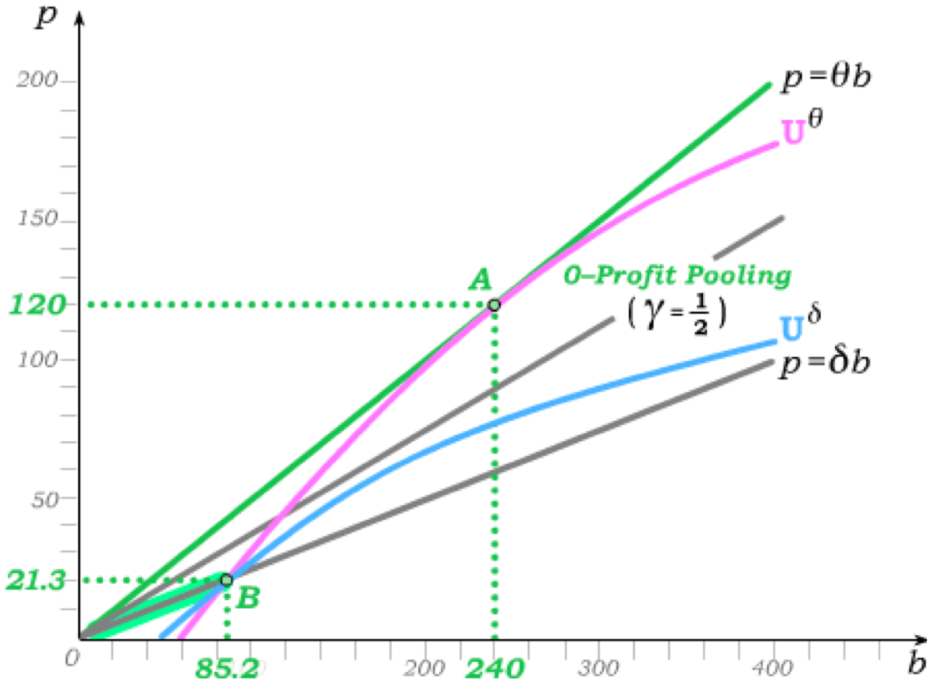
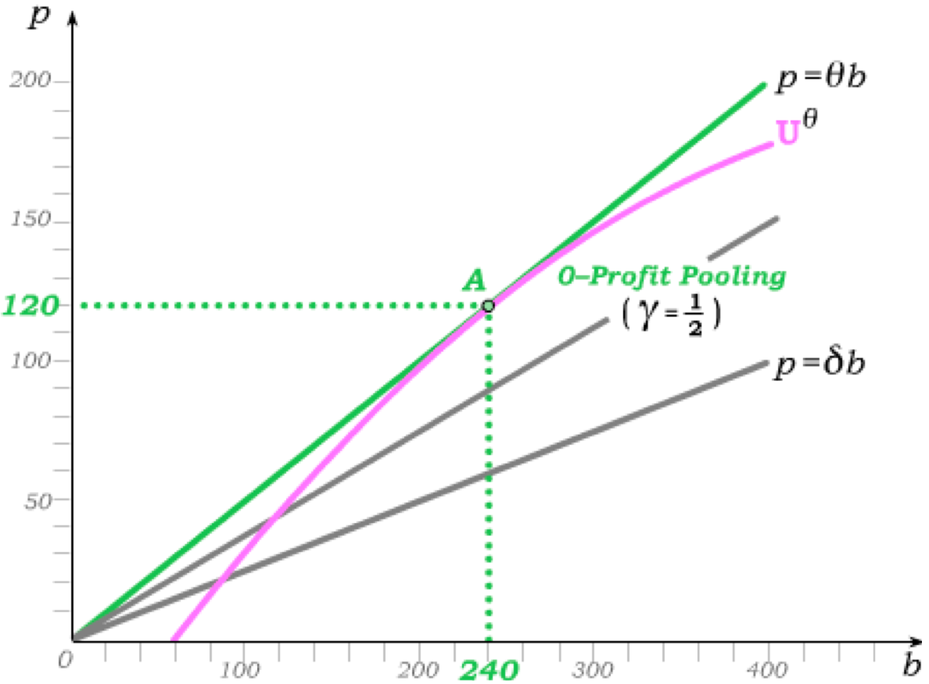
A Pooling Equilibrium?
High risk θ-types will always prefer to choose from the 0-profit pooling line …
… but low risk δ-types will prefer choosing from the portion of the low-risk contract line that can be offered in a separating equilibrium if γ is sufficiently low.
Insurance firms can always offer p = δb contracts below B, and so low risk δ-types will not choose from the pooling line if they get higher utility at B.
Thus, if γ is sufficiently low, no pooling equilibrium can emerge.

Slide 32
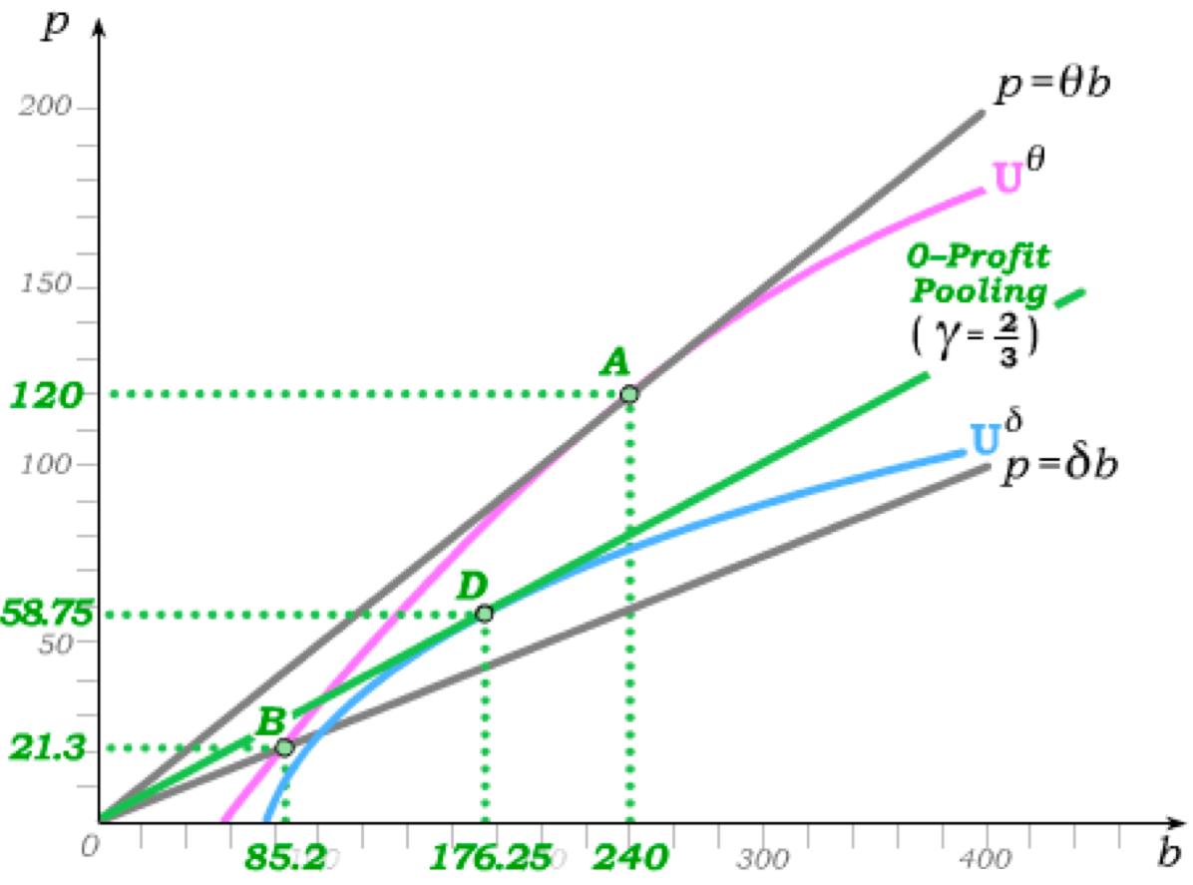
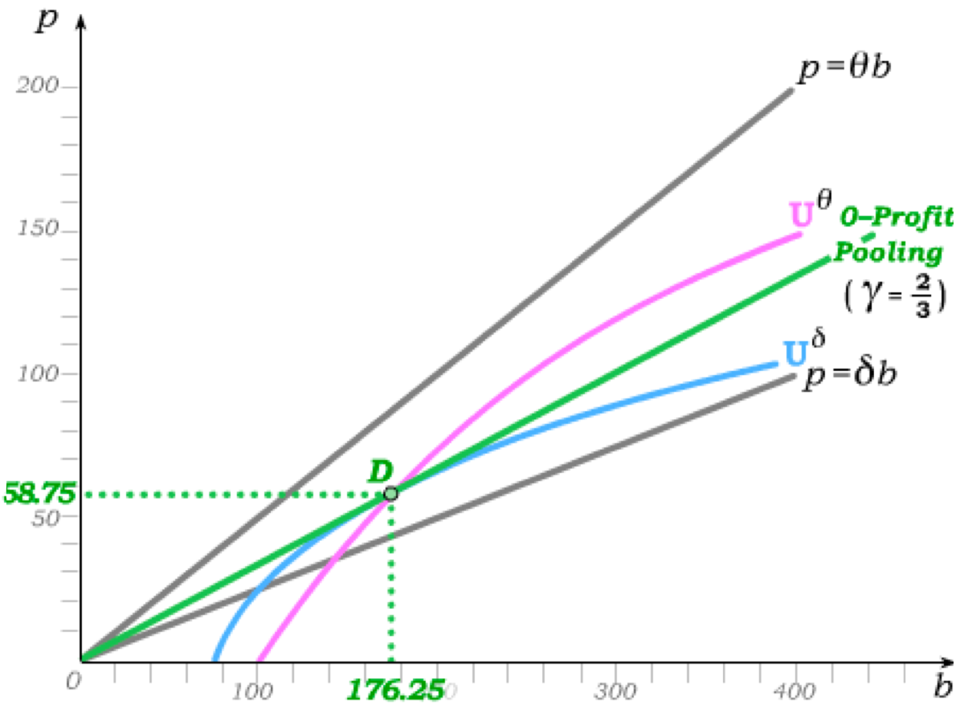
Potential Pooling when γ is High
For use with Nechyba, Intermediate Microeconomics © 2018 Cengage EMEA, ISBN: 9781473759008
Since half the population being low risk (γ = ½) is insufficient for a pooling equilibrium in our example, γ has to increase – thus bringing the 0-profit pooling line closer to the actuarially fair low-risk line.
When γ = 2/3, the 0-profit pooling insurance contract D is now more attractive to low-risk δ-types than the most preferred separating contract B.
If only D is offered by insurance firms, both risk types would then prefer D to any contract they could obtain in a separating equilibrium …
… and both types would therefore choose it.

Slide 33
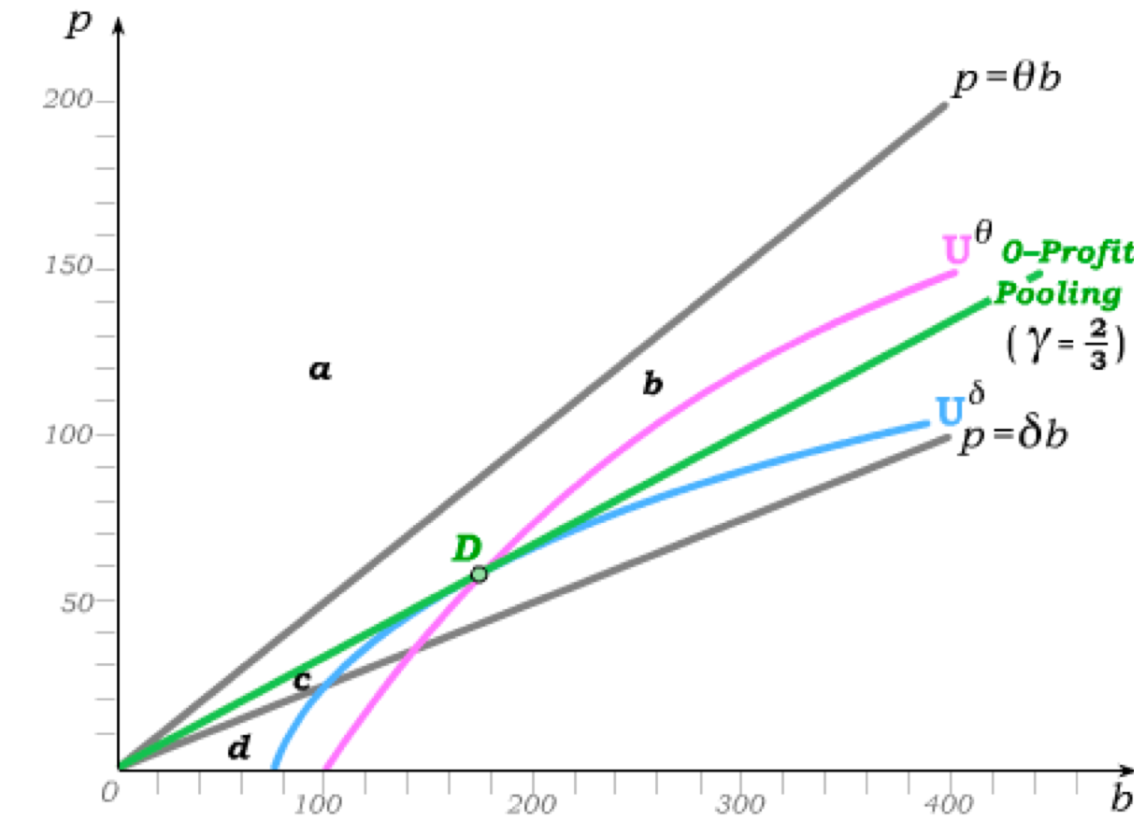
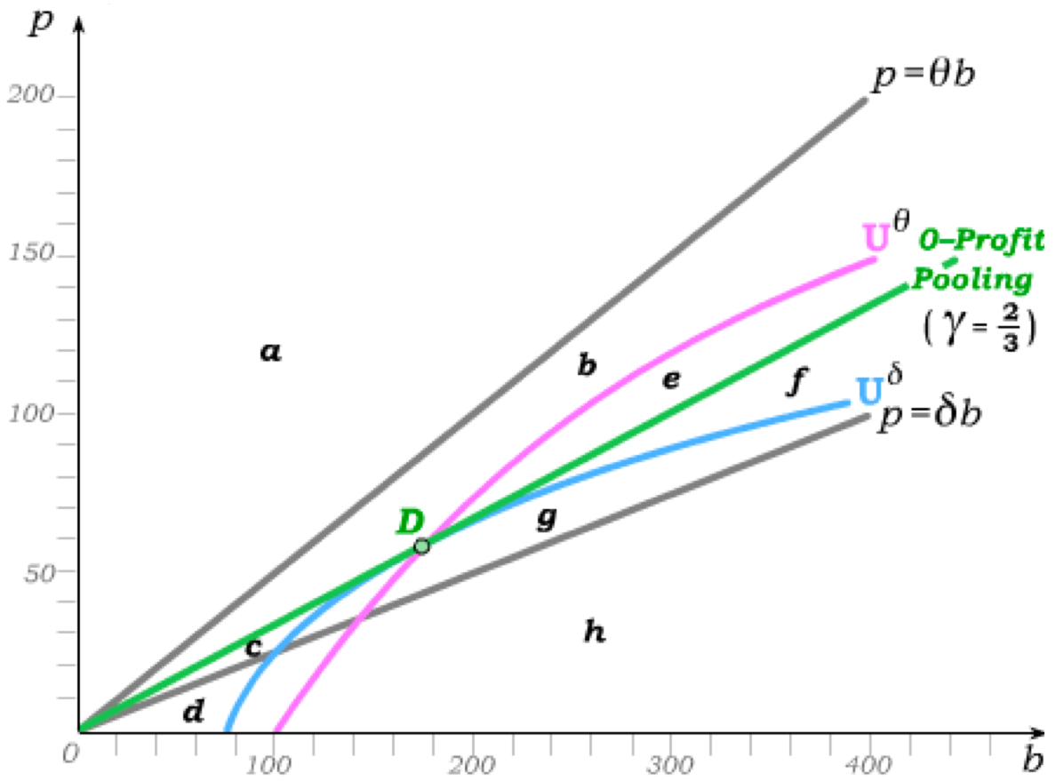
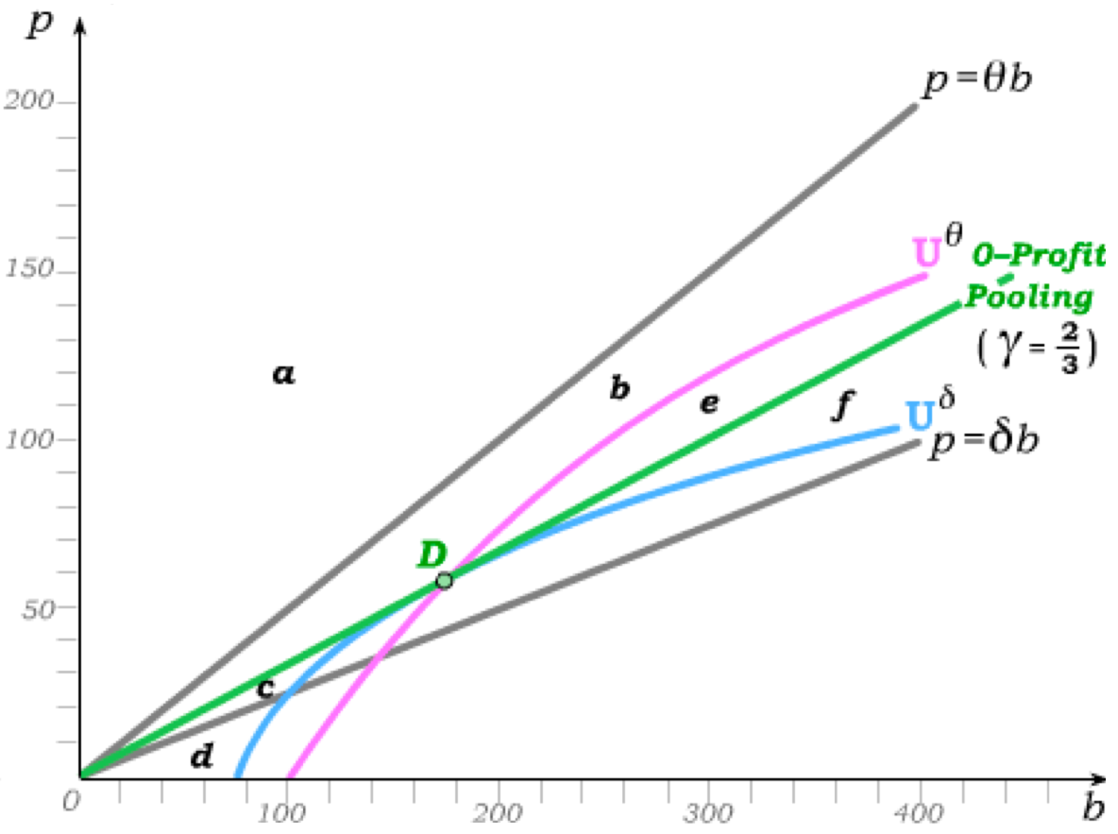
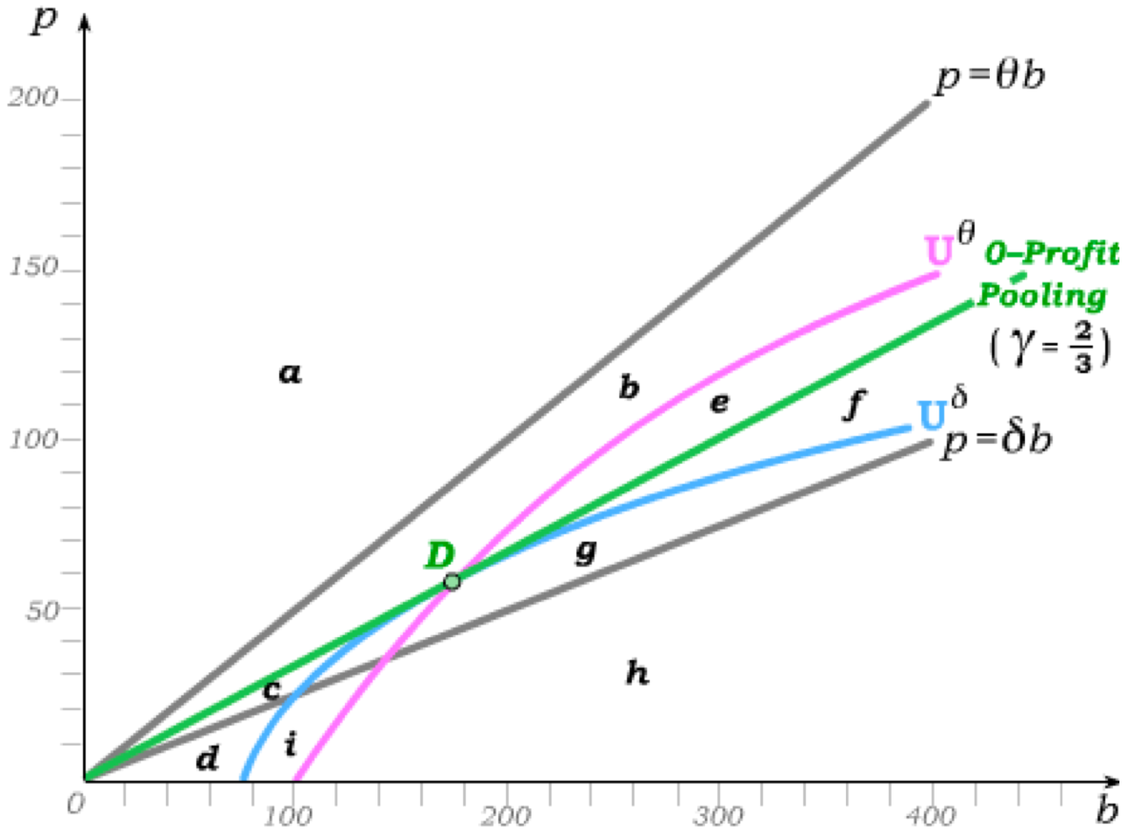
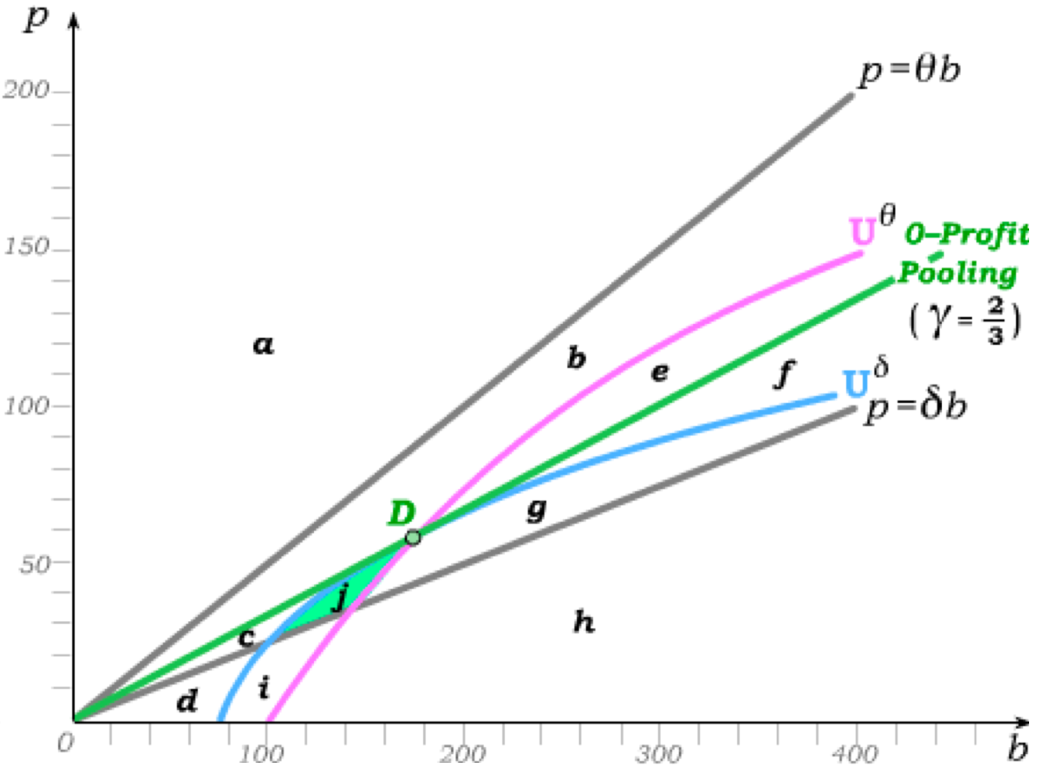
Equilibrium Pooling
We have shown that both risk types prefer the pooling contract D to any separating contract that would reveal risk types.
Now we ask: If all firms in a competitive industry offer D as a pooling contract, could a new firm make a profit by offering a different contract?
Any contract in areas a, b, c, or d would attract no customers.
Contracts in e and f would attract only high risk θ-types and would thus make negative profit.
Contracts in g and h would attract both risk types but would make negative profit.
Contracts in i would attract only low risk γ-types but would make negative profit.
This only leaves contracts in j that would attract only low risk γ-types and would make positive profit.

