Slide 1




Sociology of Work
Changing professional structures, workforce changes and labour segmentation
Adam Standring, PhD.

Slide 2
Jobs in the global economy according to Robert Reich
From previous lectures: technology → spread of high qualified work
Robert Reich’s critique:
Increased heterogeneity between professional groups
Low qualified work still important in a service economy
Professional groups in a service economy
Routine prodution
Personal services
Symbolic analytical services

Slide 3

Routine production
The “pawns” of data gathering and management in an information technology
Examples: data insertion and processing (research: graphs, transcription), automated assembly lines in factories → gender segmentation, competition from 3rd World
AI → replacing “blue collar” service jobs → supervision
Decreasing(?) relevance of these types of jobs
Middle-managers and supervisors in office setting (standardized procedures)

Slide 4

Personal services
End use services (e.g. taxi-drivers, mechanics, sales and department stores)
Interpersonal relations and contact: emotional labour (e.g. carers, hospitality industry)
Heterogeneous qualifications: high qualifications (e.g. healthcare) vs low qualifications (e.g. cleaning, carers)
Atypical employment forms: part-time, “0 hour contracts”
‘Baumol cost disease’: low paid
Insulated from global competition, but welfare retrenchment
Predominance of women
Growing relevance

Slide 5

Symbolic analytical services
High expertise, knowledge and creativity
Not easily replicable by technology
Examples: engineers, software developers, researchers, marketing, consulting
Added value to organizations
High bargaining power and status
Smaller group of the three, but growing
Predominance of white male

Slide 6

What about artificial inteligence (AI)? The optimist view
AI is inseparable from ICT
Improve/change nature of work: repetitive tasks, improve decision-making.
Not just routine workers (e.g. Amazon Mechanical Turk), but also health care
Impact on jobs overblown (remember organizational development?)
Firms as organizations of humans, management of human interactions, resistance from consumers (e.g. airlines, care).
Enhance efficiency and reduce error (e.g. healthcare)
Proof? Pre-COVID: full-employment rather than large structural unemployment

Slide 7

What about artificial inteligence (AI)? The pessimist view
Previous technologies were task-oriented: AI has the ability to perform wider range of tasks, handle big data, “learn how to do it”
Widens the range of jobs at risk of automation: between 10-20% and ¼ of jobs (OECD , 2016, PwC, 2018)
This includes even high-skilled tech jobs
Greater possibility for job surveillance
Taylorization and further degradation of work (e.g. Amazon Mechanical Turk)
Will lead to growing inequalities

Slide 8
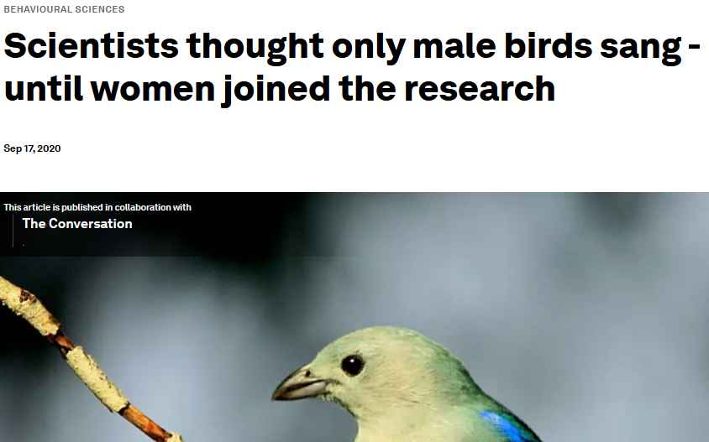
AI and inequalities in the labour market
Uneven impact on jobs: 35% of male jobs and 23% of female jobs (PwC, 2018) vs women more likely to work on routine/repetitive jobs (EIGE, 2023)
AI risks replicating inequalities
Gender/minorities gap in tech funders, tech workers… → what get’s developed and how
Based on existing data: biasing recruiting and HR management
E.g.: previous hiring, work breaks, soft skills
Broader impact: disinformation, privacy, tax evasion
Source: https://www.weforum.org/agenda/2020/09/women-biology-sex-gender-birds-stem-female/

Slide 9

AI and the social shapping of technology (remember?)
AI develops not in a vacuum: agency of actors, impact of social structure
Oligopoly (Amazon, Facebook, Google, Apple, Microsoft) and ‘state capture’
Is cost-cutting the main driver of automation?
Auto-industry (male, unionized, high wages) → automation
Textile-industry (female/migrants, non-unionized, low wages) → no automation
Automation as a strategy to deskill
“deskilling weakens the power deriving from nonreplicable skills” (Howcroft and Taylor, 2020: 359)

Slide 10
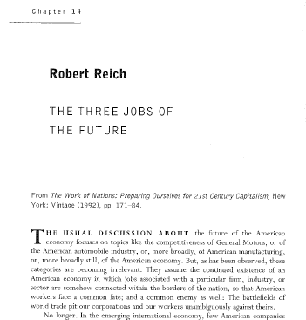
Essential reading:
REICH, Robert (1992), “The information age. The three Jobs of the Future”, in R. Reich, The Work of Nations, New Work City, Vintage Press, pp: 204-211.

Slide 11

Essential reading:
EIGE (2023), Artificial intelligence, platform work and gender equality, Publications Office of the European Union, Luxembourg. Chapters 1 and 2, pp. 18-61. (https://eige.europa.eu/publications-resources/publications/artificial-intelligence-platform-work-and-gender-equality-report?language_content_entity=en)

Slide 12
Gender inequalities in the labour market
Major trends and country differences
Portugal in the European context
Zooming in on Gender Wage Gap in Portugal

Slide 13
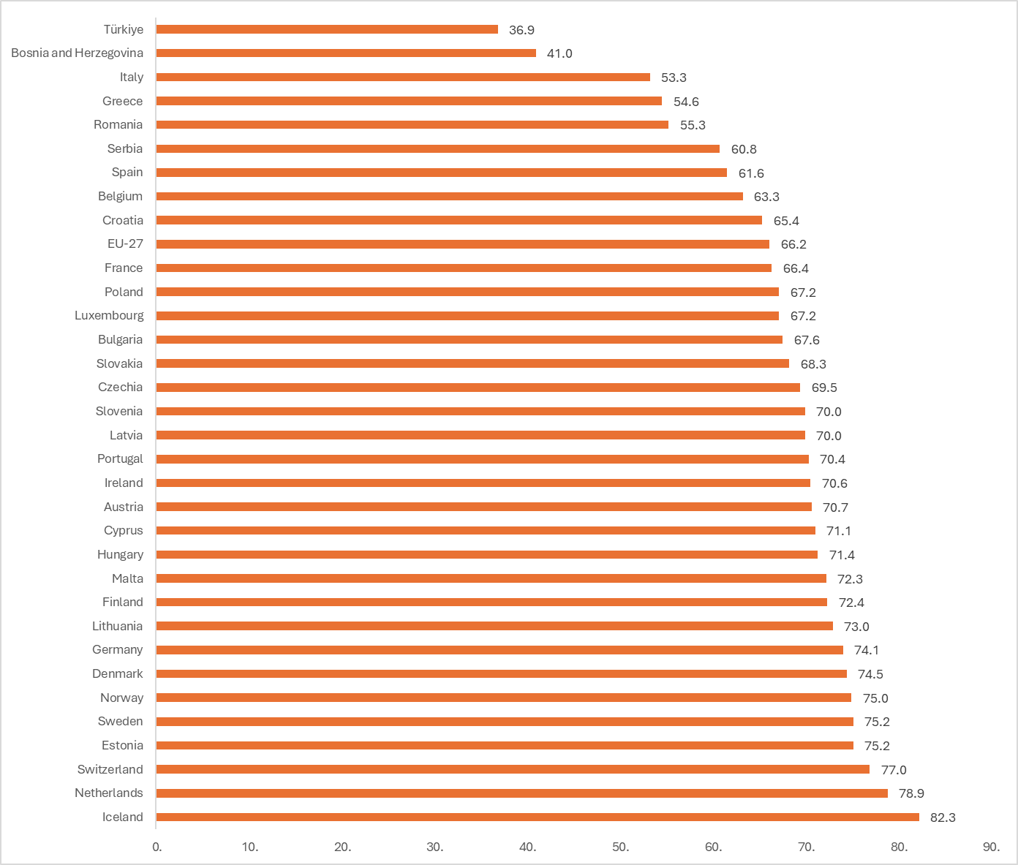
Female employment
Female employent rate 15-64 age group (2024), percentage
Source: Eurostat, Labour Force Survey, https://ec.europa.eu/eurostat/databrowser/view/lfsi_emp_a__custom_17958120/default/bar?lang=en

Slide 14
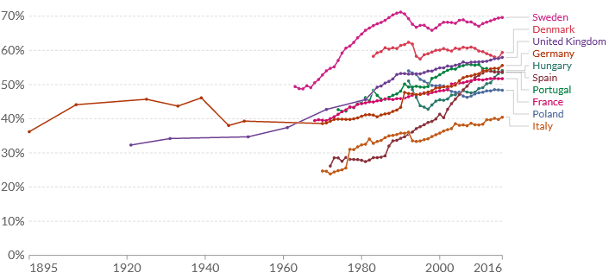
Female employment over time
Proportion of 15+ female population that is active in the labour market
Source: Ortiz-Ospina, Tzvetkova and Roser (2018) - "Women’s employment". OurWorldInData.org.

Slide 15
Evolution of female employment in Portugal
Employment rate of women and men for Portugal, 15-64 age group (2000-2020)
Men
Women
Source: Eurostat, Labour Force Survey

Slide 16
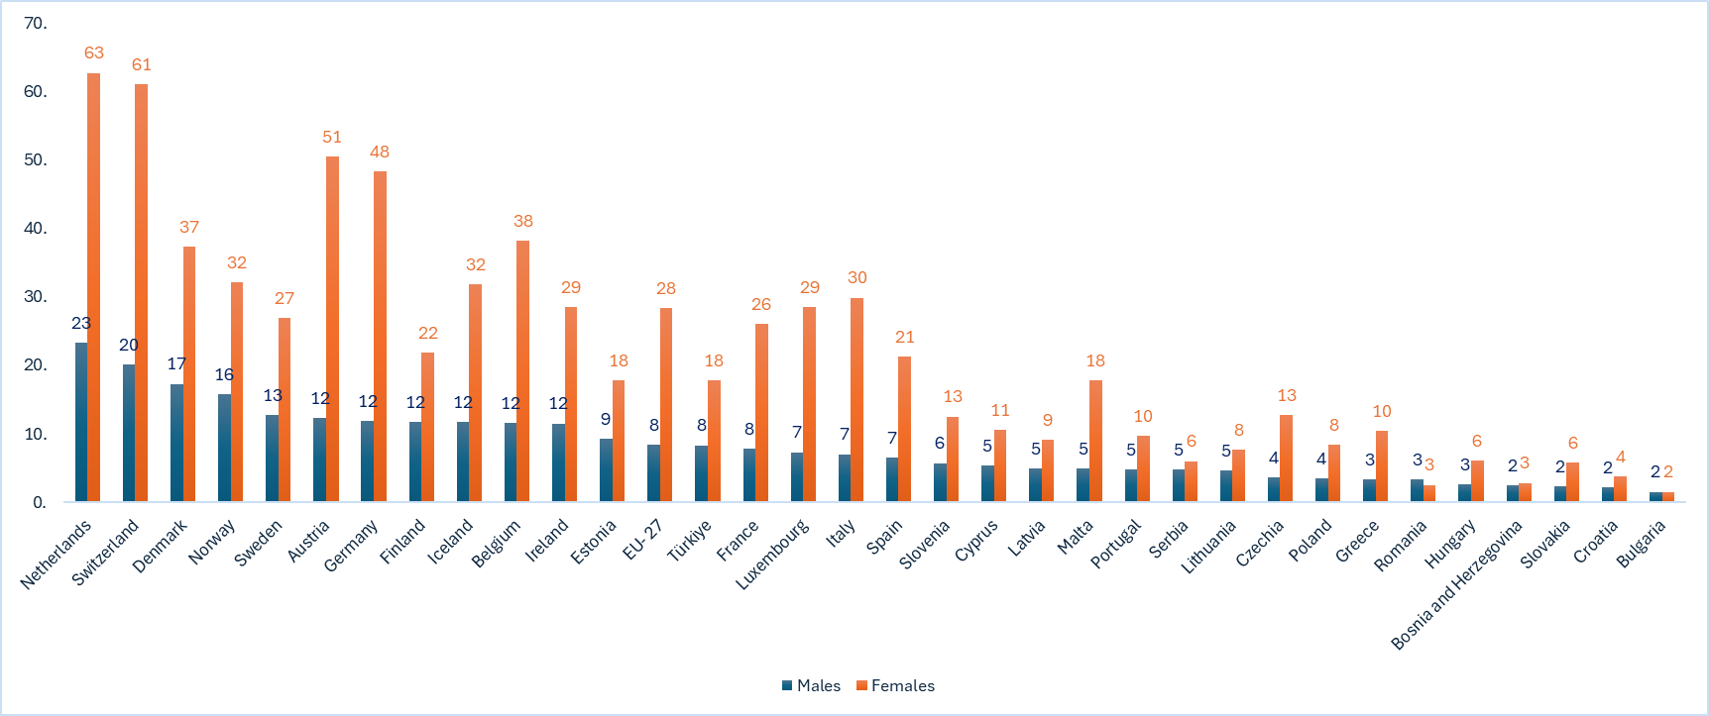
Female employment: nuances
Men and women employed part-time (percentage of employed women), 15-64 age group (2024)
Source: Eurostat, Labour Force Survey https://ec.europa.eu/eurostat/databrowser/view/lfsi_pt_a__custom_17959837/default/table

Slide 17
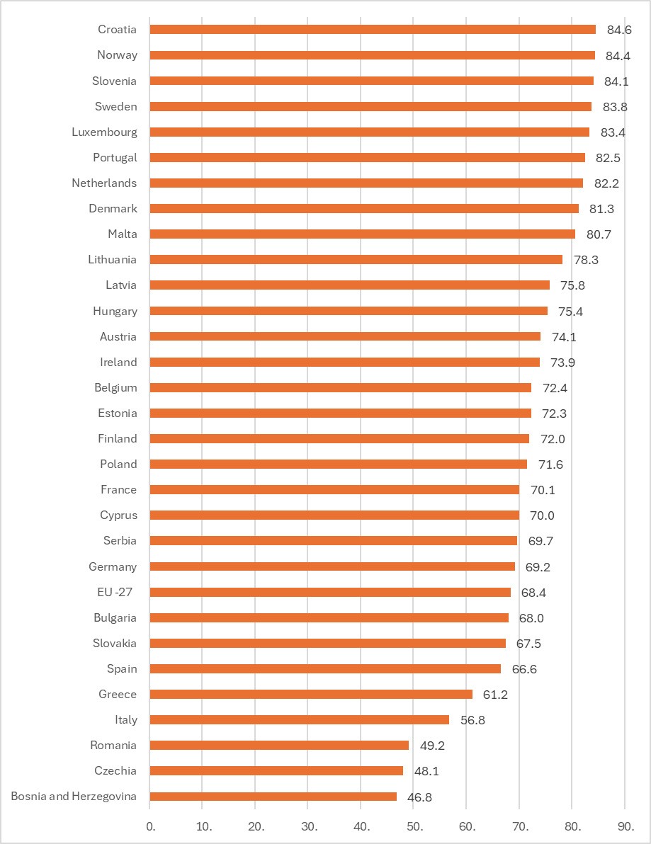
Female employment and maternity
Employment rate of women with small children (<6 years-old), 20-49 age group (2024)
Source: Eurostat, Labour Force Survey, https://ec.europa.eu/eurostat/databrowser/view/lfst_hheredch__custom_17959922/default/table

Slide 18
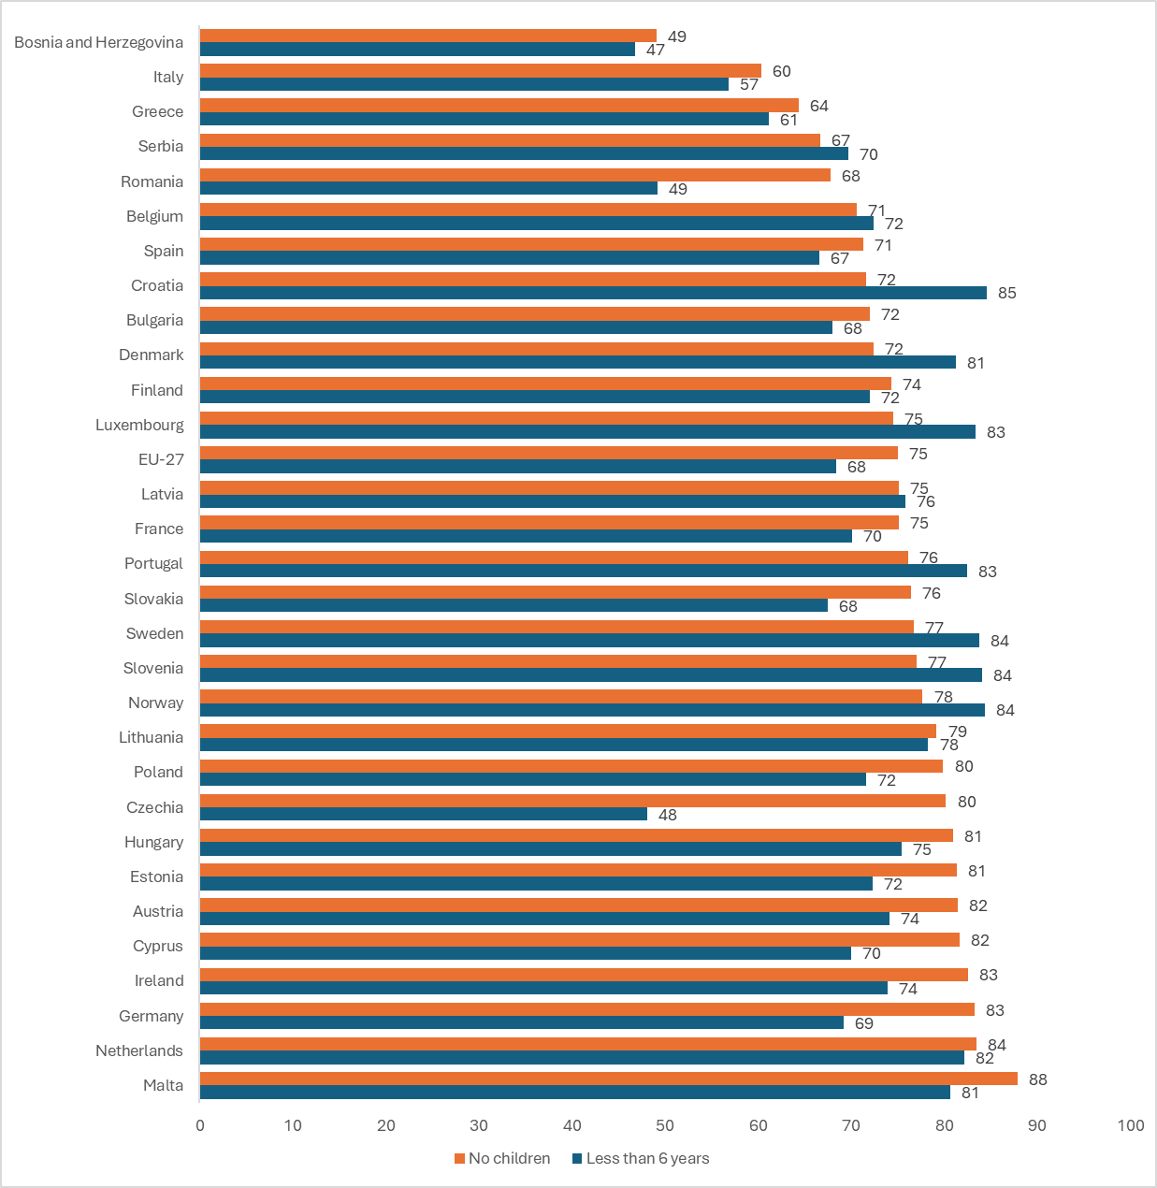
Female employment and maternity
Employment rate of women with and without small children (<6 years-old), 20-49 age group (2024)
Source: Eurostat, Labour Force Survey

Slide 19
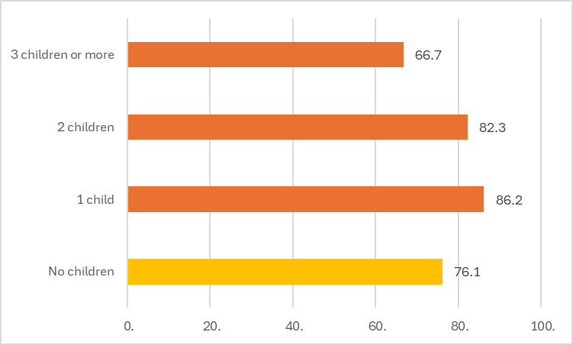
Female employment and fertility
Employment rate of women in relation to number of small children (<6 years-old) in Portugal, 20-49 age group (2020 and 2024)
3 or more children
2 children
1 child
No children
2020
2024
Source: Eurostat, Labour Force Survey, https://ec.europa.eu/eurostat/databrowser/view/lfst_hheredch__custom_17954636/default/table

Slide 20
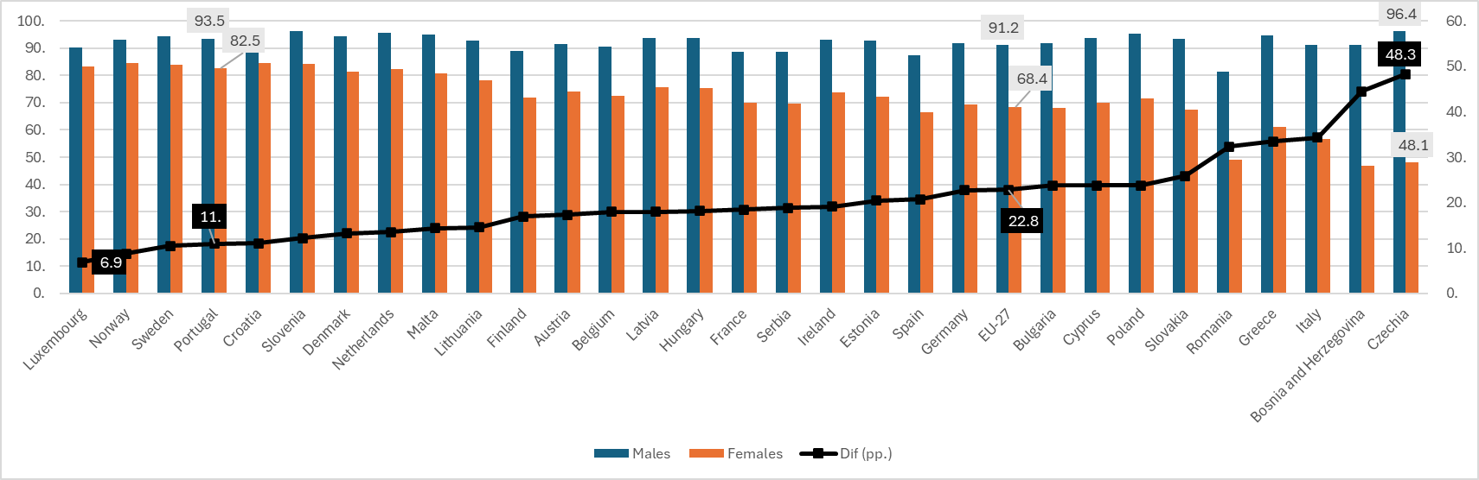
Female employment and fertility
Employment rate of women and men with small children (<6 years-old), 20-49 age group (2024)
Source: Eurostat, Labour Force Survey

Slide 21
To summarize
Wide country variation in employment rates despite historic convergence (activity)
Part-time employment more prevalent among women
Portugal: relatively high female employment rate, nearly all full-time
Portugal: unlike EU, maternity reinforces female employment
Portugal: one of the lowest sex differential in employment rate of parents with small children
Something’s gotta give: unavailable childcare, ‘second shift’ → low fertility rate

Slide 22
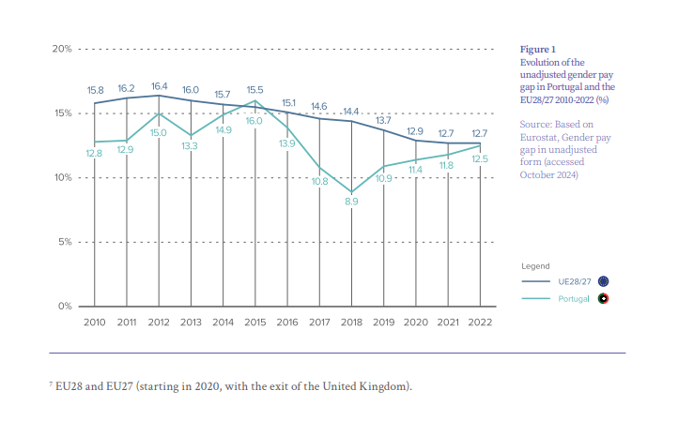

What about wages?
Unadjusted Gender Pay Gap for Portugal and EU (2010-2022)
Source:
https://www.iseg.ulisboa.pt/genero-trabalho-poder/wp-content/uploads/sites/26/2025/01/BarometerGPG.pdf

Slide 23
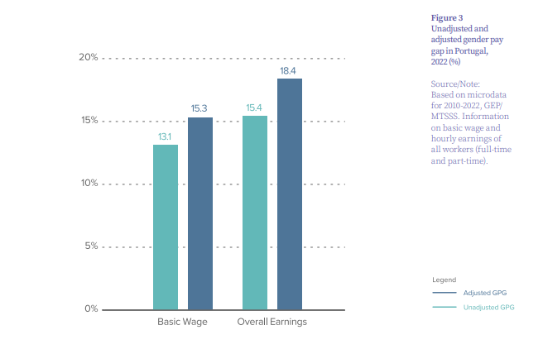
What about wages?
Adjusted and unadjusted Gender Pay Gap for Portugal (2022)
Source:
https://www.iseg.ulisboa.pt/genero-trabalho-poder/wp-content/uploads/sites/26/2025/01/BarometerGPG.pdf

Slide 24

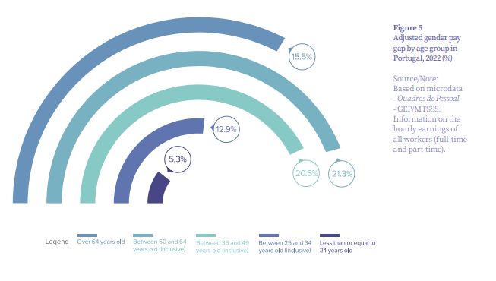
What about wages?
Adjusted Gender Pay Gap for Portugal, by age and education (2022)
Source:
https://www.iseg.ulisboa.pt/genero-trabalho-poder/wp-content/uploads/sites/26/2025/01/BarometerGPG.pdf

Slide 25
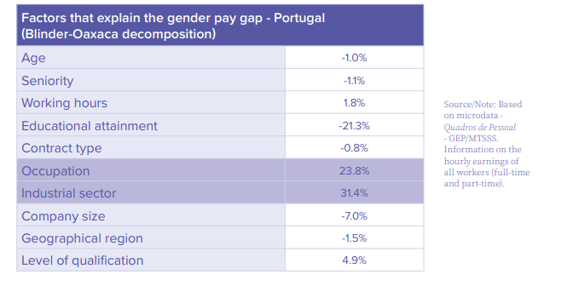
To summarize (also in the EU)
Determinants of the gender pay gap for Portugal (2022)
Horizontal gender segregation: women concentrated in sectors and professions with lower remunerations (e.g. personal services)
Vertical sexual segregation: women under-represented in top positions, limited tenure
Precarious jobs
Gender wage/pay gap
Source:
https://www.iseg.ulisboa.pt/genero-trabalho-poder/wp-content/uploads/sites/26/2025/01/BarometerGPG.pdf

Slide 26
The labour market for migrants
Major trends and country differences
Portugal in the European context
Zooming in on migrant workers in Portugal

Slide 27
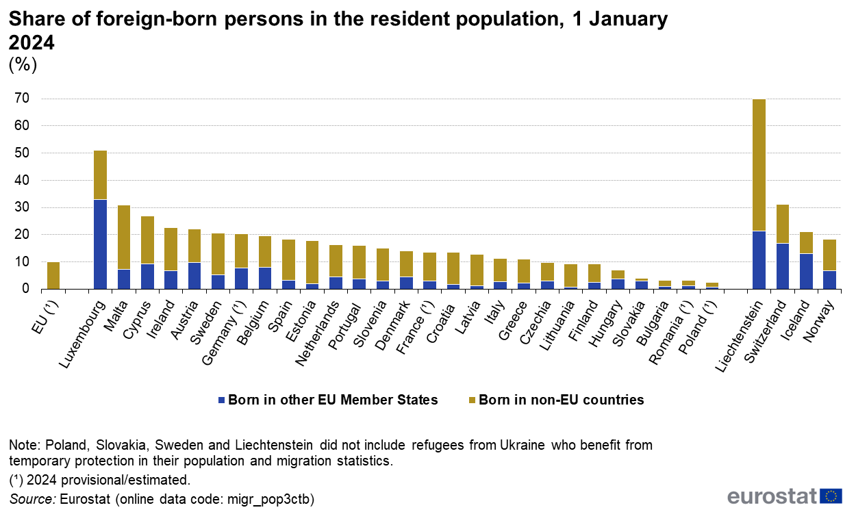
Migrants in the general population: host countries

Slide 28
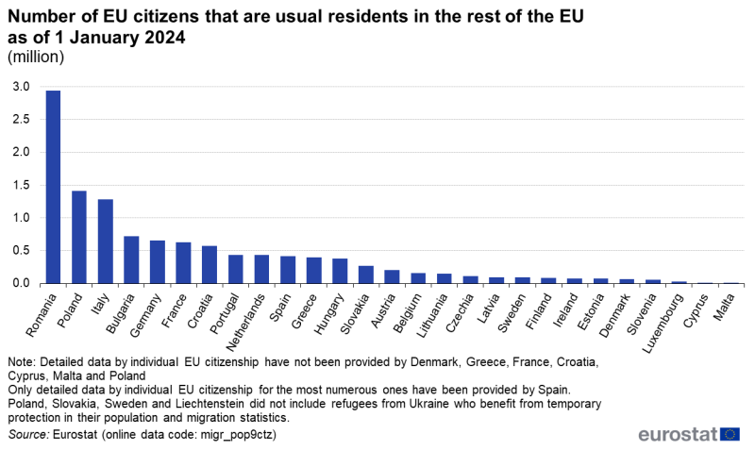
Migrants in the general population: sending countries

Slide 29
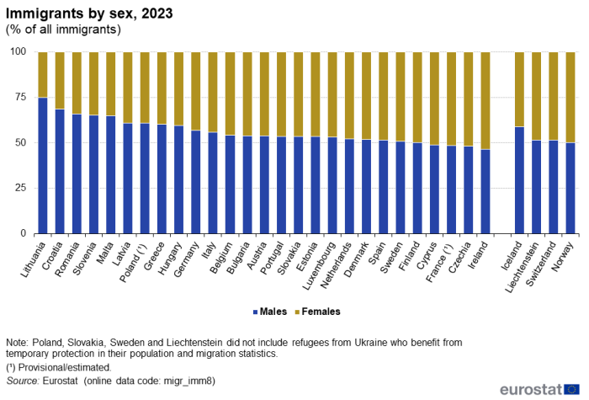
Migrants in the general population: host countries

Slide 30
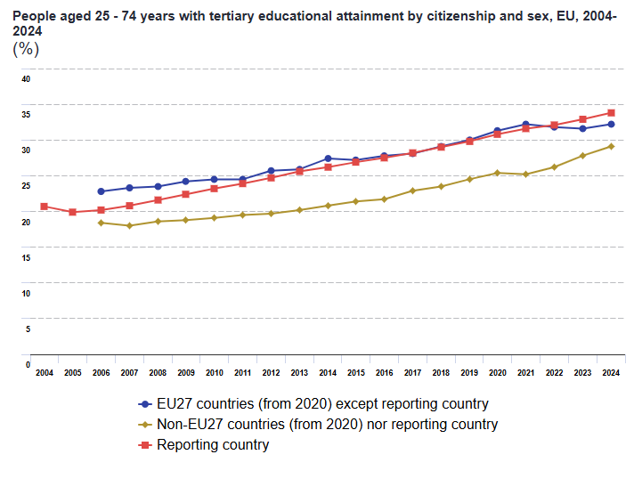
Migrants in the general population: education

Slide 31
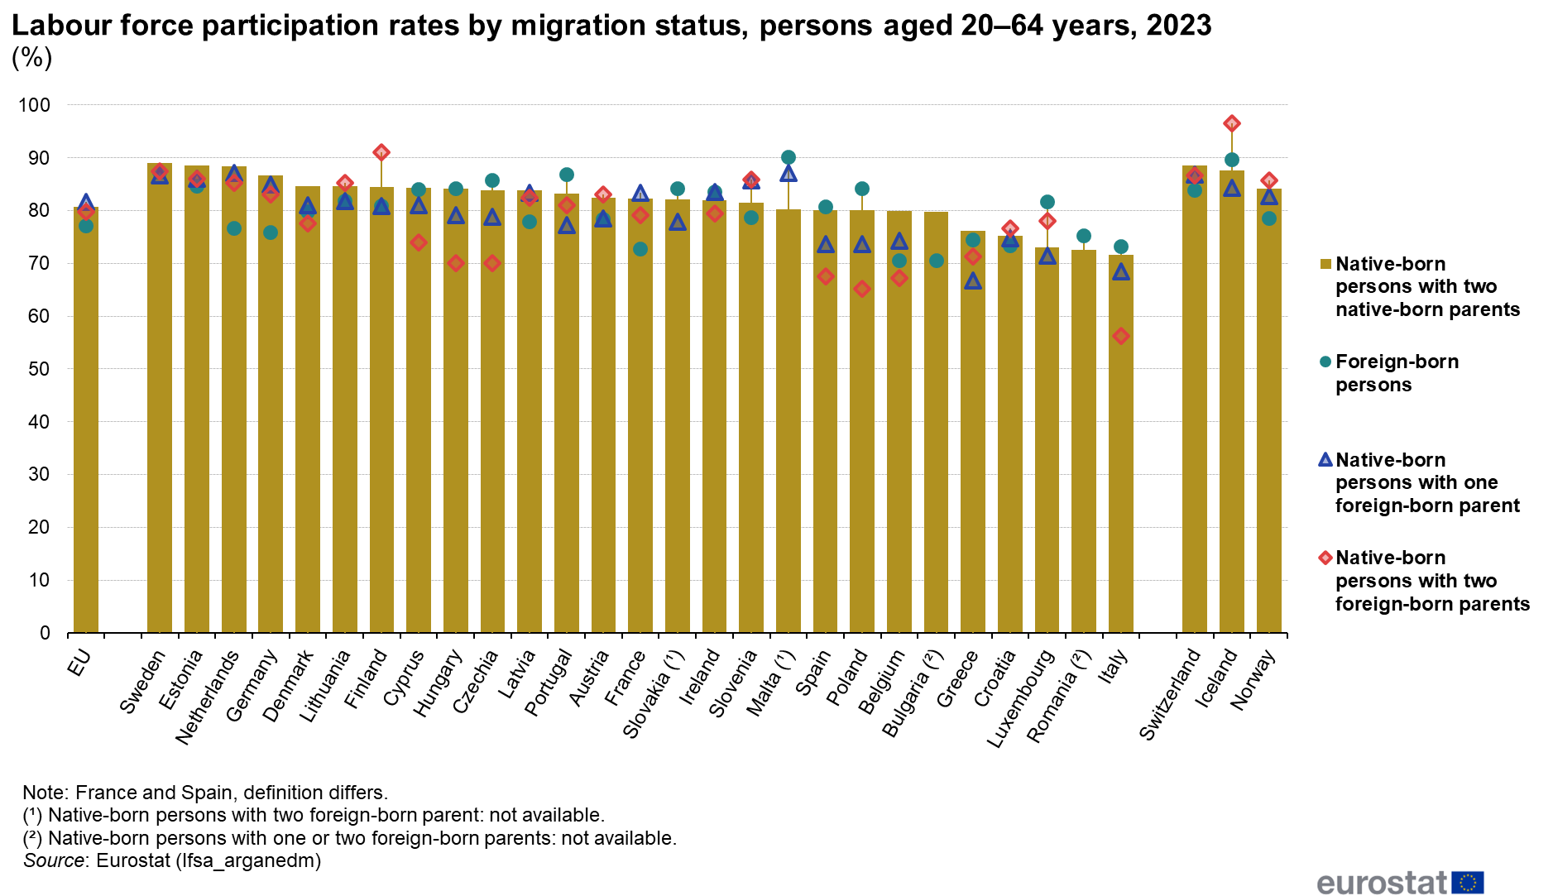
Migrants in the labour market: natives, foreigners and 2nd generation

Slide 32
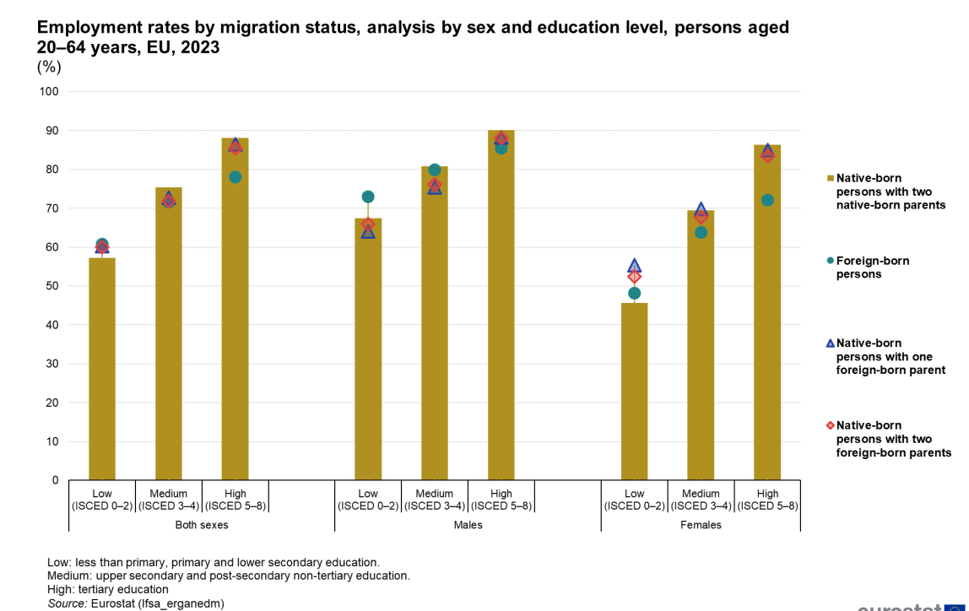
Migrants in the labour market: natives, foreigners and 2nd generation, by education

Slide 33
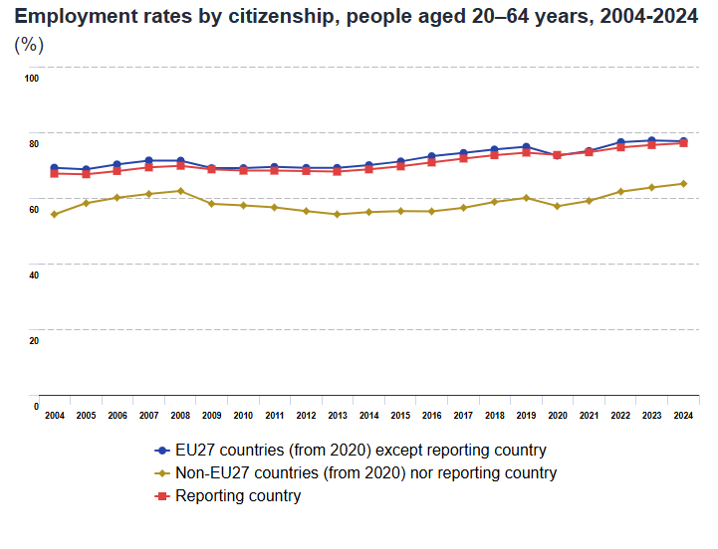
Migrants in the labour market: citizenship and employment

Slide 34
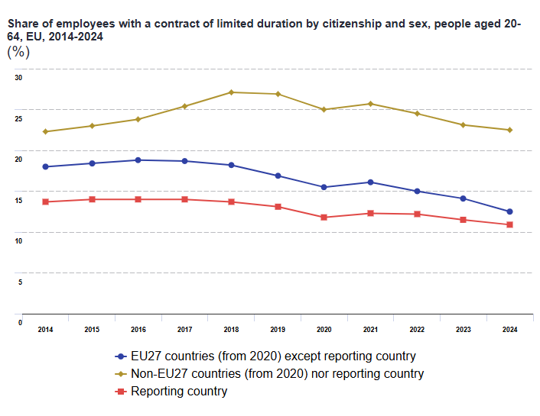
Migrants in the labour market: citizenship and precarious jobs

Slide 35
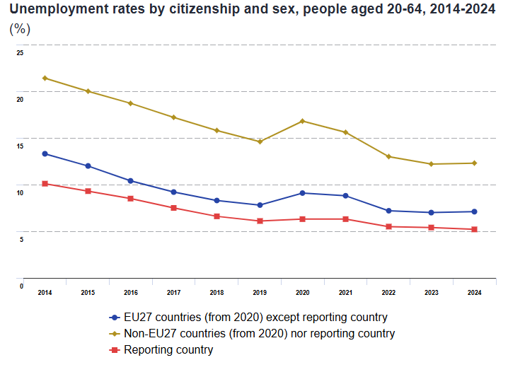
Migrants in the labour market: citizenship and unemployment

Slide 36
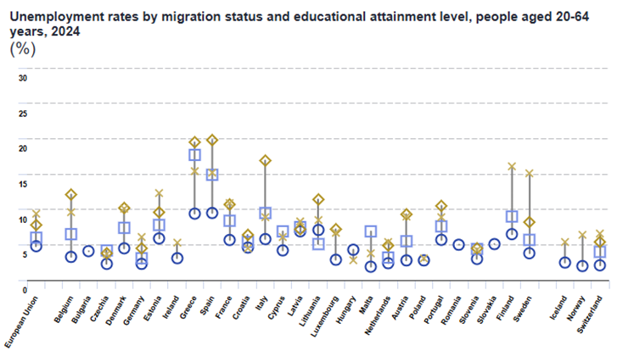
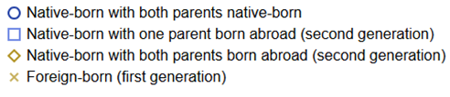
Migrants in the labour market: citizenship and unemployment

Slide 37
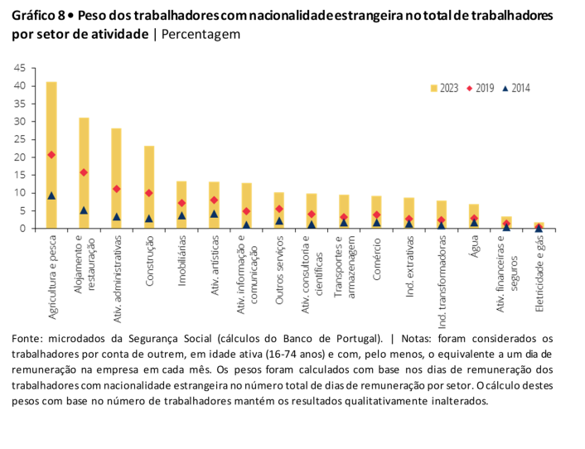
To summarize
Foreign workers as a share of total workers by sector, Portugal
High activity rates
Dual labour markets: Migrants more likely to experience...
Precarious employment
Higher unemployment
Temporary work and atypical forms of work
Part-time work
Heterogeneity: education, but especially citizenship
Agriculture and fisheries
Tourism and restaurants
Administrative activities
Construction
Real Estate
Artistic activities
Information and comunication
Other services
Consultancy and scientific
Transports
Retail
Mining and similar
Manufacturing
Water
Financial sector
Electricity and gas
Source: Social Security administrative data and Bank of Portugal. Employers (16-74) who reported social contributions at least one day per month.

Slide 38


www.iseg.ulisboa.pt

