Slide 1
Intermediate Microeconomics: An Intuitive Approach with Calculus, 1e
Chapter 26 –
Product Differentiation and
Innovation in Markets

Slide 2
Moving toward the “Real World”
Much of our emphasis so far has been on particular market structures, most of which are relatively extreme.
the “real world”
Perfect Competition:
perfectly substitutable outputs produced by many (often identical) firms
with no barriers to entry
2-Firm Oligopoly:
perfectly substitutable output (with no close substitutes) produced by two firms protected by high barriers to entry
Monopoly:
output with
no close substitutes produced by one firm protected by high barriers to entry
Bertrand Price Competition
with product innovation and
Monopolistic Competition
falling entry barriers
Oligopoly Cournot Competition with increasing numbers of firms
One way to “fill in the gaps” is through the Cournot Model as we assume large numbers of firms in the oligopoly.
But another, often more realistic, way is to extend the Bertrand Model to incorporate product differentiation, innovation and entry with falling fixed entry costs.
Such a market structure is called Monopolistic Competition.

Slide 3
Differentiated Products in Bertrand Oligopolies
Recall the extreme prediction of the Bertrand price competition model: With just 2 firms in the oligopoly, p = MC.
We can begin to see the role product differentiation can play by dropping our assumption that both firms produce the same product.
Consider, for instance, the 2-firm oligopoly of Coke and Pepsi:
While many consumers view the two products as perfect substitutes, other consumers have a clear preference of one over the other all else being equal.
Suppose, then, that Pepsi charges p = MC.
It is now no longer the case that p = MC is a best response for Coke.
This is because some people will still buy Coke rather than Pepsi even if the price of Coke is a little higher than the price of Pepsi.
Product differentiation can then soften the extreme price competition that we predict in a Bertrand model with identical (perfectly substitutable) products.
This can also be seen by plotting the best response functions for the two firms, with price as each firm’s strategic variable.

Slide 4
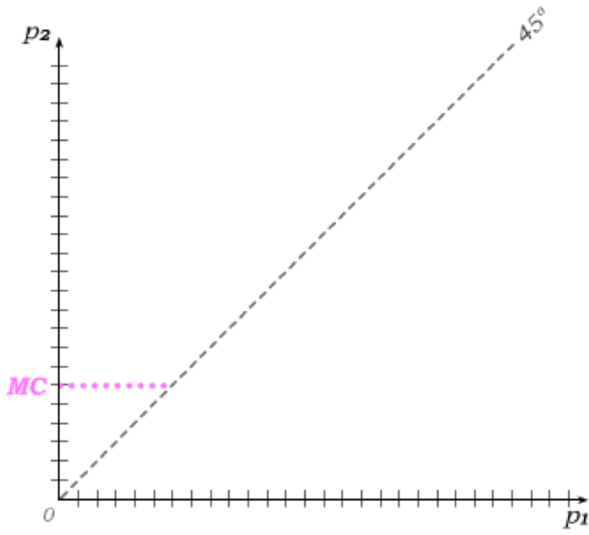
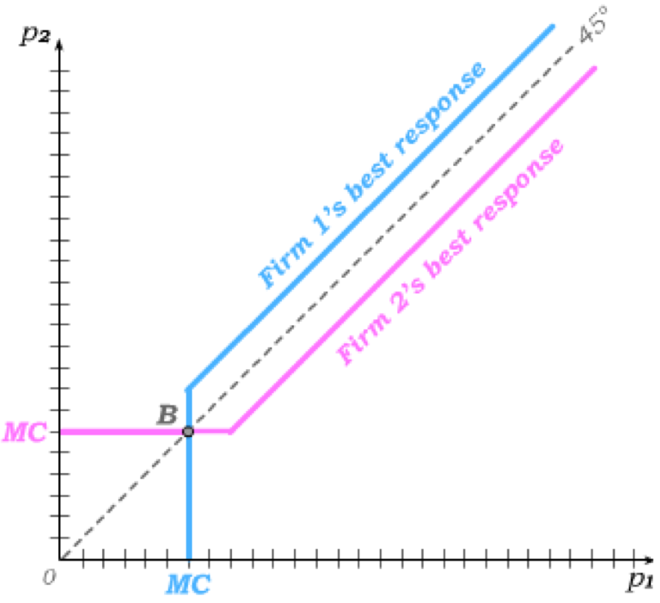
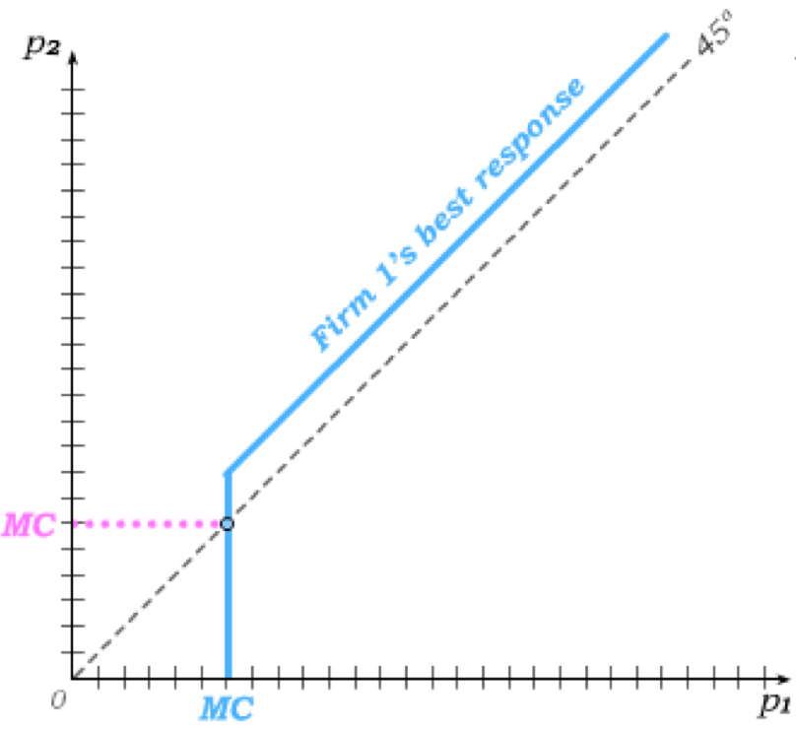
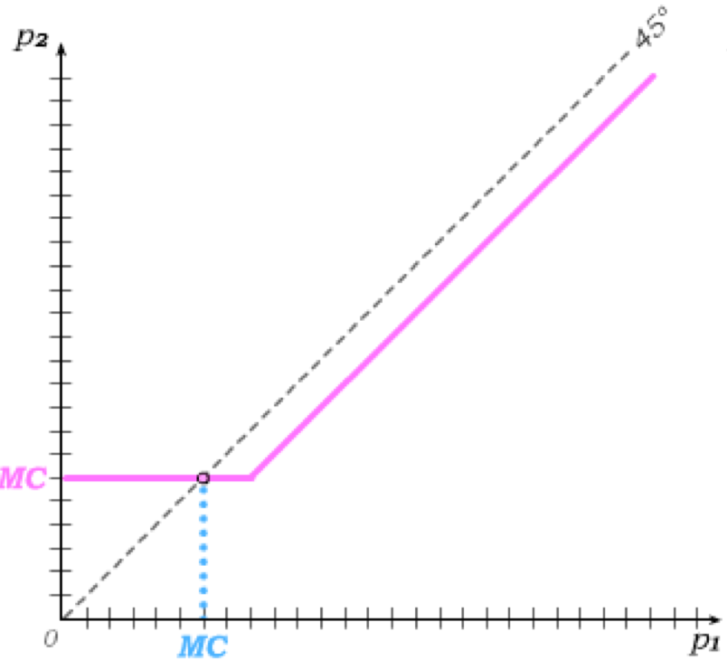
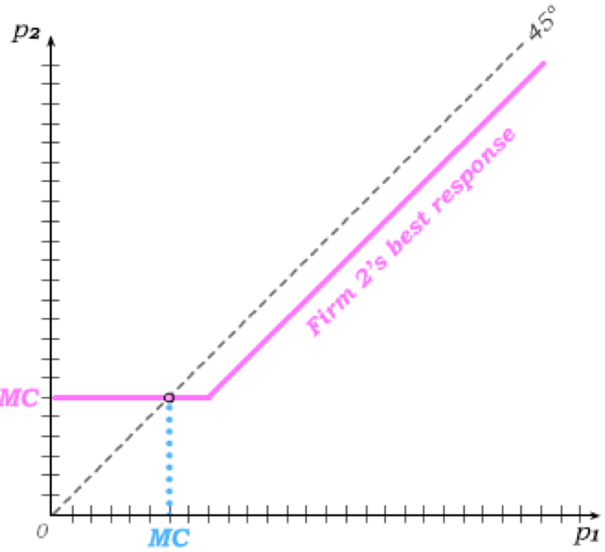
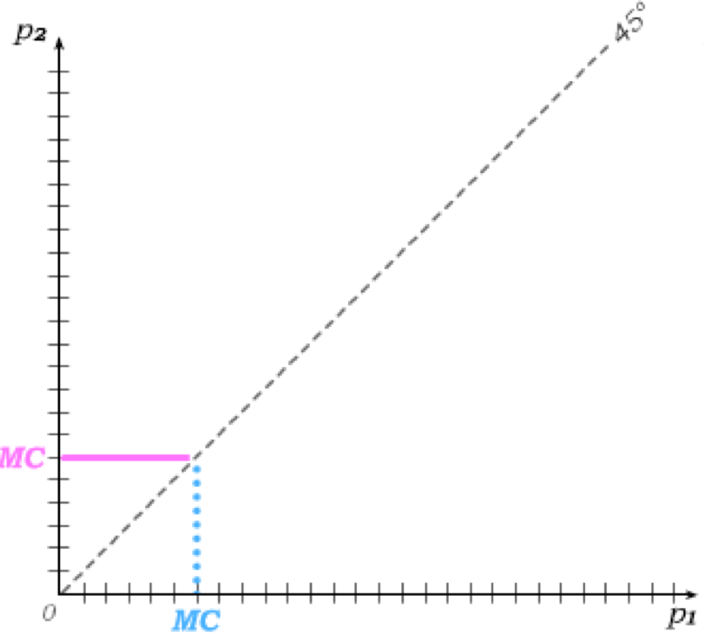
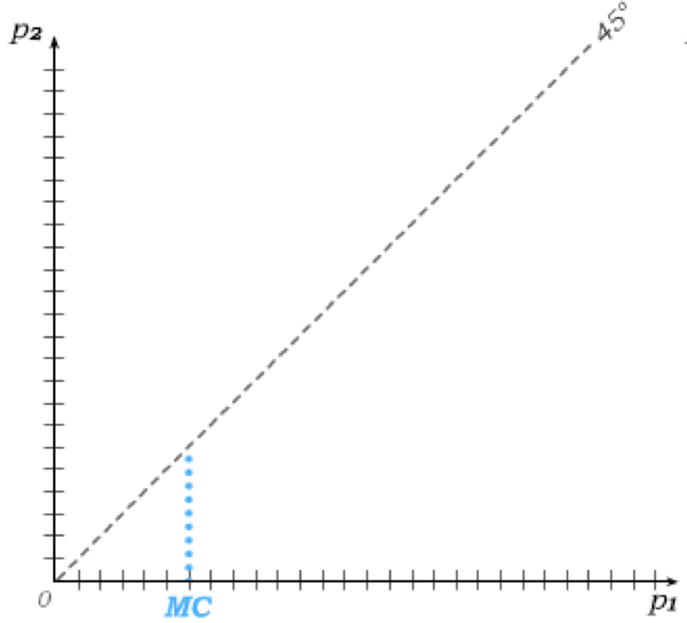
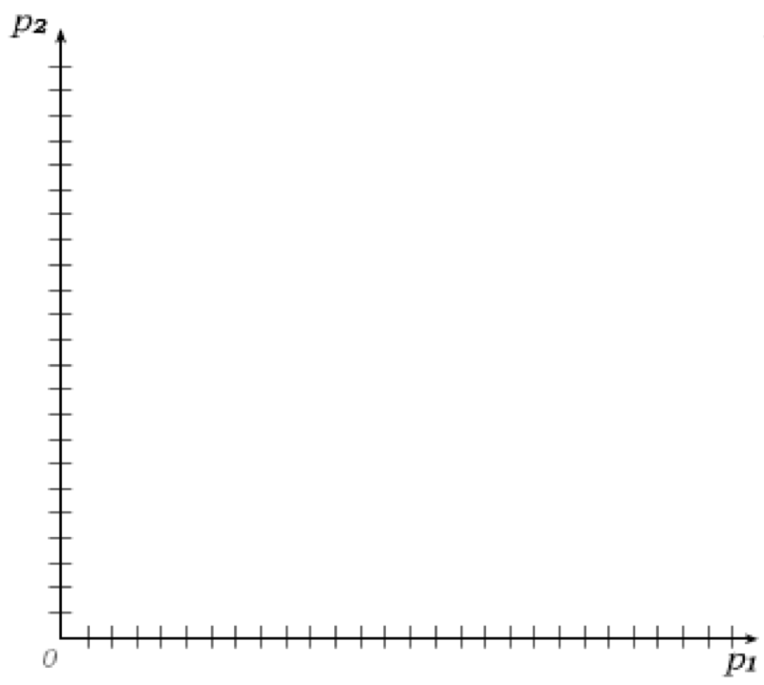
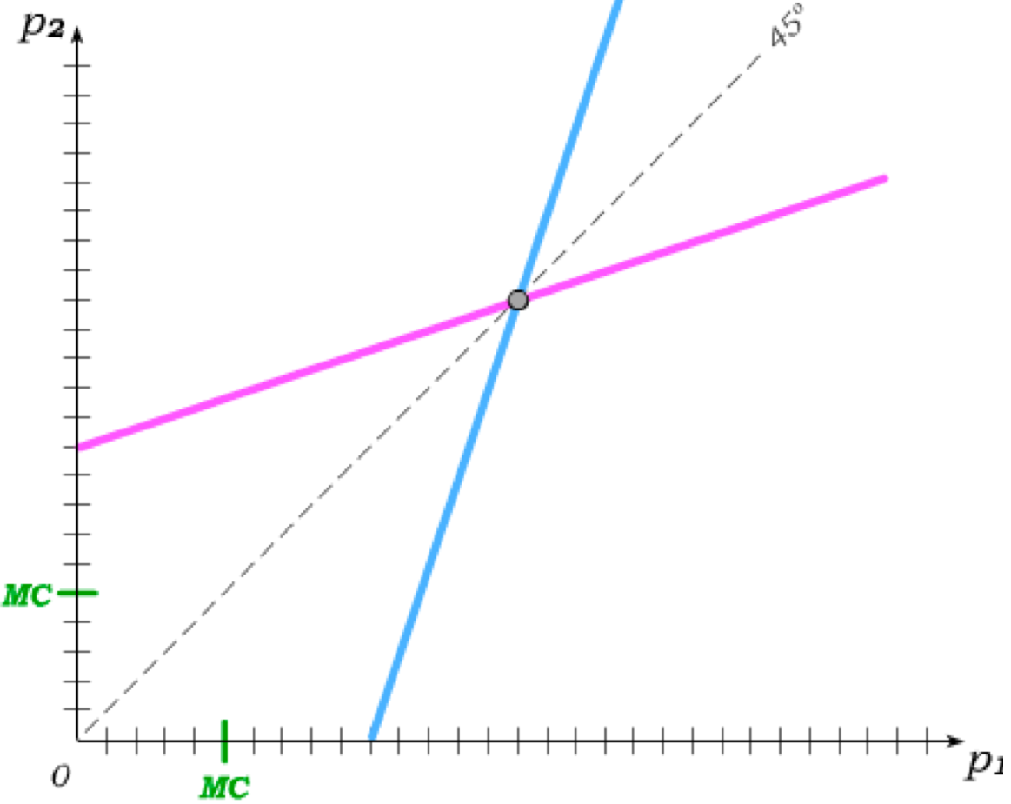
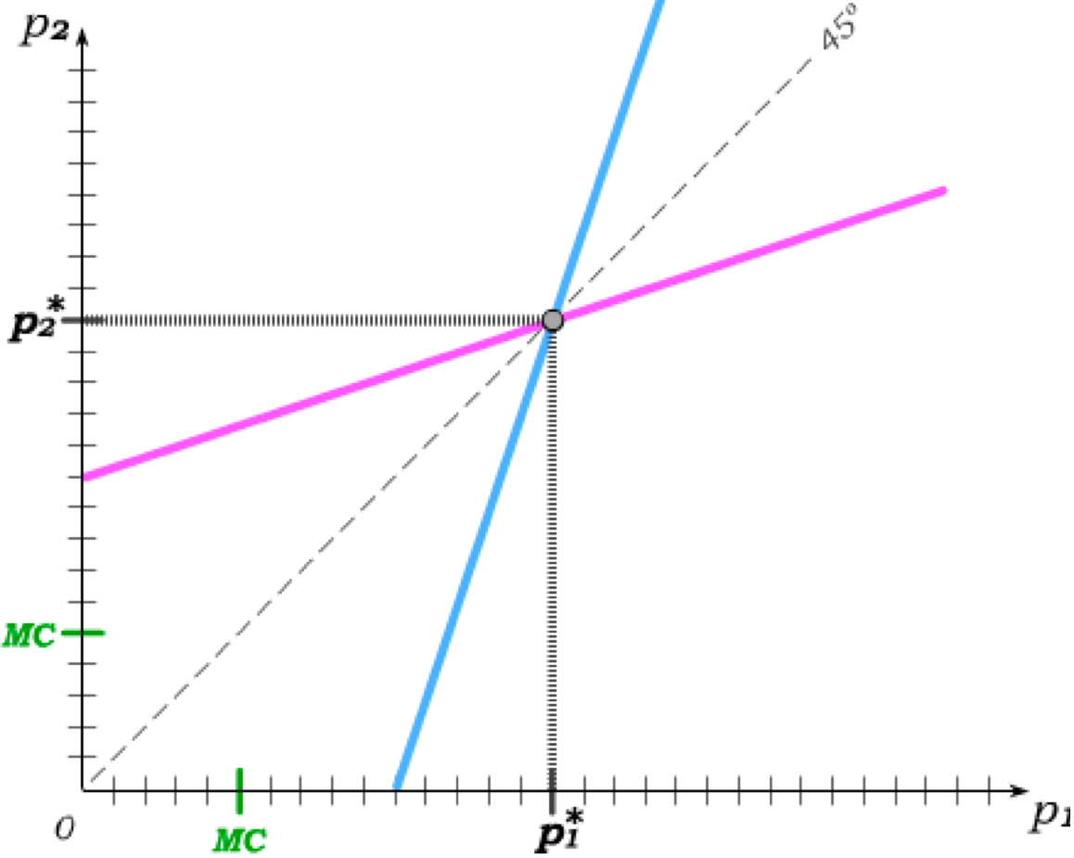
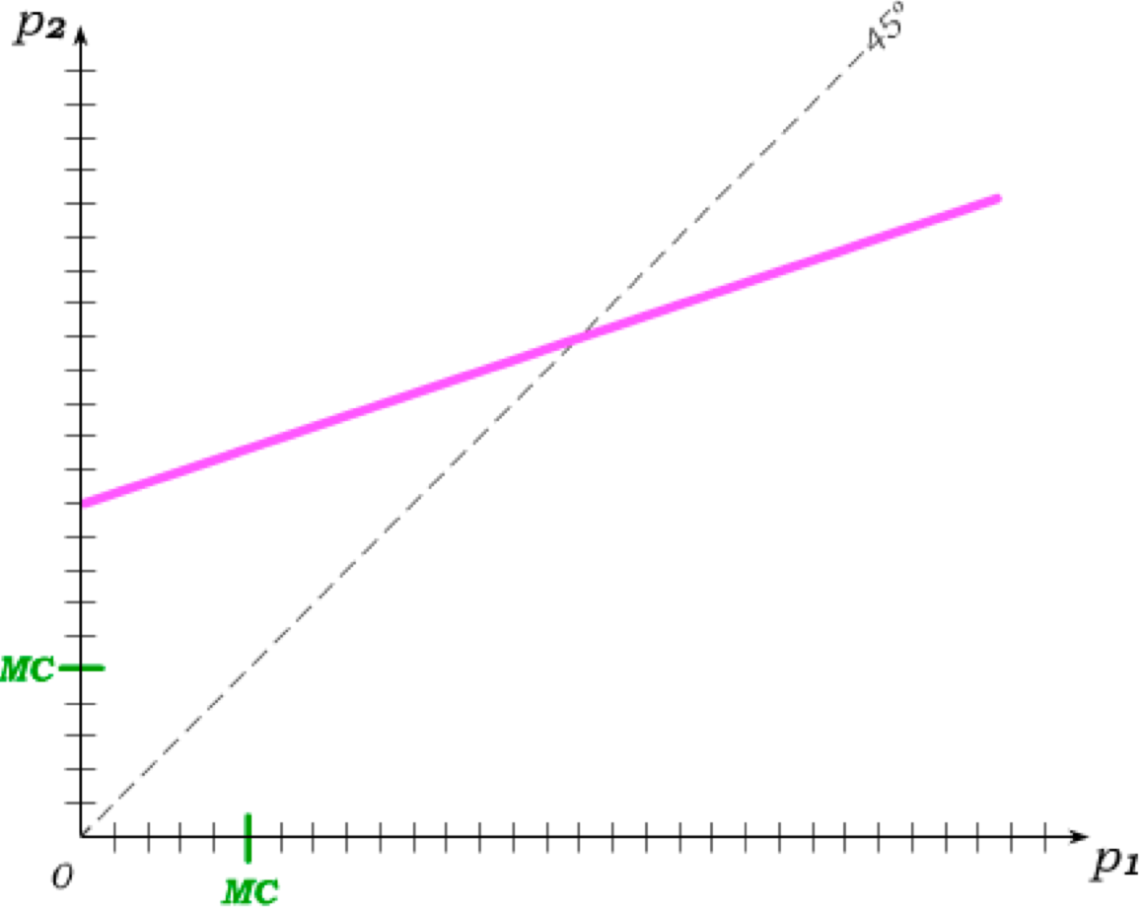
Bertrand Price Competition
In the Bertrand Model, we assume firms strategically set price and then produce what is demanded.
In the absence of product differentiation, firm 2 best-responds to firm 1 by
setting p₂ just below p₁ unless p₁ ≤ MC when it best-responds by setting p₂ = MC.
The same is true for if firm 1’s best response to firm 2’s price.
And this implies a Nash
equilibrium where both firms set p = MC.
But with sufficient product differentiation, firm 2 can sell at least some of its output at p₂ > MC.
It’s best response to firm 1 then begins above MC and is upward-sloping throughout.
The same holds for firm 1 …
… giving us a Nash equilibrium with both firms producing at p* > MC.
Bertrand price competition is softened by product differentiation.

Slide 5
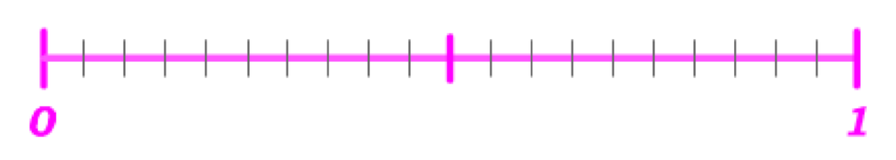
The Hotelling Model
Two firms produce somewhat different products where the possible product characteristics fall on an interval:
Firm 1 Market Share
Firm 1 Market Share
Each consumer has an ideal point on this interval and, all else equal, becomes less satisfied the further the product characteristic of the good lies away from this ideal point.
The ideal points of consumers are distributed uniformly across the [0,1] interval.
Hotelling model: Price is fixed, and the only strategic variable is the product characteristic. Bertrand model: Product characteristic is fixed, and the only strategic variable is the price.
firm 1 best-responds by choosing a
If firm 2 chooses a product characteristic below 0.5,
characteristic just above (and thus capturing more than half the market.)
firm 1 best-responds by choosing a
If firm 2 chooses a product characteristic above 0.5,
characteristic just below (and thus again capturing more than half the market.)
giving us a
But when both firms choose 0.5, they are best-responding to one another,
Nash equilibrium without product differentiation.

Slide 6
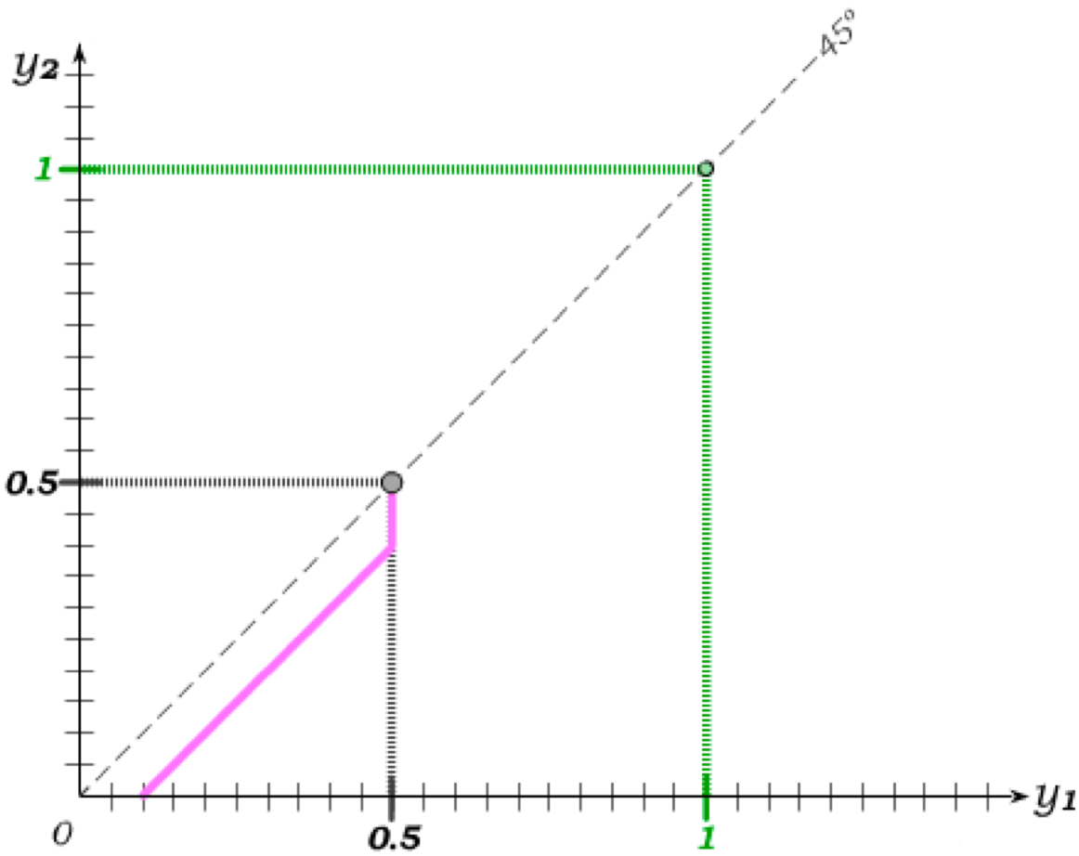
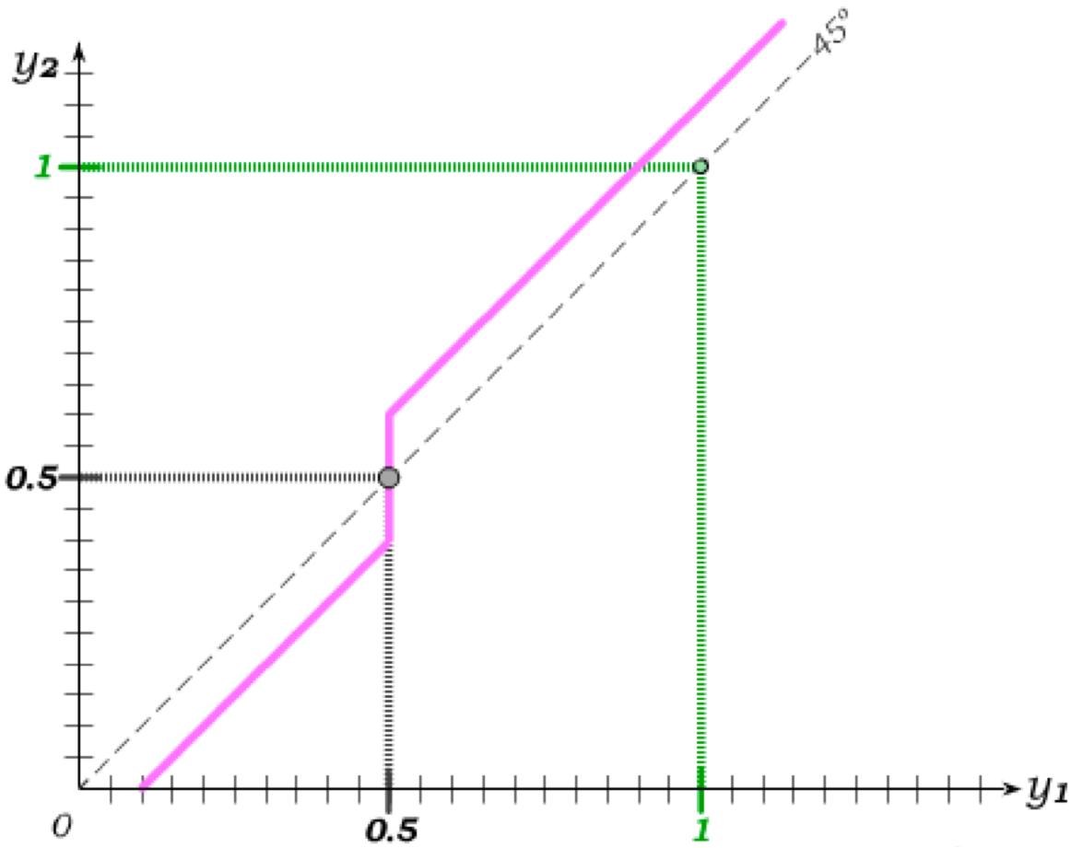
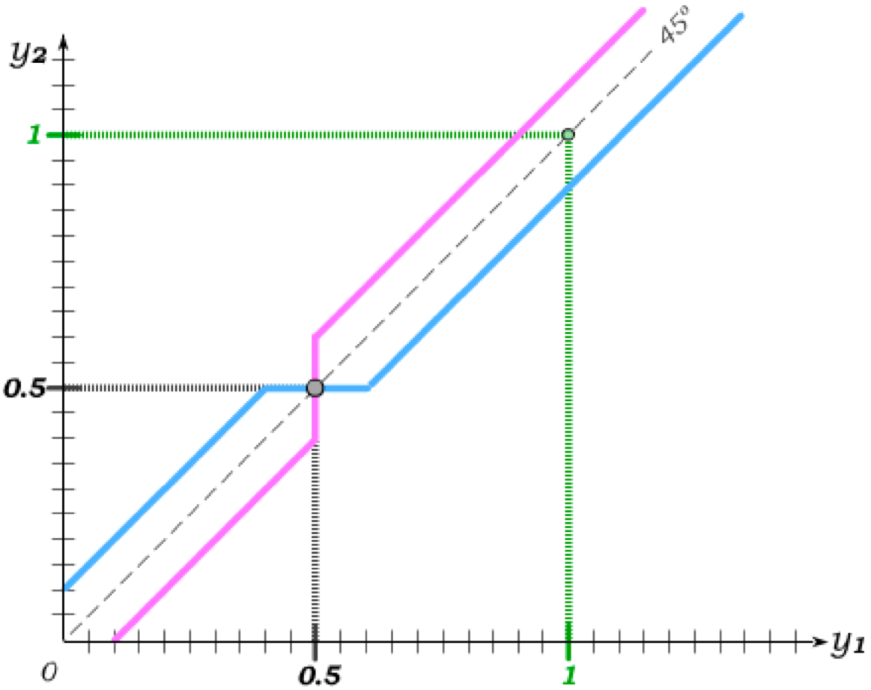
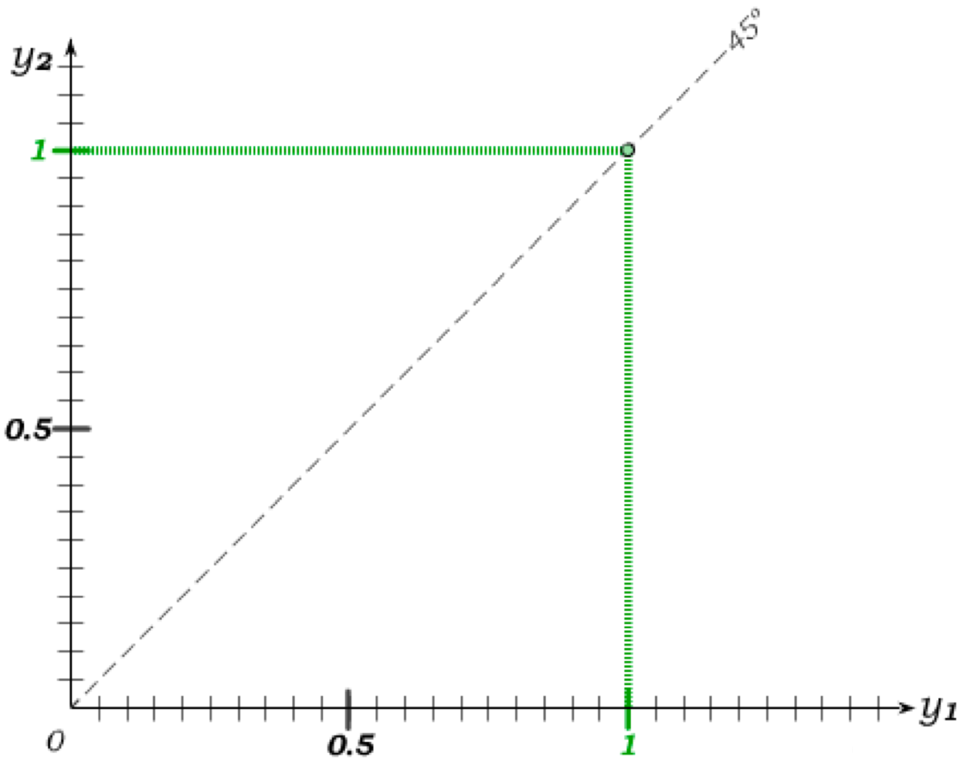
No Product Differentiation w/o Price Competition
We can also see this result by plotting the two firms’ best response functions when the strategic variable is the choice of product characteristics y (and price is fixed).
If firm 2 sets y below 0.5, firm 1 best-responds by setting its y just above firm 2’s.
And if
firm 2 sets y above 0.5, firm 1 best-responds by setting its y just below firm 2’s.
The analogous holds for firm 2’s best response to firm 1.
In the absence of price competition, the firms do not engage in product differentiation.
The incentive to differentiate products therefore arises from price competition – with product differentiation softening such competition.

Slide 7
Price Competition and Product Differentiation
We have now seen that:
– When products are already differentiated and price is the strategic variable, the existing product differentiation allows firms to set p > MC (Bertrand model w/ prod. diff.)
– When prices are fixed and product characteristic is the strategic variable, firms will not choose to differentiate their products (Hotelling model).
An expanded Hotelling model would assume a more sequential structure – with firms strategically choosing product characteristics in stage 1 and then choosing price in stage 2.
From our two results holding one strategic variable fixed, it is reasonable to conclude that such a model would result in
Product differentiation in stage 1
in anticipation of
Softened price competition in stage 2 such that firms set p > MC.
Bertrand price competition for 2 firms becomes more realistic as
product differentiation becomes part of the strategic environment.

Slide 8

Adding Entry into a Differentiated Market
The Hotelling Model with 2 firms provides intuition for how product differentiation and price competition interact.
But it is not as useful a model for thinking about how the number of firms in an industry that produces differentiated products emerges in the face of fixed entry costs.
To investigate this, we instead model product characteristics as points located around a circle. This is the Salop model.
As in the Hotelling model, we continue to assume that consumers who purchase a single good have tastes with ideal points that also lie on this circle.
A firm can then locate its product anywhere on the circle, establishing some market power by differentiating its product from others.
All else equal, consumers are better off the closer the product they consume lies to their ideal point.
Finally, as in the Hotelling model, we assume that consumer ideal points are uniformly distributed along the circle.

Slide 9
A 2-Stage Sequential Game
We then think of equilibrium in this market as emerging in a 2-stage sequential game:
Stage 1: Firms decide whether to enter the industry and, if they do enter, where to locate their product on the circle.
Stage 2: The firms that enter in stage 1 determine the price they will charge for their product.
To characterize the subgame-perfect equilibrium, we begin at “the bottom of the game tree” at stage 2 – taking as fixed the number of firms N that entered in stage 1.
Given what we know from the Hotelling model about the incentive to differentiate products in the face of price competition, it is reasonable to conclude that the N firms must have located at equal distances from one another.
In the price setting game of Stage 2, each firm then faces two competitors – on on each side of her location on the circle.
Assuming the same marginal costs for all firms, the Nash equilibrium price that then emerges from symmetric best-response functions depends only on N.

Slide 10
The Subgame Perfect Equilibrium
For any given number of firms N that entered in Stage 1, the firms then know the equilibrium price p*(N) that will emerge in Stage 2.
That equilibrium price will reflect the level of market power derived by each firm from its differentiated product – with market power diminishing as N increases.
Thus, p*(N) > MC for any finite N – with p*(N) converging to MC as N gets large.
We can now consider what happens in the entry game of Stage 1 in light of what firms know will happen in the price-setting game of Stage 2.
While the fixed entry cost FC is a sunk cost in Stage 2, it is an economic cost of entry.
Firms will thus enter in Stage 1 so long as the expected profit in Stage 2 is not negative …
… which implies that, in equilibrium, the number of firms N that enter in Stage 1 will be such that profits in Stage 2 are non-negative and profits in Stage 2 would become negative if the number of firms increased to (N+1).

Slide 11
Monopolistic Competition
We can then come to the following general conclusions about the equilibrium in this model of monopolistic competition:
Firms inside the market make positive profit equal to at least the fixed entry cost.
Firms outside the market would make negative or zero profit by entering the market (because of the fixed entry costs).
The lower the fixed entry cost, the more firms will be operating in the market, with each firm’s market power falling as fixed costs fall.
As fixed entry costs fall to zero, the number of firms gets large and the market becomes perfectly competitive.
As fixed entry costs get large, the number of firms gets small, eventually resulting in a single monopoly in the industry.
As fixed entry costs fall, the model fills in completely the gap between monopoly and perfect competition.

Slide 12
Monopolistic Comp. w/o Game Theory
The simultaneous existence of positive economic profits for incumbents and zero to negative profits for potential entrants is quite plausible in the presence of fixed entry costs.
This idea is one that predates game theory. In the absence of game theory, we think about this issue a bit differently and in ways that link to our previous discussion of monopoly.
Realize that TC=FC+VC, so that ATC=AFC+AVC. Since fixed costs FC are sunk for incumbents, they are making profits as long as p>AVC. In turn, for potential entrants the fixed costs are not sunk, and they may make losses even if p>AVC, namely when p<ATC.
Hence, in a monopolistic competitive equilibrium with fixed costs, incumbents can make positive economic profits and potential entrants would make loses upon entry.
The next model of monopolistic competition allows us to make this point without game theory. This model will also allow us to have a story for (dynamic) innovation.

Slide 13
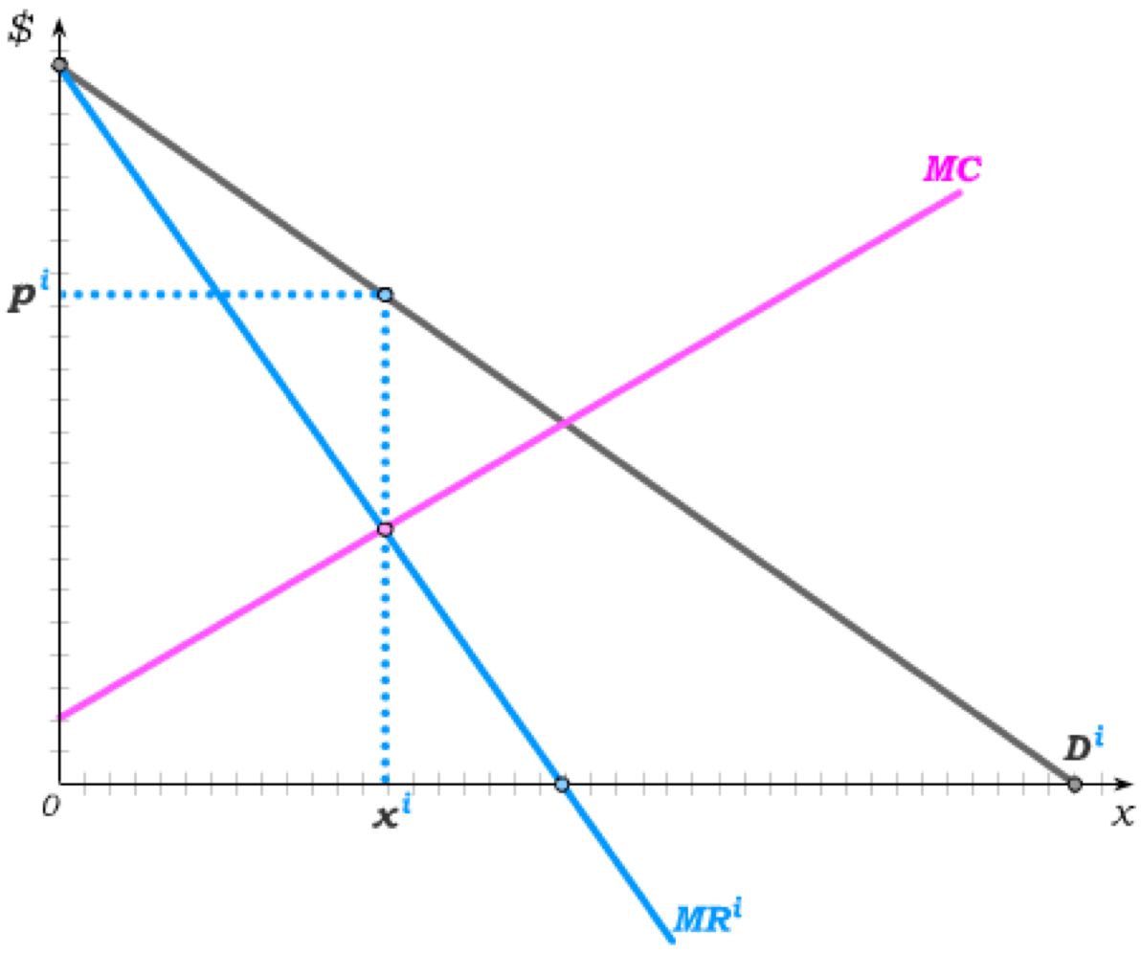
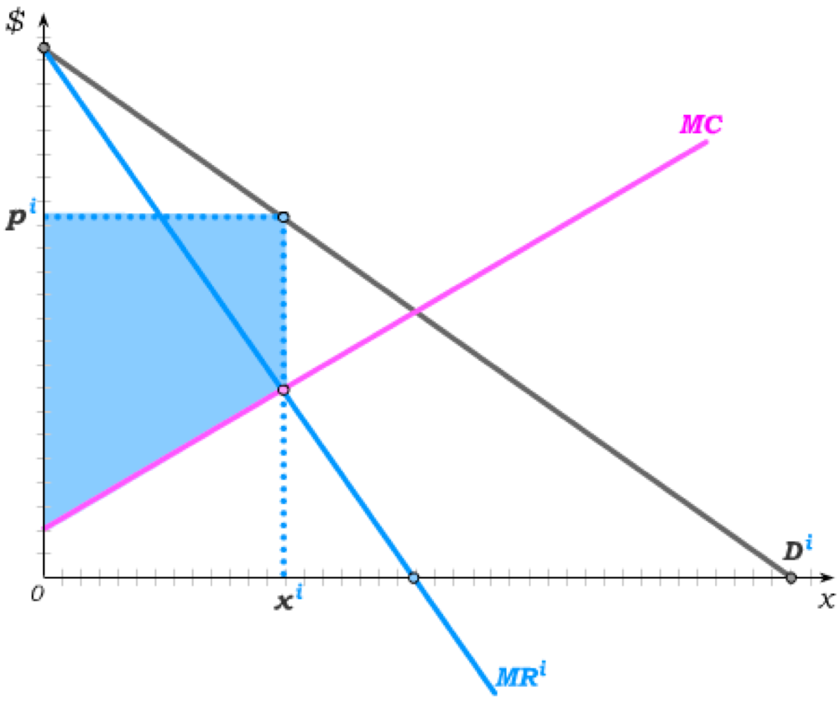
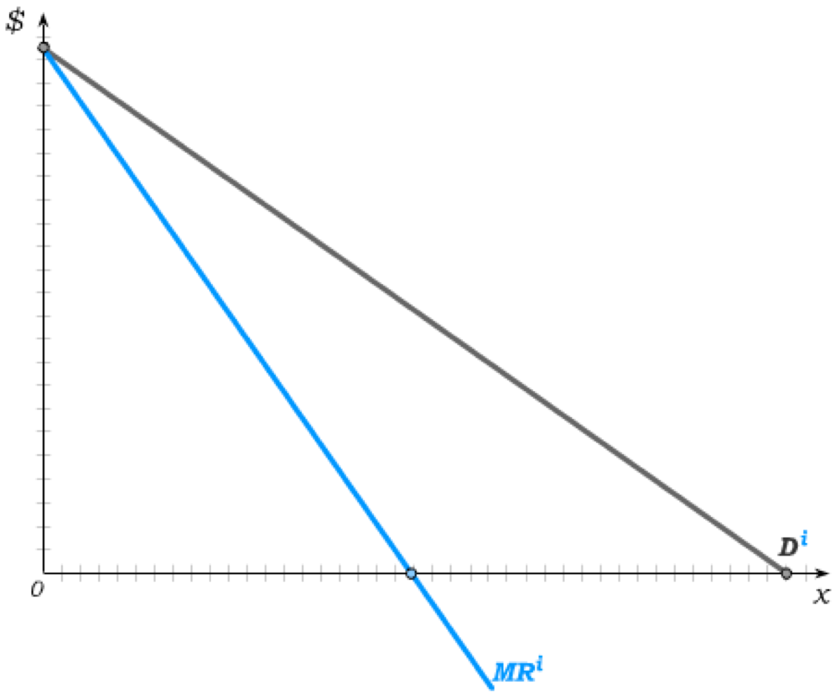
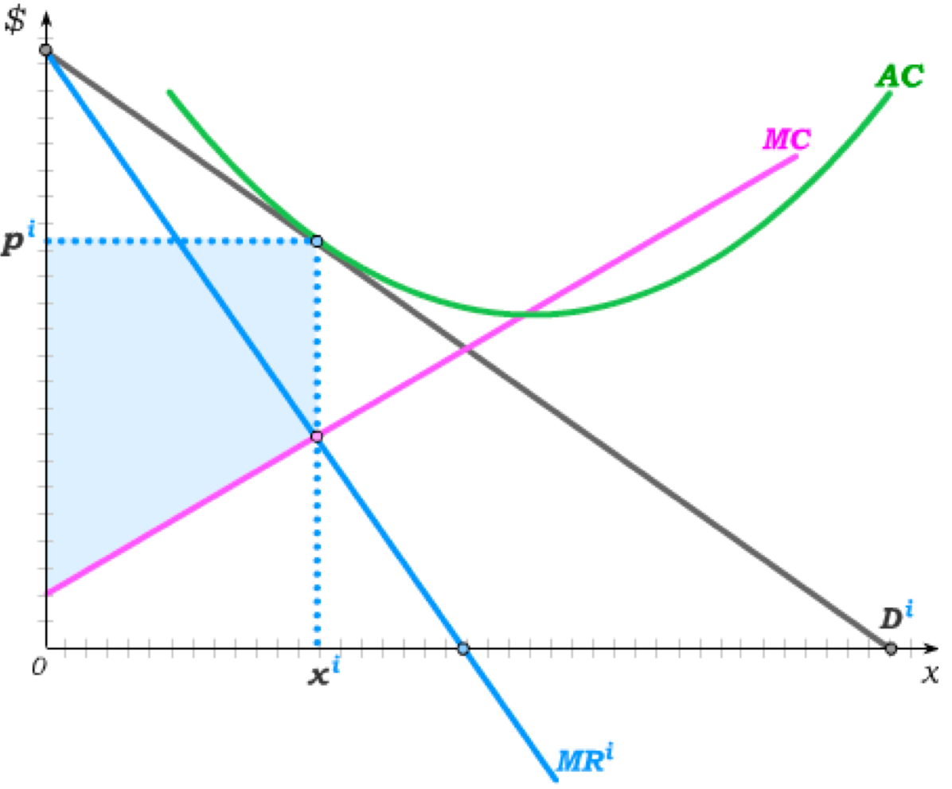

Monopolistic Competition
We can picture a single firm in a monopolistically competitive market as a monopoly – because each firm in fact has some market power derived from its differentiated product.
The firms inside the industry then make positive profit because the FC is sunk.
But for firms outside the industry, the FC is an economic cost of entry – and in equilibrium must be at least as large as the profit firms could make by entering.

Slide 14
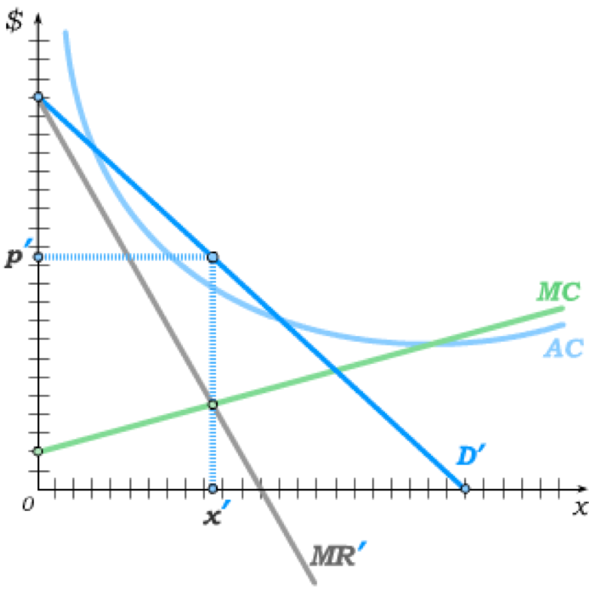
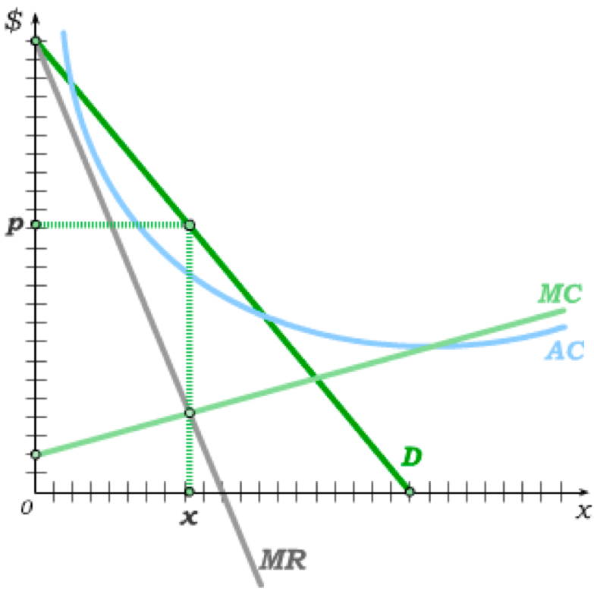
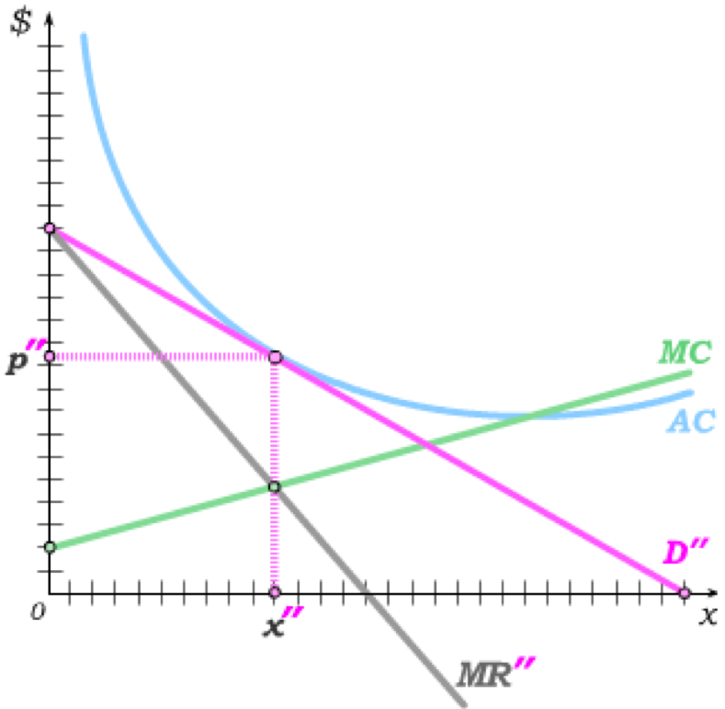
Innovation and Monopolistic Competition
We have seen that the profits in a monopolistically competitive industry derive from product differentiation.
Firms can then increase profit by innovating in one of two ways:
(1) Creating a new desirable product characteristic
shifts demand for the firm’s product out
€
implies
p > AC
(2) Finding a cheaper production technology
shifts the firm’s cost curves down
As a result, firms in the industry will imitate and/or new firms will enter …
… causing market power for the initial firm to decrease …
… until the new monopolistic competition equilibrium is restored.
There is always an incentive to innovate to raise short run profit – even if it ultimately disappears without further innovation.

Slide 15
Innovation and Monopolistic Competition
Perfect Competition
Monopolistic Competition
Monopoly
price competition, innovation and decreasing FC
While there are indeed perfect competitive markets with perfectly substitutable goods, many small firms and virtually no barriers to entry, and there are indeed monopolies protected by high barriers to entry, much of the world operates in between.
It is in these less extreme markets that our equilibrium probably never holds – because such markets are characterized by ongoing entry and exit and innovation.
Still, by understanding the idea of an equilibrium in such markets, we come to understand how innovation changes the world as it interacts with pressures to re-establish equilibrium.
Many of these markets are also characterized with legal protections for innovations -- allowing innovative firms to benefit for longer periods from patents and copyrights.
Although we have spend much time devoted to the more extreme models, we should not lose sight of the fact that much of the “surplus” in markets arises from such innovation.

Slide 16
Advertising and Marketing
We have so far treated product differentiation in terms of differentiation of actual product characteristics. Such differentiation may also arise from advertising.
It is useful to distinguish between two types of advertising:
Informational Advertising
Image Marketing
Provides information about the quality or price of a product to “rational” but uninformed consumers
Altering the image rather than providing information to “malleable” consumers
increases price competition by informing consumers of choices
decreases price competition by differentiating products through changes in product image
All advertising is costly, but informational advertising may have enough benefits through increases in price competition, and hence lower prices, to justify these costs.
But the distinction between these is blurry at best as it requires us to paternalistically judge what the actual “information” (as opposed to “image”) is.

Slide 17
Tutorial exercises
Within-chapter exercises:
26A.1, 26A.2, 26A.3, 26A.4, 26A.11, 26A.12, 26A.14, 26A.15
End-of-chapter exercises:
26.1A, 26.4, 26.5A, 26.6A

Slide 18
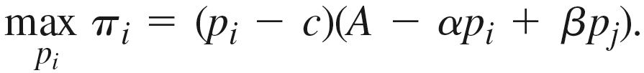
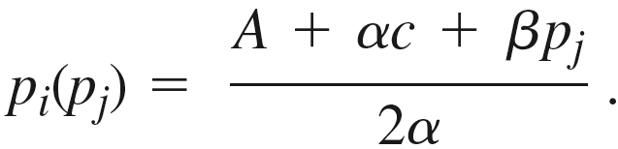
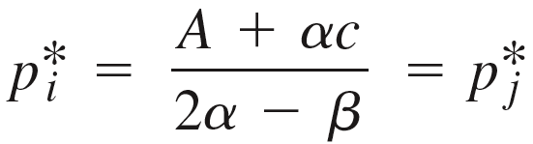

Bertrand Pricing with Differentiated Products
We can introduce the idea of differentiated products into a 2-firm oligopoly by letting demand for firm i’s depend on both the price p_{i} set by firm i and the price p_{j} set by firm j; i.e.
A higher p_{i} implies a lower quantity of x_{i} is demanded.
A higher p_{j} implies a higher quantity of x_{i} is demanded.
With constant marginal cost c, each firm then solves the problem
Solving this in the usual way, we get firm i’s best response function to p_{j} as
Firm firm j’s best response function p_{j}(p_{i}) is analogously derived, and substituting it into p_{i}(p_{j}) lets us solve for the Nash equilibrium prices
p > MC so long as

Slide 19



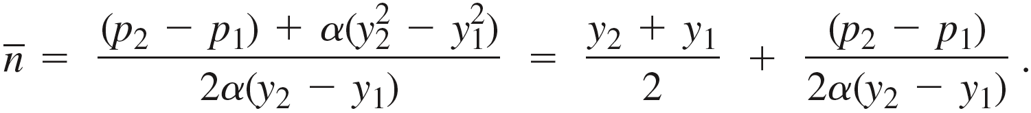
Hotelling Model
The Hotelling Model begins with an interval [0,1] that contains all possible product characteristics y.
Consumer ideal points also lie on this interval, with consumer n’s ideal point given by
.
Suppose that, in addition to having to pay the product price, the consumer pays a “taste cost” of for consuming a product characteristic that does not perfectly match her ideal point.
For any set of product characteristic and price choices made by two firms, we can then identify the consumer who is indifferent between consuming from the two firms by solving
to get

Slide 20

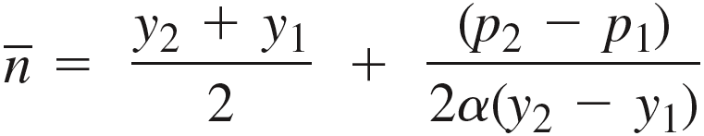

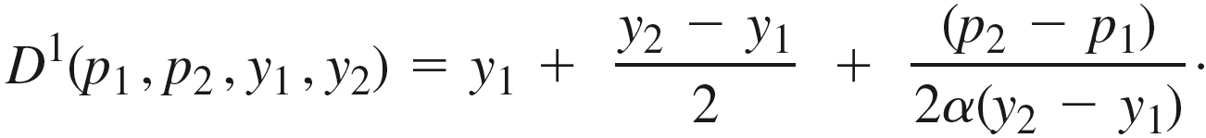
Consumer Demands
If y₁ < y₂ , everyone in the interval the consumes from firm 1, with everyone else consuming from firm 2.
The expression for is then also the demand for firm 1, which – by adding y₁ and subtracting (2y₁/ 2) – can also be written as
The remainder of the population buys from firm 2 – i.e.
With this background, we can now solve for the subgame-perfect equilibrium to a 2-stage game:
Stage 1: Firms simultaneously choose a product characteristic from the Hotelling line
Stage 2: Firms simultaneously choose price, taking as given the product characteristics from stage 1.

Slide 21
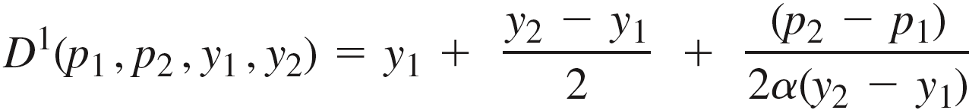
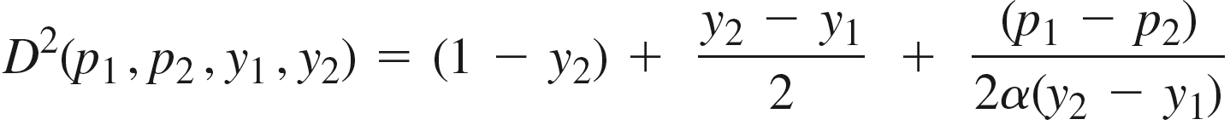
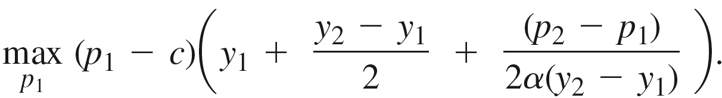
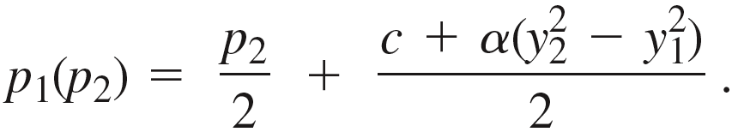
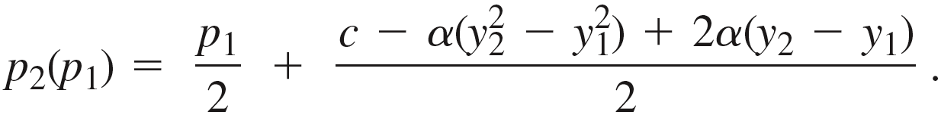
Stage 2: Price Setting Game
In Stage 2, each firm already knows both firms’ product characteristic.
Firm 1 then solves the problem
which we can write as
Solving in the usual way, we then get firm 1’s best price-response function
And going through analogous steps for firm 2, we get firm 2’s best price-response function

Slide 22
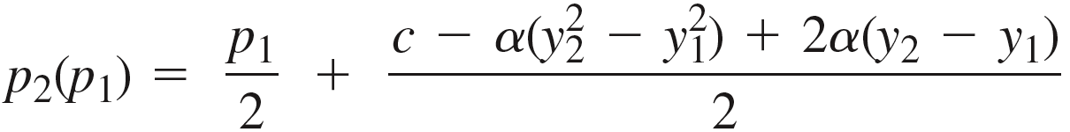
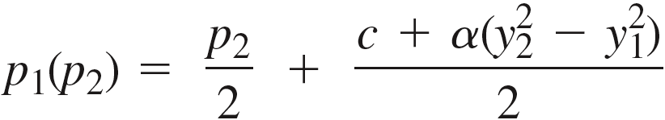
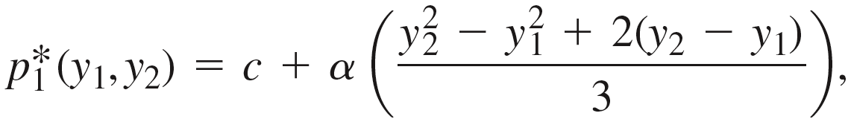
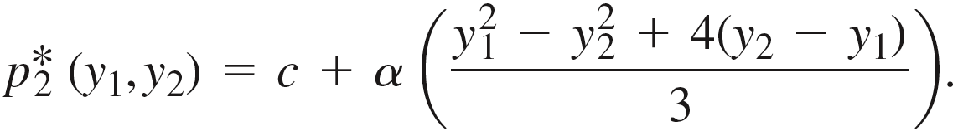
Stage 2: Pricing Equilibrium
We can find where the two best response functions cross by plugging p₂(p₁) in for p₂ in p₁(p₂) to get firm 1’s equilibrium price
and plugging this back into p₂(p₁), we get firm 2’s equilibrium price
These are Nash equilibrium prices for the Stage 2 pricing game where firms take the product characteristics (y₁, y₂) from Stage 1 as given.
In Stage 1, firms can predict what these Nash equilibrium prices will be in Stage 2 for any combination of product characteristics (y₁, y₂).
As a result, these equilibrium price functions enter the firms’ calculations as they set product characteristics (y₁, y₂) in Stage 1.

Slide 23
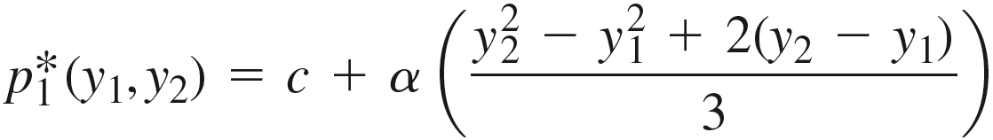
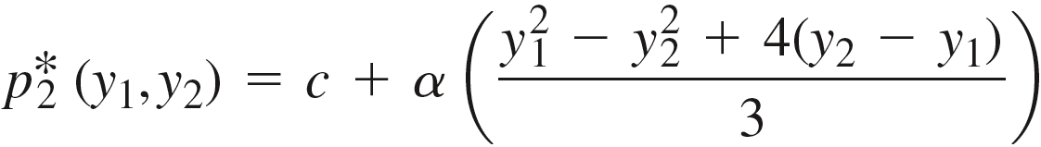
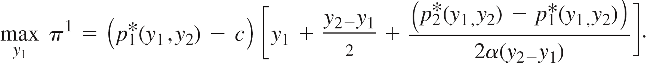

Stage 1: Product Characteristic Game
In Stage 1, firm 1 takes the equilibrium price functions from Stage 2 as given when choosing the product characteristic y₁ to maximize profit.
It therefore solves
which can be expanded to
But the variable y₁ is furthermore constrained to lie in the interval [0,1], and, because we have implicitly assumed y₁ ≤ y₂ when we constructed D¹, the full constraint on the y₁ variable is .
The resulting constrained optimization problem – involving inequality constraints – then requires optimization methods beyond the Lagrange method. But we can conclude what the solution to the problem is by evaluating profit for different (y₁, y₂).

Slide 24
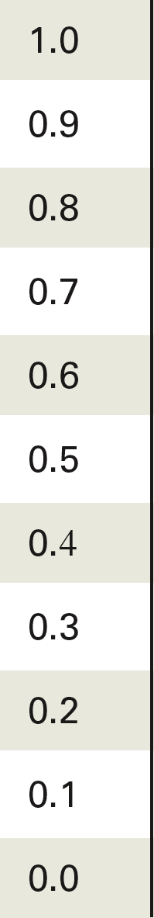

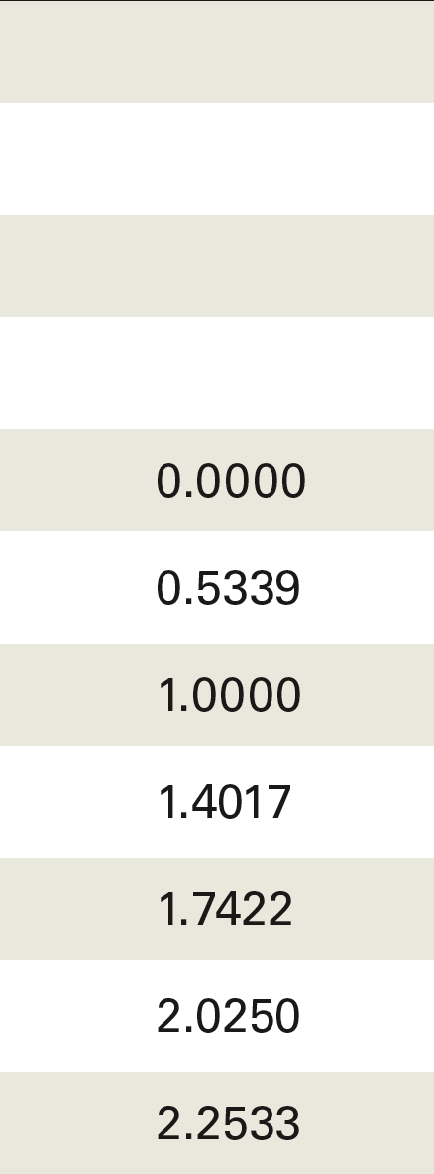

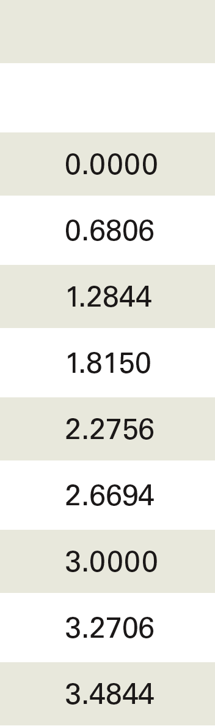
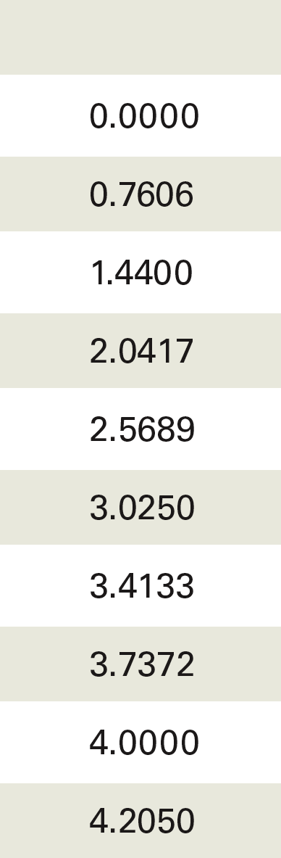
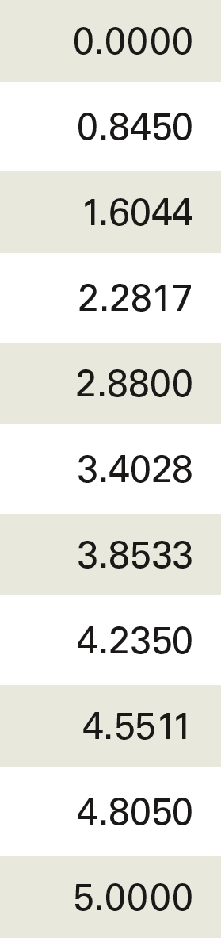
Setting Product Characteristics in Stage 1

Slide 25


Subgame Perfect Equilibrium
We then see that, for any product characteristic y₂ ≥ 0.5 chosen by firm 2, firm 1 best-responds by choosing the product characteristic 0.
The analogous can be derived for firm 2: For any product characteristic y₁ ≤ 0.5 chosen by firm 1, firm 2 best-responds by choosing the product characteristic 1.
In the subgame-perfect equilibrium, the firms therefore engage in maximal product differentiation.
Plugging these Stage 1 equilibrium product characteristics into the Stage 2 equilibrium price functions, we then get equilibrium prices set at
Recall that α is a taste parameter, with consumers becoming worse off by for not consuming at their ideal point.
Product differentiation becomes more powerful
Equilibrium prices rise more above MC
As α increases

Slide 26
Equilibrium vs. Efficient Differentiation
This maximal product differentiation arises in the Hotelling Model when we assume the “quadratic taste cost” together with a uniform distribution of ideal points along the Hotelling line.
We can then ask whether such extreme product differentiation is efficient.
Because of the “quadratic” utility cost from consuming away from one’s ideal point, the marginal cost of moving from the ideal point is increasing in distance.
As a result, the efficient level of product differentiation would minimize the average distance between ideal points and the closest product characteristic.
Thus, while the equilibrium product characteristics are located at the extreme ends of the Hotelling line,
the efficient placement of product characteristics would occur at the
points 0.25 and 0.75.
Because of the softening of price competition that results from maximal product differentiation, firms engage in socially excessive differentiation.

Slide 27

Firm Entry and Product Differentiation
The Hotelling model’s incentives for product differentiation similarly drive entry decisions into monopolistically competitive markets with constant marginal cost c.
Suppose that, rather than lying on the Hotelling line segment, product characteristics lie on the unit circle.
Consumer ideal points are similarly located on this circle, with individual n defined by her ideal point – and her utility cost
from consuming a product characteristic y_{i} given by .
As in the Hotelling model, we assume each consumer purchases a single good in this market, and consumer ideal points are uniformly distributed.
We then consider the following two-stage sequential game:
Stage 1: Firms decide whether to enter the industry and, if they do enter, where to locate their product on the unit circle.
Stage 2: The firms that enter in stage 1 determine the price they will charge for their product.

Slide 28





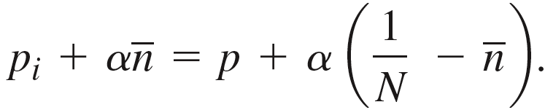
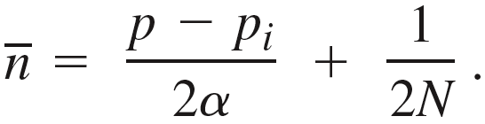
Stage 2: Price Setting
Let y_{i}’s location be defined as 0,
and suppose that N firms entered in Stage 1 and spaced
out evenly across the unit circle.
Let the firm adjacent (in terms of product characteristics) to i have characteristic y_{j}.
Since there are N firms equally spread across the unit circle, the product characteristic for firm j is then
In equilibrium, firms will charge the same price p – to which firm i will be best-responding.
The consumer that is indifferent between y_{i} and y_{j} is then defined by the equation
Substituting y_{i} = 0 and y_{j} = 1/N into this equation, we get
And solving this for , we get the ideal point for the indifferent consumer

Slide 29
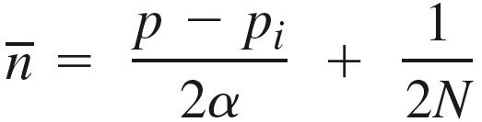
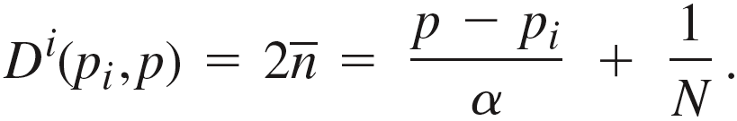




Stage 2: Price Setting
Given firm i charges p_{i} and all other firms charge p, consumers with ideal points between y_{i} and will then consume from firm i.
The same is true to firm i’s other side – implying that demand is twice ; i.e.
Firm i’s best response to other firms charging price p is then determined from the profit-maximization problem
Solving this in the usual way, we get the best response function
And since all firms will charge the same price in equilibrium, it must be that , which implies an equilibrium price
Price > MC

Slide 30




Stage 1: Market Entry
Prior to deciding whether to pay a fixed entry cost FC to enter the market, firms then know the equilibrium price that will emerge in Stage 2 depending on how many firms entered in Stage 1.
Firms will then enter so long as the profit from entering is not negative.
In a subgame-perfect equilibrium, firm i’s profit from entering is then
With all N firms charging the same price, demand for each firm along the unit circle is 1/N.
Substituting 1/N in for D^{i}(p*,p*) and substituting p*(N) in for p*, this implies
which we can solve to get the equilibrium number of firms .
And substituting N* in for p*(N), the equilibrium price is

Slide 31


Equilibrium
The number of firms increases
As tastes for diverse goods diminish, and as fixed entry costs fall, the monopolistically competitive market becomes perfectly competitive.
– as tastes for diverse goods intensify, and
– as fixed entry costs fall.
Price rises further above MC
– as tastes for diverse goods intensify, and
– as fixed entry costs increase.
But as tastes for diverse goods intensify and fixed entry costs rise, the number of firms falls – and each firm’s market power increases.

Slide 32


Equilibrium vs. Efficient Number of Firms
As in the Hotelling model, we can then ask how this equilibrium number of firms compares to the efficient number of firms.
A social planner would consider the following:
– a total fixed entry cost of N(FC) is paid to set up firms;
– the average consumer cost from not consuming at the ideal point is α/(4N).
The social planner therefore solves the problem
This is because the farthest a consumer will consume from her ideal point is 1/(2N) – implying an average distance of 1/(4N).
The first order condition is , implying
The efficient number of firms is therefore half the equilibrium number – implying that there is an inefficiently large number of firms in the industry.

Slide 33



Tastes for a Diverse Mix of Goods
So far, we have modelled each consumer as having an ideal point in the space of product characteristics – with consumers in aggregate exhibiting tastes for product diversity.
We now consider markets in which individuals consumers have tastes for variety – implying we can no longer characterize consumer tastes with ideal points.
Example: Tastes for restaurants in a city
We’ll then assume that consumer welfare increases as the diversity of product offerings in the differentiated product market y increases.
They consume an undifferentiated composite good y as well as the diverse product characteristics y_{i} produced by the N firms in the differentiated product market.
We then model the resulting consumer side of the economy with a representative consumer whose tastes can be represented by the utility function
where

Slide 34



Dixit-Stiglitz Utility Functions
Tastes for the diversified product market are then captured by the sub-utility function that takes on the CES form.
This function aggregates the consumption of the y goods in a way that treats the diversified goods within the diversified product market with constant elasticity of substitution of
By assuming that ρ lies between 0 and –1, we therefore assume that the elasticity of substitution between the y goods lies between 0 and infinity; i.e. the goods in the diversified product market are relatively substitutable.
The functional form for the u function is then assumed to be Cobb-Douglas, giving us
with an elasticity of substitution of 0 between the composite good and the y goods.
Functions that incorporate a taste for product diversity in this way are called Dixit-Stiglitz utility functions.

Slide 35





Dixit-Stiglitz Utility Functions
It is a property of Cobb-Douglas utility functions that expenditures on x are αI, and expenditures on the y-goods sum to (1–α)I.
This implies
assuming all N of the y-goods sell for the same price
Plugging these into u, we get
The derivative of this with respect to N,
is then positive (because –1 < ρ < 0).
All else equal, utility increases in the diversity of y-goods.

Slide 36


Utility increasing in Product Diversity
For particular parameter values, we can then illustrate just how much utility changes for the representative consumer as product diversity increases.
We begin with a single firm producing a single y-good – which we can think of as a one-restaurant town.
Going from 1 to 10 restaurants then raises utility by over 25% -- and would
make it possible to lower income by over 20% without making the consumer worse off.
Similar increases in utility arise from additional increases in the number of restaurants, implying people are willing to pay to live in places that offer more variety of the y-good.

Slide 37




Utility Maximization and Demand
The representative consumer’s budget constraint is
which, when solved for x, can be substituted into the utility function all allow us to write the utility maximization problem as
The problem becomes easier to solve if we transform the utility function using the natural log,
We then get N different first order conditions from the utility maximization problem:

Slide 38


Demand
Solving the first order condition for y_{j} we get
If N is relatively large, y_{j} has little impact on any summation over all y_{i}’s.
W can therefore approximate demand for y_{j} by
Since each y_{j} is produced by a different firm, this is the demand faced by firm j.

Slide 39




Pricing
Firm j’s profit maximizing price level then emerges from
Solving this in the usual way, we get the simple result that
Since –1 < ρ < 0, this implies that price is set above marginal cost c, …
… and as the y-goods become increasingly substitutable (i.e., as ρ converges to –1), price converges to marginal cost.
With firms in the y-goods industry facing the same costs and demands, we can then conclude that the equilibrium price charged in the y-goods industry is

Slide 40




Equilibrium Output of Firms
Given the equilibrium price p*, we can now determine the equilibrium number of firms given a fixed entry cost FC.
Firms will enter the y-goods market until or
which we can solve for the equilibrium quantities
With –1 < ρ < 0, this implies that firm output rises
– as the goods become more substitutable (with ρ approaching –1),
– as the marginal cost c decreases, and
– as the fixed cost FC increases.

Slide 41



Equilibrium Number of Firms
Finally, with p* as the equilibrium price and y* as the equilibrium firm output, consumers must be demanding what is supplied.
We previously calculated the first order condition from which consumer demand is derived as
This must now hold at the equilibrium price and quantity – which implies we can replace all p_{i} terms with p* and all y_{i} terms with y* to write the first order condition as
Cross-multiplying the first and third term, we can then solve for the N as
And substituting in our expressions for p* and y*, we get

Slide 42


Equilibrium Example
The equilibrium number of firms then increases
– as consumers value the y-goods more (i.e. as α falls);
– as the fixed entry costs FC fall;
– as consumer income I rises; and
– as the y-goods become more substitutable (i.e. as ρ goes to –1).
For specific parameters, we can then easily calculate the equilibrium in this market:
€
€
€
€
€
€

Slide 43

Informational Advertising
Informational advertising is aimed at informing consumers about products they may not know of in the absence of advertising.
Suppose, for instance, the market is perfectly competitive with many identical firms producing an undifferentiated product x at constant marginal cost c.
There are n identical consumers, each willing to pay an amount s where s > c for one unit of x and an amount less than c for any additional units.
With no informational constraints, all consumers buy 1 unit at p = c under perfect competition.
Each consumer buys 1 unit of x so long as p ≤ s, and
firms produce what is demanded so long as p ≥ c.
But suppose consumers are unaware of the existence of a product unless they receive an advertisement that tells them a particular firm is producing x at some price p.
Firms can send advertisements randomly to consumers at a cost of c_{a} per ad.
With n consumers, the probability that an ad will reach a particular consumer is 1/n.
The price announced on an ad must be such that
lowest MC for firm
highest price consumers will pay

Slide 44


Informational Advertising
Let x(p) be the probability that an ad announcing price p will result in a sale.
The zero-profit condition (from free entry into perfectly competitive markets) then implies
where x*(p) is the equilibrium probability that an ad announcing price p will result in a sale.
Despite perfect competition, many prices might be advertised and paid by consumers.
– higher priced ads have lower probabilities of a sale
– lower priced ads have higher probabilities of a sale
Even when a firm sends an ad with price p = s, there is a positive probability of a sale –
And no matter how many ads are sent, some consumers may not receive an ad.
But if the probability of this is greater than x*(s), a firm could make a positive expected profit by sending out an add announcing p = s.

Slide 45


Informational Advertising
In equilibrium, the perfectly competitive industry then produces a price(s) above MC because of the need to convey information to consumers – leading to an industry that has the characteristics of monopolistic competition.
Is the equilibrium amount of information that is conveyed efficient?
A social planner will consider the following:
– the cost of sending out one more ad
c_{a}
– the social gain from sending out one more ad
P(a) (s – c)
probability the next ad will reach an uninformed consumer
The planner then keeps sending ads until
implying
In this model, the equilibrium probability of an ad reaching a consumer is efficient.

Slide 46





Image Marketing
Now, suppose that instead of conveying information, the advertising is meant to alter the image of the product.
Consider this in the context of the Hotelling model with 2 firms:
– Consumers are spread uniformly over the interval [0,1] and demand at most 1 unit of the output.
– Consumer incurs a “utility cost” of from consuming
.
Now, however, we suppose that α is a function of advertising a₁ and a₂ by firms 1 and 2; i.e. .
no “utility cost” – market is undifferentiated
The Hotelling product characteristics are therefore “produced” by advertising by the two firms.

Slide 47





Image Marketing
We then imagine a 3-stage game:
Stage 1
Stage 2
Stage 3
Firms choose advertising levels a₁ and a₂
Firms choose product locations y₁ and y₂
Firms choose prices p₁ and p₂
Since ,
This is just the standard Hotelling model – for which we derived the subgame-perfect equilibrium
Suppose .
We can then derive firm i’s best response to firm j’s advertising a_{i} in Stage 1 by solving

Slide 48



Image Marketing Equilibrium
Solving this in the usual way, we get firm i’s best response function
And since the firms are identical and symmetric to one another, firm j’s best response function is similar – allowing us to find the Nash equilibrium in the first stage of our game as
The equilibrium level of “image differentiation” is then
Given our specification of the model, this is unambiguously inefficient – because the advertising leads to utility losses for all consumers with ideal points inside the [0,1] interval.

Slide 49


Efficient?
But the inefficiency of image marketing in our model derives from our assumption that the “utility cost” of not consuming at the ideal point is
Suppose instead that we had specified the utility implication of image differentiation as
where γ > 0.
Stages 2 and 3 of our expanded Hotelling game remain unchanged – implying that firms will maximally differentiate at y₁ = 0 and y₂ = 1 and set prices equal to
as before.
The profit maximization problem used to derive best respond functions in Stage 1 is similarly unchanged as
Thus, the equilibrium in the model is unaffected when γ > 0.
But if γ is sufficiently high, average utility will now increase as a result of image advertising – and may even increase for all consumers.

Slide 50

Equilibrium and Efficiency

