Slide 1
IntegrativeNegotiation

Slide 2
What Makes Integrative Negotiation Different?
Focus on commonalties rather than differences
Address needs and interests, not positions
Commit to meeting the needs of all involved parties
Exchange information and ideas
Invent options for mutual gain
Use objective criteria to set standards

Slide 3
Overview of the Integrative Negotiation Process
Create a free flow of information
Attempt to understand the other negotiator’s real needs and objectives
Emphasize the commonalties between the parties and minimize the differences
Search for solutions that meet the goals and objectives of both sides

Slide 4
Key Steps in the Integrative Negotiation Process
Identify and define the problem
Understand the problem fully
identify interests and needs on both sides
Generate alternative solutions
Evaluate and select among alternatives

Slide 5
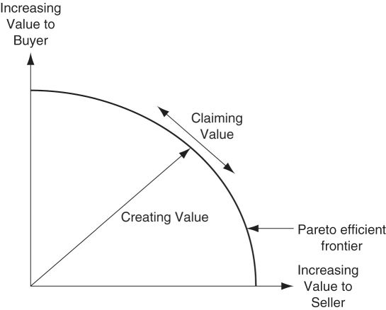
Claiming and Creating Value

Slide 6
Identify and Define the Problem
Define the problem in a way that is mutually acceptable to both sides
State the problem with an eye toward practicality and comprehensiveness
State the problem as a goal and identify the obstacles in attaining this goal
Depersonalize the problem
Separate the problem definition from the search for solutions

Slide 7
Understand the Problem Fully – Identify Interests and Needs
Interests: the underlying concerns, needs, desires, or fears that motivate a negotiator
Substantive interests relate to key issues in the negotiation
Process interests are related to the way the dispute is settled
Relationship interests indicate that one or both parties value their relationship
Interests in principle: doing what is fair, right, acceptable, ethical may be shared by the parties

Slide 8
Generate Alternative Solutions
Invent options by redefining the problem set:
Expand the pie
Logroll
Use nonspecific compensation
Cut the costs for compliance
Find a bridge solution
Generate options to the problem as a given:
Brainstorming
Electronic brainstorming
Surveys

Slide 9
Evaluation and Selection of Alternatives
Narrow the range of solution options
Evaluate solutions on:
Quality
Objective standards
Acceptability
Agree to evaluation criteria in advance
Be willing to justify personal preferences
Be alert to the influence of intangibles in selecting options
Use subgroups to evaluate complex options

Slide 10
Evaluation and Selection of Alternatives
Take time to “cool off”
Explore different ways to logroll
Exploit differences in expectations and risk/ time preferences
Keep decisions tentative and conditional until a final proposal is complete
Minimize formality, record keeping until final agreements are closed

Slide 11
Factors That Facilitate Successful Integrative Negotiation
Some common objective or goal
Faith in one’s own problem-solving ability
A belief in the validity of one’s own position and the other’s perspective
The motivation and commitment to work together

Slide 12
Factors That Facilitate Successful Integrative Negotiation
Trust
Clear and accurate communication
An understanding of the dynamics of integrative negotiation

Slide 13
Why Integrative Negotiation Is Difficult to Achieve
The history of the relationship between the parties
If contentious in past, it is difficult not to look at negotiations as win-lose
The belief that an issue can only be resolved distributively
Negotiators are biased to avoid behaviors necessary for integrative negotiation

Slide 14
Why Integrative Negotiation Is Difficult to Achieve
The mixed-motive nature of most negotiating situations
Purely integrative or purely distributive situations are rare
The conflict over the distributive issues tends to drive out cooperation, trust needed for finding integrative solutions

Slide 15
Ethics in Negotiation

Slide 16
What is the State of Ethics in Business?
Enron
WorldCom
Catholic Priests
2002 Winter Olympics Figure Skating
Societal views of lawyers, politicians, etc.
Ponzi Schemes – Madoff
Miguel Relvas

Slide 17
The Importance of Wise Choices
Acting unethically is a choice
In any situation we can choose to act ethically or not
Sometimes we can trust our “gut”
Other times we can’t

Slide 18
Why Is This a Dilemma?
We make unethical decisions for one of these reasons:
We do what is most convenient (thoughtless)
We do what we must to win (need)
We rationalize our choices with relativism.
We don’t know any better or practice ignorance of convenience
We are fearful (actual or perceived threat)

Slide 19
Ethics vs. Societal Norms
Ethics
Etiquette
Fashion
Grammar
All four are societal codes but only the first deals with character.

Slide 20
WHY DO NEGOTIATORS NEED TO KNOW ABOUT ETHICS?
What are ethics and how do they apply to negotiation?
What are the major ethical concerns that apply to negotiation?
What major types of ethical and unethical conduct are likely to occur in negotiation?
What factors shape a negotiator’s predisposition to use unethical tactics?
How can negotiators deal with the other party’s use of deception?

Slide 21
WHAT ARE ETHICS AND WHY DO THEY APPLY TO NEGOTIATION?
What is right or wrong in a particular situation
Ethics define the nature of the world in which we live
Prescribe rules for living together

Slide 22
WHAT ARE ETHICS AND WHY DO THEY APPLY TO NEGOTIATION?
Make the decision on the basis of
expected results, or what would give us the greatest return on investment.
What the law says, on the legality of the matter.
The strategy and values of my organization.
My own personal convictions and what my conscience told me to do

Slide 23
The Fallacy of Relying on the Law
As a western society we set our legal standard well below our ethical standard
Not always true in other societies

Slide 24
Relative Standards

Slide 25
The Rule of Law
“I’ve lived my life in a society where there was no rule of law. And that’s a terrible existence. But a society where the rule of law is the only standard of ethical behavior is equally bad.”
- Aleksandr Solzhenitsyn

Slide 26
Blanchard/Peale’s Three Questions
Is it Legal?
Is it Balanced?
How Will it Make me Feel About Myself?
Blanchard, Ken and Norman Vincent Peale, The Power of Ethical Management.

Slide 27
WHAT ARE THE MAJOR ETHICAL CONCERNS THAT APPLY TO NEGOTIATION?
Ethical System | Definition | Major Proponent
End-Result Ethics | Rightness of an action is determined by considering consequences | John Stuart Mill (1806-1873)
Rule Ethicas | Rightness of an action is determined by laws and standards | Immanuel Kant (1724-1804)
Social Contract Ethics | Rightness of an action is determined by the customs and norms of a community | Jean Jacques Rousseau (1712-1778)
Personalistic Ethics | Rightness of an action is determined by one's conscience | Martin Buber (1878-1965)

Slide 28
HOW DO WE CLASSIFY THE MAJOR ETHICAL QUESTIONS?
Three major dimensions of ethical conduct arise in negotiations
Means/Ends
Relativism/Absolutism
Truth-Telling

Slide 29
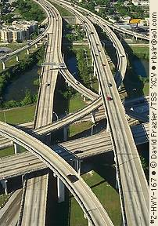
HOW DO WE CLASSIFY THE MAJOR ETHICAL QUESTIONS?
Means/Ends
Utilitarianism
Seek the greatest good for the greatest number
Quantitate and optimize happiness in society while minimizing pain
Examples: Interstate highways through farms benefit the larger public

Slide 30
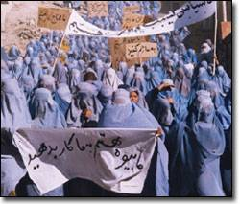
HOW DO WE CLASSIFY THE MAJOR ETHICAL QUESTIONS?
Relativism/Absolutism / Nihilism
Absolutism
What is right is universal, timeless, and absolute
Relativism
What is right may be different for different people or cultures
Nihilism
There is no right or wrong

Slide 31
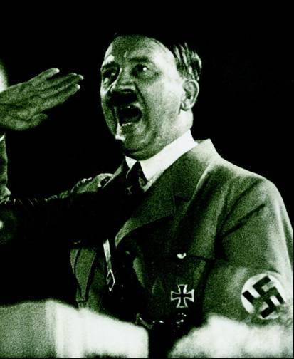
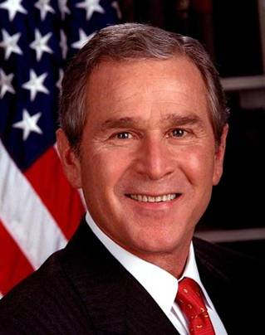
HOW DO WE CLASSIFY THE MAJOR ETHICAL QUESTIONS?
Truth-Telling
How does one define truth?
How does one classify various deviations from truth? Are they all lies?

Slide 32
HOW DO WE CLASSIFY THE MAJOR ETHICAL QUESTIONS?
Deception and disguise may take several forms in negotiation
Misrepresentation of one’s position
Bluffing
Falsification
Deception
Selective disclosure or mispresentation to constituencies

Slide 33
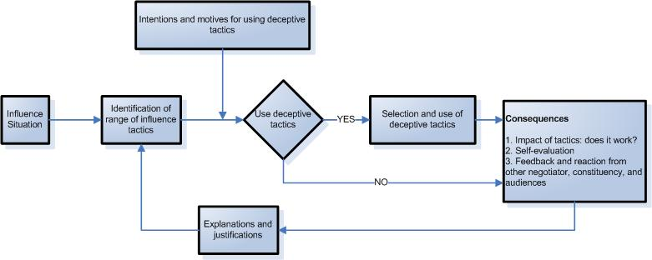
WHAT MAJOR TYPES OF ETHICAL AND UNETHICAL CONDUCT ARE LIKELY TO OCCUR IN NEGOTIATION?

Slide 34
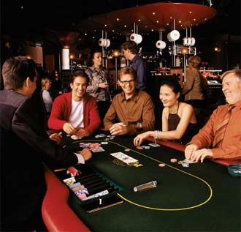
ETHICS IN NEGOTIATION IS MOSTLY ABOUT TRUTH TELLING
Carr (1968): Businesspeople ought to play the game as poker players do

Slide 35
TYPOLOGIES OF DECEPTIVE TACTICS AND ATTITUDES TOWARD THEIR USE
Category | Example
Traditional competitive bargaining | Not disclosing your walkaway; making an inflated opening offer
Emotional manipulation | Faking anger, fear, disappointment; faking elation,satisfaction
Misrepresentation | Distorting information or negotiation events in describing them to others
Misrepresentation to opponent's networks | Corrupting your opponent's reputation with his peers
Inappropriate information gathering | Bribery, infiltration, spying, etc..
Bluffing | Insincere threats or promises

Slide 36
INTENTIONS AND MOTIVES TO USE DECEPTIVE TACTICS
O’Connor and Carnevale (1997)
Two forms of deception in misrepresenting the common-value issue:
Misrepresentation by omission
Misrepresentation by commission

Slide 37
THE MOTIVATION TO BEHAVE UNETHICALLY
O’Connor and Carnevale (1997)
“individualistic” orientation
“cooperative” orientation

Slide 38
THE CONSEQUENCES OF UNETHICAL CONDUCT
Consequences:
Will occur depending on whether the tactic worked or not
May result depending on how the negotiator evaluates his/her use of tactic
May come from the judgements and the evaluations of that negotiator

Slide 39
EXPLANATIONS AND JUSTIFICATIONS
The tactic was unavoidable
The tactic was harmless
The tactic will help to avoid negative consequences
The tactic will produce good consequences
“They had it coming” or “they deserve it” or “I’m just getting my due”
“They were going to do it anyway, so I will do it first
The tactic is fair or appropriate to the situation

Slide 40
WHAT FACTORS SHAPE A NEGOTIATOR’S PREDISPOSITION TO USE UNETHICAL TACTICS?
Demographic Factors
Personality Differences and Moral Development
Moral Development and Personal Values

Slide 41
WHAT FACTORS SHAPE A NEGOTIATOR’S PREDISPOSITION TO USE UNETHICAL TACTICS?
Demographic Factors
Sex
Women tend to make more ethically rigorous judgments than men
Age and experience
Both men and women behave more ethically as they age Individuals with more general work experience, and with direct work experience, are less likely to use unethical negotiating tactics

Slide 42
Ethnicity
Nationality and cultural background
Significant differences are found across different nationalities and cultural backgrounds
Professional orientation
People in different professions differ on judgments of perceived appropriateness
Academic background

Slide 43
WHAT FACTORS SHAPE A NEGOTIATOR’S PREDISPOSITION TO USE UNETHICAL TACTICS?
Personality Differences and Moral Development
Competitiveness versus cooperativeness
Machiavellianism
Some individuals are more willing and able con artists
Are more likely to lie when they need to
Better able to lie without feeling anxious about it
More persuasive and effective in their lies

Slide 44
Locus of control
The degree to which individuals believe that the outcomes they obtain are largely a result of their own ability and effort (internal control) versus fate or chance (external control)
Individuals who are high in internal control are more likely to do what they think is right

Slide 45
WHAT FACTORS SHAPE A NEGOTIATOR’S PREDISPOSITION TO USE UNETHICAL TACTICS?
Moral Development and Personal Values
A preconventional level (Stage 1 and 2)
Individual is concerned with concrete outcomes that meet his or her own immediate needs, particularly external rewards and punishments

Slide 46
A conventional level (Stage 3 and 4)
Individual defines what is right on the basis of what immediate social situation and peer group endorses or what society in general seems to want
A principled level (Stage 5 and 6)
Individual defines what is right on the basis of some broader set of universal values and principles

Slide 47
The higher the stage people achieve:
More complex their moral reasoning should be
More ethical their decisions should be

Slide 48
CONTEXTUAL INFLUENCES ON UNETHICAL CONDUCT
Past experience
Role of incentives
Relationship between the negotiator and the other party
Relative power between the negotiators
Mode of communication
Acting as an agent versus representing your own views
Group and organisational norms and pressures
National culture norms

Slide 49
HOW CAN NEGOTIATORS DEAL WITH THE OTHER PARTY’S USE OF DECEPTION?
Intimidation
Futility portrayal
Discomfort and relief
Bluffing
Gentle prods
Minimization
Contradiction
Altered information

Slide 50
HOW CAN NEGOTIATORS DEAL WITH THE OTHER PARTY’S USE OF DECEPTION?
A chink in the defense
Self-disclosure
Point of deception cues
Concern
Keeping the status quo
Direct approach
Silence

Slide 51
HOW CAN NEGOTIATORS DEAL WITH THE OTHER PARTY’S USE OF DECEPTION?
Ask Probing Questions
Recognize the Tactic
İgnore the tactic
Ask questions
“Call” the tactic
Respond in kind
Discuss what you see and offer to help the other party change to more honest behaviors

