Slide 1
Portfolios, Systematic Risk & the CAPM (capital asset pricing model)
Gestão Financeira I
Gestão Financeira
Corporate Finance
Licenciatura / Undergraduates
2015-2016

Slide 2
Outline
Mean-variance portfolio analysis
Developed by Harry Markowitz in the early 1960’s (1990 Nobel Prize in Economics)
Foundation of modern finance.
Used by all pension plans, endowments, wealthy individuals, banks, insurance companies, ...
There is an industry of advisors (e.g. Wilshire Associates) and software makers (e.g. BARRA, Quantal) that implement what we will learn next.
The Capital Asset Pricing Model (CAPM) is an equilibrium model that establishes a relationship between the price of a security and its risk.
In particular, the CAPM is used to determine the cost of capital: minimum return required by investors for a certain level of risk.
The CAPM assumes investors are well diversified. Hence the risk premium is proportional to a measure of market (or systematic) risk, known as Beta.

Slide 3
Modern Investment Theory
Investors should control the risk of their portfolio not by re-allocating among risky assets, but through the split between risky assets and the risk-free asset.
The optimal portfolio of risky assets should contain a large number of assets – it should be well diversiﬁed – and is the same for all investors.

Slide 4
An Individual Security: Return and Risk
Characteristics of individual securities that are of interest are the:
Expected Return;
Variance and Standard Deviation of the return;
Covariance or Correlation (to another security or index).

Slide 5
Expected Return (or Mean Return)
where
r_{s} :return if state (scenario) s occurs
p_{s} : probability of state s happening
Example: Consider the following two risky asset world.
There is a 1/3 chance of each state of the economy, and the only assets are stock A and stock B

Slide 6
Example: Expected Return
Note: In practice, many times, instead of really forecasting future scenarios and stock returns in each scenario, investors simply use the historical average return (remember previous slides 11).

Slide 7
Variance and Standard Deviation
The Variance of the Returns measures the deviations towards the mean
A Shortcut
The Standard Deviation is the square root of the variance. Also known as Volatility.

Slide 8
Example: Variance of Returns

Slide 9
Example: Standard Deviation

Slide 10
Covariance and Correlation of Returns
The Covariance is a measure of simultaneous movement of two stocks:
The Correlation Coefficient between the returns of two stocks:

Slide 11
Example: Covariance and Correlation

Slide 12
Correlation Coefficient
The Correlation Coefficient measures the co-movement of two stocks. It varies between -1 and +1.
Perfect positive correlation: 1
Independence: 0
Perfect negative correlation: -1

Slide 13
Estimating Means and Covariances
(in practice…)
In real life we do not know probability of each state of the world and the return that corresponds to it
We need to use historical data to estimate average returns, variance and covariance of returns

Slide 14
Estimating Means and Covariances (cont.)
We can use the functions average(), var(), and stdev() in Excel
We are implicitly assuming that the returns came from the same probability distribution in each year of the sample
The estimated mean and variance are themselves random variables since there is estimation error that depends on the particular sample of data used (sampling error)
We can calculate the standard error of our estimates and figure out a confidence interval for them
This contrasts with the true (but unknown) mean and variance which are fixed numbers, not random variables…
Annualizing Means and Covariances:
Annual return is approximately equal to the sum of the 12 monthly returns; assuming monthly returns are independently distributed (a consequence of market efficiency) and have the same variance:
If mean, standard deviation or covariance are estimated from historic monthly returns, estimates will be per month.
To annualize:
mean, variance, covariance: multiply by 12
standard deviation: multiply by sqrt(12)

Slide 15
Forming Portfolios
Portfolio Weights: fraction of wealth invested in different assets
add up to 1.0
denoted by ‘w’
Example
$100 MSFT, $200 in GE
Total investment: $100+$200=$300
Portfolio weights
MSFT: $100/$300 = 1/3
GE: $200/$300 = 2/3
PS: Can we have negative portfolio weights? Yes, if short-selling is allowed (idea is “borrow” the stock now and sell it, and then you’ll have to buy it – pay – later).

Slide 16
Portfolio: Expected Return
Portfolio return (based on realized returns)
Average of returns on individual securities weighted by their portfolio weights
The expected return on the portfolio (based on expected returns)

Slide 17
Example: Portfolio Expected Return
Consider a portfolio with 50% weight in Stock A and 50% weight in Stock B:
Expected rate of return on the portfolio is a weighted average of the expected returns on stocks in portfolio:

Slide 18
Portfolio:
Variance and Standard Deviation
The Variance of a portfolio is:
We can use the Correlation term instead of the covariance:
The standard deviation of the portfolio is just the square root of the variance of the portfolio.

Slide 19
Example: Portfolio Variance
Variance of the rate of return on the two stock portfolio Wa=Wb=1/2:
NOTE: Notice the decrease in risk that diversification offers
Portfolio with 50% in stock A and 50% in stock B has less risk than either stock in isolation!!!

Slide 20
Efficient Frontier: with 2 stocks
We can consider other portfolio weights besides 50% in stock A and 50% in stock B.
Note: only efficient to invest “above” the Minimum Variance (SD) portfolio

Slide 21
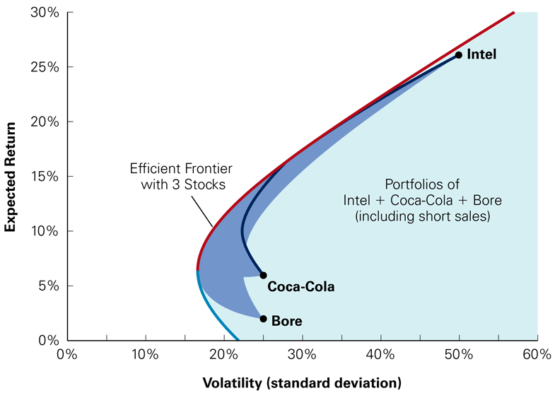
Efficient Frontier with Many Stocks
Section of the opportunity set above the minimum variance portfolio is the efficient frontier (north-west edge): offers minimum risk for a given expected return

Slide 22
Diversification Benefit
Diversification can substantially reduce the variability of returns without an equivalent reduction in expected returns.
This reduction in risk arises because worse than expected returns from one asset are offset by better than expected returns from another
However, there is a minimum level of risk that cannot be diversified away, and that is what we call systematic risk.

Slide 23
Portfolio Risk and Limits to Diversification
In a large portfolio the variance terms are effectively diversified away, but the covariance terms are not
σ
Diversifiable Risk; Nonsystematic Risk; Firm Specific Risk; Idiosyncratic Risk
Portfolio risk
Nondiversifiable risk; Systematic Risk; Market Risk
Number of stocks

Slide 24
Moving to a Pricing Model: Not only (risky) Stocks, but also a Risk Free Asset
Allow for lending and borrowing at risk-free rate (T-bill)
Capital allocation line (CAL): feasible combinations of stock(s) and riskless asset
Optimal portfolios are somewhere along the CAL: a combination of the riskfree asset and the Tangency portfolio of stocks
E(return)
Tangency
portfolio
T
r_{f}
σ_{P}
If E(r_{P})< E(r_{T}): riskless lending, w_{T} < 100%
If E(r_{P}) > E(r_{T}): riskless borrowing, w_{T} > 100%

Slide 25
CAPM: Capital Asset Pricing Model
The Capital Asset Pricing Model (CAPM) is an equilibrium model that establishes a relationship between the price of a security and its risk.
In particular, the CAPM is used to determine the cost of capital: minimum return required by investors for a certain level of risk.
The CAPM assumes investors are well diversified. Hence the risk premium is proportional to a measure of market (or systematic) risk, known as Beta.

Slide 26
CAPM: Assumptions and Equilibrium
Assumptions:
Frictionless markets
No trading costs
No taxes
Unlimited borrowing and lending
No restrictions on short sales
Lending and borrowing rates are the same
Investors care only about means and variances
All investors are fully rational and have the same information (homogeneous expectations)
Market Equilibrium
Since everyone has the same efficient frontier, then:
Everyone holds the same risky tangency portfolio.
Then
THE TANGENCY PORTFOLIO IS
THE MARKET PORTFOLIO

Slide 27
Capital Market Line
CML
E(return)
M
r_{f}
σ_{P}
Where the investor chooses to be along the CML depends on his risk aversion – but all investors face the same CML

Slide 28
What about Individual Stocks?
Security Market Line and Beta
The CML gives risk-return trade-off for efficient portfolios.
In equilibrium, what is the relation between expected return and risk for individual stocks?
Individual stocks are “below” the CML.
This relation is named Security Market Line (SML).
Individual stock risk is measured by its covariance with market portfolio because it is the marginal variance.
According to the Security Market Line, for any security i:
where
Beta measures the responsiveness of a stock to movements in the market portfolio (i.e., systematic risk).

Slide 29
CAPM: Expected Return of a Stock
1.0

Slide 30
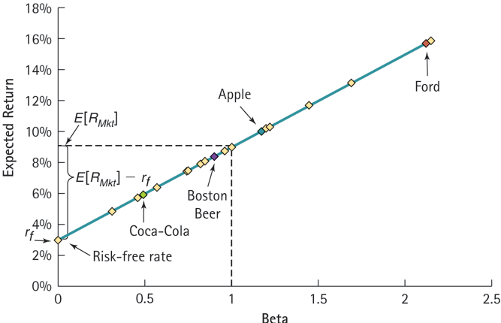
CAPM: Security Market Line Example

Slide 31
CAPM: Expected Return of a Stock
Expected return on a stock
Risk-free rate
Beta of stock
Market risk premium
=
+
×
Assume β_{i} = 0, then
Assume β_{i} = 1, then
Assume β_{i} < 1, then
Assume β_{i} > 1, then

Slide 32
Beta of a Portfolio
Beta of a portfolio is portfolio-weighted average of individual assets:
Thus, we can use SML for any portfolio:

Slide 33
Why Beta?
Because investors can diversify their portfolios, they only require a risk premium for non-diversifiable (market, systematic) risk. This is what Beta measures.
High beta stocks are risky, and must therefore offer a higher return on average to compensate for the risk
Why are high beta stocks risky?
Because they pay up just when you need the money least, when the overall market is doing well
And they loose money when you really need it – when the overall market is doing poorly
If anyone is to hold this security, it must offer a high expected return

Slide 34
Estimation of Beta
β_{i} usually estimated using a time-series regression
Typical R²=25%
Estimation issues
Betas may change over time
Data might be too old
Five years of weekly or monthly data is reasonable
Use Data Analysis / Regression or Linest in Excel

Slide 35
Variables to use for the Market Return and the Risk-free rate
What market proxy?
CAPM says it should be all the assets in the world
Typically people use broad, value-weighted stock market index (e.g. S&P 500)
What risk-free rate?
CAPM says it should be riskless and match the horizon of the application
People use short-term sovereign debt: T-bills or similar

Slide 36
Market Risk Premium
This is the hardest input to measure in the CAPM equation
From January 1926 to December 2005, the excess market return has been 6.7%
Depending on the sample and on whether we use the arithmetic or geometric mean, we can come up with numbers between 5% and 8%
Can we trust this historical average?
Standard error of the estimate is 2.2%

Slide 37
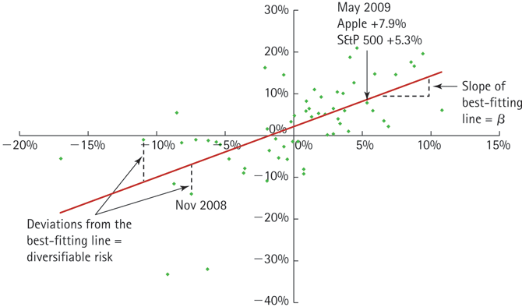
Example: Scatterplot of Monthly Returns for Apple versus the S&P 500, January 2008 through December 2012
Suppose the risk-free return is 3% and you measure the market risk premium to be 6%. Apple has a beta of 1.2. According to the CAPM, what is its expected return?

Slide 38
So, what do we know about the CAPM?
Assumptions of CAPM are restrictive
Gives a simple and elegant relation for expected returns and a nice measure of risk
Research shows that it is not very accurate
But, widely used in corporate finance and investments

