Slide 1
Os gestores e as organizações
1

Slide 2
Objetiv0s
Explicar porque é que os gestores são importantes para as organizações.
Definir o que é um gestor e o que fazem os gestores.
Descrever as funções, papéis e competências dos gestores.
Descrever os fatores que estão a modificar e a redefinir o trabalho dos gestores.
Explicar o interesse de estudar a gestão.

Slide 3
Porque é que os gestores são ImportantES?
As organizações necessitam cada vez mais de competências e capacidades de gestão nos tempos incertos, complexos e caóticos que atravessamos.
As competências e capacidades de gestão são fundamentais para conseguir realizar tarefas e atingir objetivos.
A qualidade da relação superior/subordinado é a variável mais importante para a produtividade e a lealdade.
Notes:
Let’s look at three reasons why managers are important to organizations.
First, managers are important because organizations need their managerial skills and abilities more than ever in uncertain, complex, and chaotic
times. As organizations deal with today’s challenges, managers play an important role in identifying critical issues and crafting responses.
Another reason why managers are important to organizations is because they’re critical to getting things done. The job of a manager is to ensure that all the employees are getting their jobs done.
Managers matter. A Gallup poll has found that the single most important variable in employee productivity and loyalty isn’t pay, or benefits, or the workplace environment—it’s the quality of the relationship between employees and their direct supervisors.

Slide 4
Quem são os gestores?
Gestor – Alguém que coordena e supervisiona o trabalho de outros, de forma a que os objetivos da organização possam ser atingidos.
Notes:
Managers run large corporations, medium-sized businesses, and entrepreneurial start-ups. They’re found in government departments, hospitals, small businesses, not-for-profit agencies, museums, schools, and even such nontraditional organizations such as political campaigns and music tours. In many organizations, the changing nature of work has blurred the distinction between managers and non-managerial employees. So, how do we define who managers are? A manager is someone who coordinates and oversees the work of other people so that organizational goals can be accomplished.

Slide 5
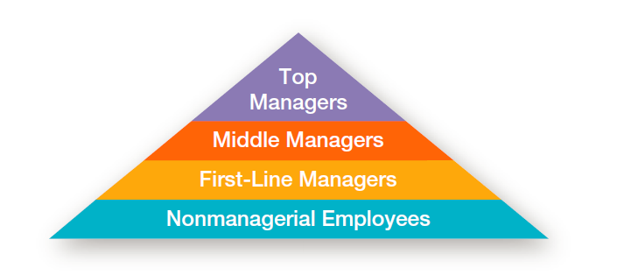
Figura 1-1
Tipos de gestores
Notes:
In traditionally structured organizations (often pictured as a pyramid because more employees are at lower organizational levels than at upper organizational levels), managers can be classified as first-line, middle, or top management.

Slide 6
Tipos de gestores
Supervisores / Gestores de primeira linha – Nível mais baixo da gestão. Responsáveis por não gestores.
Gestores intermédios – Não sendo gestores de topo, gerem o trabalho de outros gestores, como por exemplo, os gestores de primeira linha.
Gestores de topo – Nível mais alto da gestão. Responsáveis por decisões que afetam toda a organização e por estabelecer planos e objetivos para toda a organização.
Notes:
At the lowest level of management, first-line managers manage the work of non-managerial employees who typically are involved with producing the organization’s products or servicing the organization’s customers. First-line managers may be called supervisors or even shift managers, district managers, department managers, or office managers.
Middle managers manage the work of first-line managers and can be found between the lowest and top levels of the organization. They may have titles such as regional manager, project leader, store manager, or division manager.
At the upper levels of the organization are the top managers, who are responsible for making organization-wide decisions and establishing the plans and goals that affect
the entire organization. These individuals typically have titles such as executive vice president, president, managing director, chief operating officer, or chief executive.

Slide 7
Onde trabalham os gestores?
Organização
Combinação deliberada de pessoas, de modo a cumprir uma determinada finalidade.
Caraterísticas das organizações
Finalidade
Pessoas
Estrutura
Notes:
What is an organization? It’s a deliberate arrangement of people to accomplish some specific purpose. Your college or university is an organization; so are fraternities and sororities, government departments, churches, Zynga, your neighborhood grocery store, the United Way, the St. Louis Cardinals baseball team, and the Mayo Clinic, all are considered organizations and have three common characteristics.
First, an organization has a distinct purpose typically expressed through goals the organization hopes to accomplish. Second, each organization is composed of people. It takes people to perform the work that’s necessary for the organization to achieve its goals. Third, all organizations develop a deliberate structure within which members do their work.

Slide 8
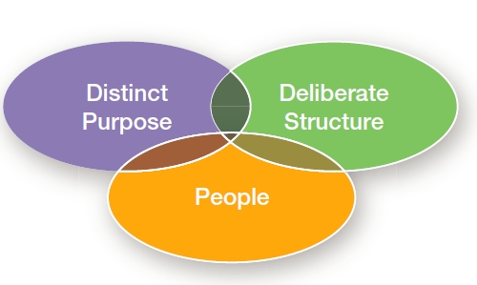
Figura 1-2
CaraCterísticas das Organizações

Slide 9
O que fazem os gestores?
A gestão diz respeito à coordenação e supervisão das atividades de trabalho dos membros da organização, de modo a que essas atividades sejam realizadas de forma eficaz e eficiente.
Notes:
Management involves coordinating and overseeing the work activities of others so their activities are completed efficiently and effectively. While coordinating and overseeing the work of others is what distinguishes a managerial position from a non-managerial one, this doesn’t mean that managers can do what they want anytime, anywhere, or in any way. Instead, management involves ensuring that work activities are completed efficiently and effectively by the people responsible for doing them, or, at least that’s what managers should be doing.

Slide 10
Eficiência e Eficácia
Efficiency
Effectiveness
Doing things right
[Fazer as coisas da melhor forma.]
  Doing the right things
[Fazer as coisas certas.]
Recursos
Objetivos
Notes:
Efficiency refers to getting the most output from the least amount of inputs or resources. Managers deal with scarce resources—including people, money, and equipment—and want to use those resources efficiently.
Effectiveness is often described as “doing the right things,” that is, doing those work activities that will result in achieving goals.
Whereas efficiency is concerned with the means of getting things done, effectiveness is concerned with the ends, or attainment of organizational goals.

Slide 11
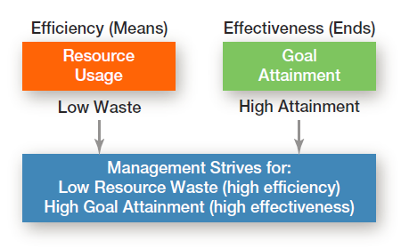
Figura 1-3
Eficiência e Eficácia

Slide 12
Gestão: A Abordagem das funções (Fayol)
Planeamento – Definição de objetivos, estabelecimento de estratégias para atingir esses objetivos, e desenvolvimento de planos para integrar e coordenar as atividades.
Organização – Combinação e estruturação do trabalho para atingir os objetivos da organização.
Direção – Trabalhar com e através das pessoas, para atingir os objetivos da organização.
Controle – Monitorar, comparar e corrigir o desempenho planeado.
Notes:
According to the functions approach, managers perform certain activities or functions as they efficiently and effectively coordinate the work of others. What are these
functions? Henri Fayol, a French businessman, first proposed in the early part of the twentieth century that all managers perform five functions: planning, organizing,
commanding, coordinating, and controlling. Today, these functions have been condensed to four: planning, organizing, leading, and controlling (see Exhibit 1-4).

Slide 13
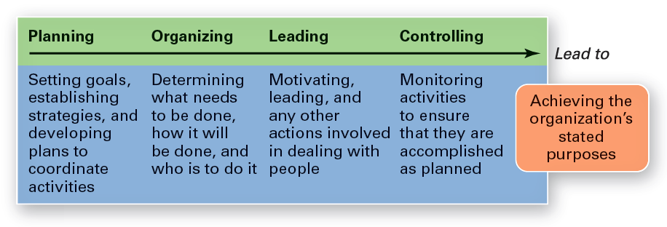
Figura 1-4
As quarto funções da gestão
Notes:
As managers engage in planning, they set goals, establish strategies for achieving those goals, and develop plans to integrate and coordinate activities.
When managers organize, they determine what tasks are to be done, who is to do them, how the tasks are to be grouped, who reports to whom, and where decisions are to be made.
When managers motivate subordinates, help resolve work group conflicts, influence individuals or teams as they work, select the most effective communication
channel, or deal in any way with employee behavior issues, they’re leading. To ensure goals are met and work is done as it should be, managers monitor and evaluate performance. Actual performance is compared with the set goals. If those goals aren’t achieved, it’s the manager’s job to get work back on track.
This process of monitoring, comparing, and correcting is the controlling function.

Slide 14
Gestão: A Abordagem dos papéis (Mintzberg)
Os papéis são as ações e os comportamentos esperados dos gestores.
Mintzberg identificou 10 papéis, agrupados em 3 categorias:
papéis interpessoais;
papéis informacionais;
papéis decisionais.
Notes:
Henry Mintzberg, a well-known management researcher, studied actual managers at work. In his first comprehensive study, Mintzberg concluded that what managers do can best be described by looking at the managerial roles they engage in at work. The term managerial roles refers to specific actions or behaviors expected of, and exhibited by, a manager.

Slide 15
Os TRÊs tipos de papéis
Papéis interpessoais
  Representante, líder e ligação.
Papéis informacionais
  Monitor, disseminador e porta-voz.
Papéis decisionais
  Empreendedor, solucionador de conflitos, distribuidor de recursos e negociador.
Notes:
As shown in Exhibit 1-5, these 10 roles are grouped around interpersonal relationships, the transfer of information, and decision-making.
The interpersonal roles involve people (subordinates and persons outside the organization) and other ceremonial and symbolic duties. The three interpersonal
roles include figurehead, leader, and liaison. The informational roles involve collecting, receiving, and disseminating information. The three informational roles include monitor, disseminator, and spokesperson. Finally, the decisional roles entail making decisions or choices and include entrepreneur, disturbance handler, resource allocator,
and negotiator.

Slide 16
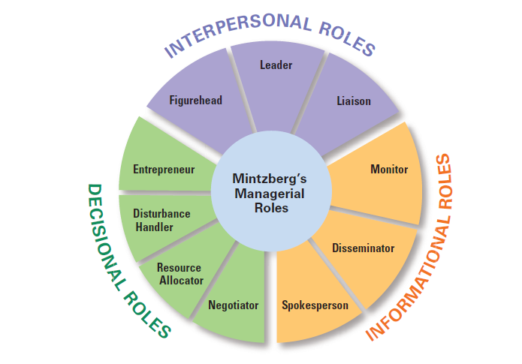
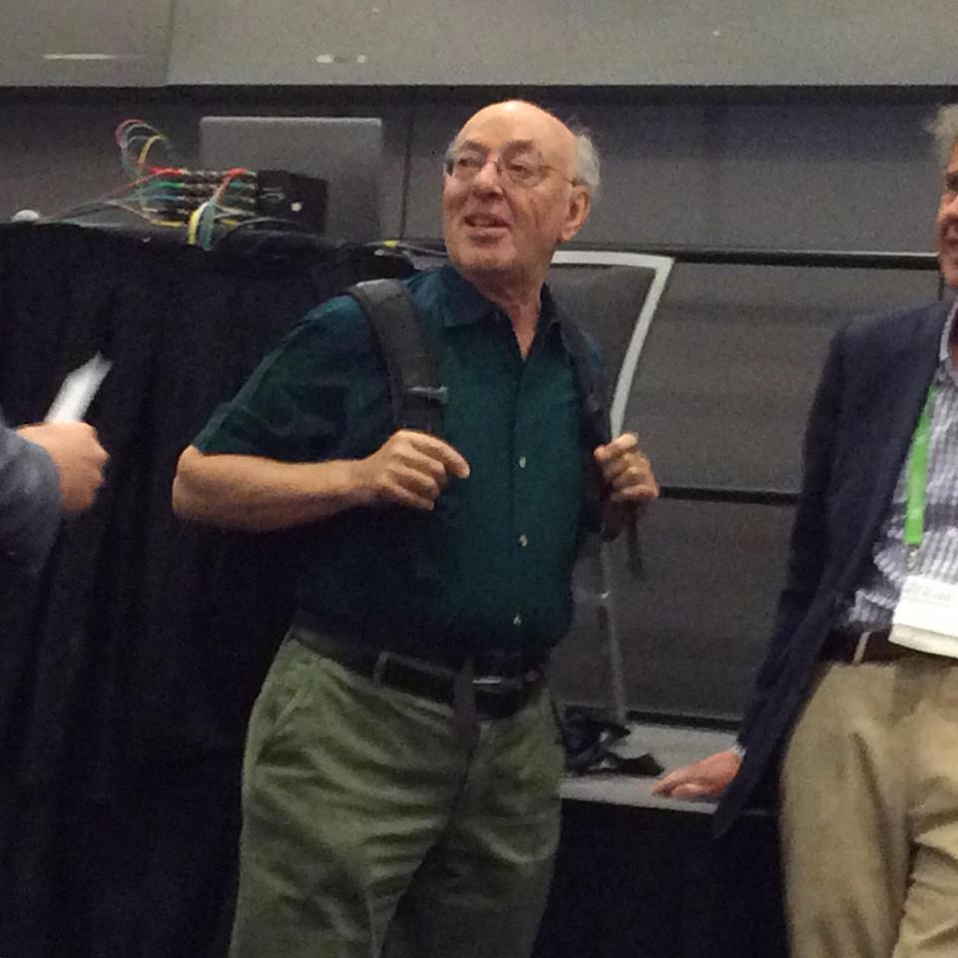
Figura 1-5
Os papéis dos gestores
Conferência da Academy of Management
Agosto de 2015, Vancouver, Canadá

Slide 17
Gestão: Competências dos gestores (Katz)
Competências técnicas
  Conhecimento numa área específica, que permite desempenhar tarefas nessa área.
Competências humanas
  Capacidade de trabalhar bem com outras pessoas.
Competências concetuais
  Capacidade de pensar e concetualizar situações abstratas e complexas.
Notes:
What types of skills do managers need? Robert L. Katz proposed that managers need three critical skills in managing: technical, human, and conceptual.
Technical skills are the job-specific knowledge and techniques needed to proficiently perform work tasks. These skills tend to be more important for first-line managers because they typically manage employees who use tools and techniques to produce the organization’s products or service the organization’s customers.
Human skills involve the ability to work well with other people both individually and in a group. Because all managers deal with people, these skills are equally important to all levels of management.
Finally, conceptual skills are the skills managers use to think and to conceptualize about abstract and complex situations. Using these skills, managers see the organization
as a whole, understand the relationships among various subunits, and visualize how the organization fits into its broader environment. These skills are most important
to top managers.

Slide 18
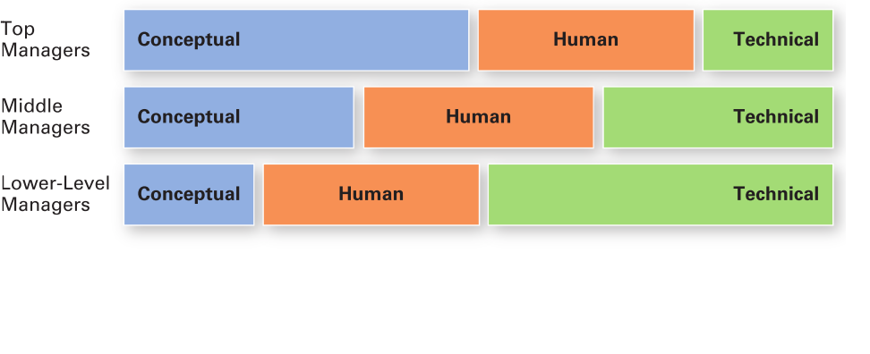
Figura 1-6
Competências necessárias nos diferentes níveis de gestão (KatZ)

Slide 19
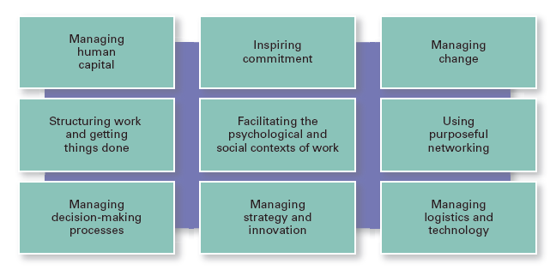
Figura 1-7
Competências necessárias na atualidade
Notes:
Other important managerial skills that have been identified are listed in Exhibit 1-7. In today’s demanding and dynamic workplace, employees who want to be valuable assets must constantly upgrade their skills, and developing management skills can be particularly beneficial in today’s workplace.

Slide 20
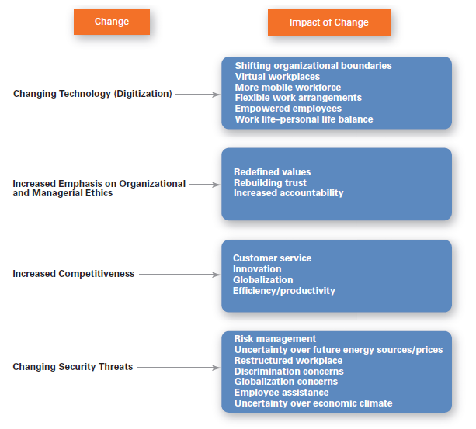
Figura 1-8
Desafios atuais no trabalho dos gestores
Notes:
In today’s world, managers are dealing with global economic and political uncertainties, changing workplaces, ethical issues, security threats, and changing technology. It’s likely that more managers will have to manage under such demanding circumstances, and the fact is that how managers manage is changing. Exhibit 1-8 shows some of the most important changes facing managers.

Slide 21
A importância dos clientes
Clientes – a razão de ser das organizações.
  Gerir as relações com os clientes é da responsabilidade de todos os gestores e empregados.
  Uma qualidade de serviço ao cliente consistente é essencial para a sobrevivência.
Notes:
You need customers. Without them, most organizations would cease to exist. Yet, focusing on the customer has long been thought to be the responsibility of marketing types. Today, the majority of employees in developed countries work in service jobs. Almost 77 percent of the U.S. labor force is employed in service industries.

Slide 22
A importância dos media
Redes sociais (digitais)
  Formas de comunicação eletrónica através das quais os utilizadores podem criar comunidades online, para partilhar ideias, informação, mensagens pessoais e outros conteúdos.
Notes:
Today, the new frontier is social media, forms of electronic communication through which users create online communities to share ideas, information, personal messages, and other content. “More than a billion people use social platforms such as Facebook, Twitter, YouTube, LinkedIn, and others. Although sources say it’s too early to draw any conclusions, it appears that managers who actively make use of social media have increases in performance.”

Slide 23
A importância da inovação
Inovação
  Fazer as coisas de modo diferente, explorar novos territórios e correr riscos.
  Os gestores devem encorajar os empregados a estarem atentos e a agirem rapidamente, quando ocorrem oportunidades de inovação.
Notes:
Innovation means doing things differently, exploring new territory, and taking risks. Innovation isn’t just for high tech or other technologically sophisticated organizations. Innovative efforts can be found in all types of organizations.

Slide 24
A importância da sustentabilidade
Sustentabilidade
Capacidade da organização para atingir os seus objetivos de negócio e aumentar o seu valor de mercado, no longo prazo, através da integração de oportunidades económicas, ambientais e sociais nas suas estratégias de negócio.
Notes:
What’s emerging in the twenty-first century is the concept of managing in a sustainable way, which has had the effect of widening corporate responsibility not only to managing in an efficient and effective way, but also to responding strategically to a wide range of environmental and societal challenges. From a business perspective, sustainability has been defined as a company’s ability to achieve its business goals and increase long-term shareholder value by integrating economic, environmental, and social opportunities into its business strategies.

Slide 25
Qual o interesse de estudar a gestão?
Universalidade da gestão
  A gestão é necessária
    em todos os tipos e tamanhos de organização
    em todos os níveis da organização
    em todas as áreas da organização
    Em todas as organizações, independentemente da sua localização.
Notes:
We can say with absolute certainty that management is needed in all types and sizes of organizations, at all organizational levels and in all organizational work areas, and in all organizations, no matter where they’re located. This is known as the universality of management (See Exhibit 1-9.)

Slide 26
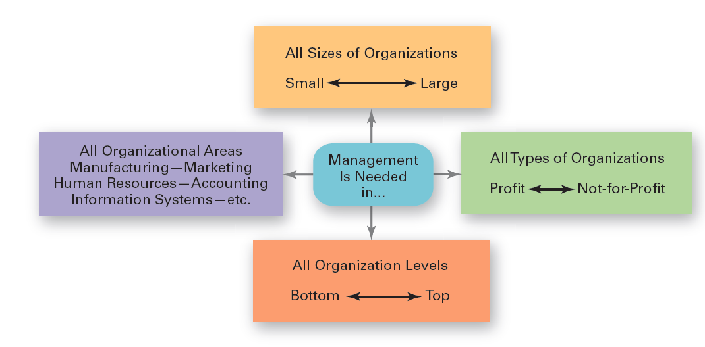
Figura 1-9
Universalidade da gestão
Notes:
Effective management is universally needed in all organizations, therefore it’s imperative to find ways to improve the way organizations are managed. Why? Because we interact with organizations every single day. Organizations influence every aspect of our lives.

Slide 27
Desafios
  Pode ser um trabalho que ninguém reconhece.
  Pode incluir muitas tarefas administrativas.
  Passar grande parte do tempo em reuniões e ser constantemente interrompido.
  Ter de lidar com pessoas com personalidades muito distintas.
  Ter de lidar com recursos limitados.
Notes:
There are many challenges to being a manager. It can be a tough and often thankless job. Additionally, a portion of a manager’s job (especially at lower organizational levels) may entail duties that are often more clerical (compiling and filing reports, dealing with bureaucratic procedures, or doing paperwork) than managerial. A large percentage of managers spend significant amounts of time in meetings and deal with interruptions, which can be time consuming and sometimes unproductive. Managers often have to deal with a variety of personalities and have to make do with limited resources. It can be a challenge to motivate workers in the face of uncertainty and chaos, which are constants in management regardless of the field or discipline.

Slide 28
Benefícios
  Ser responsável pela existência de um ambiente de trabalho produtivo.
  Reconhecimento e status, tanto na organização como na comunidade.
  Recompensas financeiras atrativas, na forma de salários, bónus ou ações da empresa.
Notes:
Despite challenges, being a manager can be rewarding. You’re responsible for creating a work environment in which organizational members can do their work to the best of their ability and thus help the organization achieve its goals. You help others find meaning and fulfillment in their work. You get to support, coach, and nurture others and help them make good decisions. In addition, as a manager, you often have the opportunity to think creatively and use your imagination. You’ll get to meet and work with a variety of people—both inside and outside the organization. Other rewards may include receiving recognition and status in your organization and in the community, playing a role in influencing organizational outcomes, and receiving attractive compensation in the form of salaries, bonuses, and stock options.

Slide 29
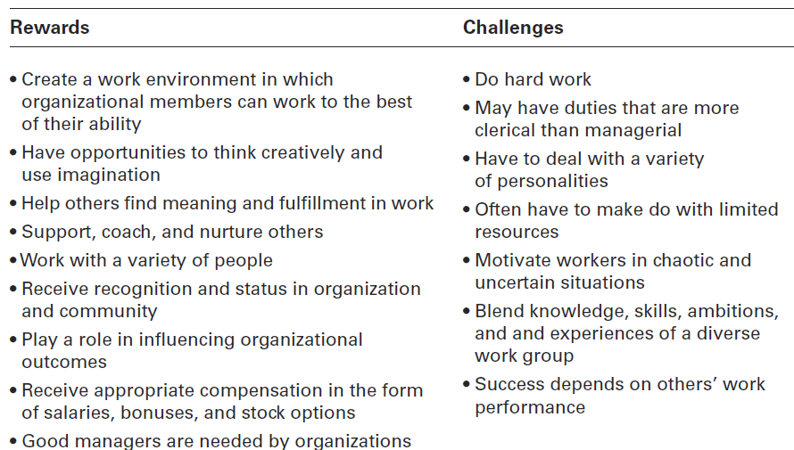
Figura 1-10
Benefícios e desafios dos gestores

Slide 30


