Slide 1
Chapter 3
Cost of Capital – “CORPORATE FINANCE SECTION”

Slide 2
1. Introduction
The cost of capital is the cost of using the funds of creditors and owners.
Creating value requires investing in capital projects that provide a return greater than the project’s cost of capital.
  When we view the firm as a whole, the firm creates value when it provides a return greater than its cost of capital.
Estimating the cost of capital is challenging.
  We must estimate it because it cannot be observed.
  We must make a number of assumptions.
  For a given project, a firm’s financial manager must estimate its cost of capital.
Notes:
LOS: Calculate and interpret the weighted average cost of capital (WACC) of a company.
Page 128
1. Introduction
The cost of capital is the cost of using the funds of creditors and owners.
The cost of capital for the company as a whole is often used as a basis for estimating project costs of capital.
In Chapter 2, the cost of capital (also known as the required rate of return) is project specific.

Slide 3
2. Cost of capital
The cost of capital is the rate of return that the suppliers of capital—bondholders and owners—require as compensation for their contributions of capital.
  This cost reflects the opportunity costs of the suppliers of capital.
The cost of capital is a marginal cost: the cost of raising additional capital.
The weighted average cost of capital (WACC) is the cost of raising additional capital, with the weights representing the proportion of each source of financing that is used.
  Also known as the marginal cost of capital (MCC).
Notes:
LOS: Calculate and interpret the weighted average cost of capital (WACC) of a company.
Pages 128–129
Cost of Capital
The cost of capital is the rate of return that the suppliers of capital—bondholders and owners—require as compensation for their contribution of capital.
The cost of capital is a marginal cost because it is the cost associated with making an investment, so everything is at the margin (that is, incremental).
Discussion question: What is the reason for the cost of capital to reflect the marginal cost of capital instead of the average or embedded cost of capital?

Slide 4
WACC
WACC = w_{d}r_{d} (1 − t) + w_{p}r_{p} + w_{e}r_{e} (3-1)
where
w_{d} is the proportion of debt that the company uses when it raises new funds
r_{d} is the before-tax marginal cost of debt
t is the company’s marginal tax rate
w_{p} is the proportion of preferred stock the company uses when it raises new funds
r_{p} is the marginal cost of preferred stock
w_{e} is the proportion of equity that the company uses when it raises new funds
r_{e} is the marginal cost of equity
Notes:
LOS: Calculate and interpret the weighted average cost of capital (WACC) of a company.
Page 129
WACC
Note that the costs and tax rate are all on the margin.

Slide 5
Example: Wacc
Suppose the Widget Company has a capital structure composed of the following, in billions:
If the before-tax cost of debt is 9%, the required rate of return on equity is 15%, and the marginal tax rate is 30%, what is Widget’s weighted average cost of capital?
Solution:
  WACC = [(0.20)(0.09)(1 – 0.30)] + [(0.8)(0.15)]
  = 0.0126 + 0.120
  = 0.1325, or 13.25%
Debt | €10
Common equity | €40
Notes:
LOS: Calculate and interpret the weighted average cost of capital (WACC) of a company.
Pages 128–129
Example: WACC
Calculations
Weight of debt = €10 ÷ (€10 + €40) = 0.20 or 20%
Weight of common equity = €40 ÷ (€10 + €40) = 0.80 or 80%
This example is similar to Example 3-1 but without any preferred equity.

Slide 6
Example: WACC
Interpretation:
When the Widget Company raises €1 more of capital, it will raise this capital in the proportions of 20% debt and 80% equity, and its cost will be 13.25%.
Notes:
LOS: Calculate and interpret the weighted average cost of capital (WACC) of a company.
Example: WACC

Slide 7
Taxes and the Cost of capital
Interest on debt is tax deductible; therefore, the cost of debt must be adjusted to reflect this deductibility.
  We multiple the before-tax cost of debt (r_{d}) by the factor (1 – t), with t as the marginal tax rate.
  Thus, r_{d} × (1 − t) is the after-tax cost of debt.
Payments to owners are not tax deductible, so the required rate of return on equity (whether preferred or common) is the cost of capital.
Notes:
LOS: Describe how taxes affect the cost of capital from different capital sources.
Pages 129–130
Taxes and the Cost of Capital
If the concept of tax deductibility of interest is needs more explanation, consider an example:
Suppose a company has earnings before interest and taxes (EBIT) of $100, $200 of debt with a before-tax cost of 8%, and a 25% tax rate. Then:
Without tax deductibility:
EBIT $100
Taxes –25
Net income $75
With tax deductibility:
EBIT $100
Interest –16
Earnings for taxes $84
Taxes –21
Net income $63
Therefore, the tax deductibility of the $16 of interest saves $25–$21 = $4 of taxes, or 25% × $16 = $4.

Slide 8
Weights of the Weighted Average
The weights should reflect how the company will raise additional capital.
Ideally, we would like to know the company’s target capital structure, which is the capital structure that is the company’s goal, but we cannot observe this goal.
Alternatives
  Assess the market value of the company’s capital structure components.
  Examine trends in the company’s capital structure.
  Use capital structures of comparable companies (e.g., weighted average of comparables’ capital structure).
Notes:
LOS: Explain alternative methods of calculating the weights used in the WACC, including the use of the company’s target capital structure.
Pages 131–133
Weights of the Weighted Average
The target capital structure is the ideal, but as analysts, we cannot observe it.
The proxies include
the current market value,
the extrapolated trend in the company’s capital structure, and
the capital structure of comparables.
Example 3-3 demonstrates the market value and the comparables approach.

Slide 9
Applying the Cost of capital to capital Budgeting and Security Valuation
The investment opportunity schedule (IOS) is a representation of the returns on investments.
We assume that the IOS is downward sloping: the more a company invests, the lower the additional opportunities.
  That is, the company will invest in the highest-returning investments first, followed by lower-yielding investments as more capital is available to invest.
The marginal cost of capital (MCC) schedule is the representation of the costs of raising additional capital.
  We generally assume that the MCC is upward sloping: the more funds a company raises, the greater the cost.
CR: BE CAREFUL WITH THIS ASSUMPTION
Notes:
LOS: Explain how the marginal cost of capital and the investment opportunity schedule are used to determine the optimal capital budget.
Page 133–135
Applying the Cost of Capital to Capital Budgeting and Security Valuation
The optimal capital budget occurs when the benefits (from the IOS schedule) equal the costs (the MCC schedule).

Slide 10
Optimal Investment Decision
CR: BE CAREFUL WITH THIS ANALYSIS. WHICH THEORY PREDICTS THIS? IS THE RISK CHANGING?? DOES THE WACC INCREASE AS COMPANIES USE MORE CAPITAL OVERALL? NOT NECESSARILY! IT WILL DEPEND ON THE RISKINESS/TYPE OF PROJECT UNDER ANALYSIS
Notes:
LOS: Explain how the marginal cost of capital and the investment opportunity schedule are used to determine the optimal capital budget.
Pages 133–135
Optimal Investment Decision
The optimal investment decision is the amount of investment in which the marginal cost of capital is equal to the return on new investment.
The graph is similar to Exhibit 3-1.

Slide 11
Using the MCC in capital
Budgeting and Analysis
The WACC is the marginal cost for additional funds and, hence, additional investments.
In capital budgeting
  We use the WACC, adjusted for project-specific risk, to calculate the net present value (NPV).
  Using a company’s overall WACC in evaluating a capital project assumes that the project has risk similar to the average project of the company.
In analysis
  Analysts can use the WACC in valuing the company by discounting cash flows to the firm.
Notes:
LOS: Explain the marginal cost of capital’s role in determining the net present value of a project.
Pages 134–135
Using the MCC in Capital Budgeting and Analysis
Capital budgeting issues:
If the project has risk that is similar to that of the firm as a whole, then using the WACC in discounting project cash flows to calculate the NPV is appropriate.
What if the project is not of average risk? Without adjustment, profitable projects with below-average risk would likely be rejected and unprofitable projects with higher-than-average risk may be accepted.
Security valuation issues:
When discounting cash flows of the entire company (e.g., free cash flows to the firm), use the WACC.
When discounting equity cash flows (e.g., dividends or free cash flows to equity), use the cost of equity.

Slide 12
3. Costs of the Different sources of capital
Costs of Capital
Cost of Debt
Cost of Preferred Equity
Cost of Common Equity
Yield to Maturity
Debt Rating
Return on Preferred Stock
Variations because of Callability, etc.
Capital Asset Pricing Model
Dividend Discount Model
Bond Yield plus Risk Premium
Notes:
LOS: Calculate and interpret the cost of fixed rate debt capital using the yield-to-maturity approach and the debt-rating approach.
Page 135–138
3. Costs of the Different Sources of Capital

Slide 13
The cost of Debt
Alternative approaches
  Yield-to-maturity approach: Calculate the yield to maturity on the company’s current debt.
  Debt-rating approach: Use yields on comparably rated bonds with maturities similar to what the company has outstanding.
Notes:
LOS: Calculate and interpret the cost of fixed rate debt capital using the yield-to-maturity approach and the debt-rating approach.
Pages 135–138
The Cost of Debt
Yield-to-maturity approach: Calculate the yield to maturity on existing debt.
Debt-rating approach: Estimate the yield based on similarly rated debt and the average yield in that debt class.

Slide 14
Example: Cost of debt
Yield-to-Maturity Approach
Consider a company that has $100 million of debt outstanding that has a coupon rate of 5%, 10 years to maturity, and is quoted at $98. What is the after-tax cost of debt if the marginal tax rate is 40%? Assume semi-annual interest.
Solution:
r_{d} = 0.0526 (1 – 0.4) = 3.156%
The cost of debt capital is 3.156%
Debt-Rating Approach
Consider a company that has nontraded $100 million of debt outstanding that has a debt-rating of AA. The yield on AA debt is currently 6.2%. What is the after-tax cost of debt if the marginal tax rate is 40%?
Solution:
r_{d} = 0.062 (1 – 0.4) = 3.72%
The cost of debt capital is 3.72%
CR: NOTICE THAT THERE IS NO DISCUSSION WHATSOEVER ON DEBT BEING RISKY AND EXPECTED RETURNS LOWER THAN “PROMISED” YIELDS
Notes:
LOS: Calculate and interpret the cost of fixed rate debt capital using the yield-to-maturity approach and the debt-rating approach.
Pages 135–138
Example: Cost of Debt
Yield to maturity
PMT = 2.5
N = 20
PV = 98
FV = 100
Solve for I, then multiple by 2 → YTM = 5.26%
Debt-Rating approach
The yield is the yield for similarly rated bonds.

Slide 15
Issues in estimating the cost of debt
The cost of floating-rate debt is difficult because the cost depends not only on current rates but also on future rates.
  Possible approach: Use current term structure to estimate future rates.
Option-like features affect the cost of debt.
  If the company already has debt with embedded options similar to what it may issue, then we can use the yield on current debt.
  If the company is expected to alter the embedded options, then we would need to estimate the yield on the debt with embedded options.
Nonrated debt makes it difficult to determine the yield on similarly yielding debt if the company’s debt is not traded.
  Possible remedy: Estimate rating by using financial ratios.
Leases are a form of debt, but there is no yield to maturity.
  Estimate by using the yield on other debt of the company.
Notes:
LOS: Calculate and interpret the cost of fixed rate debt capital using the yield-to-maturity approach and the debt-rating approach.
Pages 135–138
Issues in Estimating the Cost of Debt
For each issue, there are possible alternatives, although each of these alternatives may be problematic.
The cost of floating-rate debt is difficult because the cost depends not only on current rates, but also on future rates.
Possible approach: Use current term structure to estimate future rates (that is, forward rates).
Option-like features affect the cost of debt (e.g., callability, putability, convertibility).
If the company already has debt with embedded options similar to what it may issue, then we can use the yield on current debt.
If the company is expected to alter the embedded options, then we need to estimate the yield on the debt with embedded options.
Nonrated debt makes it difficult to determine the yield on similarly yielding debt if the company’s debt is not traded.
Possible remedy: Estimate rating by using financial ratios (although this method is imprecise).
Leases are a form of debt, but there is no yield to maturity.
Estimate by using the yield on other debt of the company (i.e., debentures).

Slide 16
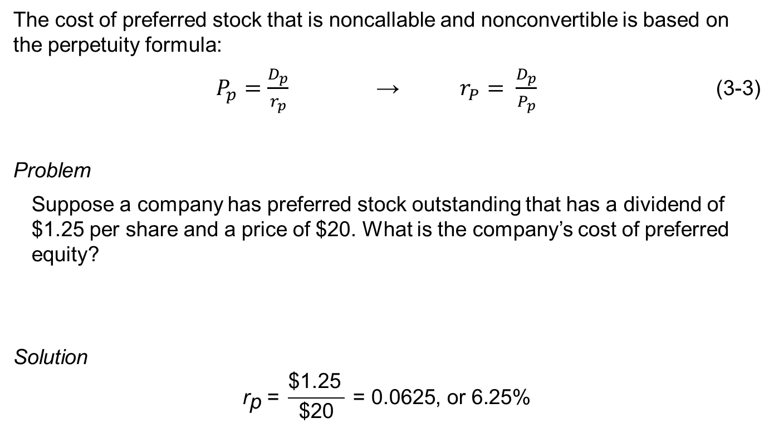
The Cost of Preferred Stock
The cost of preferred stock that is noncallable and nonconvertible is based on the perpetuity formula:
$P_{p}=\frac{D_{p}}{r_{p}}$ → $r_{P}= \frac{D_{p}}{P_{p}}$ (3-3)
Problem
  Suppose a company has preferred stock outstanding that has a dividend of $1.25 per share and a price of $20. What is the company’s cost of preferred equity?
Solution
$${\text{r}}_{\text{p}} \text{= }\frac{\text{\$1.25} }{\text{\$20}} \text{= 0.0625, }\text{or}\text{ 6.25\%}$$
Notes:
LOS: Calculate and interpret the cost of noncallable, nonconvertible preferred stock.
Pages 138–140
The Cost of Preferred Stock
See also Examples 3-5 and 3-6.
Note: The tax rate is irrelevant for the calculation of the cost of preferred stock because the dividends on preferred stock are not tax deductible by the issuer.

Slide 17
The Cost of Equity
Methods of estimating the cost of equity:
Capital asset pricing model
Dividend discount model
Bond yield plus risk premium
Notes:
LOS: Calculate and interpret the cost of equity capital using the capital asset pricing model approach, the dividend discount approach, and the bond yield plus risk premium approach.
Page 140
The Cost of Equity

Slide 18
Using the CAPM to estimate the
Cost of Equity
The capital asset pricing model (CAPM) states that the expected return on equity, E(R_{i}) , is the sum of the risk-free rate of interest, R_{F}, and a premium for bearing market risk, β_{i} [E(R_{M}) – R_{F}]:
E(R_{i}) = R_{F} + β_{i} [E(R_{M}) – R_{F}] (3-4)
  where
    β_{i} is the return sensitivity of stock i to changes in the market return
    E(R_{M}) is the expected return on the market
    E(R_{M}) – R_{F} is the expected market risk premium or equity risk premium (ERP)
Notes:
LOS: Calculate and interpret the cost of equity capital using the capital asset pricing model approach, the dividend discount approach, and the bond yield plus risk premium approach.
Pages 140–144
Using the CAPM to Estimate the Cost of Equity
The CAPM requires estimating:
The risk-free rate of interest
The stock’s beta
The market risk premium

Slide 19
Example: Cost of Equity using the CAPM
Problem:
  If the risk-free rate is 3%, the expected market risk premium is 5%, and the company’s stock beta is 1.2, what is the company’s cost of equity?
Solution:
  Cost of equity = 0.03 + (1.2 × 0.05) = 0.03 + 0.06 = 0.09, or 9%
Notes:
LOS: Calculate and interpret the cost of equity capital using the capital asset pricing model approach, the dividend discount approach, and the bond yield plus risk premium approach.
Page 140–144
Example: Cost of Equity using the CAPM
This example is similar to Example 3-7.

Slide 20
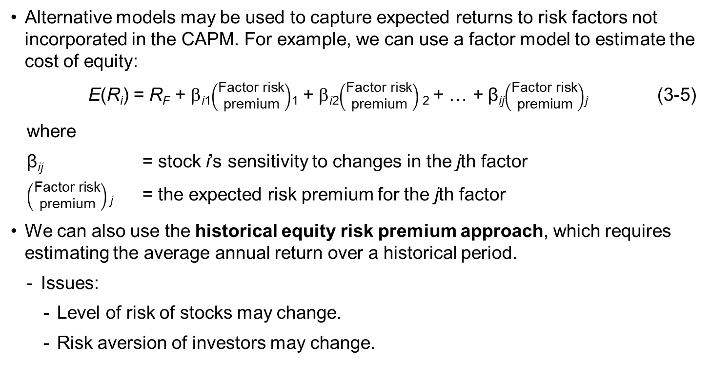
Alternatives to the CAPM
Alternative models may be used to capture expected returns to risk factors not incorporated in the CAPM. For example, we can use a factor model to estimate the cost of equity:
  E(R_{i}) = R_{F} + β_{i1}$\left(\begin{matrix}\text{F}\text{actor} \text{risk} \\ \text{premium}\end{matrix}\right)$₁ + β_{i2}$\left(\begin{matrix}\text{F}\text{actor} \text{risk} \\ \text{premium}\end{matrix}\right)$₂ + … + β_{ij}$\left(\begin{matrix}\text{F}\text{actor} \text{risk} \\ \text{premium}\end{matrix}\right)$_{j} (3-5)
  where
  β_{ij} = stock i’s sensitivity to changes in the jth factor
  $\left(\begin{matrix}\text{F}\text{actor} \text{risk} \\ \text{premium}\end{matrix}\right)$_{j} = the expected risk premium for the jth factor
We can also use the historical equity risk premium approach, which requires estimating the average annual return over a historical period.
  Issues:
    Level of risk of stocks may change.
    Risk aversion of investors may change.
Notes:
LOS: Calculate and interpret the cost of equity capital using the capital asset pricing model approach, the dividend discount approach, and the bond yield plus risk premium approach.
Pages 140–144
Alternatives to the CAPM
The factor models may include macroeconomic factors (e.g., arbitrage pricing theory models), company-specific factors (e.g., Fama–French models), or indices in addition to the market (e.g., industry index).
The historical equity premium approach requires the estimation of the mean return over a period of time.
Preferred: geometric mean return
Issues:
The level of the stock market risk may change over time.
The risk aversion of investors may change over time.

Slide 21
Using the Dividend Valuation Model to Estimate the Cost of Equity
The dividend discount model (DDM) assumes that the value of a stock today is the present value of all future dividends, discounted at the required rate of return.
Assuming a constant growth in dividends:
P=DPS/(Re-g)
  which we can rearrange to solve for the required rate of return:
Re=DPS/P+g (3-6)
We can estimate the growth rate, g, by using third-party estimates of the company’s dividend growth or estimating the company’s sustainable growth.
The sustainable growth is the product of the return on equity (ROE) and the retention rate (1 minus the dividend payout ratio, or ):
g= ROE * retention rate
Notes:
LOS: Calculate and interpret the cost of equity capital using the capital asset pricing model approach, the dividend discount approach, and the bond yield plus risk premium approach.
Pages 144–145
Using the Dividend Valuation Model to Estimate the Cost of Equity
If dividends do not grow at a constant rate, estimating the required rate of return on equity is much more challenging.
We can estimate the sustainable growth using the product of the retention rate and the return on equity.
Note: Some averaging over time may be appropriate because of the variability of earning and ROE for some companies.

Slide 22
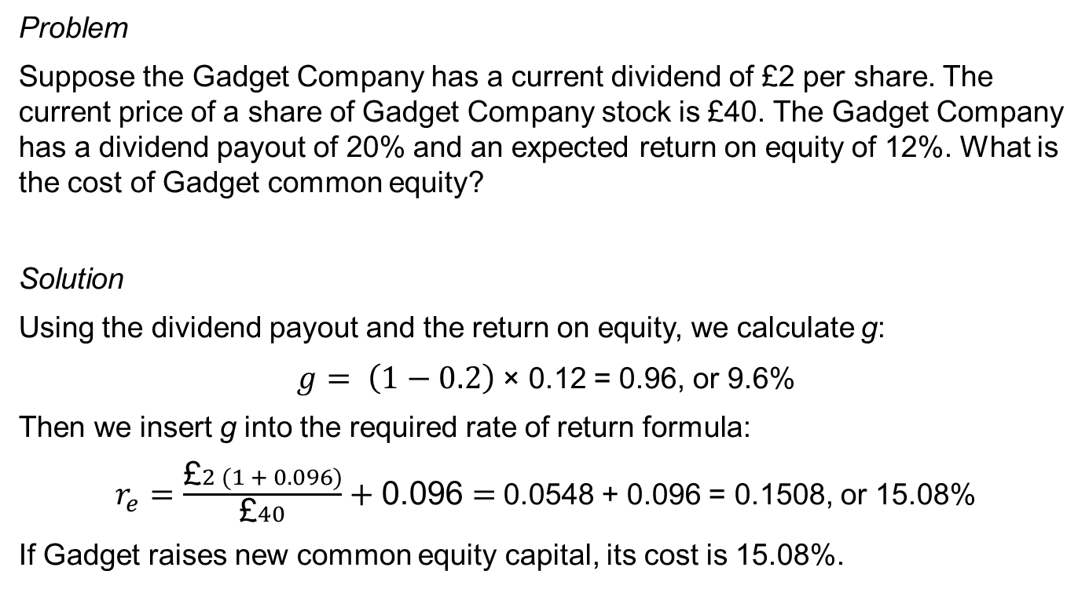
Using the DDM to estimate the cost of Equity
Problem
Suppose the Gadget Company has a current dividend of £2 per share. The current price of a share of Gadget Company stock is £40. The Gadget Company has a dividend payout of 20% and an expected return on equity of 12%. What is the cost of Gadget common equity?
Solution
Using the dividend payout and the return on equity, we calculate g:
$g= \left(1−0.2\right)$ × 0.12 = 0.96, or 9.6%
Then we insert g into the required rate of return formula:
$r_{e}=\frac{\text{£}2 (1 + 0.096)}{\text{£}40}+\text{0.096}=$0.0548 + 0.096 = 0.1508, or 15.08%
If Gadget raises new common equity capital, its cost is 15.08%.
Notes:
LOS: Calculate and interpret the cost of equity capital using the capital asset pricing model approach, the dividend discount approach, and the bond yield plus risk premium approach.
Pages 144–145
Using the DDM to Estimate the Cost of Equity
The dividend payout is 20%, so the retention ratio is 80%.
The product of the retention ratio and the expected return on equity is 0.8 × 0.12 = 0.096, or 9.6%.
Common error, using simply £2 in the numerator instead of the correct £2 × (1 + 0.096) = £2.192.

Slide 23
Using the bond yield plus risk premium approach to estimating the cost of equity
The bond yield plus risk premium approach requires adding a premium to a company’s yield on its debt:
r_{e} = r_{d} + Risk premium (3-8)
  This approach is based on the idea that the equity of the company is riskier than its debt, but the cost of these sources move in tandem.
CR: THIS IS A TOTALLY AD-HOC ADJUSTMENT… NOT FOLLOWING THE MM ANALYSIS AND SUBSEQUENT THEORY…
Notes:
LOS: Calculate and interpret the cost of equity capital using the capital asset pricing model approach, the dividend discount approach, and the bond yield plus risk premium approach.
Page 145–146
Using the Bond Yield Plus Risk Premium Approach to Estimate the Cost of Equity
The bond yield plus risk premium approach requires adding a premium to a company’s yield on its debt:
Required rate of return on equity = Before-tax cost of debt + Risk premium
The bond yield plus risk premium approach assumes that the spread between a company’s bond yield and its required rate of return is constant.

Slide 24
4. Topics in cost of capital estimation
Estimating a project’s beta
Estimating country-risk premiums
Using an upward-sloping marginal cost of capital schedule
Dealing with flotation costs
Notes:
LOS: Calculate and interpret the beta and cost of capital for a project.
LOS: Explain the country equity risk premium in the estimation of the cost of equity for a company located in a developing market.
LOS: Describe the marginal cost of capital schedule, explain why it may be upward sloping with respect to additional capital, and calculate and interpret its break points.
LOS: Explain and demonstrate the correct treatment of flotation costs.
Pages 146–160
4. Topics in Cost of Capital Estimation
Estimating a project’s beta (project versus company beta)
Estimating country-risk premiums (whether or not to add a premium and, if adding, what spread to add)
Using an upward-sloping marginal cost of capital schedule (when do component costs change?)
Dealing with flotation costs (typical versus preferred method)

Slide 25
Project Betas
Issues in estimating a beta:
Judgment is applied in estimating a company’s beta regarding the estimation period, the periodicity of the return interval, the appropriate market index, the use of a smoothing technique, and adjustments for small company stocks.
If a company is not publicly traded or if we are estimating a project’s beta, then we need to look at the risk of the company or project and use comparables.
When selecting a comparable for the estimation of a project beta, we ideally would like to find a company with a single line of business, and that line of business matches that of the project.
  This ideal comparable is a pure play.
  We use the beta of the comparable company to estimate an asset beta (beta reflecting only business risk) and then use it for the subject project or company.
Notes:
LOS: Calculate and interpret the beta and cost of capital for a project.
Pages 146–153
Project Betas
A comparable company is a company that has the same business risk as the project (or nontraded company).
A pure play is a company that is publicly traded that has a single line of business.
Examples: 7-11 and McDonalds.

Slide 26
Using comparables to estimate beta
Select a Comparable
Estimate the Beta for the Comparable
Unlever the Comparable’s Beta to Estimate the Asset Beta
Lever the Beta for the Project’s Financial Risk
Notes:
LOS: Calculate and interpret the beta and cost of capital for a project.
Pages 146–153
Using Comparables to Estimate Beta
The process:
Select comparables.
Estimate the beta for comparables.
Unlever the comparable’s beta to estimate the asset beta.
Lever the beta for the project’s financial risk.

Slide 27
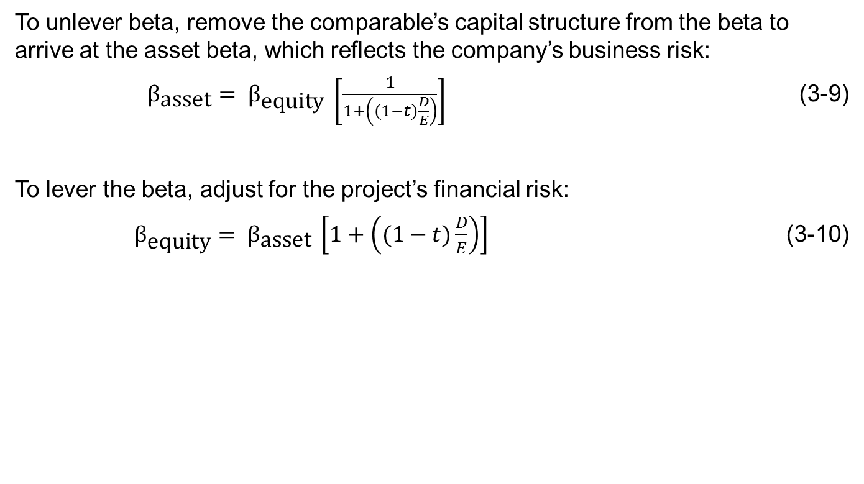
Levering and unlevering beta
To unlever beta, remove the comparable’s capital structure from the beta to arrive at the asset beta, which reflects the company’s business risk:
$β_{\text{asset}}= β_{\text{equity}} \left[\frac{1}{1+\left((1−t)\frac{D}{E}\right)}\right]$ (3-9)
To lever the beta, adjust for the project’s financial risk:
$β_{\text{equity}}= β_{\text{asset}} \left[1+\left((1−t)\frac{D}{E}\right)\right]$ (3-10)
CR:
THIS METHOD USES (THEY MIGHT NOT KNOW IT) TWO IMPORTANT UNDERLYING ASSUMPTIONS:
THAT DEBT IS PRE-DETERMINED AND PERPETUAL, “D”.
THAT DEBT HAS ZERO RISK
Notes:
LOS: Calculate and interpret the beta and cost of capital for a project.
Pages 146–153
Levering and Unlevering Beta
The formulas remove leverage (Equation 3-9) and put leverage back in (Equation 3-10).
Caution: Tax rates and debt/equity may differ between the project and its comparable firm (even though the formula does not subscript these to associate these with a specific firm).
Discussion question: Instead of applying this method to a capital project, how would you apply this method of levering and unlevering a beta to estimate the beta of a company that is not publicly traded? Explain your steps.

Slide 28
Example: Levering and Unlevering Betas
Problem
Consider the following information for the Whatsit Project and its comparable, Thatsit Company:
What is the asset beta and equity beta for the Whatsit Project based on the comparable company information and a tax rate of 40% for both companies?
Solution
  β_{asset} = 1.4 {1÷ [1 + (1 – 0.4)(100/200)]} = 1.4 × 0.76923 = 1.0769
  β_{equity} = 1.0769 [1 + (1 – 0.4)(10/40)] = 1.0769 × 1.15 = 1.2384
  The beta of the Whatsit Project is 1.2384
 | Whatsit Project | Thatsit Company
Debt | €10 | €100
Equity | €40 | €200
Equity beta | ? | 1.4
Notes:
LOS: Calculate and interpret the beta and cost of capital for a project.
Pages 146–153
Example: Levering and Unlevering Betas
The key to this calculation is to remove Thatsit’s financial leverage from its beta and then use this beta (the asset beta) as the base for applying Whatsit’s leverage.

Slide 29
Country Risk Premium
The country risk premium is the additional risk premium associated with doing business in a developing nation.
The additional premium, added to the required rate of return estimated from the CAPM, is the country equity premium, or the country spread.
To estimate the country risk premium:
  Use the sovereign yield spread, which is the difference in government bond yields.
  Adjust the sovereign yield spread by a factor that is the ratio of the
    annualized standard deviation of the developing nation’s equity index to the
    annualized standard deviation of the sovereign bond market in the developed market currency.
Notes:
LOS: Explain the country equity risk premium in the estimation of the cost of equity for a company located in a developing market.
Pages 153–154
Country Risk Premium
In the case of a project in a developing nation, we add a risk premium.
We can estimate this premium using the sovereign yield spread, which we can adjust by the ratio of the developing nation’s market index volatility to the developing nation’s bond market volatility (Equation 3-13).
See Example 3-12.

Slide 30
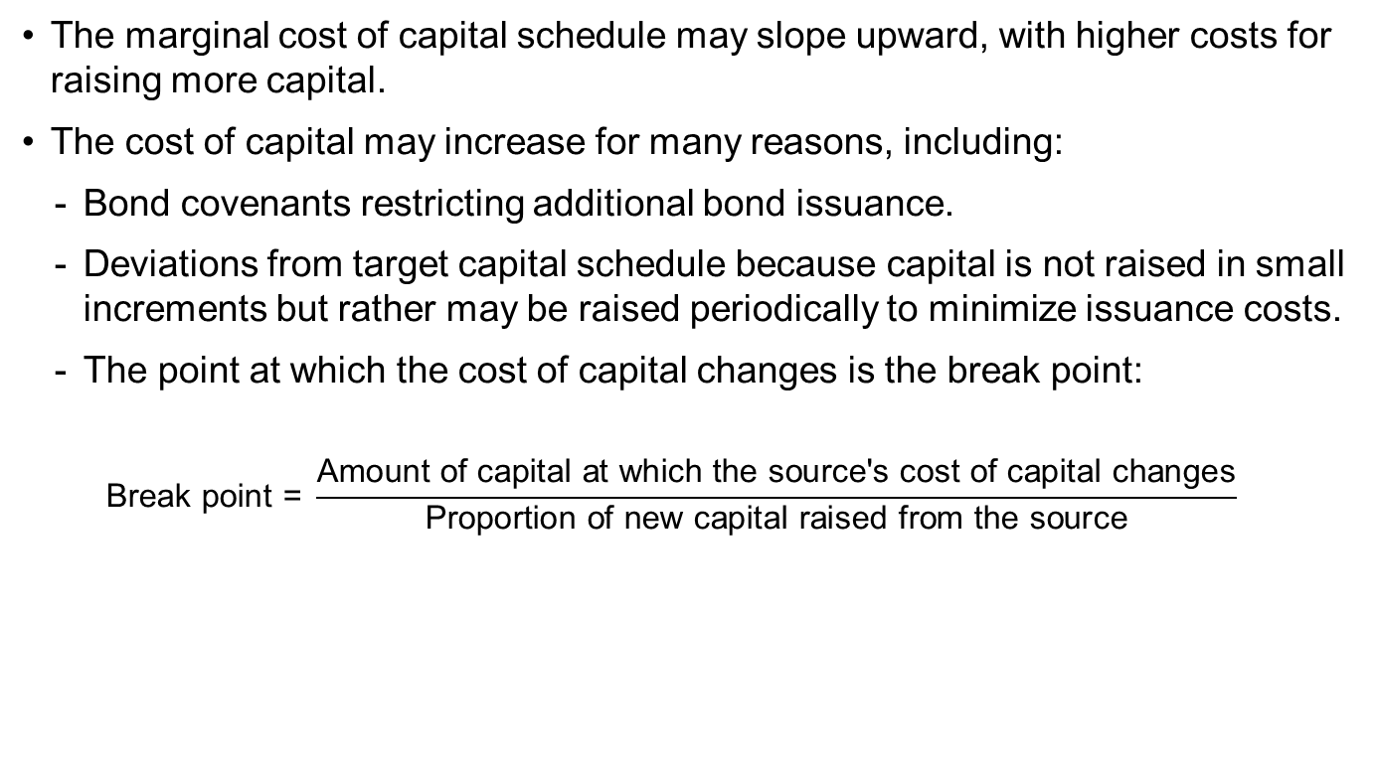
The Upward-sloping Marginal cost of capital schedule
The marginal cost of capital schedule may slope upward, with higher costs for raising more capital.
The cost of capital may increase for many reasons, including:
  Bond covenants restricting additional bond issuance.
  Deviations from target capital schedule because capital is not raised in small increments but rather may be raised periodically to minimize issuance costs.
  The point at which the cost of capital changes is the break point:
  $$\text{Break} \text{point}\text{ = }\frac{\text{Amount} \text{of} \text{capital} \text{at} \text{which} \text{the} \text{source}\text{′}\text{s} \text{cost} \text{of} \text{capital} \text{changes}}{\text{Proportion} \text{of} \text{new} \text{capital} \text{raised} \text{from} \text{the} \text{source}}$$
CR: THE EXAMPLES IN THE CFA PREP BOOKS INCLUDE THIS. BUT NOTICE THAT IN THEIR “AD-HOC” CHOICE OF INCREASING COST OF DEBT, THIS IS NOT DONE “IN EQUILIBRIUM”… AND THEY END UP SHOWING US AN OPTIMAL CAPITAL STRUCTURE WITH THE LOWEST WACC, ETC… ALTHOUGN THEY ONLY EXPLICITKY CONSIDER THE ITS AS A FACTOR OF DEVIATION FROM MM’S PERFECT WORLD. YOU KNOW BETTER THAN THAT.
Notes:
LOS: Describe the marginal cost of capital schedule, explain why it may be upward sloping with respect to additional capital, and calculate and interpret its break points.
Pages 154–157
The Upward-Sloping Marginal Cost of Capital Schedule
Break points occur because of limits on the issuance of a security (e.g., imposed by bond covenants) or because of the lumpiness of issuing securities (infrequent issuance to minimize investment banking costs).
We can estimate a break point by comparing the capital at which a source’s cost may change with the proportion of the source in the capital structure.
There may be many break points.
Discussion question: Why does the MCC slope upward?

Slide 31
Flotation Costs
A flotation cost is the investment banking fee associated with issuing securities.
There are two treatments for flotation costs:
  Adjust the price of the security in the return calculation by the flotation cost, or
  Adjust the NPV of the project for the monetary cost of flotation.
Adjusting the NPV is preferred because the flotation costs occur immediately rather than affect the company throughout the life of the project.
Problem
  Suppose a company has a project with an NPV of $100 million. If the company issues $1 billion of equity to finance this project and the flotation costs are 1.2%, what is the NPV after adjusting for flotation costs?
Solution
  NPV = $100 million – $12 million = $88 million
Notes:
LOS: Explain and demonstrate the correct treatment of flotation costs.
Pages 157–159
Flotation Costs
Most textbooks use the first approach, which adjusts the security price for the flotation costs (see Equation 3-16 in the text). The problem is that the resulting cost of capital is used to discount cash flows of the project that occur in the future, even though the flotation costs occur immediately (time = 0 in Chapter 2).
Discussion question: Why not simply subtract the flotation cost from the proceeds of the issues in calculating the cost of capital?

Slide 32
What do CFOs Do?
Cost of equity: Single-factor CAPM
Project cost of capital: Single cost of capital, but some use an adjustment for individual projects
Notes:
Page 160
What Do CFOs Do?
The evidence is from surveys.
The dividend discount model has lost favor with companies (although it was once popular).

Slide 33
5. Summary
The weighted average cost of capital is a weighted average of the after-tax marginal costs of each source of capital.
An analyst uses the WACC in valuation. For example, the WACC is used to value a project using the net present value method.
The before-tax cost of debt is generally estimated by means of one of two methods: yield to maturity or bond rating.
The yield-to-maturity method of estimating the before-tax cost of debt uses the familiar bond valuation equation.
Because interest payments are generally tax deductible, the after-tax cost is the true, effective cost of debt to the company.
The cost of preferred stock is the preferred stock dividend divided by the current preferred stock price.
The cost of equity is the rate of return required by a company’s common stockholders. We estimate this cost using the CAPM (or its variants) or the dividend discount method.
Notes:
5. Summary

Slide 34
Summary (continued)
The CAPM is the approach most commonly used to calculate the cost of common stock.
When estimating the cost of equity capital using the CAPM when we do not have publicly traded equity, we may be able to use the pure-play method, in which we estimate the unlevered beta for a company with similar business risk and then lever that beta to reflect the financial risk of the project or company.
It is often the case that country and foreign exchange risk are diversified so that we can use the estimated β in the CAPM analysis. However, in the case in which these risks cannot be diversified away, we can adjust our measure of systematic risk by a country equity premium to reflect this nondiversified risk:
The dividend discount model approach is an alternative approach to calculating the cost of equity.
Notes:
5. Summary

Slide 35
Summary (continued)
We can estimate the growth rate in the dividend discount model by using published forecasts of analysts or by estimating the sustainable growth rate:
In estimating the cost of equity, an alternative to the CAPM and dividend discount approaches is the bond yield plus risk premium approach.
The marginal cost of capital schedule is an illustration of the cost of funds for different amounts of new capital raised.
Flotation costs are costs incurred in the process of raising additional capital. The preferred method of including these costs in the analysis is as an initial cash flow in the valuation analysis.
Survey evidence indicates that the CAPM method is the most popular method used by companies in estimating the cost of equity.
Notes:
5. Summary

