Slide 1
Notes:
Banking institutions are more important than armies

Slide 2
Notes:
Rothschild quote on the power of money

Slide 3
“Any sizable group anywhere, any day, could start a nonpolitical monetary unit and system. There is no law against it, and no legislation need to be invoked.”
E.C. Riegel

Slide 5
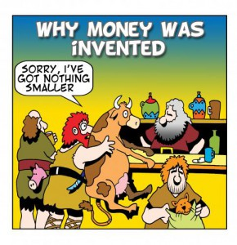
A story of Money
Trading agriculture surplus
Markets appear
1st currencies appear to facilitate trading
Energy and Complexity
Recollective societies
20,000 years BC
3,000 years BC
800 years BC
t

Slide 6
A story of Money
Direct trade (Barter):
Coincidence of desires
Common agreement on the value of goods
Divisibility and fraccioning
Transaction costs
Characteristics of a currency
Durable
Divisible
Convenient
Universally accepted

Slide 7
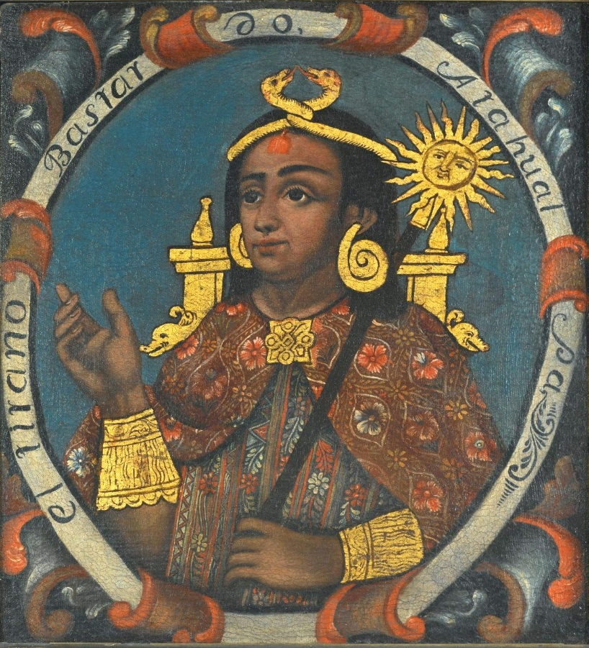
A story of Money
1ªs currencies:
Salt
Neckless
Sea shells
Tea (China)
Ivory (Africa)
Dates (Persia)
Cattle (India)
Metals:
Gold
Silver
Coper
Iron

Slide 8
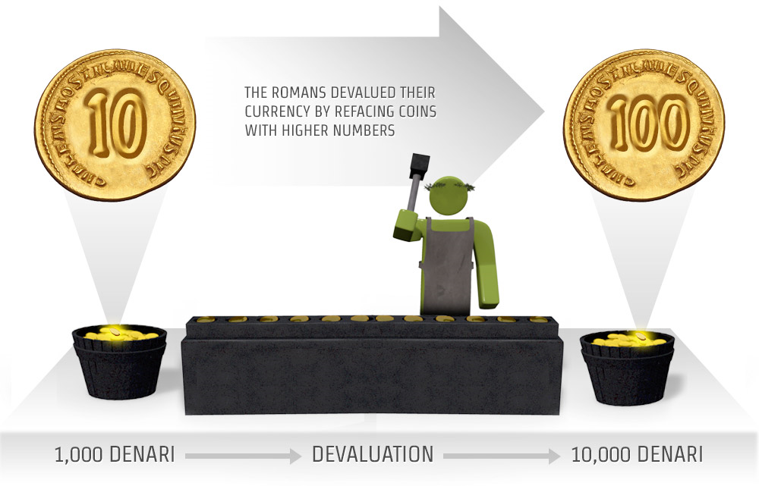
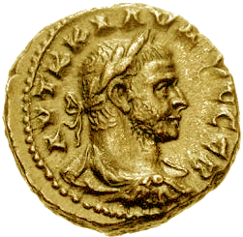
A story of Money
Weighted currency
Counted currency
Paper currency
Minted currency
Banks
The importance of the Templars
III a.c. – Romans used to coin currency in the temple of Juno Moneta whose funtion was to predict future events (“monere”)

Slide 9
A story of Money
Paper currency – letters of deposit/Bills of exchange
Commercial banking & Fiat currency (no convertibility to gold)
Electronical/Digital currency
Banking institutions and the multiplication of money
Central Banks
1694
Monetary Mass increases
Transactions costs reduced
Marginal cost of money reduced

Slide 10
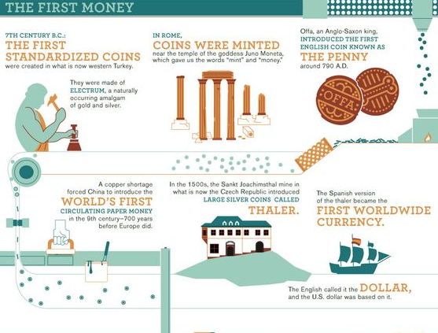
Energy and Complexity
Trading agriculture surplus
Markets appear
Precious metals and other currencies
1st currencies appear to facilitate trading
Paper money
Digital Money
What’s wrong with this story?
Recollective societies
20,000 years BC
3,000 years BC
800 years BC
500 years BC
600 years AD
2017

Slide 11
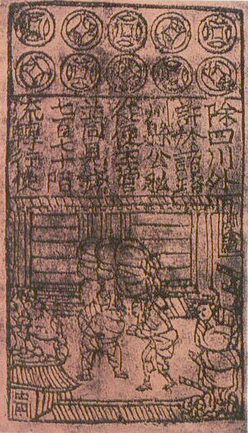
All these pieces of paper are, issued with as much solemnity and authority as if they were of pure gold or silver... with these pieces of paper, made as I have described, Kublai Khan causes all payments on his own account to be made; and he makes them to pass current universally over all his kingdoms and provinces and territories, and whithersoever his power and sovereignty extends... and indeed everybody takes them readily, for wheresoever a person may go throughout the Great Kaan's dominions he shall find these pieces of paper current, and shall be able to transact all sales and purchases of goods by means of them just as well as if they were coins of pure gold
Marco Polo, The Travels of Marco Polo
Notes:
Visão eurocêntrica da evolução monetária..e arrogante..é impossivel afzer o trace back do dinheiro e saber o que é ou não moeda do passado pois estamos a olhar para a nossa concepção actual do que é moeda e dinheiro..

Slide 12
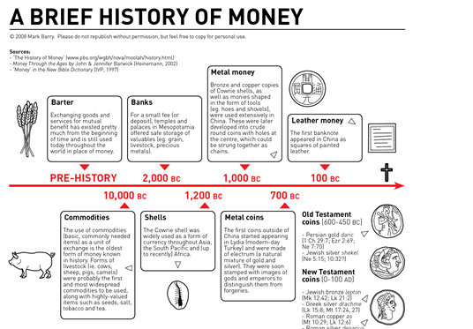
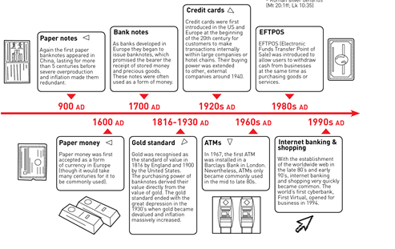

Slide 13
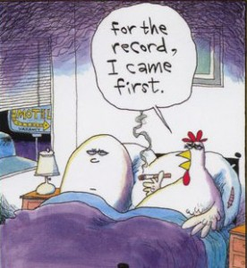
Trading agriculture surplus
Markets appear
1st currencies appear to facilitate trading
Energy and Complexity
Gift economy
Shared economy
Community/familiar economy
Recollective societies
t
Notes:
Debt came first..imagine first writings accounting debts :D

Slide 14
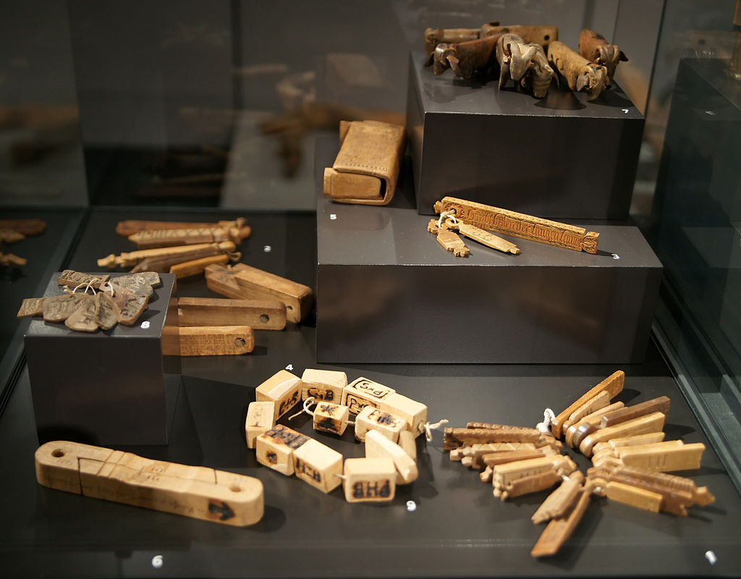
“The standart economic-history version has little to do with anything we observe when we examine how economic life is actually conducted, in real communities and marketplaces, almost anywhere – where one is much more likely to discover everyone is in debt to everyone else in a dozen different ways, and that most transaction take place without the use of currency.”
David Graeber, Debt: the first 5000 years
Tally sticks – used from 18.000 BC to 1826 AD
Notes:
Introduzir a lógica de que é a moeda que cria o Mercado e não ao contrário…
Sistemas de IOU, mesmo a própria moeda é um IOU pois não tem valor intrínseco..passagem para o mito 2

Slide 15
Trading agriculture surplus
Markets appear
1st currencies appear to facilitate trading
Energy and Complexity
“No example of a barter economy, pure and simple, has ever been described, let alone the emergence from it of money; all available ethnography suggests that there never has been such a thing.” Caroline Humphrey
Recollective societies
t

Slide 17
Human societies
B.1 Monetary –based economies
B.1.2 Single dominant currency
B.1.1 Multiple complementary currencies
B.2 Non-monetary-based economies
B.2.1No currency - Gift economies
Public control (Gov. Powered Money)
Privately controlled
B.2.2 Non-monetary mutual credit systems
B.2.3 Tribal sharing economies
Co-operatively/ Collectively controlled

Slide 18
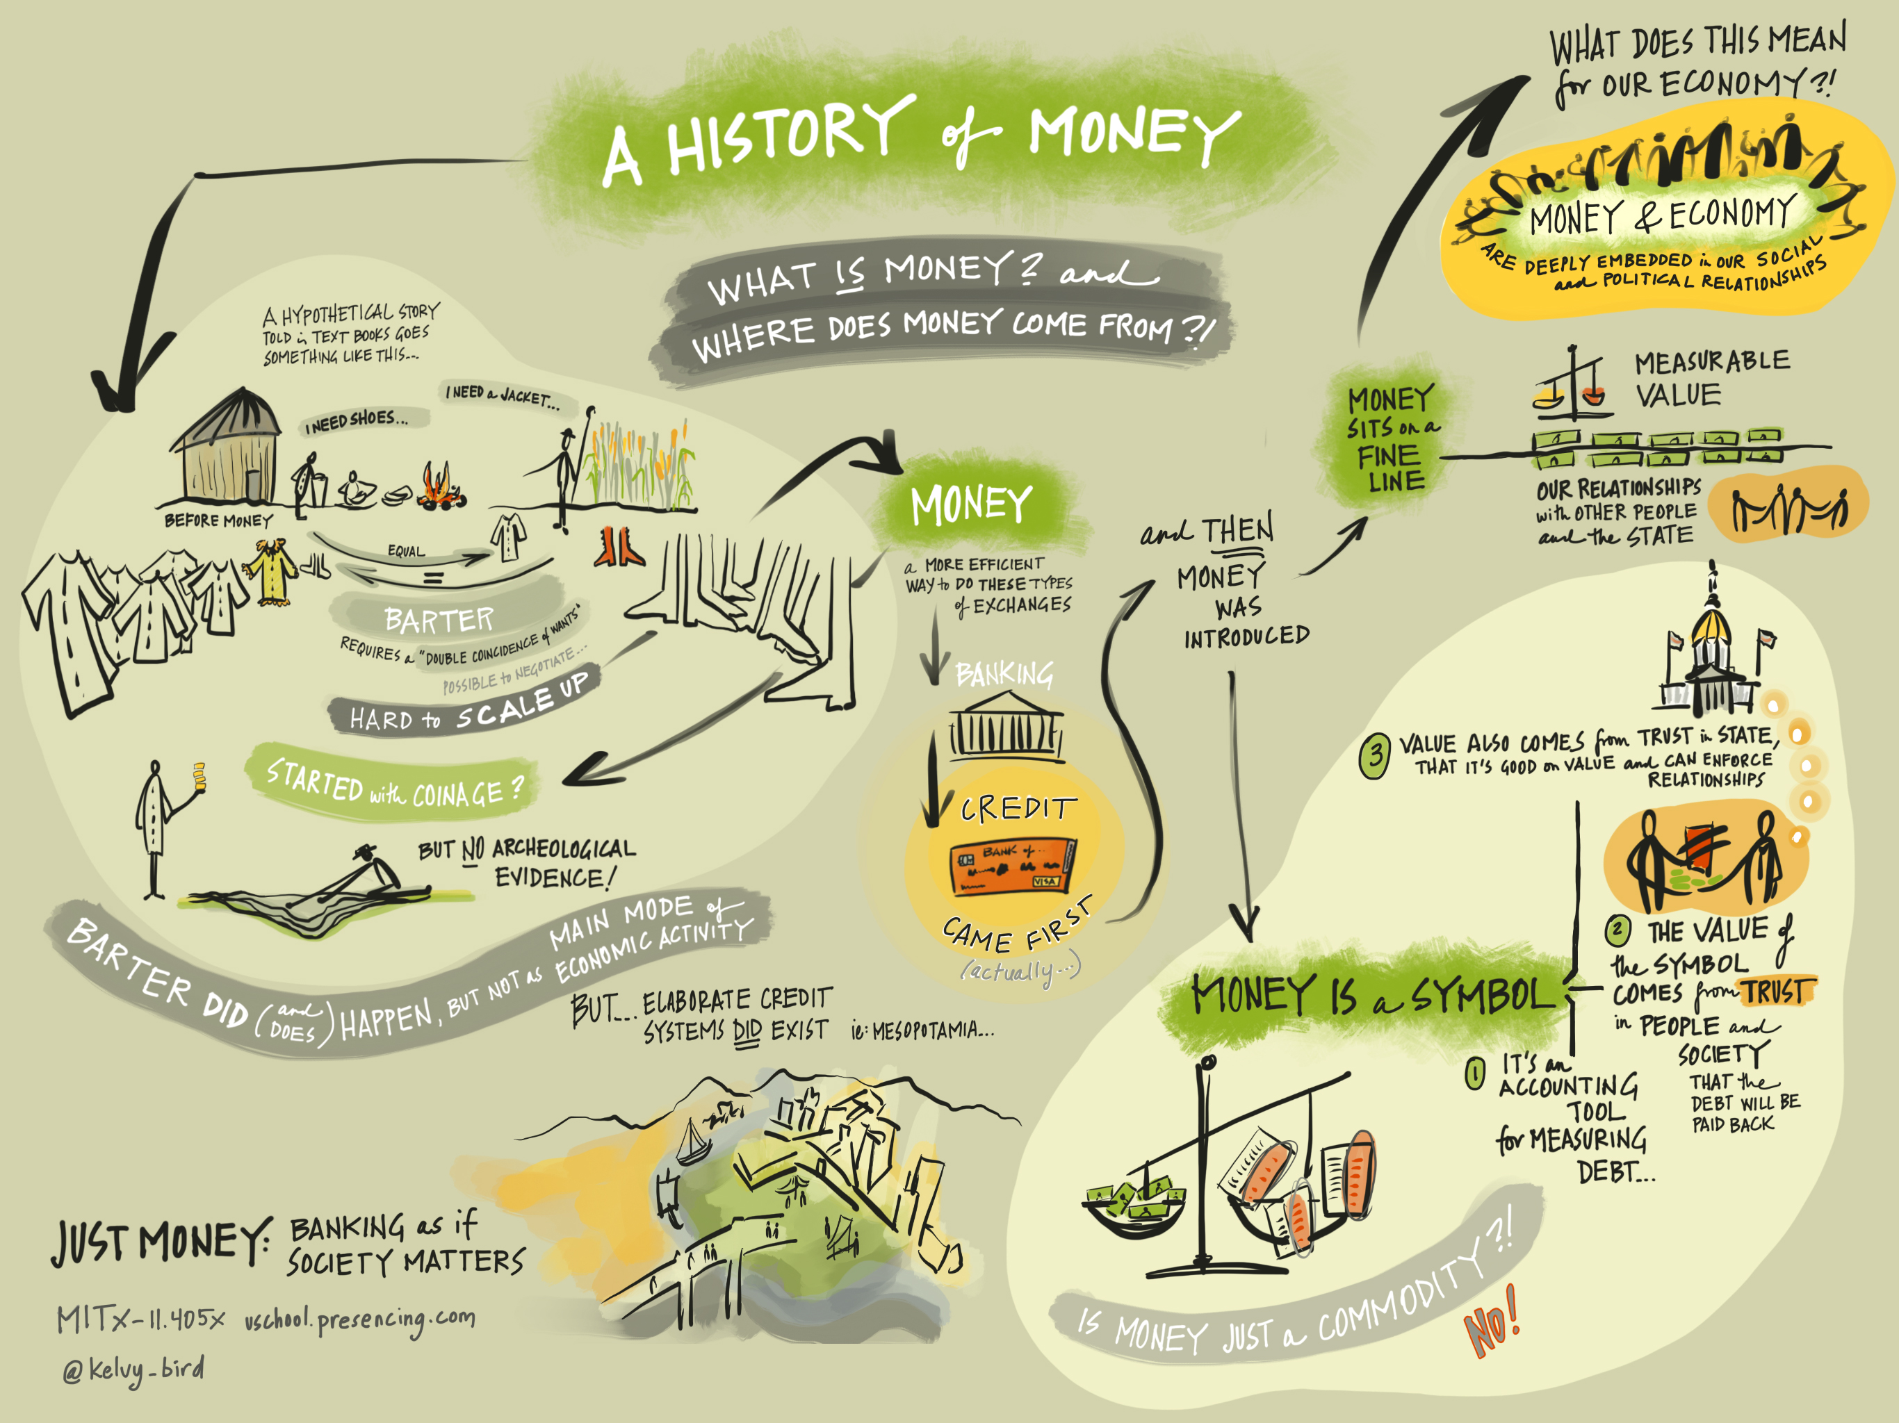
Notes:
A moeda como algo vivo em constante mutação e adaptação social…

Slide 19
Who issues money?
Who controls money circulation?
Notes:
A história e evolução do dinheiro e da moeda e bem mais complexa e não linear do que a historia neoclássica que nos é contado. Contudo requer muito mais aulas e muito mais tempo para ser aprofundada..como tal quero apenas focar-me nos últimos 100 anos e perceber como chegamos a isto.

Slide 20
1833 – Bank notes as Legal Tender during peace time in the British Empire
1844 – Bank of England has the monopoly of bank note issuing
1944 – Bretton Woods, world goes back to the Gold standard having the US dollar as an intermediary
1970 – US goes off the Gold standard, floating currencies era begins
1973 and 1975 – “Oil for dollars” gives birth to the Petrodollar system

Slide 21
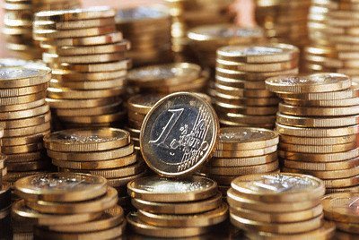
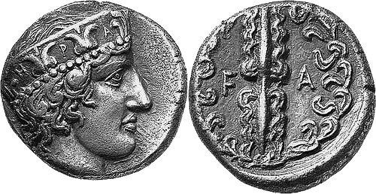
Central Bank
Issues money after King or Parlimant decision
Regulates Monetary mass according to needs
Comercial Bank
Multiplies electronic currency
De-regulated since the 1970’s
State/Gov/King
Issues money mostly to finance wars or to increase control over its territory through Tax
Imposes Seignorage

Slide 22
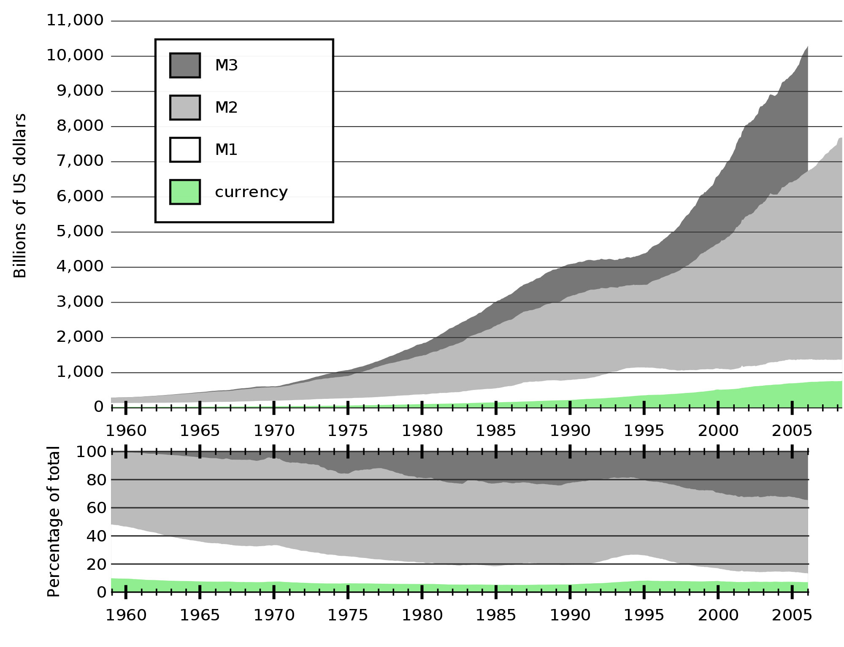
Tabela:^{[5]} Sistema de empréstimo com reserva fracionada, passando por 10 ciclos com uma taxa de reserva em 20%^{[2][6][7]}
banco individual | quantidade depositada | quantidade emprestada | reservas
A | 100 | 80 | 20
B | 80 | 64 | 16
C | 64 | 51.20 | 12.80
D | 51.20 | 40.96 | 10.24
E | 40.96 | 32.77 | 8.19
F | 32.77 | 26.21 | 6.55
G | 26.21 | 20.97 | 5.24
H | 20.97 | 16.78 | 4.19
I | 16.78 | 13.42 | 3.36
J | 13.42 | 10.74 | 2.68
K | 10.74
 |  |  | reservas totais:
 |  |  | 89.26
 | total depositado: | total emprestado: | reservas totais + a ultima quantidade depositada:
 | 457.05 | 357.05 | 100
 | dinheiro comercial criado + dinheiro do banco central: | dinheiro do banco comercial criado: | dinheiro do banco central:
 | 457.05 | 357.05 | 100

Slide 23
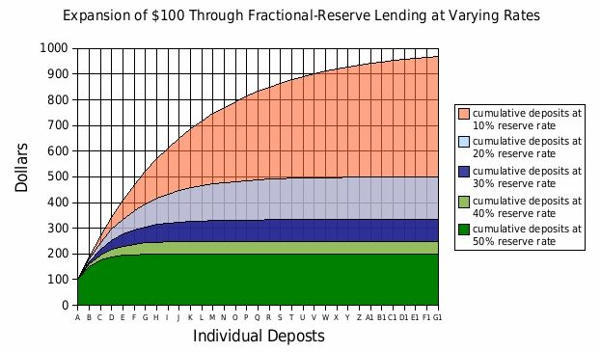
UK
Reserve ratio
1850: 60%
1947: 32%
1971: 12,5 %
1980: 0%
Notes:
Should be isent and free for influence institutions..imagem do FED

Slide 24
Basel III (or the Third Basel Accord)
1%
Notes:
Should be isent and free for influence institutions..imagem do FED

Slide 25
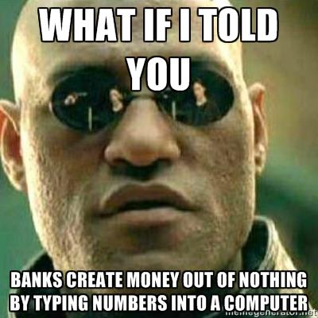
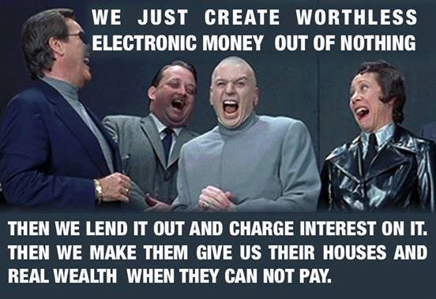

Slide 26
Who controls money?
State?
People?
Parlament?
King?
Efficient markets?

Slide 27
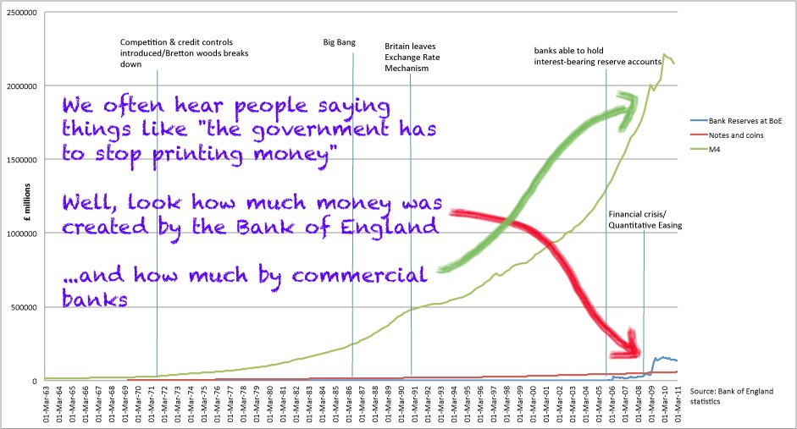

Slide 28
How much of banking money (M3) goes to finance productive investments?
A: 8%
C: 43%
D: 68%
B: 22%

Slide 29
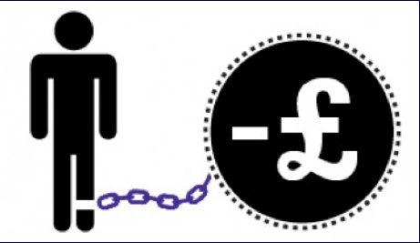
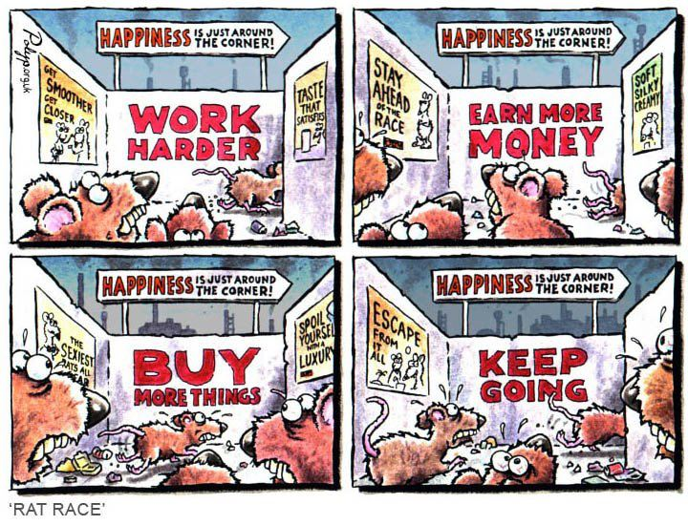

Slide 30
Economic inequality
Financial instability (Boom & Bust cycles)
Environmental and Social unsustainability
Unethical and immoral behaviors
Non-democratic control of money and power
Economic scarcity and competition
Our current monetary systems drives..

