Slide 1
Financial Globalization in Historical Perspective
Monetary and Financial History
Professor Rita Martins de Sousa
Group Members:
Li Chenxue, 47485
Katharine Cardwell, 47621
Long Tingting, 47677
Yang Ying, 47891
Cao Xinrui, 47959

Slide 2
Introduction
Basic Questions
Is Globalization a new phenomenon?
What is the link between trade and finance?
Oral Comment:
Alexander Salles (2004), Financial Globalization in historical perspective: Some empirical evidence contrasting the U-shaped pattern with the J-Curve proposition.

Slide 3
Introduction
In response to:
Dennis P Quinn (2003) “Capital Account Liberalization and Financial Globalization, 1890-1999: A Synoptic View”, International Journal of Finance and Economics, 8: 189-204

Slide 4
Introduction
1. The U-Shaped Pattern
2. The J-Shaped Proposition
2.1 Evidence of Foreign Assets and Liabilities
2.2 Evidence about Foreign Direct Investment
2.3 New Financial Markets:
Additional Indication of a Huge Surge of Global Financial Activity after 1970
3. Conclusion

Slide 5
1. The U-Shaped Pattern
Financial markets presented high levels of integration during the forty years prior to WWI. This integration declined sharply in the years between the wars, recovering gradually after the Bretton Woods agreements until it reached again, in the 1990s, the comparably high levels of financial integration attained before 1914
1) The first era of financial globalization lasted from 1870 to 1914 and the second from the 1980s to the mid-1990s;
2) The level of capital integration before 1914 was comparable to or even higher than that of the 1990s.

Slide 6
2. The J-Shaped Proposition
These markets were globally integrated during pre-1914 era.
Their activities collapsed in the period between the wars.
After a gradual post-war recovery they reached a higher level of activity starting from the 1960s, reaching a peak from the second half of the 1990s.

Slide 7
2.1 Evidence of Foreign Assets and Liabilities
First: The number of countries that have reliable data to estimate capital stocks is very limited for the pre-1914 time.
Second: Financial development has expanded the number of balance sheets in the economy. This trend, however, could happen at any point in time without any underlying change in the extent of foreign asset holdings. Adjustment of the research indicator lead to the discovery of the J curve.

Slide 9
Many countries had limited or no information about foreign investments.
An alternative to solve this problem is to include in the denominator the GDP of the same number of countries that have data for foreign investment. Thus, the sample from 1870 to 1960 was considerably reduced, including only seven major economies (UK, France, Germany, the Netherlands, US, Canada and Japan).
By the year 2000, the sample was expanded to over 60 countries. It provides an alternative estimation called “foreign assets to sample GDP”.

Slide 10
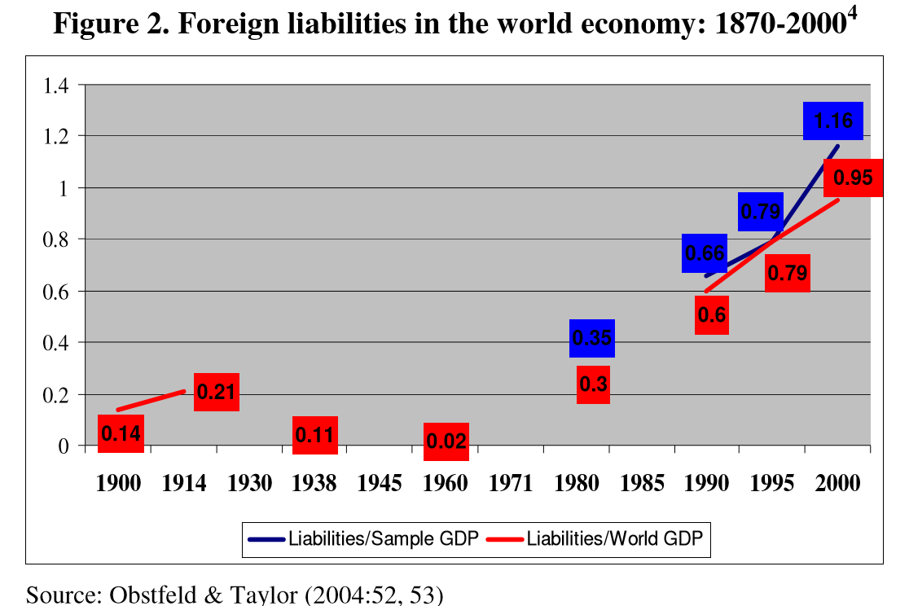

Slide 11
2.2 Evidence about Foreign Direct Investment
FDI: An investment made by a resident entity devoted to acquiring long-term interest in enterprises operating outside of the economy of the investor (its foreign affiliate).
- Inward FDI: foreign capital is invested in local resources,
- Outward FDI: local capital is invested in foreign areas.
It’s controversial to choose the accurate data during the Gold Standard and the interwar period.
- Data of the world economy, developed and developing countries
between 1914 and 2003

Slide 12
Outward FDI
Two markedly different growth patterns.
- from 1914 to 1960
- from 1973 to 2003
Considering the last thirty years, the world outward stock of FDI increased an incredible thirty-seven fold.
Volume of investment in developing countries.
- This investment is concentrated in some
emerging countries, especially in the
four BRIC economies.

Slide 13
Outward FDI
Taking into account the three decades, the growth of world inward stock of FDI was forty-eight fold, even more impressive than the outward growth figure.

Slide 14
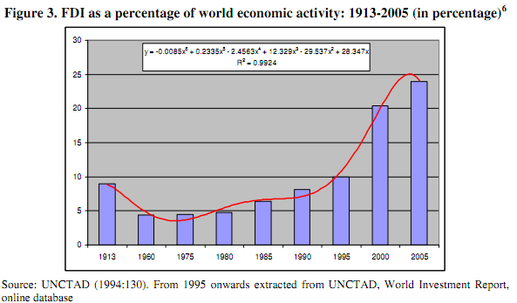
2.2 Evidence about Foreign Direct Investment (Cont…)
1. U-curve could be traced from 1913 to 1990 or even to 1995.
2. Another piece of evidence pointing to the J-curve:
The stock of FDI gradually became more important during the course of the 20th century
- Peek: the end of the 1990s and beginning of the 21st century
Advantage of author´s analysis:
1. Expand the database to 2005 so that it’s more clear that a J-curve corresponds more appropriately to the reality of the foreign investment.
2. Choose a greater sample of countries, including developing economies, which has a considerably higher international coverage.

Slide 15
2.3 New financial market:additional indication of a huge surge of global financial activity after the 1970s
For some reasons, the dearth of historical data hinders comparisons between 19th and 20th century for several financial indicators.

Slide 16
Characteristics of the world economy after the 1970s :
The emergence of a variety of financial instruments to deal with the higher volatility and uncertainty that accrued after a sequence of crises and supply shocks.

Slide 17
additional evidence of a huge surge of financial activity from the 1990s onwards is the main message underlying the J-shaped proposal.

Slide 18
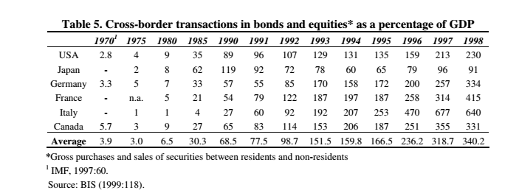
1.The first indicator to be presented is the cross-broder transactions in bonds and equities.
Table 5 show its growth from 1970 until the end of the 1990s.

Slide 19
2.The net international bank loans is another key indicator that has been progressing significantly since the last quarter of the 20th century

Slide 20
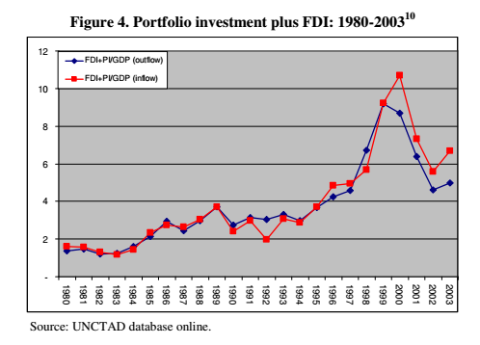
3.The growth of FDI and portfolio investment (PI)
The figure 4 represents the flows of FDI and PI relative to the GDP for developed countries.

Slide 21
OTC derivative transactions
The international financial scenario of the late 20th century was marked by the introduction of an enormous amount of financial innovations such as derivatives (futures, swaps and options)

Slide 22
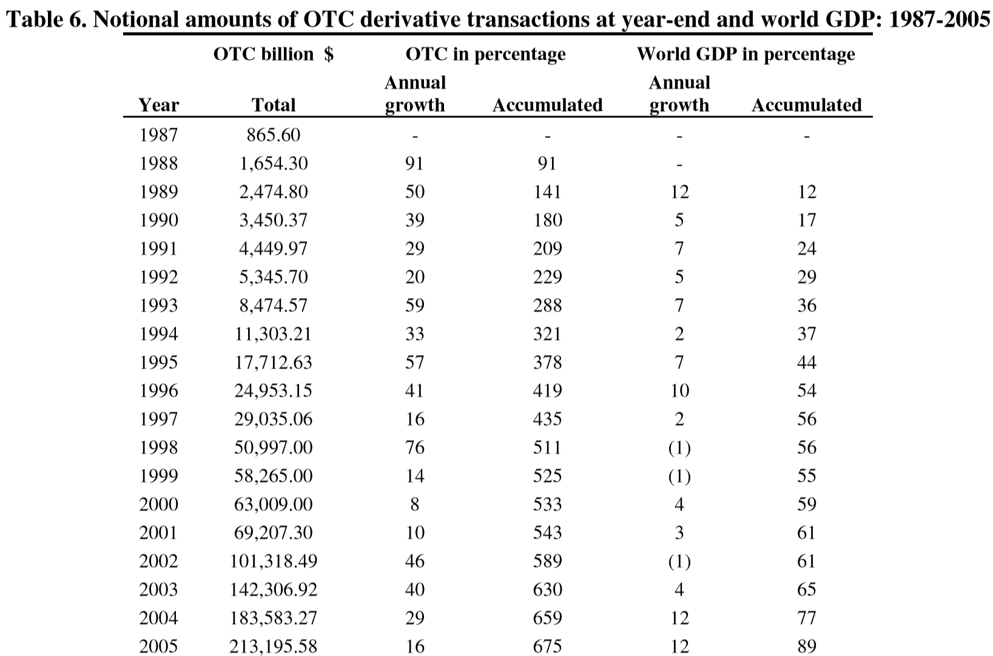
The OTC market is assessed in notional amounts
The table 6 describes its evolution from 1987 to 2005 . The rate of world GDP growth was used to measure the acceleration of the activity in the OTC market over the past 2 decades. The difference between them is large. One of the indicators usually quoted as expansion of international financial activity is the global foreign exchange market turnover.

Slide 23
Once more, the figures presented in Table 7 show an impressive increase in exchange markets since 1989.This shows a volume of external transactions without precedent. To a large extent this reflects a number of mergers, acquisitions, exports, hedges contracts and an unrestrained variety of financial activities in general that marked the world economy during the post-1970s era.

Slide 24
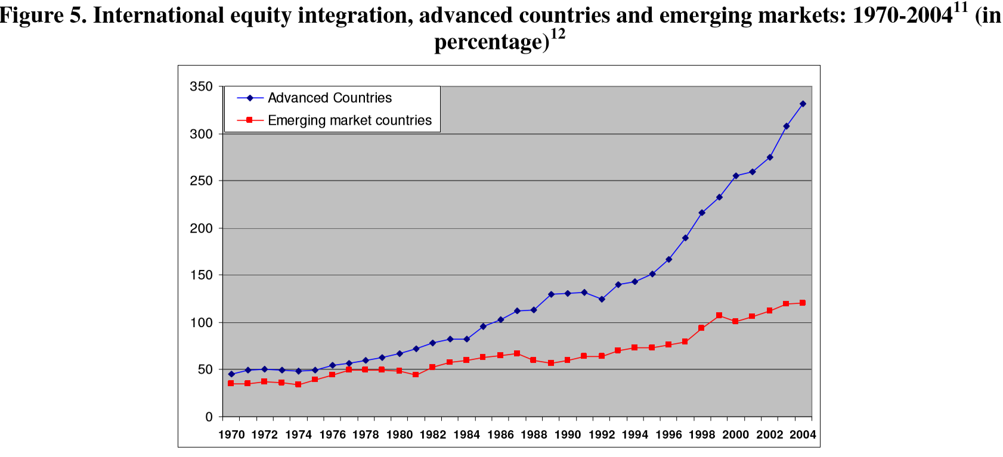
the importance of overseas financial transactions

Slide 25
current financial globalization as an unprecedented era as proposed by the J-curve
Overall, Figure 5 shows clearly that over the past quarter of century, both foreign assets and liabilities to GDP ratio have increased significantly, and this growth accelerated since the mid-1990s, being even higher for advanced economies.The evidence provided here suggests that the relative pace of international financial integration has lagged behind the expansion in trade integration and the growth of world GDP. Despite comparisons with the first financial globalization era are not possible, the indicators point out linking patterns to strengthen the argument to describe the current financial globalization as an unprecedented era as proposed by the J-curve.

Slide 26
3. Conclusion
Is Globalization a new phenomenon?
No it’s not. Salles notes in his article that the first era of financial globalization lasted from 1870 to 1914 and the second from the 1980s to the mid-1990s.

Slide 27
3. Conclusion Cont...
What is the link between trade and finance?
Along with this surge of growth in globalization, there was an increase in desire to mitigate risk and thus drive higher demand and need for a greater variety of financial instruments. “Plenty of evidence of the massive growth of the current global financial market can be gathered through investigation of its evolution from the 1970s on.” Exponential growth in conventional and novel markets such as:
Portfolio Investment
International Banking loans
Notional amount of OTC market and foreign assets & liabilities

Slide 28
3. Conclusion Cont...
U-curve vs J-curve
The U-curve attempts to be a general standard that includes all financial markets and establish a unique historical pattern for all of them.
The J-curve using two indicators, proposes that the degree of global financial market integration by the end of the 1990s did not repeat the same level achieved during the gold standard.
The main point of the article is that the magnitude of foreign investment assets and FDI stocks did not match the “back to the future” scenario proposed by the U-curve.

Slide 29
3. Conclusion Cont...
Filling the Gap…
Bordo, Eichengreen & Kim (1998) reconsidered the U-Shaped pattern as an appropriate shape reflecting international market integration.
They conclude that changes in operation in global financial markets induced by new information technologies and financial innovations reduced the “market-segmenting effects”of asymmetric information encouraging a wide range of financial securities, thus broadening the international financial linkages.
Nonetheless, they do not present statistical evidence showing these broader global financial linkages on the level of current financial activities in comparison to the pre-1914 era.
Moreover, none of those scholars (individually or in partnership) have presented this sort of evidence in their articles published after 1998.

Slide 30
Grand Finale
"Capital account liberalization, it is fair to say, remains one of the most controversial and least understood policies of our day".
(Eichengreen, 2002)

