Slide 1
2
Stochastic Interest Rate Models

Slide 2
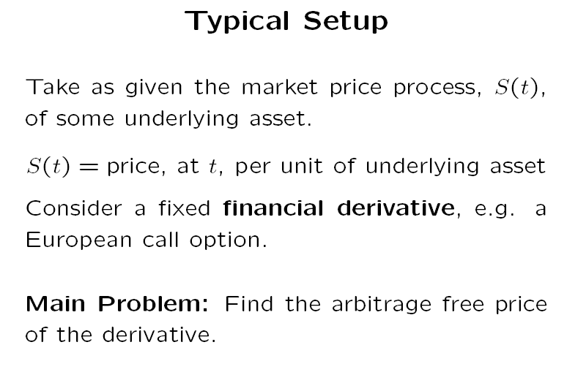
2.1 – Introduction: Continuous Time Finance Recap

Slide 3
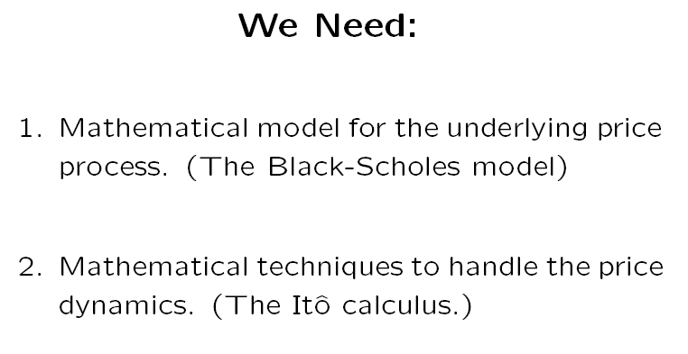
Basic Tools

Slide 4
Stochastic Processes
Discrete vs continuous time stochastic processes:
  Discrete – the variable value can change only at certain fixed points in time
  Continuous – changes can take place at any time
Continuous vs discrete variables:
  Discrete – only certain values are possible
  Continuous – can take any value within a certain range
Continuous-variable, continuous-time – variables can assume any value and changes can occur at any time.

Slide 5


Stochastic Processes

Slide 6
Stochastic Processes
Continuous-variable, continuous-time stochastic processes are key to understanding the pricing of options and other derivatives.
However, in practice, most asset prices do not follow continuous-variable, continuous-time stochastic processes.
For instance, stock prices are restricted to discrete values (e.g. multiples of a cent) and changes can be observed only when the markets are open.
Nonetheless, continuous-variable, continuous-time stochastic processes are useful for many valuation purposes.

Slide 7
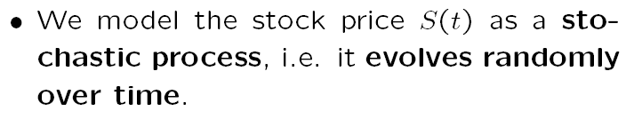
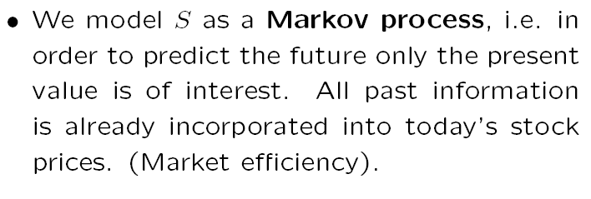
Stochastic Processes
(Market efficiency – weak form)

Slide 8
Stochastic Processes
If the weak form of market efficiency were not true, market analysts could make above-average returns by interpreting the past behavior of asset prices.
It is the competition that tends to ensure that weak-form market efficiency holds.

Slide 9
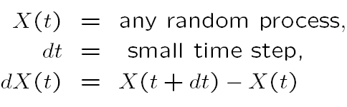


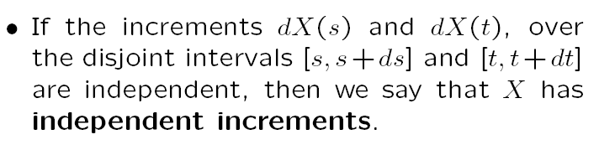
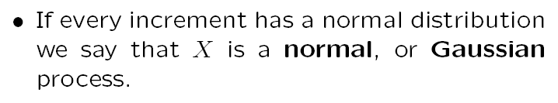
Notation

Slide 10
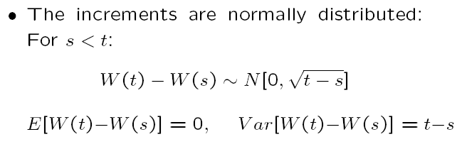


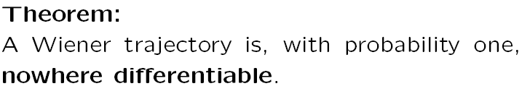
Wiener Process
A stochastic process W is called a Wiener process (or the continuous random walk) if it has the following properties:

Slide 11
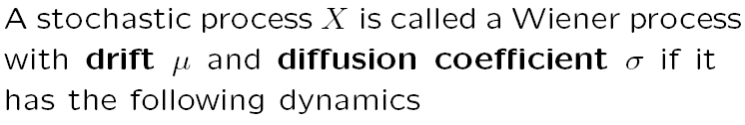
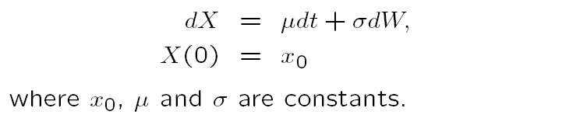


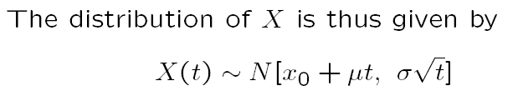
Generalized Wiener Process
Therefore , uncertainty is proportional to the square root of time.
The average increases are proportional to time (if there is no drift, the average doesn’t change).

Slide 12
Wiener Process
Wiener processes for different magnitudes of change in time:
When Δt -> 0, the path becomes much more irregular, as the size of the movement in the variable in time Δt is proportional to the . When Δt is small, is much larger than Δt.
Source: Hull, John (2009), “Options, Futures and Other Derivatives”, Pearson Prenctice Hall, 7th Edition

Slide 13
Generalized Wiener Process
Source: Hull, John (2009), “Options, Futures and Other Derivatives”, Pearson Prenctice Hall, 7th Edition

Slide 14
Generalized Wiener Process
Generalized Wiener process with initial value of 50, annual drift and variance of 20 and 900, respectively:
t | 0 | 0.5 | 1
μ | 20 | 60 (=50+20*0,5 = x₀+μ*dt) | 70 (=50+20)
σ² | 900 | 21.21 (=30*sqrt(0,5)=σ*sqrt(t)) | 30 (=30*sqrt(1))

Slide 15

Itô Process
Definition: Generalized Wiener process with average and standard-deviation as functions of the underlying variable and time (instead of constant along time):
Please recall that
For small time intervals, we may assume that the average and the standard-deviation don’t change:

Slide 16
Itô Process
It may be tempting to assume that a stock price follows a generalized Wiener process (constant drift and variance).
However, this assumption is not valid, having in mind that investors require or expect a given level of returns (as a % variation) regardless the price level, i.e. for higher prices, expected changes will be higher too.
One can replace the assumption of constant expected drift by the assumption of constant expected returns (i.e. constant expected drift divided by the stock price).

Slide 17
Itô Process
If S is the stock price at time t => expected drift rate in S must be μS (being μ constant, corresponding to the expected rate of return on the stock, expressed in decimal form).
In a short interval of time Δ_{t}, the expected increase in S is μSΔ_{t}, i.e the expected rate of return on the stock, times the stock price, times the time interval:
If Δt -> 0 =>
This corresponds to the price of an asset following a continuously compounding process:

Slide 18
Geometric Brownian Motion
Given that asset prices actually exhibit volatility, a reasonable assumption is that the variability of the percentage return in a short period of time Δ_{t} is the same regardless the stock price.
This means that an investor is as uncertain about his return when the stock price is high or low.
Accordingly, the standard deviation of the change in a short period of time must be proportional to the stock price, as the standard deviation for the percentual change is constant – Geometric Brownian Motion:

Slide 19
Itô’s Lemma
An option price is a function of the underlying asset’s price and time.
Therefore, it is important to understand the behavior of functions of stochastic variables.
An important result was discovered by K. Itô in 1951 and is known as Itô’s lemma.
Assuming that a variable x follows a Itô process:

Slide 20
Itô’s Lemma
Thus, G (the derivatives price) also follows an Itô process with a drift rate
Assuming that the stock price follows a Geometric Brownian Motion, with constant μ and σ:
From Ito’s Lemma it follows that

Slide 21
Itô’s Lemma
Therefore, both S and G are affected by the same volatility source – dz.
This is in line with the Black-Scholes option pricing formula, as G (the option price) is determined by the instantaneous volatility of the returns of the underlying asset price.

Slide 22
Itô’s Lemma
How can Itô’s Lemma be considered as a natural extension of simpler results?
Assuming a continuous and differentiable function G of a variable x.
If Δx is a small change in x and ΔG is the resulting change in G, one gets
Thus, ΔG is approximately equal to the rate of change of G with respect to x, multiplied by Δx.

Slide 23
Itô’s Lemma
If more precision is required, a Taylor series expansion of ΔG can be used:
For a continuous and differentiable function G of 2 variables x and y, one obtains
and the Taylor series expansion becomes

Slide 24
Itô’s Lemma
When Δx and Δy tends to zero, one gets
Extending this version in order to cover functions of variables following Itô processes – -
one obtains (basically replacing y by t):

Slide 25
Itô’s Lemma
Discretizing
one gets:
Or, by dropping the arguments,
From this equation we get

Slide 26
Itô’s Lemma
This shows that in equation
there are terms in Δx² that depend on t.

Slide 27
Itô’s Lemma
Given that the variance of a standardized normal distribution =1:
As => => is non-stochastic and equal to its expected value Δt.
Consequently, Δx² becomes non-stochastic and equal to b²dt.

Slide 28
Itô’s Lemma
Therefore, taking limits as Δt and Δx tend to zero in equation
one gets:
If we consider that , replacing dx in the former expression by the latter, one obtains

Slide 29
Probability Distribution
From the stochastic process of the rate of returns,
Its distribution gets
Being , since , it follows from the Itô’s lemma that

Slide 30
Probability Distribution
This equation shows that ln S_{T} is normally distributed (and S_{T} has a log normal distribution), with a standard deviation that is proportional to the square root of time.

Slide 31
Probability Distribution
Source: Hull, John (2009), “Options, Futures and Other Derivatives”, Pearson Prenctice Hall, 7th Edition

Slide 32
Martingales
Definition: A martingale is a zero drift stochastic process:
(where dz is a Wiener process)
The best estimate for the future price is the current one:

Slide 33

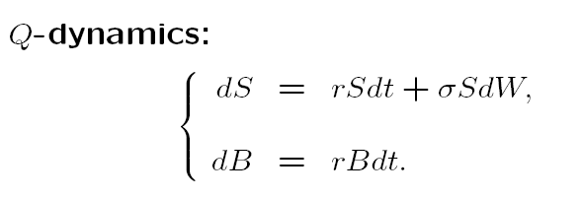

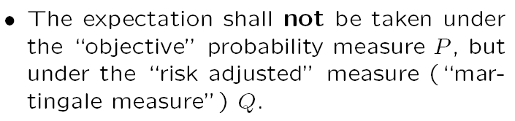
Risk-Neutral Valuation Result
X is the payoff at T
Assuming constant interest rates

Slide 34


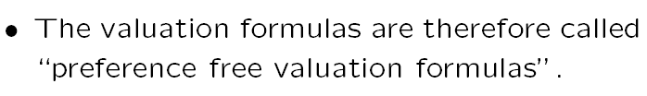
Reasoning

Slide 35



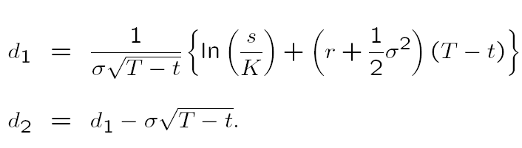

Example: The Black-Scholes Formula

Slide 36

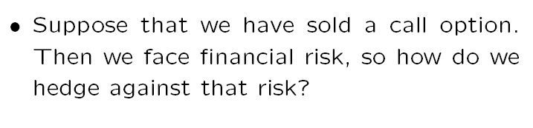
Market Completeness

Slide 37
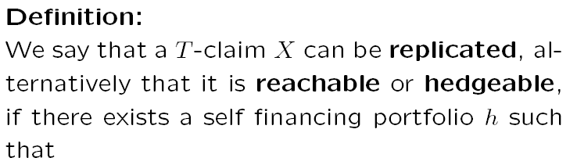

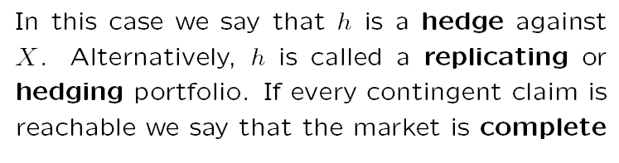
Reachable (or Hedgeable) claim

Slide 38
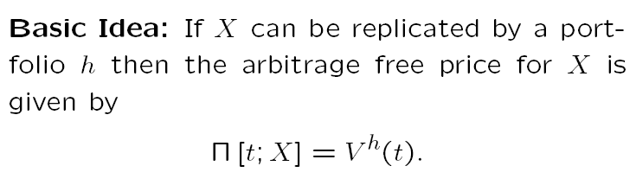
Classical Example:
The Black-Scholes Model

