Slide 1

Informed trade in spot foreign exchange markets: an empirical investigation
Richard Payne (2003)
International Financial Markets
Guilherme Alferes
Ricardo Torre
ISEG, November 2017

Slide 2
Research questions
What is the impact of asymmetrically informed trading in inter-dealer FX bid-ask spreads?
Are time-of-day effects relevant to permanent price variation?
ISEG, November 2017

Slide 3
Theoretical Framework
Agents are heterogeneously informed about future asset prices
  An uniformed dealer widens the bid-ask spread to recoup the losses inflicted upon them by informed agents
It is not possible to distinguish information about future fundamentals and future risk premia.
Transaction activity carries information and permanently affect prices.
  This means FX markets are relevant in determining exchange rates.
Only one venue of the FX is observed – informed agents may trade elsewhere.
ISEG, November 2017

Slide 4
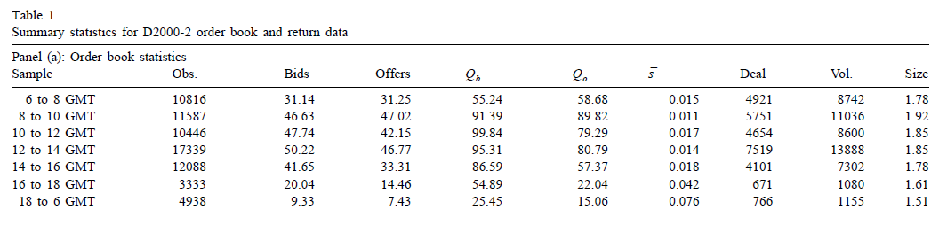
Dealing system and data
The data set used is a week’s worth of USD/DEM trading in the D2000-2 (an electronic order driven system).
These series have strong repetitive time-of-day patterns. The aggregate size on the book follow an inverted U-shape during the GMT trading day (8:00 to 16:00)
ISEG, November 2017

Slide 5


Methodology
Assumptions on the data set:
  Informed agents only submit market orders. Uninformed agents submit both market orders and limit orders – Private information can only influence prices through unexpected trading activity.
  Public information is immediately reflected in quotes.
They employ a reduced form VAR model in trades and quote revisions and a variance decomposition method.
Midquote equation
Transaction’s Characteristics
equation
Variance Decomposition equation
ISEG, November 2017

Slide 6
Results I
A market buy tends to increase quotes.
  An unexpected market buy leads to an upward quote revision of 0.005% on average (1 pip)
The average percentage bid-ask spread on this data set is approximately 0.016%.
Around 60% of this spread is compensation for asymmetric information.
Size variables were generally insignificant
  Likely due to the very little variation in trade size.
ISEG, November 2017

Slide 7
Results II
High volume periods are characterized by a large amount of market orders and increased competition between informed agents, with these effects reducing the price impact of a trade.
Variance decomposition shows that 41% of the permanent return variance is attributable to order flow.
The proportion of all return variation explained by order flow information and the size of the permanent component have a positive correlation with volume.
When volume is high the information content of a single trade is small, but a large amount of information is entering the midquote.
ISEG, November 2017
Notes:
>Variance decomposition shows that 41% of the permanent return variance is attributable to order flow.
This value is close to similar studies for equities and stocks.
>The proportion of all return variation explained by order flow information and the size of the permanent component have a positive correlation with volume.
So time of day effects have a strong impact.

Slide 8
Questions
Why does the possibility of informed trading impact the bid-ask spread?
Is the assumption that informed traders only submit market orders reasonable?
Is the permanent price impact of a single trade higher during low volume or high volume periods? What about the aggregate impact of trades?
ISEG, November 2017

Slide 9
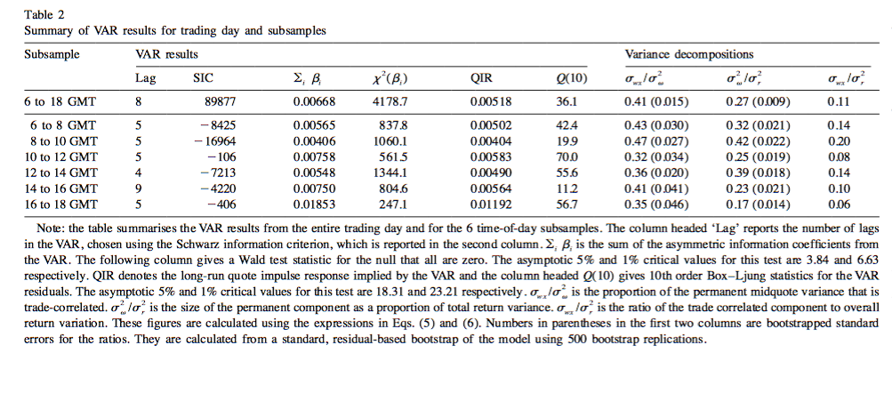
Annex - Results

