Slide 1
Enterprise Applications:
ERP (Enterprise Resource Planning), CRM e SCM

Slide 2
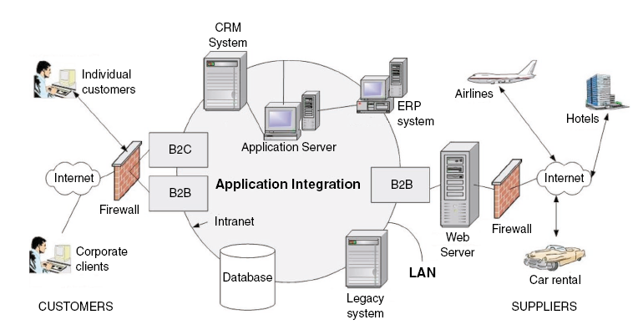
Enterprise Applications existing in a Arquitectura Empresarial
Rainer Jr, Turban, Potter (2007)

Slide 3
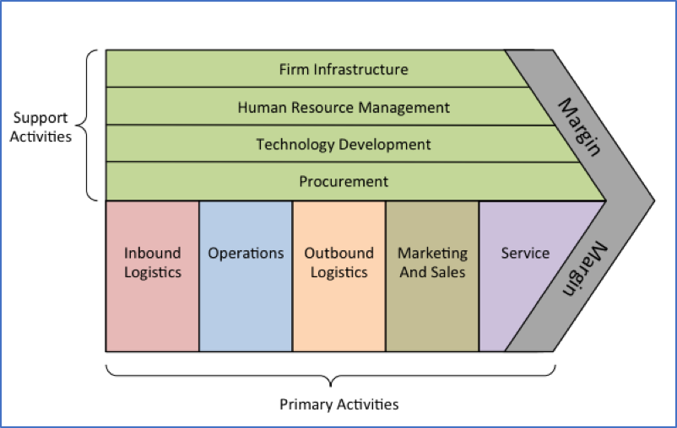
Enterprise Applications supporting the value chain
Notes:
CEAGP, 4 Abril 2005

Slide 4
ERP - Enterprise Resource Planning
Enterprise resource planning (EPR): Software that integrates the planning, management and use of all resource in the entire enterprise.
SAP R/3 the leading EPR software (form SAP AG Crop.): a highly integrated package containing more than 70 business activities modules.

Slide 5
ERP - Enterprise Resource Planning
The first generation of ERP concentrated on activities within the enterprise that were routine and repetitive in nature.
The objective of second –generation EPR is to leverage existing information systems in order to increase efficiency in handling, transaction, improve decision making, and transform ways of doing business into e-business.

Slide 6
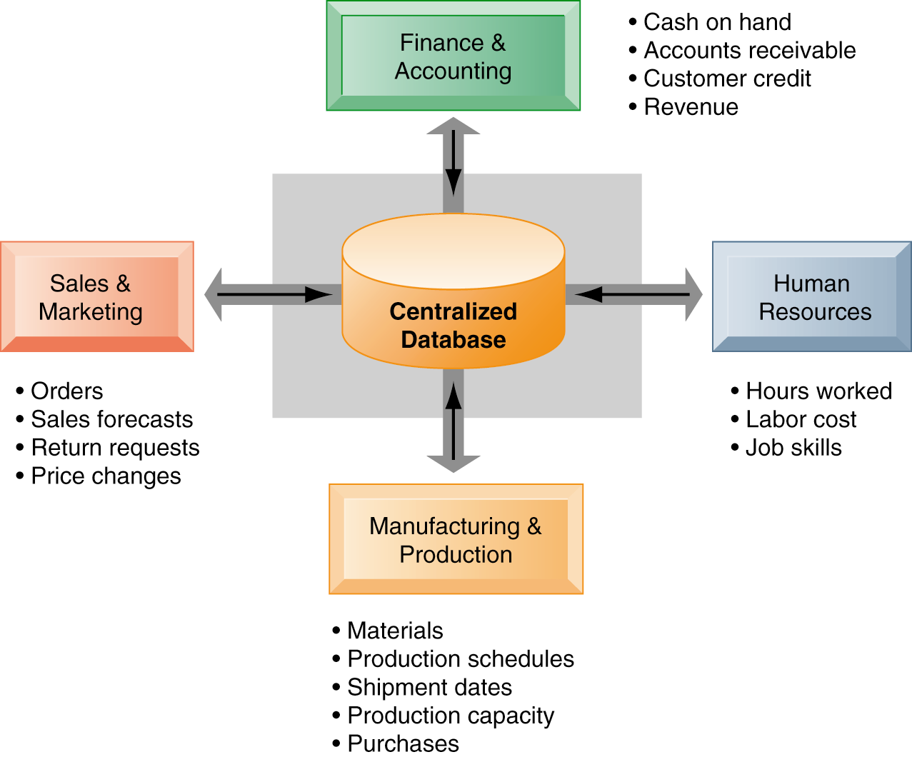
Enterprise Resource Planning

Slide 7
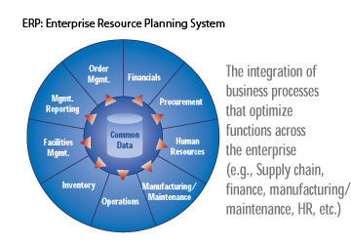
Enterprise Resource Planning
Reiner, R.K.; Turban, E.; Potter, R.E. (2007). Introduction to Information Systems – Supporting and Transforming Business, John Wiley.

Slide 8
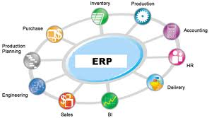
Enterprise Resource Planning
ERP integrates the planning, management and use of all the resources of an organization.
The main purpose of ERP is to integrate all the functional areas of a company and allow a flow of information across all areas.
Rainer, Turban e Potter (2007)

Slide 9
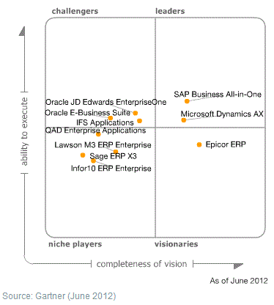
Enterprise Resource Planning
Magic Quadrant for Single-Instance ERP for Product-Centric Midmarket Companies, 27 June 2012 ID:G00219256, http://www.gartner.com/technology/reprints.do?id=1-1B4MV8J&ct=120628&st=sg

Slide 10
Enterprise Resource Planning
Business process is a set of steps or procedures that should produce a certain outcome.
ERPs support an organization's business processes. Examples :
Accounting and Finance
Sales and Marketing
Production
Human Resources

Slide 11
Enterprise Resource Planning
An ERP system uses best practices, which are "successful" methods for solving problems related to business objectives.
An ERP system can be complex, expensive and time-consuming to implement.
ERP imposes accuracy and organization of business processes, making it more likely to align IT with business goals.
The adoption of an ERP usually leads to a redesign of the organization's business processes

Slide 12
ERP characteristics:
Enterprise Resource Planning
Modularity
Scope
Integration
Uniformity
Ability to "customize"
Incorporation of best practice
Quality of information
Functional opening
Solution evolution guarantee

Slide 13
ERP: Key Success factors
Robust and quality software
Involvement and support of top management
Intensive training
Proper management of the implementation process
ERP adoption project manager with necessary skills
Change in organizational processes
Capable and committed users

Slide 14
Strategy for Acquiring an IT Application(p.e. ERP)
Buy Software (package previously developed)
ASP (application service provider)
In-house development
Rainer, Turban e Potter (2007)

Slide 15
ERP Vendors in Portugal
Propietary ERP:
Microsoft Dynamics NAV - http://bit.ly/9szMLU
Oracle - http://bit.ly/9f2Zs8
Primavera - http://bit.ly/98D9dO
SAGE - http://bit.ly/bC91hB
SAP - http://bit.ly/c9zOCM
PHC - http://www.phc.pt/portal/programs/cindex.aspx
ERP Open Source:
Adempiere - http://www.adempiere.com (Spain)
Evaristo - http://bit.ly/cplsTO (Portugal)
Openbravo - http://www.openbravo.com (Spain)
xTuple - http://www.xtuple.com
WebERP - http://www.weberp.org

Slide 16
ERP Evolution
CRM
ERP
MRP
ROP
MRP-II
eBusiness
SCM
ROP (Re-order Point Systems)
MRP (Materials Requirements Planning)
MRP-II (Manufacturing Resources Planning)
SCM (Supply Chain Management)
CRM (Customer Relationship Management)

Slide 17
ERP Evolution
Material requirement planning (MRP). A planning model that integrates production, purchasing and inventory management of interrelated product.
Manufacturing resource planning (MRP II). An enhanced planning model that adds labor requirements and financial planning to MPR.

Slide 18
ERPs Advantages
ERPs provide real-time information from all functional areas of the organization;
ERPs allows greater rigor and standardization of procedures and data by the organization;
ERPs use the best practices included in the applications;
ERPs increase efficiency in the organization;
ERPs strengthen the means for planning and control through available reports and analysis of information

Slide 19
Enterprise Applications
SCM – Supply Chain Management Systems
Supply chain: The flow of materials, information, money, and services from raw material suppliers, through factories and warehouses to the end customer; includes the organizations and processes involved.
Supply chain management (SCM): The planning, organizing and coordinating of all supply chain’s activities.
E-supply chain: A supply chain that is managed electronically usually with Web-based software

Slide 20
Enterprise Applications
SCM – Supply Chain Management Systems
Materials flows: These are all physical products, raw materials, supplies, and so forth, that flow along the chain. The concept of materials flows include reverse flows-returned products, recycled products and disposal of materials or products.
Information flows: All data related to demand, shipments, orders, returns, and schedules.
Financial flows: All transfers of money, payments, credit card information and authorization, payment schedules, e-payments and credit related data

Slide 21
Enterprise Applications
SCM – Supply Chain Management Systems
The supply chain involves three segment:
Upstream, where sourcing or procurement from external suppliers occur
Internal, where packaging, assembly, or manufacturing take place
Downstream, where distribution or dispersal take place, frequently by external distributors
Supply chain also include the movement of a product or a service and the organizations and individuals involved, are part of the chain as well

Slide 22
Enterprise Applications
SCM – Supply Chain Management Systems (ex: Nike)
ex: Plastic Products
Upstream
ex: EUA Plant
Supplier
Downstream
NIKE
Wholesaler
Retailer
Client
Supplier
Bullwhip Effect
How Systems may help?
ex: Footware producers
3ª Trier
2ª Trier
1ª Trier
Suppliers

Slide 23
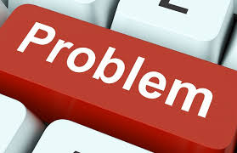
Enterprise Applications
SCM – Supply Chain Management Systems
Problems along the supply chain from two sources:
Uncertainties
Need to coordinate several activities, internal units and business partners
A major source of supply chain Uncertainties is the demand forecast. The actual demand may be influenced by several activities such as competition, prices, weather conditions, technological developments, customers’ general confidence, delivery times and more.

Slide 24
Enterprise Applications
SCM – Supply Chain Management Systems
Bullwhip Effect
Erratic shifts in orders up and down the supply chain. It is related to properly setting inventory levels in various parts of the supply chain.

Slide 25
Enterprise Applications
SCM – Supply Chain Management Systems
Vertical integration: the upstream part of the supply chain with the internal part, typically by purchasing up- steam suppliers, in order to ensure availability of supplier .
Using inventories: The most common solution used by companies to solve supply chain problems is building inventories as an “insurance“ against supply chain uncertainties.

Slide 26
Enterprise Applications
SCM – Supply Chain Management Systems
Information sharing: sharing information along the supply chain can improve demand forecasts. Such sharing can be facilitated by EDI, extranets, and groupware technologies.
Vendor-managed inventory (VMI): allowing suppliers to monitor, the inventory levels of their products in the retailors’ stores and to replenish inventory when needed.

Slide 27
Enterprise Applications
SCM – Supply Chain Management Systems
Changing a linear SC to a Hub: In linear supply chains, information is processed in a sequence , which slows down its flow. One solution is to change the linear chain into hub. Each partner in the supply chain can directly access the images in the data bank
Supply chain collaboration:. Proper supply chain and inventory management requires coordination of all different activities and links of the supply chain. Successful coordination enables goods to move smoothly and on time from supplier to manufacturers to customers, which enables a firm to keep inventories low and costs down.

Slide 28
Enterprise Applications
SCM – Supply Chain Management Systems
SC Team: A group of tightly integrated businesses that work together to serve the customer; each task is done by the member of the team who is best capable of doing the task.
Virtual factory:. Collaborative enterprise application that provides a computerized model of a factory

Slide 29
Enterprise Applications
SCM – Supply Chain Management Systems
Problem Area | Solution
Slow communication | Use wireless devices to find vehicle locations to expedite salespeople’s contact with headquarters. Use hub supply chain to enable online access to information
Difficult product configuration | Use DSS and intelligent systems for rapid and accurate analysis
Select and coordinate suppliers | Use DSS to determine which suppliers to use, determine how to create strategic partnerships
Supplier arrive when needed | Use just-in-time approach and collaboration with suppliers.
Handle peak demands | use IT-enable outsource. Use DSS to determine what to outsource and when to buy and not make
Expedite lead time for buying and selling | Use e-commerce tools and business intelligence models
Tool many or too few suppliers | Use optimization models to decide and employ e-procurement
Control inventory levels | Manufacture only after order received (online) . Use VMI and web-serviced
Forecast fluctuating demand | Use collaboration (like CPFR) or intelligent system
Expedite flows in the chain | Automate material , information and money flows
suppliers relationships | Improve supplier relationship by using portals, web-based call center, and other CRM and PRM tools

Slide 30
Enterprise Applications
SCM – Supply Chain Management Systems
Ford Manufacturing Supply Chain
http://www.youtube.com/watch?v=qyO9QSo0FjU

Slide 31
Enterprise Applications
CRM– Customer Relationship Management Systems
Customer relationship management (CRM): An enterprise wide effort to acquire and retain customers, often supported by IT.

Slide 32
Enterprise Applications
CRM– Customer Relationship Management Systems
Operational CRM: activities involving customer services, order management, invoice /billing and sale/marketing automation and management .
Analytical CRM: activities that capture, store, extract , process, interpret, and report customer data a corporate. user.
Collaboration CRM: deals with all the necessary communication coordination and collaboration between vendors and customers.

Slide 33
Enterprise Applications
CRM– Customer Relationship Management Systems
Registration and analysis of the relationship with clients
Ideally, all the processes in which the client participates should go through the CRM system
Consolidate multiple communication channels (telephone, email, web, new relational technologies)
Common Topics in CRM:
retention
satisfaction
which products and services provide

Slide 34
Enterprise Applications
CRM - Customer Relationship Management Systems
Sales Force Automation – automate teams and selling processes
Marketing – generate leads, channel monitoring
Customer Service and Support – example CTI (Computer Telephone Integration)
Analytics – improve segmentationa and positioning
Dind types of Information System to eache CRM?

Slide 35
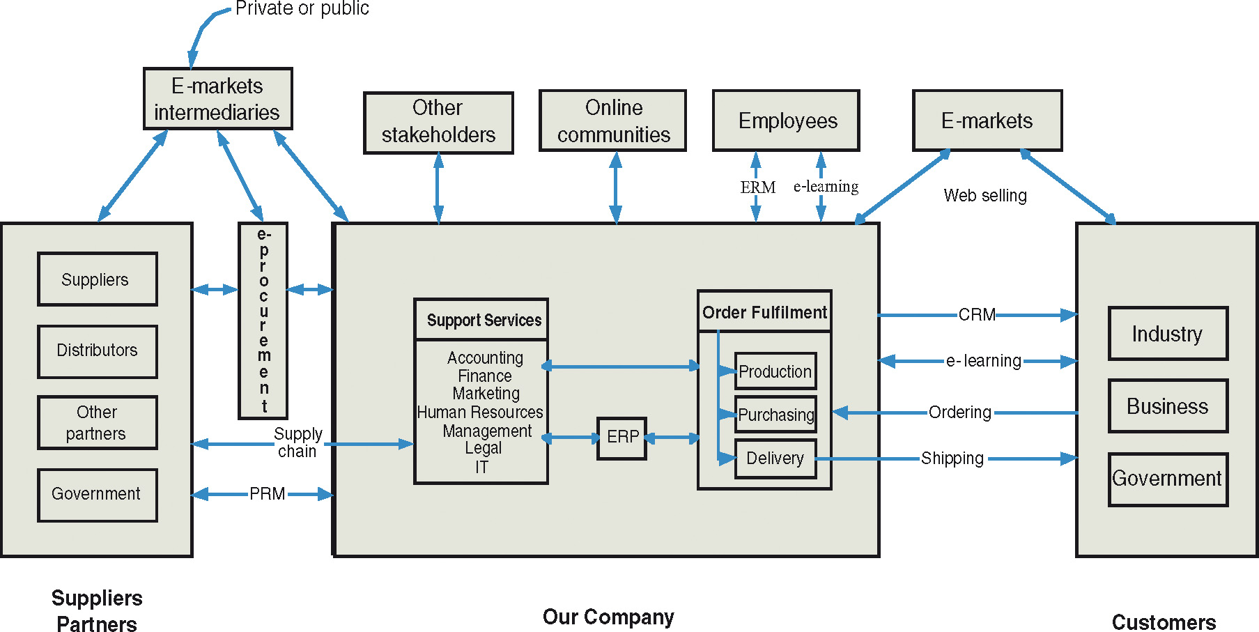
ERP & CRM
Enterprise Applications
Rainer Jr, Turban, Potter (2007)

Slide 36
Enterprise Applications
CRM - Customer Relationship Management Systems
SugarCRM – conceitos básicos
http://www.youtube.com/watch?v=BMtv6sbmdLc&NR=1

Slide 37
Software Slection
Identify potential sellers.
Determine the evaluation criteria.
Request For Information (RFI) is a document sent to potential sellers, summarizing the company's objectives and needs, requesting information about its software - features, features, requirements, licensing policies, licensing and maintenance pricing. The response to an RFI is an informational document and does not constitute a contractual commitment.
Request For Proposal (RFP) is a document sent to potential sellers requesting a proposal to address a concrete need. In the Proposal, the supplier describes its software package, explaining how it responds to the specific needs of the company. Usually the Proposal has contractual value or is an Annex of the Contract to be entered into.
Evaluate sellers and their packages.
Choose seller and package
Negotiate the contract
Establish a "Service Level Agreement".
SLA is a formal / contractual agreement that specifies how the work will be divided between the company and the seller.
Rainer, Turban e Potter (2007)

Slide 38
Enterprise Resource Planning - ERP
Example of ERP Usage
Simple ERP exemple: FrontAccounting

Slide 39
Referências
Laudon Kenneth P.; Laudon, Jane P. (2015) Management Information Systems – Managing the Digital Firm. Global Edition. Pearson.
Rainer Jr, R.; Turban, E.; Potter, R. (2007): Introduction to Information Systems – Supporting and Transforming Business, Wiley.

Slide 40
Contributors
List of authors/contributors to these materials:
Carlos J. Costa (2018)
Cristiane Pedron (2011)
Jesualdo Fernandes (2011)
João Coelho (2011)
Mário Romão (2014, 2015)

