Slide 1

Interest Rate & Credit Risk Models
Jorge Barros Luís ©
Oct 2018

Slide 2
Objectives
Main Goal
Be able to evaluate and manage credit and interest rate risk in increasingly complex debt markets.
Interest Rate Theory
Understand the distinction between different interest rates in the market: spot rates, forward rates, yield-to-maturity, etc.
Identify under which conditions a stochastic interest rate model is needed and when a deterministic interest rate models is sufficient.
Identify and apply the stochastic spot rate models, deriving the basic term structure properties from the spot rate.
Handle forward rate models and understanding the fundamental difference the spot and the forward rate modeling approach.

Slide 3
Objectives
Credit Risk Theory
Understand the approach of the structural models, in particular the Merton Model.
Be familiar with main reduced form models.
Understand the limitations of structural and reduced form models when used to model portfolio credit derivatives.
Be able to incorporate correlated defaults.

Slide 4
PART I
Fixed Income Markets and Interest Rate Risk

Slide 5
1.1. Definitions
Fixed-income market - the global financial market on which various medium to long term fixed interest rate instruments, such as bonds, swaps, FRAs, swaptions and caps are traded.
Several fixed-income markets operate => many concepts of interest rates have been developed.
Interest Rate Risk - changes in the net present value (the price) of a stream of future cash flows resulting from changes in interest rates.
Management of interest rate risk - pricing and hedging of interest rate products and balance sheets.

Slide 6
Interest Rate Risk in Banks Balance Sheets
      In banks, the goal is to measure the sensitivity of the balance sheet and the P&L to interest rate shifts.
      2 types of interest rate risk:
        Risk of Net Interest Income fluctuation
        Risk of optionality embedded in assets and liabilities, e.g. prepayment of loans and early redemption of deposits, impacting on cash-flows.
      Target variables:
      Net Interest Income: captures cash-flows in a given period (e.g. 1 year)
      NPV of assets minus liabilities: allows to capture all balance sheet cash-flows, usually through duration.
      Earnings-at-risk (EaR):
      Impact on earnings (NI or EV) from several very unfavorable scenarios for interest rates.

Slide 7
Interest Rate Risk in Banks Balance Sheets
      Sources of interest rate risk:
      liquidity flows:
        Direct – new loans, issued debt or deposits received
        Indirect - prepayments, early redemptions
      repricing of existing assets and liabilities
      Measurement:
      interest rate or repricing gaps - corresponding to the differences between the assets and the liabilities to be repriced in different time buckets (usually up to 1 year), excluding non-interest rate bearing balance sheet items (e.g. fixed assets and capital, even though capital may be considered as a fixed rate liability). As in liquidity risk, these gaps may be static or dynamic.
      difference between average repricing term of assets and liabilities (with fixed rates, corresponds to the differences between residual maturities).

Slide 8
Interest Rate Risk in Banks Balance Sheets
      EBA guidelines:
      FIs must measure their exposure to IRR in the banking book, in terms of both potential changes to economic value (EV), and changes to expected NII or earnings, considering:
        different scenarios for potential changes in the level and shape of the yield curve, and to changes in the relationship between different market rates (i.e. basis risk);
        assumptions made on non-interest bearing assets and liabilities of the banking book (including capital and reserves);
        assumptions made on customer behaviour for ‘non-maturity deposits’ (i.e. the maturity assumed for liabilities with short contractual maturity but long behavioural maturity);
        behavioural and automatic optionality embedded in assets or liabilities, considering:
          impacts on current and future loan prepayment speeds from the underlying economic environment, interest rates and competitor activity;
          the speed/elasticity of adjustment of product rates to changes in market interest rates; and
          the migration of balances between product types, due to changes in their features.

Slide 9
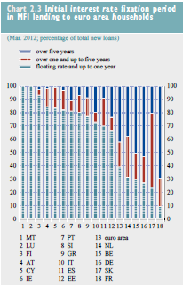
Interest Rate Risk in Banks Balance Sheets
Source: Fitch (2016), 2016 Fitch Credit Outlook Conference, Lisbon, 28 Jan.
Source: European Central Bank (2012), “Financial Stability Review”, June.

Slide 10
Interest Rate Risk in Banks Balance Sheets
      Hedging of gaps is done through the spot market, forward/futures, options or swaps, as well as by changing the pricing structure of balance sheet.
Portuguese banks usually have positive interest rate gaps, as credit rates are mostly indexed to money market rates (e.g. Euribor), while among liabilities only bonds issued are usually indexed, given that term deposits are typically short term liabilities (though may be renewed) and their interest rates are typically fixed by the bank.
Therefore, short term interest rate decreases are, ceteris paribus, unfavorable to banks (as long as repricing gaps are shorter for assets than for liabilities).
However, we must also bear in mind that higher interest rates may reduce credit risk.

Slide 11
Interest Rate Risk in Banks Balance Sheets
Interest rate risk management in FIs creates a demand for mathematical models:
  Calculation of durations/modified durations for bonds
  Pricing of exotic options
  Prepayment models for loans and deposits in banks
  Behavior models for key balance sheet items, namely as a function of interest rates
  Estimation of the Term Structure of Interest Rates

Slide 12
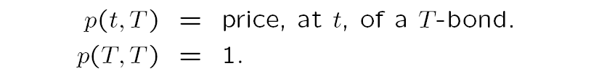
1.2. From Bonds to Interest Rates
Definition of a zero-coupon (or discount) bond of maturity T:
  financial security paying the holder the principal (aka face or nominal value) at a single pre-specified date T in the future, i.e., with no intermediary cash-flows (coupons).
  Assuming that the principal is 1 unit of cash:
The price of the bond will tend to 1 along time (pull-to-par) and at the maturity date it will be 1.

Slide 13
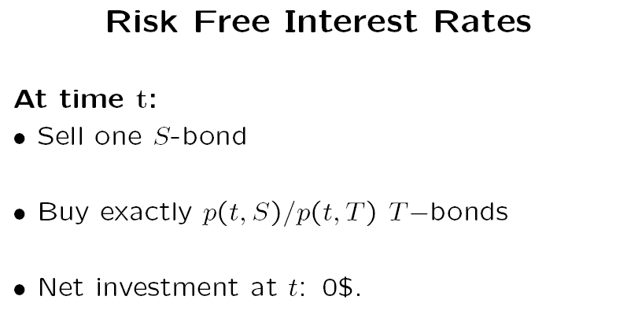
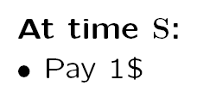
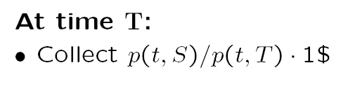
Being t (current time) < S < T
Issue 1 S-bond, receiving p(t,S)
Q(T)
The amount raised is equal to the amount invested:
Q(S)*P(S) = Q(T)*P(T)
1*p(t,S) = [p(t,S)/p(t,T)]*p(t,T)
p(t,S) = p(t,S)
Q(T)
(the principal of the bond issued, may be funded again by the bond markets)
(assuming it is a zero coupon bond, it only pays the principal)

Slide 14



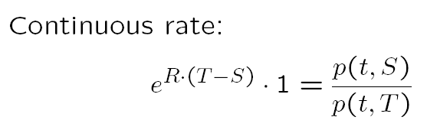
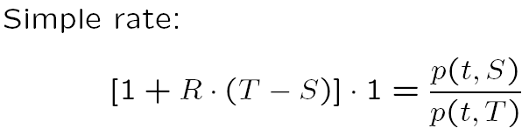
Net Outcome
Continuously compounded return
The investment of 1 at time S (the amount that was paid at S) will allow to obtain the return p(t,S)/p(t,T), i.e. the return at time T (from the previous slide).

Slide 15
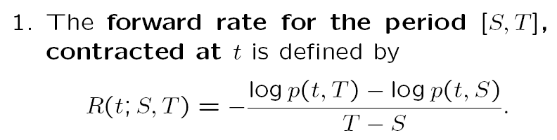
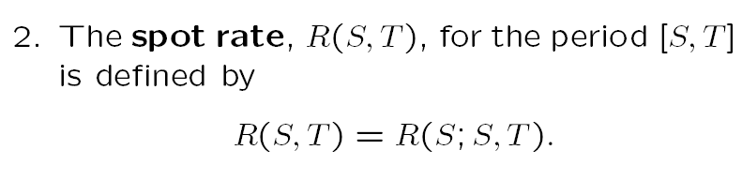
However, as we are at t and S is a future moment (S>t), R is not a spot, but a forward rate, obtained solving the continuous rate formula in the previous slide, in order to R:

Slide 16
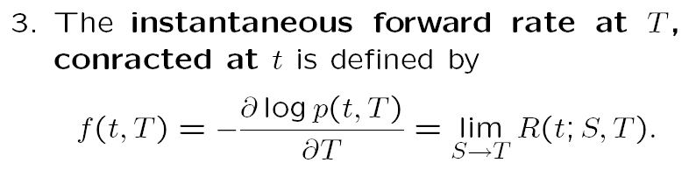
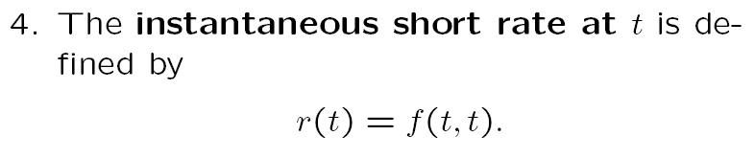
3. The instantaneous forward rate is the forward for a very short time to maturity, obtained by calculating the limit of the continuous rate formula in the previous slide, when S is very close to T:
The forward rate equation in the previous slide corresponds to the symmetric of the first derivative, when S is very close to T
4. The instantaneous short rate at t corresponds to the instantaneous forward when T is very close to t, i.e. when the maturity of the instantaneous forward (the time to settlement) is close to zero.

Slide 17
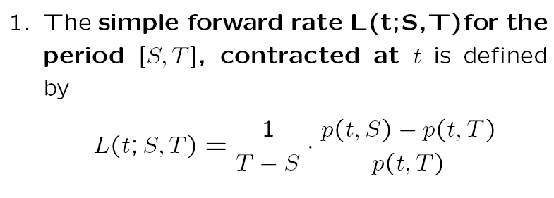
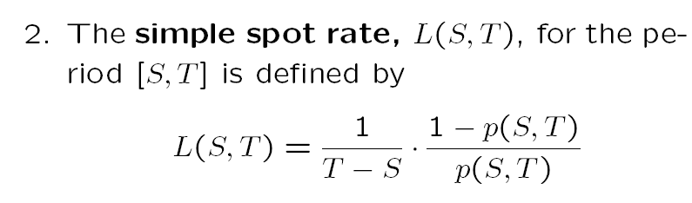
Continuous and Simple Interest Rates
Solving the last equation of slide 14 in order to R
Given that p(S,S) =1

Slide 18
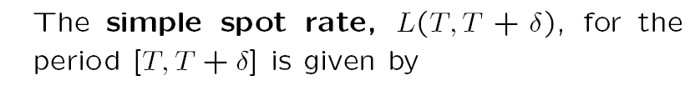
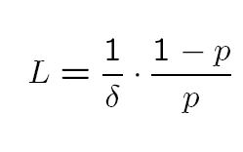
Continuous and Simple Interest Rates
As T-S in the last equation now becomes δ and p(S,T) becomes p

Slide 19
Coupon-bearing Bonds
Coupon rate is the stated interest rate on a security
  It is called the coupon rate because in the past bondholders kept coupons that had to be presented at the payment agents for interest payments
  It is referred to as an annual percentage of face value
  It is often paid twice a year
The current yield gives you a first idea of the return on a bond
Example
  A $1,000 bond has a coupon rate of 7 percent
  If you buy the bond for $900, your actual current yield is

Slide 20
1.3. Yield-to-maturity
The yield-to-maturity (YTM) is the interest rate that makes the present value of the bond’s payments equal to its price.
YTM is the IRR of the cash-flows delivered by the bonds:
  There is no closed formula to compute the YTM, given that it usually involves equations of order higher than 2.
  However, YTM may be easily computed by iterative (trial-and-error) methodologies.
  One of the conceptual problems of YTM is that each cash-flow is discounted using the same rate, implicitly assuming that the yield curve is flat.
  Conversely, we may be discounting cash-flows of different bonds occurring at the same dates with different discount rates (yields).
  The yield is equal to the coupon rate whenever the bond price corresponds to the redemption value.

Slide 21
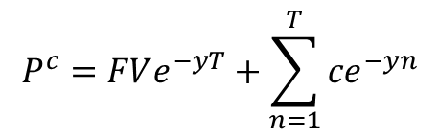
c
c
c
c
c
c
c
c+FV
Price of a constant coupon paying bond (as the coupon is constant, c doesn’t have a subscript)
It is the solution to:
  Simple YTM
  (annual)
  (other)
  Continuous Time YTM
  (annual)
  (other)
$$P^{c}=FVe^{−yT}+\sum_{n=1}^{T}{{ce}^{−yn}}$$

Slide 22
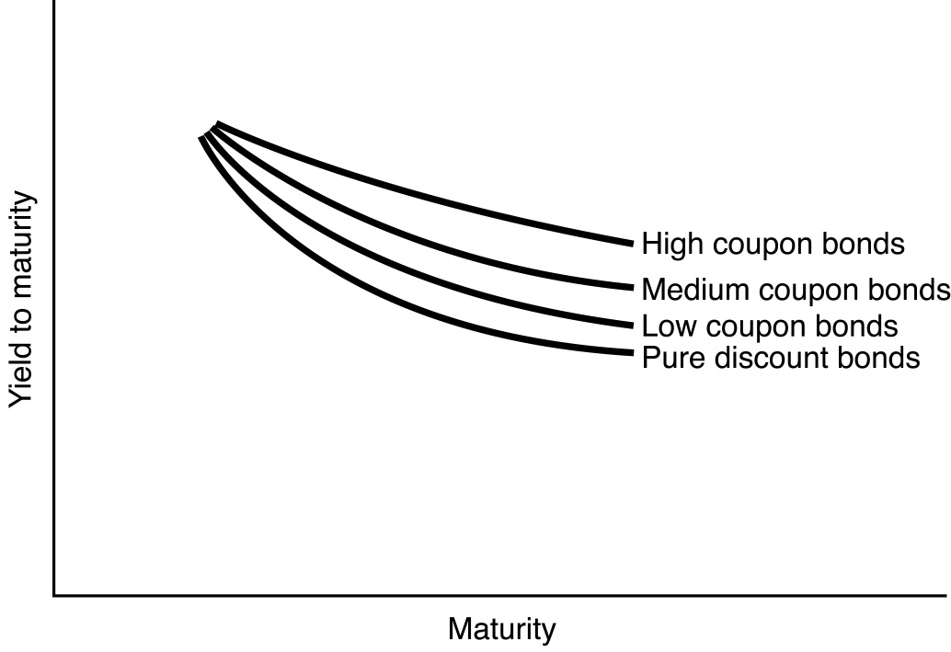
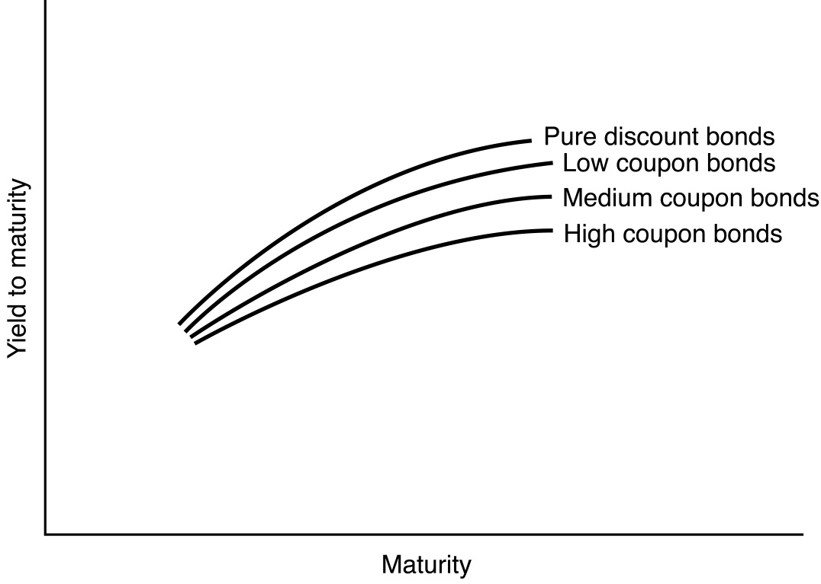
Therefore, the YTM depends on:
  The bond’s maturity
  The bond’s coupon rate
Actually, the yield curve has a less pronounced slope and curvature when the coupons are higher, as the higher weight of intermediate cash-flows reduces the effect of higher maturities in the discount process.

Slide 23
2 - Term Structures (TS)
Empirical Evidence and Classical Theories
2.1. Types of TS
2.2. Dynamics of the TS
2.3. Stylized Facts
2.4. Theories of the TS

Slide 24
2.1. - Types of TS
The term structure of interest rates (TSIR) is the relationship between “risk-free” interest rates and maturities at a given time.
The TSIR may be represented in 3 ways:
  The spot (or zero-coupon) curve
  The forward curve
  The discount factor curve
The TSIR is most commonly illustrated by the yield curve (graphical representation of the spot curve) and may assume different monotonic or non-monotonic shapes:
  Quasi-flat
  Increasing
  Decreasing
  Humped

Slide 25
Illustration: Quasi-Flat
Quasi-Flat

Slide 26
Illustration: Increasing
Increasing

Slide 27
Illustration: Decreasing
Decreasing (or inverted)

Slide 28
Illustration: Humped (1)
Humped
(decreasing then increasing)

Slide 29
Illustration: Humped (2)
Humped
(increasing then decreasing)

Slide 30
2.2 - Dynamics of the TS
The term structure of interest rates changes in response to
  Economic shocks
  Market-specific events
  Policy decisions
Example
  The recent announcement by the Italian Government that next year’s budget will involve a higher deficit => sell-off Italian Govt. bonds => increase in Italian yield and also some contagion on Spanish and Portuguese Govt. bonds.

Slide 31
2.3 - Stylized Facts
Volatility
Correlation
Standard Movements
  Shift Movements
  Twist Movements
  Butterfly Movements

Slide 32
Stylized Facts (1) : Volatility
Yields and bond prices are typically much less volatile than prices in other asset classes.
In countries where the credibility of monetary policy is lower, or, correspondingly, the currency is weaker, the volatility of short term interest rates is usually higher than long term interest rates.
In countries where credit risk issues arise, long term interest rates typically become more volatile.
Even though volatility of long-term rates is usually lower than short-term rates, volatility of bond prices in longer maturities may be higher, due to the higher impact of interest rate shifts on bond prices in higher maturities (durations).

Slide 33
Stylized Facts (2) : Correlation
Rates with different maturities are
  Positively but not perfectly correlated, meaning that there is more than one factor behind the yield curve dynamics
  Correlation decreases with differences in maturity
Example:

Slide 34
Stylized Facts (3): standard movements
The evolution of the interest rate curve can be split into 3 standard movements, regardless the time period or the market:
  Shift movements (changes in level), which account for 70 to 80% of observed movements on average.
  Twist movements (changes in slope), which accounts for 15 to 30% of observed movements on average.
  Butterfly movements (changes in curvature), which accounts for 1 to 5% of observed movements on average.
  => 1 or 2-factor models tend to be enough to explain the behavior of the yield curve in most occasions.

Slide 35
2.4 - Theories of the TS
Explanatory theories of the TSIR depend mostly on:
  the preferences of market participants for maturities, i.e. their credit and liquidity risk aversion.
  the expectations on the future behavior of short-term interest rates, i.e. monetary policy.
Term structure theories attempt to explain the relationship between interest rates and their residual maturity.
Explanatory theories:
  Expectations
  Preferred habitat
  Liquidity premium
  Market segmentation

Slide 36
The expectations theory postulates that long term rates depend on the current short term rates and the expectations on their future path.
Let us assume that an investor has 2 investment alternatives:
  A long term bond (T maturity)
  A set of bonds with short term maturities (maturity = 1, being T>1)
The expected returns for these 2 alternatives must be equal (being r(t,T) the yield in time = t of a bond maturing at a later period T):
  [1+r(t,T)]^{n} = (1+r(t,1)) x (1+E(t) (r(t+1),1)) x (1+E(t) (r(t+2),1)) x … x (1+E(t) (r(T-1),1))
  r(t,T)=[(1+r(t,1)) x (1+E(t) (r(t+1),1)) x (1+E(t) (r(t+2),1)) x … x (1+E(t) (r(T-1),1))]^{1/n}-1

Slide 37
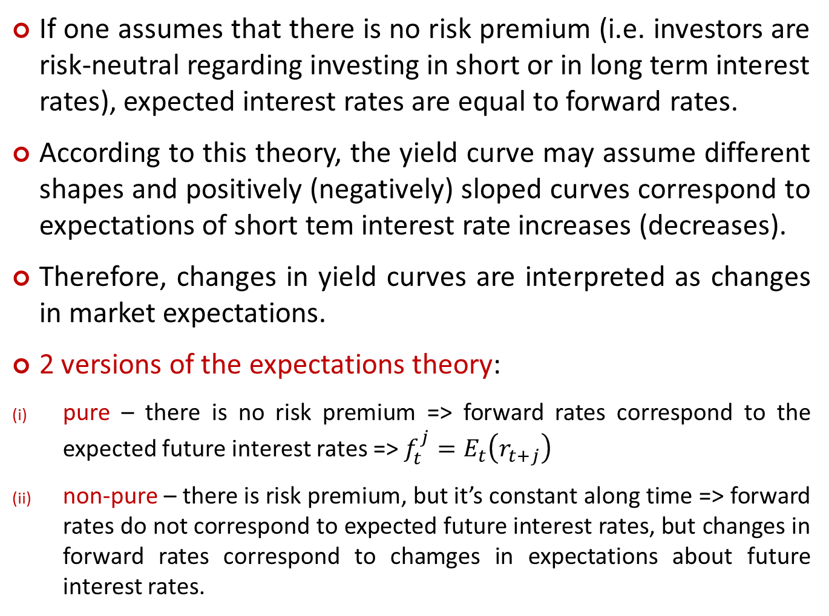
If one assumes that there is no risk premium (i.e. investors are risk-neutral regarding investing in short or in long term interest rates), expected interest rates are equal to forward rates.
According to this theory, the yield curve may assume different shapes and positively (negatively) sloped curves correspond to expectations of short tem interest rate increases (decreases).
Therefore, changes in yield curves are interpreted as changes in market expectations.
2 versions of the expectations theory:
pure – there is no risk premium => forward rates correspond to the expected future interest rates => $f_{t}^{j}=E_{t}\left(r_{t+j}\right)$
non-pure – there is risk premium, but it’s constant along time => forward rates do not correspond to expected future interest rates, but changes in forward rates correspond to chamges in expectations about future interest rates.

Slide 38
The preferred habitat theory sustains that investors have preferred maturities, but they accept to invest in different maturities if they are compensated for that.
Therefore, this theory may be seen as a smoothed version of the previous one, with premiums paid to attract investors to maturities different from those preferred, but not necessarily increasing with the maturity.
Consequently, under this theory, moves in the yield curve do not correspond necessarily to changes in investors’ expectations about the future path of short-term interest rates and the yield curve may have different shapes.
Forward rates (or their changes) cannot be used to gauge expectations about future interest rates.

Slide 39
Liquidity premium theory is a particular case of the preferred habitat theory
Investors always prefer short to long maturities
Investors always demand a premium to invest in longer maturities
Long term interest rates > short term interest rates
The yield curve will always be positively sloped
A positively sloped curve is usually considered as a regular curve, given that investors tend to be risk-averse => premium to invest in longer maturities due to the uncertainty on the future path of interest rates.

Slide 40
The market segmentation theory postulates that interest rates in each maturity stem only from the supply and demand in that maturity.
As a consequence, there is no relationship between interest rates in different maturities and the yield curve may have very irregular shapes.
Main conclusions:
the yield curve shape is explained by a mix of all these theories, even though market participants usually consider that a normal yield curve is a positively sloped one.
the risk premium is usually considered as increasing with maturities.
even though the risk premium is not nil, changes in long-term interest rates may be considered as changes in expectations on future short-term interest rates’ behavior if one assumes that risk premium is constant along time, which tends to happen, at least, in short periods of time.

Slide 41
3 – Hedging Interest Rate Risk
Basic principle: attempt to reduce as much as possible the dimensionality of the problem, i.e. to hedge risk with as few factors as possible.
First step: duration hedging
  Consider only one risk factor
  Assume only small changes in the risk factor
Beyond duration: convexity hedging
  Relax the assumption of small interest rate changes

Slide 42
3.1 - Duration
We will study the sensitivity of the bond price to changes in yield - Interest rate risk:
  Rates change from y to y+dy
  dy - small variation in yields, e.g. 1 bp (e.g., from 5% to 5.01%)
  dP - variation in bond price due to dy
The relationship between the bond prices and the yields is not linear.
However, for small changes in yields, a good proxy for dP is the first derivative of the bond price in order to y.
P
y

Slide 43
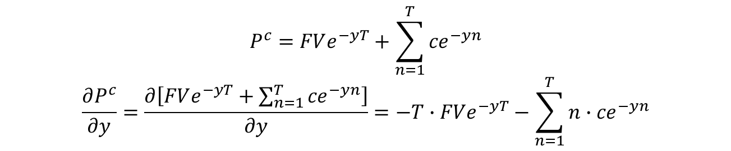

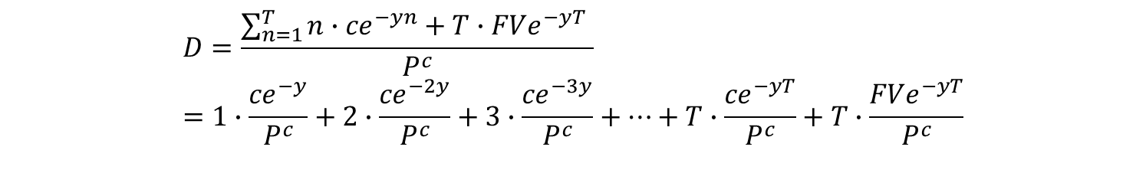
With continuously compounded interest rates, we have:
$$P^{c}=FVe^{−yT}+\sum_{n=1}^{T}{{ce}^{−yn}}$$
$$\frac{∂P^{c}}{∂y}=\frac{∂\left[FVe^{−yT}+\sum_{n=1}^{T}{{ce}^{−yn}}\right]}{∂y}=−T∙FVe^{−yT}−\sum_{n=1}^{T}{{n∙ce}^{−yn}}$$
Macaulay Duration (Frederick Macaulay, 1938) – aka effective maturity: Average maturity (measured in years) of all cash-flows weighted by the relevance of their NPV on the bond price (while residual maturity is just the maturity of the final cash-flow)
Calculated as (the absolute value of) the partial derivative of the bond price with respect to yield, divided by the bond price:
$$D=\frac{\sum_{n=1}^{T}{{n∙ce}^{−yn}}+T∙FVe^{−yT} }{P^{c}}=1∙\frac{{ce}^{−y}}{P^{c}}+2∙\frac{{ce}^{−2y}}{P^{c}}+3∙\frac{{ce}^{−3y}}{P^{c}}+…+T∙\frac{{ce}^{−yT}}{P^{c}}+T∙\frac{{FVe}^{−yT}}{P^{c}}$$
$\frac{∂P^{c}}{∂y}=−DP^{c}⇒$ $\frac{dP^{c}}{P^{c}}=−Ddy$
it tells how much relative change in price follows a given small change in yield impact

Slide 44

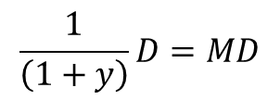
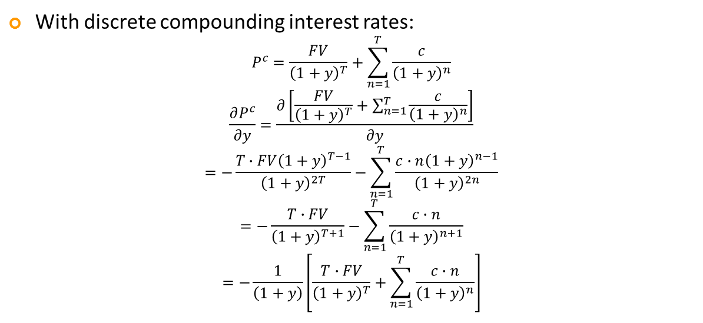
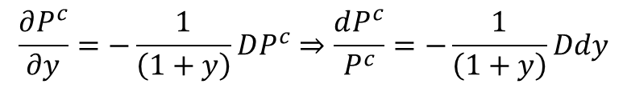
With discrete compounding interest rates:
$$P^{c}=\frac{FV}{{\left(1+y\right)}^{T}}+\sum_{n=1}^{T}{\frac{c}{{\left(1+y\right)}^{n}}}$$
$$\frac{∂P^{c}}{∂y}=\frac{∂\left[\frac{FV}{{\left(1+y\right)}^{T}}+\sum_{n=1}^{T}{\frac{c}{{\left(1+y\right)}^{n}}}\right]}{∂y}$$
$$=−\frac{T∙FV{\left(1+y\right)}^{T−1}}{{\left(1+y\right)}^{2T}}−\sum_{n=1}^{T}{\frac{c∙n{\left(1+y\right)}^{n−1}}{{\left(1+y\right)}^{2n}}}$$
$$=−\frac{T∙FV}{{\left(1+y\right)}^{T+1}}−\sum_{n=1}^{T}{\frac{c∙n}{{\left(1+y\right)}^{n+1}}}$$
$$=−\frac{1}{\left(1+y\right)}\left[\frac{T∙FV}{{\left(1+y\right)}^{T}}+\sum_{n=1}^{T}{\frac{c∙n}{{\left(1+y\right)}^{n}}}\right]$$
Weighted-average maturity of all cash-flows (weighted by the relative weight of their NPV on the bond price)
$$D=\frac{\frac{T∙FV}{{\left(1+y\right)}^{T}}+\sum_{n=1}^{T}{\frac{c∙n}{{\left(1+y\right)}^{n}}}}{P^{c}}$$
$$\frac{∂P^{c}}{∂y}=−\frac{1}{\left(1+y\right)}DP^{c}⇒\frac{dP^{c}}{P^{c}}=−\frac{1}{\left(1+y\right)}Ddy$$
$$\frac{1}{\left(1+y\right)}D=MD$$
modified duration – percentage impact (%) on bond price of a given change (percentage points) in the yield

Slide 45
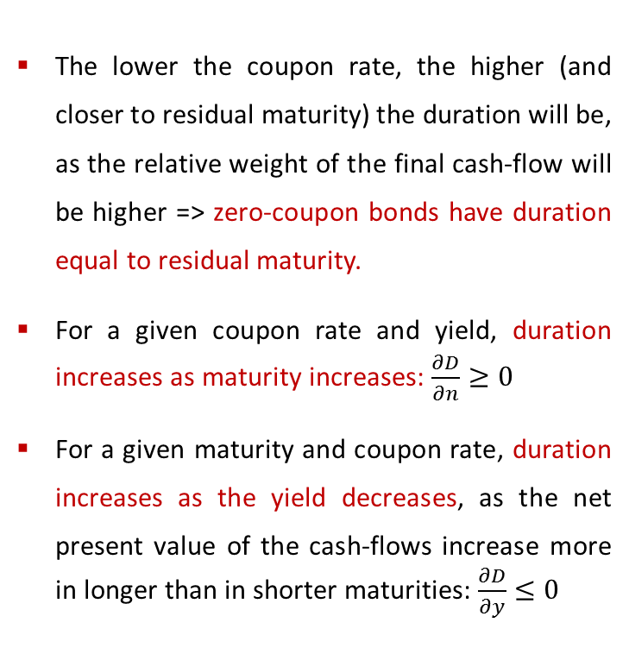
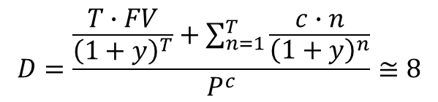
Example (see calculation in spreadsheet)
T = 10, c = 5%, y = 5% (bond at par)
  The lower the coupon rate, the higher (and closer to residual maturity) the duration will be, as the relative weight of the final cash-flow will be higher => zero-coupon bonds have duration equal to residual maturity.
  For a given coupon rate and yield, duration increases as maturity increases: $\frac{∂D}{∂n}≥0$
  For a given maturity and coupon rate, duration increases as the yield decreases, as the net present value of the cash-flows increase more in longer than in shorter maturities: $\frac{∂D}{∂y}≤0$
$$D=\frac{\frac{T∙FV}{{\left(1+y\right)}^{T}}+\sum_{n=1}^{T}{\frac{c∙n}{{\left(1+y\right)}^{n}}}}{P^{c}}≅8$$

Slide 46
Duration Hedging
Principle: immunize the value of a bond portfolio with respect to changes in yield:
  P = value of the portfolio
  H = value of the hedging instrument
Hedging instrument may be:
  Bonds
  Swaps
  Futures
  Options
  FRAs
Duration hedging is very simple to do, but it is only valid for small changes and parallel shifts of the yield curve.

Slide 47
Changes in value
  Portfolio
  Hedging instrument
Strategy: hold q units of the hedging instrument so that
Solution
  given that P’(y)=dP/dY and dP/P = -D x dy (with countinuously compounded interest rates) ⬄dP/dy = -P x D

Slide 48
Example:
At date t, a portfolio P has a price of $328635, a 5.143% yield and a 7.108 duration.
Hedging instrument – bond with price = $118.786, yield = 4.779% and duration = 5.748.
Hedging strategy involves taking a short position (i.e. selling futures contracts) as follows:
  q = -(328635x7.108)/(118.786x5.748) = - 3421
Therefore, 3421 units of the hedging bond should be sold.

Slide 49
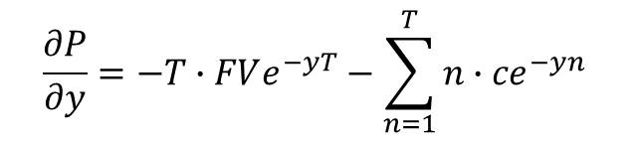
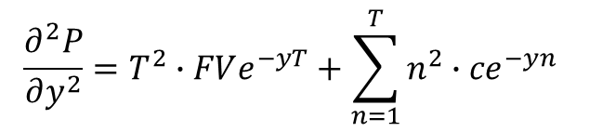
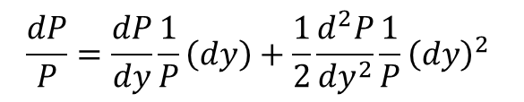
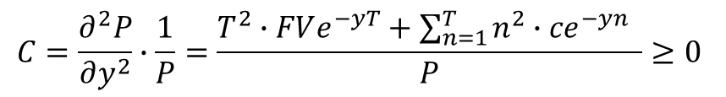
3.2. Convexity
Considering a second order Taylor approximation:
$$\frac{dP}{P}=\frac{dP}{dy}\frac{1}{P}\left(dy\right)+\frac{1}{2}\frac{d^{2}P}{{dy}^{2}}\frac{1}{P}{\left(dy\right)}^{2}$$
-D
C
With continuous compounding:
$$\frac{∂^{2}P}{∂y^{2}}=T^{2}∙FVe^{−yT}+\sum_{n=1}^{T}{{n^{2}∙ce}^{−yn}}$$
$$\frac{∂P}{∂y}=−T∙FVe^{−yT}−\sum_{n=1}^{T}{{n∙ce}^{−yn}}$$
as
$$C=\frac{∂^{2}P}{∂y^{2}}∙\frac{1}{P}=\frac{T^{2}∙FVe^{−yT}+\sum_{n=1}^{T}{{n^{2}∙ce}^{−yn}} }{P}≥0$$

Slide 50
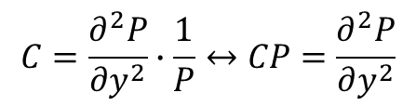
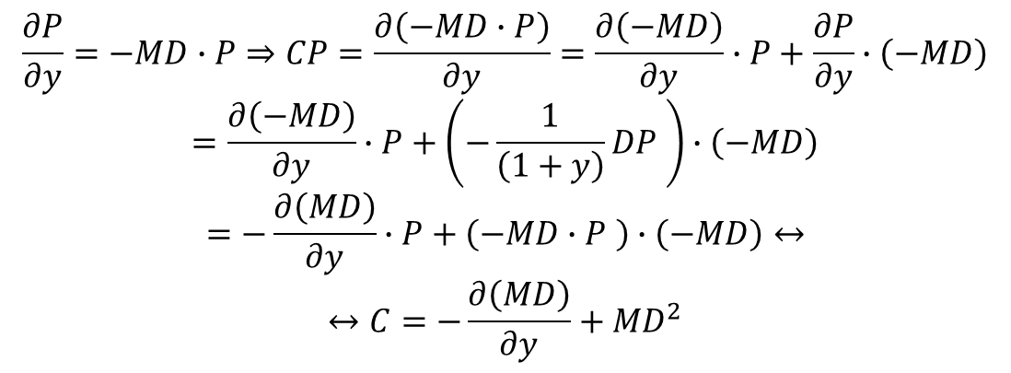

With discrete compounding, convexity may be written as a function of MD and its first derivative in order to the yield:
$$C=\frac{∂^{2}P}{∂y^{2}}∙\frac{1}{P}↔CP=\frac{∂^{2}P}{∂y^{2}}$$
$$\frac{∂P}{∂y}=−MD∙P⇒CP=\frac{∂\left(−MD∙P\right)}{∂y}=\frac{∂\left(−MD\right)}{∂y}∙P+\frac{∂P}{∂y}∙\left(−MD\right)$$
$$=\frac{∂\left(−MD\right)}{∂y}∙P+\left(−\frac{1}{\left(1+y\right)}DP \right)∙\left(−MD\right)$$
$$=−\frac{∂\left(MD\right)}{∂y}∙P+\left(−MD∙P \right)∙\left(−MD\right)↔$$
$$↔C=−\frac{∂\left(MD\right)}{∂y}+{MD}^{2}$$
As MD decreases with the yield =>
$$C≥0$$

Slide 51
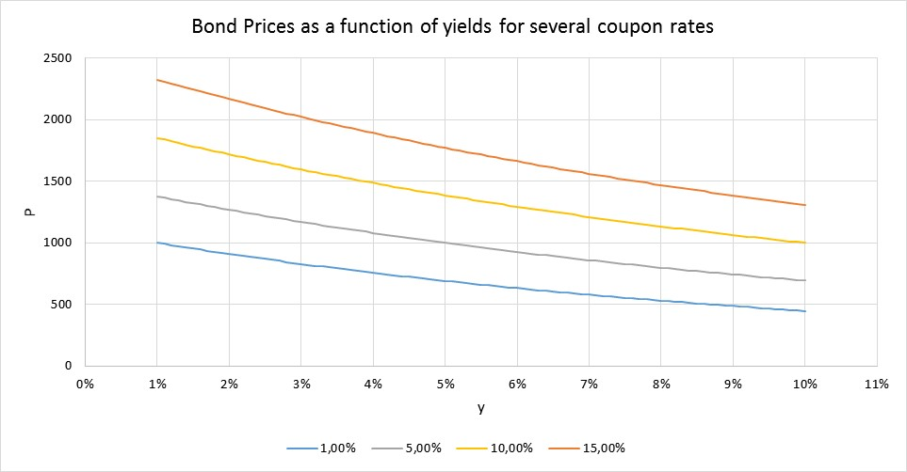
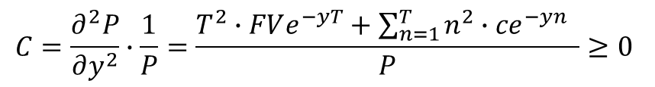
Convexity- properties
$$C=\frac{∂^{2}P}{∂y^{2}}∙\frac{1}{P}=\frac{T^{2}∙FVe^{−yT}+\sum_{n=1}^{T}{{n^{2}∙ce}^{−yn}} }{P}≥0$$
For a given maturity and yield, convexity increases when the bond provides regular payments along time => convexity increases with the coupon rate.
But if the coupon rate increases, the yield will also increase, bring convexity (and duration) down.
For a given maturity and coupon rate, convexity increases when the yield decreases.
For a given coupon rate and yield, convexity increases when maturity increases.
A bond with higher convexity is always preferred, as its price benefits more from yield decreases and its less impacted by yield increases => bonds with low coupon rates.

Slide 52
Duration + Convexity Hedging - principle
Principle: immunize the value of a bond portfolio with respect to changes in yield:
  Denote by P the value of the portfolio
  Two hedging instruments, whose value is H₁ and H₂, because one wants to hedge one risk factor (parallel shifts in the yield curve) but also the second order effect:
  Portfolio
  Hedging instruments

Slide 53
Strategy: hold q₁ and q₂ units of the first and second hedging instruments so that
Solution
- Under the assumption of unique dy – parallel shifts (impacting simultaneously on the price of the portfolio and the hedging instruments):
  - Or under the assumption of a unique y – flat yield curve (in this case, the change in the hedging instruments’ and bond prices will result straight from the duration and convexity):

Slide 54
Example:
Optimal quantities q₁ and q₂ of each hedging instrument are given by
Portfolio at date t
  Price P = $ 32863.5
  Yield y = 5.143%
  Modified duration = 6.76
  Convexity Conv = 85.329
Hedging instrument 1
  Price H₁ = $ 97.962
  Yield y₁ = 5.232 %
  Modified duration = 8.813
  Convexity Conv₁ = 99.081
Hedging instrument 2:
  Price H₂ = $ 108.039
  Yield y₂ = 4.097%
  Modified duration = 2.704
  Convexity Conv₂ = 10.168
Solving in order to q1 and q2, you should sell 305 units of H₁ and buy 140 units of H₂.

Slide 55
Duration + Convexity Hedging - limitations
Actually, the yield curve is not flat => more complex calculations.
Furthermore, yield curve shifts are not only parallel, but its shape also changes => more complex calculations.
Therefore, the yield curve dynamics is not fully explained by one factor models => multifactor models are needed.

Slide 56
4 –IR Derivatives
Forward Rate Agreements (FRAs)
Interest rate futures
Interest sate swaps (IRS)
Interest rate Options:
  Plain vanilla Bond or short-term futures Options
  Interest rate CAPS
  Swaptions

Slide 57
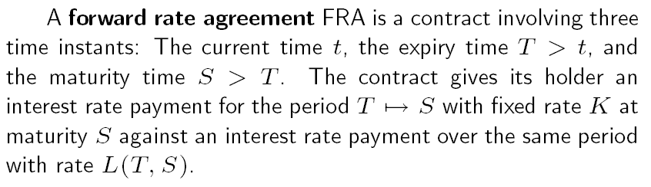

FRAs
T is also usually known as the settlement date and the difference between t and T as the time to settlement.
If one assumes that investor are risk-neutral, the FRA’s interest rate corresponds to the expected interest rate for time T and term S-T.

Slide 58
FRAs
FRAs are quoted by financial institutions in over-the-counter market.
Therefore, they are not listed in exchange markets.
Additionally, they are quoted for fixed times to settlement and maturities, e.g. 3 x 9 (6-month interest rate forward, with a time to settlement of three months).
Quotes are in percentage points, as usual interest rates (e.g. 2%, 4%).
In order to cancel an exposure to a FRA, one cannot sell the contract, but can take a short exposure on a futures contract, for a time to settlement and an interest rate maturity as close as possible.
Just like for a bond, the value of a FRA contract is an inverse function of the interest rate: an increase in spot rates reduces the value of a FRA contract => for the buyer/holder of a long position in a FRA, interest rate increases are unfavorable.

Slide 59
FRAs
Being S the FRA contract value, there is a positive pay-off to the long (short) position holder when interest rates decrease (increase).
Source: Hull, John (2009), “Options, Futures and Other Derivatives”, Pearson Prenctice Hall, 7th Edition

Slide 60
Interest Rate Futures
Futures contracts are traded in exchange markets, for fixed settlement dates (and consequently different times to settlement and maturity), e.g. the 3-month Euribor futures for Dec.2016 settlement).
Conversely, FRAs are traded for variable settlement dates and fixed times to settlement and maturity.
Therefore, in order to cancel a long position in such a contract, an investor can take a short position in (sell) the same contract.
Usually, one can find futures contracts for short and long term interest rates.
Short-term futures contracts are quoted as 100 minus the implied interest rates.
Long-term futures contracts are priced as a % of the nominal value of the theoretical bond embedded in the futures contract, just like the true bonds.

Slide 61
Interest Rate Futures
Therefore, an increase in both types of futures contracts means that the implied interest rate is decreasing.
Short-term interest rate futures have financial settlement, while long-term interest rate futures usually have physical settlement, through the cheapest-to-deliver bond (among the bonds considered as deliverable, i.e. proxies for the theoretical underlying bond).
Short and long term interest rate futures are usually available for quarterly settlement dates (pre-specified days in March, June, September and December).
However, short term futures are available for a longer set of settlement dates (comparing to long term interest rate futures and also FRAs), even though the most liquid contracts are those with shorter times to settlement.

Slide 62
Interest Rate Futures
Futures prices converge to the spot value when the settlement date is approaching.
Source: Hull, John (2009), “Options, Futures and Other Derivatives”, Pearson Prenctice Hall, 7th Edition

Slide 63
IRS
IRS are contracts that settle the exchange of fixed for variable interest rates at pre-specified dates.
Therefore, they may be seen as a long (short) position in a fixed rate bond or a set of FRAs, on one hand, and a short (long) position in a variable interest rate bond, on the other hand.
The swap value or price corresponds to its replacement cost, i.e. the amount of money that should be paid to one counterparty to the other to cancel the contract, reflecting the dynamics of short and long term interest rates since the initial date or the last payment date.
This also corresponds to the difference between a fixed and a floating rate bond:
(from the floating rate payer’s point of view)
Consequently, at the initial and all payment dates, the swap value returns to 0.

Slide 64
Interest Rate Options
Interest rate volatilities have to be estimated.
Consequently, the Dynamics of the yield curve must be assessed => Stochastic Interest Rate Models.
Cap - set of put options on the several interest rates to be paid in the future.
Each of these options is a caplet and can be traded individually.
Swaption-option giving the right to enter into a swap at a future pre-specified rate.
Therefore, the option will be exercised only if the IRS has a positive value.
Contrary to the caps, the several cash-flows of the swaption cannot be traded separately and the whole yield curve has to be modelled, including the correlation between the several interest rates.

Slide 65
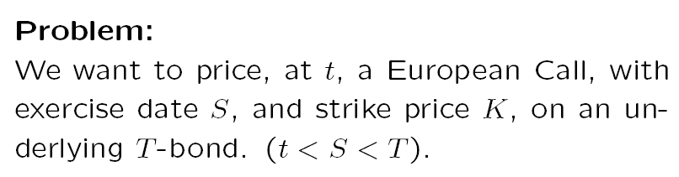
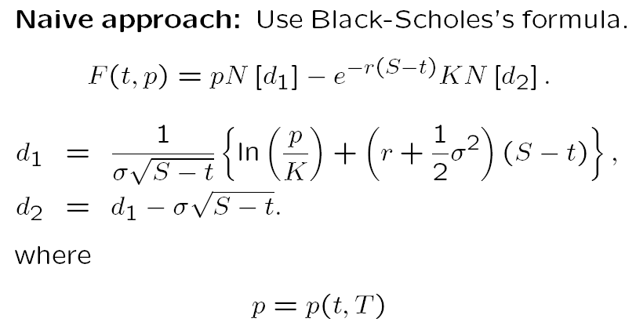


Slide 66
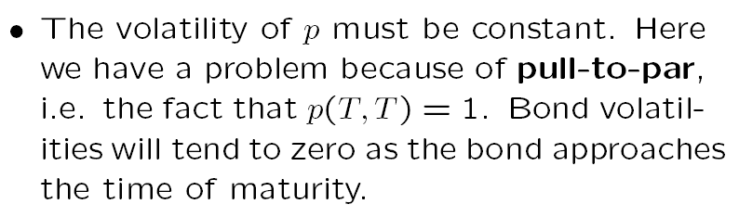
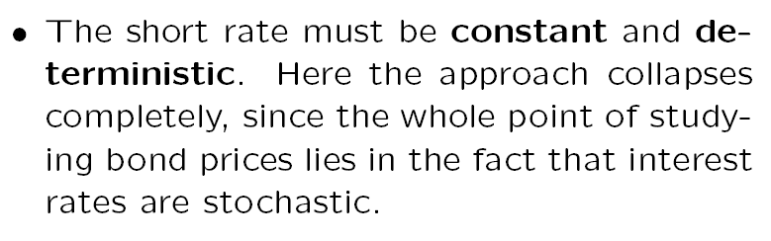
Therefore, one needs to estimate a model for bond prices or interest rates.

