Slide 1
Interest Rate Models
PART II

Slide 2
1 Static Interest Rate Models

Slide 3
1.1 - Fitting the TS of Interest Rates
Fundamental Asset Pricing Formula
Spot Rates
Recovering the Term Structure
Direct Methods: Bootstraping and Interpolation
Indirect Methods: Deterministic interest rate models
Spline Methods

Slide 4
Fundamental Asset Pricing Formula
R(0,t) is the discount rate (the yield in the case of a bond)
p(0,t) is the discount factor (equal to 1 if cash-flows are received at t=0)
Two main questions:
Q1: Where do we get the p(0,t) or R(0,t) from?
Q2: Do we use the equation to obtain bond prices or implied discount factors/discount rates?

Slide 5
Answers:
Q1: Where do we get the p(0,t) or R(0,t) from?
Any relevant information concerning how to price a financial asset must be primarily obtained from market sources
Discount factor p(0,t) is the price of a t-Bond with unitary face value and maturity t
Spot rate R_{0,t} is the annualized rate of a pure discount bond:

Slide 6
Example: Getting Spot rates from Bond Prices:
Consider a 2-year pure discount bond that trades at 92€.
The 2-year spot rate R_{0,2} is:
In the real world, zero-coupon bonds are not abundant.
However, we are still able to compute spot rates from market information.

Slide 7
Q2: Do we use the equation to obtain bond prices or implied discount factors/discount rates?
It depends on the situation!
One would like to use the price of existing securities as given, and derive implied discount factors or discount rates from them.
Then, one could use that information (more specifically the term structure of interest rates, represented by the discount rates) to price any other security.
This is known as relative pricing.

Slide 8
1.1.1 - Direct Methods
Bootstrapping method
Carleton and Cooper (1976)
Interpolation methods:
Linear
polynomial

Slide 9
Bootstrapping
Consider 2 securities (nominal value = 100€):
1-year pure discount bond selling at 95€.
2-year 8% bond selling at 99€, with annual coupon payments.
1-year spot rate:
2-year spot rate:

Slide 10
The same type of reasoning can be developed for any number of bonds, e.g. 4 bonds:
Coupon
Maturity (year)
Price
Bond 1
5
1
101
Bond 2
5.5
2
101.5
Bond 3
5
3
99
Bond 4
6
4
100
Solve the following system:
101 = 105 p(0,1)
101.5 = 5.5 p(0,1) + 105.5 p(0,2)
99 = 5 p(0,1) + 5 p(0,2) + 105 p(0,3)
100 = 6 p(0,1) + 6 p(0,2) + 6 p(0,3) + 106 p(0,4)
and obtain
p(0,1)=0.9619, p(0,2)=0.9114, p(0,3)=0.85363, p(0,4)= 0.7890
R(0,1)=3.96%, R(0,2)=4.717%, R(0,3)=5.417%, R(0,4)=6.103%

Slide 11
A usual practical way to estimate the yield curve involves the employment of interbank money market rates for several maturities:
1 year and 2 months rate
x=5.41%
Maturity
ZC
Overnight
4.40%
Coupon
Maturity (years)
Price
1 month
4.50%
Bond 1
5%
1 y and 2 m
103.7
2 months
4.60%
Bond 2
6%
1 y and 9 m
102
3 months
4.70%
Bond 3
5.50%
2 y
99.5
6 months
4.90%
9 months
5.00%
1 year
5.10%

Slide 12
Conclusions
If one can find different bonds with coincident cash-flow dates and one of them only has one remaining cash-flow date, then one can get the spot rates directly.
These rates are not yields (except for the shortest bond) and consequently they do not face their consistency problems.
Therefore, we have a single spot rate for each maturity and the yield curve may have any shape.
One can also calculate spot rates by using money market rates.

Slide 13
Carlton and Cooper (1976)
Estimation of the discount factors by OLS method if the number of bonds is larger than the number of discount factors to be estimated.
Where
i = 1, …, k - riskless government bonds considered
t = 1,…, n - the cash-flows for which the discount factors are to be calculated.
P = vector of the prices of the i bonds (a column vector with i rows);
CF = matrix of the cash-flows of the i bonds for the t cash-flows (i rows and t columns);
d = vector of the discount factors for the t cash-flows (a column vector with t cash-flows).

Slide 14
Carlton and Cooper (1976)
This method has several drawbacks:
it only allows the estimation of some points of the discount function (for the maturities of the cash-flows considered);
it does not impose any smoothness on the discount function, allowing meaningless shapes (non-monotonically decreasing and convex); and
It faces multicolinearity problems resulting from the linear dependence between the cash-flows of, at least, some of the securities taken into consideration.

Slide 15
Interpolation - Linear
Interpolations may be useful if we don’t have all market information required to get spot rates for the same maturities, being interest rates calculated as functions of maturities, with linear interpolations as the simplest approach.
Assuming that we know discount rates for maturities t₁ and t_{2,} the rate for maturity t, being t₁< t <t₂, corresponds to the weighted average of the adjacent rates, being the weights higher for the maturity closer to t (e.g. if t=t₂, t₁ will not have any relevance to calculate t):
Linear interpolations provide good proxies for near maturities.
However, for distant maturities, the shape of the resulting yield curve tends to be kinked.
By definition, linear interpolation doesn’t allow to get estimates for maturities longer than those observed.

Slide 16
Interpolation – Polynomial
Polynomial interpolations of the interest rates allow to obtain smoother yield curves, with interest rates as polynomial functions of maturities.
A very common polynomial interpolation is the cubic => one can estimate the full term structure just by knowing the spot rates for 4 maturities.
Therefore, if R(0, t₁), R(0, t₂), R(0, t₃) and R(0, t₄) are known, one can solve the following system in order to the four coefficients of the 3rd order polynomial.
, being
If one uses more than 4 spot rates, these coefficients are estimated by econometric techniques (as we will have degrees of freedom), e.g. ordinary least squares (as the functions are linear in the coefficients).
Otherwise,
, being
$$R=T∙A$$
$$R=\left[\begin{aligned}R(0,1) \\ R(0,2) \\ R(0,3) \\ R(0,4)\end{aligned}\right], T=\left[\begin{matrix}t_{1}^{3} & t_{1}^{2} & t_{1} & 1 \\ t_{2}^{3} & t_{2}^{2} & t_{2} & 1 \\ t_{3}^{3} & t_{3}^{2} & t_{3} & 1 \\ t_{4}^{3} & t_{4}^{2} & t_{4} & 1\end{matrix}\right], A=\left[\begin{aligned}a \\ b \\ c \\ d\end{aligned}\right]$$
$$R=T∙A⟺A=T^{−1}∙R$$

Slide 17
Example
The calculation of a, b, c and d allows to obtain the spot rate for any maturity t:
Assuming the following rates are known:
R(0,1) = 3%
R(0,2) = 5%
R(0,3) = 5.5%
R(0,4) = 6%
Goal - Compute the 2.5 year rate:
R(0,2.5) = a x 2.5³ + b x 2.5² + c x 2.5¹ + d = 5.34375%
$$\left\{\begin{aligned}R\left(0,1\right)=a∙1^{3}+b∙1^{2}+c∙1+d \\ R\left(0,2\right)=a∙2^{3}+b∙2^{2}+c∙2+d \\ R\left(0,3\right)=a∙3^{3}+b∙3^{2}+c∙3+d \\ R\left(0,4\right)=a∙4^{3}+b∙4^{2}+c∙4+d\end{aligned}\right.$$

Slide 18
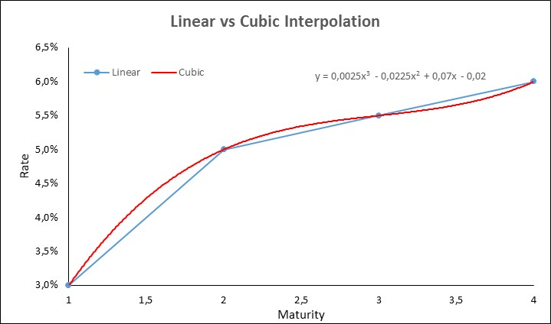
Illustration: Polynomial versus Linear

Slide 19
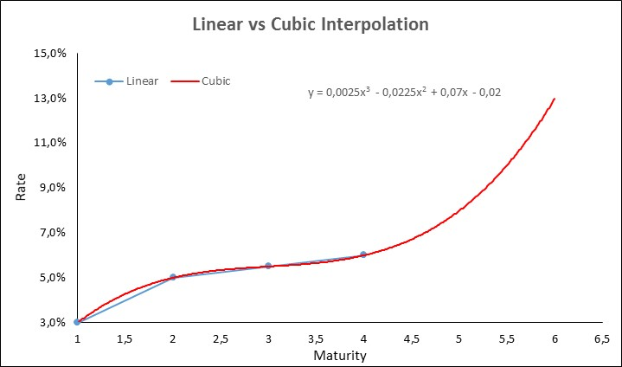
Conclusions
The resulting spot curve using 3rd order polynomial methods tends to be too irregular, namely when:
one uses it to estimate a rate for a maturity much higher than the maximum maturity used to calculate the polynomial coefficients (e.g. in the previous example the 10-year would be 93%!)
the difference between two consecutive maturities is too large.
Polynomial splines improve the adjustment, by allowing different specifications for the polynomials in different maturity buckets.
Nonetheless, the explosive behavior of the resulting curves is kept.

Slide 20
Polynomial Functions
1.1.2 - Spline Methods
Discount factors (p) as polynomial functions of the maturity (s), with all coefficients differing in the different maturity buckets:
Imposing continuity constraints and given the fact that the discount factor for zero maturity is 1, the number of parameters is reduced:
The number of parameters may be even further reduced if it is assumed that only one of the parameters is different in the several maturity buckets => McCulloch (1971, 1975) splines.
$$p_{0}\left(5\right)=p_{5}\left(5\right)$$
$$p_{5}\left(10\right)=p_{10}\left(10\right)$$
$$p_{0}\left(0\right)=1$$

Slide 21
Polynomial Splines
Dividing the maturity spectrum is divided in k-2 intervals, with k-3 vertices, the discount function can be defined by a cubic function, adding a factor (spline) to the 3rd order component in k-3 intervals (the polynomial in the 1st interval will not have this additional factor, being the discount function given straight by the 3rd order polynomial), being No. of parameters = k:
where Dh(t) for h=1,2,…, k-3 are functions defined on the basis of the vertices of the intervals, as follows:
=0, if t<t_{h}, =1, if , for h=1,….,k-3.
The discount function is continuous ⬄ for all vertices, the values for the discount function are given as:
where gh(t) are the polynomial functions of third degree. To have d(0)=1, we assume that a0=1 and gh(0)=0. Thus, the number of parameters to be estimated (a1 to ak) will be k, i.e., equal to the number of intervals defined plus two.
The number of intervals must be defined taking into account that a number of intervals too low approximates this method to the simple polynomial adjustment and a number of intervals too high imposes an excessive number of parameters and does not allow for enough smoothness.

Slide 22
Polynomial Splines
How to choose the number of parameters/intervals and the vertices:
McCulloch proposes k = square root of the number of observations (bonds), rounded to the nearest integer, with the vertices chosen to ensure all intervals have the same No. observations (or the difference between the No. observations in each interval is not higher than 1).
Alternative methodology - fixing the vertices of the intervals in maturity dates corresponding to the maturities in which the market is traditionally “divided”: 1, 3, 5 and 10 years.

Slide 23
Polynomial Splines
If the vertices of the intervals correspond to the maturities in which the market is traditionally “divided” - 1, 3, 5 and 10 years – we have:
No. Intervals: k-2 = 5 (0-1, 1-3, 3-5, 5-10 and > 10y)
No. Vertices: k-3 = 4 (1, 3, 5 and 10)
, if t<1, , if , if t<3, ,if , if t<5, , if , if t<10, ,
if

Slide 24
Polynomial Splines
The method of polynomial splines provides us better estimates in sample, i.e. up to the longest observed maturity, comparing to polynomial functions.
However, the estimation problems outside the sample remain, as the discount function tends to assume irregular shapes from the longest maturity onwards, and it may even become negative.
Whenever the yield curve assumes complex shapes, the use of a high number of parameters leads the estimated curve to adjust excessively to outliers => yield curve becomes even more irregular.
This is particularly inconvenient if the objective is, as it usually happens, the estimation of the term structure of interest rates for a fixed or standardised range of maturities, or to calculate forward rates.
Therefore, more complex specifications will be required.

Slide 25
1.1.3 - Deterministic Methods
3 steps:
Step 1: select a set of K bonds with prices P^{j} paying cash-flows F^{j}(t_{i}) at dates t_{i}>t
Step 2: select a deterministic interest rate model for the functional form of the discount factors p(t,t_{i};ß), or the discount rates R(t,t_{i};ß), where ß is a vector of unknown parameters, and generate prices.
Step 3: estimate the parameters ß as the ones making the theoretical prices as close as possible to market prices:

Slide 26
Key advantages:
Parsimonious models, i.e. do not involve many parameters
Ensure stable functions
Adjust to many possible shapes of the TS
Some parameters have economic interpretation

Slide 27
Recap and Notation
Spot rate curve as a function of maturity (sm) = simple average of instantaneous forward rates:
Discount curve:
Forward rate for time to settlement m and for maturity n (with discrete compounding):
Given that the spot rate can be obtained from the discount function
We obtain

Slide 28
Nelson and Siegel
Nelson and Siegel (1987) proposed to fit the term structure using a flexible, smooth parametric function.
They demonstrated that the proposed model is capable of capturing many of the typically observed shapes that the yield curve assumes over time.
The resulting Nelson-Siegel forward curve can be assumed to correspond to a 3 unobserved factor model (as pointed out in Diebold and Li (2005)):

Slide 29
β₀ : level parameter - the long-term rate
β₀ + β₁: short-term rate
β₁ : (-) slope parameter
β₂: curvature parameter
τ : influences the speed of convergence of the curve towards the asymptotic value.
: point of inflection of the slope of the forward curve
: point of inflection of the concavity of the forward curve

Slide 30
Diebold, Piazzesi and Rudebusch
Some authors argue that the NS model has to many parameters to be estimated.
Litterman and Scheinkman (1991)* show that the variation in interest rates can be explained by a small number of underlying common factors, typically up to three, interpreted as level, slope and curvature.
The 1st factor explains 89,5% of the total variance of returns, the 2nd factor for 8,5% and the 3rd for the remaining 2%.
For this reason, Diebold, Piazzesi, and Rudebusch (2005)*² examine a 2-factor Nelson-Siegel model, even though they recognize that more than 2 factors will “be needed in order to obtain a close fit to the entire yield curve at any point in time”, e.g. for pricing derivatives.
* Litterman, Robert and José Scheinkman (1991), “Common Factors Affecting Bond Returns”, Journal of Fixed Income.
*² Diebold, Francis X., Monika Piazzesi and Glenn D. Rudebusch (2005), "Modeling Bond Yields in Finance and Macroeconomics“, American Economic Review, 95, pp. 415-420.

Slide 31
DPR (2005) Two-factor model
Compared to the 3-factor Nelson-Siegel model, the 2-factor model only contains the level and slope factor => only 3 parameters have to be estimated:
$$s_{m}=β_{0}+β_{1}∙{\left[1−e^{\left({−m}/τ\right)}\right]}/{\left(m/τ\right)}$$

Slide 32
Björk and Christensen
Although NS model can capture a wide range of shapes, it cannot handle all shapes that the term structure assumes over time.
Several more flexible NS specifications have been proposed in the literature to improve the fit to more complex shapes, namely with multiple inflection points, introducing additional factors and parameters.
One of those models was developed by Bjork, T. and Christensen B.J. (1999): ”Interest rate dynamics and consistent forward rate curves”, Mathematical Finance.

Slide 33
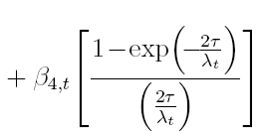
Björk and Christensen (1999) proposed to add a fourth factor to the approximating forward curve
The fourth component, resembles the second component, as it also mainly affects short-term maturities.
The difference is that it decays to zero at a faster rate.

Slide 34
BC (1999) four-factor - properties
The factor can be interpreted as a second slope factor.
As a result, the Björk and Christensen model captures the slope of the term structure by the (weighted) sum of and .
The instantaneous short rate in this case is given by

Slide 35
Bliss (1997)
A second option to make the Nelson-Siegel more flexible is through relaxing the restriction that the slope and curvature component should be governed by the same decay parameter τ.
Bliss (1997) estimates the term structure of interest rates with the 3-factor model that allows for 2 different decay parameters τ₁ and τ₂.
The forward and spot curves are then given by
$${{}_{m}f}_{0}=β_{0}+β_{1}∙e^{\left({−m}/{τ_{1}}\right)}+β_{2}∙\left[\left(m/τ\right)∙e^{\left({−m}/{τ_{2}}\right)}\right]$$

Slide 36
Svensson (1994)
A popular term-structure estimation method among central banks (see BIS, 2005) is the 4-factor Svensson (1994) model.
Svensson (1994) proposes to increase the flexibility and fit of the NS model by adding a second hump-shape factor with a separate decay parameter.
This feature is specially relevant when fitting the short segment of the yield curves, following disturbances in the money markets that lead to curves with 2 local optima (2 points of inflection of the slope) or with 2 points of inflection of the concavity.
As the NS method admits the existence of only 1 point of inflection in the slope and concavity, the fit in the short segment of the yield curve turns out to be very poor under such circumstances.

Slide 37
The resulting 4-factor forward curve is given by:
Thus, the spot rate will be given by the following expression:
β₀ : level parameter - the long-term rate
β₀ + β₁: short-term rate
β₁ : (-) slope parameter
β_{2,} β₃: curvature parameters
τ₁, τ₂ : influences the speed of convergence of the curve towards the asymptotic value.

Slide 38
Properties
H₀:
Even though the Svensson method is more adequate to estimate the term structure of interest rates for monetary policy purposes, given its higher adjustment capacity in the segment of the shorter maturities, when the yield curve assumes simple shapes in the short segment, the estimation by the NS method seems preferable since it is more parsimonious.
In fact, the NS model is a restricted version of the Svensson model with the restriction β₃ = 0 and/or τ₂→ 0. Thus, using a likelihood ratio test we can test the null hypothesis corresponding to those restrictions:
H₀ :
where: v = likelihood function of the adjustment with restrictions; v* = likelihood function of the adjustment without restrictions; q = number of restrictions.

Slide 39
Properties
In this case, v corresponds to the likelihood function of the NS model, while v* is the likelihood function of the Svensson model.
Thus, if the logarithm of the likelihood function of the Svensson model is large enough (i.e., is statistically above that of the NS model), the Svensson model will be selected.
A potential problem with the Svensson model is that it is highly non-linear, which can make the estimation of the model difficult (see Bolder and Stréliski (1999) for a discussion).
Nonetheless, one can implement it even in a spreadsheet!

Slide 40
Conclusions
Despite the drawback that they lack theoretical underpinnings, the BIS reported that 9 out of 13 central banks which report their curve estimation methods to the BIS use deterministic Interest Rate Models (BIS (2005), “Zero-coupon yield curves: technical documentation”, BIS Papers, No 25, Monetary and Economic Department, October 2005).
According to this study, most central banks reporting data have adopted either the Nelson and Siegel (1987) model or the extended version suggested by Svensson (1994). Exceptions are Canada, Japan, Sweden, UK and the US, which all apply variants of the “smoothing splines” method.
Deterministic interest rate models are also widely used among market practitioners.
Given that these models are usually non-linear in the parameters, attention has to be paid to their starting values.

