Slide 1
2.2. Short Rate Models
2.2.1. Interest Rate Trees
2.2.2. Continuous-time Single-factor models
2.2.3. Continuous-time Multi-Factor models
2.2.4. Modeling the Term Structure: Affine Models

Slide 2
2.2.1. Interest Rate Trees
Focus: How to model the term structure by specifying the behavior of the short-term interest rate?
Why do we use trees? - A tree is a discrete-time representation of the stochastic process.
Most trees are binomial, event though trinomial trees are also used, namely to value interest rate derivatives.
Source: Hull (2017)

Slide 3
2.2.1 – Interest Rate Trees
General binomial model
  Given the current level of short-term rate r, the next-period short rate can take only two possible values: an upper value r_{u} and a lower value r_{l}, with equal probability 0.5
  In period 2, the short-term interest rate can take on four possible values: r_{uu}, r_{ul}, r_{lu}, r_{ll}
  More generally, in period n, the short-term interest rate can take on 2^{n} values => very time-consuming and computationally inefficient
Recombining trees
  Means that an upward-downward sequence leads to the same result as a downward-upward sequence (regardless being binomial or trinomial trees)
  For example, r_{ul} = r_{lu}
  Only (n+1) different values at period n

Slide 4
Interest Rate Tree - Recombining

Slide 5
Interest Rate Tree – analytical
We may write down the binomial process as
where are independent variables taking on values (+1,-1) with probability (1/2,1/2)
Problem: rates can take on negative values with positive probability
Fix that problem by working with logs
with probability (1/2,1/2)

Slide 6
More general models (that can also be written on log rates, for any time increment and any mean):
Specific case – assuming that the drift and the variance are proportional to the time increment:
Continuous-time limit (Merton (1973)):

Slide 7
Interest Rate Tree – calibration
Calibration of the model is performed so as to make model consistent with the current term structure.
We have at date 0 (working in logs):
As the uncertainty source is the path of the interest rate (up or down), the difference between interest rates in t+Δt will be originated by the random factor (the deterministic factor will be the same if the interest rate increases or decreases):
(From )
If we take as given an estimate for σ and the current yield curve y_{t}, we iteratively find the values r_{u}, r_{l}, r_{uu}, r_{ul}, r_{lu}, r_{ll}, etc., consistent with the input data.

Slide 8
Example
Consider a 2 period tree (t=0 and t=1 => Δt = 1)
The price 1 year from now of a 2-year Treasury bond (at the par value, i.e. coupon rate = yield) can take 2 values:
P_{u} - associated with r_{u} (price with the interest rate increasing)
P_{l} - associated with r_{l} (price with the interest rate decreasing):
Coupon rate, which is equal to the yield for a bond at par.
NPV at t=1 of the future cash-flows of the bond - redemption and the last coupon (y₂, the 2-period yield at t=0, that corresponds to the coupon rate, as it is assumed that the bond is at par value), as in t=1 there is only one remaining period for the bond => the future cash-flows in t=1 are the redemption and the last coupon.
The uncertainty in t=0 about the bond price in t=1 stems from the uncertainty about the interest rate, which may have increased or decreased.
r_{u} and r_{l} must be seen as the 2 possible future values in t=0 of the 1-period interest rate in t=1

Slide 9
Example
Given that
taking expectations at time 0, we find an equation that can be solved for r_{u} and r_{l} , replacing r_{u} by the previous expression (and being Δt = 1) and taking into consideration that
:
Bond price in t=0 is the expected value of the future cash-flows – the coupon in t=1 and the bond price also in t=1, which is the NPV at t=1 of the cash-flows to be paid in t=2.
The bond price in t=0 is also equal to 100, as it is assumed that the bond is at par.
The probability for each bond price in t=1, with r_{u} or r_{l} , is ½.
1st year coupon, as in t=0 we have 2 coupons ahead
Discounted by y₁ as these are cash-flows that will occur in t=1

Slide 10
2.2.2 – CT Single Factor Models
General expression for a single-factor continuous-time model (from the continuous time limit - Merton (1973))
The term W denotes a Brownian motion - process with independent normally distributed increments:
  dW represents the instantaneous change.
  It is stochastic (uncertain)
  It is a stochastic variable with a normal distribution with zero mean and variance dt

Slide 11
What is a good Model?
A good model is a model that is consistent with reality
Stylized facts about the dynamics of the term structure
  Fact 1: (nominal) interest rates are positive
  Fact 2: interest rates are mean-reverting
  Fact 3: interest rates with different maturities are imperfectly correlated
  Fact 4: the volatility of interest rates evolves (randomly) in time
A good model should also be
  Tractable
  Parsimonious

Slide 12
Empirical Facts 1, 2 and 4

Slide 13
Empirical Fact 3
Daily changes in French swap markets in 1998

Slide 14
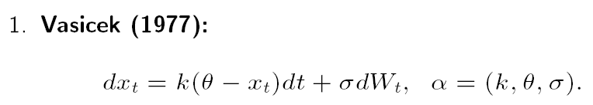
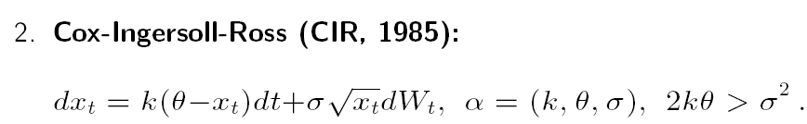
Most Popular Endogenous short rate CT Models
Most important types of one-factor interest rate (xt) models, being the short-term rate the single factor (i.e. endogenous models):
        _{(from )}
Constant volatility model with mean-reversion to θ (as it is na Ornstein-Uhlenback process
Stochastic volatility model with mean-reversion to θ

Slide 15
Most Popular Endogenous short rate CT Models
Most important types of one-factor interest rate (xt) models, being the short-term rate the single factor (i.e. endogenous models):
        _{(from )}
1. Vasicek (1977):
  The spot rate follows an Ornstein-Uhlenbeck process => contrary to the random walk (Wiener process), which diverge to infinite values in the long-run, this process converges to the long-term mean γ.

Slide 16
Vasicek Model
Therefore, the Vasicek model has some peculiarities that make it attractive:
Gaussian disturbances;
Constant volatility, making the model more tractable;
Mean reverting – expected value of the short rate tends to a constant value γ with velocity given by α.
Drawbacks:
Rates can assume negative values with positive probability.
Gaussian distributions for the rates are not compatible with the market implied distributions.

Slide 17
Cox-Ingersoll and Ross Model
2. CIR (1985):
  The CIR model is also mean reverting, like Vasicek.
  However, the volatility is not constant, depending on the short-term rate.
  This stochastic volatility brings the model closer to reality.
  However, the model becomes less tractable as it requires the single factor to be positive.

Slide 18
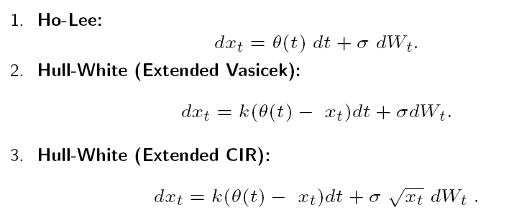
Popular exogenous short rate CT Models
Exogenous short-rate models are built by suitably modifying the above endogenous models.
The basic strategy that is used to transform an endogenous model into an exogenous model is the inclusion of time-varying parameters.
Therefore, interest rates become determined not only by the short-term rates but also by a time-varying drift:

Slide 19
Most Popular Models
2.2.3 – CT Multi Factor Models
Fong and Vasicek (1991) model - short rate and its volatility (v) as two state variables

Slide 20
Most Popular Models
2.2.3 – CT Multi Factor Models
Longstaff and Schwartz (1992) model
  Longstaff and Schwartz (1992) use the same two state variables (the short rate and its volatility) , but with a different specification.
  The starting point is a two-factor model, where the drift is governed by the two factors or state variables, while the variance is a function of only one of them:
  With this specification, it is ensured that the drift and the variance are not perfectly correlated.

Slide 21
Most Popular Models
2.2.3 – CT Multi Factor Models
Longstaff and Schwartz (1992) model
  The dynamics of the state variables are as follows:

Slide 22
Most Popular Models
2.2.3 – CT Multi Factor Models
Longstaff and Schwartz (1992) model
  With the rescaling of the state variables to , the dynamics of state variables are as follows:

Slide 23
Most Popular Models
2.2.3 – CT Multi Factor Models
Longstaff and Schwartz (1992) model
  Relevant features:
  All parameters are positive;
  r is non-negative, since both state variables follow square root processes;
  r has a long-run stationary distribution with mean and variance:
  Volatility also has a stationary distribution with mean
  r depends on volatility, but volatility also depends on r;

Slide 24
Most Popular Models
2.2.3 – CT Multi Factor Models
Longstaff and Schwartz (1992) model
  Closed-form expressions for riskless discount bond prices with τ maturity (τ = 0 => F = 1)

Slide 25
Most Popular Models
2.2.3 – CT Multi Factor Models
Longstaff and Schwartz (1992) model
  YTM of riskless discount bonds with τ maturity:
  For a given τ maturity, the yield is a linear function of r and V.

Slide 26
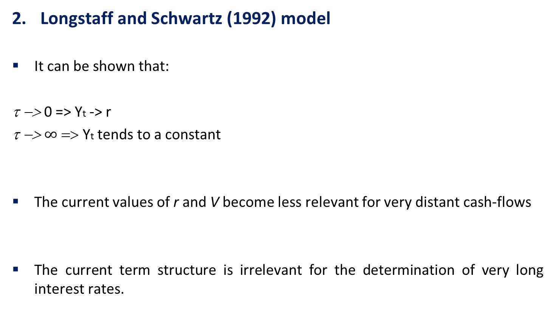
Most Popular Models
2.2.3 – CT Multi Factor Models
Longstaff and Schwartz (1992) model
  It can be shown that:
  τ −> 0 => Yt -> r
  τ −> $∞$ => Yt tends to a constant
  The current values of r and V become less relevant for very distant cash-flows
  The current term structure is irrelevant for the determination of very long interest rates.

Slide 27
Most Popular Models
2.2.3 – CT Multi Factor Models
Longstaff and Schwartz (1992) model
  This model offers a much larger variety of shapes than single factor models, with one inflexion point for the slope and the convexity.
  Instantaneous expected return for a discount bond:
  Subtracting r from the previous result, one obtains the risk premium.
  For a given τ maturity, the term premium is a linear function of r and V, depending on λ (market price of risk):
    λ <0 => term premium > 0.
    λ =0 => term premium = 0 => Expectations theory holds.
  For small τ, the term premium is an increasing function of r.

Slide 28
3. Balduzzi et al. (1996) models
  Balduzzi et al. (1996) suggest the use of a three-factor model by adding the mean of the short-term rate to a 2-factor model.

Slide 29
2.3. Affine Models of the Term Structure
Fundamental asset pricing concept - The pricing of any financial asset is based on a very intuitive result - the price corresponds to the present value of the future asset pay-off:
(1)
being P_{t} the price of a financial asset providing nominal cash-flows and M_{t+1} the nominal stochastic discount factor (sdf) or pricing kernel, as it is the determining variable of P_{t} . In fact, solving equation (1) forward, the asset price may be written solely as a function of the pricing kernel, as:
(2)

Slide 30
Asset prices and returns are related to their risk, i.e., to the asset capacity of offering higher cash-flows when they are more needed and valued.
Actually, the more an asset helps to smooth income fluctuations, the less risky it is and the higher will be its demand for ensuring against “bad times”.
Considering that
Equation (1) may be written as:
(3)

Slide 31
When the asset is riskless, its pay-off in t+1 is known in t with certainty => P_{t+1} may be considered as a constant in t, which implies, from (1):
As the LHS of (4) is the inverse of the risk-free asset’s gross return, denoted by , replacing in equation (3) by , it is obtained:
The asset price is the discounted expected value of its future pay-off or price, adjusted by the covariance of its return with the sdf.
(4)
(5)

Slide 32
As it will become clear later, this covariance consists in a risk factor and it is positive for assets that pay higher returns when they are more needed.
The same result may be obtained for interest rates, instead of prices. Actually, dividing both sides of equation (1) by Pt, one gets:
(6)

Slide 33
Applying the already used statistical result
to (6) it is obtained
Following equation (4) we obtain:
Therefore, we get:
(7)
(8)
The interest rate of an asset results from the risk-free rate, adjusted by a risk factor => the lower the covariance, the higher the risk and the interest rate.
(9)

Slide 34
With some additional self-explanatory algebra, the following result is obtained:
In equation (10) , is the coefficient of a regression of on .
Therefore, it measures the correlation between the asset’s return and the stochastic discount factor (sdf) or the quantity of risk.
(10)

Slide 35
Market price of risk:
From equation (8), denoting by the correlation coefficient between the sdf and the asset’s rate of return and and , the excess return of any asset over the risk-free asset is:
Equation (11) illustrate a basic result in finance theory: the excess return of any asset over the risk-free asset depends on the covariance of its rate of return with the sdf => an asset with pay-off negatively correlated to the sdf is riskier.
(11)

Slide 36
The mean-variance frontier will correspond to the limiting values of equation (11) => expected values and standard-deviations must lie in the interval .
As on the frontier all asset returns are perfectly correlated with the sdf, all asset returns are also perfectly correlated with each other => it is possible to define the return of any asset as a linear combination of the returns of any 2 other assets - market or wealth portfolio and the risk-free asset:
mean-variance region
minimum risk (frontier):
(12)
- Rate of return of market portfolio
CAPM

Slide 37
.
(10) + (12) => CAPM assumes the sdf as a function of the gross rate of return of the wealth market portfolio, while the market price of risk is the spread between the expected market portfolio return and the risk-free asset return.
CCAPM: an asset will pay a higher return or is riskier when the covariance of its return with the marginal utility of consumption is lower, i.e. when consumption is higher => the asset is riskier when it pays more when those cash-flows are less needed.
(8)
(10)

Slide 38
Affine models: log-linear relationship between asset prices and the sdf, on one side, and the factors or state variables, on the other side.
These models were originally developed by Duffie and Kan (1996), for the term structure of interest rates.
Equation (1) in logs:
Assuming joint log-normality of asset prices and discount factor => if log X ~ N(μ,σ²) then log E(X) = μ + σ²/2 (as X is lognormally distributed, being its mean E(X) = exp(μ + σ²/2) => basic equation considered in the affine models:
          μ σ²
(13)
(14)

Slide 39
DK models: multifactor affine models of the term structure, where the pricing kernel is a linear function of several factors
DK models advantages:
Accommodate the most important term structure models, from Vasicek (1977) and CIR one-factor models to multi-factor models.
Allow the estimation of the term structure simultaneously on a cross-section and time-series basis.
Provide a way of computing and estimating simple closed-form expressions for the spot, forward, volatility and term premium curves.

Slide 40
Discount factors:
Higher λs ⬄ higher covariance between the discount factor and the asset return ⬄ lower expected rate of returns or lower risk.
Another way to write the pricing kernel (from (15)):
V(Zt) - variance matrix of the random shocks on the sdf, defined as a diagonal matrix with elements and No.rows/columns equal to the No. factors.
εt - independent shocks
- market prices of risks, as they govern the covariance between the stochastic discount factor and the yield curve factors.
(15)
(16)
$$−m_{t+1}=ξ+γ_{1}z_{1t}+γ_{2}z_{2t}+…+γ_{k}z_{kt}+λ_{1}σ_{1t}ε_{1,t+1}+λ_{2}σ_{2t}ε_{2,t+1}+…+λ_{k}σ_{kt}ε_{k,t+1}$$

Slide 41
The k factors z_{t} are defined as mean reverting, forming a k-dimensional vector :
From (17), we have the factors as follows:
, where
Asset prices are also log-linear functions of the factors.
θ - long-run mean of the factors.
Φ − has positive diagonal elements, that determine the speed of convergence of the factors to the long-term mean, ensuring that the factors are stationary;
(17)
(18)
(19)
n - term to maturity
An and Bn - vectors of parameters to be estimated.
Bn - factor loadings (impact of a random shock on the factors over the log of asset prices).

Slide 42
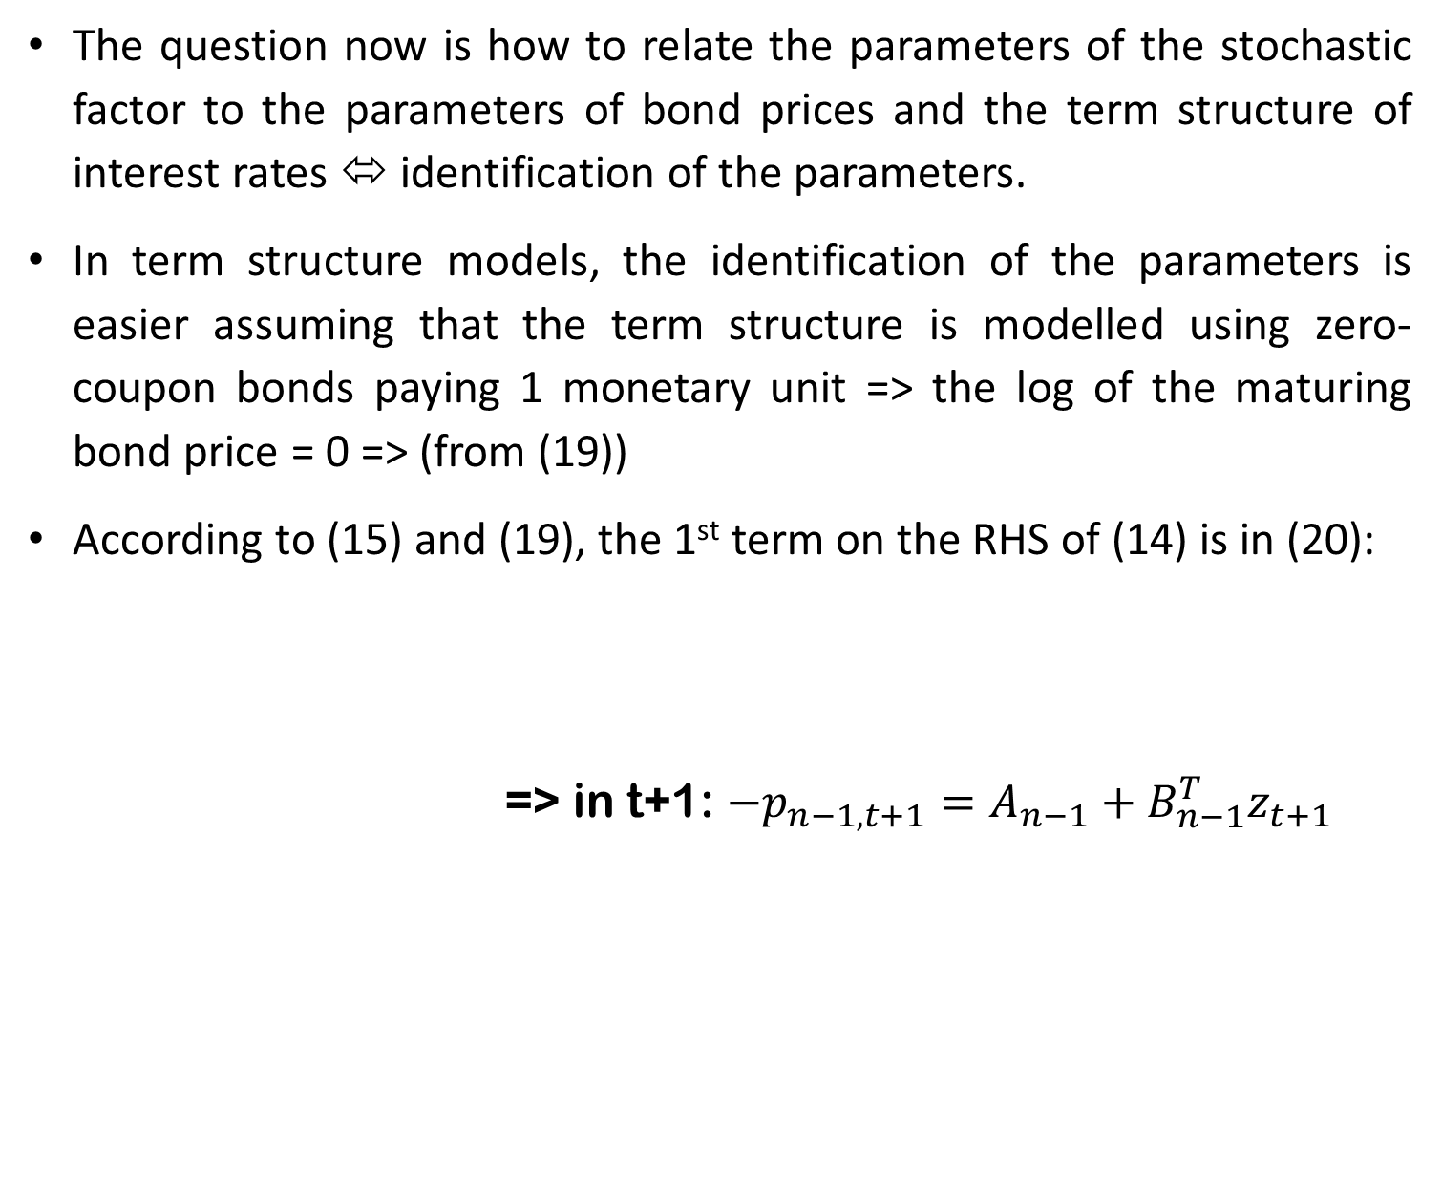
The question now is how to relate the parameters of the stochastic factor to the parameters of bond prices and the term structure of interest rates ⬄ identification of the parameters.
In term structure models, the identification of the parameters is easier assuming that the term structure is modelled using zero-coupon bonds paying 1 monetary unit => the log of the maturing bond price = 0 => (from (19))
According to (15) and (19), the 1st term on the RHS of (14) is in (20):
            => in t+1: $−p_{n−1,t+1}=A_{n−1}+B_{n−1}^{T}z_{t+1}$
(14)
(15)
(19)
(20)

Slide 43
Using the factor definition in (17) we get from (20):
Computing the expected value and given that the random shocks are assumed to have zero mean => all terms in ε_{t+1} will be cancelled => (21) may be simplified to:
(21)
(22)

Slide 44
(15) +
(19)
To obtain the variance in the 2nd term on the RHS of
(14) , all constant terms will be eliminated:
Evidencing the independent terms and the terms in z_{t} ,
(23)
(24)

Slide 45
From
Putting in evidence the independent terms and the terms in z_{t} , from (25) one obtains:
Considering that the continuously compounded yield is
(14)
(22)
(24)
(25)
(26)

Slide 46
Comparing the coefficients on the RHS of
(19)
to the independent term and the term associated to the factor in
(26)
the recursive restrictions in (27) and (28) are obtained:
(27)
(28)

Slide 47
Considering that the continuously compounded yield is:
From (29) and
(19)
the yield curve is defined as:
(29)
(30)

Slide 48
From equations (27), (28) and (30)
and
(30)
as well as the normalisation , it is obtained the short-term rate (as with n=1, A_{n-1} and B_{n-1} will be A₀ and B₀ correspondingly, both equal to 0):
(27)
(28)
(31)

Slide 49
Correspondingly, using the definition of the factors in
(17)
and solving backwards, one gets:
Given that the expression in the sum corresponds to the sum of the first n-terms of a geometric progression with rate f and first term equal to , equivalent to , the following expression is obtained:
(32)
(33)

Slide 50
To calculate the expected value of future short-term interest rate, one can use
(31)
and plug
(33)
writing in matrix form (as the matrices involved in the computations are diagonal)
(34)

Slide 51
From
one gets the variance of interest rates:
Instantaneous or one-period forward rate = log of the inverse of the gross return =>
(17)
(30)
(35)
(36)

Slide 52
From
(19)
(36)
one gets the instantaneous or one-period forward curve:
(37)

Slide 53
From the current and the one-period ahead bond prices in the price equation in
(19)
and the short-term rate in
(31)
it is obtained the term premium as the difference between the one-period expected return and the short-term interest rate:
(38)

Slide 54
From the recursive restrictions on the factor loadings in
equation (38) can be simplified as in (39):
(27)
(28)
(38)
(39)

Slide 55
The term premium can alternatively be calculated from the basic pricing equation
(14)
Solving in order to , we get:
Given that the , as is the only stochastic component in the rate of return, the previous equation is equal to:
(40)
(41)
(42)

Slide 56
According to
(14)
and considering the assumption
Solving in order to , having in mind that p₀=0, we get the price of the short-term bond:
(43)

Slide 57
From
(42)
(43)
(29) and
(38)
the term premium will be equal to
Risk premium determined by the covar. of the asset’s rate of return with the stochastic discount factor => the lower the covar., the higher the risk premium is.
(44)

Slide 58
As from
(19)
we get
(45)
the covariance in
(44) is
(46)
Consequently, equation (44) for the term premium becomes equivalente to:
(47)

Slide 59
From
(15) and
(17)
the term premium in
(47)
may be written as:
(48)
at least one of the market prices of risk must be negative in order to have a positive term premium.

Slide 60
One-factor models were the first step in modelling the term structure of interest rates.
These models are grounded on the estimation of bond yields as functions of the short-term interest rate.
Vasicek (1977) presented the whole term structure as a function of a single factor, the short-term interest rate, whose volatility was assumed to be constant.
Vasicel model can have the following DK characterisation:
* Depending on whether the true values of interest rates or their diferences to the mean are considered.
The Cox et al. (1985a) model added the stochastic volatility feature to the Vasicek model, avoiding interest rates to go negative, as in the Vasicek model. Thus, it corresponds to an analogous particular case of the DK model, with and . .
K | θ_{i} | Φ | α_{ι} | β_{ι} | ξ | γ_{ι}
1 | 0 or θ * | φ | σ² | 0 | δ+λ²/2 | 1

Slide 61
Affine models may be classified according to:
number of factors considered;
volatility properties.
According to Litterman and Scheinkman (1991), the pronounced hump-shape of the US yield curve => 3 factors are required to explain the shifts in the whole term structure of interest rates.
These factors are usually identified as the level, the slope and the curvature, being the level often responsible for the most important part of interest rate variation.

Slide 62
Given the stochastic properties of interest rates volatility, Gaussian or constant volatility models are often rejected. Besides, these models impose constant volatility and one-period term premium curves (non-pure version of expectations theory).
The forward rate also exhibits some shortcomings.
Nonetheless, Gaussian models are used very often as:
interest rate volatilities don’t suffer significant changes and during most periods;
Constant volatility models as much easier to implement, namely with non-observable or latent factor, given that the volatility depends on the square root of the factors in stochastic volatility models => signal restrictions have to be imposed, which in harder to do in iterative econometric processes.

Slide 63
Shortcomings of the forward rates under constant volatility:
(37)
as β_{i}=0, the forward rate may be written as:
(49)
As the last term of the RHS of
(28)
is zero when the volatility is constant, each factor loading in a multifactor Vasicek model corresponds to:
(50)

Slide 64
The one-period forward rate may thus be written
From
(49) as:
(51)
Though this specification of the forward-rate curve accommodates very different shapes, the limiting forward rate cannot be simultaneously finite and time-varying.
In fact, if , the limiting value will not depend on the factors, as the limit of the last term on the RHS is zero.
If , the limiting value of the instantaneous forward becomes time-varying but assumes infinite values, as in this case.

Slide 65
2-factor constant volatility (i.e. Vasicek-type) model:
Stochastic discount factor: From (15)
(52)
Factors - first-order autoregressive processes with zero mean (corresponds to considering the differences between the “true” factors and their means): From (17)
(53)
Bond prices: From (19)
(54)

Slide 66
Yield curve: From (30)
(55)
Factor loadings: From (27), (28) and (52)
(56)
(57)

Slide 67
Short-term interest rate: From (31)
(58)
Given the common normalisation
This model has the appealing feature of the short-term being the sum of 2 factors plus a constant.
The usual conjecture is that one factor is related to inflation expectations and that the other factor reflects the ex-ante real interest rate.

Slide 68
One-period forward curve:
(59)
From (30)
Volatility curve: From (35)
(60)
as the factors have constant volatility, given by , the volatility of yields depends neither on the level of the factors, nor on the level of the short-rate.

Slide 69
Term premium:
(61)
From (30)

Slide 70
If the factors that determine the dynamics of the yield curve are assumed to be non-observable and the parameters are unknown, a usual estimation methodology is the Kalman filter and a maximum likelihood procedure.
Kalman Filter - algorithm that computes the optimal estimate for the state variables at t using the information available up to t-1.
Maximum likelihood procedure – provides the estimates for the parameters.

Slide 71
The starting point for the derivation of the Kalman filter is to write the model in state-space form:
observation or measurement equation
(62)

Slide 72
state or transition equation
(63)
r – No. variables (interest rates) to estimate
n – No. observable exogenous variables (with no observable factors, n=1 => A becomes a column vector with the independent terms for each interest rate)
k – No. non-observable or latent exogenous variables (the factors).
ω_{t} and υ_{t} - i.i.d. residuals, distributed as and
Variance matrices: .

Slide 73
One may estimate simultaneously the yields and the volatilities, to avoid implausible estimates for the latter:
(64)

Slide 74
Contrary to the pioneer interest rate models, such as Vasicek (1977) and Cox et al. (1985a), where the short-term interest influenced the whole term structure, the latent factor models do not use explicit determinants of the yield curve.
As previously referred, one common conjecture is to assume that one factor is related to the ex-ante real interest rate and a second factor linked to inflation expectations.
Therefore, one may start by estimating the factors and at a second stage try to identify how does one of the factors relate to inflation.
Alternatively, one may specifically relate inflation to the second factor in the model to be estimated, as follows.

Slide 75
Assuming that inflation (π) is an AR(1) process, being its mean and ρ a parameter that measures the rate of mean-reversion:
(65)
If the short-term interest is the sum of the factors and one of the factors is related to inflation, we may write:
(66)
From the 2 previous equations:
(67)
As stated before, we have

Slide 76
If the link between inflation and the second factor is considered, the observation equation becomes:
(68)

Slide 77
Major drawback: it implies the 2nd factor to explain simultaneously the inflation as well as the long term rates, which in some periods may evidence significantly different volatilities.
In periods of higher volatility of the long-term rates, the estimated inflation tends to present a more irregular behaviour than the true inflation.
The AR(1) process for inflation is not necessarily the optimal model for forecasting inflation, being too simple concerning its lag structure and not allowing for the inclusion of other macro-economic information that market participants may use to form their expectations of inflation (e.g. monetary aggregates, commodity prices, exchange rates, wages and unit labour costs).

Slide 78
However, a more complex model would certainly not allow a simple identification of the factor.
One way to overcome these problems is by using a joint model for the term structure and the inflation, where the latter still shares a common factor with the interest rates but is also determined by a second specific factor:
(69)
          and

Slide 79
In this case, the observation and the state equations become:
(70)
(71)

Slide 80
One may also use the DK framework to model simultaneously the term structures of interest rates of 2 countries.
A first attempt to model jointly the term structures of 2 countries is found in Fung et al. (1999), where a 2-factor stochastic volatility model is used to estimate simultaneously the U.S. and the Canadian term structures.
In this case, it was assumed that both countries share a common factor related to the real interest rate, following the close trade relationship between those countries. As each country pursued its own monetary policy, it was assumed that the U.S. and the Canadian term structures also depended on a specific factor, related to the inflation expectations and, accordingly, to the monetary policy.

Slide 81

In the Euro area, the opposite happens, i.e., there is a common monetary policy and real interest rates differ among the member countries.
One can model the joint term structures of 2 Euro Area countries assuming a common factor related to the inflation expectations and a specific factor that is supposed to be related to the real interest rate, modelling the 1st term structure as previously stated and the 2nd as:
(72)

Slide 82
Remaining equations:
(73)
(74)
(75)
2-country model with (common) inflation:
(76)

Slide 83
The estimation departs from assuming that the starting value of the state vector Z is obtained from a normal distribution with mean and variance P₀ (usually it is assumed that the starting values of the factors are zero).
can be seen as a guess concerning the value of Z using all information available up to and including t = 0.
Using and P₀ and following (17), the optimal estimator for Z₁ will be given by:
(77)

Slide 84
Consequently, the variance matrix of the estimation error of the state vector will correspond to:
(78)
Given that , may be obtained from:

Slide 85
Consequently, the variance matrix of the estimation error of the state vector will correspond to:
As w_{t} is independent from X_{t} and from all the prior information on y and x (denoted by ), we can obtain the forecast of y_{t} conditional on X_{t} and directly from
(62)
(79)
Therefore, from (62) and (79), we have the following expression for the forecasting error:
(80)

Slide 86
From (80), the conditional variance-covariance matrix of the estimation error of the observation vector will be:
(81)
After the updates of the mean and variance-covariance matrices of the dependent variables, the log-likelihood function is computed to estimate the parameters:
(82)
being (for t = 1, …, T) and assuming that the starting value is zero.

Slide 87
The maximization of the log-likelihood function is often performed as the minimization of the symmetric of that function.
In order to characterise the distribution of the observation and state vectors, it is also required to compute the conditional covariance between both forecasting errors.
From (81) we get:
(83)
Therefore, using (79), (81) and (83), the conditional distribution of the vector is:
(84)

Slide 88
Consequently, following (84), the distribution of Z_{t} given Y_{t}, X_{t} and
  is , where and are respectively the optimal forecast of Z_{t} given P_{t|t} and the mean square error of this forecast, corresponding to the following updating equations of the Kalman Filter:
  (85)
  (86)
Following this update, a new estimate for these estimates can be obtained, generalizing (77) and (78):
(87)

Slide 89
(88)
The matrix is usually known as the gain matrix, since it determines the update in due to the estimation error of
Concluding, the Kalman Filter may be applied after specifying starting values for and using equations (79), (81), (85), and (86) and iterating on equations (87) and (88).
Ricatti equation

Slide 91
2.4. HJM
Goal: Model the dynamics of the entire yield curve, assuming there is just one factor in a risk-neutral world.
A zero-coupon bond return will be the risk-free rate

Slide 92
Stochastic process:
Forward rate:
From (1) and Ito’s Lemma:
(1)
(2)
The risk-neutral process for the forward rate depends solely on the bond price volatility
(3)

Slide 93
It is possible to show that:
There is a link between the drift and the standard-deviation of the instantaneous forward rate (F(t,T)).
Key problem: risk-free interest rate is non-Markov ⬄ the risk-free interest rate process depends on its previous path
(4)

