Slide 2
A story of Money
Trading agriculture surplus
Markets appear
1st currencies appear to facilitate trading
Energy and Complexity
Recollective societies
20,000 years BC
3,000 years BC
800 years BC
t

Slide 3
Energy and Complexity
Trading agriculture surplus
Markets appear
Precious metals and other currencies
1st currencies appear to facilitate trading
Paper money
Digital Money
Recollective societies
20,000 years BC
3,000 years BC
800 years BC
500 years BC
600 years AD
2017

Slide 4
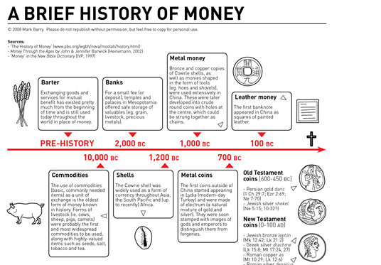
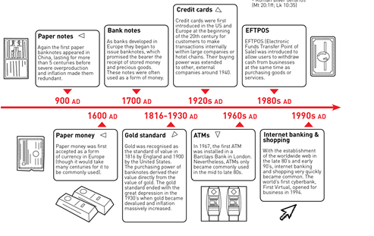

Slide 5
Perdidos na ilha…

Slide 6
A story of Money
Direct trade (Barter):
Coincidence of desires
Common agreement on the value of goods
Divisibility and fraccioning
Transaction costs
Characteristics of a currency
Durable
Divisible
Convenient
Universally accepted
Notes:
Mas se 97% do dinheiro em circulação hoje em dia é dinheiro digital será que ainda faz sentido falar em dinheiro como um bem? Como algo escasso? Money as a thing is the classical view on money..bem patente na frase de Karl Marx.

Slide 7
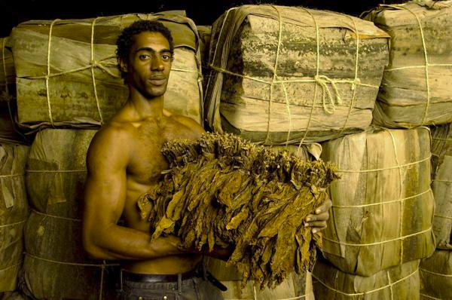
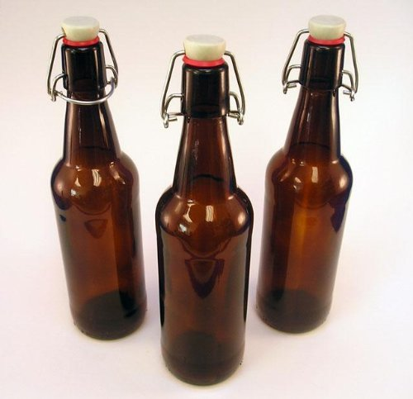
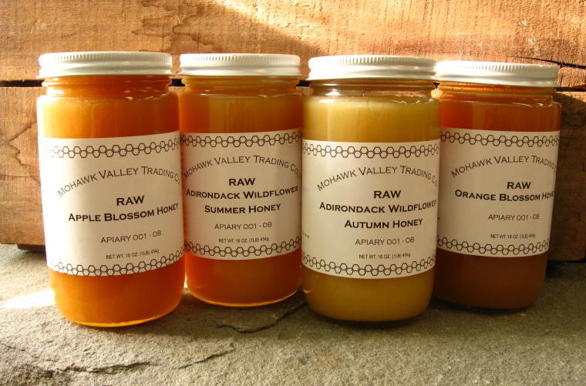
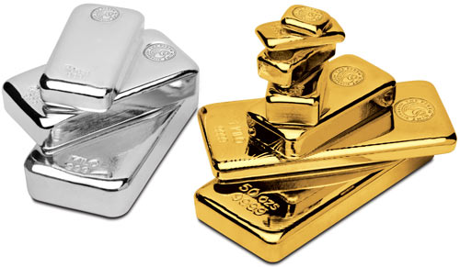
Many commodities have Aristotle's properties, more-or-less...
Beer
Tobacco
Honey
Tide detergent
Gold & Silver
Notes:
Aristotle, a Greek philosopher from around 600BC said a few things about money which show that it wasn't so very different in his day as ours.
Scholastic theologians, who were mostly concerned about usury, studied Aristotle and extrapolated that good money should have the following properties.
It must have intrinsic value. This value of money should be contained in the money itself...
It must be durable. It must not fade, corrode, or change through time.
It must be portable. It it holds a high amount of 'worth' relative to its weight and size then it is convenient for shopping, and hiding from thieves.
It must be divisible. Money should be relatively easy to separate and re-combine without affecting its fundamental characteristics.

Slide 8
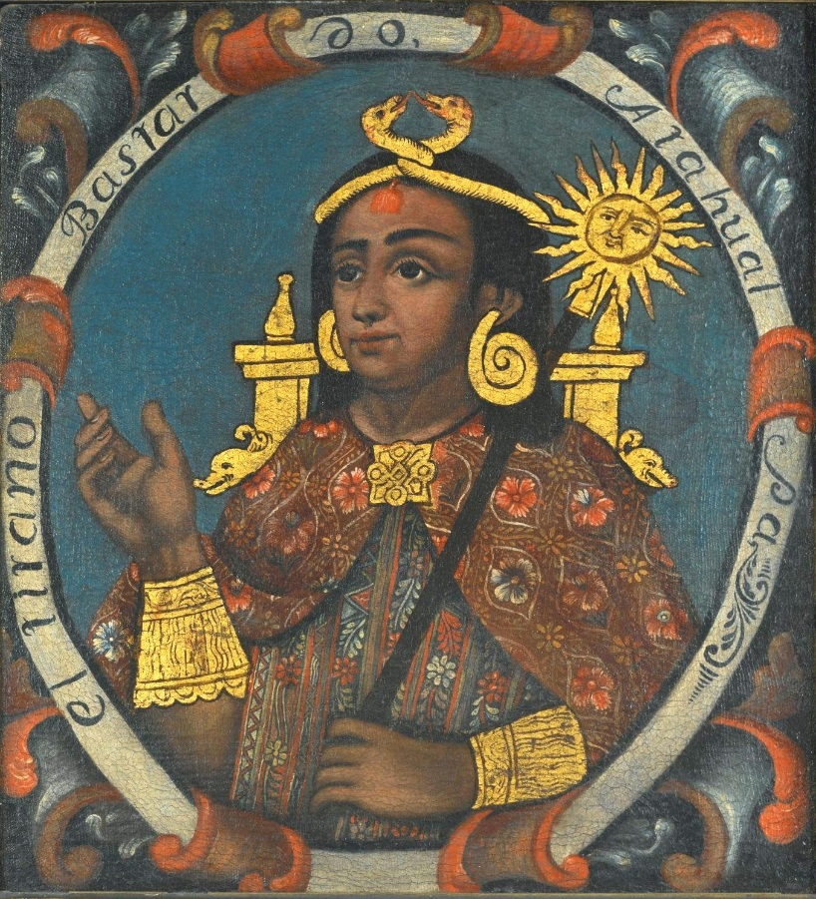
A story of Money
1ªs currencies:
Salt
Neckless
Sea shells
Tea (China)
Ivory (Africa)
Dates (Persia)
Cattle (India)
Metals:
Gold
Silver
Coper
Iron

Slide 9
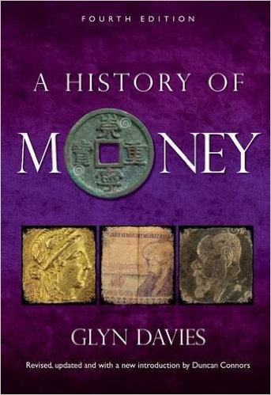
Amber
Breads
Cowries
Drums
Eggs
Feathers
Gongs
Hoes
Ivory
Jade
Kettles
Leather
Mats
Nails
Oxen
Pigs
Quartz
Rice
Salt
Thimbles
Umiaks
Yarns
Zappozats
Reference:
Davies, Glyn (1994), A History of Money from Ancient times to the present day, University of Wales Press, Cardiff, p. 240
Notes:
A variedade é tão grande que o historiador Glyn Davies compilou um alfabeto com vários bens que foram utilizados como moeda ou dinheiro ao longo da história da humanidade..

Slide 10
Energy and Complexity
Trading agriculture surplus
Markets appear
Precious metals and other currencies
1st currencies appear to facilitate trading
Paper money
Digital Money
What’s wrong with this story?
Recollective societies
20,000 years BC
3,000 years BC
800 years BC
500 years BC
600 years AD
2017

Slide 11
The Myth of Barter
OR! “No example of a barter economy, pure and simple, has ever been described, let alone the emergence from it of money; all available ethnography suggests that there never has been such a thing.”
Cambridge anthropology professor Caroline Humphrey, 1985.
Notes:
Cambridge anthropology professor Caroline Humphrey concludes "No example of a barter economy, pure and simple, has ever been described, let alone the emergence from it of money; all available ethnography suggests that there never has been such a thing. Economist and monetary historian Glyn Davies (2002) concludes "the overwhelming tangible evidence of actual types of primitive moneys from all over the world and from the archaeological, literary and linguistic evidence of the ancient world, is that barter was not the main factor in the origins and earliest developments of money.” Another Anthropologist David Graeber writes a whole chapter 'The Myth of Barter' in his book 'Debt, the First 5000 years'. Here are a few excepts showing why we need to keep an open mind about history...
“Now, all this hardly means that barter does not exist-or even that it's never practiced by ... 'savages.' It just means that it's almost never employed ... between fellow villagers. Occasionally one can even find some kind of currency beginning to develop: for instance, in POW camps and many prisons, inmates have indeed been known to use cigarettes as a kind of cur­rency, much to the delight and excitement of professional economists. But here too we are talking about people who grew up using money and now have to make do without it-exactly the situation 'imagined' by the economics textbooks.”
“Ordinarily, barter] takes place between ... people who might as well be strangers-that is, who feel no sense of mutual responsibility or trust, or the desire to develop ongoing relations... The English words 'truck and barter,' like their equivalents in French, Spanish, German, Dutch, and Portuguese, literally meant 'to trick, bamboozle, or rip off.'”
“We did not begin with barter, discover money, and then eventually develop credit systems. It happened precisely the other way around. What we now call virtual money came first. Coins came much later, and their use spread only unevenly, never completely replacing credit systems.”

Slide 12
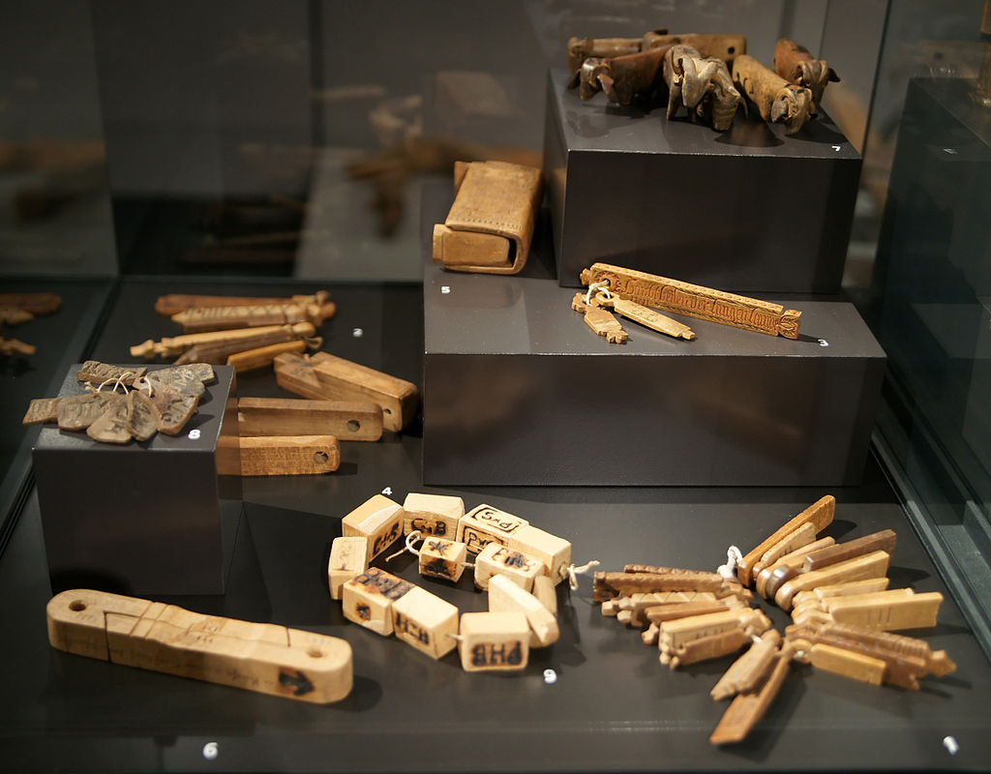
“The standart economic-history version has little to do with anything we observe when we examine how economic life is actually conducted, in real communities and marketplaces, almost anywhere – where one is much more likely to discover everyone is in debt to everyone else in a dozen different ways, and that most transaction take place without the use of currency.”
David Graeber, Debt: the first 5000 years
Tally sticks – used from 18.000 BC to 1826 AD
Notes:
Introduzir a lógica de que é a moeda que cria o Mercado e não ao contrário…
Sistemas de IOU, mesmo a própria moeda é um IOU pois não tem valor intrínseco..passagem para o mito 2

Slide 13
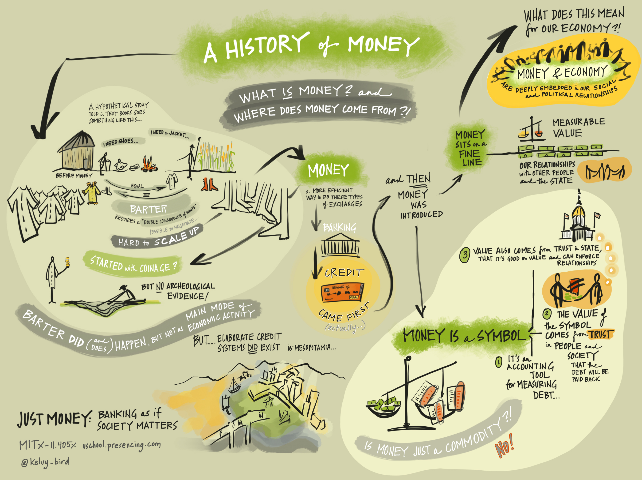
Notes:
A moeda como algo vivo em constante mutação e adaptação social…

Slide 14
Human societies
B.1 Monetary –based economies
B.1.2 Single dominant currency
B.1.1 Multiple complementary currencies
B.2 Non-monetary-based economies
B.2.1No currency - Gift economies
Public control (Gov. Powered Money)
Privately controlled
B.2.2 Non-monetary mutual credit systems
B.2.3 Tribal sharing economies
Co-operatively/ Collectively controlled

Slide 15
Who issues money?
Who controls money circulation?
Notes:
A história e evolução do dinheiro e da moeda e bem mais complexa e não linear do que a historia neoclássica que nos é contado. Contudo requer muito mais aulas e muito mais tempo para ser aprofundada..como tal quero apenas focar-me nos últimos 100 anos e perceber como chegamos a isto.

Slide 16
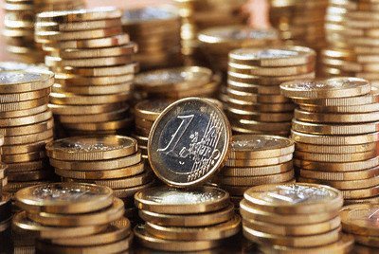
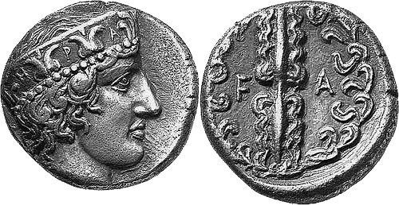
Central Bank
Issues money after King or Parlimant decision
Regulates Monetary mass according to needs
Comercial Bank
Multiplies the currency
De-regulated since the 1970’s
State/Gov/King
Issues money mostly to finance wars or to increase control over its territory through Tax
Imposes Seignorage

Slide 17
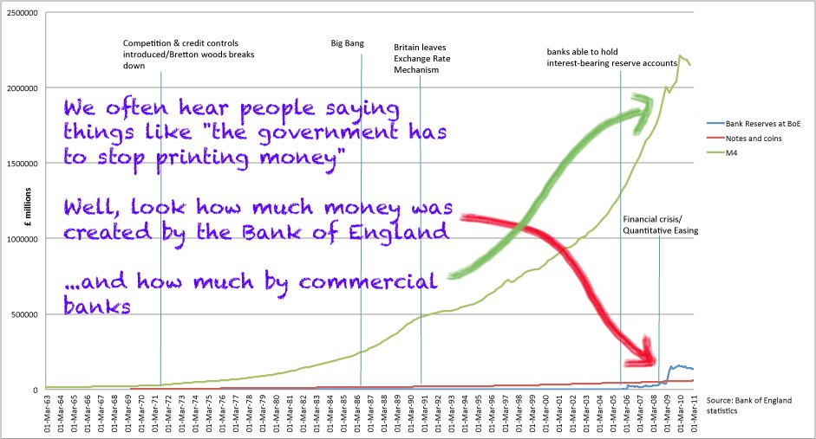

Slide 18
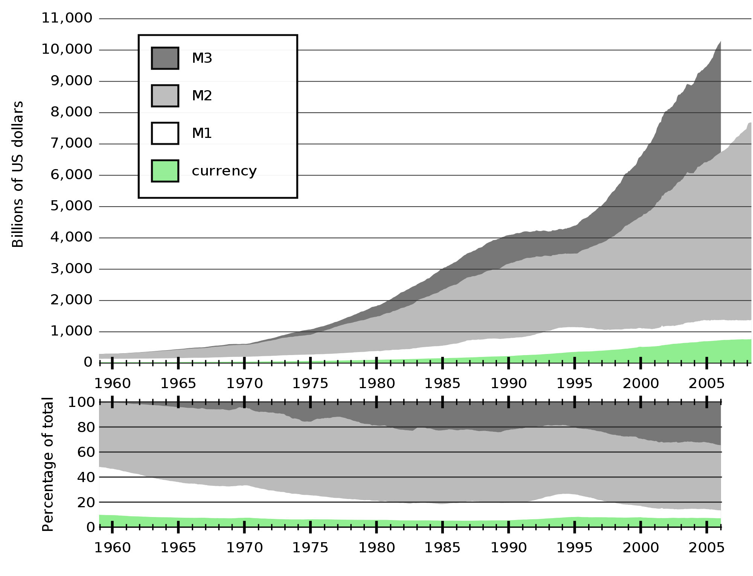
Tabela:^{[5]} Sistema de empréstimo com reserva fracionada, passando por 10 ciclos com uma taxa de reserva em 20%^{[2][6][7]}
banco individual | quantidade depositada | quantidade emprestada | reservas
A | 100 | 80 | 20
B | 80 | 64 | 16
C | 64 | 51.20 | 12.80
D | 51.20 | 40.96 | 10.24
E | 40.96 | 32.77 | 8.19
F | 32.77 | 26.21 | 6.55
G | 26.21 | 20.97 | 5.24
H | 20.97 | 16.78 | 4.19
I | 16.78 | 13.42 | 3.36
J | 13.42 | 10.74 | 2.68
K | 10.74
 |  |  | reservas totais:
 |  |  | 89.26
 | total depositado: | total emprestado: | reservas totais + a ultima quantidade depositada:
 | 457.05 | 357.05 | 100
 | dinheiro comercial criado + dinheiro do banco central: | dinheiro do banco comercial criado: | dinheiro do banco central:
 | 457.05 | 357.05 | 100

Slide 19
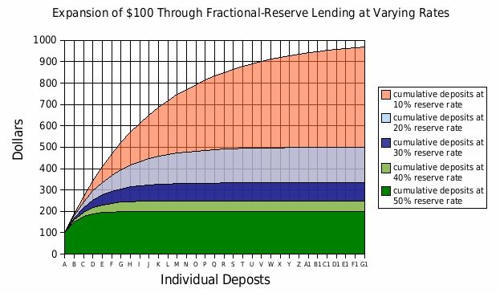
UK
Reserve ratio
1850: 60%
1947: 32%
1971: 12,5 %
1980: 0%
Notes:
Should be isent and free for influence institutions..imagem do FED

Slide 20
How much of banking money (M3) goes to finance productive investments?
A: 8%
C: 43%
D: 68%
B: 22%
https://play.kahoot.it/#/k/8875b616-5c36-4947-95ac-11580cc0070b
1137978

