Slide 1
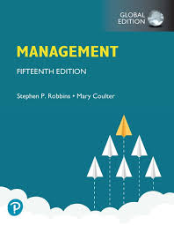
Management
15th Edition, Global Edition
Capítulo 1a
A história da gestão
Copyright © 2018 Pearson Education, Ltd. All Rights Reserved

Slide 2
Objetivos
1a.1 Descrever alguns dos contributos mais antigos.
1a.2 Explicar as várias teorias da abordagem clássica.
1a.3 Descrever o desenvolvimento e as aplicações da abordagem comportamental.
1a.4 Descrever a abordagem quantitativa.
1a.5 Explicar as várias teorias da abordagem contemporânea.

Slide 3
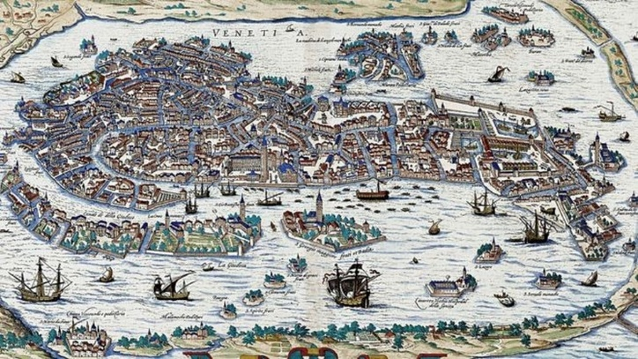


Contributos mais antigos
Grandes obras da antiguidade – Pirâmides do Egito (2630 AC) e muralha da China (220–206 AC) – necessitaram de Planeamento, Organização, Direção e Controlo.
Estaleiros de Veneza (sec. XV) – Utilizaram linhas de montagem, sistemas de contabilidade, e funções de gestão de pessoas.
Fonte: https://g1.globo.com/mundo/noticia/2020/02/23/como-os-romanos-conseguiram-construir-veneza-sobre-lama-e-agua-15-seculos-atras.ghtml
Fonte: http://www.youramazingplaces.com/the-great-wall-of-china/
Fonte: https://www.insider.com/egypt-great-pyramid-original-colors-2019-7
Notes:
Who told each worker what to do? Who ensured there would be enough stones at the site to keep workers busy? The answer is managers. Someone had to plan what was to be done, organize people and materials to do it, make sure those workers got the work done, and impose some controls to ensure that everything was done as planned.

Slide 4
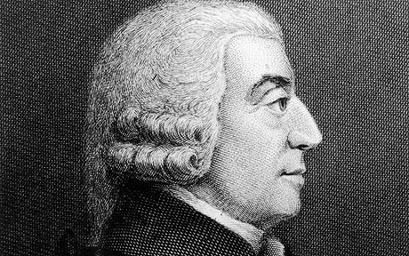
Contributos mais antigos
Adam Smith (A Riqueza das Nações, 1776)
  Divisão / especialização do trabalho – divisão do trabalho em tarefas simples e repetitivas.
Fonte: https://www.adamsmith.org/
Notes:
Smith concluded that division of labor increased productivity by increasing each worker’s skill and dexterity, saving time lost in changing tasks and creating labor-saving inventions and machinery.

Slide 5
Contributos mais antigos
Adam Smith (A Riqueza das Nações, 1776)
“While at its core Smith’s paper focused on answering the question “Why are some nations rich an others poor?” his ideas and conclusions have a broad applicability, and are especially relevant to contemporary management. (…) Adam Smith was the first to realize that specialization and the division of labor were the primary source of productivity” p. 504
“By observing the workings of a French pin factory, Smith noted that each individual worker, if working alone and responsible for making the entire pin, could not make more than 20 pins per day. But when the process was divided up so that, for example, one worker draws out the wire, another straightens it, a third cuts it, a fourth points it, a fifth grinds it at the top for receiving the head, and a sixth puts the head on the pin, that the average output per worker jumps to 4,800 pins per worker per day.” p. 507
Crowley, G. R., & Sobel, R. S. (2010). Adam Smith: managerial insights from the father of economics. Journal of Management History, 16(4), 504-508.
Notes:
Smith concluded that division of labor increased productivity by increasing each worker’s skill and dexterity, saving time lost in changing tasks and creating labor-saving inventions and machinery.

Slide 6
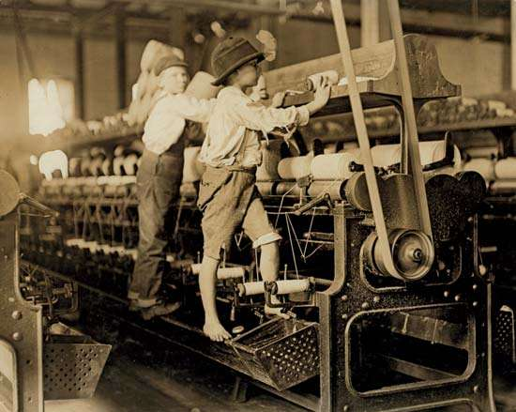
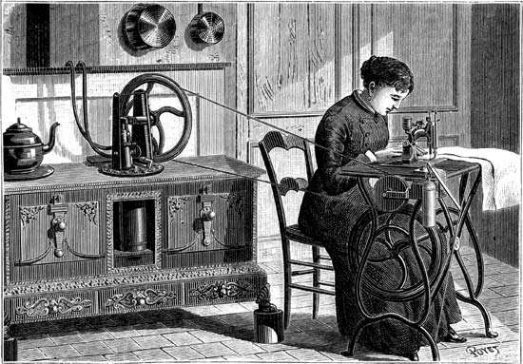
Contributos mais antigos
Revolução Industrial (1760 a 1820/40)
  Substitui o trabalho humano por máquinas.
  Levou ao aparecimento de grandes fábricas e à necessidade de formalizar a gestão.
Library of Congress, Washington, D.C. (LC-DIG-nclc-01581)
© Photos.com/Jupiterimages
Notes:
Starting in the late eighteenth century when machine power was substituted for human power, a point in history known as the industrial revolution, it became more economical to manufacture goods in factories rather than at home. These large efficient factories needed someone to forecast demand, ensure that enough material was on hand to make products, assign tasks to people, direct daily activities, and so forth.

Slide 7
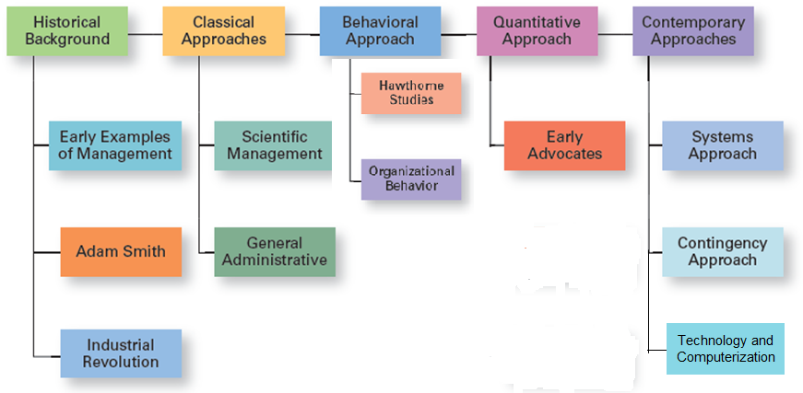
Principais abordagens na
História da Gestão
Notes:
In this module, we’ll look at four major approaches to management theory: classical, behavioral, quantitative, and contemporary (see Exhibit MH-1). Keep in mind that each approach is concerned with trying to explain management from the perspective of what was important at that time in history and the backgrounds and interests of the researchers. Each of the four approaches contributes to our overall understanding of management, but each is also a limited view of what it is and how to best practice it.

Slide 8
Abordagem clássica
Abordagem Clássica - Designa os primeiros estudos na área da gestão e enfatiza a racionalidade e o tornar as organizações e os trabalhadores o mais eficientes possível.
Inclui:
  A Gestão Científica (Taylor e os Gilbreth)
  A Teoria Administrativa (Fayol e Weber)
Notes:
The first studies of management, often called the classical approach, emphasized rationality and making organizations and workers as efficient as possible. Two major theories comprise the classical approach: scientific management and general administrative theory. The two most important contributors to scientific management theory were Frederick W. Taylor and the husband–wife team of Frank and Lillian Gilbreth. The two most important contributors to general administrative theory were Henri Fayol and Max Weber. Let’s take a look at each of these important figures in management history.

Slide 9
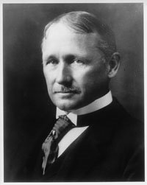
Frederick Winslow Taylor
  “Pai” da gestão científica (1911) – abordagem baseada na utilização do método científico, para encontrar o “one best way” para realizar cada tarefa (tempos, movimentos, equipamentos).
  O seu trabalho na Midvale Steel e na Bethlehem Steel estimulou o seu interesse pelo desenvolvimento da eficiência.
  A experiência do carregamento do ferro de gusa, ilustra bem a sua preocupação e os métodos utilizados – a produtividade aumentou 200%.
  (e.g., Individuo certo, com as ferramentas e equipamento apropriados, seguindo exatamente os procedimentos definidos, e motivando-o com incentivos económicos.) (vide Taylor p.44-46)
Notes:
If you had to pinpoint when modern management theory was born, 1911 might be a good choice. That was when Frederick Winslow Taylor’s Principles of Scientific Management was published. Its contents were widely embraced by managers around the world. Taylor’s book described the theory of scientific management—the use of scientific methods to define the “one best way” for a job to be done.

Slide 10
Princípios de Taylor
Principles
1. Develop a science for each element of an individual’s work to replace the old rule-of-thumb method.
2. Scientifically select and then train, teach, and develop the worker.
3. Heartily cooperate with the workers to ensure that all work is done in accordance with the principles of the science that has been developed.
4. Divide work and responsibility almost equally between management and workers. Management does all work for which it is better suited than the workers.
Notes:
Taylor’s experiences at Midvale led him to define clear guidelines for improving production efficiency. He argued that these four principles of management (see Exhibit MH-2) would result in prosperity for both workers and managers.
Source: F. W. Taylor, Principles of Scientific Management (New York: Harper, 1911).

Slide 11
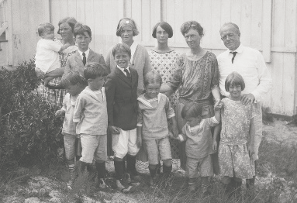
Frank e Lillian Gilbreth
Foram os primeiros a utilizar filmes para estudar movimentos das mãos e do corpo.
Conhecidos pela redução do número de movimentos necessários para realizar uma tarefa.
  Therbligs - esquema de classificação de 17 movimentos essenciais
(ex.: agarrar, puxar, empurrar).
Notes:
Taylor’s most prominent followers were Frank and Lillian Gilbreth. Frank and his wife Lillian, a psychologist, studied work to eliminate inefficient hand-and-body motions. The Gilbreths also experimented with the design and use of the proper tools and equipment for optimizing work performance.
The Gilbreths also devised a classification scheme to label 17 basic hand motions (such as search, grasp, hold), which they called therbligs (Gilbreth spelled backward with the th transposed). This scheme gave the Gilbreths a more precise way of analyzing a worker’s exact hand movements.
Many of the guidelines and techniques Taylor and the Gilbreths devised for improving production efficiency are still used in organizations today. Nowadays, adaptive robotics can help boost worker efficiency. By freeing workers from repetitive tasks, one study revealed that workers could complete essential tasks requiring manual dexterity 25 percent faster.

Slide 12
Teoria Administrativa
Teoria administrativa - Abordagem que se focaliza em identificar as boas práticas de gestão.
Henri Fayol
- Focaliza-se nas atividades dos gestores
- Identifica 14 princípios de gestão
Max Weber
- Desenvolve a teoria das estruturas hierárquicas e das relações de autoridade.
- Descreve a organização ideal como uma burocracia.
Notes:
Fayol wrote during the same time period as Taylor. While Taylor was concerned with first-line managers and the scientific method, Fayol’s attention was directed at the activities of all managers. He wrote from his personal experience as the managing director of a large French coal-mining firm.

Slide 13
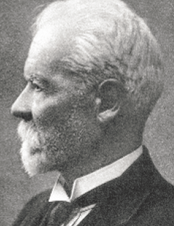
Henri Fayol
Princípios de gestão
Regras fundamentais da gestão, que poderiam ser aplicadas em todas as organizações e ensinadas nas escolas.
Notes:
Henri Fayol described the practice of management as something distinct from accounting, finance, production, distribution, and other typical business functions. His belief that management was an activity common to all business endeavors, government, and even the home, led him to develop 14 principles of management—fundamental rules of management that could be applied to all organizational situations and taught in schools. These principles are shown in Exhibit MH-3.

Slide 14
14 princípios de Fayol
Divisão do trabalho
Autoridade
Disciplina
Unidade de Comando
Unidade de Direção
Subordinação dos interesses individuais aos interesses gerais
Remuneração (justa)
Centralização das decisões
Linha de comando (Cadeia escalar)
Ordem
Equidade (Justiça)
Estabilidade do pessoal
Iniciativa
Espírito de equipa
Notes:
Dica do Prof., para memorizarem: E Liceu Eduardos

Slide 15
14 Princípios de Fayol
Principles
1. Division of work. Specialization increases output by making employees more efficient.
2. Authority. Managers must be able to give orders, and authority gives them this right.
3. Discipline. Employees must obey and respect the rules that govern the organization.
4. Unity of command. Every employee should receive orders from only one superior.
5. Unity of direction. The organization should have a single plan of action to guide managers and workers.
6. Subordination of individual interests to the general interest. The interests of any one employee or group of employees should not take precedence over the interests of the organization as a whole.
7. Remuneration. Workers must be paid a fair wage for their services.
Notes:
Source: Based on Henri Fayol’s 1916 Principles of Management, “Administration Industrielle et Générale,” translated by C. Storrs, General and Industrial Management (London: Sir Isaac Pitman & Sons, London, 1949).

Slide 16
14 Princípios de Fayol
Principles
8. Centralization. This term refers to the degree to which subordinates are involved in decision making.
9. Scalar chain. The line of authority from top management to the lowest ranks is the scalar chain.
10. Order. People and materials should be in the right place at the right time.
11. Equity. Managers should be kind and fair to their subordinates.
12. Stability of tenure of personnel. Management should provide orderly personnel planning and ensure that replacements are available to fill vacancies.
13. Initiative. Employees allowed to originate and carry out plans will exert high levels of effort.
14. Esprit de corps. Promoting team spirit will build harmony and unity within the organization.
Notes:
Source: Based on Henri Fayol’s 1916 Principles of Management, “Administration Industrielle et Générale,” translated by C. Storrs, General and Industrial Management (London: Sir Isaac Pitman & Sons, London, 1949).

Slide 17
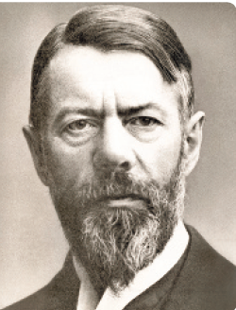
Max Weber
Burocracia
Forma de organização caracterizada pela divisão do trabalho, hierarquia bem definida, regras e procedimentos detalhados e relações impessoais.
Notes:
Max Weber (pronounced VAY-ber) was a German sociologist who studied organizations. Writing in the early 1900s, he developed a theory of authority structures and relations based on an ideal type of organization he called a bureaucracy—a form of organization characterized by division of labor, a clearly defined hierarchy, detailed rules and regulations, and impersonal relationships (see Exhibit MH-4).
Weber recognized that this “ideal bureaucracy” didn’t exist in reality. Instead, he intended it as a basis for theorizing about how work could be done in large groups. His theory became the structural design for many of today’s large organizations.

Slide 18
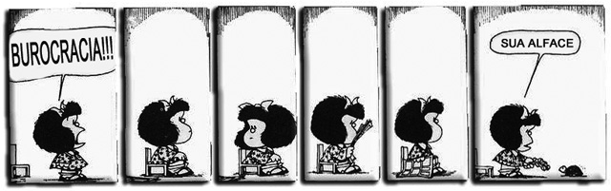
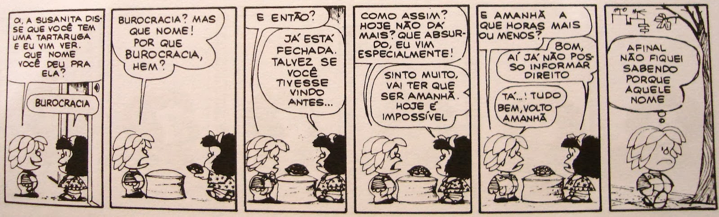
Mafalda, A Contestatária (Quino 1932-2020)

Slide 19
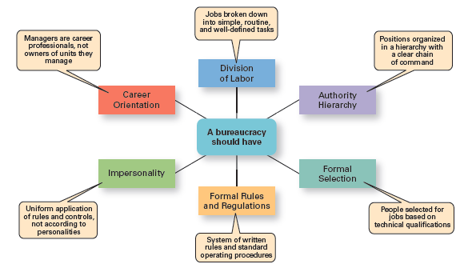
Caraterísticas da burocracia de Weber
Exhibit MH-4 shows Weber’s ideal bureaucracy.
Notes:
Source: Based on Essays in Sociology by Max Weber, translated, edited, and introduced by H. H. Gerth and C. Wright Mills (NewYork: Oxford University Press, 1946).

Slide 20
Abordagem comportamental
Abordagem comportamental - Decorre de críticas à visão mecanicista do ser humano, das abordagens anteriores. Reconhece as pessoas como o recurso mais importante das organizações.
Comportamento Organizacional (OB) - Estudo das ações das pessoas em contexto organizacional / de trabalho.
Notes:
The field of study that researches the actions (behavior) of people at work is called organizational behavior (OB). Much of what managers do today when managing people—motivating, leading, building trust, working with a team, managing conflict, and so forth—has come out of OB research.
Although a number of individuals in the early twentieth century recognized the importance of people to an organization’s success, four stand out as early advocates of the OB approach: Robert Owen, Hugo Munsterberg, Mary Parker Follett, and Chester Barnard. Their contributions were varied and distinct, yet all believed that people were the most important asset of the organization and should be managed accordingly.

Slide 21
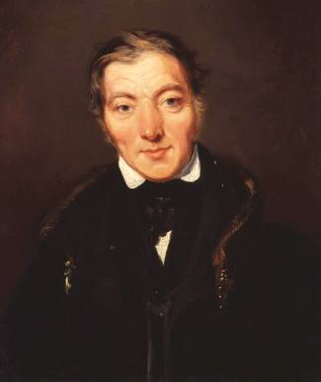
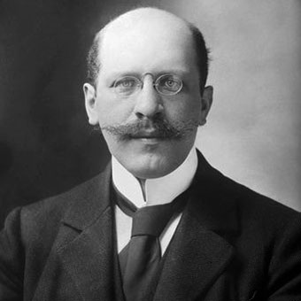
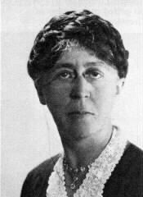
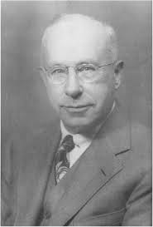
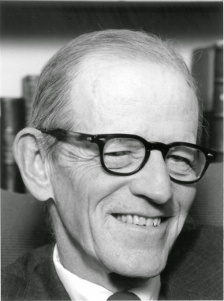
Abordagem comportamental
Percursores desta abordagem (i.e. OB)
  Robert Owen
  Hugo Munsterberg
  Mary Parker Follett
  Chester Barnard
Elton Mayo contribuiu fortemente para esta abordagem, através dos estudos de Hawthorne.
Notes:
The field of study that researches the actions (behavior) of people at work is called organizational behavior (OB). Much of what managers do today when managing people—motivating, leading, building trust, working with a team, managing conflict, and so forth—has come out of OB research.
Although a number of individuals in the early twentieth century recognized the importance of people to an organization’s success, four stand out as early advocates of the OB approach: Robert Owen, Hugo Munsterberg, Mary Parker Follett, and Chester Barnard. Their contributions were varied and distinct, yet all believed that people were the most important asset of the organization and should be managed accordingly.

Slide 22
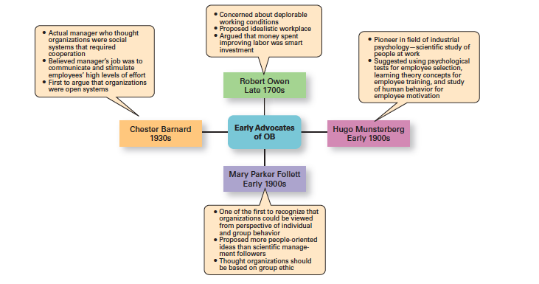
Percursores do Comportamento Organizacional
Notes:
Although a number of individuals in the early twentieth century recognized the importance of people to an organization’s success, four stand out as early advocates of the OB approach: Robert Owen, Hugo Munsterberg, Mary Parker Follett, and Chester Barnard. Their contributions were varied and distinct, yet all believed that people were the most important asset of the organization and should be managed accordingly. Their ideas provided the foundation for such management practices as employee selection procedures, motivation programs, and work teams. Exhibit MH-5 summarizes each individual’s most important ideas.

Slide 23
Estudos de Hawthorne
Estudos de Hawthorne
Estudos na fábrica da Western Electric nas décadas de 1920 e 1930, liderados por Elton Mayo. Trazem novas contribuições no que diz respeito ao comportamento individual e em grupo.
Notes:
Scholars generally agree that the Hawthorne Studies had a game-changing impact on management beliefs about the role of people in organizations. Elton Mayo conducted the Hawthorne Studies, a series of studies during the 1920s and 1930s that provided new insights into individual and group behavior. The studies concluded that people’s behavior and attitudes are closely related, that group factors significantly affect individual behavior, that group standards establish individual worker output, and that money is less a factor in determining output than group standards, group attitudes, and security. These conclusions led to a new emphasis on the human behavior factor in the management of organizations.

Slide 24
Estudos de Hawthorne
Experiência: Analisar o impacto da iluminação e dos incentivos salariais na produtividade.
Resultados: A produtividade aumentava quaisquer que fossem as mudanças nas condições de iluminação. Os incentivos remuneratórios não tinham grande impacto nos resultados.
Conclusão: Reconhecimento individual e sentimento de pertença ao grupo aumentam a produtividade.
Notes:
Scholars generally agree that the Hawthorne Studies had a game-changing impact on management beliefs about the role of people in organizations. Elton Mayo conducted the Hawthorne Studies, a series of studies during the 1920s and 1930s that provided new insights into individual and group behavior. The studies concluded that people’s behavior and attitudes are closely related, that group factors significantly affect individual behavior, that group standards establish individual worker output, and that money is less a factor in determining output than group standards, group attitudes, and security. These conclusions led to a new emphasis on the human behavior factor in the management of organizations.

Slide 25
Abordagem quantitativa
Utilização de técnicas quantitativas para melhorar a tomada de decisão, também conhecida como investigação operacional.
Tem origem nos modelos matemáticos e estatísticos desenvolvidos para resolver problemas militares na II Guerra Mundial.
Notes:
The quantitative approach is the use of quantitative techniques to improve decision making. This approach also is known as management science. The quantitative approach evolved from mathematical and statistical solutions developed for military problems during World War II. After the war was over, many of these techniques used for military problems were applied to businesses.

Slide 26
Abordagem quantitativa
Esses métodos foram posteriormente aplicados na indústria privada (ex.: o grupo militar Whiz Kids usou métodos quantitativos para melhorar a tomada de decisão na Ford nos anos 40).
Atualmente estes métodos são largamente aplicados sobretudo para o planeamento e controlo e, mais recentemente, como base da inteligência artificial (IA).
Notes:
The quantitative approach is the use of quantitative techniques to improve decision making. This approach also is known as management science. The quantitative approach evolved from mathematical and statistical solutions developed for military problems during World War II. After the war was over, many of these techniques used for military problems were applied to businesses.

Slide 27
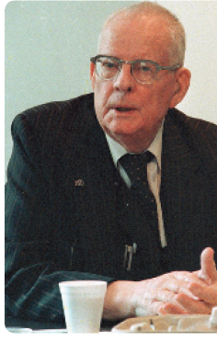
Total Quality Management
Gestão da Qualidade Total (TQM)
Uma filosofia de gestão que se baseia na melhoria contínua e numa pronta resposta às necessidades e expectativas dos clientes.
Percursores: Edwards Deming (foto) & Joseph Juran.
Notes:
Another area where quantitative techniques are used frequently is in total quality management. A quality revolution swept through both the business and public sectors in the 1980s and 1990s. It was inspired by a small group of quality experts; the most famous was W. Edwards Deming (pictured above) and Joseph M. Juran. The ideas and techniques they advocated in the 1950s had few supporters in the United States but were enthusiastically embraced by Japanese organizations. As Japanese manufacturers began beating U.S. competitors in quality comparisons, however, Western managers soon took a more serious look at Deming’s and Juran’s ideas, which became the basis for today’s quality management programs.
Total quality management, or TQM, is a management philosophy devoted to continual improvement and responding to customer needs and expectations (see Exhibit MH-6). The term customer includes anyone who interacts with the organization’s product or services, internally or externally. It encompasses employees and suppliers as well as the people who purchase the organization’s goods or services.

Slide 28
TQM
Characteristic
1. Intense focus on the customer. The customer includes outsiders who buy the organization’s products or services and internal customers who interact with and serve others in the organization.
2. Concern for continual improvement. Quality management is a commitment to never being satisfied. “Very good” is not good enough. Quality can always be improved.
3. Process focused. Quality management focuses on work processes as the quality of goods and services is continually improved.
4. Improvement in the quality of everything the organization does. This relates to the final product, how the organization handles deliveries, how rapidly it responds to complaints, how politely the phones are answered, and the like.
5. Accurate measurement. Quality management uses statistical techniques to measure every critical variable in the organization’s operations. These are compared against standards to identify problems, trace them to their roots, and eliminate their causes.
6. Empowerment of employees. Quality management involves the people on the line in the improvement process. Teams are widely used in quality management programs as empowerment vehicles for finding and solving problems.

Slide 29
Abordagens contemporâneas
Abordagem sistémica
Abordagem contingencial
Abordagem Tecnológica e da Computorização
Notes:
Most of these earlier approaches focused on managers’ concerns inside the organization. Starting in the 1960s, management researchers began to look at what was happening in the external environment outside the boundaries of the organization. Two contemporary management perspectives—systems and contingency—are part of this approach. Systems theory is a basic theory in the physical sciences, but had never been applied to organized human efforts.
A system is a set of interrelated and interdependent parts arranged in a manner that produces a unified whole. The two basic types of systems are closed and open. Closed systems are not influenced by and do not interact with their environment. In contrast, open systems are influenced by and do interact with their environment. Today, when we describe organizations as systems, we mean open systems.

Slide 30
Abordagem sistémica
Sistema - Conjunto de partes inter-relacionadas e interdependentes que funcionam como um todo.
Sistema fechado - Sistema que não interage com o ambiente e que não é influenciado por ele.
Sistema aberto - Sistema que interage com o ambiente
Notes:
Most of these earlier approaches focused on managers’ concerns inside the organization. Starting in the 1960s, management researchers began to look at what was happening in the external environment outside the boundaries of the organization. Two contemporary management perspectives—systems and contingency—are part of this approach. Systems theory is a basic theory in the physical sciences, but had never been applied to organized human efforts.
A system is a set of interrelated and interdependent parts arranged in a manner that produces a unified whole. The two basic types of systems are closed and open. Closed systems are not influenced by and do not interact with their environment. In contrast, open systems are influenced by and do interact with their environment. Today, when we describe organizations as systems, we mean open systems.

Slide 31
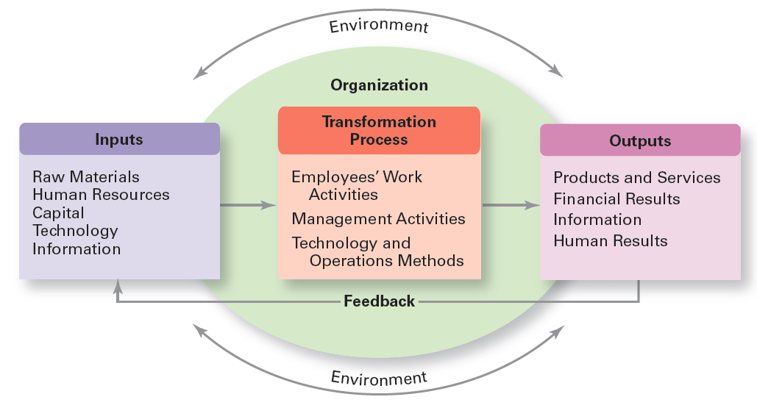
Figura HG-7
A Organização como um Sistema aberto
Notes:
As you can see, an organization takes in inputs (resources) from the environment and transforms or processes these resources into outputs that are distributed into the environment. The organization is “open” to and interacts with its environment.

Slide 32
Abordagem sistémica
Os gestores devem ter em conta que as decisões e ações numa parte da organização têm consequências em outra partes.
Os gestores devem reconhecer que as organizações necessitam, e são afetadas, por fatores com origem no ambiente externo.
Notes:
Most of these earlier approaches focused on managers’ concerns inside the organization. Starting in the 1960s, management researchers began to look at what was happening in the external environment outside the boundaries of the organization. Two contemporary management perspectives—systems and contingency—are part of this approach. Systems theory is a basic theory in the physical sciences, but had never been applied to organized human efforts.
A system is a set of interrelated and interdependent parts arranged in a manner that produces a unified whole. The two basic types of systems are closed and open. Closed systems are not influenced by and do not interact with their environment. In contrast, open systems are influenced by and do interact with their environment. Today, when we describe organizations as systems, we mean open systems.

Slide 33
Abordagem contingencial
Também conhecida como abordagem situacional.
Reconhece que diferentes organizações necessitam diferentes modelos de gestão, ou seja, o “one best way” não existe.
Questão: …
R: Depende! (…)
Notes:
Different and changing situations require managers to use different approaches and techniques. The contingency approach (sometimes called the situational approach) says that organizations are different, face different situations (contingencies), and require different ways of managing.

Slide 34
Abordagem contingencial
Os gestores devem reconhecer as variáveis situacionais para que, depois, possam identificar as práticas de gestão mais adequadas.
Exemplos de variáveis situacionais:
Dimensão, tecnologia, grau de incerteza ambiental, diferenças individuais dos trabalhadores (educação, personalidade, etc.).
Notes:
Different and changing situations require managers to use different approaches and techniques. The contingency approach (sometimes called the situational approach) says that organizations are different, face different situations (contingencies), and require different ways of managing.

Slide 35
Variáveis contingenciais
Variable
Organization Size. As size increases, so do the problems of coordination. For in- stance, the type of organization structure appropriate for an organization of 50,000 employees is likely to be inefficient for an organization of 50 employees.
Routineness of Task Technology. To achieve its purpose, an organization uses technology. Routine technologies require organizational structures, leadership styles, and control systems that differ from those required by customized or nonroutine technologies.
Environmental Uncertainty. The degree of uncertainty caused by environmental changes influences the management process. What works best in a stable and predictable environment may be totally inappropriate in a rapidly changing and unpredictable environment.
Individual Differences. Individuals differ in terms of their desire for growth, autonomy, tolerance of ambiguity, and expectations. These and other individual differences are particularly important when managers select motivation techniques, leadership styles, and job designs.
Notes:
Exhibit MH-8 describes four popular contingency variables. Although the list is by no means comprehensive—more than 100 different variables have been identified—it represents those most widely used and gives you an idea of what we mean by the term contingency variable. The primary value of the contingency approach is that it stresses there are no simplistic or universal rules for managers to follow.

Slide 36
Abordagem Tecnológica e da Computorização
Reflete a gestão num contexto de 4ª Revolução Industrial (ver slides seguintes, para uma breve introdução).
Uma gestão de trabalhadores altamente qualificados, de elevada mobilidade profissional e que trabalham com tecnologia de ponta.
Gestão de equipas virtuais e, possivelmente, geograficamente dispersas.
Número crescente de empresas (grandes e pequenas) baseiam a sua tomada de decisão na Big Data, que revelam padrões, tendências e comportamentos que não são detetáveis “a olho nu”.
A velocidade de integração (resposta) à oportunidade (ameaça) de uma inovação disruptiva é crítica.

Slide 37

4ª Revolução Industrial (século XXI)
Vídeo (PhD Markus Lorenz), sobre Indústria 4.0:
https://www.youtube.com/watch?v=uBZmJOHIN8E
Artigo relacionado: https://www.inovasyon.gen.tr/images/Haberler/bcgperspectives_Industry40_2015.pdf
Li Da Xu, Eric L. Xu & Ling Li (2018)

Slide 38
4ª Revolução Industrial (século XXI)
Mais recentemente, a Industria está a entrar na 4ª Revolução Industrial (a.k.a. Indústria 4.0), com a introdução dos sistema ciberfísicos (CPS), a Internet das Coisas (IoT), a computação e manufatura em nuvem, a impressão 3D (aditive manufacturing) e a integração de todas estas tecnologias com uma inteligente gestão de processos de negócios (BPM).
Embora a 3ª Revolução Industrial também se tenha concentrado na automação de máquinas e processos, a Indústria 4.0 concentra-se mais na digitalização de ponta a ponta e na integração de ecossistemas industriais digitais, buscando soluções completamente integradas.
Na Indústria 4.0, espera-se que a IoT ofereça soluções transformacionais promissoras para a operação e função de muitos sistemas industriais existentes nas empresas.
Li Da Xu, Eric L. Xu & Ling Li (2018)

Slide 39
4ª Revolução Industrial (século XXI)
Mais notavelmente, a IoT pode permitir a criação de redes virtuais para dar suporte à fábrica inteligente na Indústria 4.0.
A manufatura em nuvem (semelhante à computação em nuvem), permite uma rede de recursos e capacidades altamente distribuída e acessivel automatica e inteligentemente.
A impressão 3D permite uma flexibilização da produção e uma redução de custos de produção de peças customizadas para níveis nunca antes vistos. Os CPS são os sistemas computacionais em intensa conexão com o mundo físico circundante e os seus processos.
Com a introdução do CPS, as máquinas são capazes de comunicar entre si e os sistemas de controle descentralizados são capazes de otimizar automaticamente a produção.
Adaptado de Li Da Xu, Eric L. Xu & Ling Li (2018)

Slide 40
Questão 02:
(Responda p.f. através do Ms Teams)
Qual das abordagens históricas à Gestão lhe suscitou mais curiosidade e interesse?
1- Clássica
2- Comportamental
3- Quantitativa
4- Contemporânea: Sistémica
5- Contemporânea: Contingencial
6- Contemporânea: Tecnológica e da Computorização

Slide 41
The End

