Slide 1
Behavioural Finance
2. Theoretical Foundations: Expected Utility Theory & Prospect Theory
Antonio Silva, April 2023

Slide 2
Outline
Lesson 1
Expected Utility Theory
  Background
  Core principles
Prospect Theory
  Background
  Core principles

Slide 3
Expected value
The expected value of a gamble is what you expected to win, on average, in the long run, when you play the gamble
Notes:
Emphasise that this is not the model, but the average. So as if you played a million times. You win a euro if head, zero if head. What’s the expected value? 0

Slide 4
Rationality
Key Principles
Utility maximisation: Individuals are assumed to be rational, always making consistent decisions that maximize their utility.
Completeness: For any two options, A and B, an individual can rank them (A is preferred to B, B is preferred to A, or indifferent).
Transitivity: If option A is preferred to B and B is preferred to C, then A is preferred to C.
Independence: If A is preferred to B, then A should still be preferred to B even when both options are mixed with a third option, C, in the same proportion
Continuity: If A is preferred to B and B is preferred to C, there exists a probability mix between A and C that is equivalent in value to B
Notes:
Most of you are economists, so remind me of the axioms of rationality.
Transitivity If Steak > Chips, and Chips > Spinach, then Steak > spinach.
Continuity: 100% chance of chips should be equal to for example 50% chance of steak (the preferred option) and 50% of Spinach.
Common misconceptions:
Not about doing what is best for “you”. Perfectly rational to sacrifice own food for your child, a kidney for your loved one.
We assume these things give you utility and you act in a way that maximises your own utility.
Behavioural economics is most concerned with violations of transitivity

Slide 5
Expected Utility Theory
People have rational preferences across possible outcomes or states of nature.
Preferences can be represented by the expectation of a utility function
Expected Utility (EU): Von Neumann and Morgenstern (1944)
People maximize utility and firms maximize profits.
People make independent decisions based on all relevant information.

Slide 6
EUT deals with risk
Says that individuals should act in a certain way, when confronted with decision-making under uncertainty. Theory is really set up to deal with risk, not uncertainty.
Notes:
Tell me the difference between risk and uncertainty?
Risk is probabilities that are defined and correct. While uncertainty is a guess. In the real world often we deal with uncertainties, which is part of the reason why it’s not super useful in the real world. However, even when dealing with risk it sometimes doesn’t work.

Slide 7
Risk and uncertainty
Risk: when you know what the outcomes could be, and can assign probabilities
Uncertainty: when relevant information is unavailable and unknown. When you can’t assign probabilities; or you can’t come up with a list of possible outcomes

Slide 8
What’s a prospect?
A prospect is defined as a series of wealth or income levels and associated probabilities. For example:
    500€ with probability .8
    2000€ with probability .2
    P1 (.8, 500, 2000)
    When 2nd option is zero, let’s write
    P2 (.8, 500)
Notes:
EUT is adding risk to neoclassic micro economic theory, ie. Rationality from previous slide, but applied to to prospects

Slide 9

Expected Utility
How to calculate it
Assume one has to choose between two prospects. Based on assumptions such as ordering and transitivity, it can be shown that when such choices over risky prospects are to be made, people should act as if they are maximizing expected utility.
P - Prospect; pr - Probability; w – Wealth; U - Utility
P = (prA , wA , wB)
EU(P) = prA U(wA) + (1-prA) U(wB)
Can then generalize to more than two outcomes:
P = (prA , wA , prB , wB , prC , wC)
EU(P) = prA U(wA) + prBU(wB) + prCU(wC)
Notes:
prospect=prob of a, wealth of a, wealth of b. Where b is defined as not a.
Expect utility of the prospect=prob of a*utility of wealth of a+prob of b (the same as 1-prob of A)*utility of wealth of b.
Key point is that expected utility is utility of wealth, not the wealth.

Slide 10
Expected Utility
How to calculate it
If a bet for €100 on the toss of a coin, then the Expected Win is =
(½ x €100) + (½ x -€100) = 0, so the expected value is 0
If €100 if you win and -€50 if you lose, then the Expected Win is =
(½ x 3100) + (½ x -€50) = €25
So in theory, someone should be prepared to buy that bet for €25
This assumes risk neutrality (linear utility function)

Slide 11
Expected Utility
How to calculate it
(w) = w^{0,5}
Prospects:
  P5(.5, 1000, 500)
  P6(.6, 1200, 300)
For P5: U(P5) = .5 * 1000^{0,5} + .5 * 500^{0,5} = 26.99
For P6: U(P6) = .6 * 1200^{0,5} + .4 * 300^{0,5} = 27.71
So P6 ≻ P5.
Notes:
Now suppose a person has a utility function related to wealth to the power of 0.5. This means diminishing returns for added wealth. So has wealth goes up, each unit is worth less than the previous ones in utility.
So if we calculate 2 different prospects for this person we could have a 50% chance of getting a 1000 or 50% chance getting 500, another prospect we have 60% chance of getting 1200 or 40% of getting 300.
If now calculate the expected utility of each prospect we can see which prospect is better for this person. So the prob (0.5 or 50%) X the utility winning 1000€ + the prob of the utility of winning 500-and that gives the utility of the prospect, or the expect utility value (EUT)
We then calculate P6 in the same way and can determine that P6 is favoured.
EU(P) = prA U(wA) + prBU(wB) + prCU(wC)

Slide 12
Risk aversion assumption
This comes from frequent observation that most people most of the time are not willing to accept a fair gamble. Would you be willing to bet 100€ that you can predict a coin flip?
Risk aversion implies concavity.
Notes:
EUT allows risk aversion, because you don’t just get the utility of the expected value, but the EU is about getting the utility of each expecedt outcome, not just the average. So a fair coin toss on £1 is different than a fair coin toss on a million

Slide 13
Risk aversion implies concavity.
u(w) = w^{0,5}
Prospects:
  P5(.5, 1000, 500)
  P6(.6, 1200, 300)
For P5: EU(P5) = .5 * 1000^{0,5} + .5 * 500^{0,5} = 26.99
For P6: EU(P6) = .6 * 1200^{0,5} + .4 * 300^{0,5} = 27.71
So P6 ≻ P5.

Slide 14
Risk aversion assumption
A risk neutral agent will be indifferent between 100 for sure or to play this bet:
EU=0.5*200+0.5*0 = 100
A risk averse would not accept it. So, that means that for a risk averse this holds:
EU=0.5*U(200)+0.5*U(0) < U(100)
Notes:
The EU of the bet is less than the U of 100.

Slide 15
Risk aversion
u(w) = w0,5
Prospect:
  P5(.5, 1000, 500) -> EV(P7)=0.5*1000+0.5*500=750
  P8(1, 750) -> EV(P8)= 750*1=750
But EUT tells us that even though they have the same value, they may have different utilities.
  EU(P5) = .5 * 1000^{0,5} + .5 * 500^{0,5} = 26.99
  EU(P8)= 750^{0.5}=27.39
Therefore
  EU(p8) > EU (p5)
This is risk aversion
Notes:
EV of P5, 0.5*1000+0.5*500=750
The utility P8 of the EV is 750^0.5=27.39
Which is higher than P5
Each additional pound gives you less utility than the previous pound
P(1, 750)

Slide 16
Certainty equivalent
Certainty equivalent is defined as the wealth level which leads decision-maker to be indifferent between a particular prospect and a certain wealth level. To establish this we need to solve for w below:
EU(P7) = .5 * 1000^{0,5} + .5 * 500^{0,5} = 26.99
U = 26.99
U = w^{0.5} -> w = U²=728.4601
The EV is 750, but for a risk averse agent the EV is lower 728 -> they would sell bet for 728.
Notes:
EU(P8) = .5 * 10000,5 + .5 * 5000,5 = 26.99 this is the utility you get from p8

Slide 17
Problems with EUT
Experimental work has shown that people systematically violate EUT. The Allais Paradox is one example.

Slide 18
Allais Paradox
 | Game S | Game B
Treatment 1 | A | B
Treatment 2 | 0.25*A+C | 0.25*B+C
Independence: If A is preferred to B, then A should still be preferred to B even when both options are mixed with a third option, C, in the same proportion
Notes:
A game with these options and people only play treatment 1 or treatment 2. And independence axiom states that if you prefer A you also need to prefer any transformation of A, e.g. 0.25*A+C

Slide 19
Allais Paradox
 | Game S | Game B
Treatment 1 | 3000 with prob. 1 | 4000 with prob. 0.8 0 with prob. 0.2
Treatment 2 | 3000 with prob. 0.25 0 with prob. 0.75 | 4000 with prob. 0.2 0 with prob. 0.8

Slide 20
Allais Paradox
 | Game S | Game B
Treatment 1 | 3000 with prob. 1 | 4000 with prob. 0.8 0 with prob. 0.2
Treatment 2 | 3000 with prob. 0.25 0 with prob. 0.75 | 4000 with prob. 0.2 0 with prob. 0.8

Slide 21
Allais Paradox
 | Game S | Game B
Treatment 1 | 3000 with prob. 1 | 4000 with prob. 0.8 0 with prob. 0.2
Treatment 2 | 3000 with prob. 0.25 0 with prob. 0.75 | 4000 with prob. 0.2 0 with prob. 0.8
  U(3000)>0.8U(4000)+0.2U(0)
Multiplying both sides by 0.25
  0.25U(3000)>0.25*[(0.8U(4000)+0.2U(0)]
  0.25U(3000)> 0.2U(4000)+0.05U(0)
Adding 0.75U(0) to both sides
  0.25U(3000)+0.75U(0)> 0.2U(4000)+0.8U(0)
Notes:
So this breaks Independence which states that Independence: If A is preferred to B, then A should still be preferred to B even when both options are mixed with a third option, C, in the same proportion
because treatment is just a linear transformation of treatment 1.
Is X is better than Y? Should 2X be better than 2Y?

Slide 22

Prospect Theory
Background
EUT dominated the views of decision-making models, based on the pillars or rational choice and maximising expected utility. However, empirical observations and psychological experiments started to challenge these principles.
Prospect theory was developed by psychologists Daniel Kahnemann and Amos Tversky in 1979 in response to the limitations of EUT.
This model incorporated a broader set of psychological mechanisms underpinning human decision-making, based on how people actually behaved in the real-world.
Broad influence across a range of fields, from finance and economics to political science and public policy. Led Daniel Kahneman to win the Nobel in economics in 2022 - first non-economist to win it.
Notes:
Most successful at capturing the experimental results
Not normative, but descriptive: it simply tries to capture people’s attitudes to risky gambles
Best-known alternative theory

Slide 23
Prospect Theory
Choices among risky prospects exhibit several effects
  Certainty effect: people underweight outcomes that are merely probable in comparison with outcomes that are obtained with certainty.
  Isolation effect: people reject components that are shared by all prospects under consideration.
Prospect Theory:
  Value is assigned to gains and losses rather than to final assets
  Probabilities are replaced by decision weights.
Notes:
KAHNEMAN AND TVERSKY (1979) paper describes several classes of choice problems in which preferences systematically violate the axioms of expected utility theory.

Slide 24
Prospect Theory - Key Principles
Reference Dependence
Concept: People evaluate outcomes relative to a reference point, rather than in absolute terms. This reference point is often the status quo, but it can be influenced by expectations, historical highs or lows, or social comparisons.
Implication: This principle explains why individuals might feel joy or sorrow from the same outcome, depending on their reference point. It's crucial for understanding consumer satisfaction, investment decisions, and response to market changes.
Challenges to EUT: Preferences are relative to a reference point, and not just based on absolute preferences and rationality.

Slide 25
Prospect Theory - Key Principles
Loss Aversion
Concept: People exhibit loss aversion when the disutility of losing a certain amount is greater than the utility of gaining the same amount. This principle is a powerful driver of human behavior, reflecting a psychological bias towards avoiding losses over acquiring equivalent gains.
Implication: Loss aversion can explain phenomena such as the endowment effect (valuing owned items more than identical items not owned) and risk behavior in financial markets, where investors might hold onto losing stocks to avoid realising losses
Challenges to EUT: If losses are felt more intensely than gains, it contradicts the EUT’s assumption of consistent preference ordering and transitivity by showing that context and framing can alter preferences
Notes:
EUT predicts that purchasing insurance would only make sense if the expected utility of the insurance is greater than the cost of the insurance premium.
However people purchase insurance for risks that have very low probabilities, often at a premium that far exceeds the expected loss. This behavior is motivated by loss aversion, a tendency to strongly prefer avoiding losses to acquiring equivalent gains. The utility loss from a potential financial disaster (even if unlikely) weighs heavier on individuals' minds than the utility gain from saving the premium cost.
This inclination towards insuring against low-probability, high-loss events challenges the EUT assumption of rationality based on expected utility maximisation. Prospect Theory explains this by highlighting how individuals' value function is steeper for losses than gains, indicating a higher sensitivity to losses.

Slide 26
Prospect Theory - Key Principles
Diminishing Sensitivity & over-weighing small probabilities
Concept: The principle of diminishing sensitivity states that the impact of a change diminishes as one moves farther away from the reference point. This applies to both gains and losses, meaning that the subjective value of a financial gain (or loss) decreases (or increases) as the magnitude of the outcome grows.
Implication: This concept helps explain why people may not behave in economically rational ways when facing large-scale financial decisions. It underpins risk attitudes and has implications for understanding insurance purchasing, gambling, and investment behaviors.
Challenges to EUT: PT’s value function is concave for gains and convex for losses, in contrast to EUT's linear utility scale, affecting the continuity principle by showing that the valuation curve is not linear. Also, people overweigh small probabilities and underweigh large probabilities, challenging the independence axiom by showing that the presence of unlikely but impactful outcomes can disproportionately affect decision-making.

Slide 27
Prospect Theory - Key Principles
Certainty Effect
Concept: People disproportionately prefer certain outcomes over uncertain ones, even when the expected values are lower. It highlights how the allure of a guaranteed result can overshadow the rational, mathematical expectation of outcomes, leading individuals to avoid risk when they have a sure option.
Implication: This concept has significant implications for understanding human behavior in economic decisions, particularly in the context of risk aversion and insurance. It explains why people are willing to make choices that secure a certain outcome, often at the expense of a potentially higher, but uncertain, benefit. affecting consumer behavior, investment strategies, and policy designs.
Challenges to EUT: EUT assumes linear probability weighting while the certainty effect reveals that individuals do not treat probabilities linearly; instead, they exhibit a strong preference for outcomes that are 100% certain. This behavior suggests that the utility function for outcomes under certainty is discontinuous or experiences a sharp increase as probability approaches certainty, which is not accounted for in the traditional EUT framework.
Notes:
EUT predicts that purchasing insurance would only make sense if the expected utility of the insurance is greater than the cost of the insurance premium.
However people purchase insurance for risks that have very low probabilities, often at a premium that far exceeds the expected loss. This behavior is motivated by loss aversion, a tendency to strongly prefer avoiding losses to acquiring equivalent gains. The utility loss from a potential financial disaster (even if unlikely) weighs heavier on individuals' minds than the utility gain from saving the premium cost.
This inclination towards insuring against low-probability, high-loss events challenges the EUT assumption of rationality based on expected utility maximisation. Prospect Theory explains this by highlighting how individuals' value function is steeper for losses than gains, indicating a higher sensitivity to losses.

Slide 28
Prospect Theory - Key Principles
Framing/Isolation
Concept: Tendency of individuals to disregard components that the options share in common and to focus instead on the differences between options when making decisions. This effect highlights how the way choices are presented or "framed" can significantly influence the decision-making process, leading to different preferences or outcomes based on how information is isolated or highlighted.
Implication: Affects our understanding of consumer behavior, negotiation strategies, and policy-making. It suggests that by changing the context or framing of choices, without altering the underlying value, decision-makers can be influenced toward a particular option.
Challenges to EUT: EUT assumes that decision-makers have stable preferences that are not influenced by the presentation of information. However, the isolation effect reveals that people's choices can be swayed by how options are framed, indicating that preferences can be inconsistent and influenced by factors unrelated to the final outcomes' utility.

Slide 29
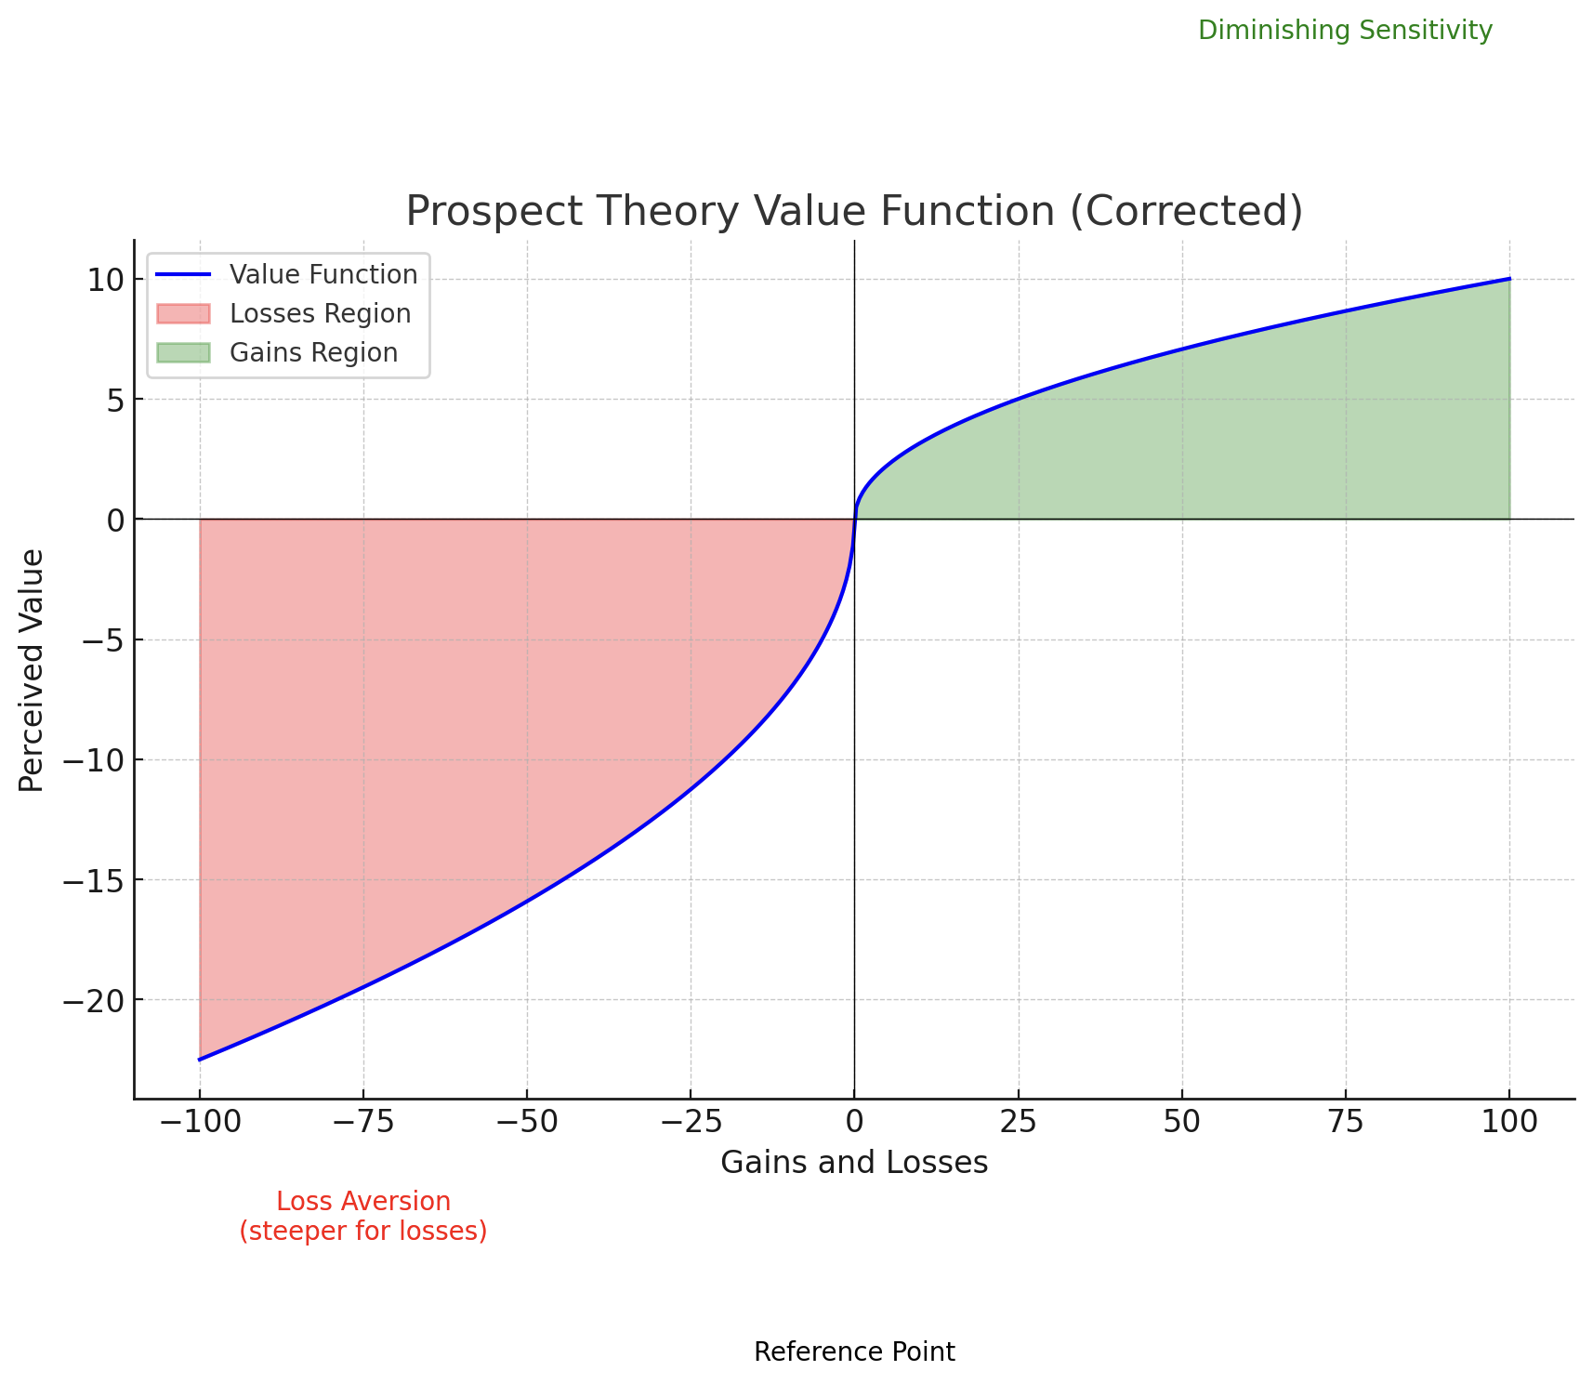
Prospect Theory
Value Function
Changes in wealth from a reference point (horizontal-axis) determine value (vertical-axis)
Concave in positive domain
Convex in negative domain

Slide 30
Prospect Theory
Decision making under risk can be viewed as a choice between prospects or gambles.
Prospect: series of payouts, each of which is associated with a probability
(p₁, x₁; p_{z}, x_{z}; p_{n}, x_{n}) -> yields outcome x_{i} with probability p_{i}, where p₁+ p_{z}+ p_{n}=1.
(p, x) -> yields x with probability p and 0 with probability 1-p.
(x) -> yields x with certainty, the riskless prospect

Slide 31
Prospect Theory
Problem 1 - Risk seeking vs aversion
Decision i)
P1(250€) or P2(0.25, 1000€)
Decision ii)
P3(-750€) or P4(0.75, -1000€)

Slide 32
Prospect Theory
Problem 1 - Risk seeking vs aversion
Decision i) [84% P1]
P1(250€) or P2(0.25, 1000€)
Decision ii) [87% P4]
P3(-750€) or P4(0.75, -1000€)
People sometimes exhibit risk aversion and sometimes risk seeking, depending on the nature of the prospect. Sometimes the same person is risk averse or risk seeking, which means the utility function isn’t the same in all wealth points.
Notes:
First decision just shows people prefer certainty
P1 has the same EV as P2, but people choose the certain option. P3 has the same EV as P4. Yet people choose the risky option because its framed as a loss
So sometimes the same person is risk averse or risk lovin, so that means that the utility function isn’t the same in all wealth points.

Slide 33
Prospect Theory
Problem 2 - Reference point
Decision i)
Assume yourself richer by 300€. Then choose between:
P5(100€) or P6(0,50, 200€)
Decision ii)
Assume yourself richer by 500€. Then choose between:
P7(-100€) or P8(0,50, -200€)
Notes:
They are identical, yet people flip their choices because of the change to the reference point

Slide 34
Prospect Theory
Problem 2 - Reference point
Decision i) [72%P5]
Assume yourself richer by 300€. Then choose between:
P5(100€) or P6(0,50, 200€)
Decision ii) [64%P8]
Assume yourself richer by 500€. Then choose between:
P7(-100€) or P8(0,50, -200€)
Peoples’ valuation of prospects depend on gains and losses relative to a reference point, not in final wealth. The reference point is usually the status quo.
Notes:
They are identical, yet people flip their choices because of the change to the reference point

Slide 35
Prospect Theory
Problem 3 - Loss loom larger than gains
What value of x would make you indifferent between?
P9(0€) or P10(0.5, x;-25€)

Slide 36
Prospect Theory
Problem 3 - Loss loom larger than gains
What value of x would make you indifferent between?
P9(0€) or P10(0.5, x;-25€)
Average response is €61, which has a much higher EV than P9
Peoples are averse to losses because losses loom larger than equivalent gains. Hence the concave utility function.

Slide 37
Prospect Theory
Problem 4 - Certainty effect
Decision i)
P15(0.8, 4000€) or P16(3000€)
Decision ii)
P17(0.2, 4000€) or P18(0.25, 3000€)

Slide 38
Prospect Theory
Problem 4 - Certainty effect
Decision i) [80% P16]
P15(0.8, 4000€) or P16(3000€)
Decision ii) [65% P17]
P17(0.2, 4000€) or P18(0.25, 3000€)
Decision ii) is similar to i)
Discontinuity when probability is 1.
Notes:
Divided both by 4, yet it flips. And it flips because of certainty. Discontinuity because you are (nearly) infinitely risk averse specifically at the probability of 1 i.e. certainty
The substitution axiom of utility theory asserts that if B is preferred to A, then any (probability) mixture (B, p) must be preferred to the mixture (A, p). Our subjects did not obey this axiom. Apparently, reducing the
probability of winning from 1.0 to .25 has a greater effect than the reduction from .8 to .2.

Slide 39
Prospect Theory
Problem 5 - Overweighing low probability events
P11(0.001, 5000€) or P12(5€)

Slide 40
Prospect Theory
Problem 5 - Overweighing low probability events
P11(0.001, 5000€) ≻ P12(5€)
Equal expected values of prospects
Choice means risk seeking in the domain of gains
Risk aversion in the positive domain shifts to risk seeking with very low probabilities
People overweight low-probability events
Notes:
Explains lottery: the expected payoff is less than the price of a ticket

Slide 41
Prospect Theory
Problem 5 - Overweighing low probability events
P13(0.001, -5000€) or P14(-5€)
Notes:
Explains insurance

Slide 42
Prospect Theory
Problem 5 - Overweighing low probability events
P13(0.001, -5000€) ≺ P14(-5€)
Equal expected values of prospects
Choice means risk aversion in the domain of losses
People overweight low-probability events
Notes:
Explains insurance

Slide 43
Prospect Theory
Problem 6 - Overweighting of low probabilities is greatest at the lowest probabilities
Decision i)
P19(0.45, 6000€) or P20(0.90, 3000€)
Decision ii)
P21(0.001, 6000€) or P22(0.002, 3000€)
Notes:
As another example, people are willing to pay the same for 1% chance of a million, as 2% of a million, despite the second having double the EV.

Slide 44
Prospect Theory
Problem 6 - Overweighting of low probabilities is greatest at the lowest probabilities
Decision i)
P19(0.45, 6000€) ≺ P20(0.90, 3000€)
Decision ii)
P21(0.001, 6000€) ≻ P22(0.002, 3000€)
Decision ii) is similar to decision i)
Notes:
As another example, people are willing to pay the same for 1% chance of a million, as 2% of a million, despite the second having double the EV.

Slide 45
Prospect Theory
Value Function
The value function replaces the utility function in EUT. The 3 key aspects of decision-making suggest:
People exhibit risk aversion in the positive domain and risk seeking in the negative domain; value function is concave in the positive domain and convex in the negative domain
Decisions are made by focusing on gains and losses; the argument for the value function changes in gains and losses
People dislike losses; the value function is steeper for losses than for gains

Slide 46
Prospect Theory
Value Function
Changes in wealth from a reference point (horizontal-axis) determine value (vertical-axis)
Concave in positive domain
Convex in negative domain

Slide 47
Prospect Theory
Decision weights
The decision weights replaces probabilities in EUT. Decision weights are a function of probabilities.
  π(pr); decision weight associated with pr
The value of P(pr, z1, z2)
  V(P); value of prospect
  v(z); value of a wealth change
  V(pr, z1, z2)=V(P)=π(pr)v(z1)+ π(1-pr)v(z2)
Notes:
prospect=prob of z1 (meaning a change in wealth), z2.
The Pi is just a weighting depending on the person,

Slide 48
Prospect Theory
EU(Ai )=Pr(S1 )∗U(Ci1 )+Pr(S2 )∗U(Ci2 )+…+ Pr(Sn )∗U(Cin )

Slide 49
Expected Utility
EU(Ai )=π[Pr(S1 )]∗v(Ci1 )+π[Pr(S2 )∗v(Ci2 )+…+ Pr(Sn )]∗v(Cin )

Slide 50
Prospect Theory
Decision weights
The decision weights function gives weights, from 0 to 1, to probabilities
π [0] = 0 and π [1] =1
For low probabilities it is assumed that: π[x] > x
For medium and high probabilities it is assumed that : π[x] < x
Notes:
For low probabilities the weighing will be greater than one, because we overweight low probs. For high probs, the weighing is less than 1, because we underweight high probs

Slide 51
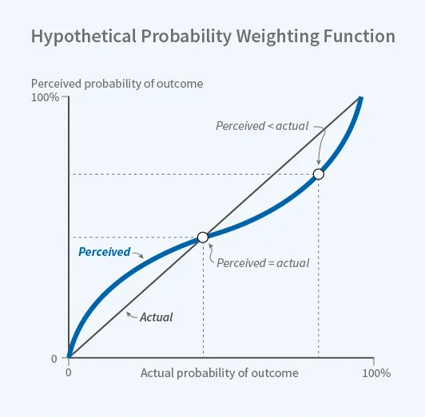
Probability weighing
EUT vs PT
EUT value function shows a linear relationship between actual and perceived probabilities.
Prospect Theory value function shows how people assign a too high probability for low probability events (left side of the line), and inversely assign too low probabilities for high probability events (right side of the curve).

Slide 52
Prospect Theory
Weighing function
Certainty effect: the slope of the π(pr) in the neighborhood of certainty is steep
The overweighting of low probabilities is greatest at the lowest probabilities
Notes:
We are risk averse but not with the lottery, because we love risk at low probs. On the other side, you would rather have certainty (100%) than 99% of a higher expected value.
People under invest in risky stocks. But they prefer savings of 3%. Index funds vs savings, savings is 100% safe and index funds is nearly 100%, yet most people choose savings.

