Slide 1
Machine learning
Ano Letivo 2026/2027

Slide 2
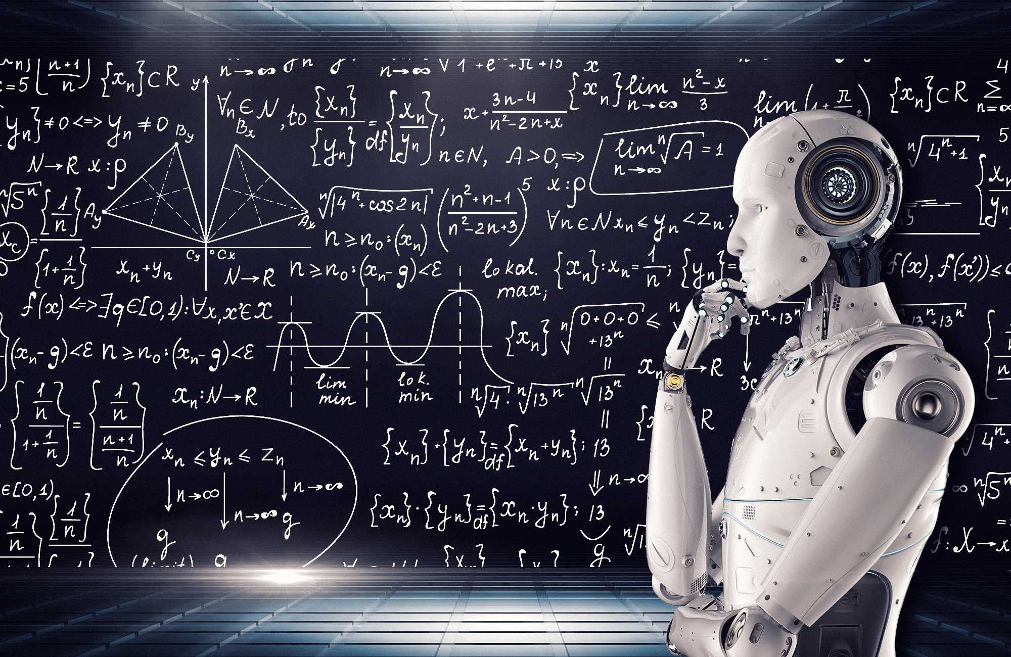
1. What is Machine Learning?

Slide 3
1. What is Machine Learning?
Branch of Artificial Intelligence
focuses on creating systems that can learn from data rather than relying on explicit programming.
Instead of writing step-by-step instructions we provide data and algorithms that detect patterns, make predictions, or group observations.

Slide 4
1. What is Machine Learning?
Key idea: Algorithms approximate relationships in data.
Common applications:
  forecasting demand,
  fraud detection,
  customer segmentation,
  recommendation systems,
  sentiment analysis.

Slide 5
2. Categories of Machine Learning
Supervised Learning
Unsupervised Learning
Reinforcement Learning

Slide 6
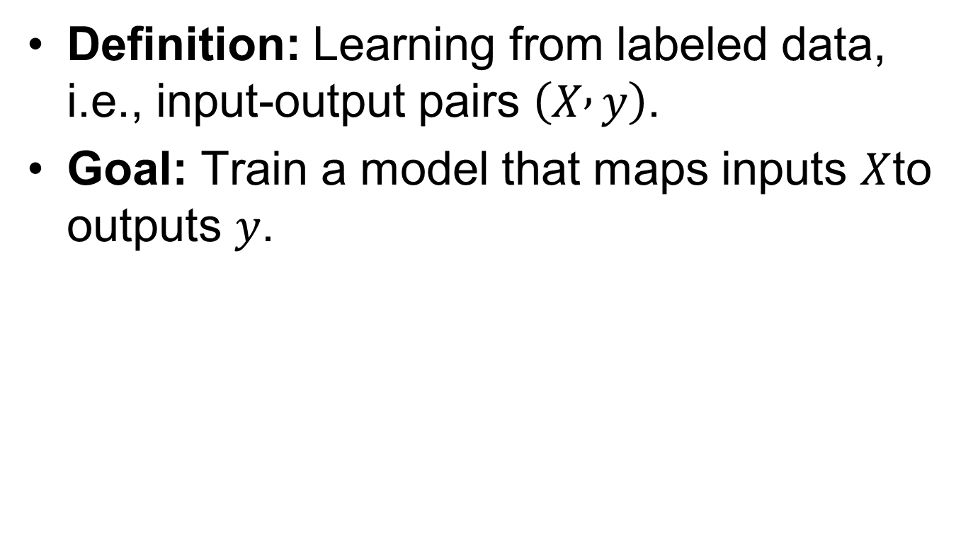
2.1 Supervised Learning
Definition: Learning from labeled data, i.e., input-output pairs $\left(X , y\right)$.
Goal: Train a model that maps inputs $X$to outputs $y$.

Slide 7
2.1 Supervised Learning
Examples:
  Predicting house prices (regression)
  Classifying emails as spam/not spam (classification)
Main algorithms: Linear Regression, Logistic Regression, Decision Trees, Random Forests, Support Vector Machines, Neural Networks.

Slide 8
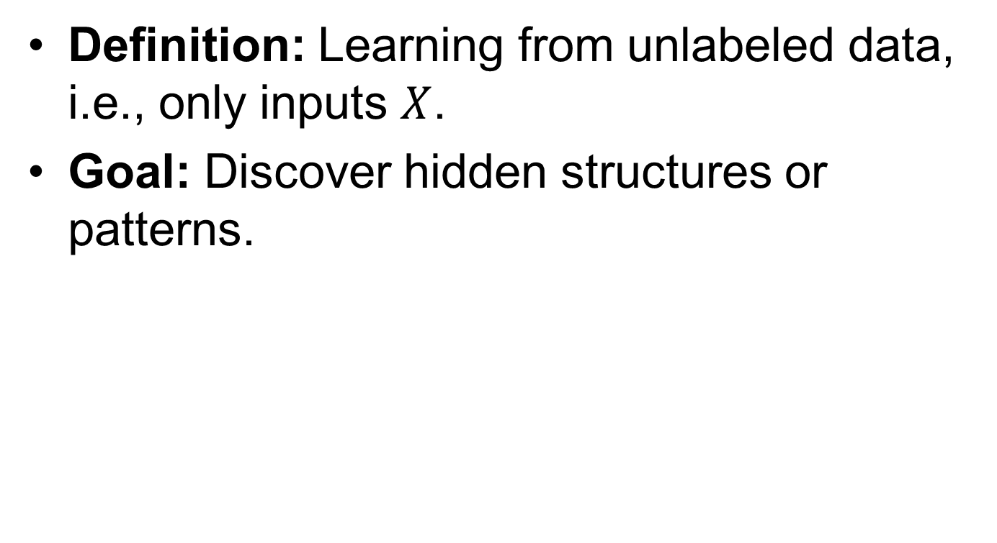
2.2 Unsupervised Learning
Definition: Learning from unlabeled data, i.e., only inputs $X$.
Goal: Discover hidden structures or patterns.

Slide 9
2.2 Unsupervised Learning
Examples:
  Customer segmentation (clustering)
  Topic modeling in documents
  Dimensionality reduction (e.g., PCA)
Main algorithms: K-Means, Hierarchical Clustering, PCA, t-SNE, Autoencoders.

Slide 10
Example of Regression
import numpy as np
import pandas as pd
from sklearn.model_selection import train_test_split
from sklearn.linear_model import LinearRegression
from sklearn.metrics import mean_squared_error, accuracy_score
np.random.seed(0)
X = np.random.rand(100, 1) * 10 # size in 0-10
y = 2.5 * X.squeeze() + np.random.randn(100) * 2 # price with noise
X_train, X_test, y_train, y_test = train_test_split(X, y, test_size=0.2)
model = LinearRegression().fit(X_train, y_train)
y_pred = model.predict(X_test)
print("Regression coefficients:", model.coef_, model.intercept_)
print("MSE:", mean_squared_error(y_test, y_pred))

Slide 11

Example of Regression (0/8)
This example illustrates Linear Regression to predict apartment prices based on size.
This is a key tool for managers to forecast and make data-driven decisions.

Slide 12
Example of Regression (1/8)
1. Import Libraries
pandas for data handling, sklearn for machine learning.
import pandas as pd
from sklearn.model_selection import train_test_split
from sklearn.linear_model import LinearRegression
from sklearn.metrics import mean_squared_error, r2_score
import matplotlib.pyplot as plt
import numpy as np

Slide 13
Example of Regression (2/8)
2. Create Sample Data
Let's simulate data: 'Size' (X) and 'Price' (y).
Imagine apartment sizes (e.g., 50-150 sq. meters) and their corresponding prices.
For consistent results
size = np.random.rand(100) * 100 + 50
Apartment sizes from 50 to 150
price = 200 * size + np.random.randn(100) * 10000 + 50000
df = pd.DataFrame({'Size_sqm': size, 'Price_EUR': price})
print("--- Sample Data (First 5 Rows) ---")
display(df.head())

Slide 14
Example of Regression (3/8)
3. Split Data for Training and Testing
We separate our data so the model learns from one part (training) and is tested on another (test).
This ensures the model can predict well on new, unseen data.
X = df[['Size_sqm']]
y = df['Price_EUR']
X_train, X_test, y_train, y_test = train_test_split(X, y, test_size=0.2, random_state=42)
print(f"\nTraining data points: {len(X_train)}, Testing data points: {len(X_test)}")

Slide 15
Example of Regression (4/8)
4. Train the Linear Regression Model
The model finds the best-fit line to describe the relationship between Size and Price.
model = LinearRegression()
model.fit(X_train, y_train)
print("\n Model Training Complete ")
print("\n Learned relationship:”,model.coef_[0],”* Size +”, model.intercept_)
print("\n Coefficient (Slope):, model.coef_[0])
print("\n Intercept (Base Price):, model.intercept_,” (Estimated price when size is zero)")

Slide 16
Example of Regression (5/8)
5. Make Predictions
Using the trained model to predict prices for our test apartments.
y_pred = model.predict(X_test)

Slide 17
Example of Regression (6/8)
6. Evaluate Model Performance
Mean Squared Error (MSE) measures how close our predictions are to actual prices.
Lower MSE indicates a more accurate model.
mse = mean_squared_error(y_test, y_pred)
print("Mean Squared Error (MSE): {mse} (Lower is better, indicates prediction accuracy)")

Slide 18
Example of Regression (7/8)
7. Visualize the Regression Line
A plot helps us see how well the line fits the data.
plt.figure(figsize=(10, 6))
plt.scatter(X_test, y_test, color='blue', label='Actual Prices')
plt.plot(X_test, y_pred, color='red', linewidth=2, label='Predicted Prices (Regression Line)')
plt.title('Apartment Price Prediction: Actual vs. Predicted')
plt.xlabel('Apartment Size (sq. meters)')
plt.ylabel('Apartment Price (EUR)')
plt.legend()
plt.grid(True)
plt.show()

Slide 19
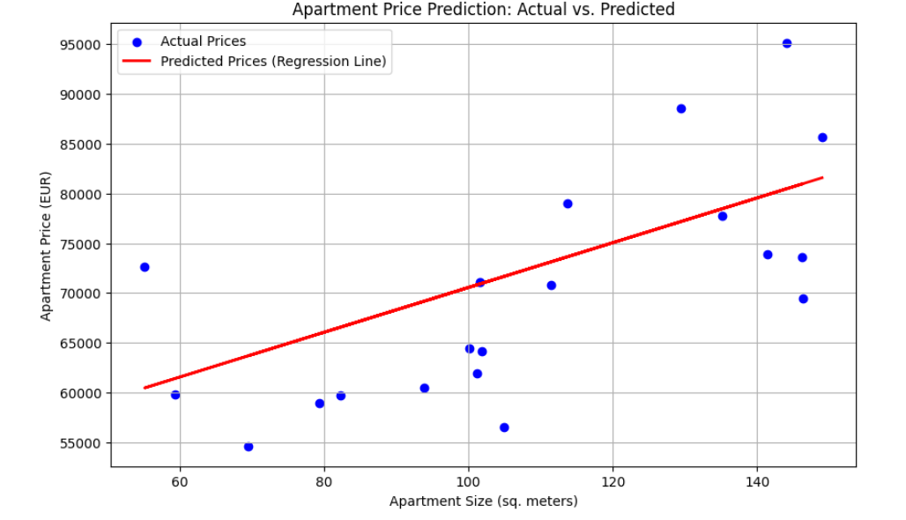
Example of Regression (8/8)

Slide 20

Example of Classification
Predicting pass/fail based on study hours

Slide 21
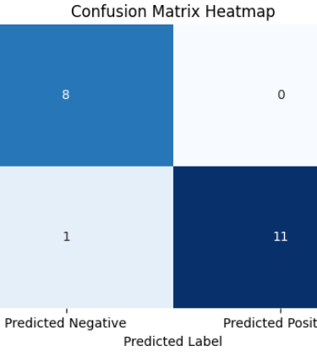
Example of Classification
import numpy as np
import pandas as pd
from sklearn.model_selection import train_test_split
from sklearn.linear_model import LogisticRegression
from sklearn.metrics import accuracy_score
hours = np.random.rand(100, 1) * 20
labels = (hours.squeeze() + np.random.randn(100)) > 10
X_train, X_test, y_train, y_test = train_test_split(hours, labels, test_size=0.2)
clf = LogisticRegression().fit(X_train, y_train)
y_pred = clf.predict(X_test)
print("Accuracy:", accuracy_score(y_test, y_pred))
Accuracy: 0.95

Slide 22
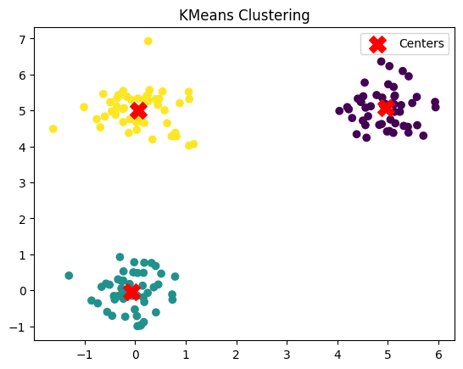
Example of Clustering
from sklearn.cluster import KMeans
import matplotlib.pyplot as plt
# Generate synthetic data: 3 clusters
np.random.seed(42)
X = np.vstack([
np.random.normal([0,0], 0.5, (50,2)),
np.random.normal([5,5], 0.5, (50,2)),
np.random.normal([0,5], 0.5, (50,2))
])
# Apply KMeans
kmeans = KMeans(n_clusters=3, random_state=0).fit(X)
labels = kmeans.labels_
# Visualization
plt.scatter(X[:,0], X[:,1], c=labels, cmap="viridis")
plt.scatter(kmeans.cluster_centers_[:,0], kmeans.cluster_centers_[:,1],
c="red", marker="X", s=200, label="Centers")
plt.title("KMeans Clustering")
plt.legend()
plt.show()

Slide 23

Sentiment Analysis
import nltk
from nltk.sentiment import SentimentIntensityAnalyzer
# Download VADER model (only needed once)
nltk.download('vader_lexicon')
# Initialize sentiment analyzer
sia = SentimentIntensityAnalyzer()
# Example texts
texts = [
"I love this product, it’s fantastic!",
"This is the worst experience I’ve ever had.",
"The movie was okay, not great but not terrible either.",
"Amazing customer support, very satisfied.",
"Totally disappointed, waste of money."
]
# Analyze each text
for t in texts:
score = sia.polarity_scores(t)
sentiment = "Positive" if score['compound'] > 0.05 else ("Negative" if score['compound'] < -0.05 else "Neutral")
print(f"Text: {t}\n Score: {score} → Sentiment: {sentiment}\n")
Notes:
Eventually
pip install nltk scikit-learn

Slide 24
Sentiment Analysis
from sklearn.feature_extraction.text import CountVectorizer
from sklearn.model_selection import train_test_split
from sklearn.naive_bayes import MultinomialNB
from sklearn.metrics import accuracy_score
# Example labeled dataset
reviews = [
"I love this phone", "This product is terrible",
"Fantastic quality, very happy", "Worst service ever",
"Not bad, but could be better", "Absolutely wonderful"
]
labels = [1, 0, 1, 0, 0, 1] # 1 = Positive, 0 = Negative
# Convert text into numerical features (Bag of Words)
vectorizer = CountVectorizer()
X = vectorizer.fit_transform(reviews)
# Split train/test
X_train, X_test, y_train, y_test = train_test_split(X, labels, test_size=0.3, random_state=42)
# Train Naive Bayes classifier
clf = MultinomialNB().fit(X_train, y_train)
y_pred = clf.predict(X_test)
print("Accuracy:", accuracy_score(y_test, y_pred))
print("Predictions:", y_pred)

Slide 25
Sentiment Analysis
How to use?
new_text = ["It is so good"]
X_new = vectorizer.transform(new_text)
prediction = clf.predict(X_new)
print("Prediction:", prediction)

Slide 26
4. Summary
Supervised Learning: learns from labeled data (prediction, classification).
Unsupervised Learning: finds hidden structures in unlabeled data (clustering, dimensionality reduction).
Python provides powerful libraries like scikit-learn for easy implementation.

