Slide 1
14th December 2021
Sustainability, Accountability and Ethics

Slide 2
Syllabus
Syllabus:
1 – Setting the context for sustainability accounting and accountability
2 – Accounting for sustainable development goals in different organizational settings
3 – Integrated reporting: strategic context, financial and non-financial data, value drivers and stakeholder’s mapping
4 – Analysing sustainability (ESG) reports: diversity of standards and measures
5 – Sustainability, organizational performance and reputation
6 – Reflecting on ethics in accounting and general business decision making

Slide 4
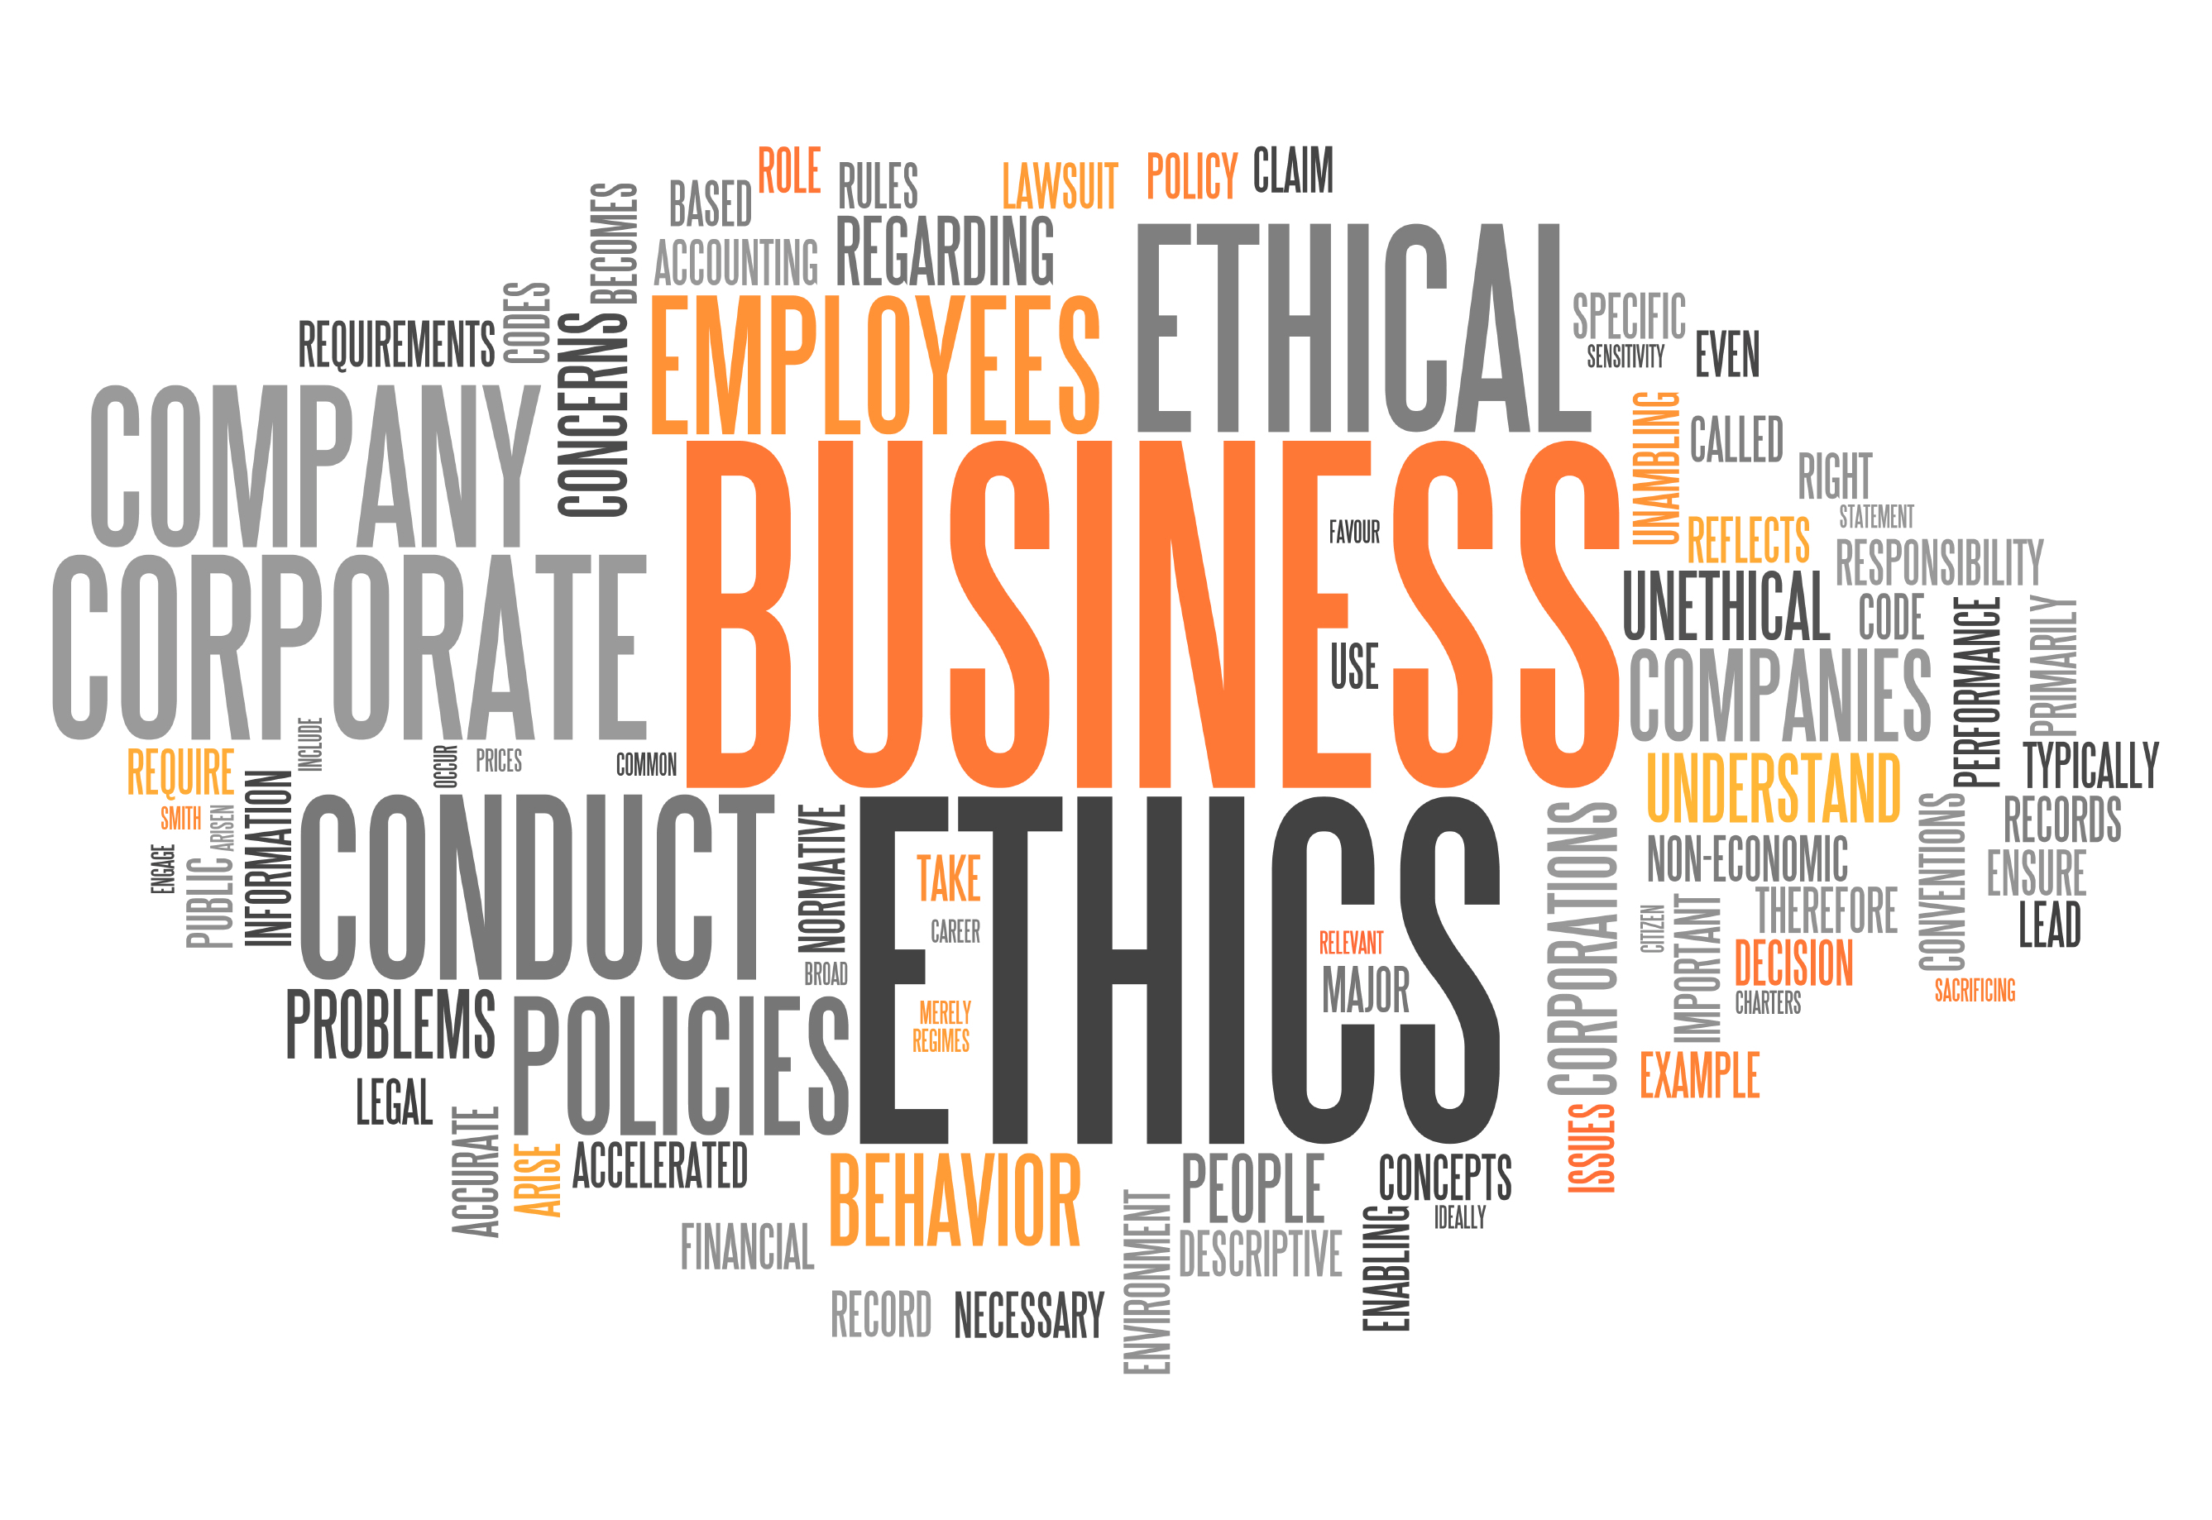
Business Ethics

Slide 6
Business Ethics
Business Ethics is simply the application of ethical and moral principles to the decisions we make in our workplace.
It is therefore important to have an idea about some of the theories of ethics that exist, since, by knowing their existence, we can make decisions more consciously.

Slide 7
Business Ethics
There are several definitions of ethics.
One of them is as follows:
Ethics is the activity that examines our moral standard or the moral standard of society, and that questions how these standards apply in our lives and whether they are reasonable or unreasonable.
Velasquez
It is thus evident that:
Ethical practices change over time and space
Ethics implies the ability to analyze and question the reasonableness of the prevailing morality in society, and then act...

Slide 8
Business Ethics
Some interesting concepts to reflect on:
“Moral" refers to the individual's set of goals, norms, beliefs, and values that are primarily derived from their religious and cultural traditions and their economic and social status.
''Ethics'' are moral values that an individual or group believes is good and correct in a specific situation.
"Personal ethics" reflect a person's individual beliefs
'Legal'' refers to behaviors and actions that are governed by a system of rules that are created and enforced by recognized authorities (Mallor et al. 2010). Laws are a formal statement of a society's values in the version codified by its government.

Slide 9
Business Ethics
One of the best-known authors academically and in consulting large companies on Business Ethics is Edward Freeman.

Slide 11
Business Ethics
Business ethics reflect the beliefs that have been agreed upon among members of a company, and which embody the collective sense of goals, norms, beliefs and values that should guide their decisions and actions in the workplace. All groups and organizations have ethics and all impose sanctions, implicit or explicit, to maintain adherence to these ethics. (Meyer et al., 2006).
Given the definition above, in the next 10 minutes, write some of your thoughts in your notebook regarding the following questions:
What are the agreed beliefs that you are able to see now? Can you identify?
What beliefs do you think should exist?

Slide 12
Business Ethics Theories
Ethics Theories
Selfishness
Deontology
Utilitarianism
Ethics of care
Virtue Ethics
The application of the theory of "Selfish" ethics implies the following premises of thought:
What makes something good or bad, right or wrong, is what satisfies your desires, or fulfills someone's needs
Basic principle: self-interest of the person who makes the decision or is affected by it
Choose the action that best meets your own interest.
Gregory B. Sadler, 2011

Slide 13
Módulo 10: Ética Empresarial
Business Ethics Theories
Ethics Theories
Selfishness
Deontology
Utilitarianism
Ethics of care
Virtue Ethics
The application of the theory of "Deontological" ethics implies the following thought premises:
What makes something good or bad, right or wrong, is whether or not it is in compliance with a duty.
Basic principle: Fulfillment of duties to yourself and to others
One should choose the action that is most in line with recognized duties
Gregory B. Sadler, 2011

Slide 14
Módulo 10: Ética Empresarial
Business Ethics Theories
Ethics Theories
The application of the "Utilitarian" theory of ethics implies the following thought premises:
What makes something good or bad, right or wrong, is that decision that produces the greatest amount of pleasure (or the absence of pain) for the greatest number of people.
Basic Principle: "The Global Happiness Principle"
Maximizing positive results for the greatest number of people, and getting negative results for the least number of people
One must choose the action that will lead to the greatest happiness (ie, the pleasure, the absence of pain) overall
Our pleasure and pain counts as much as that of others
Selfishness
Deontology
Utilitarianism
Ethics of care
Virtue Ethics
Gregory B. Sadler, 2011

Slide 15
Módulo 10: Ética Empresarial
Business Ethics Theories
Ethics Theories
Selfishness
Deontology
Utilitarianism
Ethics of care
Virtue Ethics
The application of the theory of ethics “of Caring”, implies the following thought premises:
What makes something good or bad, right or wrong, is that action that involves taking care of another, and supporting the relationship with other people
Basic principle: actions that care for those who are vulnerable or in need of support
One should choose the action that supports or encourages other people, especially those who are most vulnerable (eg children and workers)
Gregory B. Sadler, 2011

Slide 16
Módulo 10: Ética Empresarial
Business Ethics Theories
Ethics Theories
Selfishness
Deontology
Utilitarianism
Ethics of care
Virtue Ethics
The application of the theory of ethics "of Virtue", implies the following thought premises:
What makes something good or bad, right or wrong, is that action that actually embodies or promotes traits culturally recognized as good or bad
These, in turn, lead to a greater or lesser realization of the potential for fully human life ("flourishing")
Basic principle: reflexive or productive actions of good or bad character, embodied in developed and lasting traits or habits
Gregory B. Sadler, 2011

Slide 17
Business Ethics Theories
Ethics Theories
Selfishness
Deontology
Utilitarianism
Ethics of care
Virtue Ethics
The theory of ethics of "virtue" emphasizes the moral character of Man's actions and the ability of people to develop a good character that allows them to be kind, generous and willing to help others.
This theory also emphasizes the need to know how to break with the bad character habits of the past, such as greed and envy.
In this theory, rules and laws are not the main guarantee of ethical behavior. The concept of virtue ethics is based on the idea that the individual should choose his inner character, his self, rather than based exclusively on existing rules, culture and customs. If a person's character is good, then that person's choices are also good. This theory focuses attention on the individual and not on popular opinions prevailing in society.
Gregory B. Sadler, 2011

Slide 19
Individual Work -1hour
Read this article:
https://www.wgu.edu/blog/ethical-dilemmas-how-scandals-damage-companies1909.html#close
Chose one of the companies refered in the article
Look for information about the case
Try to identify which theory of ethics was underlying the decision making process and justify your choice
You can write up to 400 words
Send it to: sofia.santos2050@gmail.com

Slide 20
Readings
https://www.floridatechonline.com/blog/business/the-5-biggest-ethical-issues-facing-businesses/
https://www.forbes.com/sites/theyec/2021/04/30/eight-common-ethical-dilemmas-business-owners-face-and-how-to-overcome-them/?sh=1c1e72c53fb3

