Slide 1
Intermediate Microeconomics: An Intuitive Approach with Calculus, 1e
Chapter 23 – Monopoly

Slide 2
Monopoly Power
When firms are sufficiently “small” relative to the economic environment (i.e., there are many small firms), they cannot influence prices and are said to have no market power.
Market power implies the power to at least partially shape the economic environment that is characterized by prices – and for firms, it means that they face downward-sloping demand curves for their output.
The most extreme form of market power is monopoly power that derives from a firm’s unique position as the only one to serve a market.
Two primary conditions are required in order for a firm to sustain monopoly power: (1) it must produce a product that has no close substitutes, and (2) it must be protected from potential competitors by high barriers to entry into the industry.
A firm that has monopoly power tends to reduce output in order to raise price, and it is that tendency that creates deadweight losses.
When they are able to, monopolies can also use pricing strategies to increase monopoly profit – engaging in particular in one of three types of price discrimination.

Slide 3
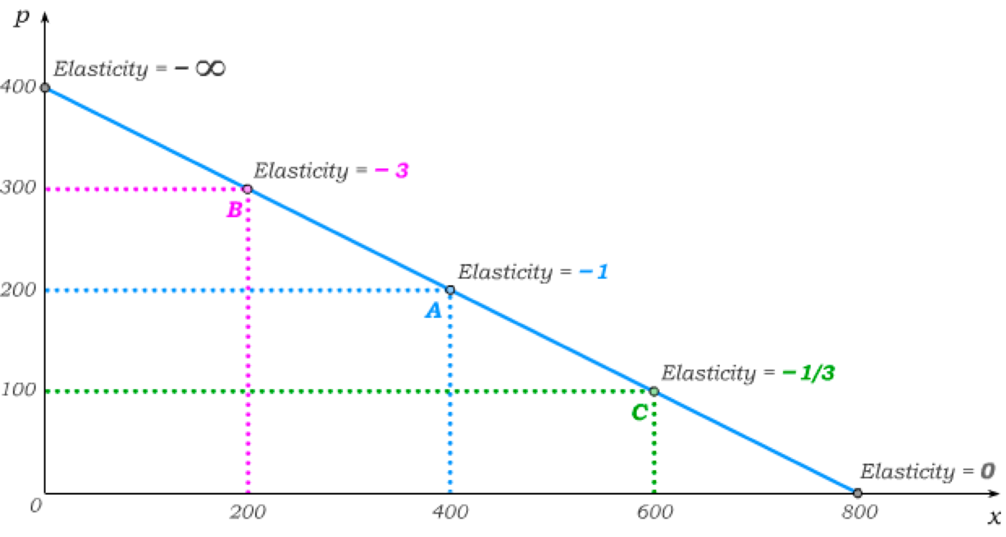
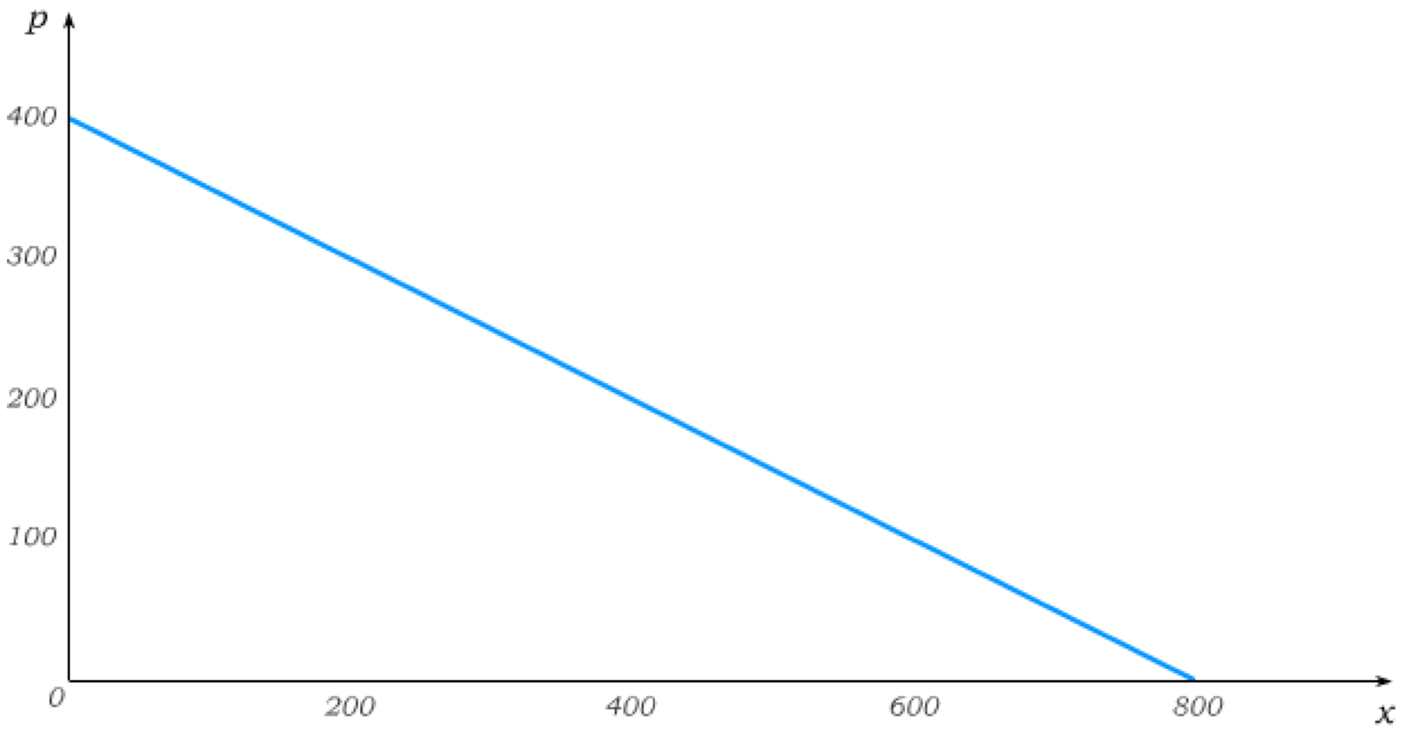
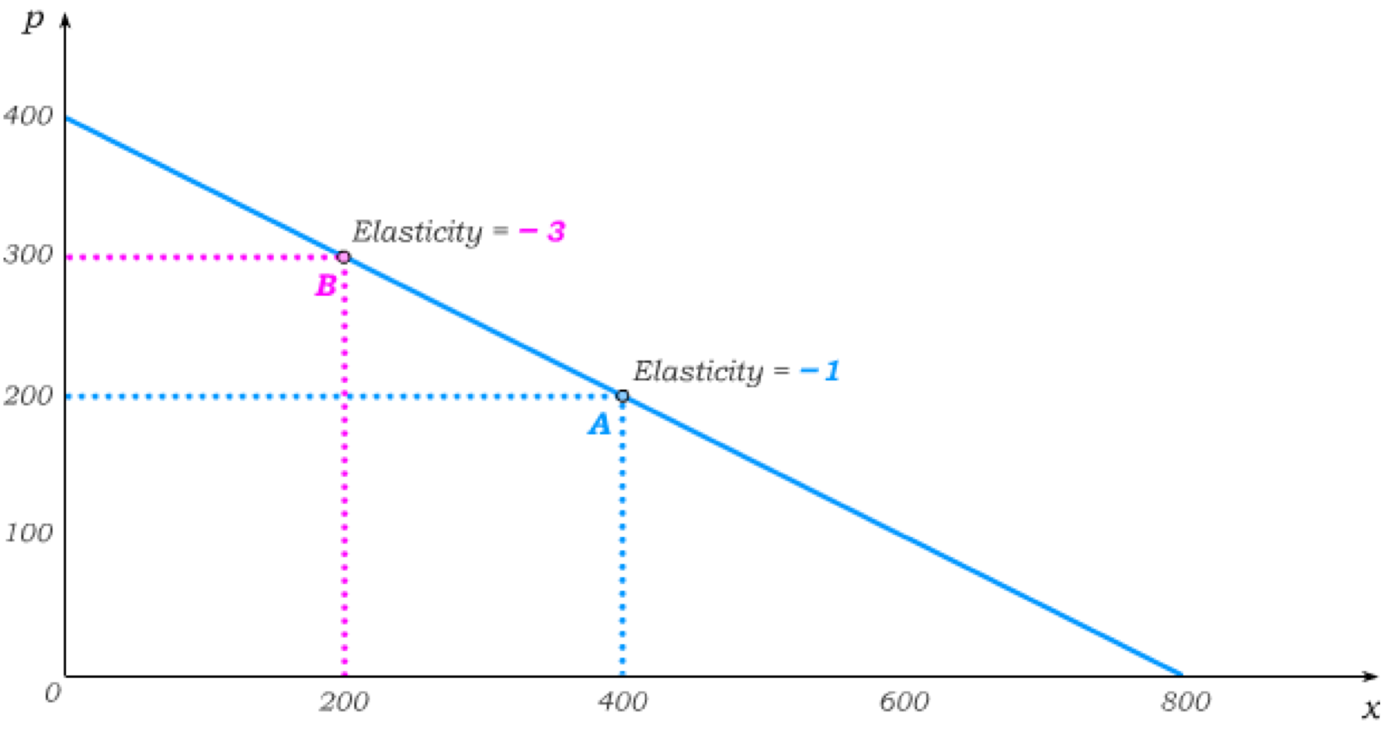
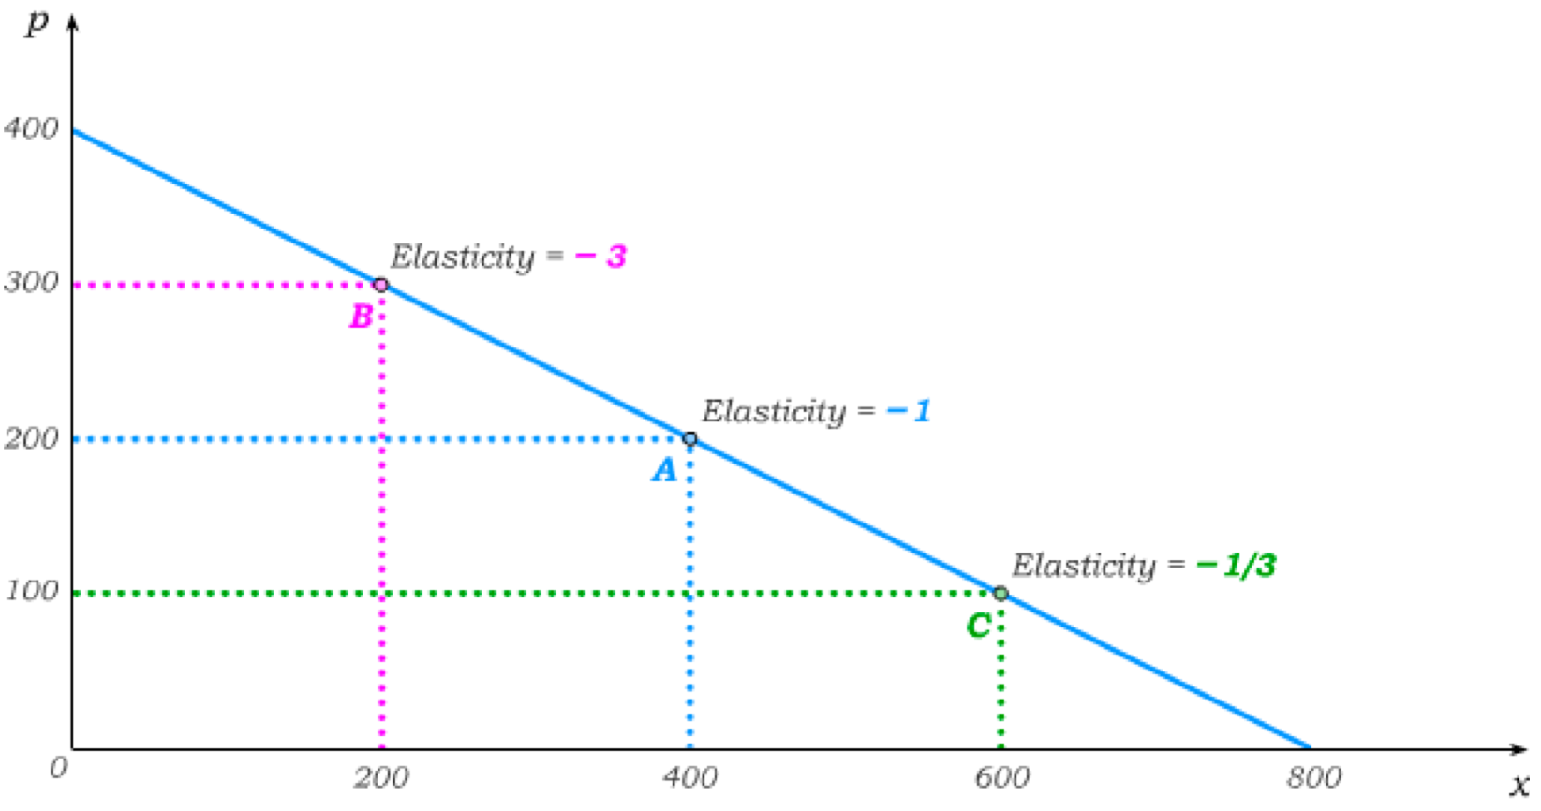
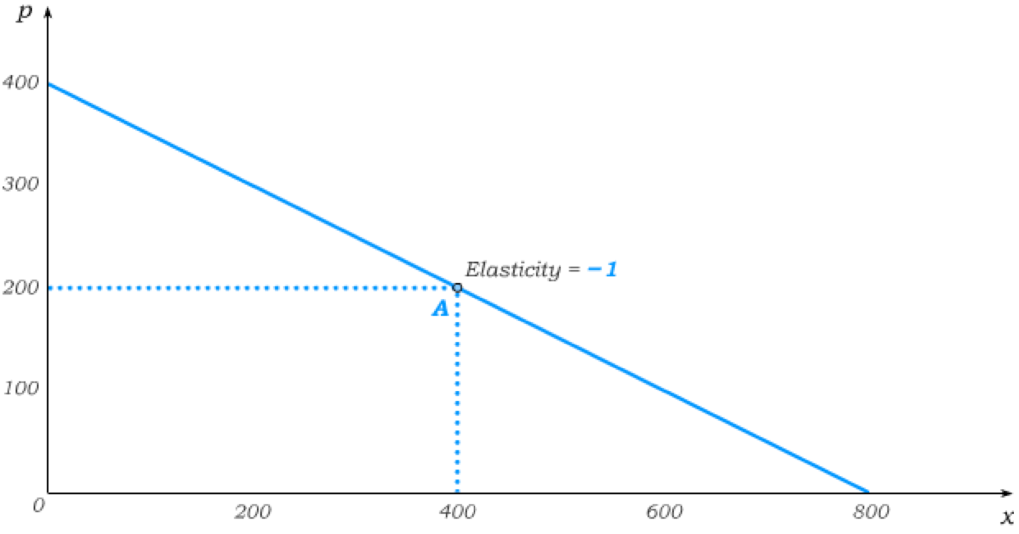
Review of Price Elasticity and Linear Demand
Along a linear demand curve, price elasticity varies along the demand curve.
Around the midpoint A of this demand curve, a 1% increase in price is 2, which causes the quantity demanded to drop by 4 – a 1% drop. Thus, price elasticity at the midpoint is –1.
Around B, a 1% increase in price is 3, which causes the quantity demanded to drop by 6 – a 3% drop from 200. Thus, price elasticity at B is –3.
Around C, a 1% increase in price is only 1, which causes the quantity demanded to drop by 2 – a (1/3)% drop from 600. Thus, price elasticity at C is –1/3.
Along a linear demand curve, the price elasticity goes from minus infinity at the vertical intercept to –1 at the midpoint to 0 at the horizontal intercept.

Slide 4
Review of Price Elasticity and Linear Demand
We will define the price elasticity of –1 as the dividing point between relatively inelastic and relatively elastic demand.
Along the price elastic part of demand, a 1% increase in price leads to more than a 1% decrease in quantity demanded.
And along the price inelastic part of demand, a 1% increase in price leads to less than a 1% decrease in quantity demanded.
price elastic
price inelastic

Slide 5
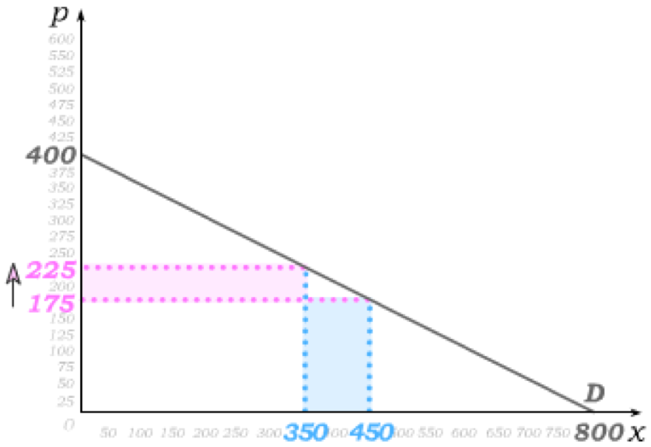
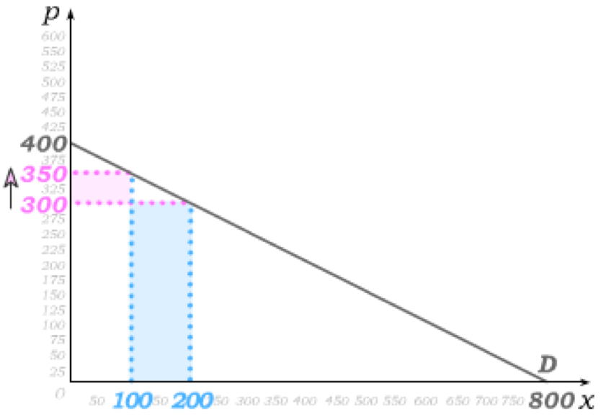
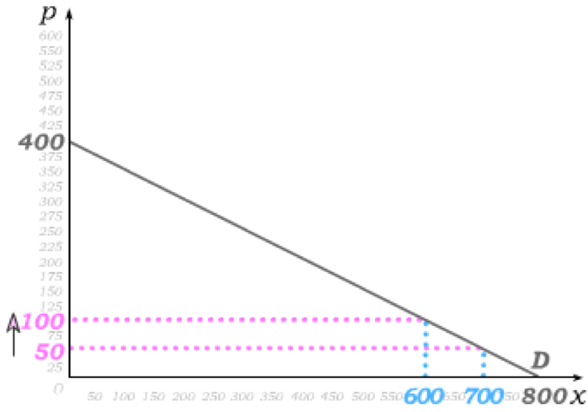
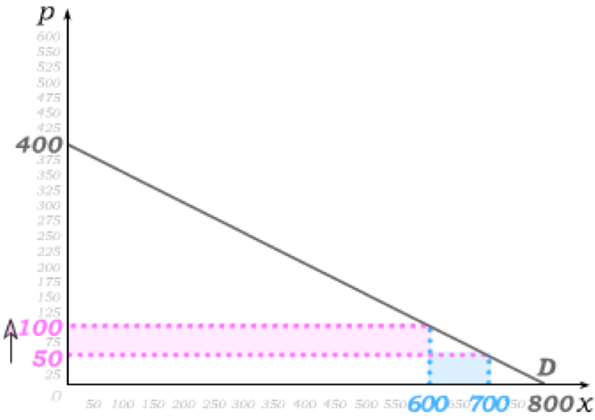
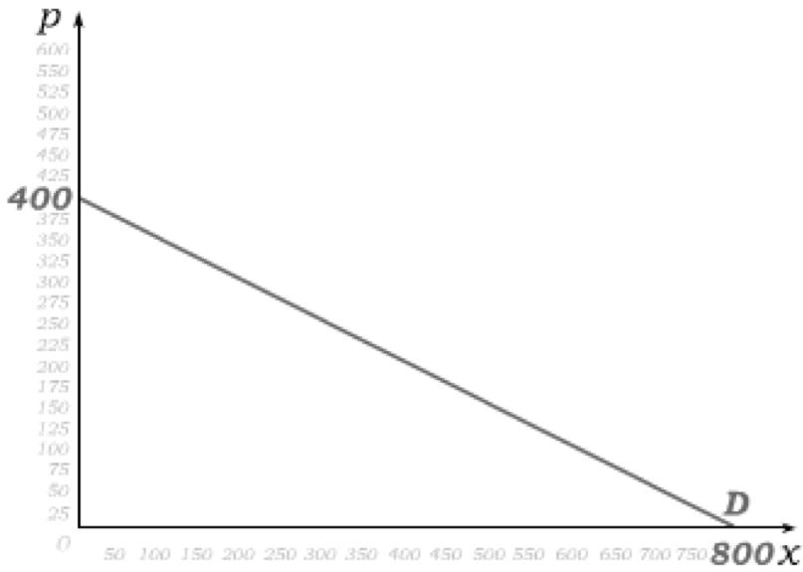
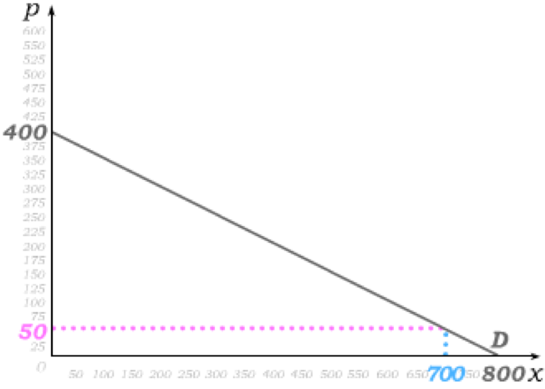
Price Elasticity and Firm Revenue
We can then identify a relationship between price elasticity and changes in revenue for firms facing downward sloping demand.
Suppose we begin at a price that places us on the inelastic portion of demand and price increases by €50.
The shaded blue area is the decrease in revenue from the lower quantity demanded while the shaded magenta area is the increase in revenue from the higher price.
The shaded blue area becomes equal to the shaded magenta area around the midpoint of the linear demand curve …
… and larger along the price elastic part of demand.
Price inelastic => an increase in price
leads to more revenue.
price elastic
Elasticity = –1 => an increase in price
leads to no Δ in revenue.
price inelastic
Price elastic => an increase in price
leads to less revenue.

Slide 6
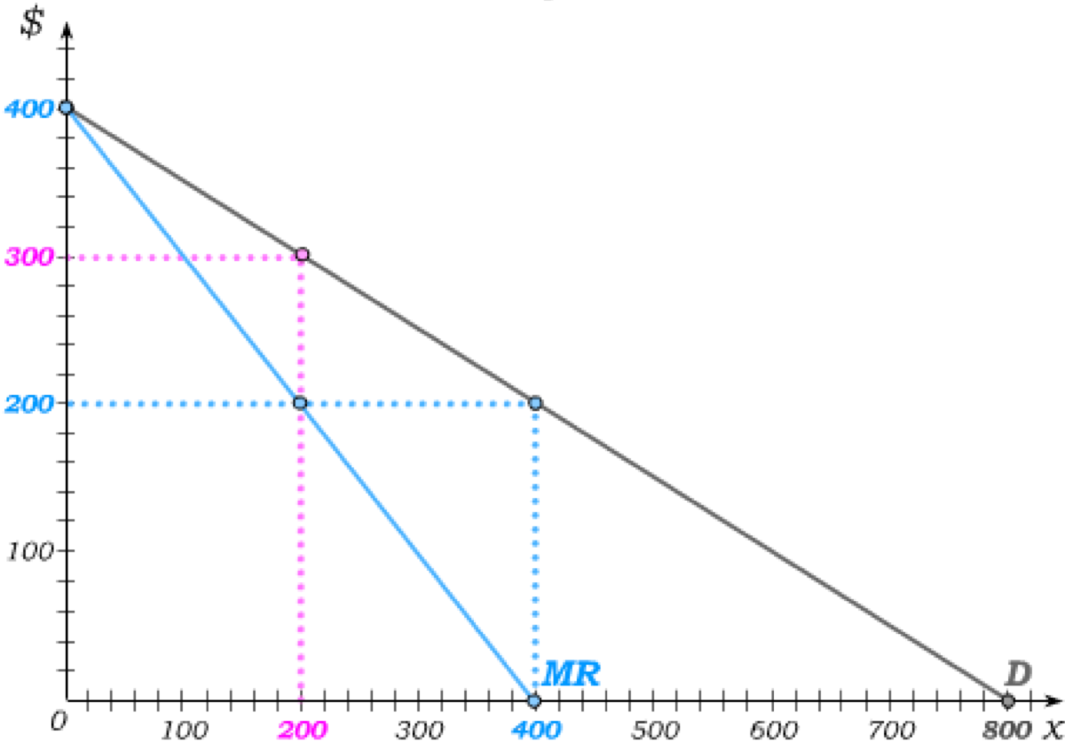
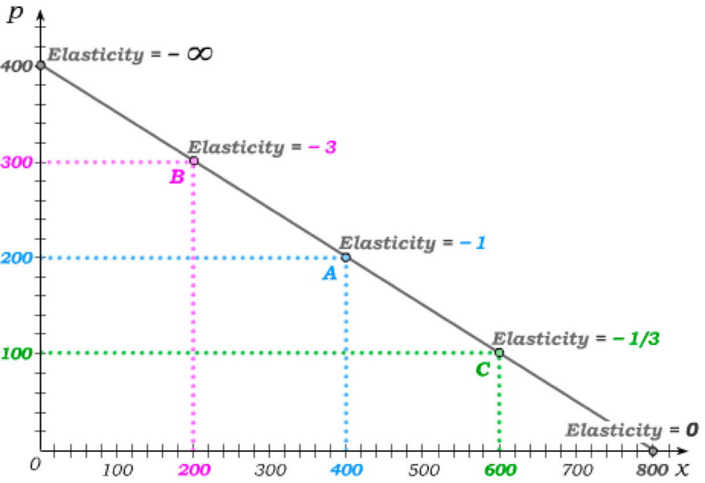
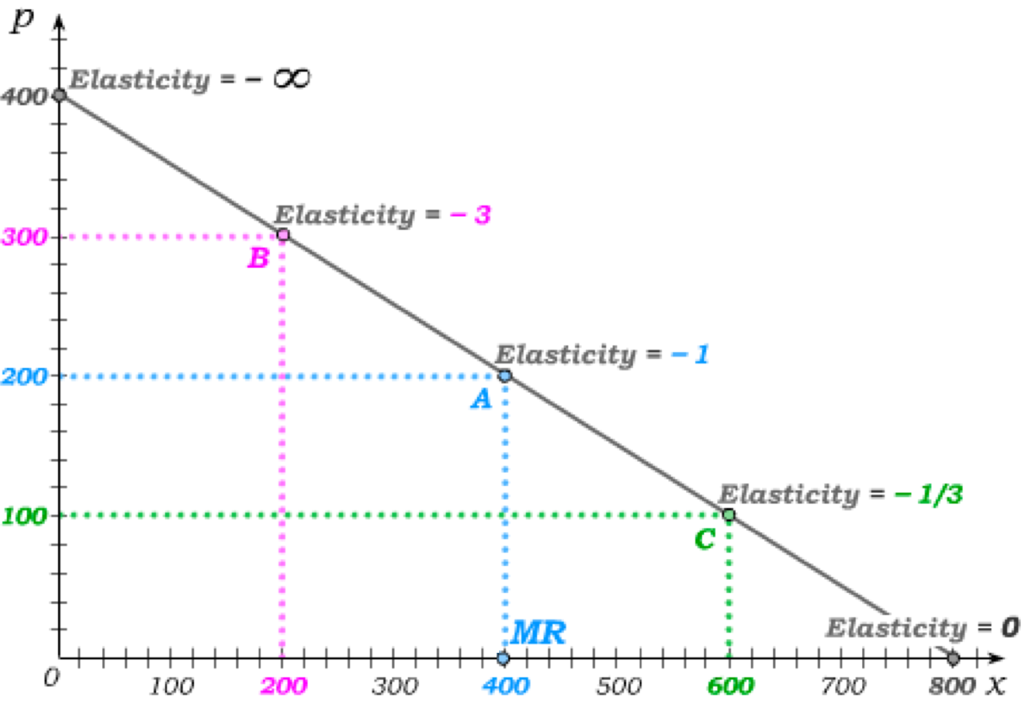
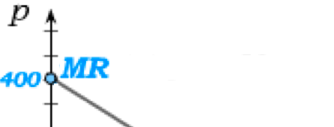
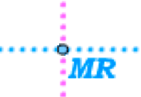
Marginal Revenue on a Linear Demand Curve
If the firm only produces 1 good, it can sell that good at €400.
Price inelastic => an increase in price
leads to more revenue.
Thus, the marginal revenue (MR) of the first good is €400 – equal to the intercept of the demand curve.
Elasticity = –1 => an increase in price
leads to no Δ in revenue.
€
At the midpoint of the demand curve (at 400 units), the price elasticity is –1. Thus, the MR at 400 units is zero. Indeed, at 399 units, two additional units would cause price to fall by €1. This implies a loss of €399 (on the first 399 units) and a gain of ~€400 (on the two additional units)
At 199 units of output, two additional units of output would similarly cause price to fall by €1.
This implies a loss of €199 (on the first 199 units) and a gain of ~€600 (on the two additional units).
The MR at 200 units is therefore €200.
The MR curve for a linear demand curve has the same intercept as D but twice the slope.

Slide 7
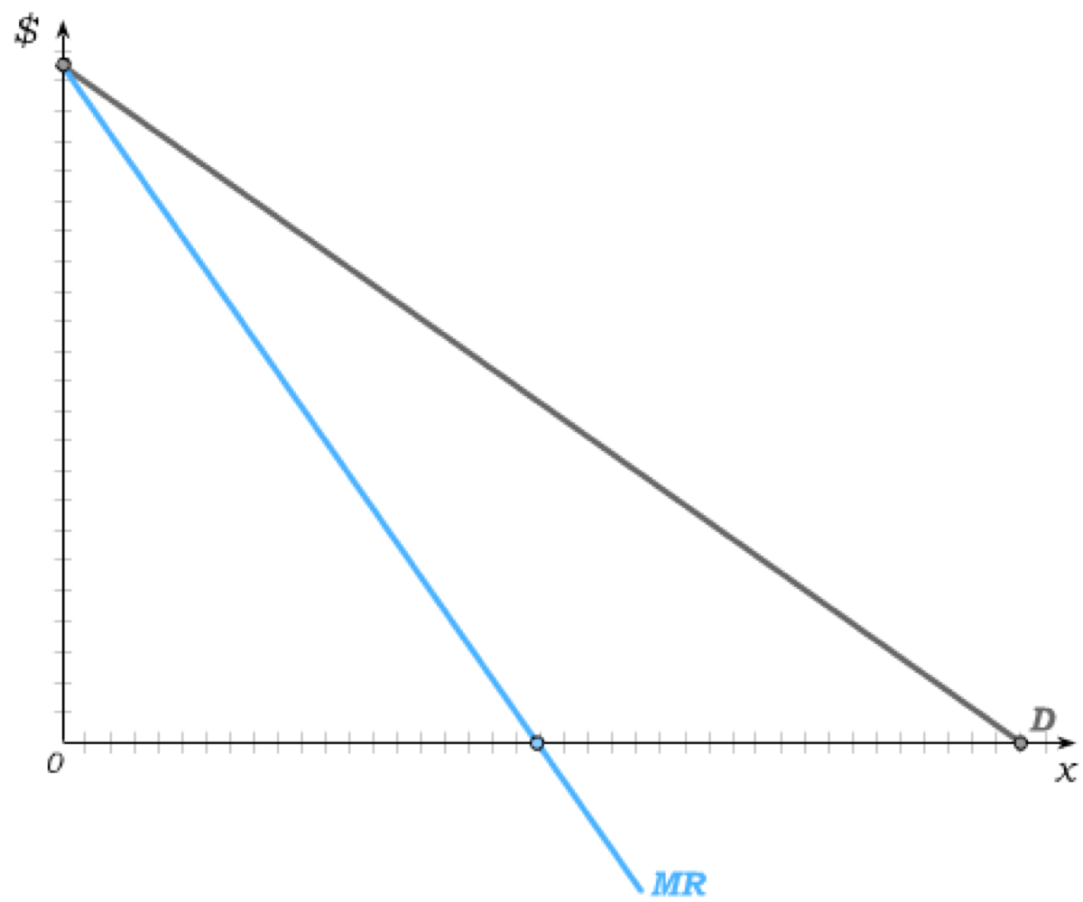
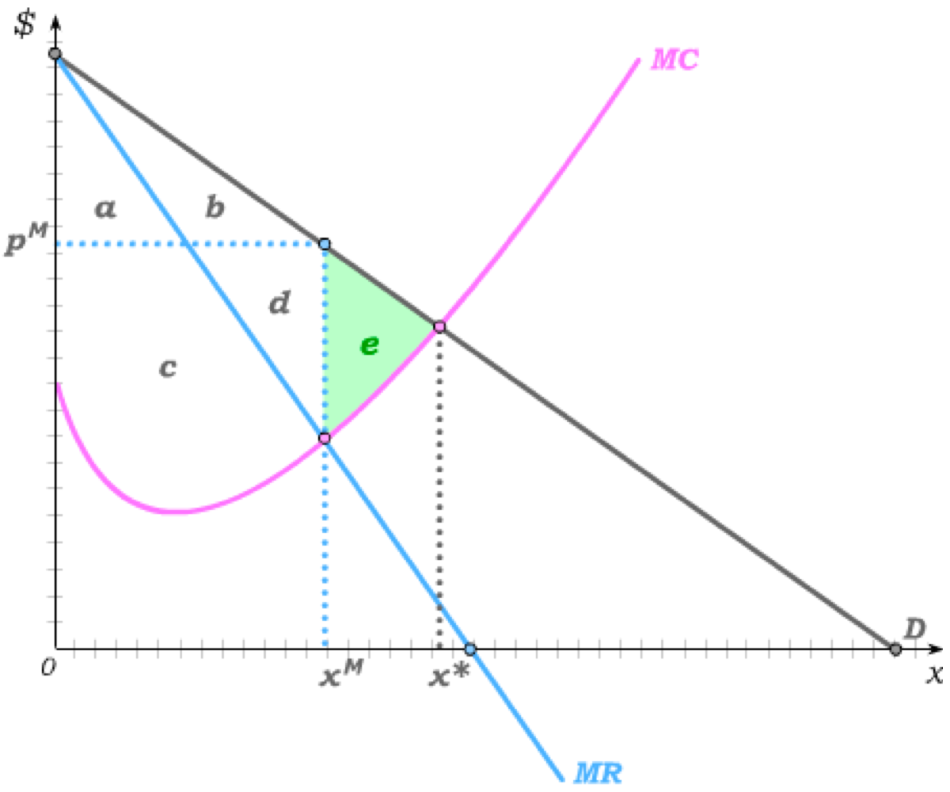
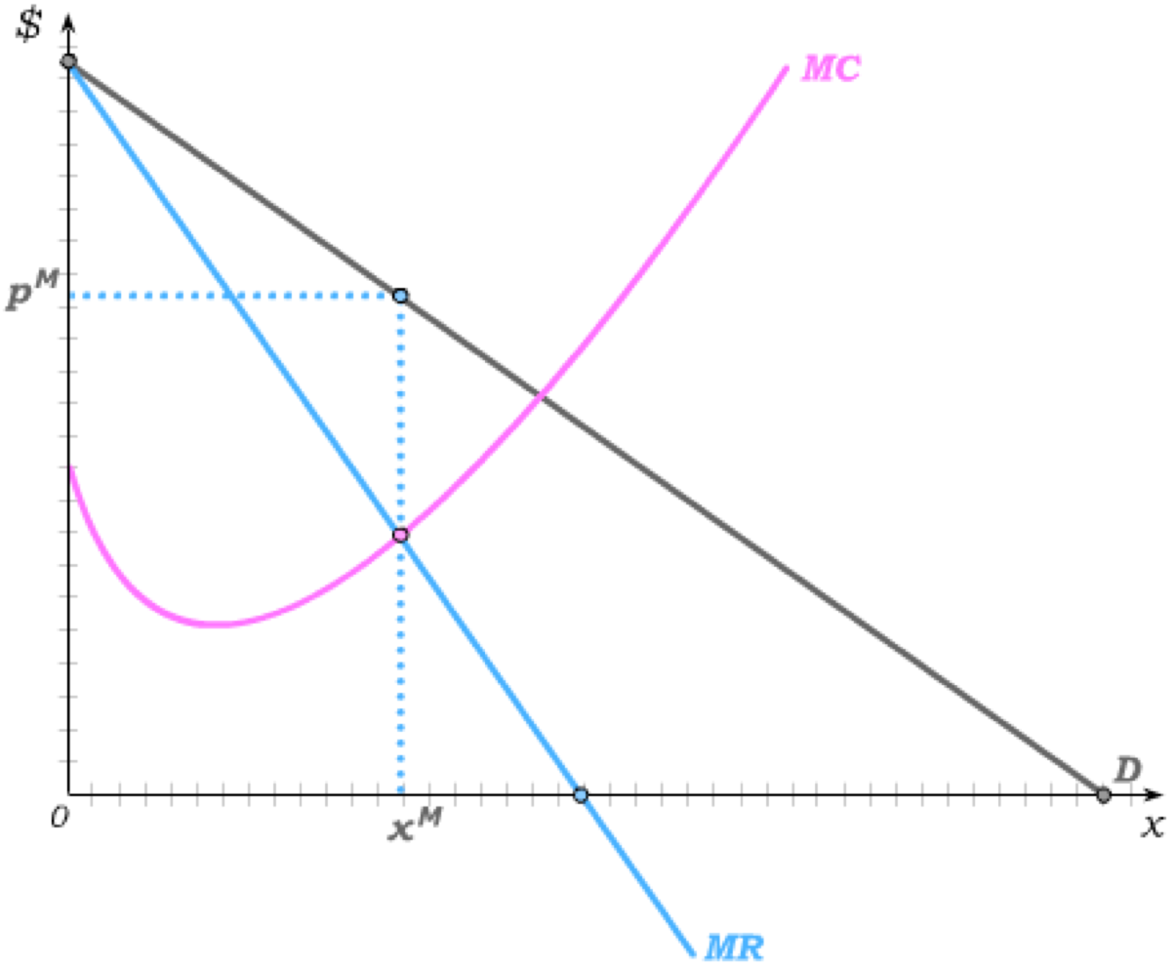
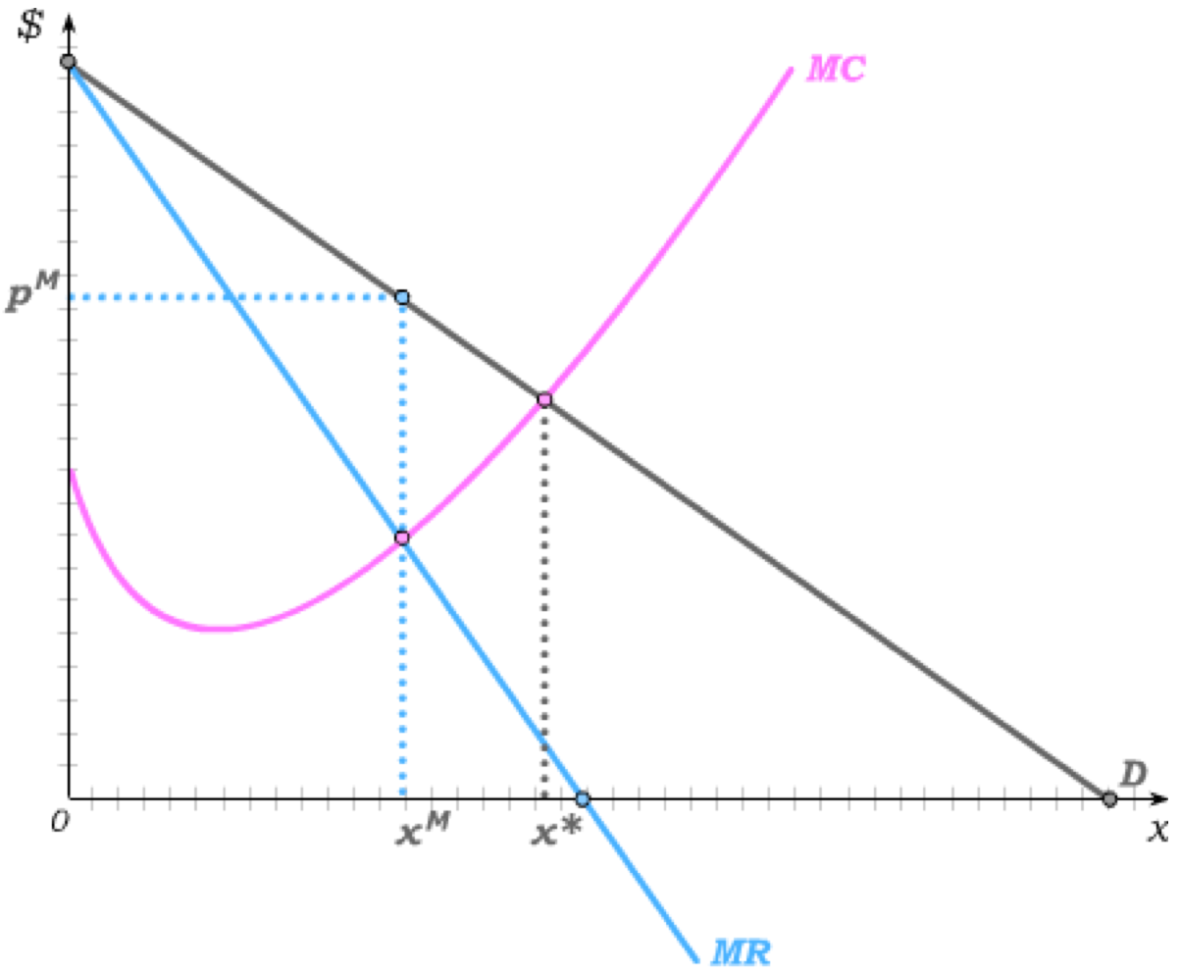

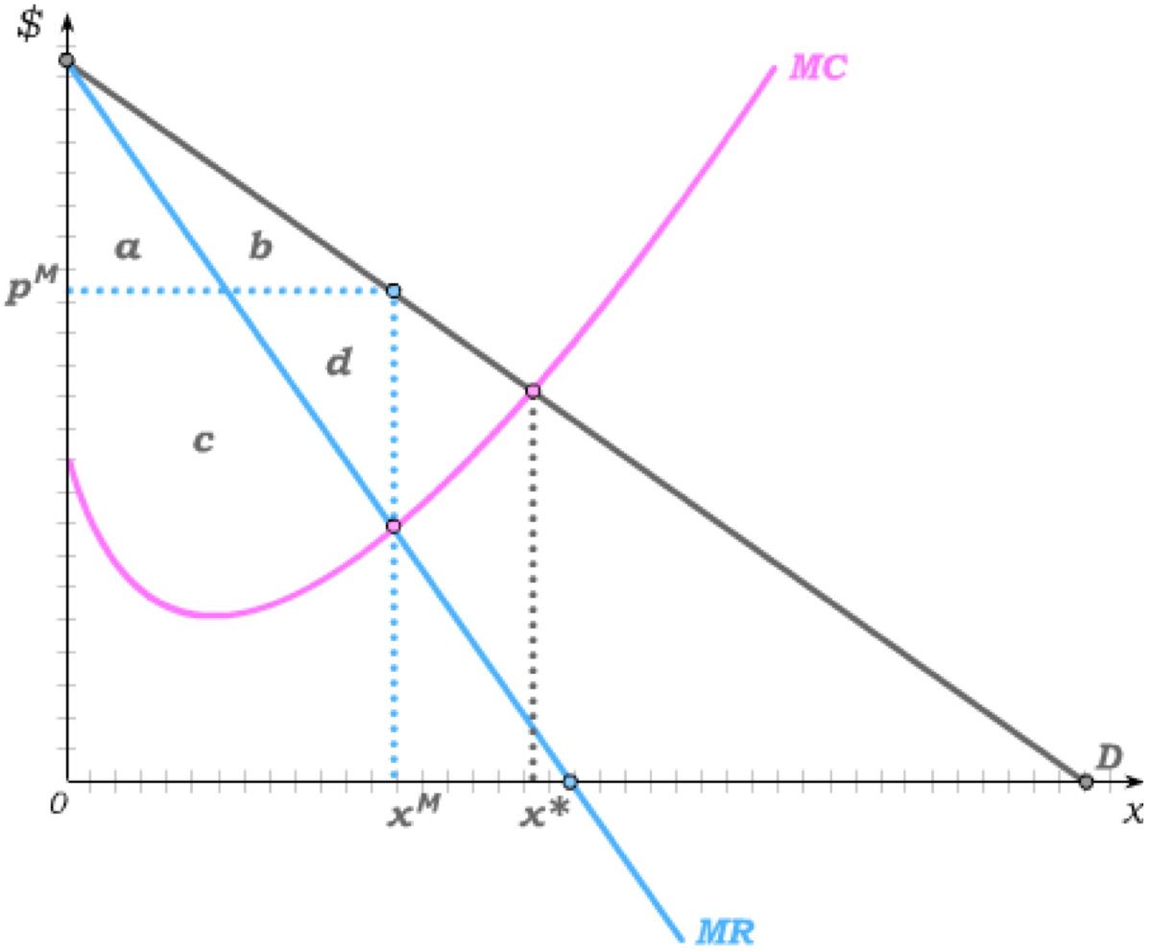
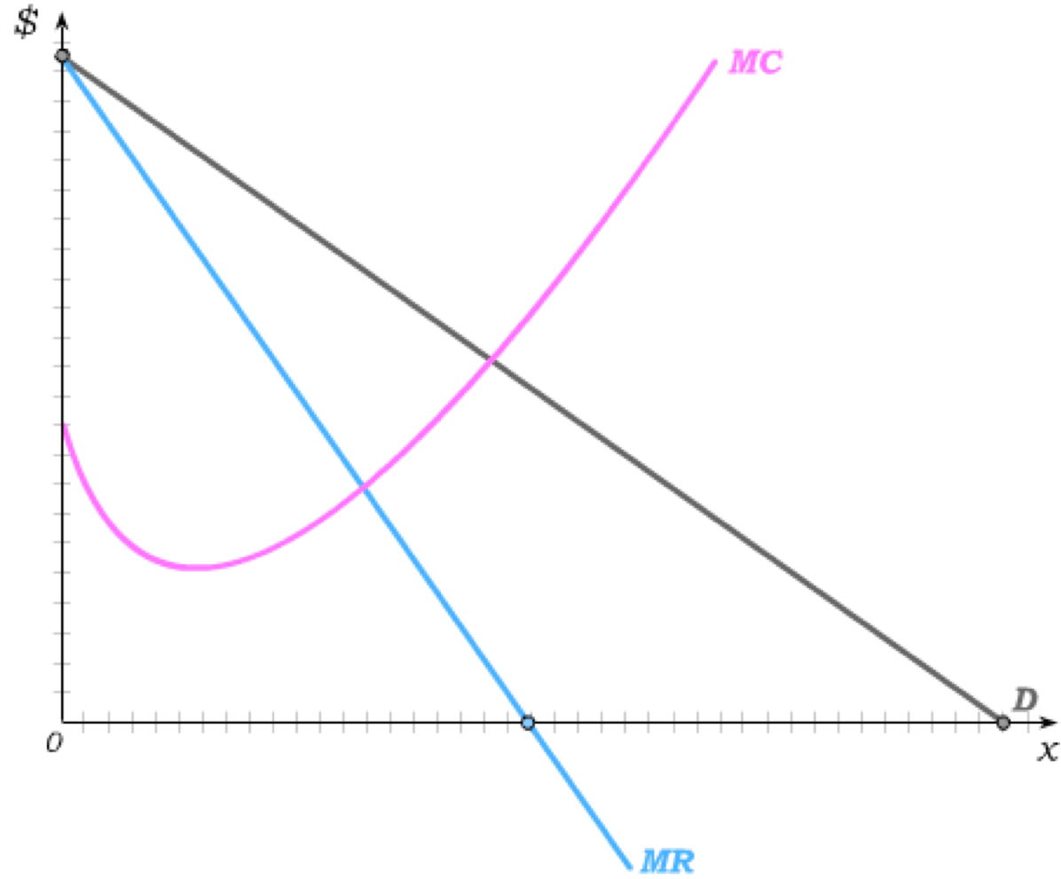
Inefficiency of Monopoly Production
The monopolist then has a downward sloping MR curve whereas the (price-taking) competitive firm’s MR curve was horizontal at the market-determined price.
But so long as a monopolist is a price-taker in the input markets (for labour and capital), her cost curves are derived exactly as they are for a competitive firm.
Profit is maximized at the output level x^{M} where MC=MR, with the monopoly price read off the demand curve as p^{M}.
€
Thus, both competitive firms and monopolists produce where MC=MR, but only for price-taking firms is MR=p resulting in MC=p.
The efficient output level is x* where MC=D.
Consumer Surplus = a+b
Producer Surplus = c+d
Deadweight Loss = e
The inefficiency emerges because monopolists restrict output in order to raise price.

Slide 8



Monopolies Produce on Inelastic Portion of D
A profit maximizing monopolist will produce the most if she faces no MC.
In that case, MC crosses MR on the horizontal axis – exactly below the midpoint of the demand curve,
where price elasticity is –1.
In this special case, profit maximization is identical to revenue maximization (because the firm has no costs) – and we know revenue is maximized where price elasticity is –1.
€
But even the slightest positive MC results in production on the price-elastic part of demand.
Price-elastic
Revenue maximization still occurs where price elasticity is –1, but profit maximization now implies less production.
Price-inelastic
The monopolist will never produce on the price-inelastic part of demand – because an increase in price on that part of demand results in an increase in revenue (and a decrease in costs as less is produced.)
MC

Slide 9
Price Discrimination
We have seen that monopolies can profit from reducing output to raise price.
But we have assumed that monopolies can set only one price.
Often monopolies can find ways of charging different prices to different types of consumers (e.g., high demanders vs. low demanders), and price discriminate.
To successfully price discriminate, monopolies have to be able to prevent resale of their products by those who buy at relatively low prices to those who are offered high prices.
If they can prevent resale, price discrimination further depends on the ability of monopolists to tell high demanders from low demanders.
If they can observe individual demands, monopolists can engage in perfect (1st degree) or imperfect (3rd degree) price discrimination.
Alternatively, if they only know the distribution of demands in the population, monopolists can strategically set price/quantity packages in ways that cause high demanders and low demanders to reveal who they are. This type of strategic price discrimination is called 2nd degree price discrimination.

Slide 10
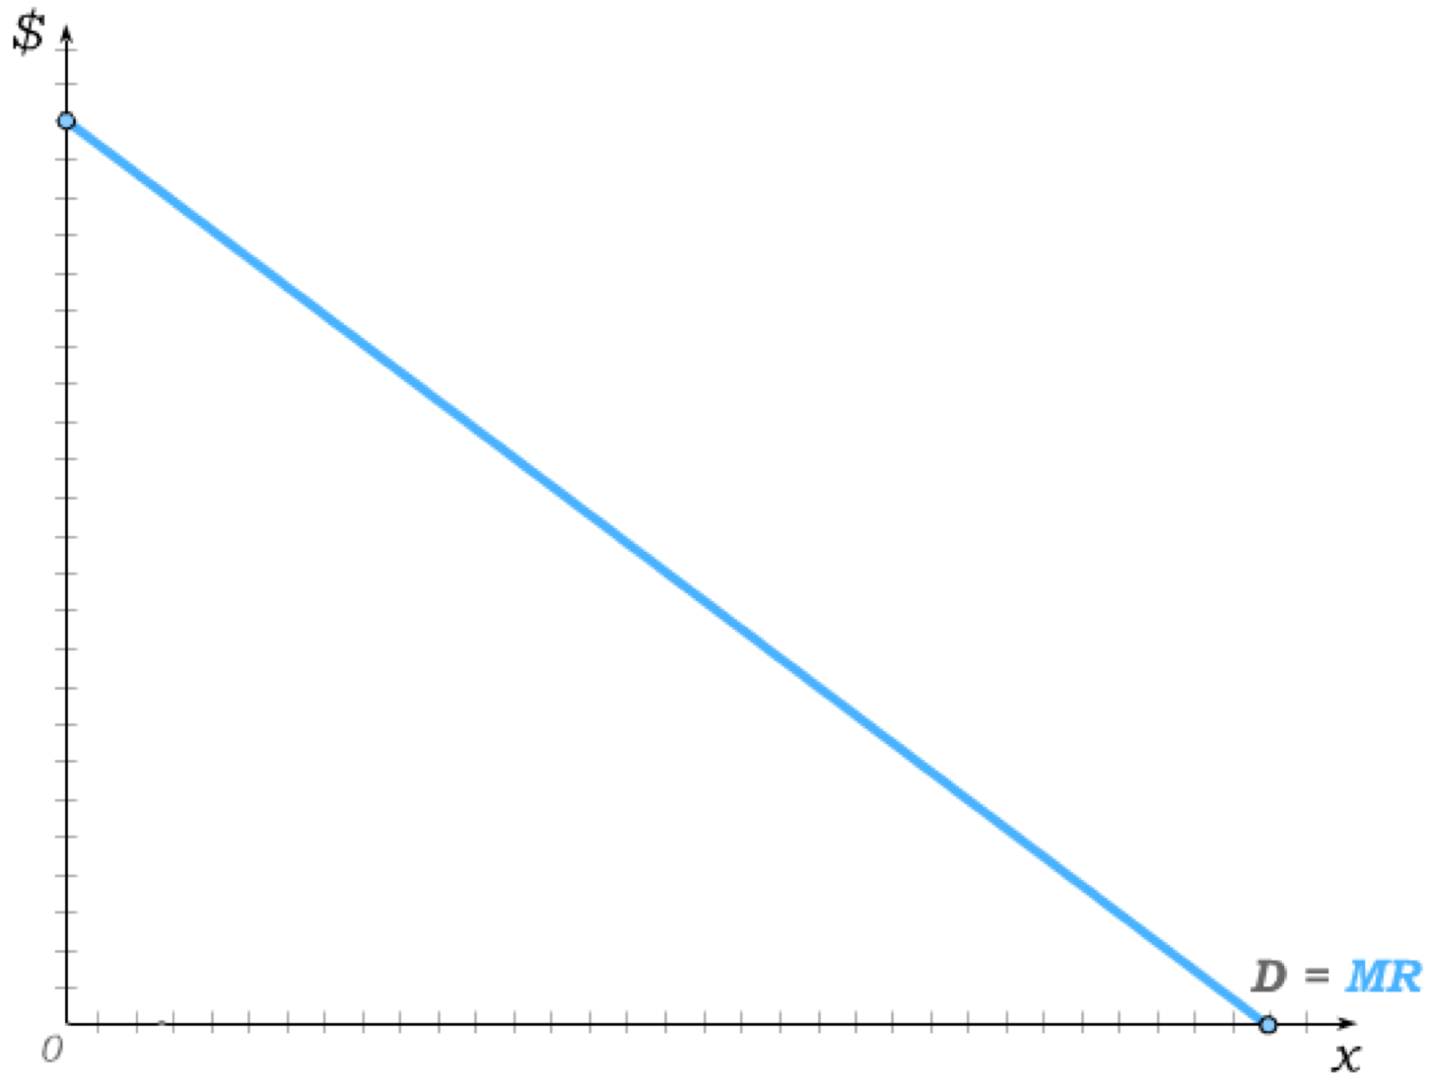
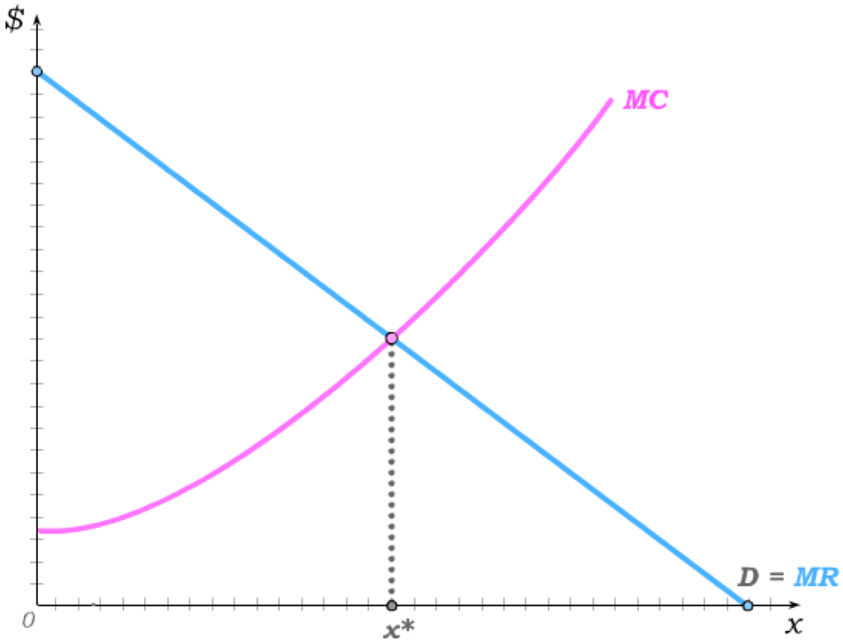
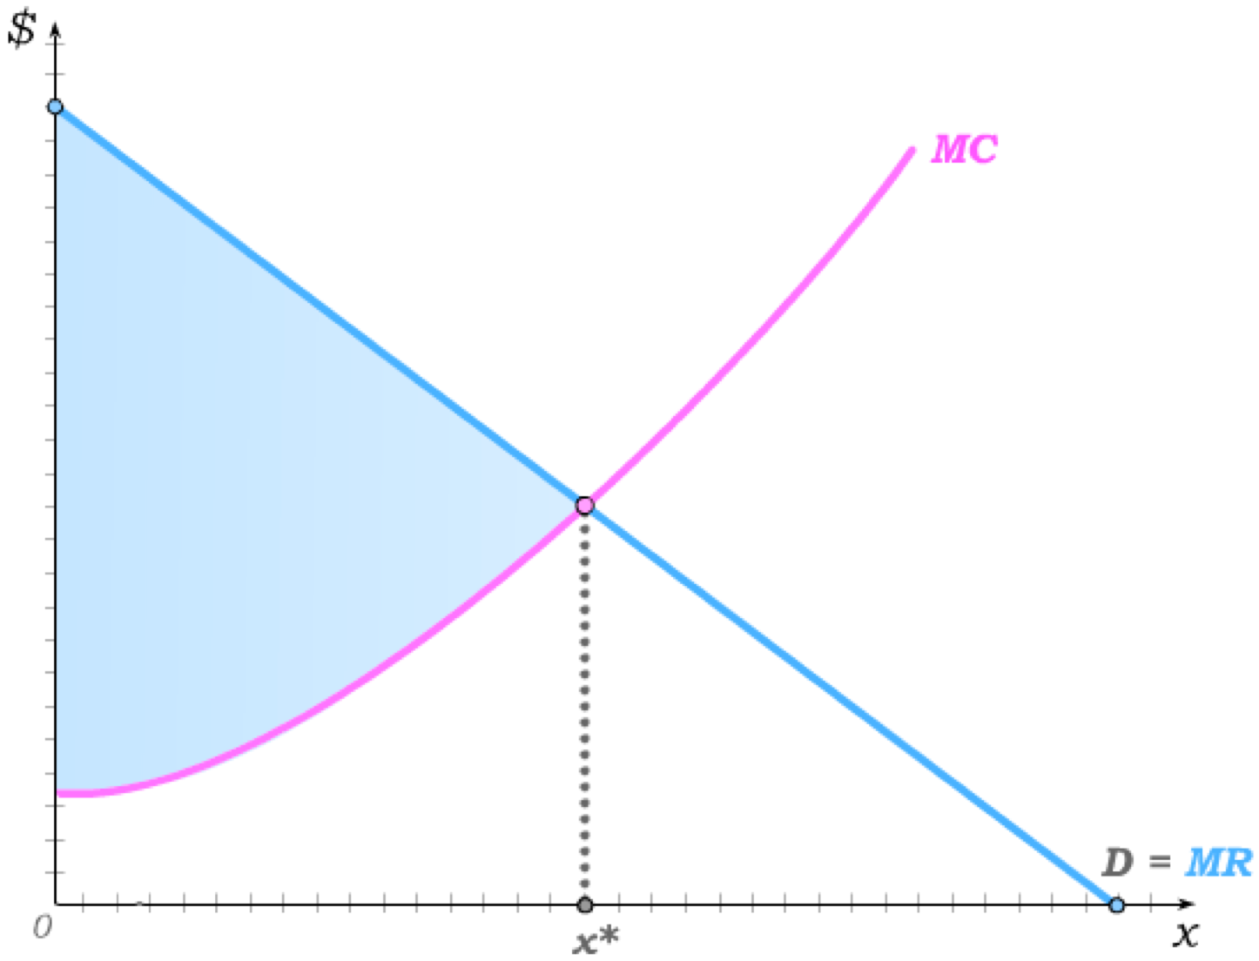
Perfect (or 1st Degree) Price Discrimination
If a monopolist can tell each consumer’s marginal willingness to pay for each of the output units the consumer buys, she can price each unit at marginal willingness to pay.
The MR curve then becomes equal to the demand curve – because the monopolist never has to reduce price on all previous goods if she tries to sell one more good.
She then produces x^{M} = x* – the efficient quantity – where MC=D.
€
But the entire surplus now becomes the monopolist’s producer surplus – leaving no surplus for consumers.
The reason for the inefficiency before was that monopolists reduced output in order to raise price – but with first degree price discrimination, the need to reduce output to raise price disappears.

Slide 11
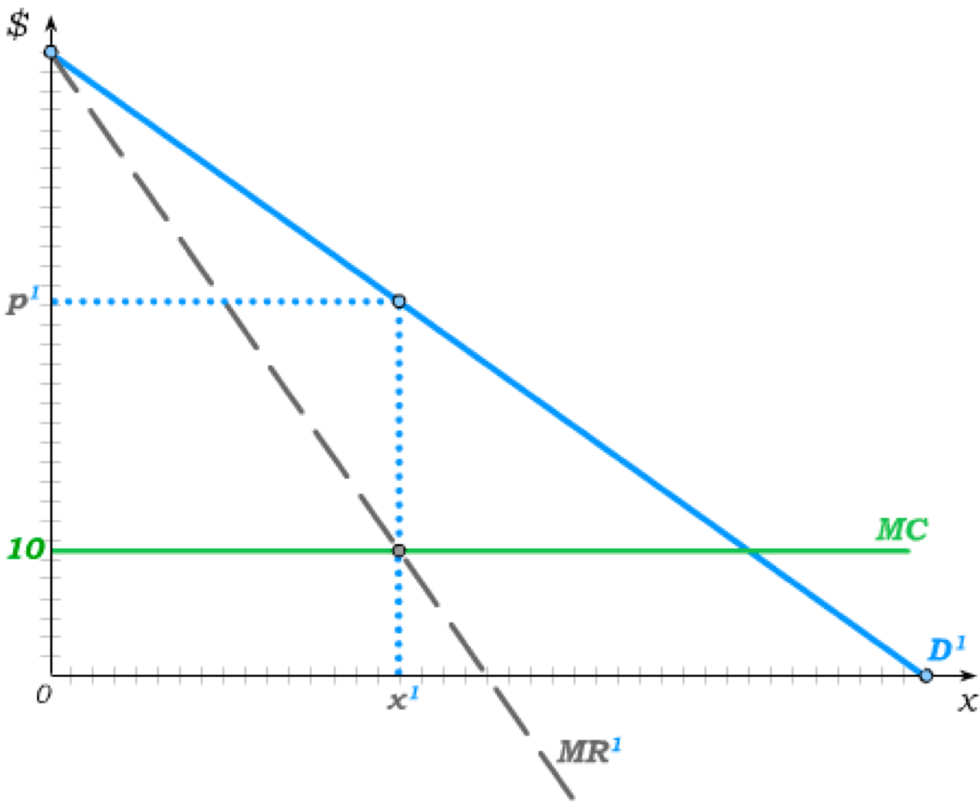
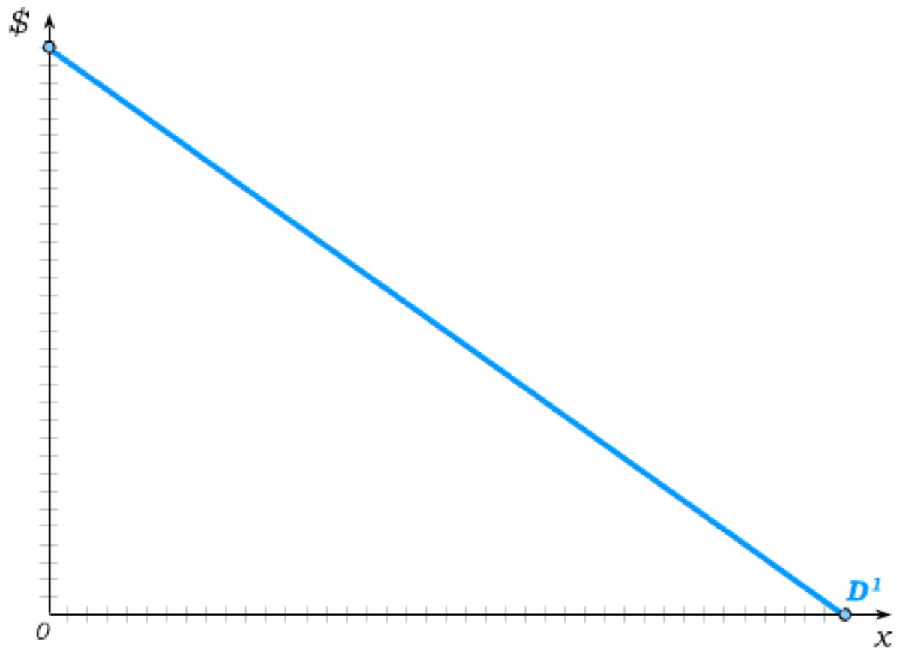
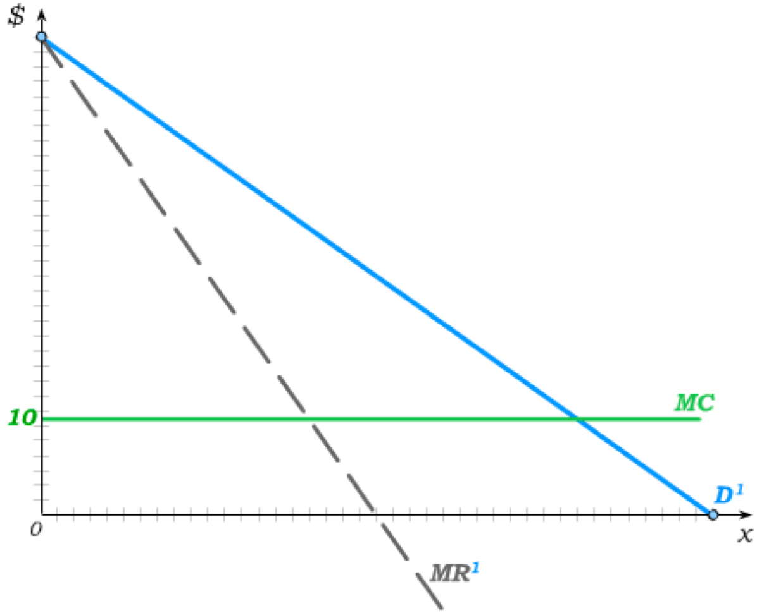
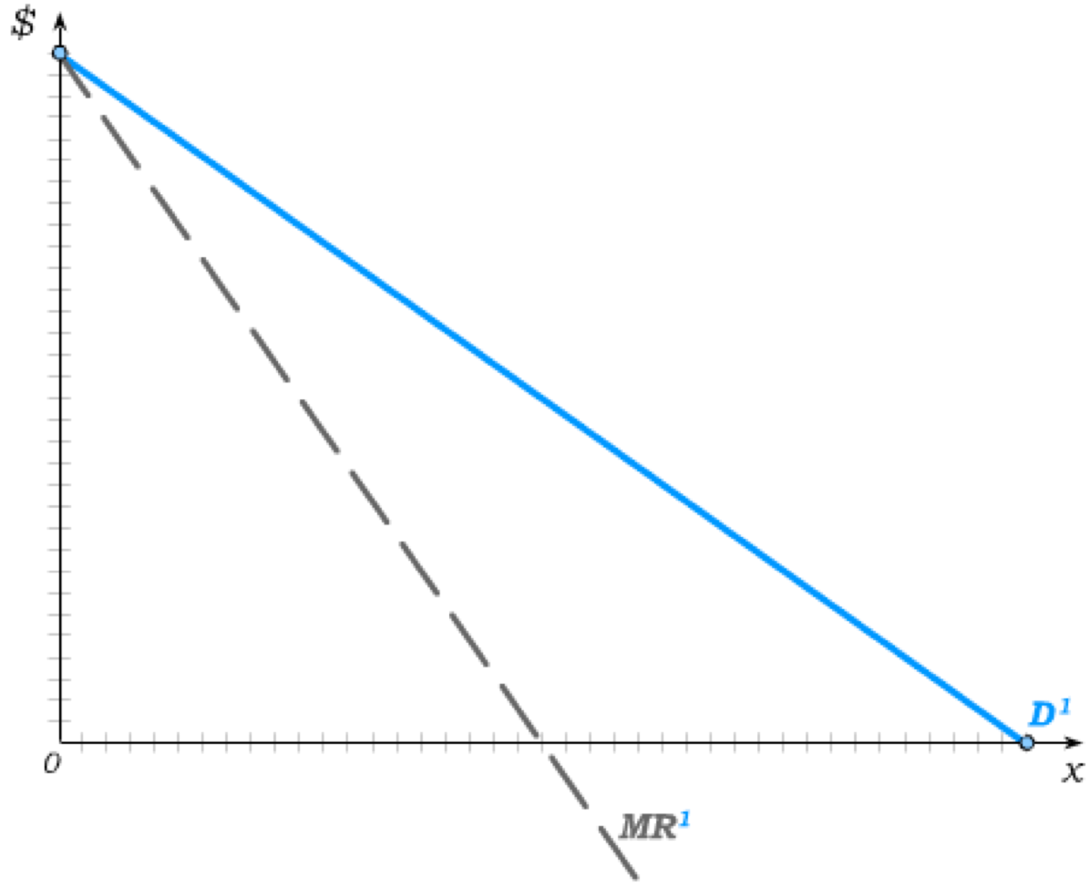
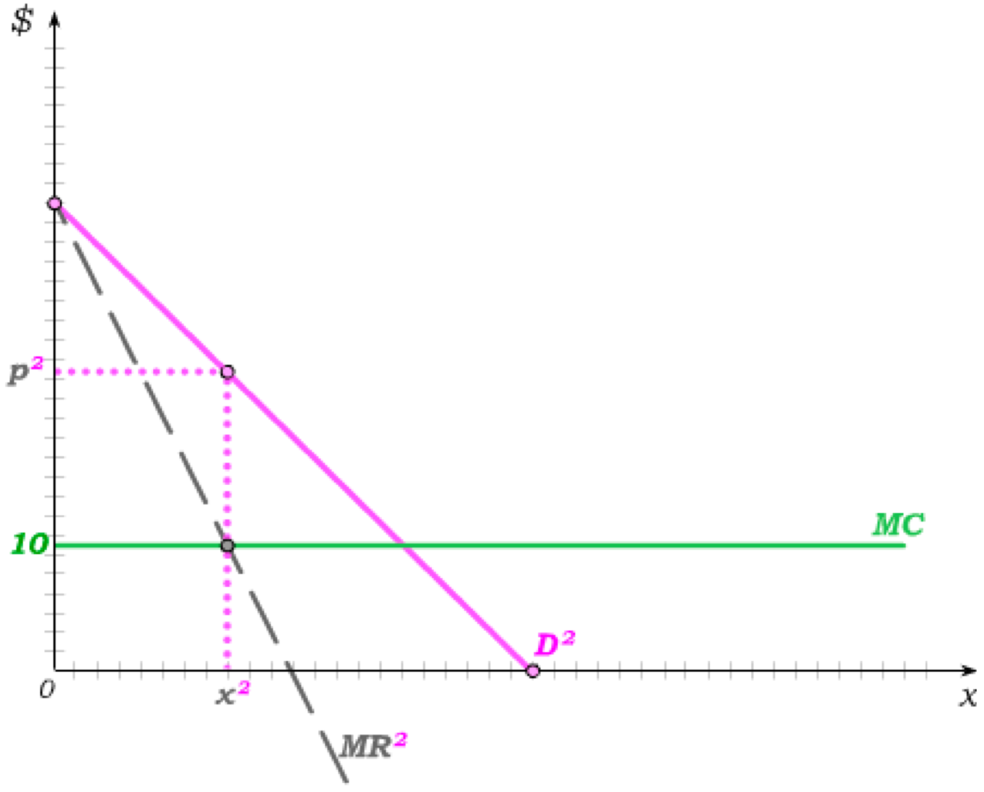
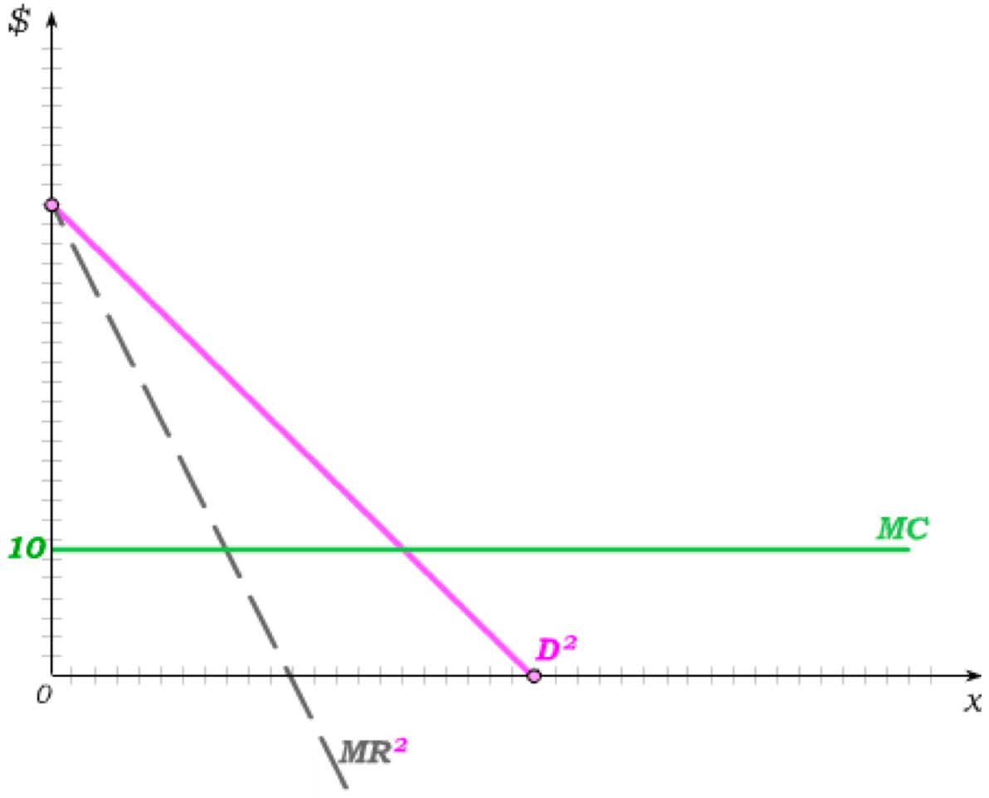
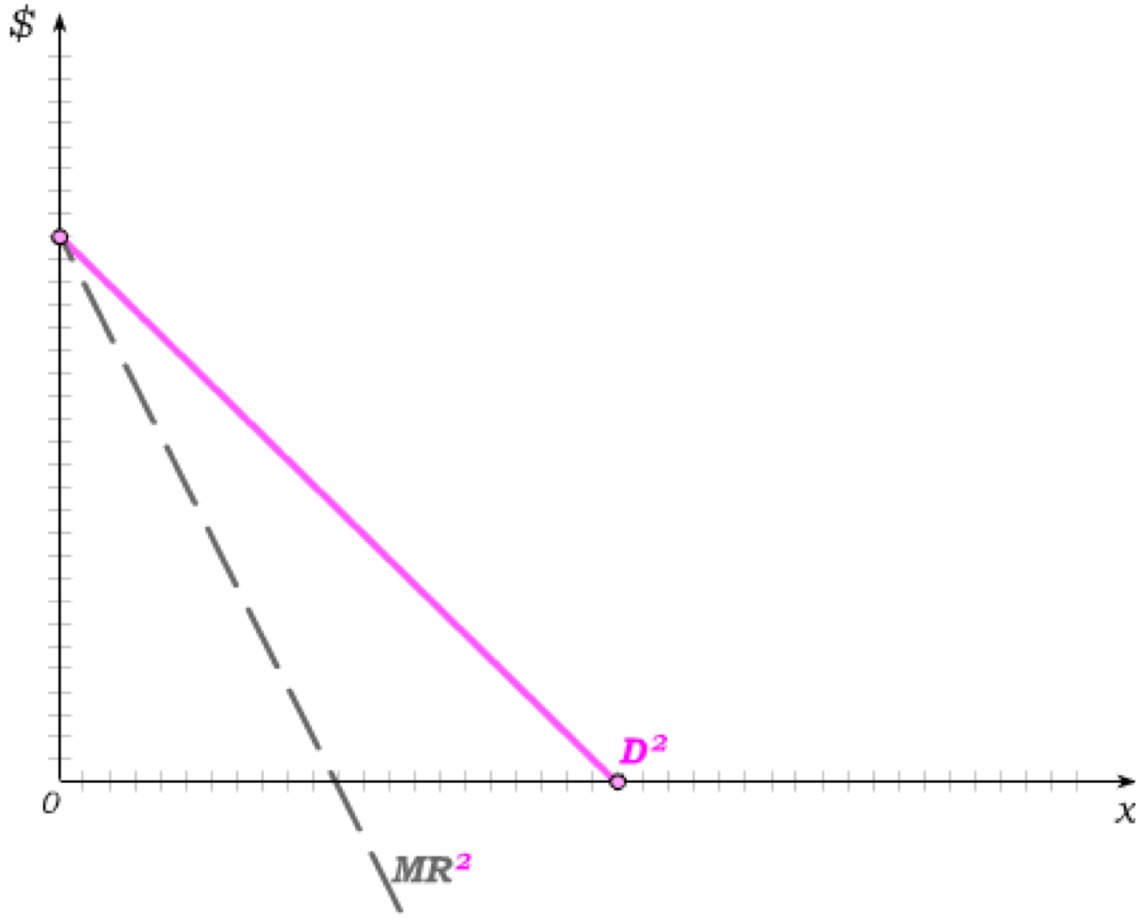
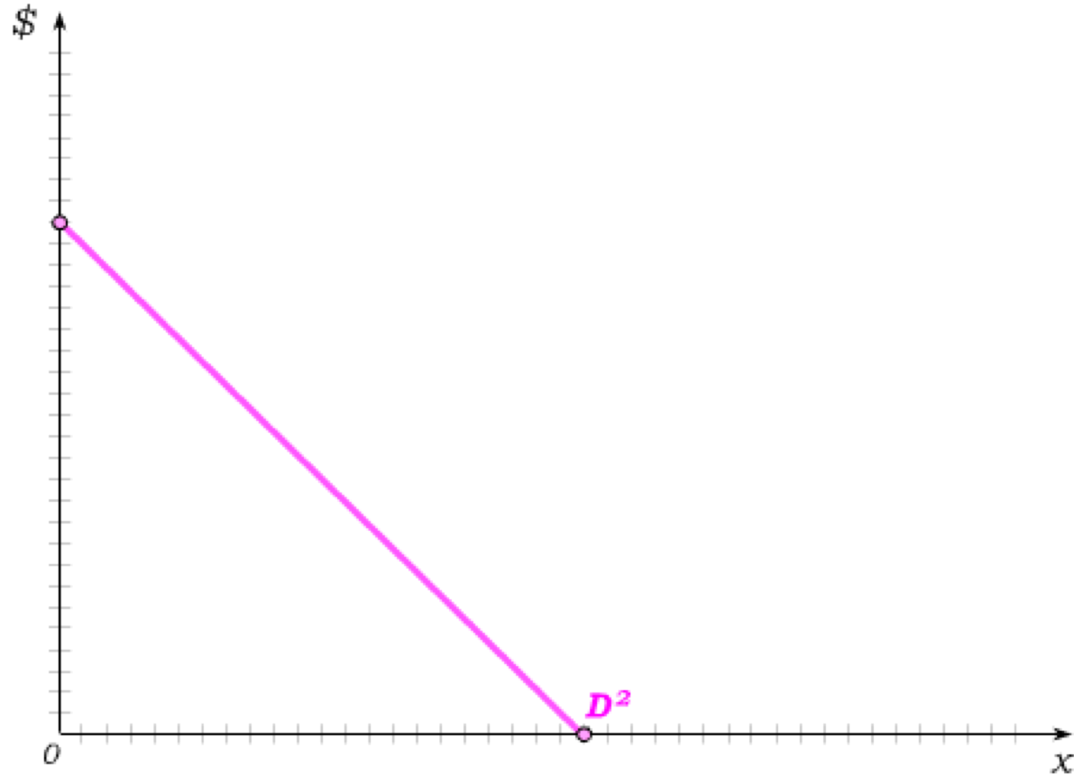
Imperfect (3rd-Degree) Price Discrimination
Consider that each consumer demands more than one unit. In that case, perfect price discrimination seems unrealistic. Under third-degree price discrimination, monopolists can charge each consumer a different per-unit price, but any single consumer has to be charged the same per unit price.
Suppose we have two consumer types – type 1 with high demand and type 2 with low demand.
The monopolist can then treat these as if they were two separate markets.
The problem is simplified if we assume constant MC – which then allows us to find where MC crosses MR in each market.
€
Type 1 consumers are then charged p¹ …
€
… while type 2 consumers are charged p².

Slide 12
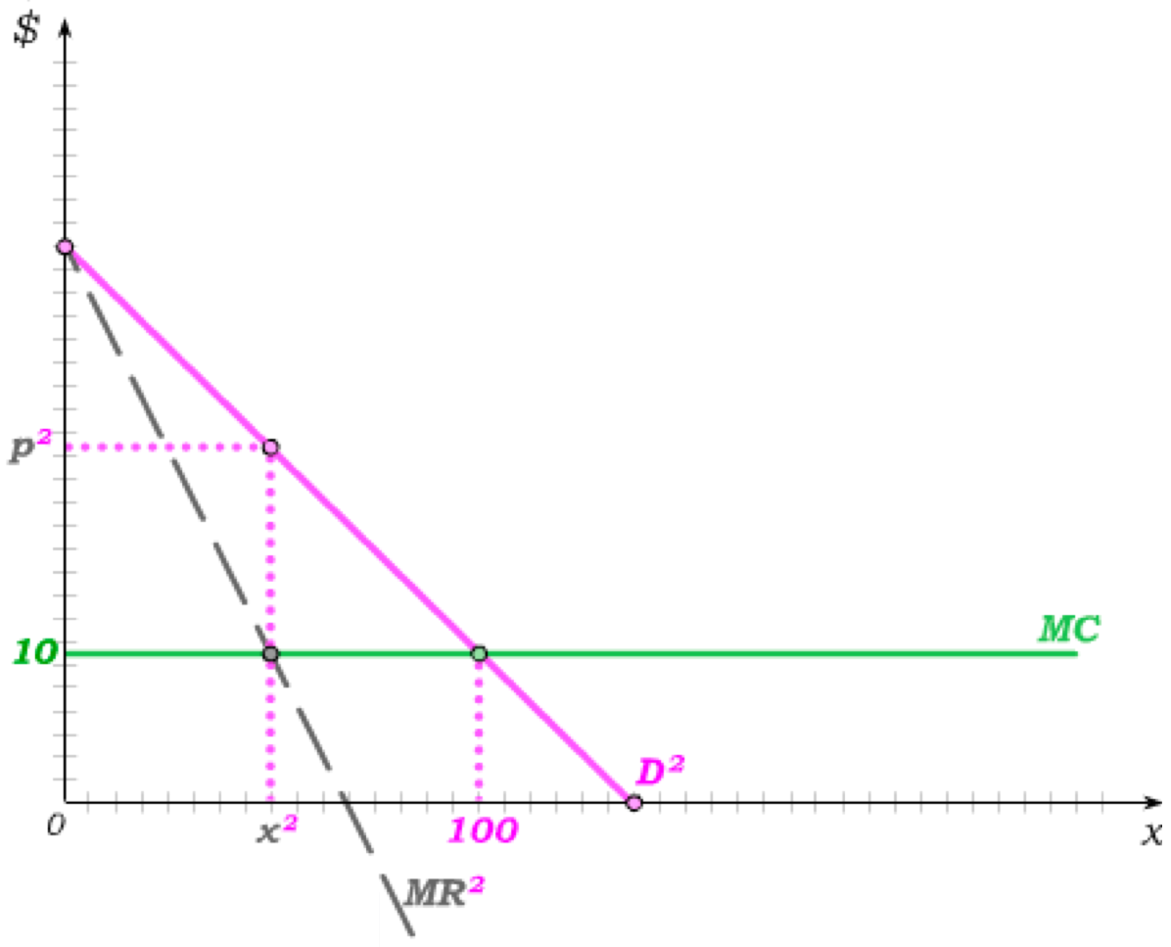
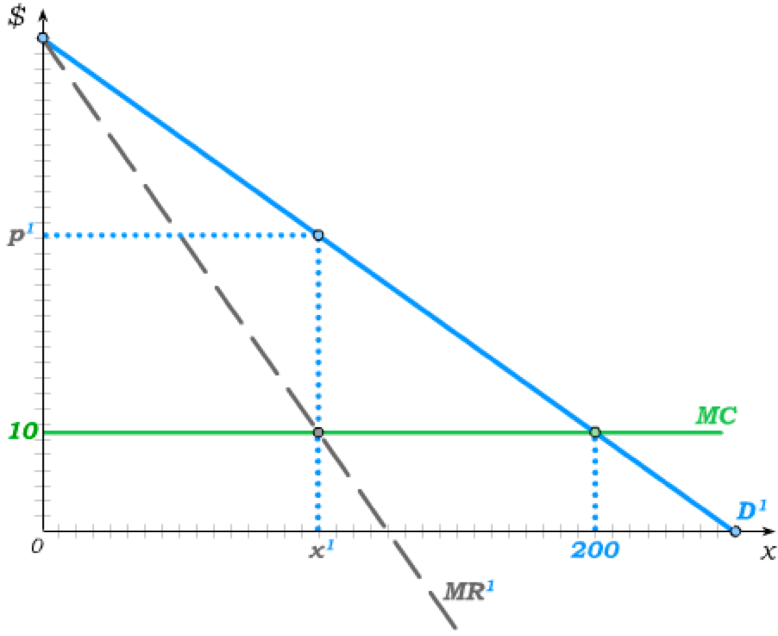
Welfare under 3rd Degree Price Discrimination
The efficient output level in the type 1 market is 200 …
… and the efficient output level in the type 2 market is 100.
These efficient quantities would be reached under
1st degree price discrimination.
But now DWL triangles appear in both markets.
Consumers, however, get surplus under 3rd degree price discrimination, because
€
€
monopolists cannot extract all surplus as they do under 1st degree price discrimination.
This then leaves monopolists with less profit.
CS
CS
Profit
DWL
Profit
DWL

Slide 13
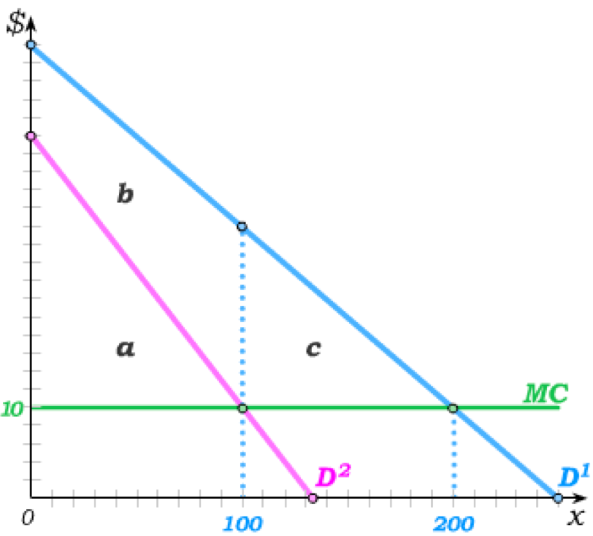
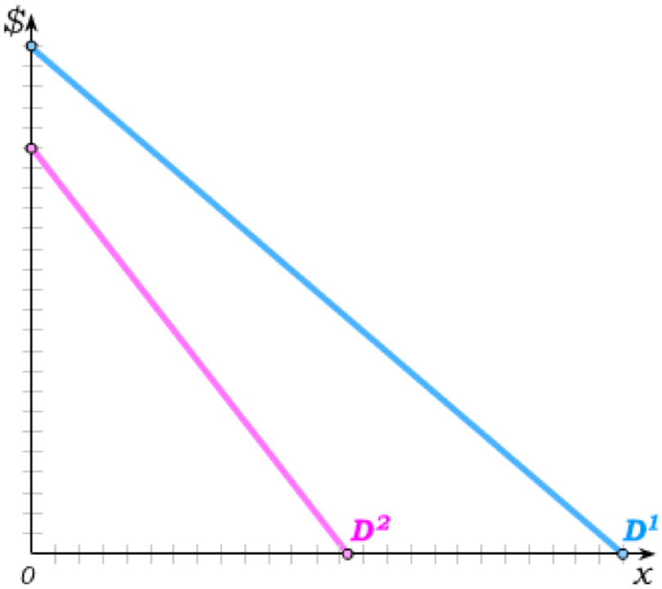
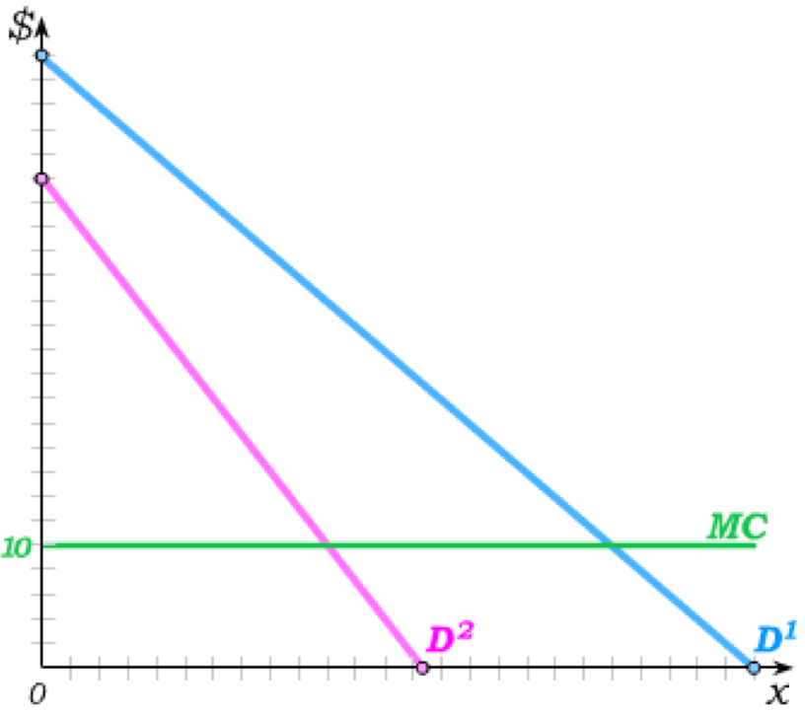
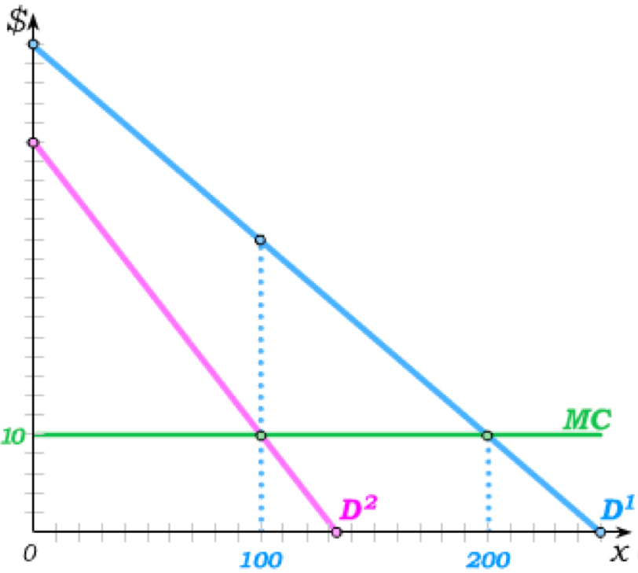
Second-Degree Price Discrimination
In both 1st and 3rd Degree Price Discrimination, the assumption is that firms can tell each of their consumers’ demands.
But what if they can’t?
Under 2nd Degree Price Discrimination, firms are assumed to know only the distribution of demands in the population but cannot tell individual demands of their consumers.
Suppose we again have high-demand and low demand consumer types, and suppose they are represented equally in the population.
€
And suppose MC is again constant at 10.
If the monopolist knew individual demands and could perfectly price discriminate, she would sell 200 units to type 1 and 100 to type 2, charging
€1,000+a to type 2 and
€2,000+a+b+c to type 1 consumers.
But if these two “packages” are offered by a second-degree price discriminating monopolist, will each type buy the package intended for him?
€1,000
€2,000

Slide 14
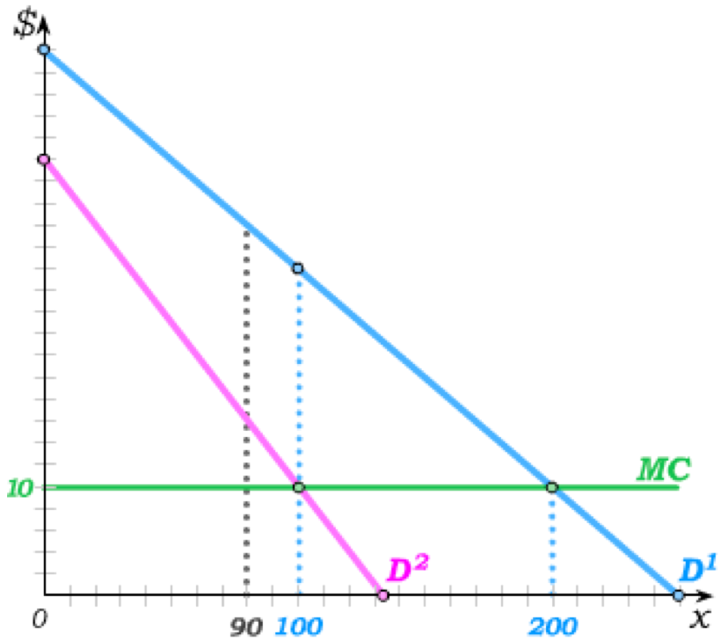
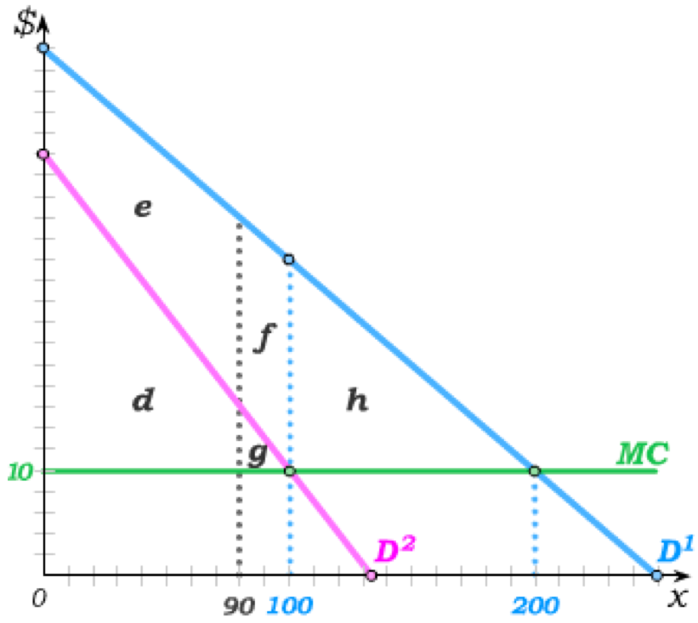
Second-Degree Price Discrimination
High-demand types would get no surplus if they bought 200 units.
But if they buy 100
units at a price of €1,000+a, they get consumer surplus equal to b.
If the monopolist charges €1,000+a for the 100 unit package, the highest price she can then set for the 200 unit package is €2,000+a+c, so that consumer surplus is also b.
To charge an even higher price to high-demanders, the monopolist must make the low-demand package less attractive.
The monopolist could then charge only €900+d for the 90-unit package,…
€
For instance, the quantity in the low-demand package could be reduced from 100 to 90.
€
… but that allows her to raise the price of the high-demand package to
€2,000+d+f+g+h.
€2,000
€2,000
€900

Slide 15
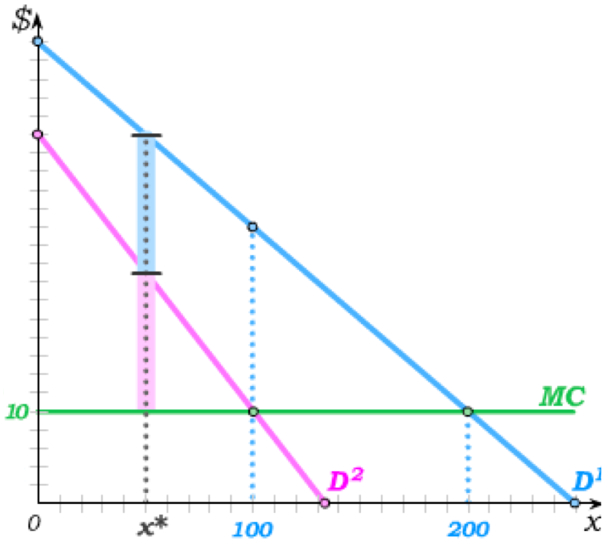
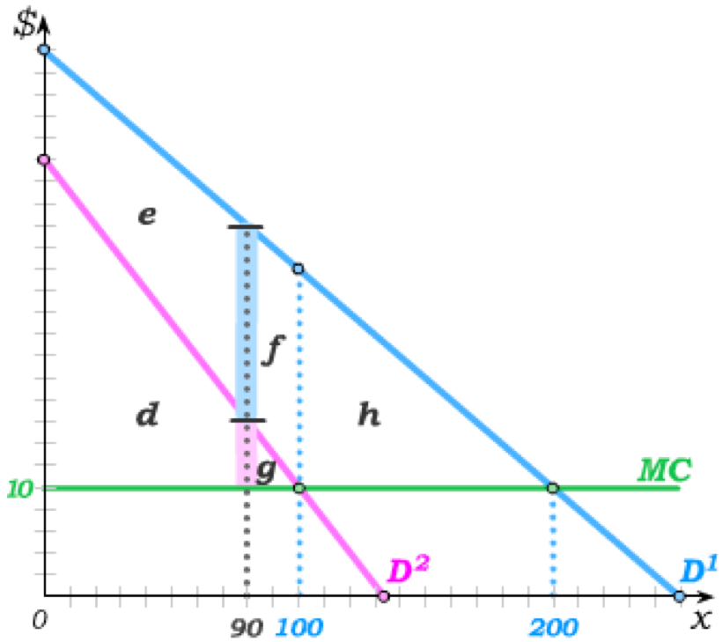
Second Degree Price Discrimination
with 100 unit low-demand package
with 90 unit low-demand package
Making the low-demand package less attractive increases profit by (f – g).
Profit from low-demand type
d+g
d
Profit from high-demand type
d+g+h
d+g+f+h
Total Profit
2d+2g+h
2d+g+f+h
When the blue > magenta, an additional reduction in the low-demand quantity will raise profit …
But even more profit can be made by making the low-demand package even less attractive to high-demand consumers.
€
€
… until we get to the profit-maximizing quantity x*.

Slide 16
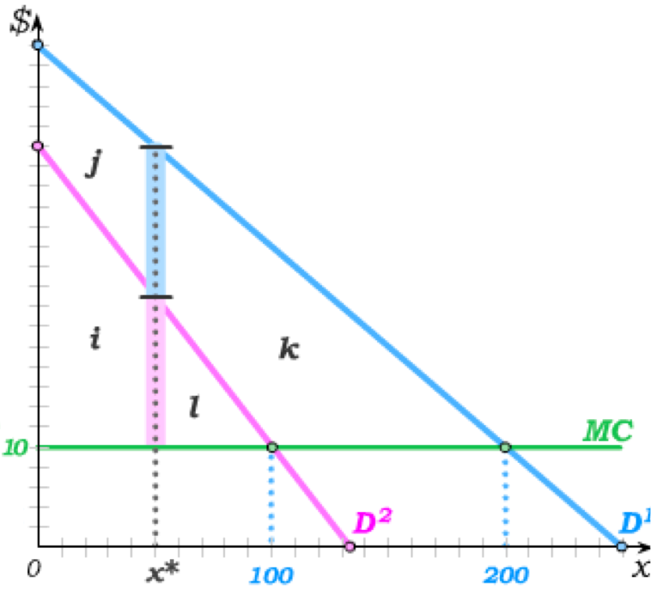
Second Degree Price Discrimination
When the monopolist cannot tell individual consumer demands, she can therefore construct packages such that consumers will reveal their type through their consumption decisions.
A profit-maximizing 2nd degree price-discriminating monopolist will offer two packages:
A low-demand package of x* at €10x* +i and
A high-demand package of 200 at €2,000+i+l+k.
€
These can also be presented as two-part tariffs with a per-unit price and a fixed fee:
Quantity
Per-unit price
Fixed Fee
Package 1
x*
10
i
Package 2
200
10
i+l+k
Low-demand consumers get no surplus while
High-demand consumers get surplus of j.
And the monopolist gets Profit=2i+l+k.

Slide 17
Barriers to Entry
Throughout, we have assumed that the firm has monopoly power in the sense that the firm is guaranteed the market for the monopoly good.
But this requires some barrier to entry that keeps potential competitors from entering the market.
One such possible barrier is a technological barrier to entry that results in downward sloping AC curves.
In particular, the downwards sloping AC curve arises from the technology: high fixed (entry) cost and low marginal costs.
Monopolies that derive their monopoly power from technological barriers to entry are called natural monopolies.
A second possible barrier is a legal barrier to entry that makes it illegal for competitors to enter the market.
Such legal barriers to entry may emerge from government grants of exclusive charters or licenses that sometimes (but not always) come in the form of patents or copyrights.
Policies to restrain monopoly power depend on the type of information available and the type of entry barrier that has created the monopoly power.

Slide 18
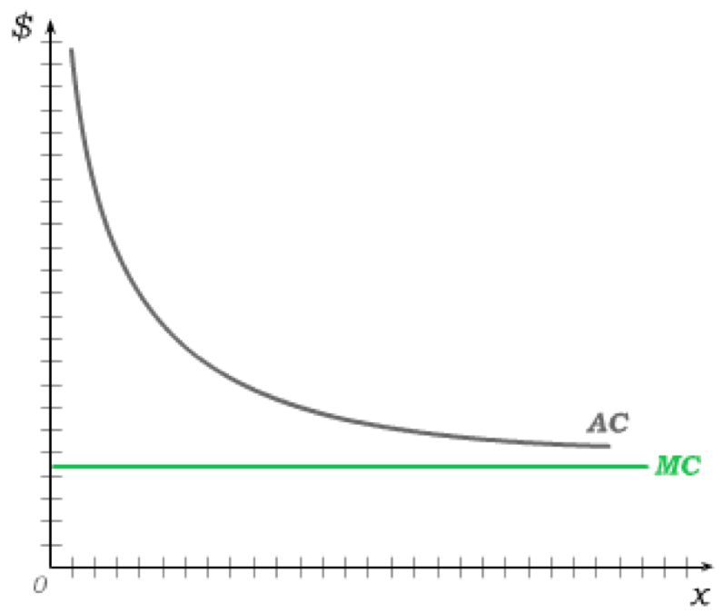
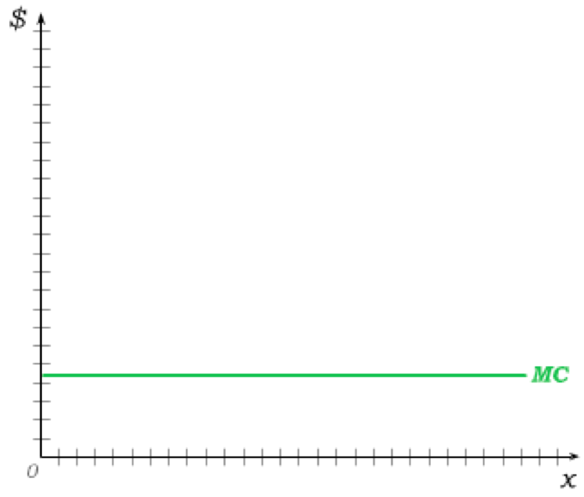
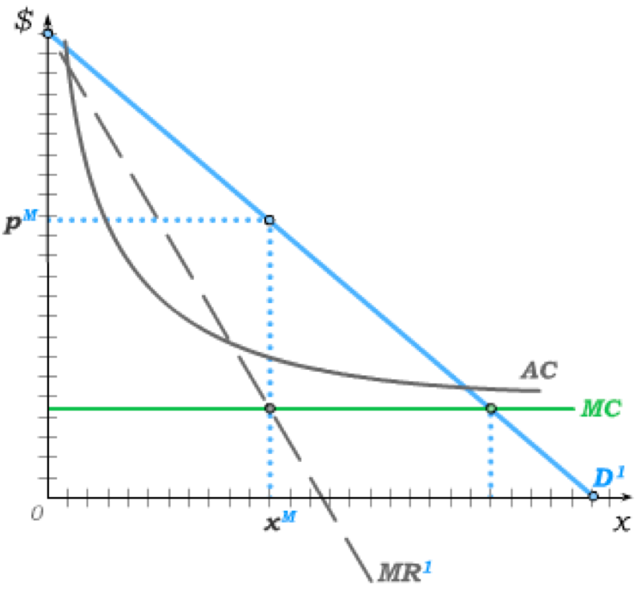
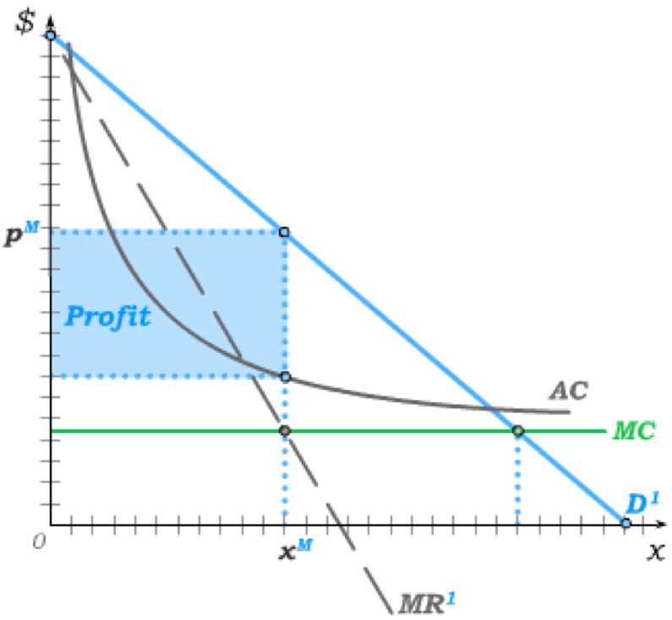
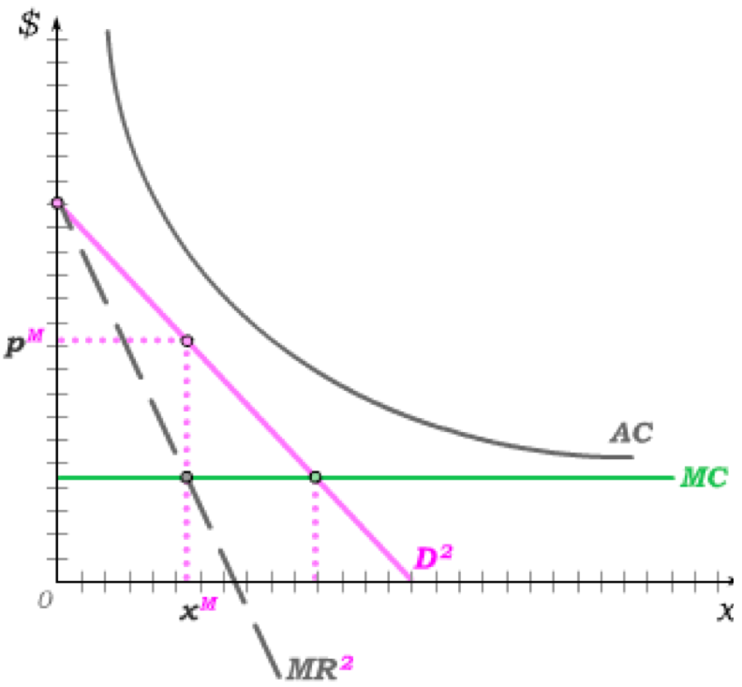
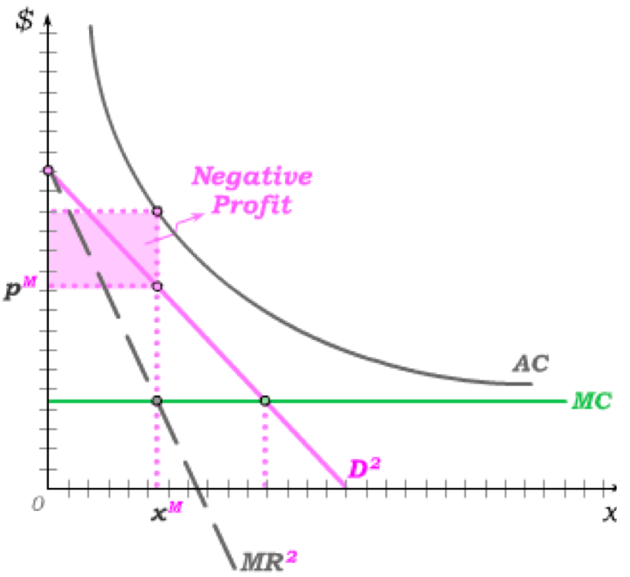

Natural Monopoly
Suppose a firm has constant MC
but downward-sloping AC.
This is an example of a natural monopoly.
In the absence of price-discrimination, the firm would then produce x^{M} and sell at p^{M},
resulting in the shaded profit area.
But if AC is high relative to demand,
AC may lie above demand –
leading to negative profit
if the firm produces where MR = MC.
€
€

Slide 19
Natural Monopoly
Firms that derive monopoly power from technological barriers to entry that result in downward-sloping AC curves are “natural” in the sense that the type of technology itself favors a single producer to minimize costs and achieve efficiency.
For this reason, governments have often resorted to price regulation aimed at insuring a “fair market return” to the monopolist.
In markets like utilities industries where there is a high fixed cost for the infrastructure necessary to serve customers, such regulation often comes in the form of a two part tariff – a fixed fee to cover the consumer’s portion of infrastructure costs, and a per-unit price charged for each output unit consumed.
The problem with price regulation is that it requires the government to have good information on costs of firms – but firms have no incentive to share such information truthfully.
Alternatively, governments have more recently introduced competition by providing the infrastructure – such that the fixed costs approach zero – and then allowing multiple firms to compete in the delivery of the product.
Just as governments provide road infrastructure and then allow trucking companies to compete in shipping goods on that infrastructure, governments can provide the utilities grid on which electricity can then be delivered by power companies that share the grid.

Slide 20
Legal Barriers to Entry
Historically, monopoly power has often been granted by governments through exclusive charters and licenses.
The incentive to seek legal protection from competition continues to be present in democratically functioning governments where the politics of concentrated benefits can result in inefficient market regulations.
Frequently, however, monopoly power is granted by modern governments as an incentive for innovation.
Such legal protections from competition come in the form of patents and copyrights that are typically limited to a fixed number of years.
To the extent to which this fosters innovations, it helps create new surplus from new products that would not otherwise exist.
The policy challenge is then to balance the static deadweight loss from monopoly power with the dynamic incentive for innovation.
This topic is treated in more detail in the material on monopolistic competition in Chapter 26.

Slide 21
Restraining Market Power
The optimal policy response to efficiency problems associated with market power is not always straightforward.
For instance, we have seen that perfect price discrimination results in efficiency – but it also results in all surplus accruing to monopolists.
Should policy primarily aim at efficiency, or should it protect consumers?
We have also seen that some legal barriers to entry may foster innovation.
Should policy be primarily static, or should it consider future consumers?
Many policies may be straightforward in a model but then require unrealistic levels of information on the part of policy makers.
Often, the most powerful restraint on monopoly power comes not from policy but from the threat of potential competition.
We will see in Chapter 25, for instance, that dominant firms in markets have an incentive to strategically deter entry by setting price below what static models of monopoly power might predict.
The fields of industrial organization and law and economics treat these issues in much greater detail.

Slide 22
Tutorial exercises
Within-chapter exercises:
  23A.1, 23A.2, 23A.5, 23A.6, 23A.8, 23A.9, 23A.11, 23A.17, 23A.19, 23A.20, 23A.21, 23A.22
End-of-chapter exercises:
  23.1, 23.5, 23.6A

Slide 23



Profit Maximizing by Monopolists
So long as a monopolist is a price-taker in the input markets for labour and capital, her cost-minimization problem is identical to that of a perfect competitor.
For a given market wage and rental rate, her cost function can then be derived exactly as we derived it previously – and written as simply c(x).
We then assume that a monopolist is facing a demand curve p(x), and we begin by assuming she is restricted to charging a single per-unit price p to all consumers.
Her profit-maximization problem can then be written as
where we know that the constraint will hold with equality; i.e. p = p(x).
Plugging the constraint p = p(x) into the objective, this turns the profit maximization problem into
Equivalently, we could use the demand function x(p) instead of the demand curve (or inverse demand function) p(x) to write the problem as

Slide 24






Profit Maximizing by Monopolists
The equivalence of these two problems – i.e. the equivalence of choosing quantity and choosing price to maximize profit – simply arises from the fact that the profit-maximizing monopolist has to choose a point on the demand curve.
A choice of x logically maps to a price p on the demand curve – just as a choice of p maps back to a quantity x.
Using the first version of the maximization problem, we then simply differentiate the objective with respect to the choice variable x and set it to zero; i.e.

Slide 25







An Example
Suppose, for instance, that the cost function is given by c(x) = cx, which makes the marginal cost just MC = c.
Suppose further that the monopolist is facing the demand function
that can equivalently written as the demand curve
Total Revenue for the firm can then be written as
From this, we can get marginal revenue as which we set equal to MC = c and solve to get
Plugging this back into the demand curve equation, we also get

Slide 26






Exploring Marginal Revenue and Price Elasticity
We can explore how marginal revenue depends on price elasticity of demand by beginning with the general expression for total revenue TR(x) = p(x)x and differentiating it to get
Multiplying the last term by p(x)/p(x), we can then write marginal revenue as
Noting that price elasticity can be written as , we can then write marginal revenue as

Slide 27

Marginal Revenue and Price Elasticity
For use with Nechyba, Intermediate Microeconomics © 2018 Cengage EMEA, ISBN: 9781473759008
MR

Slide 28


Monopoly Markups with Constant Elasticities
When demand functions have constant price elasticity (instead of varying elasticities along linear demands), we can write the profit maximizing condition as
Re-arranging terms, this can be written as
Since price elasticity is negative, the right hand side is positive.
where the term (p – MC) is referred to as the monopoly markup – i.e. the amount the monopolists marks price above MC.
The left-hand side term (p – MC)/p is referred to as the monopoly markup ratio or the Lerner Index of monopoly power.
The size of the monopoly markup ratio is then inversely proportional to the absolute value of the price elasticity of demand,
with monopoly power disappearing as price elasticity goes to minus infinity.

Slide 29






Price Discrimination in Two-Part Tariffs
We will illustrate the various forms of price discrimination mathematically for the case where there are two types of demanders and constant marginal cost MC.
Each form of price discrimination then be thought of as a combination of two-part tariffs where the total price paid by type n demanders is composed of a fixed fee and a per-unit price such that:
In the absence of any price discrimination, for instance, , with the single price set to sell the monopoly quantity determined where MR = MC.
€
Under first degree (perfect) price discrimination, firms will charge a per-unit price equal p^{c} = MC and then set the fixed fees equal to each consumer’s consumer surplus; i.e.
CS¹
p^{c}
MC
where
p^{c}x

Slide 30








Third Degree Price Discrimination
A third degree price discriminating monopolist can only set different per-unit prices for the two demand types and is thus restricted to setting .
With constant marginal cost, such a monopolist can then treat the two demand types as different markets, solving the typical monopolist’s problem twice and setting quantity in each market such that
Using MR in the price-elasticity form, this can be expressed as
If the firm sets , this equation implies that
which implies ; i.e.
The more price inelastic demand type is charged a
higher per-unit price under 3rd degree price discrimination.

Slide 31






Beginning Second Degree Price Discrimination
We have seen that no price discrimination is equivalent to two-part tariffs with no fixed fees and equal per-unit prices for both demand types.
First-degree price discrimination places no
restrictions on two-part tariffs – although monopolists will choose the same per-unit prices under constant MC.
And third degree price discrimination sets fixed fees to zero.
All these assume that the monopolist knows individual demands of consumers.
Next, we consider price discrimination when firms only know the distribution of types.
We begin with a single two-part tariff,
and then consider second degree price discrimination.
Firms know individual demands.
Firms don’t know individual demands.

Slide 32






Setting up the Problem
Suppose the consumers’ utility functions take the form
where is the single two-part tariff charged by the monopolist.
The consumer then solves the problem
which has the first order condition
Suppose further that
whose derivative with respect to x is just (1 – x). The first order condition then becomes
which solves to give us the demand function

Slide 33




Consumer Demand
For use with Nechyba, Intermediate Microeconomics © 2018 Cengage EMEA, ISBN: 9781473759008
The demand curve for consumer n is then the inverse demand function – i.e.
For a given per-unit price p, we can then identify the quantity demanded,
and the consumer surplus that would arise if there were no fixed fee.
This consumer surplus is then simply a triangle whose area can easily be calculated as

Slide 34
Expected Profit with 2 Types
Now suppose there are two types of consumers who differ only in their θ term such that θ₁ < θ₂.
The monopolist cannot tell who is a θ₁-type and who is a θ₂-type.
But she does know that the fraction of consumers that are of type θ₁ is γ.
For any per-unit price p, a low-demand θ₁-type will not buy if the fixed fee is greater than CS¹(p) – implying that the monopolist will, for a per-unit price p, set
The expected profit from setting a per-unit price p (and then setting the fixed fee accordingly) is
Fixed fee collected from both types
Per unit profit times quantity demanded by type 1
Per unit profit times quantity demanded by type 2

Slide 35


Maximizing Expected Profit with Single 2-Part Tariff
Substituting in the previously derived expressions for consumer surplus and demand, we can then write expected profit from setting a per-unit price p as
.
The only choice variable in this expression is their per-unit price p. Solving the problem of maximizing expected profit by choosing p in the usual way, we then get
,
the profit maximizing per unit price for a single 2-part tariff .

Slide 36



Consumers Reveal their Type
The single 2-part tariff has can then be graphed as a simple linear function,
which acts like a budget constraint along which consumers optimize.
And the tariff has been constructed in such a way as to get the two consumer types to optimize at different quantities, with consumers thus revealing their type by the choice they make.
Note that type 1’s optimal indifference curve passes through the origin – because the fixed fee is set at the level of consumer surplus for type 1.

Slide 37





Beginning Second Degree Price Discrimination
We previously solved for the inverse demand function – i.e. the demand curve – as
This implies that low-demand
θ₁-types have a lower vertical intercept than high-demand θ₂-types.
With the single 2-part tariff , θ₁-types consume x¹(p*) and θ₂-types consume x¹(p*).
€
Single 2-Part Tariff
Two Tariffs with p¹=p²=MC
Profit from θ₁-types
a+b
a+b+c
Profit from θ₂-types
a+b+c+e
a+b+c+d
Expected Profit
a+b+(1–γ)(c+e)
a+b+c+(1–γ)d
Suppose instead that we use two 2-part tariffs and set p¹=p²=MC. This would then allow us to set fixed fees of
For a sufficiently high fraction γ of low-demand types, profit increases.

Slide 38






Full Second Degree Price Discrimination
By decreasing the attractiveness of the low-demand “package”, we can raise the amount of surplus we can extract from high-demand types.
Suppose, then, that we raise the per-unit price for θ₁-types to , causing low-demand types to demand
And suppose we keep the per-unit price for θ₂-types at p²=MC=c.
We can then charge the 2-part tariff to θ₁-types,
and this enables
us to charge θ₂-types the tariff
€
Shaded blue area
Shaded magenta area
Shaded red area
At this set of two 2-part tariffs, θ₁-types then again reveal their type by choosing the lower quantity and θ₂-types reveal their type by choosing the high quantity.
And, once the implications for fixed fees are included, the only choice variable for the monopolist is

Slide 39



Expected Profit
The profit from encountering a low-demand θ₁-type is then the shaded blue area
and the profit from encountering a high-demand θ₂-type is the sum of the blue and magenta areas
€
.
When the fraction of consumers that is of θ₁-type is γ, this implies the expected profit from setting is

Slide 40


Maximizing Expected Profit
For use with Nechyba, Intermediate Microeconomics © 2018 Cengage EMEA, ISBN: 9781473759008
Substituting in our previously derived expressions for demands in this expression for expected profit, we can then write the monopolist’s optimization problem as
which then solves in the usual way to give us the profit maximizing price charged to θ₁-types as
The four elements of the two 2-part tariffs then emerge directly from this, with high-demand consumers charged a per-unit price c, with both consumers charged the blue CS¹ as a fixed fee and with high-demand consumers charged the additional magenta area as part of their fixed fee.

Slide 41

The Possibility of Dumping Type 1 Consumers
For use with Nechyba, Intermediate Microeconomics © 2018 Cengage EMEA, ISBN: 9781473759008
The two 2-part second-degree price discriminating tariffs we have derived are profit maximizing given that monopolists cannot identify individual types …
… unless there are sufficiently few low-demand θ₁-type; i.e. unless γ is sufficiently low.
Under the two 2-part tariffs, monopolists give up the shaded green area from high-demand θ₂-types in order to be able to collect the shaded blue area from low-demand θ₁-types.
€
If there aren’t enough low-demand θ₁-types, the monopolist can increase profit by setting a single 2-part tariff, with per unit price equal to marginal cost c and the fixed fee equal to the sum of the blue, green and magenta areas.
As a result, low-demand θ₁-types would no longer purchase any output …
… and the monopolist essentially becomes a first-degree price discriminator relative to the high-demand θ₂-types by focusing only on them and giving up on low-demand θ₁-types.

Slide 42






Comparing Different Monopoly Pricing
For use with Nechyba, Intermediate Microeconomics © 2018 Cengage EMEA, ISBN: 9781473759008

Slide 43

Welfare Effects of Price Discrimination
For use with Nechyba, Intermediate Microeconomics © 2018 Cengage EMEA, ISBN: 9781473759008
Many welfare implications of price discrimination depend on the particular assumptions made about demand and demand differences. A few of them, however, hold more generally:
Profit
Low-Demand Consumer Surplus
High-Demand Consumer Surplus
Deadweight Loss
Policy implications then depend both on specifics of markets and on policy objectives.

