Slide 1




Sociology of Work
Flexibility in labour relations and new forms of work
Adam Standring, PhD

Slide 2
What has changed? The model underlying the Golden Age
A central role for the State
Economic regulation (keynesianism)
Providing social benefits and welfare (welfare state)
Wage setting and working conditions
Full employment and economic growth

Slide 3
What has changed? The model underlying the Golden Age
Contracts are regulated
Stable and linear life-course
Working time is regulated
Fordism-keynesianism
Cncentration of production
Labour relations strongly regulated
Context: Male breadwinner model, traditional gender roles.

Slide 4
A paradigm shift: from fordism-keynesianism to flexibility
Fordism-keynesianism | Flexibility (Post-Fordism)
Labour contracts are regulated; stable and permanent employment. ‘Employment for life’. | Persistent and increasing unemployment (also long-term unemployment). Flexible employmet: insecurity, low wages, limited or no social protection. Career discontinuity (e.g. gap years).
Working time is regulated, regular and sinchronized (“normal” working time/week); full-time employment. Production is concentrated in the firm/company. | Flexible working and rest time: irregular and unpredictable. Flexibility also in the place of production (working from home).
Labour relations are strongly regulated, collective rights (collective work agreements). | Labour relations are organized at an individual level. Shifting balance between capital and labour. Collective work agreements at the firm level.
Homogeneous working conditions and social protection. Concentration of production favors unionization. | Differentiation and segmentation of labour markets and workers. Difused production.
Paid work central for social rights, identity and citizenship. | Paid work AND other dimensions of social life. Precarious jobs leading to erosion of social rights.
Source: Adapted from Casaca, S. (2012), Mudanças Laborais e Relações de Género: Novos vetores de Desigualdade, Almedina/Fundação Económicas, p. 13.

Slide 5



Making sense of the arguments
Optimist & Determinist
Pessimist Determinist
Non-determinist

Slide 6




Optimist & Determinist
Flexibility brings new opportunities
Comercial-like contracts
Entrepreneur spirit
“Portfolio” of careers
Convergence (class, social groups, countries, gender and social roles)

Slide 7
Pessimist & Determinist
Flexibility brings new risks and widens inequalities
Dualization and erosion of the social contract: winners and loosers → disaffiliation (Robert Castel)
Work: no longer a source of identity (individual and collective)
Firms are mere places of prodution, not socialization
Drifting biographies and life-courses / “corrosion of caracter” (Sennett);
No recognized social citizenship but individual values (Petrella);
“End of work” (Rifkin) and social desintegration.

Slide 8
Pessimist & Determinist
Flexibility brings new risks and widens inequalities
Inequalities
Class
Spatial (regions, countries)
Gender
Uncertainty
Paid work is overvalued
Risk
Working time becomes dominant and ‘invades’ other social times
Insecurity
Segmentation based on gender

Slide 9
Workforce segmentation
Work | Key workers | Peripheric workers
Work contents | Complex tasks, autonomy and responsibility | Limited tasks that do not demand qualifications
Training and qualifications | Professional socialization: professional training aimed at ensuring functional flexibility and multi-tasking | Minimum qualification for simple and repetitive tasks
Remuneration | High and regular | Low and irregular
Participation | Multiple ways | Low or non-existent
Bargaining power | Strong | Low
Social security | Yes | May or not cover these workers
Overview | Highly-skilled, high education, mature male workers | Low or unskilled, low education, women, young, migrants

Slide 10
Flexibility and working time
Part-time
Job sharing
Compressed week
Flexible time (by the week, month, etc), time banks and fixed working time exemption
Shift work (regular and irregular)
“Anti-social working times” (weekends, evenings, nights).
Leaves (sabbatical, paternity, training…).

Slide 11
Other ‘flexibilities’
Workplace
Remote work / teleworking
Digital nomads
Contracts
Fixed-termed, seasonal
No contract
Subcontracting (consultancy, ‘0 hour’ contracts, self-employed workers…)
Labour careers or life-courses
Career breaks: training, unemployment, gap years and volunteering, family responsibilities
Mobility between employers, firms, eventually professions (voluntary or involuntary)

Slide 12
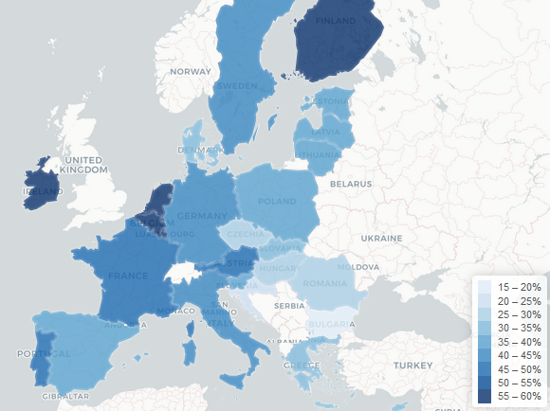
Zooming in on teleworking... During the pandemic
Share of respondents who worked from home during the pandemic
Mobility in the workplace:
https://www.euronews.com/2020/05/15/coronavirus-is-working-from-home-going-to-be-a-legacy-of-lockdown
Source: Eurofound (2020), Living, working and COVID-19 dataset, Dublin, http://eurofound.link/covid19data

Slide 13
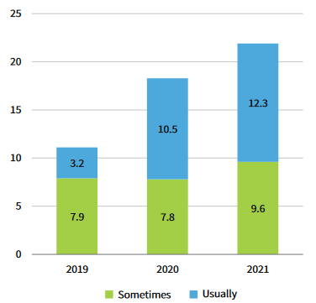
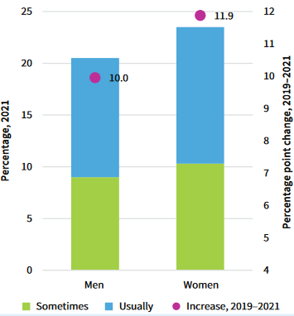
Zooming in on teleworking
Before the pandemic
White-collar, high earners, highly educated
Urban, densily populated
NL, SE, LU, FI, DK: ¼ working from home
Key drivers of increase during the pandemic
Lockdowns
But not small children
Women more likely to work in teleworkable sectors/occupations
Share of employees working from home 2019-2021 (left) and gender distribution (right), EU27
Source: Eurofound (2022): Fig. 3 (left) and Fig. 4 (right), Eurostat

Slide 14
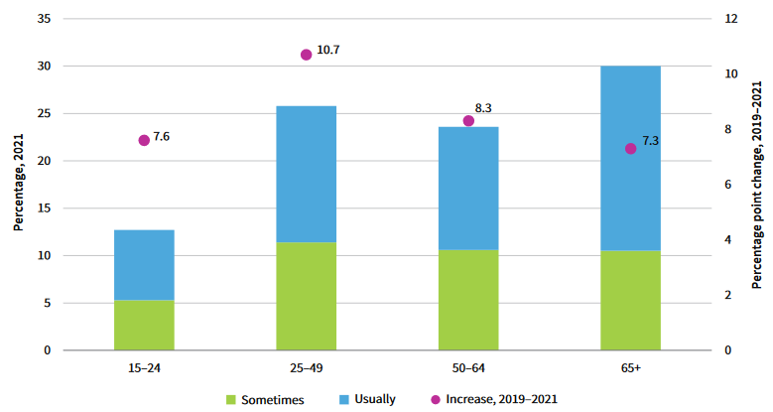
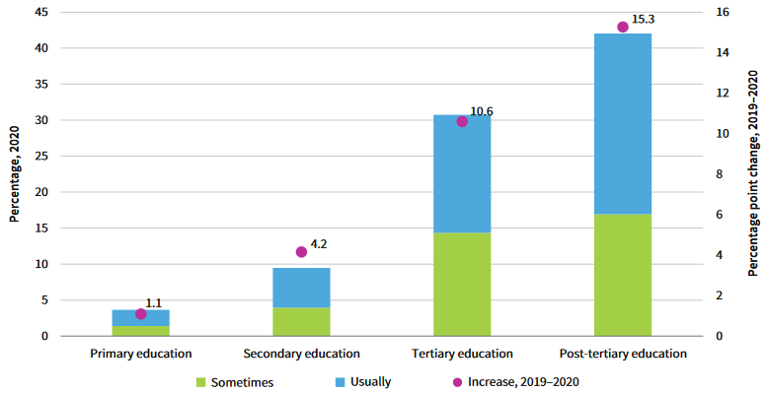
Zooming in on teleworking
Employees working from home, by age (left) and level of education (right), 2021 and evolution
Source: Eurofound (2022): Fig. 6 )left) and Fig. 10 (right), Eurostat

Slide 15
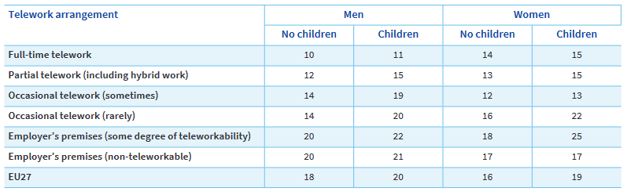
The mith of conciliation of work and family time?
Share of employees with a poor work-life balance, by teleworking arrangement, gender and having children or not, 2021, EU27
Source: Eurofound (2021): Table 4, EWCTS

Slide 16
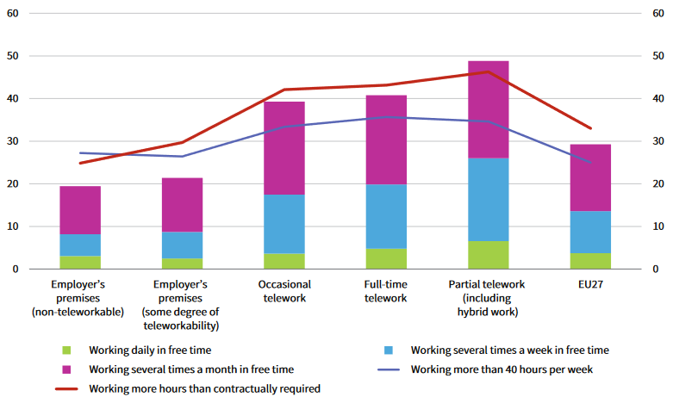
The myth of conciliation of work and family time?
Share of full-time employees working overtime, during their free time or more than 40 hours per week, per teleworking arrangement, 2021, EU27
However...
Pandemic was itself a factor
Greater anxiety and worse health symptoms (e.g. headaches)
Right to disconnect: EU Directive (proposal), FR (2013), IT, BE, FR, ES and PT (2021)
Source: Eurofound (2022): Fig. 17, EWCTS

Slide 17
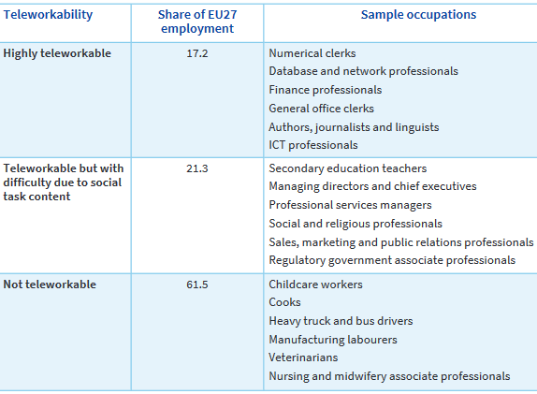
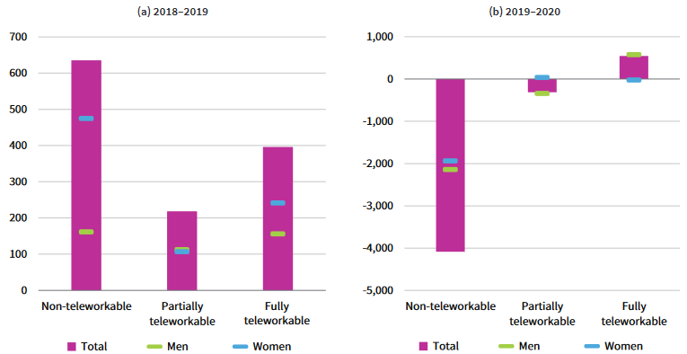
Teleworking and the future of work
Absolute change (thousands) in employment by degree of teleworkability and sex, EU27
Teleworkable employment
Source: Eurofound (2022): Tab. 2 and Fig. 15, Eurostat (Fig. 15) and Eurostat and Sostero et al (2020) (Tab 2)

Slide 18
Contractual precarity
Objective dimensions
Subjective dimensions
  Fixed-term contracts or even more flexible contractual arrangements with reduced or null social protection; underemployment
  Poor working conditions
  Time devoted to job-search; on-call time
  (In)voluntary nature of precarious work is deemed as inevitable
  Subjective perception of uncertainty and insecurity
  Insatisfaction with working conditions
  Intrinsic motivation and rewards
Consequences:
Poor health
Poverty
Inability to plan
Poor attachment to employer
The Precariat

Slide 19
Flexibility and working time
Labour precarity
Social precarity
  Contractual relationship that is involuntary → uncertainty about future employment prospects
  Low paid work with low social recognition and limited professional or on-job training → uncertainty about future employment prospects
  Vulnerable social protection (present and future) and health
Disaffiliation
Social distitution
Under-qualification
Social
Exclusion

Slide 20
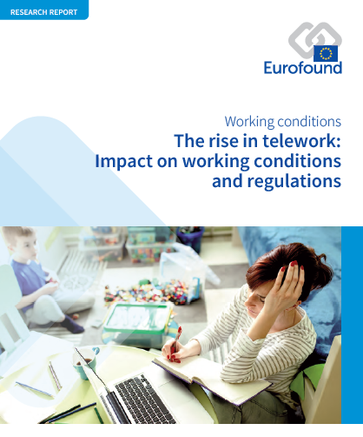
Essential reading:
Eurofound (2022), The rise in telework: Impact on working conditions and regulations, Publications Office of the European Union, Luxembourg. Chapters 1 and 2, pp. 7-44. (https://www.eurofound.europa.eu/sites/default/files/ef_publication/field_ef_document/ef22005en.pdf)

Slide 21


www.iseg.ulisboa.pt

