Slide 1
Intermediate Microeconomics: An Intuitive Approach with Calculus, 1e
Chapter 24 –
Strategic Thinking and Game Theory

Slide 2
Using “Games” to Understand Incentives
Games are models in which players potentially have reason to think strategically. An economic game is one that models incentives that mimic the incentives in a “real world” situation involving multiple individuals.
“To think strategically” is to think about how other players might behave and how that might influence how you should behave to maximize your objective.
In perfectly competitive settings, we did not have to think strategically because everyone is “small” -- no one can affect the economic environment (i.e., the price is fixed) and so there is no strategic interaction between players.
For a monopolist there were no other players at all.
But in settings where players are “large”, their own actions can impact the economic environment – as can their reactions to others’ actions, and so there is strategic interaction.
Our basic notion of equilibrium will not change all that much: an equilibrium is reached when everyone is doing the best she can given her circumstances and given what everyone else is doing.

Slide 3
Types of “Games”
We can broadly categorize games into four categories, with games differing across two dimensions:
simultaneous moves
sequential moves
complete information
rock, paper, scissors
chess
incomplete information
N/A
N/A
Complete information games (Chapter 24A) are games in which players know how other players evaluate the possible outcomes of the game.
Incomplete information games (Chapter 24B) are games in which at least some players do not know at least some other player’s evaluation of possible outcomes. Chapter 24B not part of the exam
Simultaneous move games are games in which all players must choose their actions at the same time (and thus without observing any other player’s action).
Sequential move games are games in which at least some players observe the actions of another player prior to having to choose their own actions.

Slide 4
The Structure of a Complete Information Game
Any complete information game has 4 elements:
Example
Players
Player 1: employer
Player 2: job applicant
Who are the players?
How many are there?
Actions
offer a euro wage w
accept or reject offer
What action(s) can each of the players “play”?
Is there a discrete number of possible actions? or
Are the actions defined by some continuous interval?
w from continuum
accept/reject – discrete
Sequence and Information
employer moves first; applicant moves next knowing the wage offer from stage 1
Do all the players choose their action simultaneously?
Do the players play in sequence?
What do players know about earlier moves by others?
Payoffs
employer: (MRP – w) if offer
is accepted; 0 otherwise
applicant: w if accepts; next
best alternative otherwise
What do players get at the end of the game?
How does this depend on how the game is played?

Slide 5
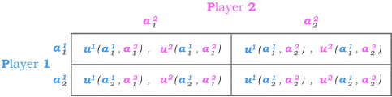
2-Player Simultaneous Move Game
A 2-player simultaneous move game is often represented in a payoff matrix.
Players
Player 1 is represented on the left and Player 2 at the top of the matrix.
Actions
Player 1 has 2 possible actions – and .
Player 2 also has 2 possible actions – and .
Sequence and Information
Players move simultaneous with no information about the other’s chosen action.
Payoffs
Each player’s payoff depends on her own as well as her opponents’ action.
Player 1’s payoff from playing when player 2 plays is , ,
and player 2’s payoff from the same actions is .

Slide 6
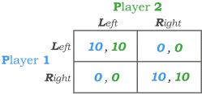
Example: A Coordination Game
Suppose player 1 and player 2 have to choose a side of the road on which to drive.
Neither has an inherent preference of one side of the road over the other – they just don’t want to crash into each other by driving on opposite sides.
Players
The game then has 2 players.
Actions
Both players can choose from the actions Left and Right.
Sequence and Information
The players make their choice at the same time without knowing what the other is doing.
Payoffs
The players get 10 each if they choose the same side and 0 each if they choose opposite sides.
A game of this kind is called a coordination game because the main objective of the two players is to coordinate their actions to be the same.

Slide 7
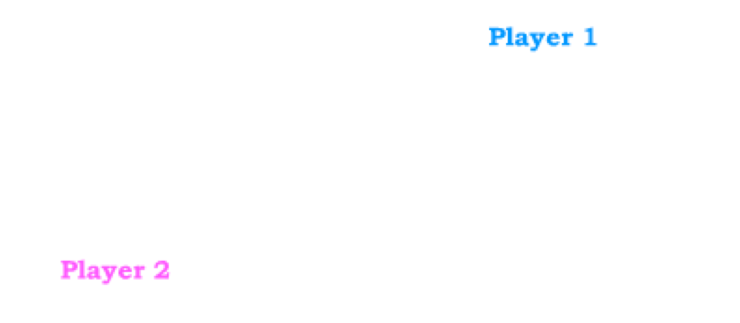
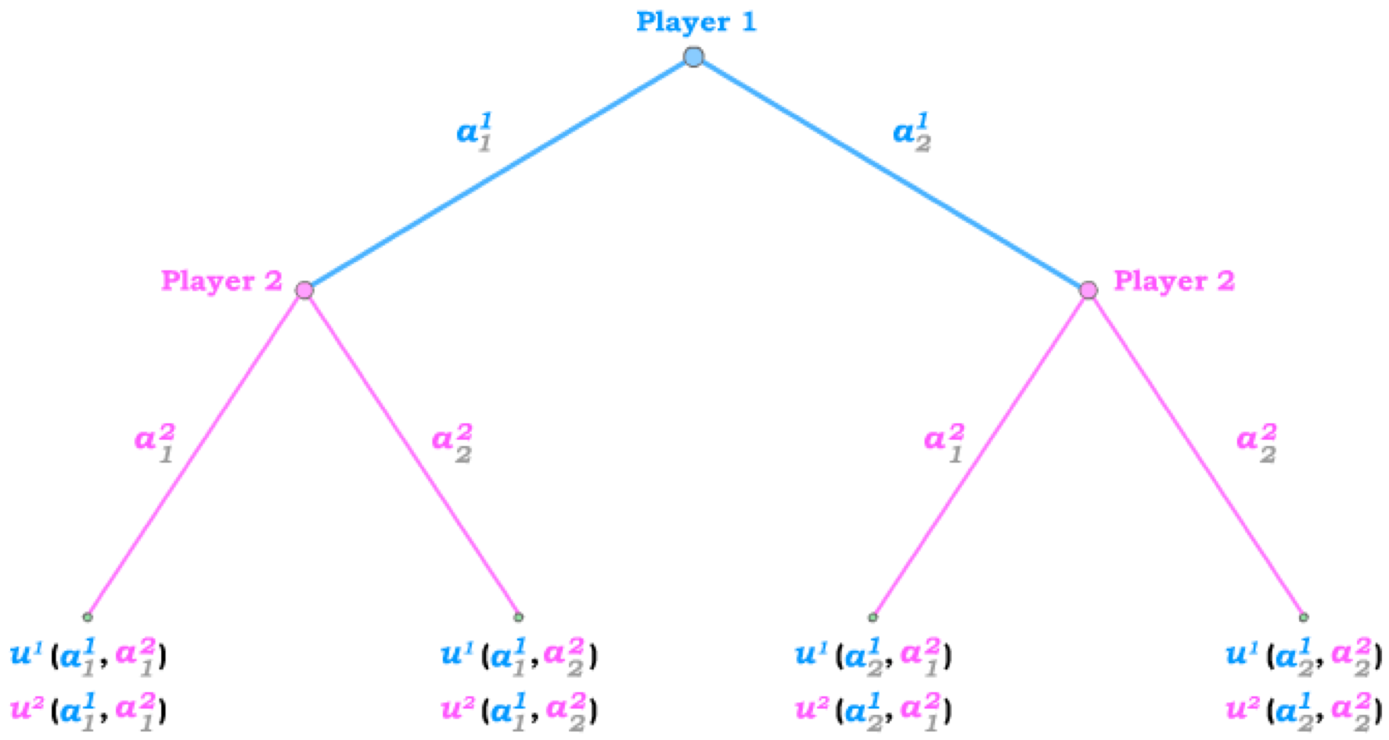
2-Player Sequential Move Game
A 2-player sequential move game is often represented in a game tree.
Player 1 can play or .
Players
Player 1 and Player 2.
Actions
Player 2 can play or .
Sequence and Information
Player 1 makes her decision first.
Player 2 observes Player 1’s choice before choosing.
Payoffs
Each player’s payoff depends on her own as well as her opponents’ action.
Player 1’s payoff from playing when player 2 plays is ,
and player 2’s payoff from the same actions is .

Slide 8
Information Nodes and Sets
In a sequential move game, players that move later in the game have multiple information nodes or information sets.
In our game, player 2 makes his decision from one of two possible information nodes – where the information is the action by player 1 that has been observed.
If player 2 were to make his choice without knowing player 1’s action, both these nodes would be in the same information set – implying player 2 cannot tell which node he is playing from when making his choice.
This would be indicated in the game tree by encircling the two nodes into one information set.
Such a game would then be equivalent to a simultaneous move game.

Slide 9
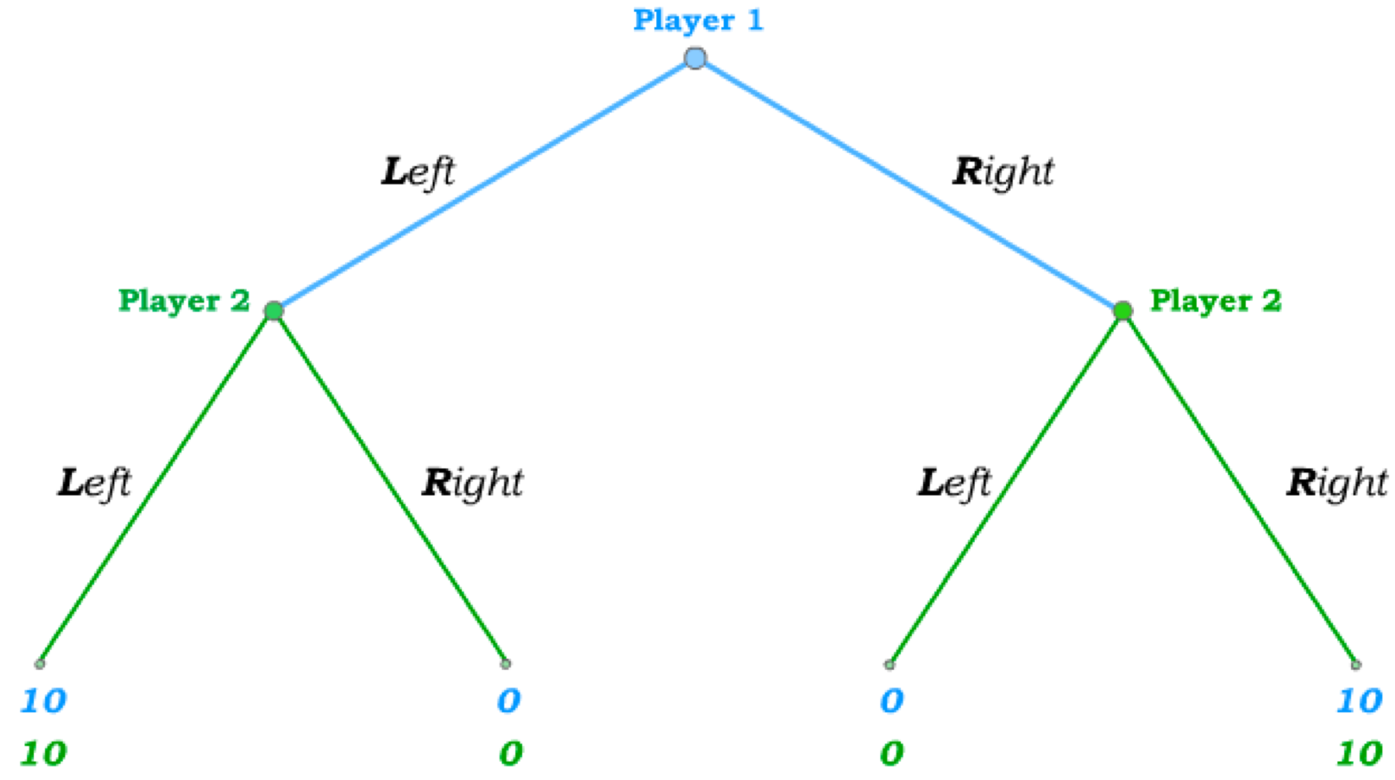
A Sequential Version of the Right/Left Game
In a sequential move version of our game in which players choose on which side of the road to drive, player 1 chooses her action first.
After observing player 1 on the road, player 2 then chooses his side,…
… choosing from the left information node if observing player 1 on the left
… and choosing from the right information node if observing player 1 on the right.
The payoffs are then again 10 for both if they choose the same side and 0 if they choose opposite sides.

Slide 10
Strategies
A strategy is a complete plan for how to play the game prior to the beginning of the game.
In a simultaneous move game, a complete plan simply involves making a choice of which action to play when the game starts.
But in a sequential move game, a complete plan of action (prior to the beginning of the game) implies a plan for what action to take from each information set.
Player 2’s strategy must therefore specify what he plans to do if he observes player 1 going Left …
… AND what he plans to do if he observes player 1 going Right!

Slide 11
Strategies in Sequential Move Games
Because he moves first (and thus has no information about what player 2 does when he makes his choice), player 1 still has only two possible pure strategies: Left and Right.
But player 2 and two possible actions from two possible information sets – implying four possible pure strategies:
(Right, Left) – a plan to go Right from the left and Left from the right node
(Left, Right) – a plan to go Left from the left and Right from the right node
Plan from right node
(Right, Right) – a plan to go Right from both nodes
Plan from left node
Plan from right node
(Left, Left) – a plan to go Left from both nodes
Plan from left node
Plan from right node
Plan from left node
Plan from right node
As we next define an equilibrium, it will become important to keep in mind the difference between the actions and the strategies for a player.
Plan from left node

Slide 12
Best Response Strategies
A player is playing a best response strategy (to the strategies played by others) if and only if he has no other possible strategy that would result in a higher payoff for him.
For instance, if player 2 plays the strategy Left,
player 1 best responds by also playing the strategy Left.
But if player 2 plays the strategy Right,
player 1 best responds by also playing the strategy Right.
In the sequential version,
if player 2 plays the strategy (Left, Left),
player 1 best responds by playing the strategy Left.
If player 2 instead plays the strategy (Left, Right),
both Left and Right are best responses for player 1.

Slide 13
Nash Equilibrium
A Nash equilibrium is a set of strategies – one for each player – such that every player is playing a best response strategy given the (best response) strategies played by others.
A less formal way of saying the same thing is: A Nash equilibrium occurs when everyone is doing the best he/she can given what everyone else is doing.
To find a pure Nash equilibrium in a 2-payer payoff matrix,
– Begin with player 2’s first strategy and ask
“what is player 1’s best response?”
– Then, for this best response by player 1, ask
“what is player 2’s best response to it?”
If player 2’s first strategy is a best response to player 1’s best response to player 2’s first strategy, then we have found a Nash equilibrium, {L,L}.
– Then move to player 2’s second strategy and go through the same steps again.
In our Left/Right game, we then find a second pure strategy Nash equilibrium, {R,R}.
Tip: underline the payoff of each player’s best response, and the entry with both payoffs underlined is a Nash equilibrium.

Slide 14
Nash Equilibria NOT always Efficient
Now suppose that both players were raised in England where people drive on the left side of the road.
As a result, the players have an inherent preference for driving on the left, but driving on the right is still better than crashing into one another.
In our payoff matrix, this implies a lower payoff for both players in the lower right box.
Both players playing Left is still a Nash equilibrium – and it is efficient.
5 , 5
But if player 2 plays Right,
player 1’s best response is
to also play Right.
And if player 1 plays Right, player 2’s best response is to still play Right.
Both players playing Right therefore is also still a Nash equilibrium – but it is not efficient.

Slide 15
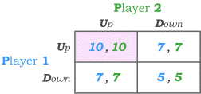


Dominant Strategy Nash equilibrium
In some games, a single strategy is always the best response to any strategy played by others.
Such a strategy is called a dominant strategy.
Consider the Up/Down game – which we construct by beginning with the last Left/Right game (where we found two pure strategy Nash equilibria).
Now suppose the (0,0) payoffs are changed to (7,7).
Both players playing Up remains a pure strategy equilibrium.
But when player 2 plays Down, it is now not the case that Down is player 1’s best response.
Rather, player 1’s best response is to play Up.
And player 2’s best response to that is to go
Up as well,
leading us back to the one remaining Nash equilibrium, {U,U}.
This results directly from Up being a dominant strategy for both players: Regardless of what the other player does, it is always a best response to play Up.
When every player in a game has a dominant strategy,
there is only a single Nash equilibrium in the game.
In our case here, this Nash equilibrium is efficient, but that is not always the case …

Slide 16
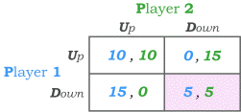

Inefficient Dominant Strategy Equilibrium
Let’s begin again with the coordination game where both players playing Up as well as both players playing Down are Nash equilibria.
But then suppose we change the (0,0) payoffs to (15,0) on the bottom left
and to (0,15) on the top right.
We can now check whether the efficient outcome (10,10) can still arise in a Nash equilibrium.
If player 2’s strategy is Up,
player 1’s best response is
to play Down.
So (10,10) cannot arise in equilibrium.
Down is in fact a dominant strategy for player 1,
as it is for player 2.
The unique Nash equilibrium of this game is thus for both players to play Down,
so that the Nash equilibrium = {D,D}, which results in the inefficient payoff pair (5,5).
Note that the reason each player is playing Down is NOT because each player anticipates that the other will play Down. Rather, regardless of what the other player does, each player’s best response is to play Down.
We will later call a game of this type a Prisoner’s Dilemma.

Slide 17
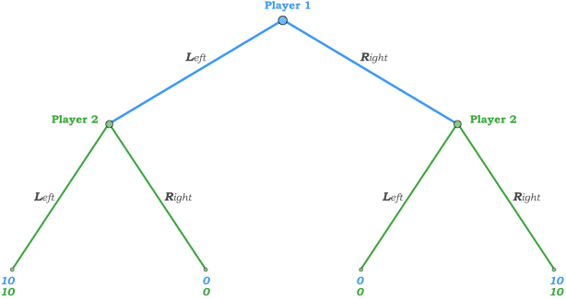
Nash Equilibria in Sequential Move Games
Now consider a sequential version of the Left/Right game where both players are British and thus have an inherent preference for driving on the left side of the road.
Recall that player 2 has four possible strategies,
and a Nash equilibrium is a set of
such that both players are best-responding to one another.
Suppose player 2 plays (Left,Left) – i.e. she always plans to go Left.
Player 1 then best-responds by playing Left.
And (Left,Left) is a best response for player 2 to Left.
The outcome (10,10) is then a Nash equilibrium outcome.
But suppose player 2 plays (Right, Right) – i.e. she always plans to go Right.
Then player 1 best-responds by going Right.
And (Right, Right) is a best response for player 2 to Right …
… giving us a second possible Nash equilibrium outcome.

Slide 18
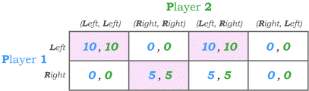

Finding all NE in Sequential Games
One way to find all the pure-strategy Nash equilibria in a sequential game is to depict the game in a payoff matrix – with strategies on the axes of the matrix.
When players end up driving on opposite sides of the road, they get 0 payoff each.
When both players end up driving on the right side of the road, they get a payoff of 5 each.
And when both players drive on the left, they both get a payoff of 10.
If player 2 picks either (Left,Left) or (Left,Right),
player 1 best-responds with Left,
and the original player 2 strategies are best responses to Left, giving us two Nash equilibria: {L,{L,L}} and {L,{L,R}}.
But if player 2 (Right,Right),
player 1 best-responds with Right,
to which the original
(Right,Right) is a best response for player 2, giving a third Nash equilibrium: {R,{R,R}}.

Slide 19
Non-Credible Plans and Threats
There is, however, a “problem” with the Nash equilibrium under which all players end up choosing Right.
Although every player is indeed best-responding, the equilibrium requires that player 1 thinks that player 2 plans to choose Right from her left node after observing player 1 choosing Right!
Since player 2 never reaches that node in the equilibrium, planning to always go Right is still a best-response if player 1 plays Right.
But such a player 2 plan should be viewed as non-credible by
player 1.
So far, player 2 has no incentive to threaten such a plan …
… and player 1 best-responds by playing Right IF he believes the threat.
… but that changes if player 2 is American and not British!
But the threat is still just as non-credible.
Player 2’s “plan” to
play (Right,Right) is
now intended as a threat to
player 1 …
10
5
5
10

Slide 20
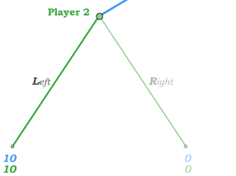
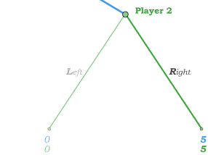
Eliminating Non-Credible Threats
We can eliminate Nash equilibria that are based on non-credible threats by assuming player 1 will only consider credible strategies by player 2.
Player 1 therefore looks down the game tree and knows player 2 will play Left after observing Left from player 1,
and he knows player 2 will play Right after observing Right.
The only credible strategy for player 2 is then (Left,Right).
Such refinements / credible strategies are called
subgame-perfect.
Subgame-perfect because we are considering sub-games that begin at each information node …
and we insist that the
“sub-strategies” from
each node are
best responses
from that node
The single subgame-perfect NE: {L,{L,R}}

Slide 21
Subgame Perfect Nash Equilibrium
Subgame-perfect strategies are then strategies that involve best responses at every information node – whether that node is reached in equilibrium or not.
As a result, all non-credible threats are eliminated when we focus only on subgame-perfect strategies.
A subgame-perfect Nash equilibrium is a Nash Equilibrium
in which only subgame-perfect strategies are played. This eliminates the equilibria that are supported by non-credible threats.
When a sequential game has a finite number of stages, it is easy to solve for the subgame-perfect Nash equilibrium via backward induction:
– Begin with the last stage (at the bottom of the tree) and ask what actions the player will take from each of her information node.
– Go to the second-to-last stage and ask what actions the player will take from each information node given he knows the next player’s credible strategy.
– Keep working backwards along the tree in the same way.

Slide 22
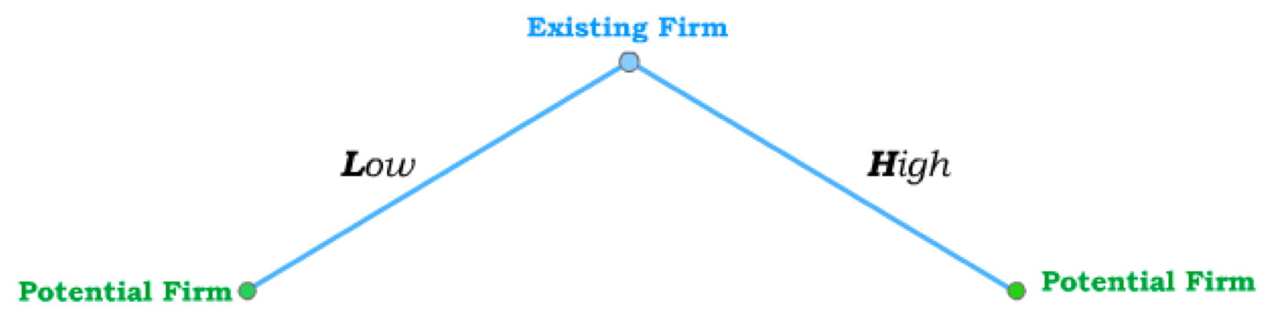
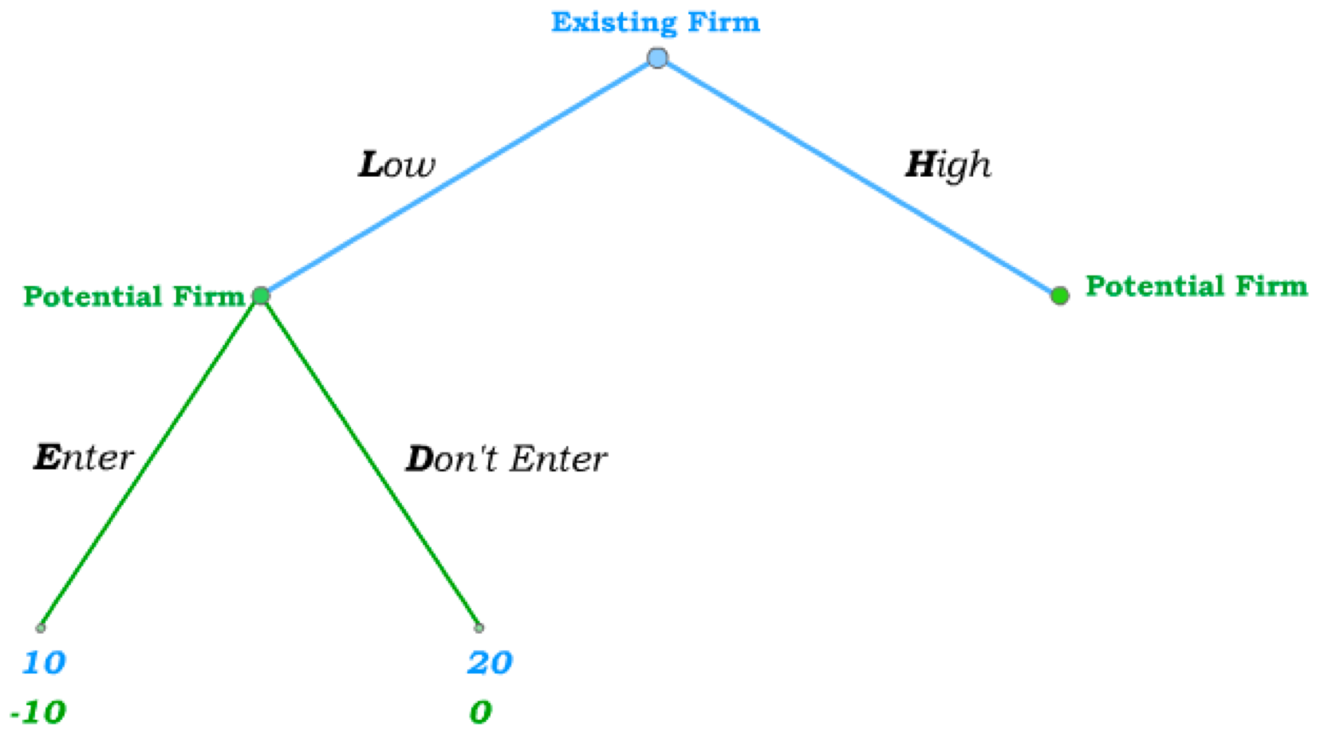
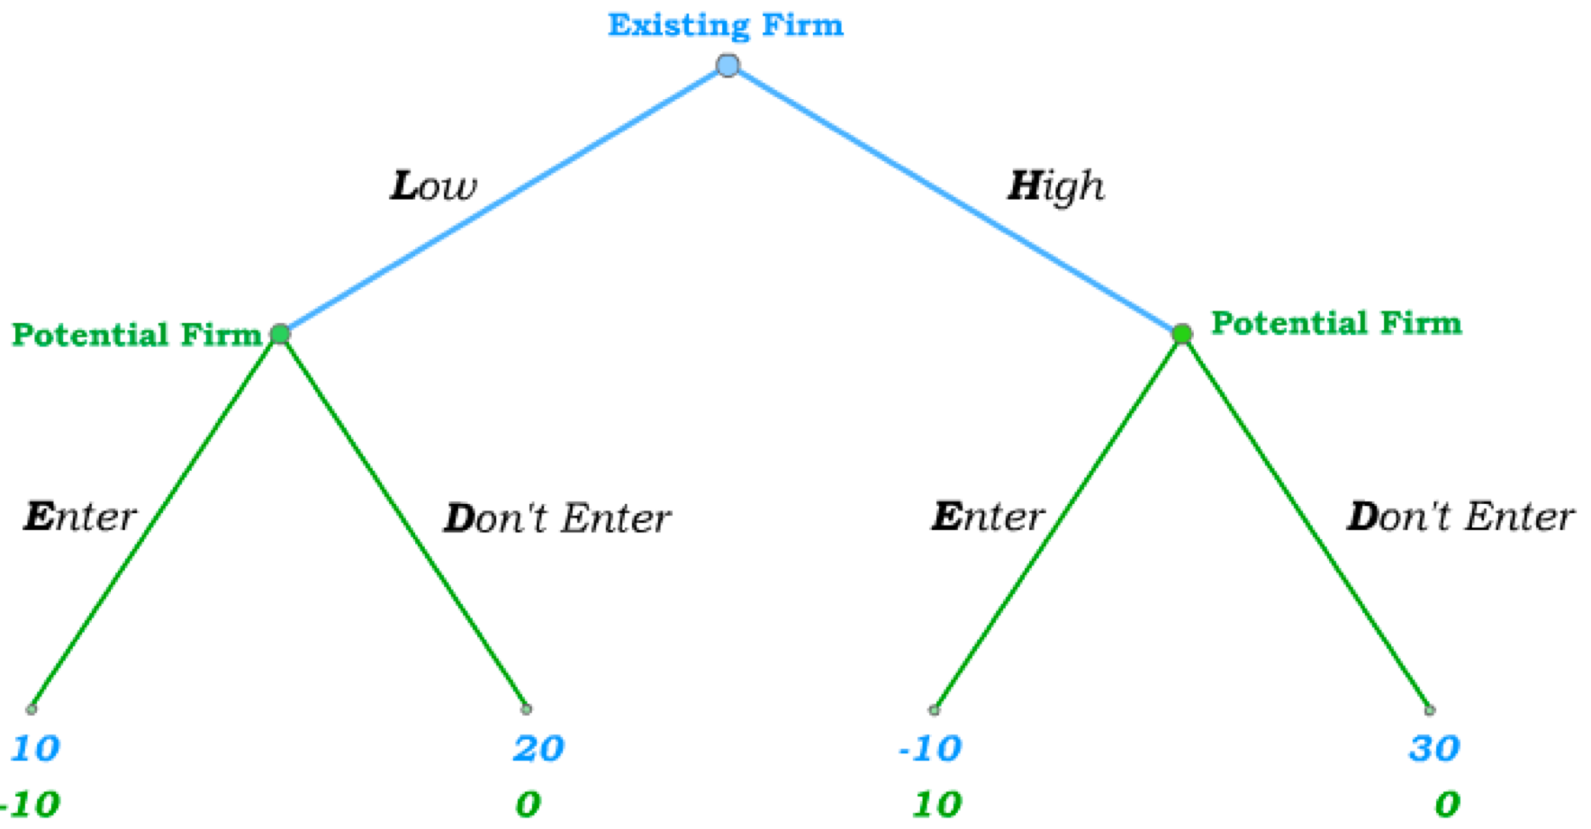
Another example
Consider the case of an Existing Firm that is threatened by competition from a Potential Firm that might choose to enter the market.
The Existing Firm moves first and sets either Low or a High price.
The Potential Firm then
either Enters or Doesn’t Enter.
If it Enters after the Existing Firm sets a Low price, its
expected profit is negative (b/c of a fixed entry cost) while the first firm’s profit is positive.
If it Doesn’t Enter at a low price, it makes zero profit while the first firm has higher profits.
If the Potential Firm Enters following a High price set by the Existing Firm, it can price lower and make positive profit while
causing the first firm to make losses.
But if the Potential Firm Doesn’t Enter, the Existing Firm gets the highest possible profit (and the second firm gets zero.)

Slide 23
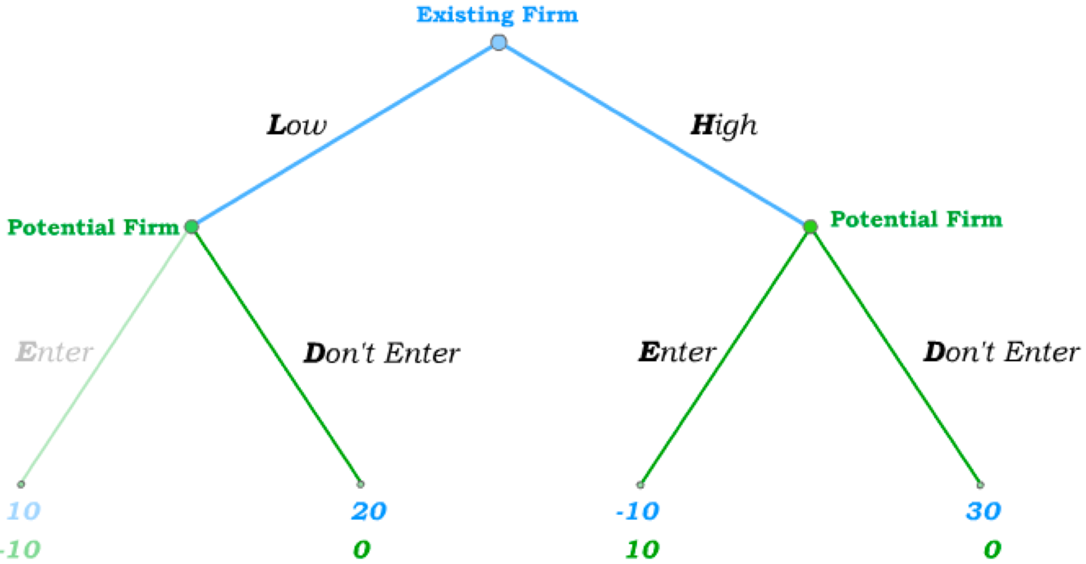
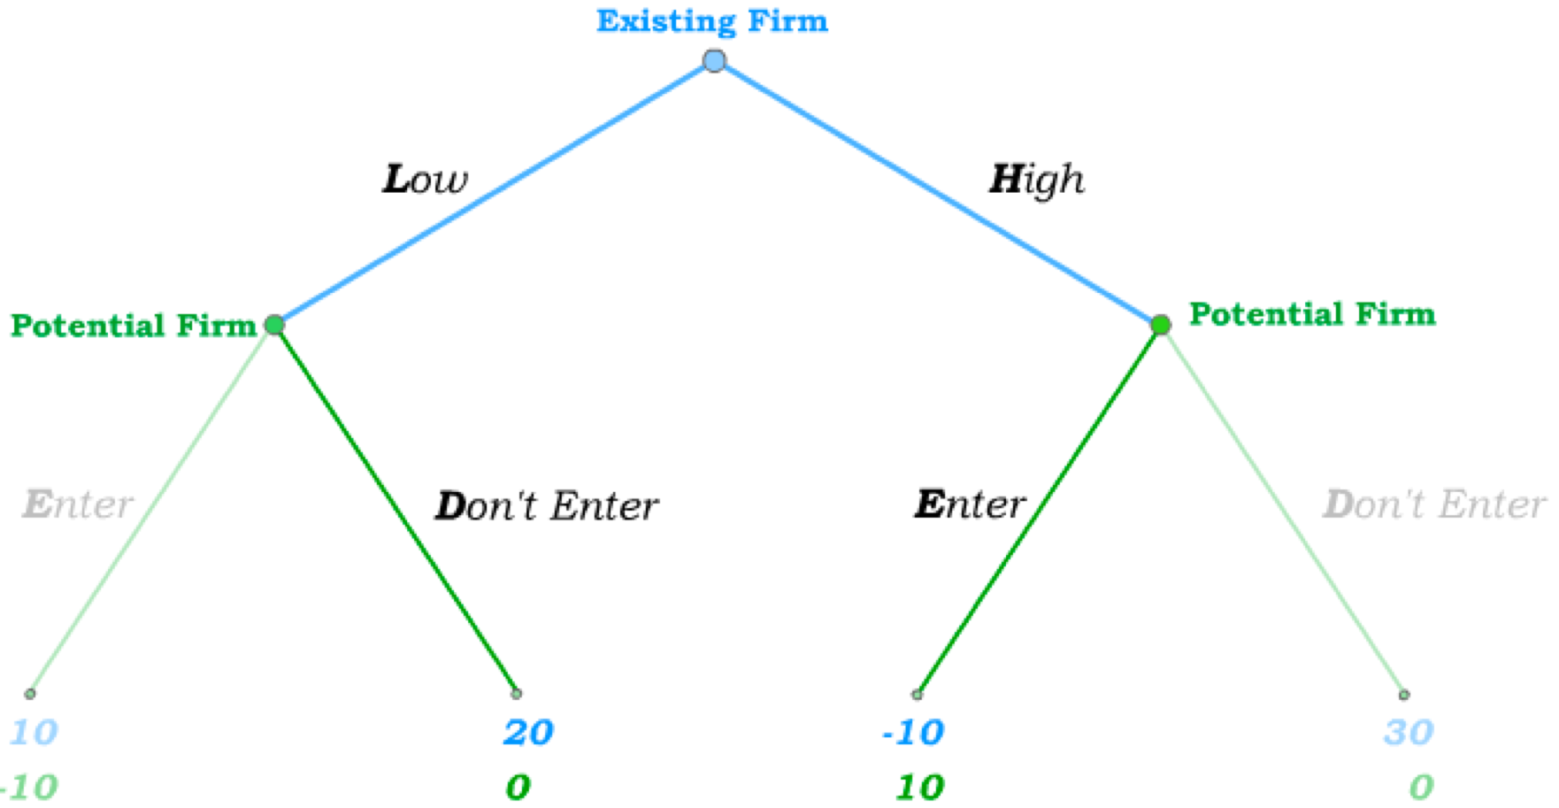
Solving for the Subgame-Perfect Equilibrium
To solve for the subgame-perfect Nash equilibrium, we solve from the bottom up.
We begin at the Potential Firm’s first node and see that, following a Low price, it does better by not entering.
And from its second node, following a High price, the Potential Firm
does better by Entering.
The Potential Firm’s subgame-perfect strategy is then (Don’t Enter, Enter).
The Existing Firm can anticipate this and therefore chooses between a payoff of 20 for Low and a payoff of -10 for High.
In the subgame–perfect equilibrium, the Existing Firm sets a Low price and the Potential Firm stays out of the market. SPNE={L,{D,E}}

Slide 24
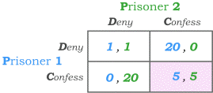

The Prisoner’s Dilemma
The Prisoner’s Dilemma is the most famous game in game theory because it applies to an extraordinarily large number of real world settings.
It derives its name from the following scenario:
– Two prisoners were caught committing a minor crime, but the prosecutor is quite convinced that they
also committed a more major crime together.
– The prosecutor puts them in separate rooms and tells each of them that they can either Deny the major crime or Confess to it.
– If they both Deny, they will both be convicted of the minor crime and receive a 1-year jail sentence.
– If they both Confess, the prosecutor will agree to a plea bargain that will get both of them a 5-year jail sentence.
– If prisoner 1 Confesses while prisoner 2 Denies, the prosecutor will use the confession to get a 20-year jail sentence for prisoner 2 while letting prisoner 1 go free.
– If prisoner 2 Confesses while prisoner 1 Denies, prisoner 1 gets the 20-year jail sentence while prisoner 2 goes free.

Slide 25
Nash Equilibrium in Prisoner’s Dilemma
Now consider prisoner 1’s incentives:
– If prisoner 2 Denies, prisoner 1’s best response is to Confess and get no jail.
– If prisoner 2 Confesses, prisoner 1’s best response is to Confess and get 5 years in jail (rather than 20).
Prisoner 2 has the same incentives to Confess regardless of what prisoner 1 does.
Confessing is therefore a dominant strategy for both prisoners.
The only Nash equilibrium to the game is {C,C}, both prisoners therefore confess, and both end up with 5-year jail sentences …
… but both would much prefer the outcome of only a 1-year jail sentence in the top left corner of the payoff matrix.
Cooperating with one another by Denying the crime is the efficient outcome in this game – but it cannot be sustained in an equilibrium.

Slide 26
Hiring an Enforcer
Suppose the two prisoners entered into an agreement prior to committing the major crime – an cooperative agreement to Deny the crime if questioned.
In the absence of an enforcement mechanism, such an agreement cannot be sustained in equilibrium …
X
… because it remains a dominant strategy to Confess when the time comes.
X
X
X
It then becomes in each player’s best interest to hire an enforcer to their agreement.
The two could, for instance, join a mafia organization that changes the payoffs to Confessing to X that is much worse than 20 years in jail.
It then becomes a dominant strategy to Deny – with “efficiency” restored.
In many real-world applications of the Prisoner’s Dilemma incentives, the “outside enforcer” we hire is the government.
Examples: Taxes for public goods; combating negative externalities
In other cases, social norms and social pressures can take the role of altering the incentives of a Prisoner’s Dilemma.

Slide 27
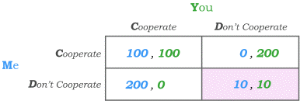
“Unraveling of Cooperation” in Repeated PD
What happens with repeated interactions in a prisoner's dilemma? Consider a different version of the Prisoner’s Dilemma, with Me and You as
players and with payoffs in terms of utility or euro values.
The only Nash equilibrium is again for neither of us to cooperate – thus getting payoffs (10,10) when we could have (100,100) by cooperating.
Now suppose we play this game N different times – giving us a game in which we repeatedly play a simultaneous move game at each of N stages.
In the final stage, the game becomes the same as if we only played once – implying a dominant strategy of NOT cooperating in the final stage.
To find the subgame-perfect equilibrium, we now have to work backwards.
In the second-to-last stage, we know there will be no cooperation in the last stage – which makes it a dominant strategy to NOT cooperate in the second-to-last stage.
Continuing the same reasoning, we see that cooperation unravels from the bottom of the repeated game up.

Slide 28
“Infinitely Repeated” Prisoner’s Dilemmas
But now suppose that the simultaneous move game is repeated infinitely many times, or, more realistically, that each time we encounter each other we know that there is a good chance we will encounter each other again to play the same game.
We can then no longer “solve the game from the bottom up” – because there is no “bottom”.
Suppose that I then propose we play the following strategy:
I will Cooperate the first time, and I will continue to Cooperate as long as you cooperated in all previous stages. But if you ever Don’t Cooperate, I will NEVER cooperate again.
Is it a best response for you to play the same strategy?
Yes, assuming the chance of us meeting again is sufficiently large and we care sufficiently about the future (not a too high discount rate), so that the present discounted value of future cooperation outweighs the immediate one-time benefit from not cooperating.
Such a strategy is called a trigger strategy because it uses an action by the opposing player to “trigger” a change in behaviour.

Slide 29
Equilibrium Trigger Strategies
Each of us playing this trigger strategy is therefore a Nash Equilibrium to the infinitely repeated Prisoner’s Dilemma – with cooperation emerging in equilibrium
Is it subgame-perfect?
Since we can no longer solve for the subgame-perfect equilibrium from the bottom up, we have to return to a more general definition of subgame-perfect:
A Nash equilibrium is subgame-perfect if all subgames – whether they are reached in equilibrium or not – also involve Nash equilibrium strategies.
Note that each subgame of the infinitely repeated Prisoner’s Dilemma is also an infinitely repeated Prisoner’s Dilemma!
Since each of us playing our trigger strategy is a Nash equilibrium to the infinitely repeated Prisoner’s Dilemma, it is therefore also a Nash equilibrium in every subgame.
Cooperation can therefore be sustained as a subgame-perfect Nash equilibrium in infinitely repeated Prisoner’s Dilemma games.

Slide 30
More “Forgiving” Trigger Strategies
The trigger strategy that punishes one act of non-cooperation with eternal non-cooperation is the most unforgiving trigger strategy that can lead to cooperation.
The same outcome can be achieved with more forgiving trigger strategies that punish deviations from cooperation with some period of non-cooperation but give a chance to the opposing player to recover cooperation at a cost.
The most famous such strategy is known as Tit-for-Tat:
I will Cooperate the first time, and from then on I will mimic what you did the last time we met.
A branch of game theory known as evolutionary game theory has given strong reasons to expect Tit-for-Tat to be among the most “evolutionarily stable” trigger strategies in infinitely repeated Prisoner’s Dilemma games.
In the study of how cooperation may evolve in systems governed by mechanisms akin to evolutionary biology, Tit-for-Tat is a likely candidate for a strategy that evolves as a social norm within civil society.
Interested to know more? Watch this amazing video by Veritasium: https://www.youtube.com/watch?v=mScpHTIi-kM&t=322s

Slide 31
Mixed Strategies
So far, we have dealt only with pure strategies – i.e. strategies that involve choosing an action with probability 1 at each information set.
A mixed strategy is a game plan that settles on a probability distribution that governs the choice of an action (at an information set).
Pure strategies are in fact a special case of mixed strategies, as they select a probability distribution that places all weight on one action.
Games with multiple pure strategy equilibria (like the Right/Left game) also have mixed strategy equilibria.
And games that have no pure-strategy equilibrium always have a mixed strategy equilibrium.
It is often not easy interpret what it is that we really mean by a mixed strategy equilibrium.
One way to interpret the concept of a mixed strategy equilibrium is to recognize that one randomizes over possible actions with a certain probability distribution.

Slide 32
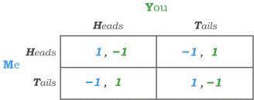
Matching Pennies
Consider a game in which Me and You can choose Heads or Tails in a simultaneous move setting.
If we choose the same action, I get a payoff of 1 and You get a payoff of –1.
If we choose different actions, I get a payoff of –1 and You get a payoff of 1.
If You choose Heads, my best response is to also choose Heads.
But if I choose Heads, Your best response is to choose Tails.
But if You choose Tails, my best response is to also choose Tails.
But if I choose Tails, Your best response is to choose Heads.
Thus, there is no pure strategy Nash Equilibrium in this game.
This game, called the Matching Pennies game, is then often used to motivate the idea of a mixed strategy equilibrium.

Slide 33
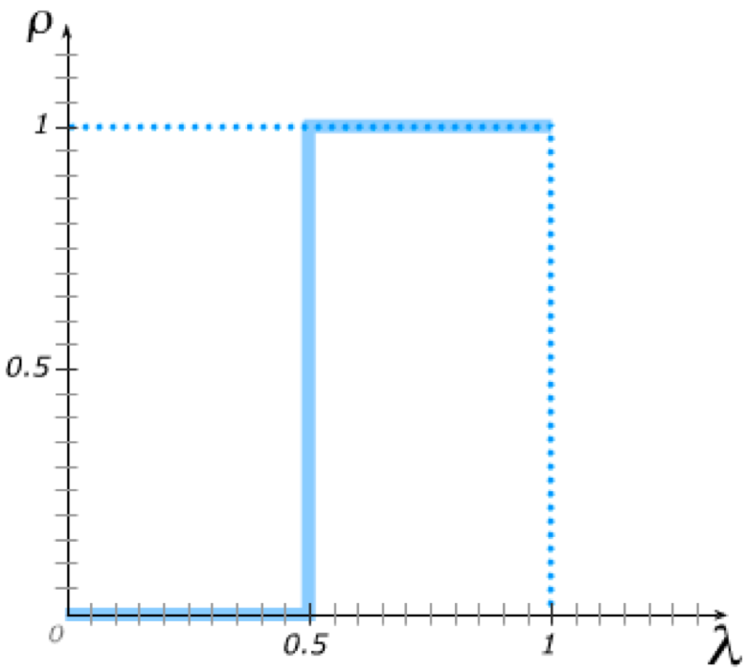
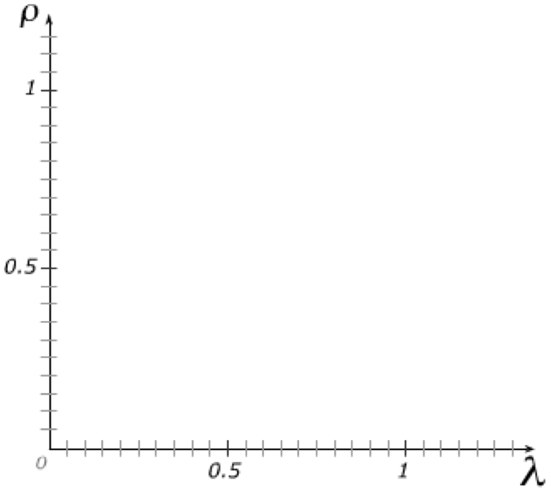
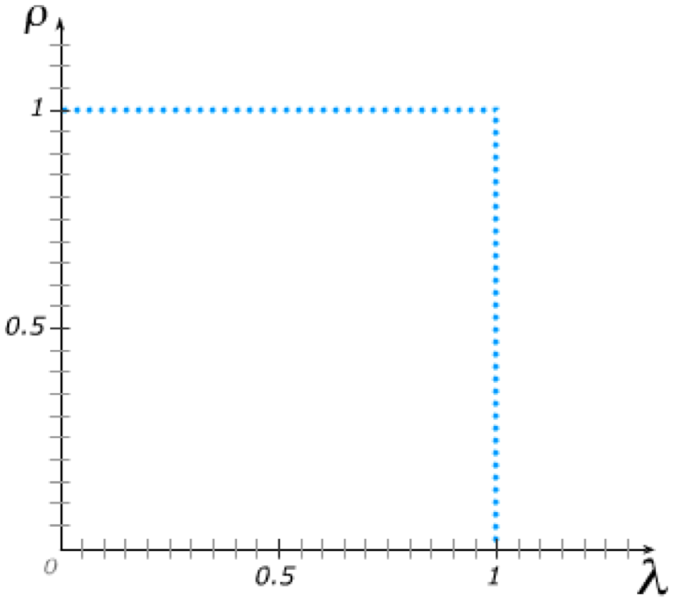
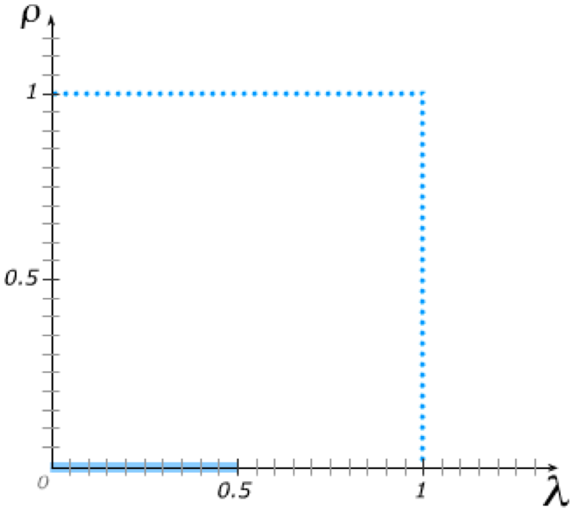
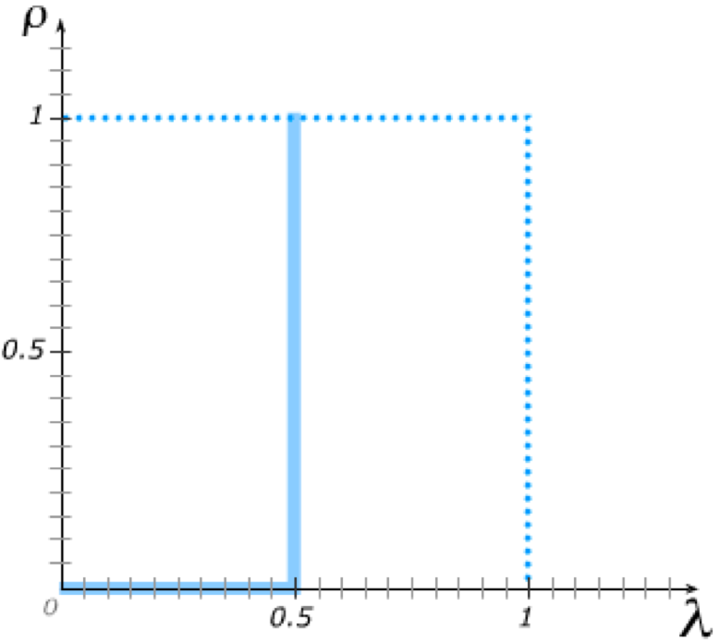
Best Response Functions with Mixed Strategies
Suppose I believe you will play Heads with probability λ,
and I try to determine my best response in terms of probability ρ with which I play Heads.
My goal is to maximize the chance that I will match what you do …
… which means I will choose Tails if you are (more) likely to choose Tails and Heads if you are (more) likely to choose Heads.
The only time I am indifferent between Heads and Tails is if λ =0.5.
My best response probability ρ to your λ is then:

Slide 34
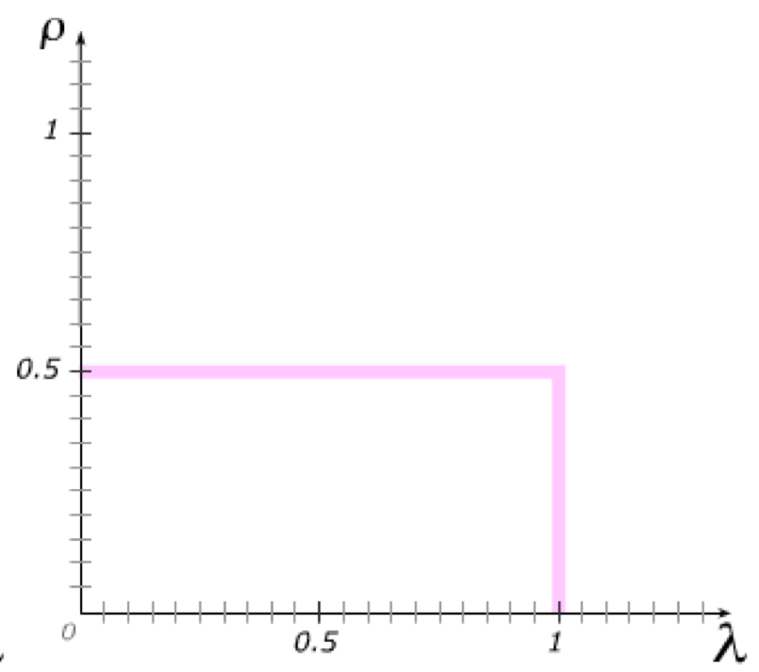
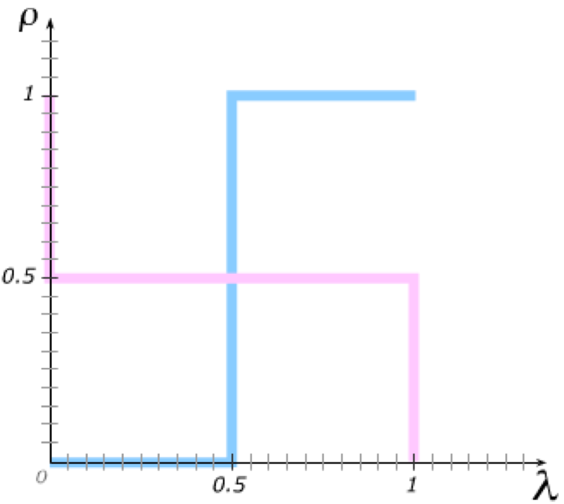
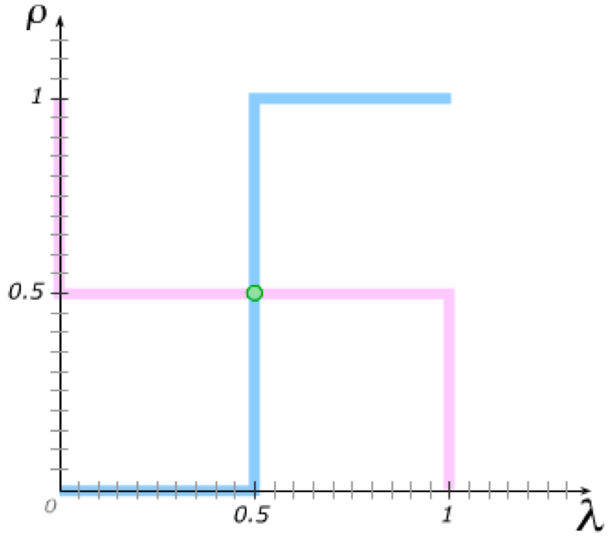
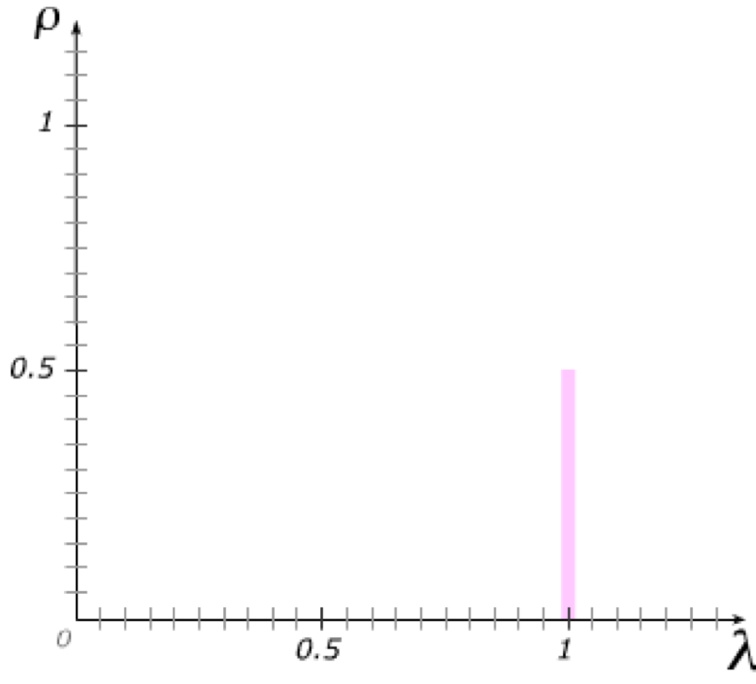
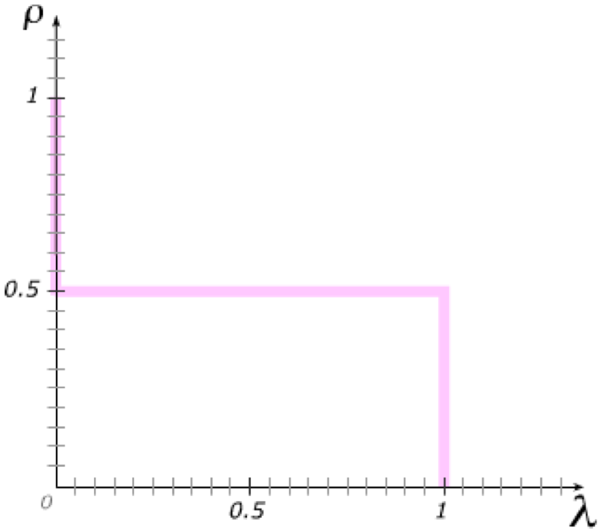
Mixed Strategy Nash Equilibrium
Your goal is to maximize the chance that you will NOT match what I do …
In a Nash equilibrium, we have to best-respond to one another ...
… which means our best response functions must intersect.
At the intersection, ρ = λ = 0.5.
The only Nash equilibrium to the “Matching Pennies” game is a mixed strategy Nash equilibrium with both of us playing each of our actions with probability 0.5.

Slide 35
Mixed Strategy Nash Equilibrium
To summarize the mixed strategy Nash equilibrium :
  I choose H and T with probability ρ and (1− ρ) to make you indifferent
  You choose H and T with probability λ and (1− λ) to make me indifferent
(i) guarantees that any λ is a best response and (ii) guarantees that any ρ is a best response. Hence this is a Nash equilibrium.
I am indifferent if expected payoff of H and T are equal:
λ−(1− λ) = − λ+(1− λ)
2λ−1 = − 2λ+1
4λ = 2
λ = 1/2
You are indifferent if expected payoff of H and T are equal:
− ρ +(1− ρ) = ρ −(1− ρ)
−2ρ +1 = 2ρ −1
4ρ = 2
ρ=1/2

Slide 36
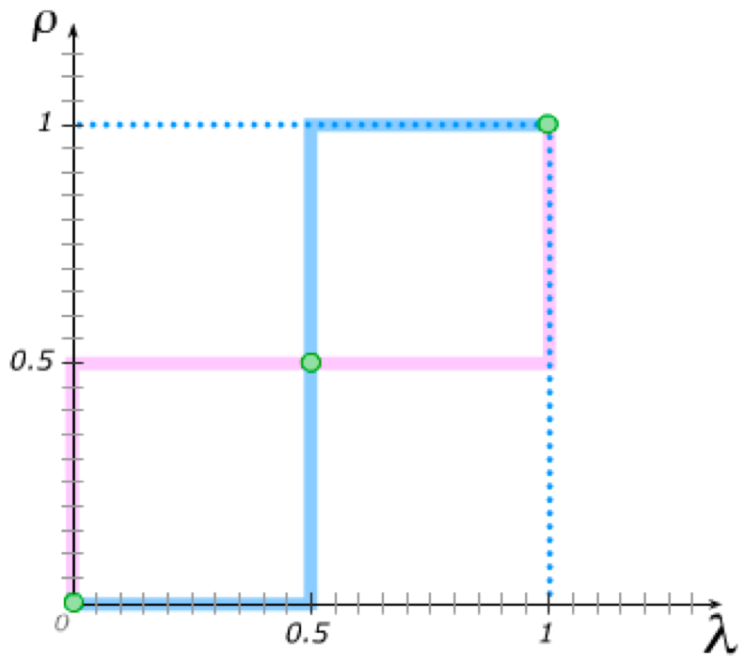
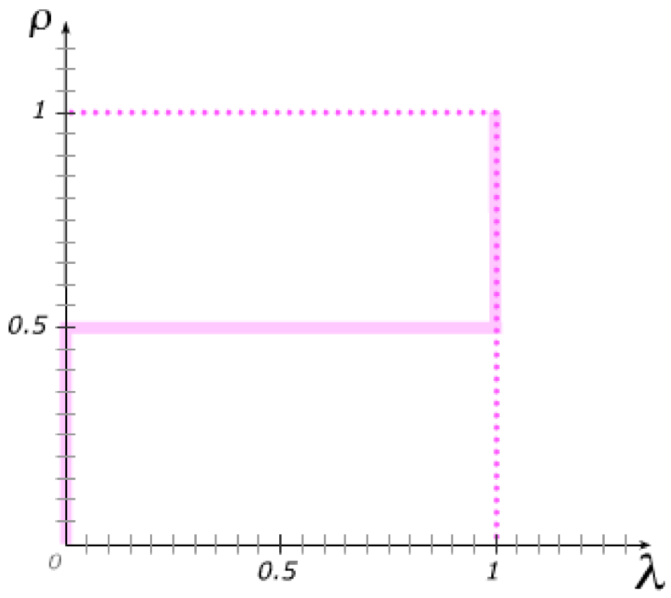
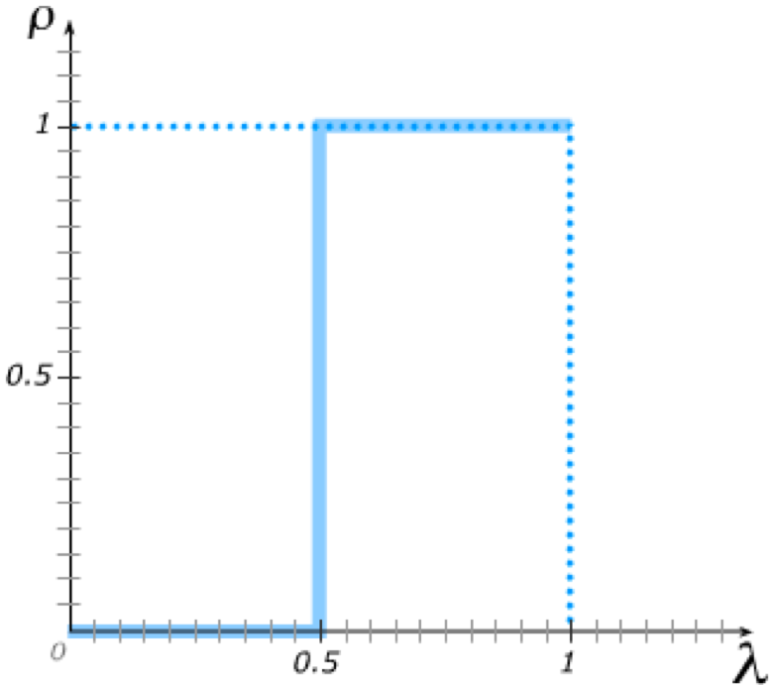
Back to the Right/Left Game
In the Right/Left game, my goal continues to be to match what you do.
You
Letting ρ and λ be the probabilities me and you place on Left, my best response function then looks as it did for “Matching Pennies”.
Me
But your best response function now also has you trying to match what I do …
… resulting in three intersections of our best response functions.
our previous pure strategy Nash equilibria
a new mixed strategy Nash equilibrium
Whenever there are multiple pure strategy Nash equilibria, there is also at least one mixed strategy equilibrium.

Slide 37
Mixed Strategy NE with Different Probabilities
Now suppose that the payoffs from coordinating on Right are 5 instead of 10, with ρ and λ still the probabilities me and you place on Left.
You
My expected payoff from going Left is then 10λ, and my expected payoff from going Right is 5(1 – λ).
Me
These are equal to one another when λ=1/3, implying I am indifferent between Left and Right when λ=1/3,
5 , 5
will best-respond
with Left when λ > 1/3,
and with Right when λ < 1/3.
You face the same incentives, giving rise to the same best response λ to my ρ.
We still see the same pure strategy Nash equilibria, but now …
The mixed strategy equilibrium now has us both playing Heads with probability 1/3.
1/3
1/3

Slide 38
Mixed Strategy NE with Different Probabilities
To summarize the mixed strategy Nash equilibrium :
  I choose L and R with probability ρ and (1− ρ) to make you indifferent
  You choose L and R with probability λ and (1− λ) to make me indifferent
(i) guarantees that any λ is a best response and (ii) guarantees that any ρ is a best response. Hence this is a Nash equilibrium.
I am indifferent if expected payoff of L and R are equal:
10λ = 5(1− λ)
10λ = 5− 5λ
15λ = 5
λ=1/3
You are indifferent if expected payoff of L and R are equal:
10ρ = 5(1− ρ)
10ρ = 5 −5ρ
15ρ = 5
ρ = 1/3
5 , 5

Slide 39
Tutorial exercises
Within-chapter exercises:
  24A.2, 24A.3, 24A.4, 24A.6, 24A.7, 24A.8, 24A.9, 24A.10, 24A.12, 24A.14, 24A.16, 24A.19, 24A.20, 24A.23, 24A.24, 24A.25, 24A.26, 24A.30, 24A.31
End-of-chapter exercises:
  24.1 (skip B.c-e), 24.2A, 24.6

