Slide 1
Behavioural Finance
1. Introduction
Antonio Silva, April 2023

Slide 2
A bit about me
Academic background: Environmental Biology, Photography and Evolutionary Anthropology
Started working at the Behavioural Insights Team in 2013. BIT is the world’s first government institution dedicated to the application of behavioural sciences started by the UK Government in 2010 – also known as the Nudge Unit.
I’ve worked across all policy areas, with a focus on social cohesion. Ran over 30 RCTs to find out what works (and as importantly) what doesn’t.
Started a research scholarship in ISEG in 2019 on applying behavioural science to public policy in the Portuguese context.
Currently working on i) reducing accidents in the UK, ii) exploring how social capital affects social mobility using Facebook data and iii) trying to stop Russian misinformation and reduce support for the war.

Slide 3
Behavioural Finance
Course Outline
Introduction to Behavioural Finance
Theoretical Foundations: Expected Utility Theory & Prospect Theory
Theoretical Foundations: Expected Utility Theory & Prospect Theory II
Heuristics & Behavioural Biases: Representativeness and Availability
Heuristics & Behavioural Biases II: Anchoring and Affect
Heuristics & Behavioural Biases III: Cognitive Bias
Heuristics & Behavioural Biases IV: Emotional Bias
Heuristics & Behavioural Biases V: Emotional Bias II
Public Policy & Behavioural Insights
Public Policy & Behavioural Insights II
Experimental Economics
Game Theory

Slide 4
Introduction to Behavioural Finance
Lesson Outline
Why context matters
Standard Finance Model
Behavioural Finance Model
Course readings and assessment

Slide 5
Getting the neurons firing
Snore
Nap
Peace
Yawn
Drowsy
Bed
Rest
Awake
Tired
Dream
Wake
Snooze
Blanket
Doze
Slumber
Snore
Nap
Peace
Yawn
Drowsy
Notes:
HOW TO DO IT:
Read the words aloud. Wait about 10 more seconds.
TIMING:
30 sec

Slide 6
Take a moment to write down the words you remember
Notes:
KEY MESSAGE: “Write down words you remember”
HOW TO DO IT: Give them 45 seconds in silence
MATERIALS: They use phones or pen/paper to write words.
TIMING: 1 min

Slide 7
No sleep here
Snore
Nap
Peace
Yawn
Drowsy
Bed
Rest
Awake
Tired
Dream
Wake
Snooze
Blanket
Doze
Slumber
Snore
Nap
Peace
Yawn
Drowsy
Notes:
HOW TO DO IT:
Read the words aloud. Wait about 10 more seconds.
TIMING:
30 sec

Slide 8
40 – 55% of people falsely recall “sleep”
Memory can be influenced by context
Source: Roediger, H. & McDermott, K., (1995), ‘Creating False Memories: Remembering Words Not Presented in Lists’, Journal of Experimental Psychology: Learning, Memory, and Cognition, Vol. 21, No. 4, pp. 803-814.
Notes:
PURPOSE:
Introduce memories are influenced by context and mental shortcuts lead to false recall.
KEY MESSAGE:
“Now, you shouldn’t feel at all bad if you were one of the people with your hand up. And I don’t just say that because I was one of you the first time I saw this. Apart from me you’re in good company: about half of the people in a room will falsely recall the word “sleep” when they get shown this list.
What your brain has done is something quite smart: it’s spotted a pattern – in this case a group of words that all have something in common – and it’s filled in the blank.
Our brains are wired to do this all the time; it’s how we manage the enormous amount of information thrown at us everything and don’t crumble with indecision. To optimise performance your brain engages in pattern recognition. And it’s predictable mental shortcuts like this that are at the heart of behavioural science; I’ll be talking about that in a lot more detail in about five minutes.
However this pattern recognition that we engage in can lead to false recall which about half of you have just experienced.
Our memories are influenced by context.”
TIMING:
1-2 mins

Slide 9
Framing effects
Reference Point
Small changes to our environment, to the way choices are presented and services are designed, can have a big impact on our behaviour
9

Slide 10
Framing effects
Analogy
© The Behavioural Insights Team

Slide 11
Framing effects
Analogy
© The Behavioural Insights Team

Slide 12
Which would you choose?
Imagine that you want to buy a subscription to The Economist and you can choose from the following three options:
Online subscription (£59.00): One-year subscription to Economist.com
Print subscription (£125.00): One-year subscription to the print edition of The Economist
Online + Print subscription (£125.00): One-year subscription to the print edition of The Economist plus online access.
Notes:
Skip if you are presenting 60 minutes only
PURPOSE:
Setting up preferences are also influenced by context.
KEY MESSAGE:
“Another game for you...Imagine you are considering a subscription to the Economist. You are presented with three options:
1. You can get an online prescription for a year for £59
2. You can get a print subscription for a year for £125
3. Or you can get both the online and print subscription for the year for £125
So who would go for option 2 – No-one
Who would go for option 1? Option 3?
HOW TO DO IT:
Set up ‘game’. Read choices and ask people to put their hands up.
TIMING:
1-2 mins
LINK:
To next 3 slides

Slide 13
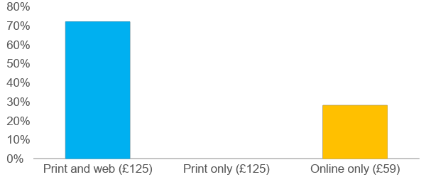
Which would you choose?
A group of MBA students were asked the same question and this is what they chose:
72%
28%
Notes:
Skip if you are presenting 60 minutes only
PURPOSE:
Setting up preferences are also influenced by context.
KEY MESSAGE:
“You’re behaving roughly in line with what happened when a group of MBA were asked the same question.
They predominantly went for the print and web option.
Nobody went for the print only option – it’s obviously a terrible deal.”
TIMING:
1-2 mins
LINK:
To next slide

Slide 14
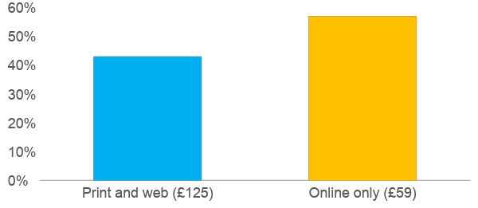
Which would you choose?
However, when presented with only two choices the proportion of students that choose the print and web option drops to 43%:
43%
57%
Source: Kivetz, R., Netzer, O., Srinivasan, V. 2004. Extending Compromise Effect Models to Complex Buying Situations and Other Context Effects. Journal of Marketing Research, Vol. XLI, 262-268.
Notes:
Skip if you are presenting 60 minutes only
PURPOSE:
Setting up preferences are also influenced by context.
KEY MESSAGE:
“What’s interesting about this is to look at what happens when you remove the print only option...
...Their preferences essentially flip”
TIMING:
1 min
LINK:
To next slide

Slide 15
Irrelevant decoy information sways choice
Decoy
72%
28%
Notes:
Skip if you are presenting 60 minutes only
PURPOSE:
Preferences are also influenced by context.
KEY MESSAGE:
“The middle option was a decoy which made one option look better by virtue a less good comparison and it actually shifts people’s preferences.
So what we learn from this game is that preferences are also influenced by context”
TIMING:
1 min

Slide 16
Contextual influences have real consequences
Memory
Judgement
Preferences
70% of false convictions are caused by an inaccurate eyewitness statement
Yellow lines on the train tracks in India reduced the number people hit by trains by 75%
61% of patients choose comfort-oriented care over life-extending care. With default this increased to 77%
Notes:
PURPOSE:
Memory, judgement and preferences are all influenced by context which have huge life changing implications
KEY MESSAGE:
“So memory, judgement and preferences are all influenced by context. What is impact of this (real world consequences)? Turns out huge..life changing in some instances.
Memory - False recall leads to mistaken eyewitness identifications which are the leading factor in wrongful convictions. 70% of false convictions are caused by a inaccurate eyewitness statement. This means up to 100 innocent people could be wrongfully convicted each year of a violent crime in the UK because of these false eyewitnesses (source Innocence Project). Remarkably eyewitness testimony is the main form of evidence in more than 20% of cases.”
“Judgement errors – we can’t judge the speed of large objects well. In India, crossing train tracks by foot is quite routine and the casualties from this are high. Painting regular sets of yellow lines on the train tracks reduced the number people hit by trains by 75%. People were better able to judge the distance and speed of oncoming trains (source Final Mile Consulting Project)
“Preferences - Context even influences people’s preferences on how they die. In palliative care patients are typically offered comfort-oriented care or life-extending care. An experiment found that when patients had to choose which type of care they wanted to receive, 61 % of patients selected comfort-oriented care. However when comfort-oriented care was presented as the default 77% chose this pathway. When the life extending care option was presented as the default only 43% rejected this option to choose the comfort oriented pathway. We infer that defaults have been carefully chosen and are the best thing for us - They send a signal of legitimacy. (Source Health Aff)
TIMING:
30 sec

Slide 17
Why do environmental and contextual factors have such an impact on our behaviour?
Notes:
PURPOSE:
Introduce Dual Processing Theory and the game
KEY MESSAGE:
“...So why does this happen? Why do environmental and contextual factors have such an impact on our behaviour?
We’ll look at some of the theory of Systems 1 and 2 that describes these behaviours.
But before we explain this theory, we want you to experience systems 1 and 2 in action”
HOW TO DO IT:
Game with audience as a whole. You will click through slides and they will say colours outloud.
TIMING:
1 min

Slide 18
What is the colour of the font?
Notes:
KEY MESSAGE:
“I’m going to put up words on the screen and together say the colours of the fonts.”
HOW TO DO IT:
Game with audience as a whole. You will click through slides and they will say colours outloud.
TIMING:
1 min (for colours game)

Slide 19
Blue

Slide 20
Red

Slide 21
Green

Slide 22
Brown

Slide 23
Orange

Slide 24
Pink
Notes:
KEY MESSAGE:
“What was the difference between the first set of words and the second set? Harder? Slower?
You have just experienced using 2 different styles of thinking.”
TIMING:
1 min (slides 47-53)

Slide 25
We need to think differently about behaviour
Biases
Emotions
System 2
Slow thinking/Reflective deliberate, analytic
24x17
Planning a trip overseas
Intuition
System 1
Fast thinking/Automatic intuitive, effortless
2x2
Taking your daily commute
Daniel Kahneman, Nobel Laureate
Social Influence
Heuristics
Notes:
A growing body of psychological research divides our decision-making into two systems. System 1 thinking is fast, effortless, automatic and largely involuntary - the kind of thinking that we use to take our daily commute or to react when we hear a loud noise. By contrast, System 2 is more deliberative, effortful, attentive, and voluntary. System 2 thinking is used to undertake complex thought processes like writing a job application or deciding which school to send our children. Both systems are important for getting through life effectively and efficiently but we are increasingly learning that System 1 thinking can sometimes lead us astray and we have limited capacity for System 2 thinking.
Intuition – Aggregate of past experience and assumptions
Mental short-cuts – we’re fast and frugal thinkers, using rules-of-thumb and instinct a lot of the time, rather than careful deliberation
Emotions – choices are often made on their emotional resonance, not deliberate logic
Social influence – we social creatures, often conforming to the masses, and use others as a source of information.
Biases – stereotypes, assumptions, and our tendencies to focus on some aspects of a situation and ignore others, our tendency to ignore information that doesn’t support our pre-existing opinions and beliefs.

Slide 26
Standard Finance
Principles of finance based on Neoclassical economics assumptions
Behavioural Finance | Sandra Maximiano Lecture 1|Nov 2 2021

Slide 27
Standard Finance
It often fails to adequately explain how normal people and markets actually behave.
Behavioural Finance | Sandra Maximiano Lecture 1|Nov 2 2021

Slide 28
Standard Finance
Homo Economicus
Market Efficiency
Standard Portfolio Theory
Standard Asset Price Theory
Standard Life-Cycle Theory

Slide 29
Homo Economicus
Rational
Always knows what is in their best interest
Is a utility maximiser
Constant preferences
Updates beliefs optimally

Slide 30
Homo Economicus
$$\max_{x_{i}^{t}∈X_{i}}{\sum_{t=0}^{∞}{δ^{t}}}\sum_{s_{t}∈S_{t}}{p\left(s_{t}\right)U\left(x_{i}^{t}|s_{t}\right)}$$
Individuals care about their own payoff
Discount all future periods at the same rate
Know and take into account the actual probabilities of each state

Slide 31
Market Efficiency
The Efficient Market Hypothesis suggests that markets are rational and their prices fully reflect all available information. Due to the timely actions of investors, prices of stocks quickly adjust to the new information, and reflect all the available information.
Behavioural Finance | Sandra Maximiano Lecture 1|Nov 2 2021
Notes:
The Market Efficiency Hypothesis, commonly known as the Efficient Market Hypothesis (EMH), is a fundamental concept in financial economics that suggests financial markets are "efficient" in reflecting all available information about the prices of securities. Introduced by Eugene Fama in the 1960s, EMH argues that it's impossible for investors to consistently achieve higher returns than average market returns on a risk-adjusted basis, because asset prices already incorporate and reflect all relevant information.
EMH is divided into three forms based on the extent of information considered to be reflected in the stock prices:
1. **Weak-Form Efficiency**: This form asserts that all past trading information, including historical prices and volumes, is fully reflected in stock prices. Therefore, technical analysis, which attempts to predict future stock prices based on past trends, cannot consistently outperform the market.
2. **Semi-Strong Form Efficiency**: According to this, all publicly available information (including past trading information, financial statements, news articles, etc.) is already reflected in stock prices. If this form of efficiency holds true, neither technical analysis nor fundamental analysis (which evaluates securities by attempting to measure their intrinsic value) would be able to consistently produce excess returns.
3. **Strong-Form Efficiency**: This is the most stringent form of the EMH and suggests that all information, public and private (including insider information), is fully reflected in stock prices. Under strong-form efficiency, no one can consistently achieve higher returns because even insider information is already priced into market values.

Slide 32
Standard Portfolio Theory
People construct portfolios as described by mean-variance portfolio theory, where people's portfolio wants include only high expected returns and low risk.
Behavioural Finance | Sandra Maximiano Lecture 1|Nov 2 2021
Notes:
Standard Portfolio Theory, often referred to as Modern Portfolio Theory (MPT), is a foundational financial concept introduced by Harry Markowitz in 1952. It's centered on the idea of optimizing the balance between risk and return in an investment portfolio. Some of its core principles are:
1. Diversification: MPT emphasizes the importance of diversifying investments to reduce risk. By holding a mix of assets that don’t move in tandem (i.e., their prices don’t increase or decrease together), an investor can lower the overall volatility of their portfolio.
2.Risk and Return: Risk is typically quantified as the standard deviation of returns, representing the volatility or the degree to which an asset's returns vary from its average return. The theory assumes that investors are risk-averse; they prefer a higher return to a lower one and a lower risk to a higher one, all else being equal.
3. Correlation: The theory places significant importance on the correlation between asset returns. Assets with low or negative correlations are preferred for diversification because they help in reducing the portfolio’s overall risk.
In practice, applying Standard Portfolio Theory involves selecting a mix of investments that aligns with an investor’s risk tolerance while aiming for the maximum possible return. This involves careful analysis of each asset’s expected return, risk, and how it correlates with other assets in the portfolio. Financial advisors and investment funds widely use MPT principles to build and manage portfolios for their clients.

Slide 33
Standard Life-Cycle Theory
People save and spend as described by standard life-cycle theory, where people find it easy to identify and implement the right way to save and spend.
Behavioural Finance | Sandra Maximiano Lecture 1|Nov 2 2021
Notes:
The Standard Life-Cycle Theory, often referenced in economics and personal finance, is a theory that describes how individuals plan their consumption and savings behaviour over the course of their lifetime. This theory, attributed to the work of economists Franco Modigliani and his colleagues, underpins the Life-Cycle Hypothesis (LCH). Here’s an outline of its key concepts:
Consumption Smoothing: Central to the Life-Cycle Theory is the idea of consumption smoothing. Individuals prefer to maintain a stable consumption level throughout their life, rather than experiencing significant fluctuations based on their income at any given time. This implies that people save during their working years when income exceeds consumption needs and draw down their savings during retirement.
Income Patterns: An individual’s income typically follows a predictable pattern – generally lower at the beginning and end of the work life, and higher during peak working years. Savings are thus accumulated in anticipation of retirement, when income significantly drops.
Forward-looking Behaviour: The Life-Cycle Theory says that individuals make forward-looking financial decisions based on their entire lifecycle. They estimate their lifetime income and plan their savings and consumption accordingly to smooth out their consumption over their lifespan.
This theory underpins a lots of things. For example, pensions and social security are both based on this model the life-cycle model. These income sources allow for greater consumption smoothing by providing a predictable income stream in retirement, reducing the need for personal savings to some extent. Young individuals, for example, might borrow to invest in education or purchase a home, expecting that their future income will allow them to pay off this debt.
The Life-Cycle Theory has profound implications for personal financial planning, suggesting that individuals should consider their long-term income and consumption patterns when making decisions about savings, investment, and spending. It also has implications for government policies on pensions, taxation, and social welfare.

Slide 34
Standard Asset-Price Theory
Expected returns of investments are accounted for by standard asset pricing theory, where differences in expected returns are determined only by differences in risk.
Behavioural Finance | Sandra Maximiano Lecture 1|Nov 2 2021
Notes:
Standard Asset-Price Theory, often discussed within the realms of financial economics, revolves around understanding and explaining how assets are priced in the market. This theory encompasses various models and principles that seek to predict the prices of assets based on their inherent risk, expected returns, and the overall market dynamics. Here’s a look at some key concepts and models integral to this theory:
Efficient Market Hypothesis (EMH): Central to asset pricing theory, the EMH asserts that asset prices fully reflect all available information. This means that it's impossible to consistently achieve higher returns without taking on additional risk, as prices always incorporate and reflect the true value of the asset. EMH is categorized into three forms: weak, semi-strong, and strong, each differing in terms of the information considered to be reflected in asset prices.
Capital Asset Pricing Model (CAPM): The CAPM provides a framework to assess the expected return on an investment given its risk relative to the market. It introduces the concept of the beta coefficient, which measures an asset’s volatility or risk compared to the broader market. The model posits that investors require a higher expected return to compensate for higher risk.
Arbitrage Pricing Theory (APT): APT is a multi-factor model that suggests asset prices are influenced by several economic factors or risks, unlike the CAPM, which considers only the market risk. These factors could include inflation rates, interest rates, and GDP growth, among others. The theory argues that arbitrage opportunities (buying undervalued and selling overvalued assets) will bring prices to their correct levels, based on the sensitivity of the asset’s return to these factors.
Fundamental Analysis: This approach involves evaluating the intrinsic value of an asset by examining related economic, financial, and other qualitative and quantitative factors. Fundamental analysts believe that the market may overvalue or undervalue an asset in the short term, but eventually, the asset's price will adjust to reflect its true fundamental value.

Slide 35
Main standard economic assumptions
Rationality
Self-interest
Consistent preferences
Optimal beliefs updating

Slide 36
Main Standard Economic assumptions have yielded fantastic insight and tractable models but…

Slide 37
Are agents maximising their expected utility?

Slide 38
Are agents driven by their emotions?

Slide 39
Are agents selfish?

Slide 40
Behavioural Finance
Principles of finance based on Behavioural Economics
Behavioural Finance | Sandra Maximiano Lecture 1|Nov 2 2021

Slide 41
Behavioural Economics
The study of economic decision-making by individuals and institutions assuming that the individuals are influenced by social, cognitive, and emotional factors
Behavioural Finance | Sandra Maximiano Lecture 1|Nov 2 2021

Slide 42
Behavioural Finance
The study of the influence of psychology and other disciplines on the behaviour of financial practitioners and the subsequent effect on markets. Also focuses on applying psychological and economic principles for the improvement of financial decision-making.
Behavioural Finance | Sandra Maximiano Lecture 1|Nov 2 2021

Slide 43
Behavioural Finance
Homo sapiens
Market Inefficiency
Behavioural Portfolio Theory
Behavioural Asset Price Theory
Behavioural Life-Cycle Theory

Slide 44
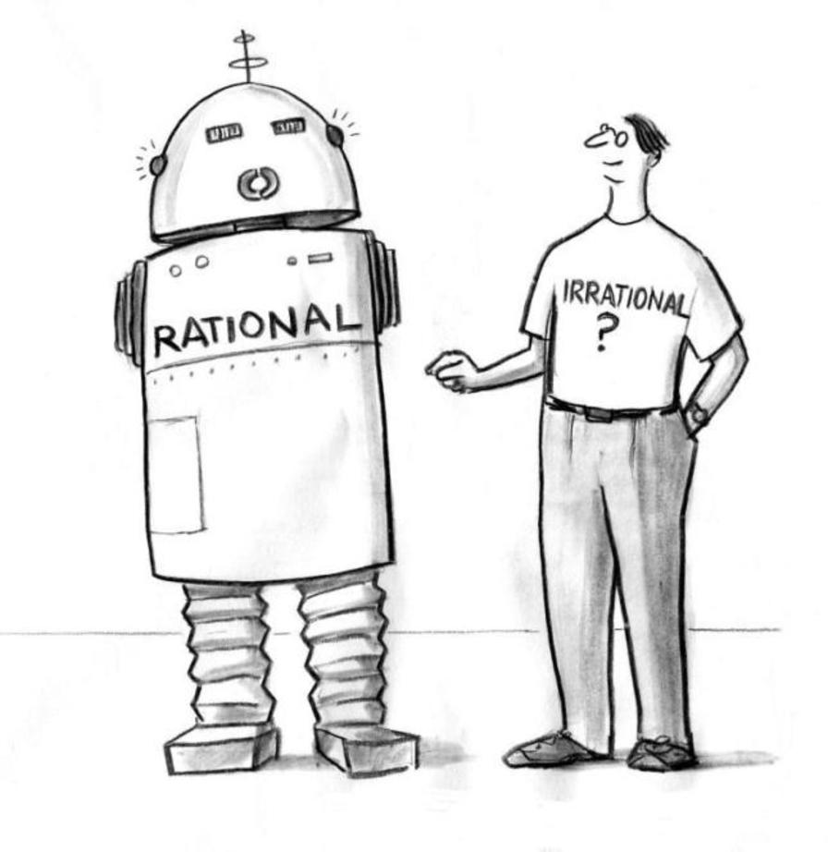
Homo sapiens
Bounded Rational
Not always knows what is in their best interest
Is a utility satisfier, not a utility maximiser
Suffers from cognitive biases
Uses heuristics and intuitions to make decisions
Notes:
humans strive to make rational choices, their cognitive capacity to process and analyze information is limited. Additionally, individuals operate under constraints such as limited time, information, and computational abilities. Therefore, instead of optimizing, people often settle for satisfactory solutions that fulfill their needs or goals adequately, rather than the best possible outcome.

Slide 45
Homo sapiens
Makes choices that are dependent of context and irrelevant events
Is affected by social pressure
Is an emotional being
Is a moral being, feels shame and guilt

Slide 46
Market Inefficiency
An inefficient market is one in which an asset's prices do not accurately reflect its true value. With an inefficient market all the publicly available information is not reflected in the price, suggesting that bargains are available or that prices could be over-valued.
Behavioural Finance | Sandra Maximiano Lecture 1|Nov 2 2021

Slide 47
Behavioural Portfolio Theory
People construct portfolios as described by behavioural portfolio theory, where people’s portfolio wants extends beyond high expected returns and low risk, such as wants for social responsibility and social status.
Behavioural Finance | Sandra Maximiano Lecture 1|Nov 2 2021
Notes:
Developed by Hersh Shefrin and Meir Statman in the late 1990s and early 2000s, BPT challenges the classical view that investors solely aim to maximize returns for a given level of risk. Instead, it suggests that investors create portfolios based on layers of goals that reflect different aspects of their financial needs and desires, often leading to behaviors and choices that deviate from those predicted by traditional financial theories.

Slide 48
Behavioural Portfolio Theory
Key Concepts
Mental Accounting: Investors divide their investments into separate "mental accounts" osuch as saving for retirement, emergency fund, or saving for a holiday. Each account has its own level of risk tolerance and investment objective, which may not align with the optimal risk-return trade-off suggested by traditional portfolio theory.
Safety-First and Aspiration Levels: investors prioritise safety-first goals (e.g., ensuring a minimum standard of living) before seeking higher levels of aspiration (e.g., luxury travel, legacy building). This often results in a portfolio structure where lower-risk investments are allocated to secure basic needs, while higher-risk investments are targeted towards achieving aspirational goals
Notes:
Examples:
1. Consider an investor who organizes their savings into three main buckets: a savings account for emergency funds, a conservative mix of bonds and stocks for retirement savings, and a speculative account for investing in high-risk, high-reward stocks. This approach contradicts traditional portfolio theory, which would advocate for a single, optimally diversified portfolio. Instead, the investor's choice reflects a preference for security and potential growth, influenced by psychological comfort rather than mathematical optimization.
2. An investor experiencing significant losses in the speculative part of their portfolio may irrationally sell off these investments in a downturn to prevent further losses, despite the long-term potential for recovery. This behavior, driven by the pain of loss (loss aversion), leads to selling low and potentially buying high later, deviating from the rational decision-making model of buying low and selling high.
3. An investor overly confident in their ability to select winning stocks might allocate a disproportionate amount of their portfolio to individual stocks they believe will outperform, underestimating the risks involved. This behavior often results in insufficient diversification and potentially higher volatility and losses, showcasing how overconfidence bias can lead to suboptimal investment decisions.

Slide 49
Behavioural Life-Cycle Theory
People save and spend as described by behavioural life-cycle theory, where impediments, such as weak self-control, make it difficult to save and spend in the right way.
Behavioural Finance | Sandra Maximiano Lecture 1|Nov 2 2021

Slide 50
Behavioural Life-Cycle Theory
Key Concepts
Self-Control and Present Bias: Individuals display a present bias, valuing immediate gratification more highly than future benefits. This can lead to under-saving for retirement and over-spending in the present. BLT suggests that people may struggle with self-control, making it difficult to follow through on long-term financial plans.
Rules of Thumb and Heuristics: Instead of making complex calculations to determine the optimal savings rate, individuals often rely on simpler rules of thumb or heuristics, such as saving a fixed percentage of income.
Notes:
Examples:
Retirement Savings: Consider an individual who knows they should be saving for retirement but prioritizes short-term spending on vacations and luxury items instead. This behavior, influenced by present bias, leads to inadequate retirement savings. Recognizing this bias, some opt into automatic retirement savings plans that deduct contributions directly from their paycheck, helping to overcome the temptation to spend now rather than save for later.
Emergency Fund: An individual might mentally categorize a certain sum of money as an emergency fund, strictly for use in unexpected situations, while accumulating high-interest debt on credit cards for everyday expenses. This behavior, influenced by mental accounting, ignores the financial logic that paying off high-interest debt should be a priority over holding cash in low-interest accounts.
Paying Off Mortgages Early: Some individuals prioritize paying off their mortgage early over contributing to retirement accounts, even when the mortgage interest rate is low compared to the expected return on retirement savings. This decision is often driven by a strong aversion to debt and the psychological comfort of being debt-free, rather than an objective analysis of the financial trade-offs.

Slide 51
Behavioural Asset-Price Theory
Expected returns of investments are determined by more than just differences in risk – for example, by levels of social responsibility and social status.
Behavioural Finance | Sandra Maximiano Lecture 1|Nov 2 2021

Slide 52
Behavioural Asset-Price Theory
Key Concepts
Overconfidence and Overoptimism: Investors often overestimate their knowledge, ability to predict future market movements, or the quality of the information they possess. This overconfidence can lead to excessive trading, underestimation of risks, and bubbles where asset prices are driven far above their intrinsic values.
Representativeness Heuristic: Investors might judge the probability of an event based on how much it resembles their existing knowledge rather than on objective data. For example, if a company's stock has been rising, investors might assume it will continue to do so without considering the underlying fundamentals.
Anchoring: Investors fixate on specific price levels or historical data points when making decisions, potentially ignoring new information that should warrant a change in their valuation. For instance, an investor might be reluctant to sell a stock at a loss, waiting for it to return to its purchase price even in the face of deteriorating fundamentals.
Loss Aversion and Disposition Effect: Investors tend to be more sensitive to losses than to gains of an equivalent size, which can lead to holding onto losing investments for too long (to avoid realizing a loss) and selling winning investments too early (to lock in gains).
Notes:
Tech Bubble of the Late 1990s: The dot-com bubble is a classic example of behavioral asset-price dynamics. Investors, caught up in the excitement of new internet technologies, began to overvalue companies based solely on their potential, disregarding traditional metrics like earnings and cash flow. This led to a significant bubble, fueled by overoptimism and speculative behavior, which eventually burst, causing widespread losses.
Financial Crisis of 2007-2008: The lead-up to the financial crisis saw investors underestimating the risk of mortgage-backed securities and related financial products. This underestimation was partly due to overconfidence in the models used to price these assets and a failure to adequately account for the possibility of a nationwide decline in home prices. The eventual realization of these risks led to a rapid reevaluation of asset prices, contributing to the crisis.
Flash Crashes: Sudden and severe stock price declines, known as flash crashes, often cannot be explained by fundamental changes in the economy or the companies being traded. Instead, they may be driven by algorithmic trading strategies that react to market conditions in a way that amplifies price movements, reflecting a kind of 'herd behavior' among automated systems that mirrors the irrational exuberance or panic among human investors.

Slide 53
Behavioural Finance
Uses psychology and economics to understand finance
Asset pricing
Price Anomalies
IPO underperformance
Value Anomaly
Sentiment
Equity premium
PEA drift
Momentum
Bubbles
Corporate Finance
IPO timing
Winner’s curse
Cash-flow sensitivity
Overconfidence
Superstar CEO’s
Personal Finance
Procrastination
Emotional choice
Loss aversion
Narrow Framing
Return chasing
Financial illiteracy
Overconfidence
Wishful thinking
Notes:
IPO underperformance: While IPOs can exhibit strong performance in the short term, driven by hype and initial investor enthusiasm, the long-term picture often reveals a different story. After the initial post-IPO trading period, many newly public companies tend to underperform when compared to more established counterparts or broader market indices.
Post–earnings-announcement drift or PEADis the tendency for a stock’s cumulative abnormal returns to drift in the direction of an earnings surprise for several weeks (even several months) following an earnings announcement. Despite the efficient market hypothesis suggesting that stock prices should adjust almost instantaneously to reflect new information, the PEAD phenomenon indicates that stock prices adjust gradually. This implies that the market does not fully incorporate the implications of the earnings surprise immediately after the announcement

Slide 54
Changing defaults
Participation rates six months before and after the automatic enrolment into pension scheme
Source: Department for Work and Pensions (2013). Automatic enrolment: Qualitative research with large employers. Research Report No 851
Notes:
The success of Automatic Enrolment in Pensions highlights the impact of designing policy to account for System 1.
In 2012 (before the auto enrolment) less than 47% of UK employees had an active workplace pension scheme.
At this time not signing up for a pension was the default - what happened if you did nothing. Behavioural insights shows us that we have a tendency to stick to pre-selected defaults. For example, when you get a new phone - most likely you will not go through each individual setting and make changes, you will probably stick to the majority of the defaults your maker provides you with.

Slide 55
Changing defaults
Participation rates six months before and after the automatic enrolment into pension scheme
Source: Department for Work and Pensions (2013). Automatic enrolment: Qualitative research with large employers. Research Report No 851
Notes:
By making auto enrolment the default the % of UK employees with an active workplace pension scheme went up to 76% in 2018.
According to economic theory, this makes no sense and shouldn’t work. It only takes about an hour to choose a pension and it affects the rest of your life - so how that decision is presented shouldn’t matter.
But in reality it does. Even though we all want to spend time signing up for our pension, we don’t get around to it. So that’s the power of making things easy and designing policy to account for system 1
Now, in the UK more than 10 million people make additional savings of roughly £20 billion each year.

Slide 56
The intent of behavioural finance is not to explain rational or irrational behaviour, but to explain “normal” behaviour.

Slide 57
Several researchers in behavioural economics-finance and experimental economics have received the Nobel Memorial Prize In Economic Sciences

Slide 58
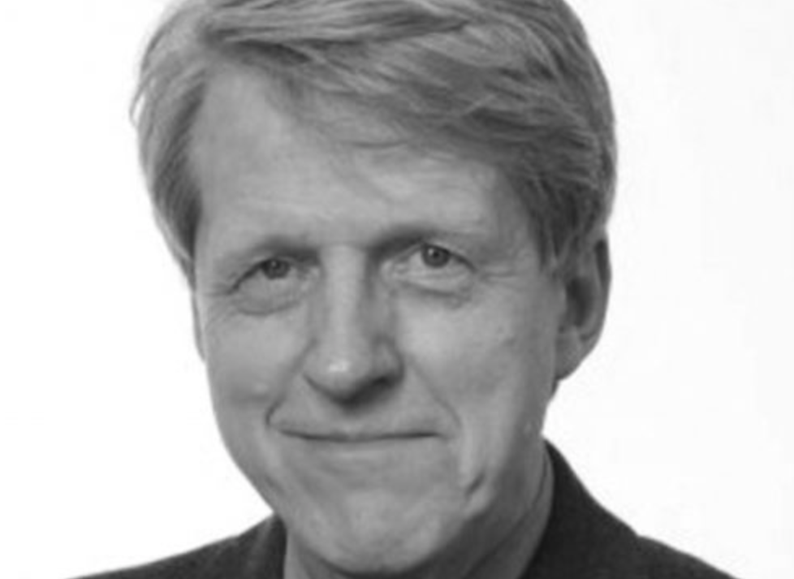
Notes:
This has been a methodological and theoretical revolution. In 2002, the attribution of the Nobel Prize in Economic Science to Vernon Smith and Daniel Kahneman In 2013, the attribution of the Nobel Prize in Economic Science to Robert Shiller In 2017, and Richard Thaler gets the Nobel Prize in Economics

Slide 59
Reading list
Academic papers
Prospect Theory: An Analysis of Decision under Risk - Daniel Kahneman and Amos Tversky. Econometrica (1979)
Prospect Theory and Asset Prices - Nicholas Barberis, Ming Huang, Tano Santos. QJE (2001)
Time Discounting and Time Preference: A Critical Review - Shane Frederick, George Loewenstein and Ted O’Donoghue. JEL (2002)
Academic Handbooks
Behavioral Finance: Psychology, Decision-Making, and Markets - Ackert, Lucy, Richard Deaves (2010)
Popular books
Irrational Exuberance - Robert J. Shiller (2015)
Nudge: Improving Decisions About Health, Wealth, and Happiness - Richard H. Thaler and Cass R. Sunstein (2008/2021)
Thinking, Fast and Slow, Daniel Kahneman (2011)

Slide 60
Assessment
Essay
Write a note to a fund/pension manager or public policy official on the usefulness of behavioural finance/economics.
Pick a topic or specific behaviour (e.g. pensions, savings, stock-market trends, taxes, health, etc) where behavioural finance/economics principles are useful to understand it and can be applied to improve outcomes.
What’s the issue? Why does it happen? How can a behavioural perspective help to understand and tackle it? What are the limitations of this approach?
Portuguese or English
You can use ChatGPT
Max 1500 words
Due by 2nd June

