Slide 1
Behavioural Finance
5. Biases
Antonio Silva, April 2023

Slide 2
Outline
Lesson 5
Types of cognitive biases
Belief perseverance biases
Information processing biases

Slide 3

Heuristics
Behavioural Bias
Representativeness
Cognitive Bias
Availability
Emotional Bias
Anchoring
Social-cultural bias
Affect
Behavioural Finance | Sandra Maximiano Lecture 4|Nov 11 2021
Notes:
The first 3 can lead to biases and systematic errors
The 4th relates to how people feel.

Slide 4
Cognitive bias
A cognitive bias is a systematic pattern of deviation from norm or rationality in judgment leading to errors in processing and interpreting information. These biases can affect various domains, including economic decisions, social behaviours, and political ideologies.
Notes:
Although everyone has cognitive biases, they often can be reduced or removed through incentives, nudges, training, and education.

Slide 5
Cognitive Biases
Types
Belief Perseverance
Conservatism bias
Confirmation bias
Self-serving attribution bias
Hindsight bias
Illusion of control bias
Information Processing
Selective attention bias
Outcome bias
Recency bias
Framing bias
Mental accounting bias
Hyperbolic discounting

Slide 6
Information-processing bias
Involve errors in how people think when processing information to make decisions.

Slide 7
Belief Perseverance
Results from people attempting to avoid conflicts between their beliefs and reality.

Slide 8
Cognitive Dissonance
Cognitive dissonance is the psychological stress experienced by someone who simultaneously holds two or more contradictory beliefs, ideas, or values.

Slide 9
Belief Perseverance & Cognitive Dissonance
You consider yourself smart so can’t accept that you made a bad stock investment. As a result of this dissonance, you are likely to avoid information suggesting you aren’t a good investor. Maybe you shift the blame to your financial advisor or to changes in the economy.
Notes:
A friend

Slide 10
Conservatism bias
Mental process in which people cling to their prior views or forecasts at the expense of acknowledging new information. Conservatism causes individuals to overweight base rates and to underreact to sample evidence.
Notes:
Assume you became aware of some bad news about a company’s earnings that contradicts a previous earnings estimate. How are you likely to react?

Slide 11
Conservatism bias
If you are a conservatism-biased investor, you are likely to put more emphasis on your initial beliefs about the outcome and less emphasis on new information. When conservatism-biased investors do react to new information, they often do so very slowly.
Notes:
Conservatism bias is a common explanation for departures from the efficient market hypothesis

Slide 12
Behavioural biases sometimes conflict with each other

Slide 13
Conservatism vs Representativess
Representativeness: overreacting to new information
Conservatism: underreacting to new information

Slide 14
Market Efficiency
The Efficient Market Hypothesis suggests that markets are rational and their prices fully reflect all available information. Due to the timely actions of investors, prices of stocks quickly adjust to the new information, and reflect all the available information.
Behavioural Finance | Sandra Maximiano Lecture 1|Nov 2 2021
Notes:
The Market Efficiency Hypothesis, commonly known as the Efficient Market Hypothesis (EMH), is a fundamental concept in financial economics that suggests financial markets are "efficient" in reflecting all available information about the prices of securities. Introduced by Eugene Fama in the 1960s, EMH argues that it's impossible for investors to consistently achieve higher returns than average market returns on a risk-adjusted basis, because asset prices already incorporate and reflect all relevant information.
EMH is divided into three forms based on the extent of information considered to be reflected in the stock prices:
1. **Weak-Form Efficiency**: This form asserts that all past trading information, including historical prices and volumes, is fully reflected in stock prices. Therefore, technical analysis, which attempts to predict future stock prices based on past trends, cannot consistently outperform the market.
2. **Semi-Strong Form Efficiency**: According to this, all publicly available information (including past trading information, financial statements, news articles, etc.) is already reflected in stock prices. If this form of efficiency holds true, neither technical analysis nor fundamental analysis (which evaluates securities by attempting to measure their intrinsic value) would be able to consistently produce excess returns.
3. **Strong-Form Efficiency**: This is the most stringent form of the EMH and suggests that all information, public and private (including insider information), is fully reflected in stock prices. Under strong-form efficiency, no one can consistently achieve higher returns because even insider information is already priced into market values.

Slide 15
Conservatism & Efficient Market Hypothesis
Efficient market hypothesis: market prices quickly and correctly reflect all available information.
Conservatism: investors don’t always react to new information
Notes:
Conservatism bias is a common explanation for the underreaction of stock prices to news of a major earnings surprise.
Instead of adjusting their estimate, both analysists and investors overconfidently remain anchored to their prior views of the company’s prospects.

Slide 16
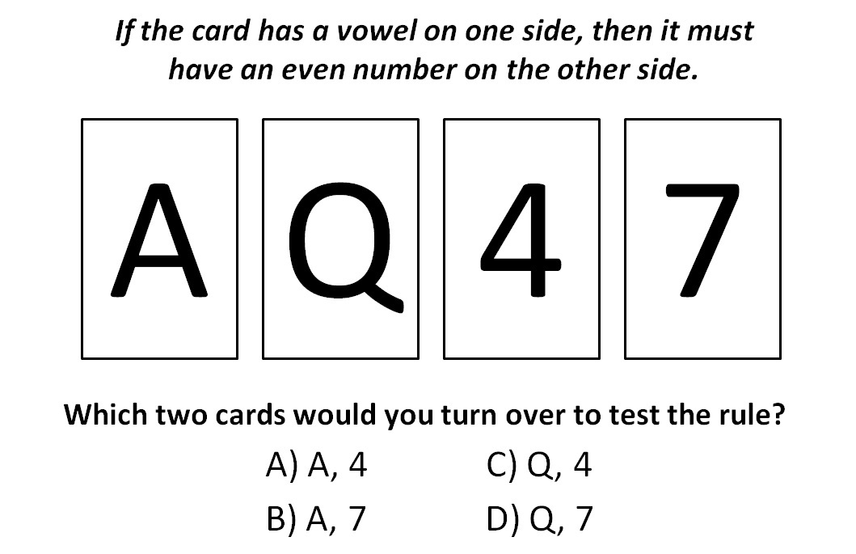
Notes:
Give them 2 minutes to think

Slide 17
Confirmation bias
Most people choose A and 4 because these are the cards capable of confirming the statement, but confirming evidence doesn’t prove anything – the 4 card has no ability to invalidate the hypothesis. Flipping the 7 card, however, could provide valuable disconfirming evidence – a vowel on the other side means not all cards with vowels have an even number on the other side.
Notes:
Correct option is B, A and 7

Slide 18
Confirmation bias
The predisposition to seek evidence or interpret information in a way that confirms existing beliefs and to discount or disregard conflicting information. Confirmation bias represents a common kind of the fallacy of selective attention in which attention focuses on certain aspects of the argument while completely ignoring or missing others.
Notes:
It is a wishful thinking, closed-mindedness, and a way to alleviate discomfort.

Slide 19
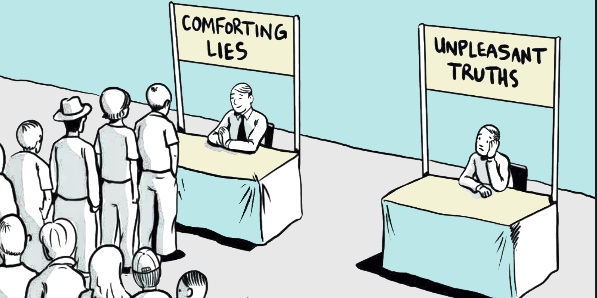
Confirmation bias
It is a wishful thinking,
closed-mindedness,
and a way to alleviate discomfort.
Notes:
It is reasonable

Slide 20
Example
You are evaluating a stock to add to your portfolio. You are likely to gather confirming evidence when making investment decisions rather than evaluate all available information.
Notes:
It is a wishful thinking, closed-mindedness, and a way to alleviate discomfort.

Slide 21
Example 2
If you like a company, the tendency is to dismiss negative information as irrelevant or inaccurate. You are likely to interpret news about the company favourably, and even search for information that reinforces the case that the company remains a good investment. Thus, you may continue to hold a stock whose price is declining far longer than you should.
Notes:
It is a wishful thinking, closed-mindedness, and a way to alleviate discomfort.

Slide 22
Exercise
5 mins
Write about a recent personal success and a recent failure.
List reasons for why each event happened, noting external (luck or external interference vs. internal factors (e.g. skills or effort).

Slide 23
Self-serving attribution
Tendency to take all the credit for success and blame external factors for failures. When things go wrong, people look for someone or something to blame, a phenomenon known as scapegoating.

Slide 24
Example
You get a good grade, you are great!
You get a bad great, and you attributed it to professor not having explained well enough.
Notes:
It is a wishful thinking, closed-mindedness, and a way to alleviate discomfort.

Slide 25
Example 2
If an investment turns out to be highly favourable, you are likely to attribute your success to your own knowledge and skill. If the investment fails to meet expectations, you may blame your financial advisor or a news article touting the investment.
Notes:
It is a wishful thinking, closed-mindedness, and a way to alleviate discomfort.

Slide 26
Self-serving attribution bias
This cognitive bias is a defence mechanism resulting from the need to maintain and enhance self-esteem or to perceive oneself in an overly favourable manner. This cognitive bias is a defence mechanism resulting from the need to maintain and enhance self-esteem or to perceive oneself in an overly favourable manner.
Benefits: Leads people to persevere even in the face of adversity. For example, investors may feel more motivated to keep investing if they attribute their poor portfolio performance to a week economy rather than to some personal failing.
Costs: Leads people to evade personal responsibility for one´s actions. For example, investors may be against learning when facing a poor portfolio performance.

Slide 27
Have you ever said to yourself:
I knew that would happen?

Slide 28
Hindsight bias
Our tendency to look back at an unpredictable event and think it was easily predictable. It is also called the ‘knew-it-all-along’ effect.

Slide 29
Example
Financial crisis of 2007-2008 began with the bursting of an $8 trillion housing bubble. After the bubble burst, many analysts claimed that signs of this bubble were clear: “everyone knew it was going to crash”.

Slide 30
Hindsight bias
Underlying factors
People distort their earlier predictions about an event. Selective memory leads to overestimating what could have been known.
People are apt to view events as inevitable.
People often assume that they could have anticipated certain events.

Slide 31
Illusion of control bias
The illusion of control bias is our tendency to overestimate our ability to control events.

Slide 32
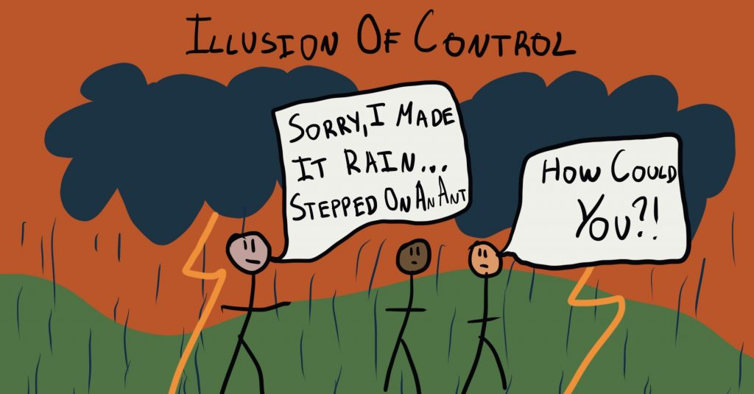
Illusion of control bias
Are you a football fan? If so, have you ever thought that your actions or rituals affected the game?
Notes:
It is reasonable

Slide 33
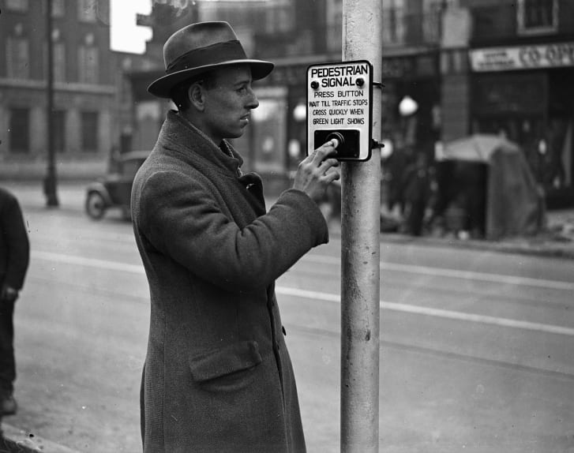
Illusion of control bias
Have you ever pushed the crosswalk button multiple times, as if pushing it more times makes the light change faster? It doesn´t but when the light changes, you might attribute the change to the flurry of button pushing.
Notes:
It is reasonable

Slide 34
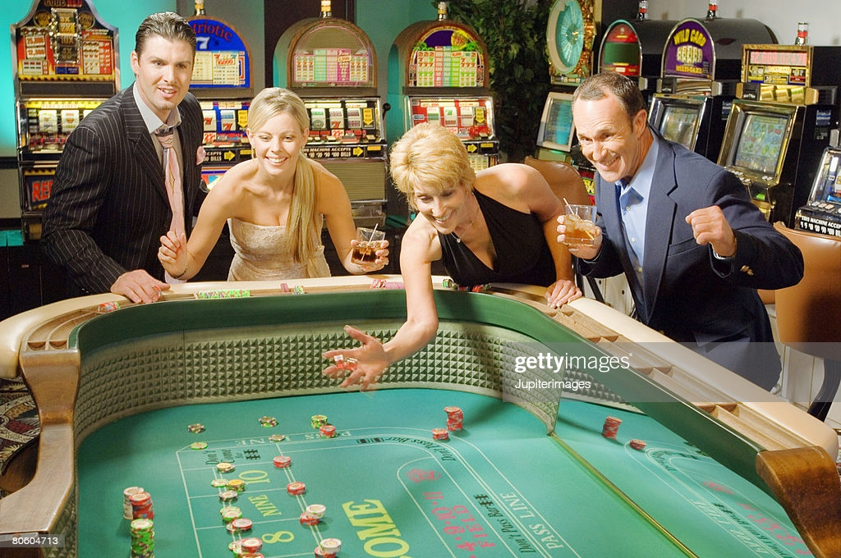
Illusion of control bias
Gamblers throw the dice harder at gambling tables when they need high numbers.
Notes:
It is reasonable

Slide 35
Illusion of control bias
Costs
People waste time, money, and mental energy trying to affect outcomes that they can´t influence.
Leads to other behavioural bias – over-confidence and over-optimism (emotional biases).
Leads investors to trade more than is prudent or maintain improper portfolio diversification

Slide 36
Cognitive Biases
Types
Belief Perseverance
Conservatism bias
Confirmation bias
Self-serving attribution bias
Hindsight bias
Illusion of control bias
Information Processing
Selective attention bias
Outcome bias
Recency bias
Framing bias
Mental accounting bias
Hyperbolic discounting

Slide 37
Information-processing bias
Involve errors in how people think when processing information to make decisions.

Slide 38
Suppose you are thinking about investing in a stock mutual fund. Given the many funds available, which one are you likely to choose?
You are likely to prefer a stock mutual fund that has recently been performing well.

Slide 39
Selective attention bias
Focus mainly on a selection of a limited number of stimuli or objects from a large number of stimuli. Inclination to pay attention to some things, while simultaneously ignoring others.

Slide 40
Example
When selecting for mutual funds, investors generally pay more attention to front-end loads, recent fund performance and less attention to operating expenses, fund marketing fees, and back-end load.
Notes:
Front-end load is a commission or sales charge applied at the time of the initial purchase of mutual fund.
Back-end load is a fee that investors pay when selling mutual fund shares.

Slide 41
Example 2
When investors are less attentive to publicly available information, we may have a post earnings announcement drift anomaly in which prices underreact to earnings news.
Notes:
Post–earnings-announcement drift or PEADis the tendency for a stock’s cumulative abnormal returns to drift in the direction of an earnings surprise for several weeks (even several months) following an earnings announcement. Despite the efficient market hypothesis suggesting that stock prices should adjust almost instantaneously to reflect new information, the PEAD phenomenon indicates that stock prices adjust gradually. This implies that the market does not fully incorporate the implications of the earnings surprise immediately after the announcement

Slide 42
Outcome bias
  Outcome bias is the tendency to judge a decision by the final outcome occurred by chance or through a sound decision-making process.
Behavioural Finance | Sandra Maximiano Lecture 5|Nov 11 2021
Notes:
It is reasonable

Slide 43
Outcome bias
When a good outcome occurs, the tendency is to judge the entire effort positively. Yet, if the end result is negative, perhaps for reasons unrelated to the process, a sound decision process may be criticized.

Slide 44
Example
Imagine a highly skilled surgeon who must decide whether to perform a risky surgery on a patient. The surgery has a high chance of significantly improving the patient’s quality of life but also carries a substantial risk of complications or death. After thorough consultations and considering all medical data, the surgeon and the patient decide to proceed with the surgery because, statistically, the expected benefits outweigh the risks.
The surgery results in a rare but serious complication, and unfortunately, the patient passes away.

Slide 45
Example
Outcome Bias -> The public and medical professionals might judge the surgeon’s decision to operate as poor because it led to a tragic outcome. They may argue that the decision was reckless and criticize the surgeon for taking the risk.
No Outcome Bias -> The decision would be evaluated based on the information available at the time, acknowledging that the surgeon made a rational choice given the potential benefits. The rare complication, while tragic, was a known risk and not necessarily a reflection of the surgeon’s competence or decision-making process.
Notes:
Politicians is the same thing, they’re judged on whether the economy grows, or unemployment goes down but often these are not related to anything they’ve done.

Slide 46
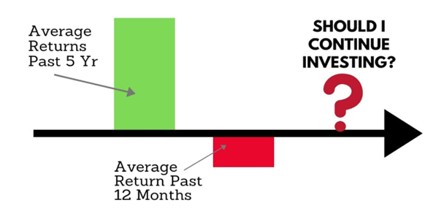
Recency bias
Tendency to focus on "what's happened lately" when evaluating or judging something.
Behavioural Finance | Sandra Maximiano Lecture 3|Nov 9 2021
Notes:
An investor invests $100,000 in a mutual fund. Over 5 years the market value of his investment grows to $175,000. Then in the last 3 months, the value falls to $150,000. The investor may look at his investment performance of as a loss of $25,000 in 2 months and not an overall profit of $50,000in 5 years.

Slide 47
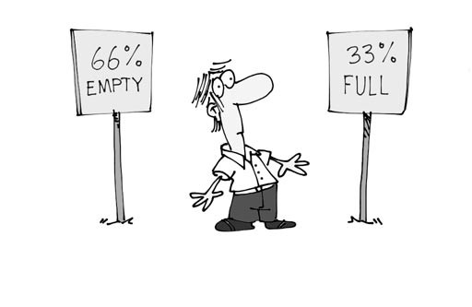
Framing bias
Propensity to process and react to information differently depending on how the choices are framed.

Slide 48
Framing bias
Two young Catholic priests who were both smokers and who both asked their Bishop for permission to smoke whilst praying
The first asked, “Would it be permissible for me to smoke whilst praying to the Lord?” and was given a resounding “No” in reply from the Bishop
The second asked, “During those moments of weakness when I smoke, would it be permissible for me to say a prayer to the Lord?” and he received the reply, “Yes, of course, my son”
Notes:
Consider a story (from Steven Robbins)

Slide 49
Procedure invariance
Preferences between alternatives should not depend on the method or procedure used to present them. This means that the choice outcome should remain consistent regardless of the way choices are described or the order in which they are presented.
Notes:
Procedure Invariance is a principle in decision theory, particularly within the framework of rational choice theory, which holds that the preference between alternatives should not depend on the method or procedure used to present them. This means that the choice outcome should remain consistent regardless of the way choices are described or the order in which they are presented. In an ideal rational scenario, different methods of eliciting preferences (e.g., choice, matching, pricing) should yield equivalent results if the underlying preferences are stable and consistent.
Anchoring violates this key principle of rational choice theory, which similar to to EUT.

Slide 50
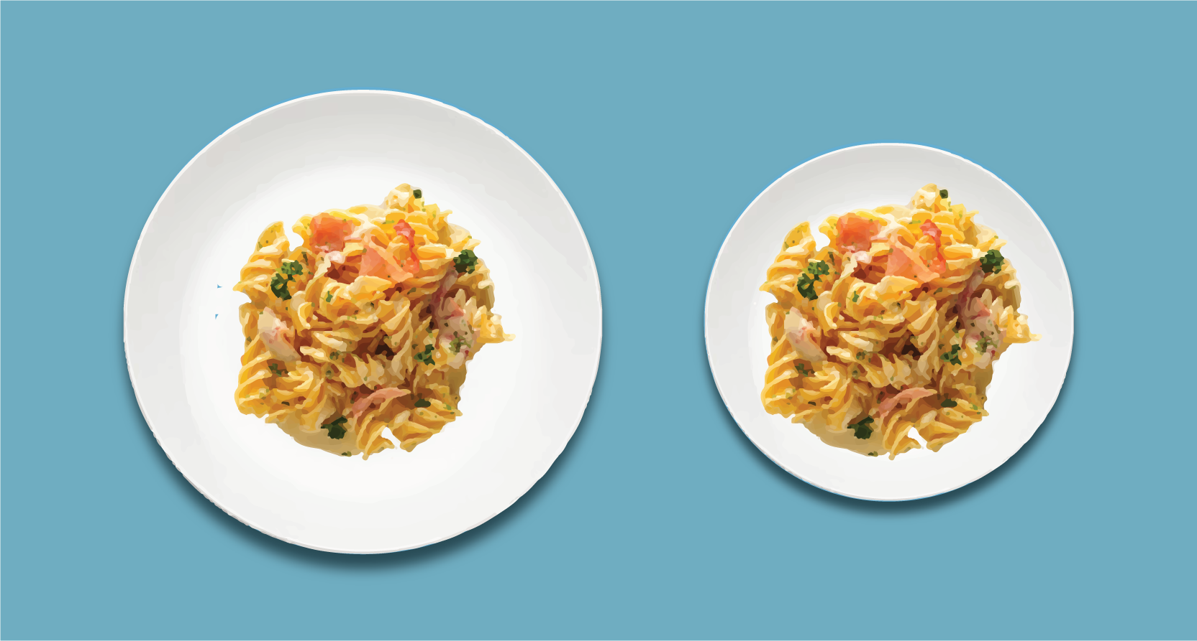
Procedure invariance & Framing
According to the standard economic model, the presentation should not influence choice or satisfaction.
Notes:
And also If the same choice is framed as a loss, rather than as a gain, different decisions are made.

Slide 51
Framing & loss aversion
Imagine that the US is preparing for the outbreak of an unusual disease, which is expected to kill 600 people. Choose a program to address the problem.
A: 200 people will be saved
B: 1/3 chance that 600 people will be saved. 2/3 chance that no people will be saved
Notes:
It is reasonable

Slide 52
Framing & loss aversion
Imagine that the US is preparing for the outbreak of an unusual disease, which is expected to kill 600 people. Choose a program to address the problem.
A: 200 people will be saved (72%)
B: 1/3 chance that 600 people will be saved. 2/3 chance that no people will be saved (28%)
Tversky & Kahneman (1981) The framing of decisions and the psychology of choice. Science, 211
Notes:
It is reasonable

Slide 53
Framing & loss aversion
Imagine that the US is preparing for the outbreak of an unusual disease, which is expected to kill 600 people. Choose a program to address the problem.
A: 400 people will die
B: 1/3 chance that nobody will die. 2/3 chance that 600 people will die
Notes:
It is reasonable

Slide 54
Framing & loss aversion
Imagine that the US is preparing for the outbreak of an unusual disease, which is expected to kill 600 people. Choose a program to address the problem.
A: 400 people will die (22%)
B: 1/3 chance that nobody will die. 2/3 chance that 600 people will die (78%)
Tversky & Kahneman (1981) The framing of decisions and the psychology of choice. Science, 211
Notes:
It is reasonable

Slide 55
1/3 chance that nobody will die. 2/3 chance that 600 people will die.
1/3 chance that 600 people will be saved. 2/3 chance that no people will be saved.
=
78%
≠
28%
Notes:
It is reasonable

Slide 56
1/3 chance that nobody will die. 2/3 chance that 600 people will die.
1/3 chance that 600 people will be saved. 2/3 chance that no people will be saved.
=
78%
≠
28%
We take great risks to avoid a loss.
Reframing the same option as a loss shifts the choice.
Notes:
This experiment demonstrates a failure Decision theory’s “invariance” assumption:
Decisions should depend on the real value of the outcomes, not the way the prospects are worded

Slide 57
Framing & failure of dominance
Choose between:
A: 25% chance to win €240 and 75% chance to lose €760
B: 25% chance to win €250 and 75% chance to lose €750
Notes:
It is reasonable

Slide 58
Framing & failure of dominance
Choose between:
A: 25% chance to win €240 and 75% chance to lose €760 (0%)
B: 25% chance to win €250 and 75% chance to lose €750 (100%)
Option B dominates A, and all respondents chose accordingly.
Notes:
It is reasonable

Slide 59
Framing & failure of dominance
I. Choose between:
C: A sure gain of €240
D: 25% chance to gain €1000 and 75% chance to gain nothing
II. Choose between:
E: A sure loss of €750
F: 75% chance to lose €1000 and 25% chance to lose nothing
Notes:
It is reasonable

Slide 60
Framing & failure of dominance
A majority of respondents make a risk averse choice for the sure gain over the positive gamble in decision (I).
An even larger majority of people make a risk seeking choice for the gamble over the sure loss in decision (II).
Effectively the majority of respondents expressed a preference for C and F over D and E (C>D and F>E)
The preferred conjunction, however, is dominated by the rejected one
Notes:
It is reasonable

Slide 61
Framing & failure of dominance
Adding the sure gain of €240 (option C) to option F yields 25% chance to win €240 and 75% chance to lose €760 (= option A)
Adding the sure loss of €750 (option E) to option D yields a 25% chance to win €250 and 75% chance to lose €750 (= option B)
The framing effects cause people to choose the dominated option
Notes:
It is reasonable

Slide 62
Framing & Emotions
An investor may be alarmed when his financial advisor informs him that his portfolio has 20% chance of losing money during the next year
😧
Notes:
It is reasonable

Slide 63
Framing & Emotions
An investor feels optimistic when his financial advisor informs him that his portfolio has 80% chance of making money during the next year
🤑
Notes:
It is reasonable

Slide 64
Mental accounting
Propensity for people to separate their money into different accounts based on various subjective criteria, such as the source of the money or its intended use.
Notes:
Procedure Invariance is a principle in decision theory, particularly within the framework of rational choice theory, which holds that the preference between alternatives should not depend on the method or procedure used to present them. This means that the choice outcome should remain consistent regardless of the way choices are described or the order in which they are presented. In an ideal rational scenario, different methods of eliciting preferences (e.g., choice, matching, pricing) should yield equivalent results if the underlying preferences are stable and consistent.
Anchoring violates this key principle of rational choice theory, which similar to to EUT.

Slide 65
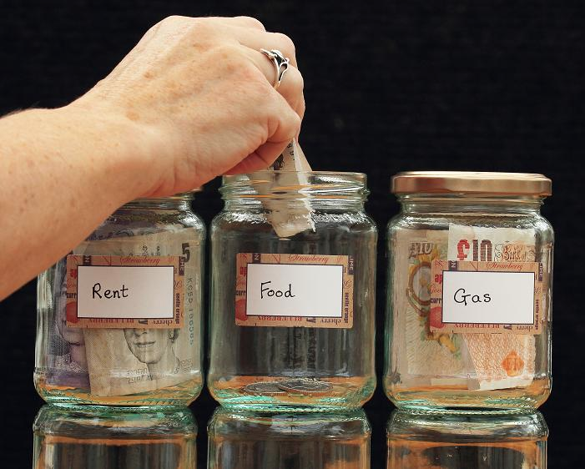
Mental Accounting
When using separate mental accounts, people view and assess individual assets separately instead of as a part of a total portfolio.
Someone may have a special “money jar” for a vacation while still carrying substantial credit card debt with high interest charges.
Notes:
It is reasonable

Slide 66
Imagine you have decided to see a play where admission is 10€. As you enter theater you discover that you have lost a 10€ bill. Would you pay 10€ for a ticket to the play? 88% said Yes
Imagine that you have decided to see a play and paid the admission price of 10€ per ticket. As you enter the theater you discover that you have lost the ticket. Would you pay 10€ for another ticket? 46% said Yes
Notes:
We say this in lecture 3. Nothing is really different about the problems.
In 2nd question, integration is more likely because both lost ticket and new ticket would be from same “account. Integration might suggest that 20€ is too much for the ticket.

Slide 67
Hyperbolic discounting
Tendendy for people to choose smaller, immediate rewards over larger, later rewards at a rate that declines over time (i.e. the discount rate decreases as the delay increases). This contrasts with exponential discounting, which assumes a constant discount rate over time and is often used in traditional economic models.

Slide 68
Hyperbolic discounting
Temporal Preference
People prefer rewards that are closer in time and thus discount the value of delayed rewards more steeply if the delay is immediate or near-term rather than in the far future. For example, someone might prefer receiving €50 today over €100 a year from now, but they might not prefer €50 in five years over €100 in six years, showing less of a preference for the immediate over the delayed as the future becomes more distant.

Slide 69
Hyperbolic discounting
Impact on decision-making
Health: Eating chocolate now rather over maintaining a long-term healthy diet.
Savings: Under-saving for retirement by preferring to spend money now rather than saving it for future financial security.
Debt: Choosing to purchase on credit for immediate satisfaction, despite the long-term costs due to interest.
Investment choices: Avoiding short-term market volatility discomfort even if it leads to higher long-term returns.
Notes:
People may act against their long-term interests by overvaluing immediate gratifications. This bias affects decisions involving trade-offs between current and future benefits or costs. It can lead to inconsistencies in preference and irrational decision-making, especially in areas like financial planning, health, and consumption. People may act against their long-term interests by overvaluing immediate gratifications — such as spending money now rather than saving for retirement, or choosing to indulge in unhealthy foods over maintaining a long-term healthy diet.
Hyperbolic Discounting fits in information processing because it fundamentally involves a distortion in processing the future consequences of current decisions. People using hyperbolic discounting misinterpret the future benefits or costs due to non-linear time preference, which skews their decision-making process.
However, it could also be argued to touch on emotional biases because immediate rewards often carry a higher emotional appeal, and avoiding immediate losses can trigger stronger emotional responses than similar future scenarios. The preference for immediate rewards that hyperbolic discounting describes is often emotionally driven, but the bias itself is rooted in the cognitive misvaluation of those rewards or penalties over time.

