Slide 1
Behavioural Finance
9. How to apply behavioural insights in public policy
Antonio Silva, May 2023

Slide 2
What are behavioural insights?
Psychology
Behavioural Insights
Public Policy
Anthropology
Understanding how people behave in practice so that we can design policy better
Behavioural Economics

Slide 3







What are behavioural insights?
Behavioural Insights
Comms & Information
Environment Design
Process Design
Incentives
Systemic Rules & Regulation
Notes:
PURPOSE:
BI is not an alternative approach that’s trying to replace traditional policy tools
KEY MESSAGE:
“And BIT is not here to replace traditional policy tools - like regulations, incentives, and information provision. We are here to enrich these tools and to increase their effectiveness by with behavioural insights both when we improve existing services and when we build new ones.
For example, financial incentives for teachers are often found to be ineffective. However, one study in the U.S. found that giving teachers an upfront bonus at the start of the year increased their students’ maths test scores. The catch was that if their students did not improve, they would need to pay the money back at the end of the year. This intervention use the principle of loss aversion.

Slide 4





Applying behavioural insights
TESTS
TARGET
EXPLORE
SOLUTION
TRIAL
SCALE
Phases
Establish the scope for a BI approach
Identify the specific behaviours you want to change
Identify a measurable behavioural outcome
Understand the system in which existing interventions are delivered
Understand the perspectives of the end-users
Understand decision points and the behavioural barriers
Draw from the insights gained in the explore phase and behavioural insights to deliver policy solutions that encourage the target behaviour
Use robust scientific designs and statistical methods to investigate whether, and by how much, the policy encourages target behaviours
Scale up policies and interventions that have proven to effectively promote the target behaviour
Activities
Notes:
PURPOSE:
Introduce in-house TESTS methodology
KEY MESSAGE:
BIT takes an iterative approach to running behavioural insights projects.“We have developed an in-house framework called TESTS that we use to address policy challenges and behavioural problems. Essentially for each project we take on we aim to go through 5 different stages: •Target •Explore •Solution •Trial •Scale. The methodology is very iterative and allows us to refine and improve the project as we go.
TIMING:
1-2 mins
LINK:
To next slide
LINK:
To next slide
LINK
To next slide

Slide 5
Target phase: case study
TARGET
EXPLORE
SOLUTION
TRIAL
SCALE
Phases
Define your goal, scope and measurable behaviours and outcomes.
Notes:
PURPOSE:
Introduce Target phase of methodology
KEY MESSAGE:
The first step in conducting a successful BI project is to clearly define a goal and to understand the behaviours that you want to change to achieve this goal and what outcome you will measure.
TIMING:
1 min
LINK:
To next slide
LINK
To next slide

Slide 6
Target phase: case study
TARGET
EXPLORE
SOLUTION
TRIAL
SCALE
Tackle the rise of antimicrobial resistance
Phases
Define your goal, scope and measurable behaviours and outcomes.
Notes:
PURPOSE:
Start example of how to narrow your focus
KEY MESSAGE:
“For example, a Chief Executive might come to us and not have a specific target in mind. They don’t have a measurable TARGET. They may say ‘can we look into tackling the rise of antimicrobial resistance?’ But this – in and of itself – is not a behavior that we can encourage or discourage.
However, we know that there are specific behaviours that contribute to this problem.”
RESOURCE
Link to Provision of social norm feedback to high prescribers of antibiotics in GP
TIMING:
20 sec
LINK:
To next slide

Slide 7
Target phase: case study
TARGET
EXPLORE
SOLUTION
TRIAL
SCALE
Over-consumption of antibiotics
Tackle the rise of antimicrobial resistance
Phases
Define your goal, scope and measurable behaviours and outcomes.
Notes:
KEY MESSAGE:
“For example, we know that over-consumption of antibiotics contributes to antimicrobial resistance.”
RESOURCE
Link to Provision of social norm feedback to high prescribers of antibiotics in GP
TIMING:
5 sec
LINK:
To next slide

Slide 8
Target phase: case study
TARGET
EXPLORE
SOLUTION
TRIAL
SCALE
Unnecessary over-prescription of antibiotics
Over-consumption of antibiotics
Tackle the rise of antimicrobial resistance
Phases
Define your goal, scope and measurable behaviours and outcomes.
Notes:
KEY MESSAGE:
“We know that overconsumption of antibiotics is partly driven by unnecessary over-prescriptions of these drugs.
Roughly 20% of antibiotics prescription in the UK are actually unnecessary.”
RESOURCE
Link to Provision of social norm feedback to high prescribers of antibiotics in GP
TIMING:
30 sec
LINK:
To next slide

Slide 9
Target phase: case study
TARGET
EXPLORE
SOLUTION
TRIAL
SCALE
If only GPs would reduce the amount of unnecessary antibiotics prescriptions
Unnecessary over-prescription of antibiotics
Over-consumption of antibiotics
Tackle the rise of antimicrobial resistance
Phases
“If only X would do Y”
Notes:
PURPOSE
Complete Target explanation
KEY MESSAGE:
“So a specific target of this project might be How do we help GPs reduce the amount of unnecessary antibiotics that they prescribe in their routine practice?
Whenever we select a target behaviour for a project we try to select one that is:
Feasibly possible to change as part of a discrete behavior change project
Likely to maximise its impact on the overall goal (e.g. tackling antimicrobial resistance)
Measurable (to understand whether the extent to which our solutions makes a difference).”
RESOURCE
Link to Provision of social norm feedback to high prescribers of antibiotics in GP
TIMING:
1 min

Slide 10
Explore phase
TARGET
EXPLORE
SOLUTION
TRIAL
SCALE
Phases
Understand the context and perspective of the end users
and the barriers to performing a target behaviour.
Notes:
PURPOSE
Introduce Explore phase of methodology. Explain four approaches used during Explore (add: refines your hypothesis)
KEY MESSAGE:
The next phase of a BIT project is the Explore phase.
The aim of the explore phase is to really understand the target behavior in its context and to identify the drivers of this behaviour.
TIMING:
1 mins
LINK
To next slide

Slide 11




Explore phase
TESTS
TARGET
EXPLORE
SOLUTION
TRIAL
SCALE
Phases
Published literature
Observation
STEP 1
STEP 2
STEP 3
STEP 4
Activities
Analyse relevant data and published literature
Understand the perspective of the end user
Identify key decision points in the user journey
Identify behavioural barriers
Data analysis
Interviews and focus groups
Notes:
PURPOSE
Explain four approaches used during Explore
KEY MESSAGE:
There are a number of methods we can apply for this phase but mainly we rely on four different approaches.”

Slide 12
Explore phase: case study
Providing feedback has been shown to produce fairly small but important changes in health-care provider behaviour in general. However, studies of feedback specifically focused on antibiotic prescribing have produced mixed results: substantial improvements have come about from more complex, intensive interventions, rather than simple feedback.
- Hallsworth et al., 2016
Published literature
Observation
Data analysis
Interviews and focus groups
Data analysis
Notes:
“We look at the literature and behavioural models to understand if other people have tried to tackle the same problem in the past and to understand what might be the drivers of our target behaviour. So for example, we might find published studies looking at why some GPs overprescribe antibiotics.

Slide 13
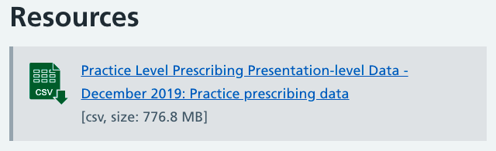
Explore phase: case study
Published literature
Observation
Data analysis
Interviews and focus groups
Data analysis
Notes:
PURPOSE
Illustrate data analysis approach in antimicrobial example
KEY MESSAGE:
“If you ask doctors, do doctors prescribe too many antibiotics...what will they say? Wait for audience to say ‘yes’.
If you ask doctors, do YOU prescribe too many antibiotics...what will they say? Wait for audience to say ‘no’ No, of course, it’s not me.
For the antibiotic prescription project, we looked at the data. This is public data you can download on a monthly basis and see what each practice is prescribing. In this data, we found that some practices were consistently overprescribing antibiotics which helped us to inform how we might tackle the problem and where we should focus our efforts.
In the data, you can even see the specific medications they are prescribing too much of! (You can look up your own GP and even sign up for a newsletter when new data is published!).
We also found that 70% of delayed prescriptions don’t get picked up - this is a prescription that says that you can get antibiotics, but only after waiting for a few days to see if you still have symptoms.
TIMING:
2 mins
RESOURCE
Link to NHS Practice level prescribing

Slide 14
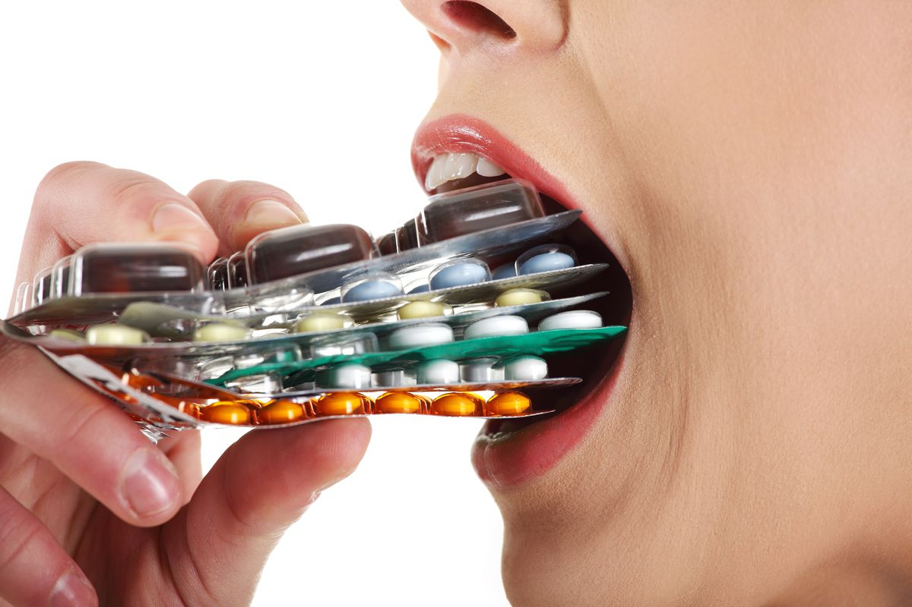

Explore phase: case study
Published literature
Observation
Data analysis
Interviews and focus groups
Data analysis
Notes:
In some of our projects we conduct observations or shadowing. For example, we might sit with some GPs - with patient consent - over a number of days to see how antibiotics are prescribed in practice and to experience first hand all the factors that might influence this behaviour.

Slide 15

Explore phase: case study
Published literature
Observation
Data analysis
Interviews and focus groups
Data analysis
Notes:
And a more traditional approach to our explore work is to run qualitative interviews where we talk with the people who perform the target behavior and we ask them about what drives that behavior and what might be specific barriers to change.

Slide 16
Solution phase
TARGET
EXPLORE
SOLUTION
TRIAL
SCALE
Phases
Apply insights from behavioural science to generate
solutions that will encourage the target behaviour.
Notes:
PURPOSE:
Introduce Solution phase of methodology.
KEY MESSAGES:
In the solution stage we develop the policy or an intervention to change the target behavior.
We do that by drawing from the insights of explore phase and from behavior change frameworks.
TIMING:
30 seconds

Slide 17
Solution phase: EAST framework
EASY
ATTRACTIVE
TIMELY
SOCIAL
Notes:
PURPOSE
Introduce EAST
KEY MESSAGE:
“We have developed the EAST framework as a practical guide to help policy-makers and practitioners who are interested in using behavioural approaches in their work.
The EAST framework takes a huge body of the Behavioural Science literature and condenses it into 4 easy to remember key principles. If you want to encourage a behaviour, you should make it Easy, Attractive, Social and Timely.
EASY: firstly, that’s the most effective way to drive action - minimise effort.
Next, ATTRACTIVE means both making it more appealing and attracting attention to it.
SOCIAL - appealing to the fact that we are social creatures and our behaviour is influenced by others.
TIMELY - ask at the right time - when someone can actually act.
Getting familiar with the EAST framework won’t turn you into the world’s leading expert on behavioural insight. There are more complex frameworks and typologies, and many subtle and fascinating effects that EAST does not cover. But if even a small percentage of policies and practices are adapted as a result, EAST should lead to services. I’ll now go through some examples.”
TIMING:
2 mins
LINK:
To next slide

Slide 18
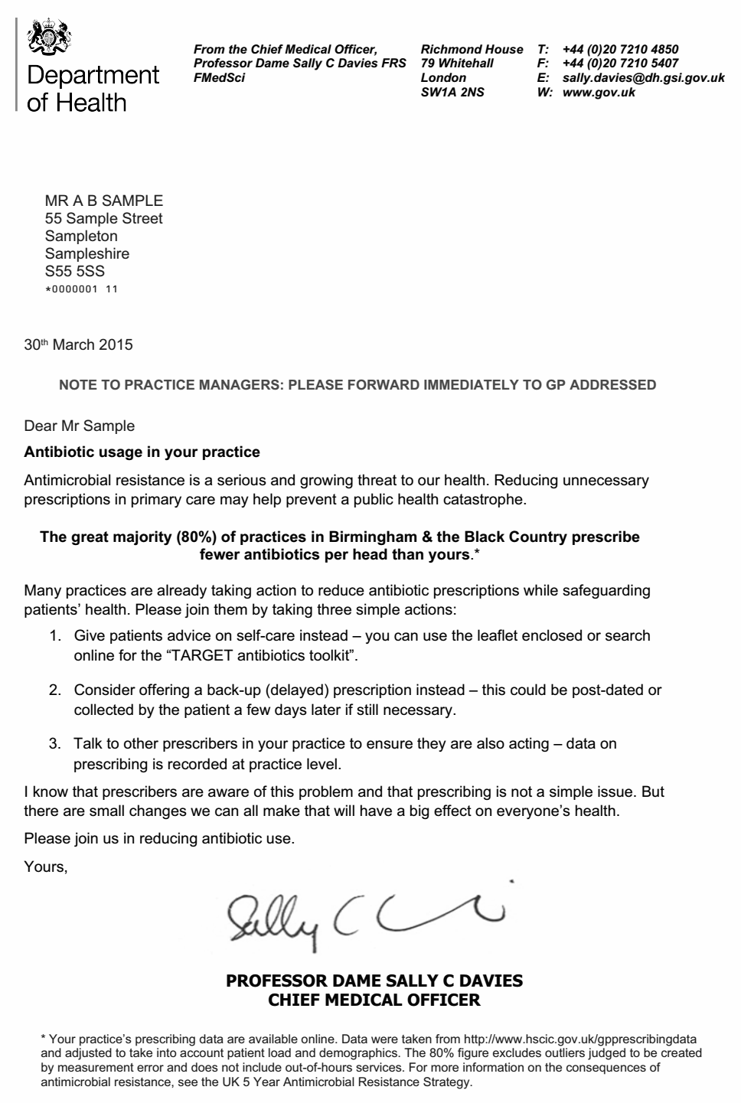
Solution phase: Case study
EASY
ATTRACTIVE
TIMELY
SOCIAL
Notes:
PURPOSE
Describe EASY elements of the intervention
KEY MESSAGE:
“Going back to the example of antibiotic prescriptions, we helped doctors prescribing fewer antibiotics by making it easy in that we provided a letter specifying 3 easy and concrete things that doctors could do reduce antibiotic prescriptions:
Advising on health care (with the leaflet)
Offering a delayed prescription to patients
Talk to other GPs in the practice
In one study, doctors gave delayed prescriptions for sore throat - that posed no risk to health outcomes - and 69% of those who received a delayed prescription did not go on to use it.
TIMING:
2 mins
LINK:
To next slide

Slide 19
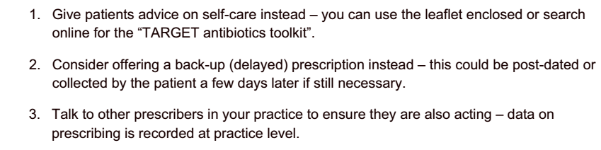
Solution phase: Easy
EASY
ATTRACTIVE
TIMELY
SOCIAL
Notes:
PURPOSE
Describe EASY elements of the intervention
KEY MESSAGE:
“Going back to the example of antibiotic prescriptions, we helped doctors prescribing fewer antibiotics by making it easy in that we provided a letter specifying 3 easy and concrete things that doctors could do reduce antibiotic prescriptions:
Advising on health care (with the leaflet)
Offering a delayed prescription to patients
Talk to other GPs in the practice
In one study, doctors gave delayed prescriptions for sore throat - that posed no risk to health outcomes - and 69% of those who received a delayed prescription did not go on to use it.
TIMING:
2 mins
LINK:
To next slide

Slide 20
Solution phase: Attractive
EASY
ATTRACTIVE
TIMELY
SOCIAL
Activities
Notes:
PURPOSE
Describe ATTRACTIVE elements of the intervention
KEY MESSAGE:
“We attract GPs attention by using a credible source. We worked with Chief Medical Officer, Sally Davies. She wrote the prose for the letter and signed them.
This leverages a behavioural insights known as the ‘messenger effect’
We hypothesised that a letter coming from the chief medical officer would be more effective than one coming from government.
TIMING:
1 min
LINK:
To next slide

Slide 21
Solution phase: Social
EASY
ATTRACTIVE
TIMELY
SOCIAL
Notes:
PURPOSE
Describe SOCIAL elements of the intervention
KEY MESSAGE:
“We made it social by outlining on the letter that most GPs already perform the target behaviour:
“The great majority (80%) of practices in London prescribe fewer antibiotics per head than yours.”
This is an example of a descriptive social norm
Local peers is an interesting aspect of the intervention design. It’s more effective if the message is relatable.
TIMING:
1-2 min
LINK:
To next slide

Slide 22
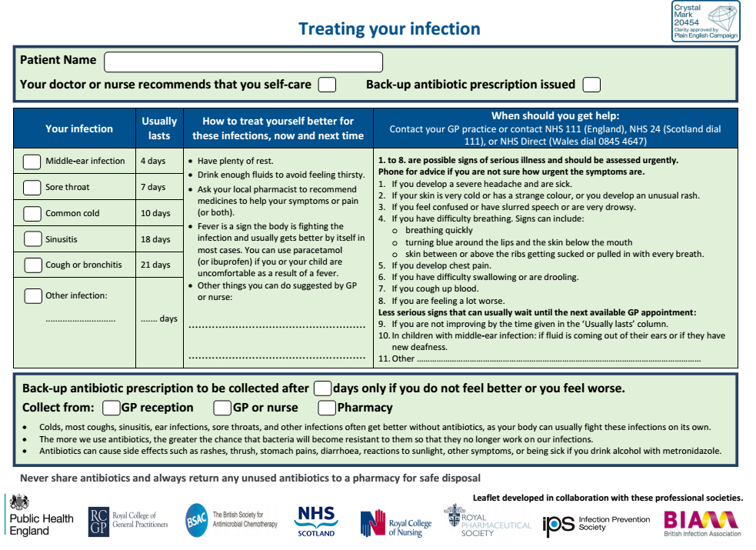
Solution phase: Timely
EASY
ATTRACTIVE
TIMELY
SOCIAL
Notes:
PURPOSE
Describe TIMELY elements of the intervention
KEY MESSAGE:
“And we made the intervention timely by providing an enclosed leaflet to give out to patients instead of antibiotics,
The letter was accompanied by a copy of the ‘Treating your infection’ leaflet which aims to facilitate communication between prescriber and patient, and increase the patient’s confidence to self-care.
And this was made in a timely fashion because we provided this aid at the same time at which we asked GPs to change their behaviour
And the delayed prescription - later you may improve without any antibiotics
TIMING:
1 min

Slide 23
Trial phase
TARGET
EXPLORE
SOLUTION
TRIAL
SCALE
Phases
Develop a strategy to assess if the results you observe are due to your intervention or not and evaluate the effectiveness of your intervention.
Notes:
PURPOSE
Introduce Trial phase of methodology.
KEY MESSAGE:
In the trial phase of our projects, we test whether our solutions were effective in changing the target behavior and to what extent they were effective in doing so.
Evaluation is a key part of BIT - rigorous evaluation. A core mission of ours has been to introduce rigourous evaluation into policy making.
It’s Crucial to test interventions because, as we’ve previously established, context is key. We need to properly test and evaluate interventions because sometimes they do nothing and sometimes they backfire.
In the trial phase we need to confirm the outcome measure
Then develop a strategy to analyse the results to see if the intervention changed any behaviours.
TIMING:
1-2 mins
LINK:
To next slide

Slide 24
We don’t need to test, we’re experts and we already know the answer
Notes:
PURPOSE
Introduce concept of testing what works and why that’s important
KEY MESSAGE:
You might be tempted to think that because we’ve researched the problem we should know what will work.
TIMING:
30 sec
LINK:
To next slide

Slide 25

The importance of trialling
Notes:
PURPOSE:
Show that results can be surprising
KEY MESSAGES:
There are some things that seem really obvious that turn out not to be:
E.g. 2/3 of US school districts use robot simulator babies to encourage students not to have sex and get pregnant. You take this robo-baby home it cries all night. The theory of change is that if a teenager experiences what this is like they’ll be more careful…
TIMINGS:
1 min
LINK:
To next slide
RESOURCE:
Efficacy of infant simulator

Slide 26
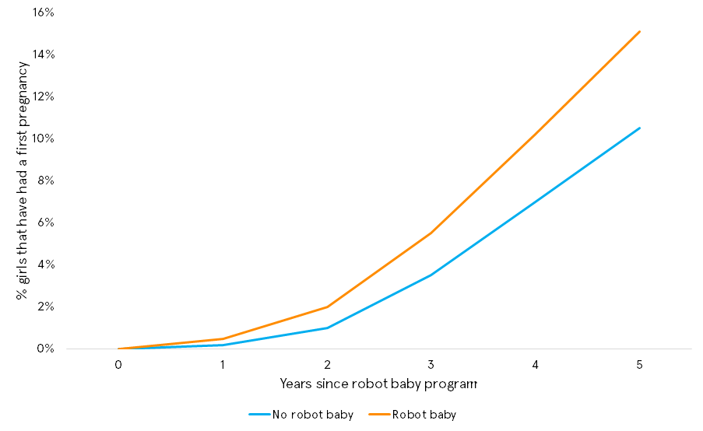
Robot babies cause teen pregnancy...
Brinkman, S. A., Johnson, S. E., Codde, J., Hart, M. B., Straton, J., Mittinty, M. N., & Silburn, S. R. (2016). Efficacy of infant simulator programmes to prevent teenage pregnancy: a school-based cluster randomised trial in Western Australia. Lancet, 388(10057).
Notes:
PURPOSE:
Demonstrating backfire effect
KEY MESSAGES:
“Sounds good until you run a randomised controlled trial on it which some researchers in Australia did.
Despite what you assume robot babies cause teen pregnancy.
The kids in the programme who receive the robo-babies were more likely to get pregnant than their peers who didn’t in the following 5 year period.
So stuff that we think is obvious isn’t always obvious and we should be testing it.
One limitation of RCTs is that we don’t know why this happens, why can hypothesise but combining RCTs with qualitative research would be more insightful.
(Additional examples to illustrate this point are Scared Straight, steroids for head injuries)”
TIMINGS:
1 min
LINK:
To next slide
RESOURCE:
Efficacy of infant simulator

Slide 27
We will apply the intervention and measure before and after to determine the effect
Notes:
PURPOSE:
Introduce before / after studies
KEY MESSAGES:
“You could do a before / after measure to see if you intervention has been successful“
TIMINGS:
30 sec
LINK:
To next slide
LINK:
To next slide

Slide 28

Before / After Experiments
BEFORE
CAMPAIGN
CAMPAIGN
ANTIBIOTIC RESISTANT ILLNESS IN THE NEWS
AFTER
Notes:
PURPOSE
Illustrate the issues associated with a before / after experiment
KEY MESSAGE:
“You could roll out the intervention to the top 20% of prescribing GPs and observe the differences.
Can anyone see what might go wrong?
What if something else happened in between? Was the reduction due to your campaign, or would the reduction have happened anyway because of high media coverage of an antibiotic resistant illness?”
TIMING:
1 min
LINK:
To next slide

Slide 29
The benefits of a control group
CONTROL GROUP
TREATMENT GROUP
BEFORE
CAMPAIGN
HIGH PROFILE ANTIBIOTIC RESISTANT ILLNESS IN THE NEWS
AFTER
Notes:
PURPOSE
Introduce the concept of a control group
KEY MESSAGE:
“Having a control group can help you to determine the impact of your intervention.
The control group doesn’t receive your interventions BUT both the control group and the treatment group are exposed to the same events so you can be more confident that the difference between these groups is due to the campaign.”
TIMING:
1 min
LINK:
To next slide

Slide 30
We can compare different individuals or groups
Notes:
PURPOSE:
Introduce comparison studies
KEY MESSAGES:
“You compare different individuals and groups.
I could give you the intervention and not give it to you and then see if it was effective. What might be an issue with this? How do we know that the groups aren’t also different in other important ways?”
TIMINGS:
30 sec
LINK:
To next slide
LINK:
To next slide

Slide 31
Group comparison studies
Group A (control)
Group B (experiment)
BEFORE
1 years of practice
10 years of practice
AFTER
Notes:
PURPOSE
Introduce group comparison studies
KEY MESSAGE:
“When comparing a control group and a treatment group it’s essential that both groups start out the same.
We could compare one GP practice with another but how can we be sure that the two groups aren’t different in important ways.
For example what if we compared two groups - one group had 10 years experience as a GP and the other had 1. How could we be sure that the difference in experience was responsible for the outcome.”
TIMING:
1 min
LINK:
To next slide

Slide 32
Randomised controlled trials
Notes:
PURPOSE:
Introduce RCTs
KEY MESSAGES:
“Randomisation controlled trials or RCTs are an experimental method that protects against some of the concerns I’ve just highlighted.
At BIT we try to tests the effect of our interventions through randomised controlled trials.
Our remit at BIT has been to introduce them to policy making
RCTs are pretty simple and they allow us to be sure that the effect we see – in this case, the reduction in antibiotic prescriptions by doctors – is actually caused by the intervention, in this case the letter to GPs from the Chief Medical Officer outlining their prescription habits relative to their peers
By walking through the stages of an RCT it is easy to understand how this works:”
TIMINGS:
1 min
LINK:
To next slide
How do we know that the groups aren’t also different in other important ways?
LINK:
To next slide

Slide 33

Choosing a sample
Eligible sample:
1581 GP practices in the top 20% of prescribers
Notes:
PURPOSE
Introduce the concept of a sample and spillover
KEY MESSAGE:
“We start by determining our sample
In this case our sample was with all GP practices who were in the top 20% in terms of antibiotic prescriptions.
It is critical to the experiment design that the control group does not hear anything about the letter.
Randomisation is easy to do but hard to maintain. Contamination / spillover happens when the control group receive treatment.
If this happens then we can’t be certain if the intervention worked and by how much.
This is why we designed the experiment at the GP practice level. If we had some GPs in a practice receiving the letter and some not, it’s likely they would talk to one another and if the control group heard about the letter they might change their antibiotic prescription behaviours.”
TIMING:
1 min
LINK:
To next slide

Slide 34

Randomisation
INTERVENTION
Rate of antibiotic prescriptions is measures in both groups and compared
Sample is split into two groups completely at random
CONTROL
Notes:
PURPOSE
Introduce concept of randomisation
KEY MESSAGE:
“We divided them in two groups completely at random - like tossing a coin.
There are many ways you could split them in half; name, location, years of practice etc.… Let’s say you chose years of practice; it would be impossible to say at the end whether your letter caused any difference you see or whether having more years of practice caused the difference in responses.
To avoid problems like this, we assign people to their group at random using a computer. Everyone has different reasons they over prescribe antibiotics which predict whether they will reduce prescriptions once they get the letter.
By assigning at random all those people, with all their reasons, have a 50/50 chance of being assigned to either group.
With a large enough sample this means the two groups will turn out balanced on all those reasons people may or may not reduce prescriptions - later we’ll look at how to ensure groups are balanced.
This means the only difference is the letter they receive.”
TIMING:
1 min
LINK:
To next slide

Slide 35
Treatment Group
TREATMENT
INTERVENTION
Rate of antibiotic prescriptions is measures in both groups and compared
CONTROL
Notes:
PURPOSE
Introduce concept of treatment group
KEY MESSAGE:
“So we have our 2 groups assigned at random.
The treatment group receives the letter.”
TIMING:
30 sec

Slide 36
Control Group
INTERVENTION
Rate of antibiotic prescriptions is measures in both groups and compared
NO INTERVENTION
CONTROL
Notes:
PURPOSE
Introduce concept of control group
KEY MESSAGE:
“The other group does not receive the letter. The group that does not is the ‘control’ group.”
TIMING:
1 min
LINK:
To next slide

Slide 37

Control Group
How can we ensure that the control group does not get exposed to the intervention?
CONTROL
NO INTERVENTION
Notes:
PURPOSE
Introduce the concept spillover
KEY MESSAGE:
“It is critical to the experiment design that the control group does not hear anything about the letter.
Randomisation is easy to do but hard to maintain. Contamination / spillover happens when the control group receive treatment.
If this happens then we can’t be certain if the intervention worked and by how much.
This is why we designed the experiment at the GP practice level. If we had some GPs in a practice receiving the letter and some not, it’s likely they would talk to one another and if the control group heard about the letter they might change their antibiotic prescription behaviours.”
TIMING:
1 min
LINK:
To next slide

Slide 38
Measure Differences
INTERVENTION
Rate of antibiotic prescriptions is measured in both groups and compared
CONTROL
Notes:
PURPOSE
Introduce concept of treatment group
KEY MESSAGE:
“Then we compare the two groups.
If we observe a difference, we are confident that this difference was caused by the intervention
This is because the only systematic difference between the two groups was whether or not they were exposed to the treatment.”
TIMING:
2 min

Slide 39

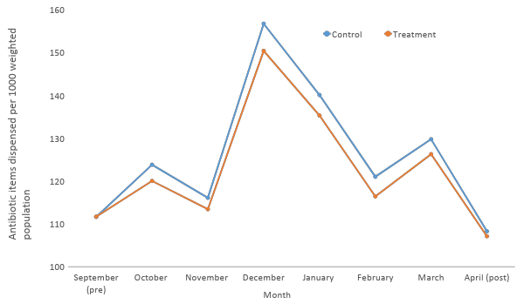
Results
n=1,581
Notes:
PURPOSE
Reveal of the result of the RCT
KEY MESSAGE:
“The primary outcome measure was the rate of antibiotic items dispensed per 1000 population
This line graph shows the antibiotic prescription rate among the practices that did not receive our letter over the 6 months study. Blue is the control group.”
TIMING:
1 min
LINK:
To next slide
RESOURCE
Link to Provision of social norm feedback to high prescribers of antibiotics in GP

Slide 40
Results
Antibiotic prescribing rate was 3.3% lower in the intervention group
n=1,581
Notes:
KEY MESSAGE:
“The orange line shows the prescribing rate among the practices receiving our letter. The moment the letter is sent, the prescribing rate in those practices drops.
Antibiotic prescribing was on average 3.3% lower in these practices.
We were seeing a significant positive effect so in March we decided to give the intervention to the control group.
The gap then closed.”
TIMING:
1 min
LINK:
To next slide
RESOURCE
Link to Provision of social norm feedback to high prescribers of antibiotics in GP

Slide 41




Direct saving of £92,356 in public sector prescription costs
The letter saved 73,406
doses across 791 practices
By treating control we showed it was possible to achieve a 0.85% reduction in antibiotic prescribing in England
Total cost of printing and mailing - £4335
£0.06 per prescription prevented
Notes:
Purpose:
Describe the real world impact beyond the statistics
KEY MESSAGE:
“During the study period alone the letter led to:
More than 73,000 fewer antibiotic prescriptions
The cost of printing and mailing to 3227 GPs in 791 practices was £4335 (would have been 2 but we messed up the printing)
This equates to £0·06 per prescription prevented during the study period (excluding the time costs of implementing the intervention).
Direct savings to the NHS of more than £92,000
We calculate that our feedback intervention would equate to a 0·85% reduction in antibiotic items nationally during the study period (if the control group was also treated)
TIMING:
1 min
LINK:
To next slide
Links to papers
https://www.thelancet.com/journals/lancet/article/PIIS0140-6736(16)00215-4/fulltext

Slide 42

Achieved 85% of the NHS Quality Premium target for
less than 1%
of the budget
Notes:
PURPOSE:
Put the reduction of prescribing in real terms.
KEY MESSAGE:
To put these figures in context, the previous year there was a NHS Quality Premium incentive scheme with a £23 million fund to incentivise doctors to reduce their prescribing by 1% - this letter cost about £4k and that shows how effective social norms can be.
We achieved 85% of this target for less than 1% of the budget (our costs wers c.£4k for the letter and project costs which would have been less than 1% £230k)
TIMING:
1 min
RESOURCE
Link to Provision of social norm feedback to high prescribers of antibiotics in GP

Slide 43
Scale phase
TARGET
EXPLORE
SOLUTION
TRIAL
SCALE
Phases
Assess if and how your intervention can be scaled
and develop a plan to scale it.
Notes:
PURPOSE
Introduce Scale phase of methodology
KEY MESSAGES:
Scale up policies and interventions that have proven to effectively promote the target behaviour
TIMING:
1 min

Slide 44
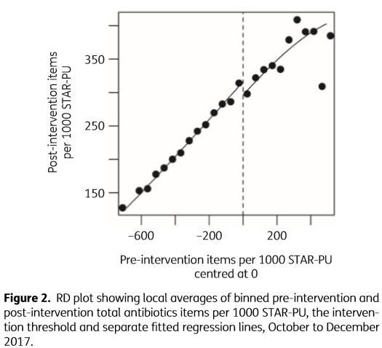
TESTS Methodology: Scale
2019 study using the same letter replicated the same effect among 67 GP practices in Northern Ireland.
4.6% reduction
19,000 fewer antibiotics
(Bradley et al 2019)
Notes:
PURPOSE
Example for Scale
KEY MESSAGE:
“A new study by researchers in Northern Ireland in Northern Ireland has replicated our Lancet study from a few years ago.
They sent social norm letters to 221 GPs in 67 practices (the top 20% of prescribers - compared against a control of 271 practices) and assessed the effect using an RDD (vs our RCT). The letter they used was essentially identical to ours but signed by NI's CMO and sent on behalf of NI's Department of Health.
Main result below - approx 19,000 fewer antibiotics were prescribed as a result of the treatment. This represents a 4.6% reduction in antibiotic prescribing by the intervention practices (vs 4.3% in our Lancet study) and a 1% reduction in NI's annual primary care antibiotic prescribing.
Specific Therapeutic group Age-sex Related Prescribing Unit (STAR PU).”
TIMING:
1-2 mins

Slide 45

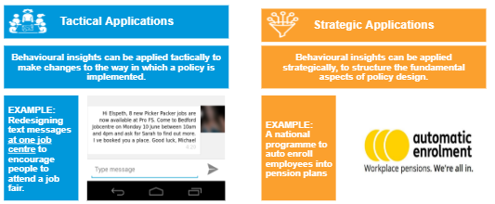
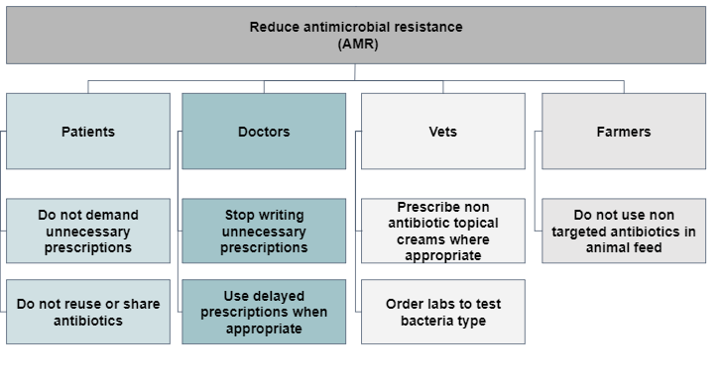
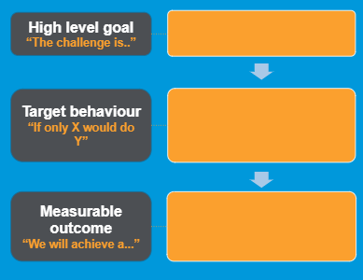


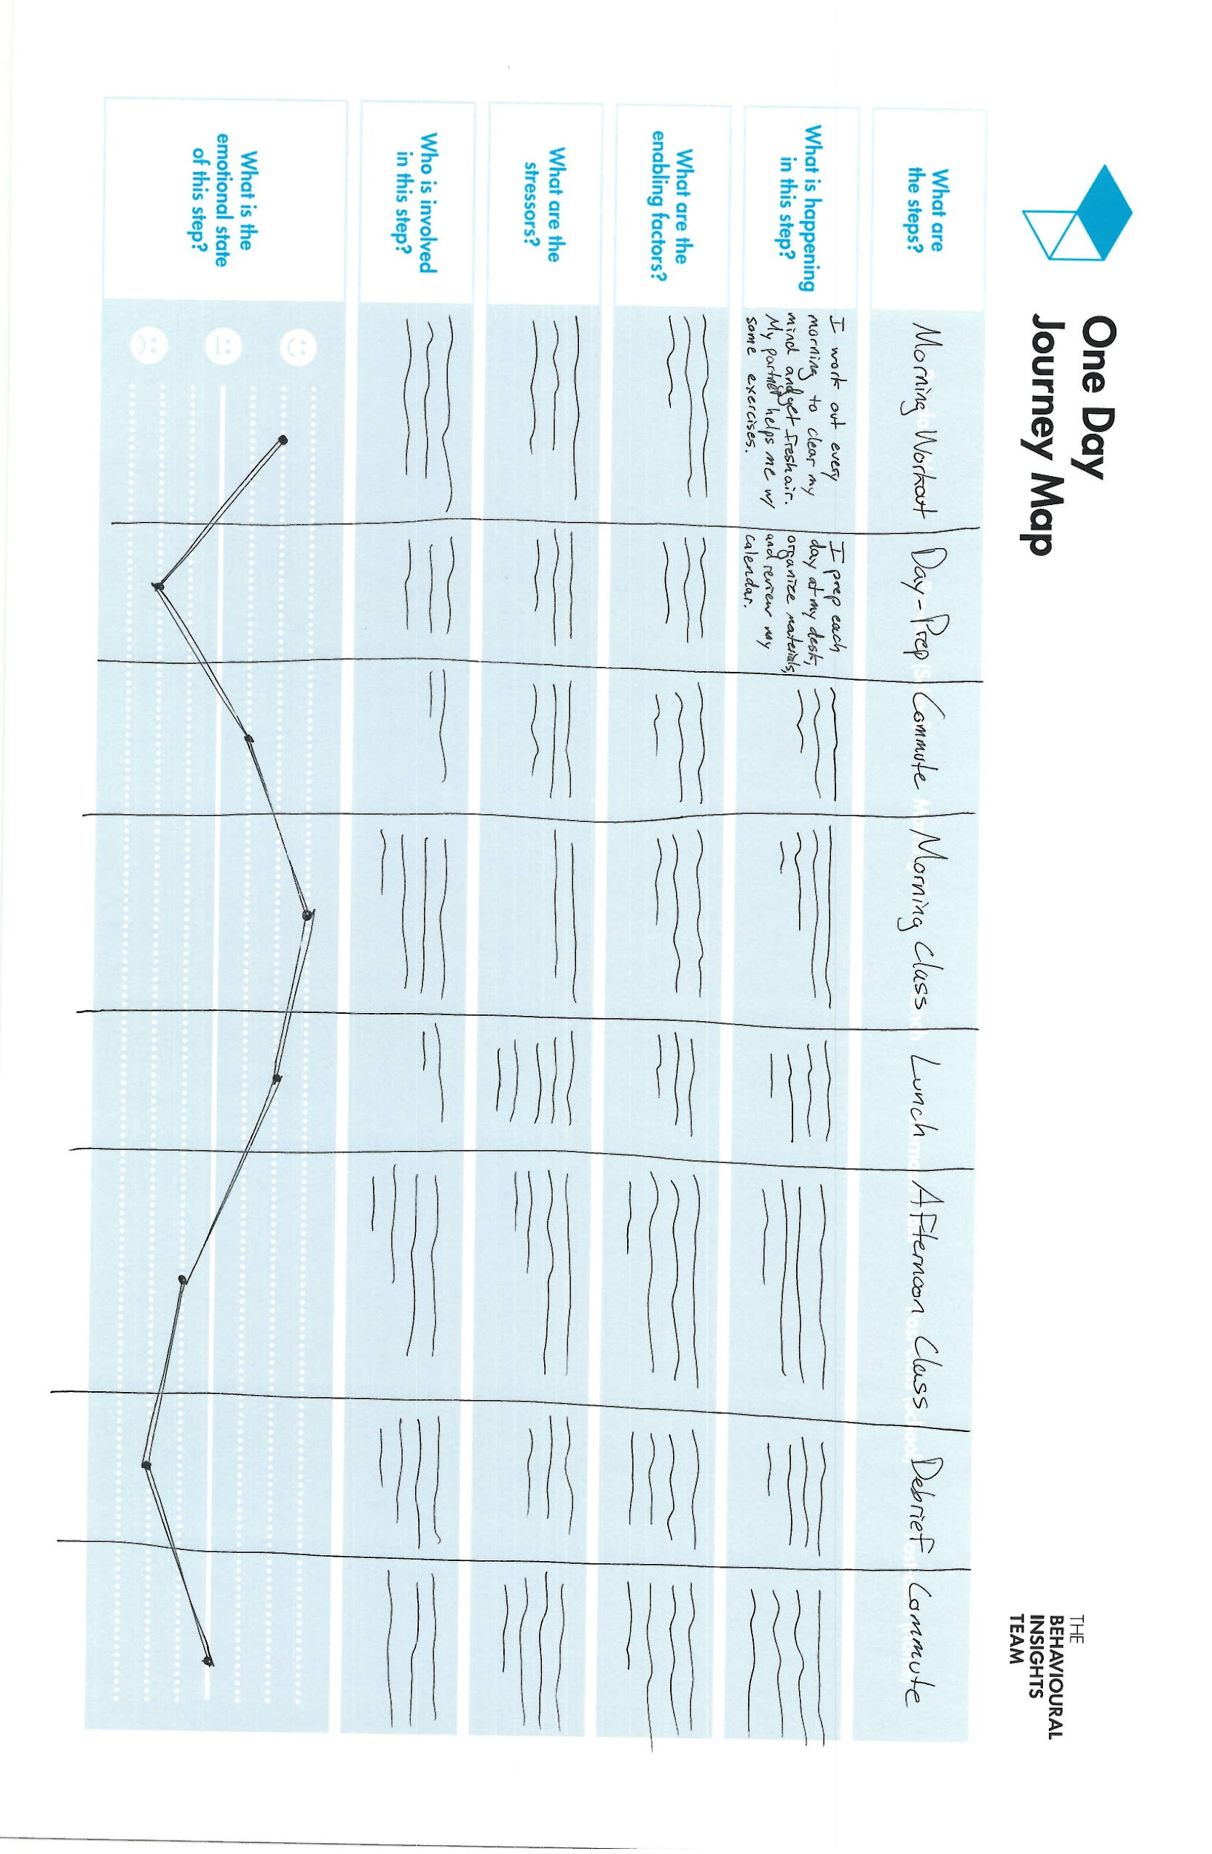
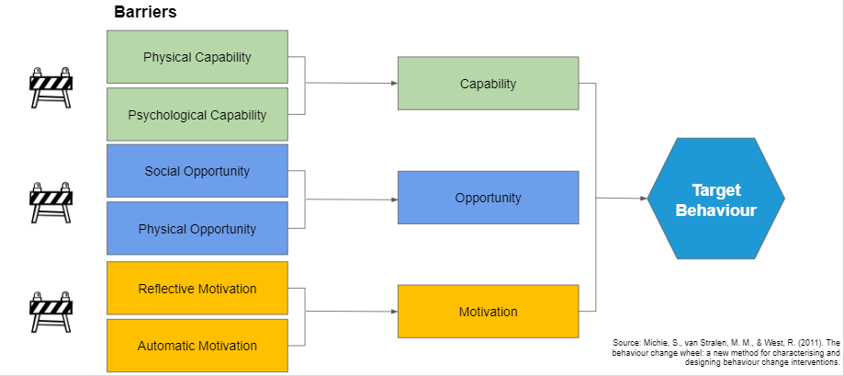
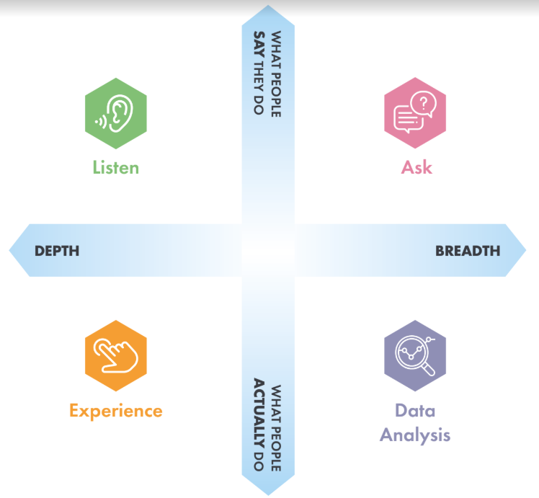
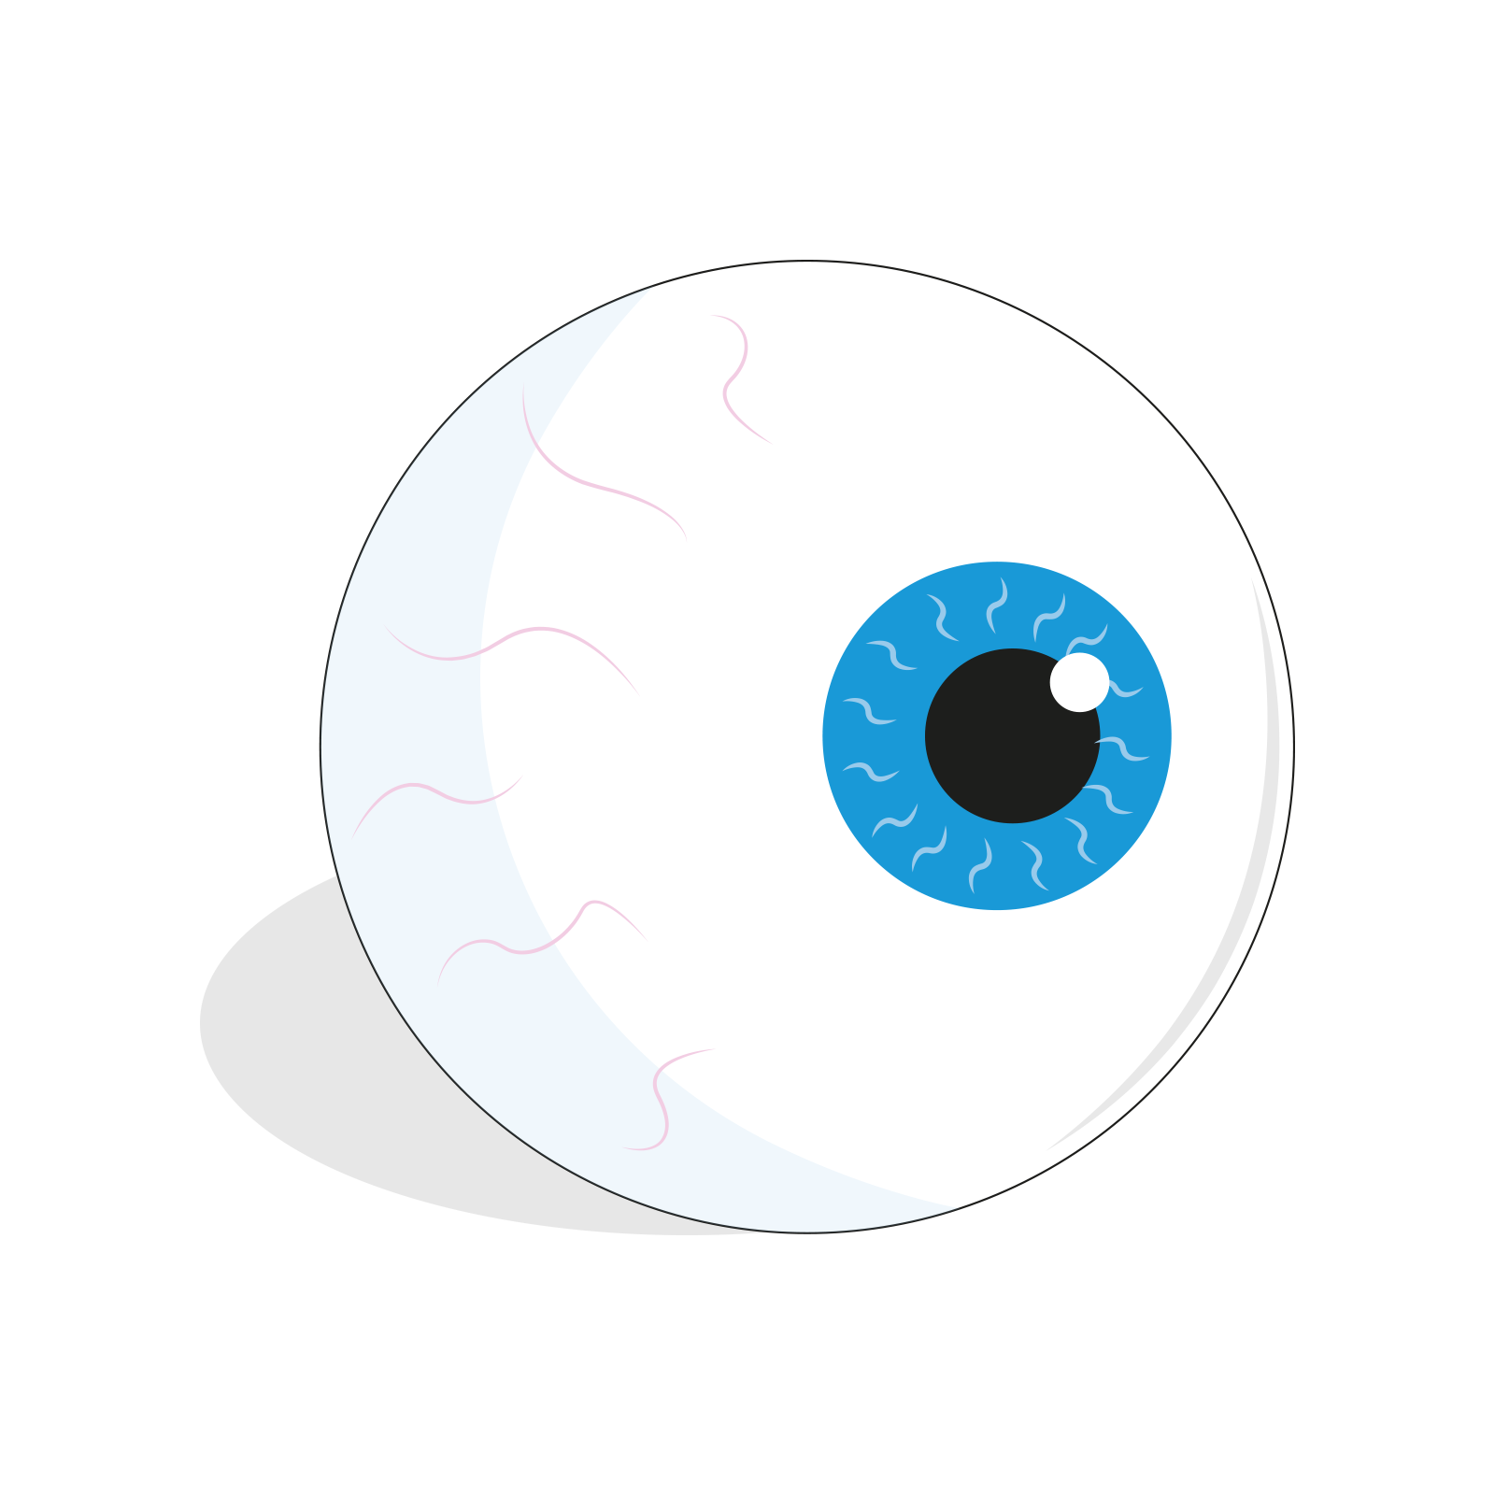

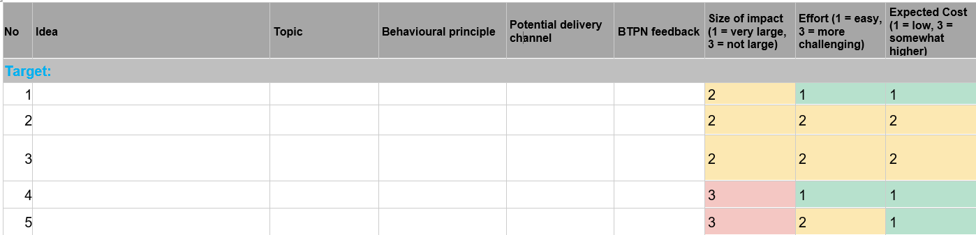
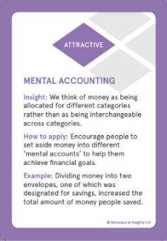
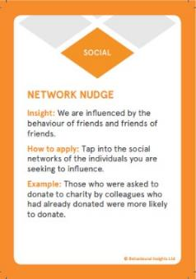
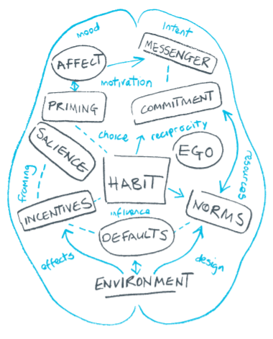
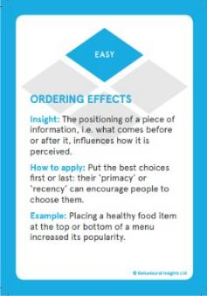
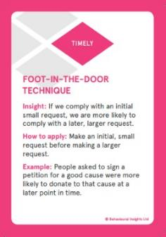
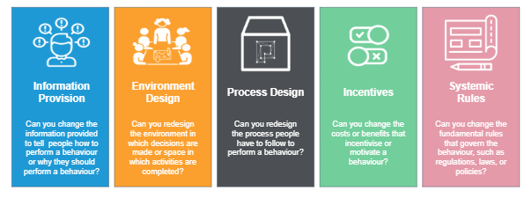
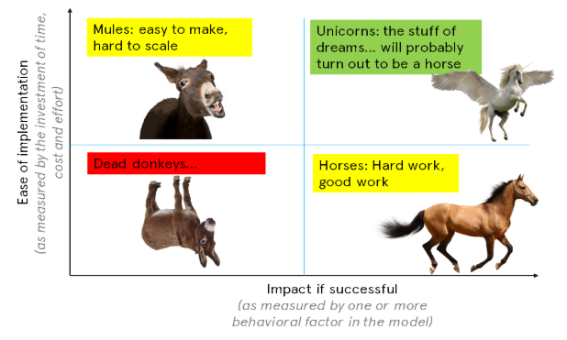

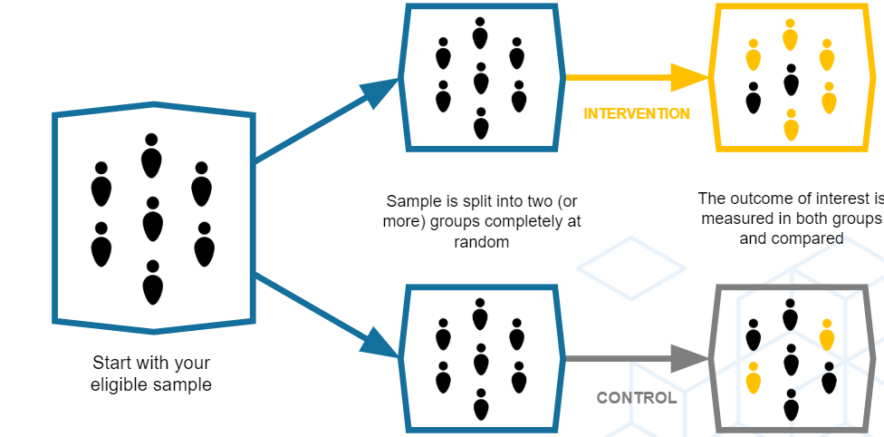




Phase
Tools
Output
Example
Goal Setting
Scoping
Behaviour
Map
Outcome Measure
A clearly defined behavioural goal
Target
Reduce the prescribing rate across the top 20% of prescribing GPs in the UK by 2% within the first 6 months of our intervention
Lit Review
Interviews
Decision Map
COM B
Explore
GPs imagine other doctors would prescribe in similar situations
Social pressure from patient
Desire to help and / or be liked
GPs believe a prescription is the fastest route to see as many patients as possible
Understanding of the context and behavioural barriers
Data Analysis
Observation
Personas
Solution
Data Science
Think-
Group
EAST
Mindspace
A letter from Chief Medical Officer to the top 20% of prescribing GPs in the UK specifying that they are in the top 20%
Letter specifies 3 easy and concrete ways that GPs can reduce prescriptions:
Advising on health care (with a leaflet to provide to patients)
Offering delayed prescriptions
Talk to other practice GPs
Behavioural intervention
Solution Prioritisation
Intervention Analysis
BITX
Quantitative Research
(e.g. RCTs)
Qualitative Research
BITX
A plan to measure if and how the intervention worked
Randomise at the practice level
Two groups: Treatment group receive the letter, control group does not
Measure 1: Prescription rates after 6 months
Measure 2: send letter to control group and measure after 3 months
Trial
Cost:Benefit Analysis
Comms & Storytelling
Business Case
BITX
A plan to maximise the benefits
Scale
Create a business case to scale nationally
Analyse opportunities to apply this insight to other challenges
Notes:
PURPOSE
The purpose of this slide is to demonstrate the vast number of methods, tools and frameworks that are used within a BI project and to demonstrate how we work.
KEY MESSAGE:
We’ve just demonstrated how our TESTS methodology was applied to create a behaviourally informed intervention to reduce anti-microbrial resistance
Each stage of the TESTS methodology has a clear output
BUT to get use to this output we use a number of Behavioural Insights tools and framework
I know this looks like a lot but I’m conscious we are introducing you to a lot of frameworks, methods and tools so I wanted to point out in advance that they do all link together.
You will use SOME of these tools today and I promise that bt the end of the day this slide won’t look so scary
TIMING:
1min
LINK
To next slide

Slide 46

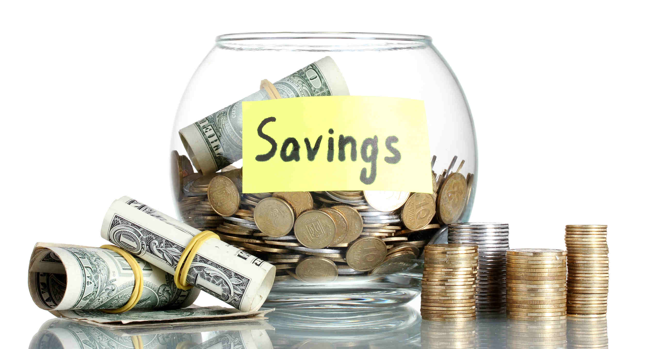





Designing Public Policy
System 1
FAST
System 2
SLOW
© The Behavioural Insights Team
Notes:
Most public policy is reliant on the idea that people use their System 2 when making decisions - that they evaluate all of their options, weigh up pros and cons, and always behave in line with the option that they expect would result in the greatest value for themselves.
In reality we know that people often use System 1 for many decisions, they have limited time or information, so they go with automatic reactions.
So developing public policies and public services assuming that people will interact with them in a an analytical deliberative way often leads to missed opportunities and to developing programmes that are not as effective as they could be if we developed them around the way in which people actually behave.
And that is what the work of BIT is all about - the common thread is that meeting people “where they are”—working with ingrained cognitive and behavioural tendencies, rather than against them—can directly impact results.
At BIT, we try to develop, or refine policies and systems with a better understanding of how systems 1 and 2 will influence decision making in a given situation.
So on that note we’ll now explain to you a bit about our organisation

Slide 47
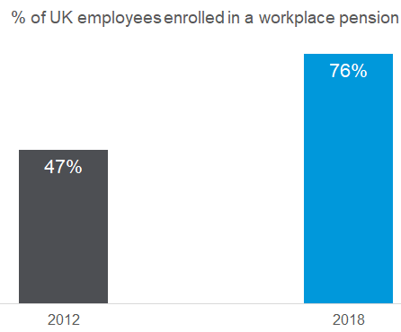

Designing policy to account for System 1 can lead to dramatic successes
Millions more workers
(ONS 2019)
Notes:
PURPOSE:
Set out system 1 example with auto enrolment as default. This example is a unicorn.
KEY MESSAGE:
“Public policy:
Often, public policy is reliant on the idea that people use their System 2 when making decisions - that they evaluate all of their options, weigh up pros and cons, and always behave in line with the option that they expect would result in the greatest value for themselves.
In reality we know that people often use System 1 for many decisions, they have limited time or information, so they go with automatic reactions.
So developing public policies and public services assuming that people will interact with them in an analytical deliberative way often leads to missed opportunities and to developing programmes that are not as effective as they could be if we developed them around the way in which people actually behave.
And that is what the work of BIT is all about - the common thread is that meeting people “where they are”—working with ingrained cognitive and behavioural tendencies, rather than against them—can directly impact results.
Auto Enrolment in Pensions example:
The success of Automatic Enrolment in Pensions highlights the impact of designing policy to account for System 1.
In 2012 (before the auto enrolment) less than 47% of UK employees had an active workplace pension scheme.
At this time not signing up for a pension was the default - what happened if you did nothing.
Behavioural insights shows us that we have a tendency to stick to pre-selected defaults. For example, when you get a new phone - most likely you will not go through each individual setting and make changes, you will probably stick to the majority of the defaults your maker provides you with.
By making auto enrolment the default the % of UK employees with an active workplace pension scheme went up to 76% in 2018.
According to economic theory, this makes no sense and shouldn’t work. It only takes about an hour to choose a pension and it affects the rest of your life - so how that decision is presented shouldn’t matter.
But in reality it does. Even though we all want to spend time signing up for our pension, we don’t get around to it. So that’s the power of making things easy and designing policy to account for system 1
Now, in the UK more than 10 million people make additional savings of roughly £20 billion each year.
BI Unicorn
As this work have brought in well over £1 billion we can class it as a Behavioural Insights Unicorn.
We borrow this phrase from business where startups valued at over £1 billion are known as unicorns . A policy ‘unicorn’ is one that has had an impact of more than £1 billion. Of course, most successful policy interventions have many partners.
Only interventions that are very unlikely to have happened without a major push from behavioural science qualify as behavioural insights unicorns.
We’ll now explain to you a bit about our organisation”
TIMING:
3-4 min
RESOURCE:
Extra info on auto enrolment
LINK:
Link to next slide

Slide 48
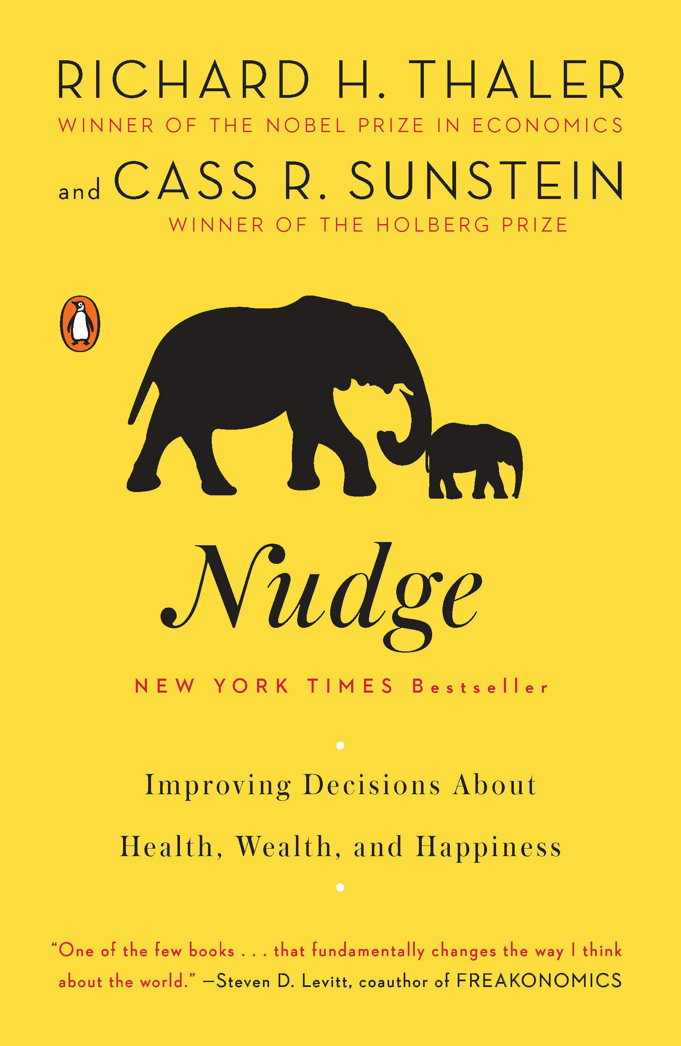
Behavioural Insights Team
World’s first government institution dedicated to the application of behavioural sciences started by the UK Government in 2010.
We are highly empirical; we test and trial our ideas before they are scaled up using experimental and quasi-experimental methods. This enables us to understand what works and (importantly) what does not work.
Notes:
MUST BE QUICK if you are presenting 60 minutes only
PURPOSE:
Introduce BIT
KEY MESSAGE:
“Who is the behavioural insights team?
We started life inside No.10 in 2010 in David Cameron’s government
Aim: support UK government and the civil service deliver better and more cost-effective public policies and public services
BIT was established with a so-called sunset clause: if it did not achieve a ten-fold return on investment (£500,000 a year), it would be shut down after two years. Not only did we stay open — we saved over 20 times our running cost.
Because we were really successful already in our early days we started to receive more and more requests of work.
In 2014 there was a govt policy that entrepreneurial parts of gov that could stand on their own two feet without being funded by the taxpayer should do so
So we were spun out of govt to become a social purpose company partly owned by cabinet office (retain strong links with govt) but also partly owned by innovation charity Nesta and BIT employees.
Social purpose company means that we operate essentially like a consulting firm but with a twist: the first question we ask when deciding whether to take on a project is not about the economic margins but is about whether the project is likely to deliver positive social impact?
We now have 220+ employees, and offices all around the world...we have just opened an office in Toronto.
Beyond of our 7 offices we work across multiple regions to build capacity for applying behavioural insights in governments that wouldn’t have resources to do this independently
Throughout this journey from No.10 our mission remains to same …. to apply an in depth understanding of how people REALLY behave to improve public policy and services, and help people make better choices for themselves.
TIMING:
2-3 min

Slide 49


BIT combines behavioural science with evaluation
+
Behavioural Science
Rigorous Evaluation
The study of how humans make choices and behave in real-world contexts
Investigating the causal link between intervention and outcomes

Slide 50
Nudge
any aspect of the choice architecture that alters people’s behavior in a predictable way without forbidding any options or significantly changing their economic incentives.

Slide 51
Nudge
To count as a mere nudge, the intervention must be easy and cheap to avoid. Nudges are not mandates. Putting the fruit at eye level counts as a nudge. Banning junk food does not.

Slide 52
Advantages of Nudges
Nudges help people achieve their goals. We would like to eat healthier, go to the gym, and save money, but we end up prioritizing immediate returns over long-term goals (i.e., time discounting).
Nudges are more effective than awareness campaigns. Due to the intention-action gap, it is more effective to focus on behavioral change than on raising awareness – we know we should save energy and not eat too many sweets, but in practice, we do not do so.
Nudges are cheap. They change the choice architecture and do not rely on expensive structural changes.
Notes:
sensibilização. Por causa dessa lacuna intenção-ação, é mais eficaz focar na mudança de comportamento, em vez de aumentar a conscientização - estamos cientes de que devemos consumir menos energia, na prática não
Nudges são eficazes em termos de custos. Eles mudam a arquitetura de escolha, não com base em mudanças estruturais caras

Slide 53
Disadvantages of Nudges
Nudges do not solve most problems. They are just another tool for designing more effective policies.
Nudges have a small impact. A recent meta-analysis estimates an average positive impact of 8.1% across various indicators (DellaVigna & Linos, 2020).
Nudges can have negative ethical implications. People are not always aware that they are receiving a nudge.

Slide 54

Is BI “just nudging”?
Photograph: KEN BOHN/AFP/Getty Images
Notes:
PURPOSE:
Explain what a nudge is and that we often use nudging in our interventions.
This slide lines us up for the next one which shows that BI interventions go beyond nudging.
KEY MESSAGE:
Nudges are an incredibly useful behaviour change tool and we use them in a lot of our interventions
A nudge is classified as a change to the choice architecture (environment) that alters people's behaviour in a predictable way without forbidding any options or significantly changing their economic incentives. To count as a mere nudge, the intervention must be easy and cheap to avoid. Nudges are not mandates.

Slide 55

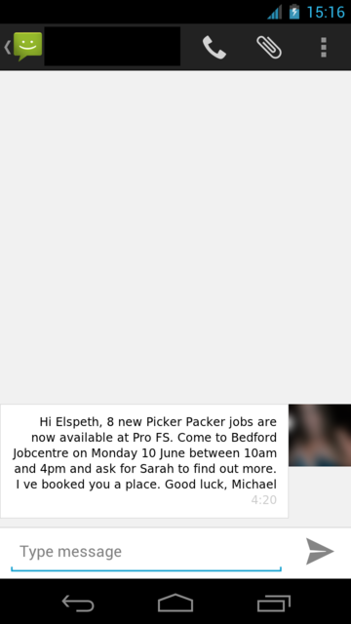
Is BI “just nudging”?
Behavioural insights can be applied to both tactical and strategic challenges
Tactical Applications
Strategic Applications
Behavioural insights can be applied tactically to make changes to the way in which a policy is implemented.
Behavioural insights can be applied strategically, to structure the fundamental aspects of policy design.
EXAMPLE:
Redesigning text messages at one job centre to encourage people to attend a job fair.
EXAMPLE:
A national programme to auto enroll employees into pension plans
© The Behavioural Insights Team
Notes:
PURPOSE:
Explain that BI can be applied to both tactical / operational AND strategic challenges. BI often uses nudges but the remit of BI goes way beyond nudging.
Explain that there two basic ways that behavioral insights can be used: tactically, to make changes to the way in which a policy is implemented; and strategically, to structure the fundamental aspects of the policy itself. You don’t want to pursue options that aren’t on the table
KEY MESSAGE:
There two basic ways that behavioral insights can be used: tactically, to make changes to the way in which a policy is implemented; and strategically, to structure the fundamental aspects of the policy itself.
Some projects are tactical, dealing with changes at an operational level or within only a limited part of a system. Others allow for intervention at a more strategic level, opening up opportunities to alter the fundamental policy or structure for addressing an issue, and perhaps changing a whole system.
TIMING:
3 min
RESOURCE:
Extra info on auto enrolment
Extra info on job seekers
LINK:
To next slide

Slide 56
Ethical considerations of behavioural insights
Notes:
PURPOSE:
Discuss ethical critiques of BI approach
KEY MESSAGE:
To round off the course, we’re going to cover the ethics of the behavioural approach
This is a topic which arises fairly regularly in the course of our work - with people very fairly asking whether it is ethical to seek to influence people’s behaviour in this way
Our short answer to the question is that there are good and bad ways to apply behavioural insights.
What we’re going to try to do is equip you with a basic framework such that you can apply behavioural insights responsibly.
What we’ll aim to do in this section is give you
TIMING:
1 min
LINK:
To next slide

Slide 57

Is a behavioural insights approach paternalistic?
Do policymakers know what individuals want better than they do?
If they do, is it right for them to act on behalf of those individuals for ‘their own good’?
Notes:
PURPOSE:
Explain critique of BI as paternalist
KEY MESSAGE:
So the tools that behavioural science has identified are already used by lots of different actors, in lots of different ways and for lots of different reasons.
What we try to do is to use them in ways that we think are beneficial for people and society.
But there are also more deontological critiques of the behavioural insights approach.
The first is that it is paternalistic.
Some critics are concerned that the characterisation of human decision making as biased breeds a view of degraded citizens as being unable to shape their behaviour independently.
This results in policymakers making false assumptions about what people ‘really’ want, and why they are acting in certain ways.
Another concern is behavioural economics itself undermines the case for government action - because policy makers are subject to the same biases they find in others, even if they don’t realise it. More and more studies are showing how decision makers are subject to confirmation bias, framing effects, group polarization and the false consensus effect, among others.
TIMING:
1 min

Slide 58
Is a behavioural insights approach paternalistic?
Libertarian Paternalism
“An approach that preserves freedom of choice but that authorizes both private
and public institutions to steer people in directions that will promote their welfare”
Thaler and Sunstein, 2003, AER
Key idea: individuals retain freedom of choice
Two considerations for assessing the risk of paternalism (among others)
1. Extent of consequences. What are the likely harms and benefits of adopting or not adopting the behavior, and where do they fall?
2. Strength of preferences. How strong and settled are the preferences of the people being influenced? What is the strength of evidence informing this judgment?
Notes:
PURPOSE:
Explain the concept of libertarian paternalism and a framework for assessing the risk of paternalism
KEY MESSAGE:
Our response to this is to encourage that behavioural insights be applied a “humble” way, based on trying to understand the reasonableness of individuals’ actions, rather than holding an inflexible, narrow view of what is “rational” in a particular situation”. Central to this is what is often called the notion of libertarian paternalism. Made popular by Nudge, it is the idea that whilst policymakers may steer individuals to take up options which might promote their welfare, the individual should always retain freedom of choice.
Elspeth Kirkman and Michael Hallsworth nuance this argument by outlining two key considerations for assessing the risk of paternalism.
The first is to consider the extent of the consequences of the behaviour in question. The starting point for this is to consider whether the harms or benefits from a behaviour fall on the individual themselves, or other people. Acting when the behaviour only affects the individual is paternalistic, whereas if the behaviour affects others there is more scope to act.
The level of harm also matters. For example, in 1998 the UK Government banned the sale of paracetamol in packs larger than 32 tablets for pharmacies and 16 tablets for non-pharmacies. This change reversed the upward trend of suicides and poisonings, saving an estimated 765 lives over the following decade. This was a paternalistic action - in that the consequences of the behaviour fall on the individual - that was deemed justifiable based on the level of harm that was being incurred.
TIMING:
1 min

Slide 59

Is a behavioural insights approach manipulative?
Are citizens aware that they are being influenced?
If they are not, does this mean BI-informed policies are unethical?
Notes:
PURPOSE:
Explain critique of BI as manipulative
KEY MESSAGE:
The second charge levelled at the behavioural approach is that it is manipulative.
The critique is that if behavioural insights interventions involve non-conscious modes of decision making, then the recipients may not be aware if and how they are being influenced.
They therefore are not able to easily resist the influence or debate and contest the intervention. Moreover, many of the interventions are designed precisely to be delivered in a seamless, unobtrusive way.
TIMING:
30 seconds

Slide 60
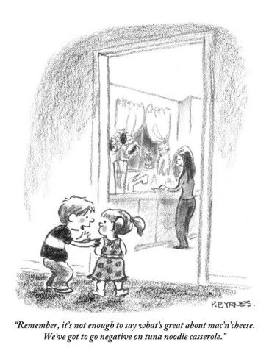
Is a behavioural insights approach manipulative?
Two considerations for assessing the risk of manipulation (among others)
1. Control. How easy is it for the relevant actor to resist the intervention, considering the context and their capabilities?
2. Transparency. How reasonable is it to expect that the target of an intervention will perceive its intention, at the moment of decision or later?
Notes:
PURPOSE:
Considerations for assessing whether a BI approach is manipulative
KEY MESSAGE:
Kirkman and Hallsworth respond to this by setting out two considerations for determining whether an intervention is manipulative.
The first is to consider the effect it has on the control of the individuals. The key aspect is how easy it is to resist the intervention. Remember that whilst we are seeking to steer the individual, they should also retain the freedom of choice to choose another option.
Of course, a crucial factor for resisting influence is to be aware of the intervention in the first place - which brings us to the second aspect, transparency. The main question here is how easy it is for someone to become aware that they are being influenced in a particular direction. One way we try to ensure this is by making our interventions public wherever we can, and sharing the results online.
TIMING:
1 min

Slide 61

“Dark Patterns”
Behavioral insights can be used in ways that are manipulative or against the best interests of both an individual and society in general (that is, in an unethical way).
Dark patterns are techniques used to coerce or deceive customers or users into making decisions that are against their best interests or personal preferences. (E.g. scams!)
A Dark Pattern is “a user interface that has been carefully crafted to trick users into doing things”.
Notes:
PURPOSE:
Explain that behavioural insights can be used in ways that are against the best interests of individuals/society in general.
KEY MESSAGE:
The tools identified by behavioural scientists are not reserved for use by policymakers.
They can be used, and are being used by a whole range of actors - and not always in the best interests of people and society.
For example, 11% of major websites routinely used “dark patterns”.
These are features of websites exploits uses or seeks to trick them into doing things that are against their preferences or interests.
For example, some websites may show you the number of people that are looking at a flight or a product at a given moment - but this number is often randomly generator.
Others may display a discount as being time limited to motivate you to act - when in fact the discount simply renews every day
TIMING:
1 min
TIMING:
1 min
A recent study of around 11,000 websites found that 11% of the sites routinely deployed “dark patterns”, and that these sites were typically ranked more highly by search engines

Slide 62

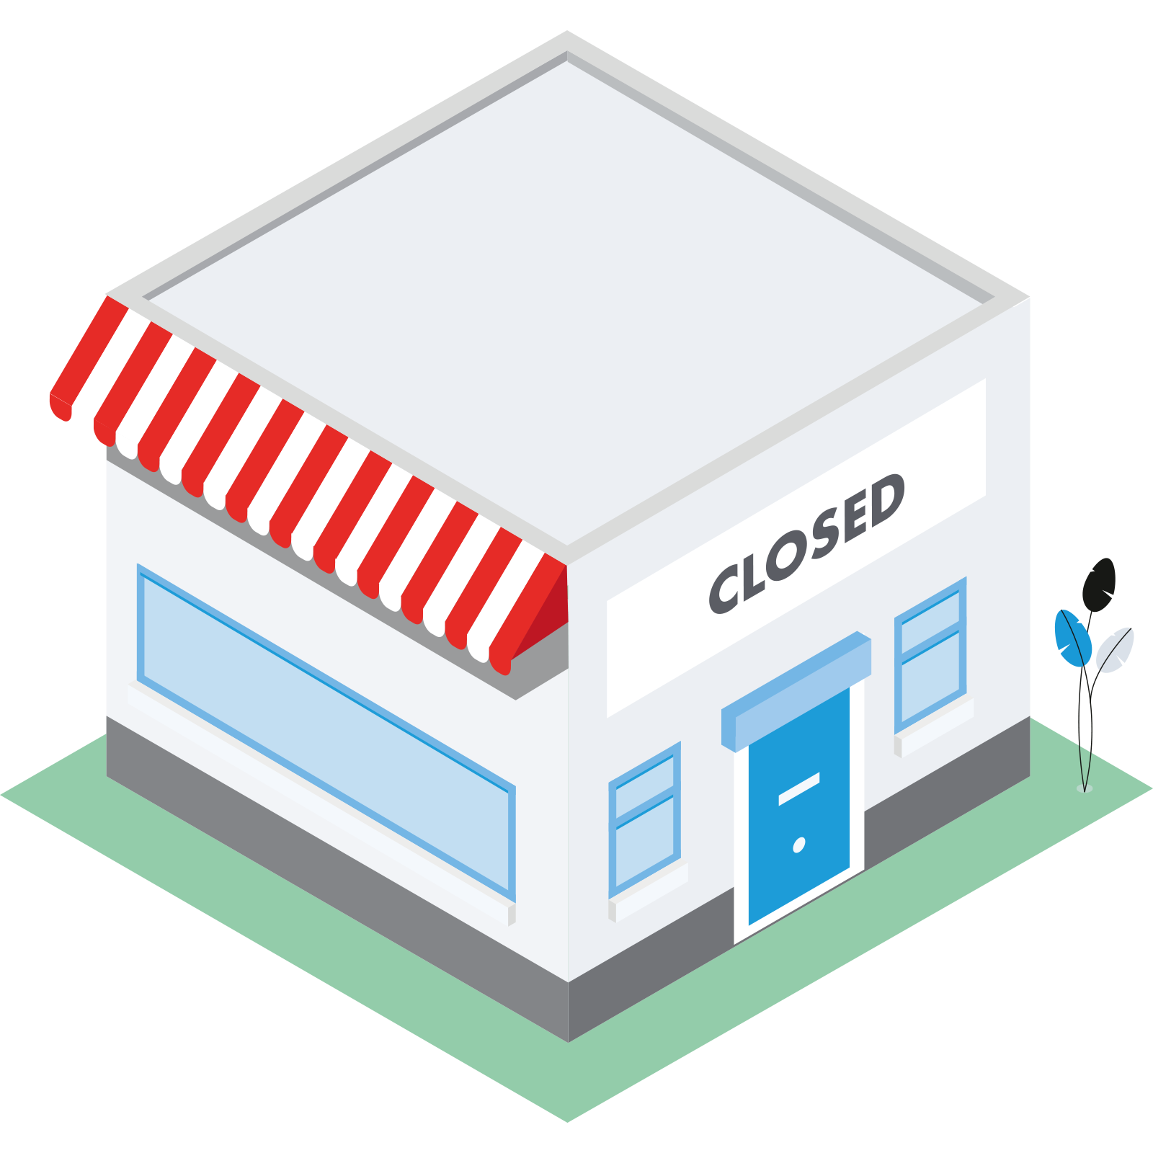
Related to this: the concept of “sludge”
The use of friction to discourage beneficial behaviors has recently coined by Richard Thaer as “sludge”, the evil twin of “nudge” (Thaler, R.H. (2018), ‘Nudge, not sludge’, Science, 361(6401): 431). For example:
Frictions that make it easy to sign up and hard to leave a service.
Frictions that make it difficult to return products.
Frictions that make it difficult to change privacy settings.
Notes:
PURPOSE:
Explain what Sludge is
KEY MESSAGE:
Another common tactic is that companies make it very easy to subscribe to their services, but very difficult to unsubscribe.
This is an example of companies using friction costs to their advantage, a tactic which has been dubbed ‘sludge’
First used by Richard Thaler, it is defined (by Sunstien) as: “the kind of friction, large or small, that people face when they want to go in one or another direction”.
Sludge is what makes it hard to return products, claim insurance or change privacy settings online.
It also affects public administration.
There is increasing interest in how governments may discourage certain groups from accessing public services by introducing administrative burdens that particularly hamper those with few resources.
For example, sludge may make it hard to people to register to vote, claim unemployment benefit or obtain financial aid to support their child’s studies.
Removing sludge from public processes could benefit people.
Justification for Sludge (In Case Someone Asks):
Sunstein identifies 5: (1) program integrity, (2) self-control problems, (3) privacy, (4) targeting, and (5) data collection
TIMING:
1 min
LINK:
To next slide
Additional info - examples of Sludge (from Sustien’s Paper)
In 2015, the United States government imposed 9.78 billion hours of paperwork burdens on the American people. Many of these hours are best categorized as “sludge,” understood as friction, reducing access to important licenses, programs, and benefits. - Sunstien puts this in perspective: “Suppose that we assembled every resident of Chicago and insisted that for the entirety of 2019, each one must work 40 hours a week engaged in just one task: filling out federal forms. In a year, the 2.7 million citizens of Chicago will not have come within four billion hours of the annual paperwork burden placed on Americans.” - “If we value an hour of work at $20,16 9.78 billion hours is the equivalent of $195.6 billion”
Example 1: People might want to sign their child up for some beneficial program, such as free transportation or free school meals, but the sludge might defeat them.
Example 2: To obtain financial aid for college, students are required to fill out the Free Application for Federal Student Aid (“FAFSA”). It is long and complicated, and it requires young people to provide information that they might not have (some of it is on their parents’ tax returns).Many students give up.
Example 3: A sludge-filled registration process may discourage voting

Slide 63

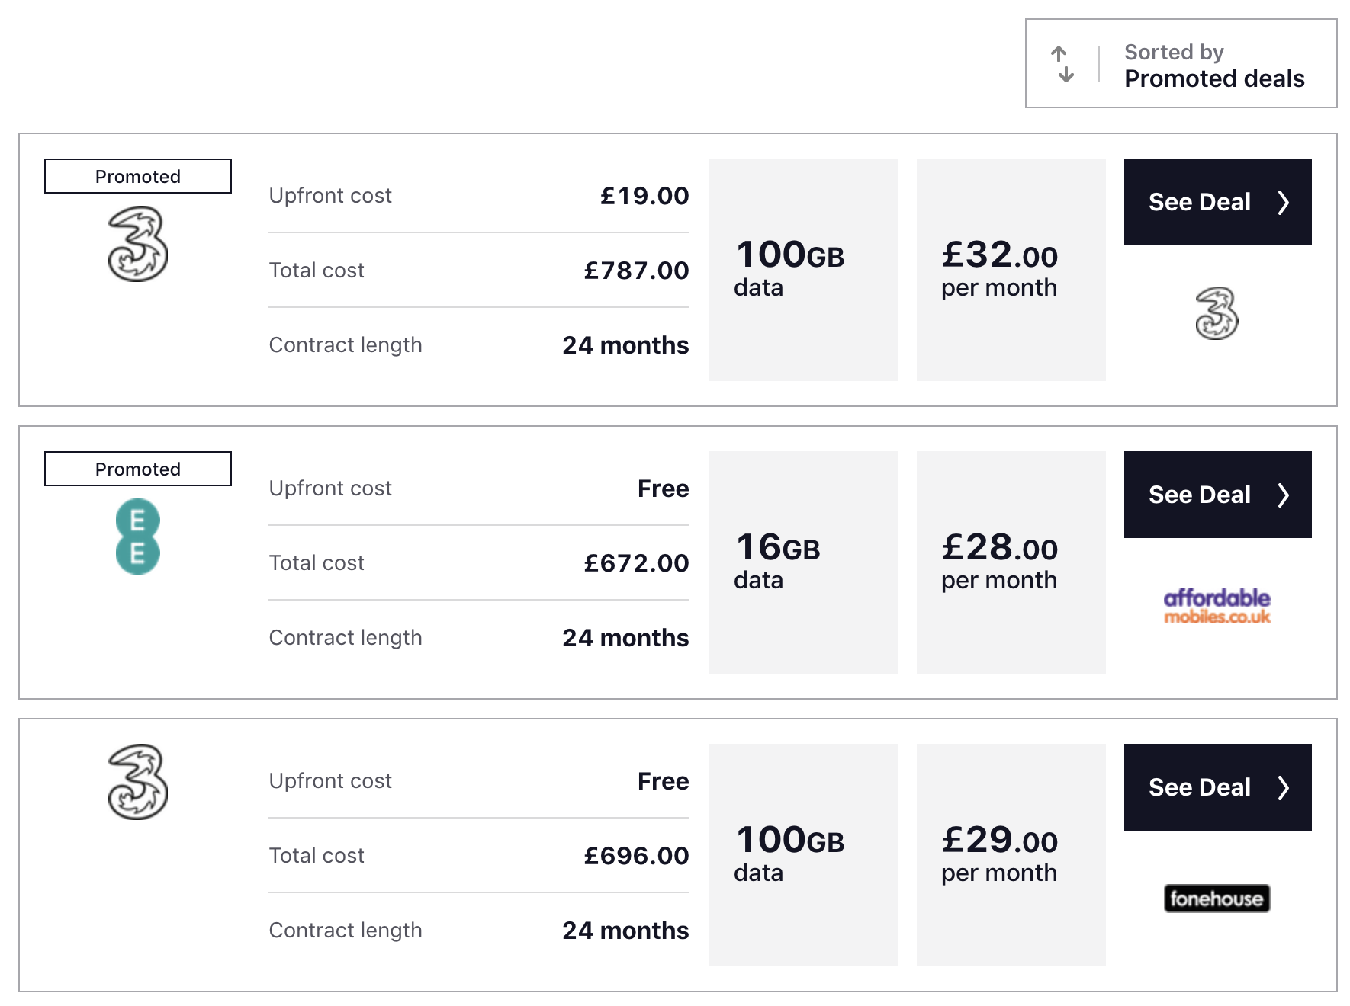

Measuring sludge for a price comparison website
By default, promoted deals are at the top of a search result.
Only 21.8%
of people found the cheapest available contract.
Notes:
PURPOSE:
Give concrete example of Sludge - uSwitch sludge audit
KEY MESSAGE:
To give you a concrete example of how this works, we performed a sludge audit of the price comparison website uSwitch. This is a website which helps users switch services - whether that be broadband, electricity, mobile phone provider - and find better deals.
During the audit, we asked we asked 128 individuals to go to the USwitch website and find the cheapest deal available for an iPhone 8 (with 64GB data).
We asked them to report back to us with the cheapest price they could find on the website, and we would pay them a small amount of money (about £4.00 on average) if they got the answer right.
Out of the 128 submissions, only 33 people correctly identified the cheapest contract.
Many reported higher prices, because they looked through the default ‘promoted by’ list and picked whatever was least expensive from there, thus never even seeing options that were cheapest.
TIMING:
1 min
LINK:
To next slide
FURTHER INFORMATION:
Companies and organisations often have good data to measure sludge for their own processes (e.g., user testing, data looking at drop-outs during a process and time spent) and an organisation could have strong incentives to remove frictions to make it easier for people (e.g. getting a subscription). However, they may have an incentive to keep certain frictions in place, and it is difficult to know how much these impact outcomes for people. This makes the case for independent audits of organisation’s processes, ideally in a way that we can compare across organisations in the same industry to establish good/bad practice. BIT has started running so-called ‘sludge audits’, where we quantify how difficult an action is to complete and how much time people take.
One process we tested was finding the cheapest deal for mobile phones on a price comparison website. For this audit, we picked USwitch, because their website automatically sorts offers by ‘promoted deals’ rather than by customer reviews or price.
In the online study that we ran, we asked 128 individuals to go to the USwitch website and find the cheapest deal available for an iPhone 8 (with 64GB data). We asked them to report back to us with the cheapest price they could find on the website, and we would pay them (about £4.00 on average) if they got the answer right. Out of the 128 submissions, only 33 people correctly identified the cheapest contract. Many reported higher prices, because they looked through the default ‘promoted by’ list and picked whatever was least expensive from there, thus never even seeing options that were cheapest.
The audits are quick and easy to run, and we are currently setting them up to evaluate processes of different companies in the same industry so that we can get a better sense of the impact of sludge, as well as identify companies that have better and worse practices.

Slide 64



Other factors affecting public opinion about the ethics of BI
Public perception of BI interventions tends to be influenced by the type of intervention, its motive and whether consultation has been conducted.
Type: Nudges and interventions targeting System 2 tend to be better received
Motive: The intent should be clear, the desired outcome one that is considered to be in the best interests of the individual
Consent: Where possible, evidence of public agreement to the intervention should be gathered
Notes:
PURPOSE:
Explain that it is important to consider how the public will react to a behavioural insights approach
KEY MESSAGE:
Another key factor behind whether the use of a BI approach is ethical and justifiable is public opinion.
This is a common and legitimate concern. In the public sector, backlash against policy choices can impose political costs, as well as causing distractions for those public servants tasked with handling the response.
In the private sector, meanwhile, one act of perceived over-reach can irrevocably damage market share.
So how do we gauge public opinion and what kinds of interventions are more or less likely to attract a negative response?
Elspeth and Kirkman outline three main concerns:
The first is the type of intervention. Research by Cass Sunstein shows broad support for light-touch, nudge interventions that preserve individual’s choice, with support for government-imposed mandates being much weaker in comparison. Interventions which target System 2 - our reflective system of thinking - are viewed more favourably than those targeting 1, largely due to the perception that they offer individual’s greater control and ability to resist the intervention should they wish.
Support also varies based on the motive of the intervention and perceptions of whether it is in the best interests of the individual. For example, interventions which default people into saving more money - which is generally in the best interests of the individual - are less controversial than those which default someone into making a charitable donation. The prevailing political consensus plays a role here in determining acceptability of a measure.
Which takes onto the last point, which is around consent. In our work, we try wherever we can to establish that there is broad public agreement to the interventions we put in place. Evidence on this can be gathered through the wider literature, surveys and consultation processes.
TIMING:
1 min

Slide 65
Next lecture:
Behavioural insights project simulation
Each group will work to apply behavioural insights to a real challenge and come up with a behaviourally-informed solution to that challenge
Pick a behaviour to focus on (this can be the topic of your essay)
Your ideas should be:
  Feasible (can your idea be implemented?)
  Impactful (will it have a social impact?)

