Slide 1

course unit:
Programming Languages

Slide 2
Presentation:
Lecturer:
Raquel Bernardino
rbernardino@iseg.ulisboa.pt
Gabinete 511 (Quelhas 6)
Education
BSc in Applied Mathematics
MSc in Statistics and Operations Research
Specialization OR
PhD in Statistics and Operations Research
Specialization Optimization
Professional background
Software developer
Siscog, S.A.
Invited assistant professor
FCUL
Assistant professor
ISEG

Slide 3
Presentation:
Course unit:
Programming Languages
Lecture Notes and Exercises
Fénix
Teams
Slides and exercises solved in class

Slide 4
Objectives:
Define concepts of Object-Oriented Programming;
Recognize good programming practices in C++;
Implement relevant algorithms to solve mathematical problems.

Slide 5
Program:
Chapter 1: Variables and operators [2 classes]
Chapter 2: Control Structurs [4 classes]
Chapter 3: Vectors [3 classes]
Chapter 4: Functions [2 classes]
Chapter 5: Error Handling [1 classes]
Chapter 6 + 7: Classes [3 classes]
Chapter 8: Operator Overloading [2 classes]
Chapter 9: Inheritance and Polymorphism [1 class]
Chapter 10: Writing and Reading Files [3 classes]
[+ 3 exercise classes]
[24 classes]

Slide 6
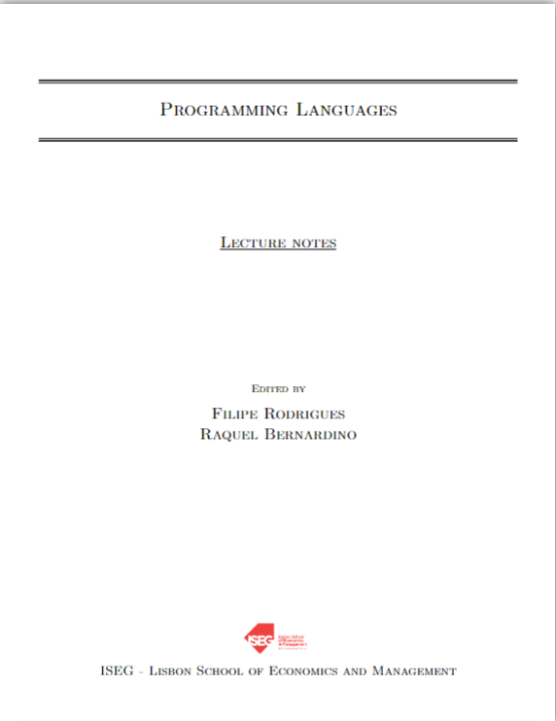
Course Materials:
Lecture Notes
Exercise Book
Preliminary Exercises
Slides
It is recommended to read the Lecture Notes before the classes.
Summary of the Lecture Notes
Notes:
Handbook
Exercise Book
Consolidation Exercises
Slides
It is recommended to read the Handbook before the classes.

Slide 7
Bibliography:
Principal:
Stroustrup, B. (2014). Programming: principles and practice using C++. Pearson Education.
Secundary:
Stroustrup, B. (2013). The C++ programming language. Pearson Education.
Stroustrup, B. (2018). A Tour of C++. Addison-Wesley Professional.
https://www.learncpp.com/

Slide 8
Assessment:
Normal Period (NP):
NP assessment consists of three exercises (E1, E2, E3) and a final exam (FE).
The final grade for the course depends on the number of exercises completed:
≤1 exercise:
Final Grade = FE Grade;
2 exercises:
Final Grade = max{FE Grade; (Sum Exercises + FE Grade)/3}
3 exercises: you may choose from
Final Grade = Average of the 3 exercises → If Ei ≥7; i=1,2,3
Final Grade = max{FE Grade; (Sum of the 2 best exercises + FE Grade) / 3}
To pass the course, the Final Grade must be greater than or equal to 9.50, and the FE Grade (if taken) must be higher than 7.

Slide 9
Assessment:
Re-sit Period (RP):
For students who did not pass during NP, the final grade in the RP is calculated in the same way as in the NP, with the RP exam replacing the final exam.
For students who wish to improve their grade in the ER, the final grade for the ER is based exclusively on the ER exam (Article 6, paragraph 2 of the General Assessment Rules).
Students who achieve a final grade equal to or higher than 18.50 in either the NP or the RP may be required to complete an additional oral exam.

Slide 10
Assessment:
Reference material:
For exercises 1 e 2: ½ A4 page
For exercise 3, exam EN and exam ER: 1 A4 page
It may contain anything you wish, but it must be handwritten (no use of tablets).
Exercises and exams:
They will be carried out on ISEG computers.
Prior registration through Fénix is required.
For all matters not specified above, the rules stated in the “General Assessment Regulations” apply.
Notes:
Exercises and exams (EN and ER): They will be carried out on ISEG computers. Prior registration through Fénix is required.
For all matters not specified above, the rules stated in the “General Assessment Regulations” apply.

Slide 11
Assessment:
Exercises:
Exercise 1: February 18th during class
Exercise 2: March 16th during class
Exercise 3: April 27th during class
Exams:
Regular Exam: May 21st at 9:00
Resit/Repeat Exam: June 8 at 12:00
Época Especial: June 30 at 15:00

Slide 12
Office hours:
Office hours:
Monday from 14:30 to 15:30
At any time via Teams (or email) ☺
If you plan to attend office hours in person, please let me know in advance.

Slide 13
Programming: concepts
Although computers are very fast, they only understand a small set of instructions and do exactly what they are told to do.
A program is a set of instructions that the computer must execute to perform a task. The process of creating a program is called programming.
Programmers create programs by writing code, which is a list of instructions in one or more files.
Objective of
Programming Languages

Slide 14
Programming: machine code
The computer’s CPU can only directly understand a limited set of instructions — machine code.
Example: 10110000 01100001
When computers were first invented, programming had to be done in machine code.
Disadvantages: difficult to program, time-consuming, and not portable.
Notes:
Second, each set of binary digits is interpreted by the CPU into a command to do a very specific job, such as compare these two numbers, or put this number in that memory location. However, because different CPUs have different instruction sets, instructions that were written for one CPU type could not be used on a CPU that didn’t share the same instruction set. This meant programs generally weren’t portable (usable without major rework) to different types of system, and had to be written all over again.

Slide 15
Programming: assembly code
The assembly programming language was created due to the difficulty of programming in machine code. In assembly, each instruction is represented by an abbreviation, and names and numbers can be used.
Example: mov al, 061h
Assembly is easier to read than machine code, but the CPU does not understand it directly. → An assembly program has to be translated by na assembler to be understood by the computer.
Disadvantages: hard to read (many instructions for simple tasks) and not portable.

Slide 16
Programming: high-level languages
High-level languages were created so that programmers can write code without worrying about the type of computer on which their program will run.
Example in C/C++: a = 97;
Programs written in high-level languages must be translated into a language the computer can understand – this is done by the compiler.
The compiler reads the source code and produces an executable that can run on any computer, thus solving the portability problem.
Notes:
Quando o Código é transformado num executável não é preciso que o executável corra o programa. Atualmente, os compiladores conseguem produzir Código otimizado rapidamente (melhor que os humanos em linguagem assembly)

Slide 17
Programming: high-level languages
Code in high-level language
Compiled by
Compiler
Originates
Executable
Runs on
Results
Produces
Computer
Notes:
Quando o Código é transformado num executável não é preciso que o executável corra o programa. Atualmente, os compiladores conseguem produzir Código otimizado rapidamente (melhor que os humanos em linguagem assembly)

Slide 18

Programming: C++
It was developed by Bjarne Stroustrup as an extension of the C
programming languange.
It became well known for being an object-oriented programming language.
C++ philosophy: “Trust the programmer.”
What is C++ good for?
When efficiency is crucial and precise control over memory and computer resources is required.
Examples of applications written in C++: Video games, real-time systems, graphical applications, and simulations.
Notes:
C++ is designed to allow the programmer a high degree of freedom to do what they want. However, this also means the language often won’t stop you from doing things that don’t make sense, because it will assume you’re doing so for some reason it doesn’t understand. There are quite a few pitfalls that new programmers are likely to fall into if caught unaware. This is one of the primary reasons why knowing what you shouldn’t do in C/C++ is almost as important as knowing what you should do.

Slide 19
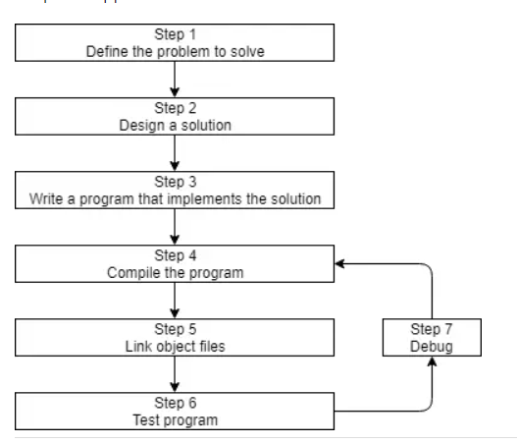
Programming: Development in C++
Program development in C++.
Source: https://www.learncpp.com/

Slide 20

Programming: IDE
An Integrated Development Environment (IDE) is software that contains everything needed to develop, compile, link, and debug programs.
We will use Qt Creator. → Installation guide available on Fénix.

Slide 21
Programming: Coding in C++
A C++ program always starts as follows:
//Preamble
int main() {
//Write your code here -> This is a comment
/*This is a
comment block*/
return 0;
}
The computer always begins executing the program from the main function.
The preamble includes external elements of the program (for example, packages from the standard library).
All instructions end with a semicolon( ; ).

Slide 22
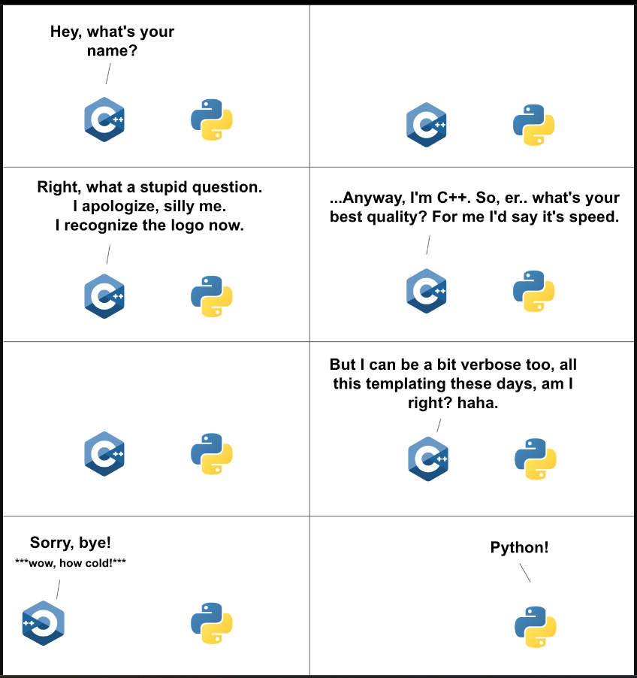
Why C++?

Slide 23
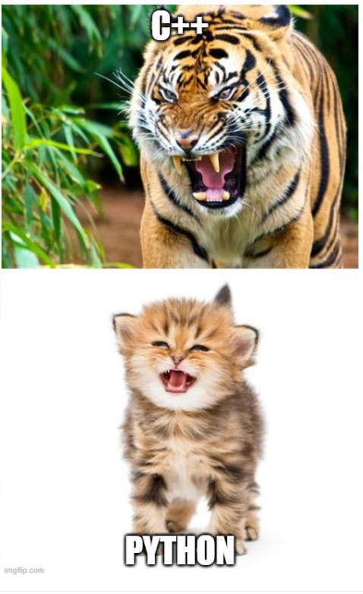
Why C++?

