Slide 1

course unit:
Programming Languages
Chapter 1:
Variables and Operators

Slide 2
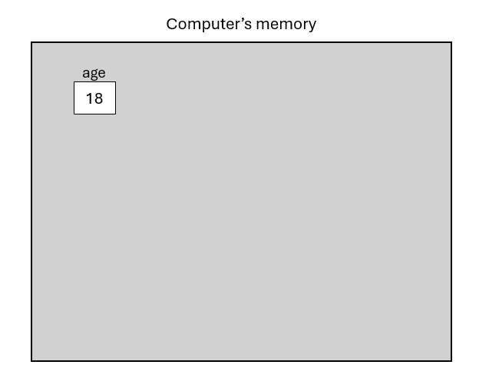
Variables:
An object is a region of the computer’s memory that can hold a value. A variable is an object with a name.
Each variable has a name and a type.
Variable age with value 18

Slide 3
Variables:
To create a variable, it must be declared and initialized.
Variable declaration: VariableType VariableName;
Example: int age;
Variable initialization: VariableName = value;
Example : age = 18;
In the declaration, the variable is created, and in the initialization, a value is assigned to it.

Slide 4
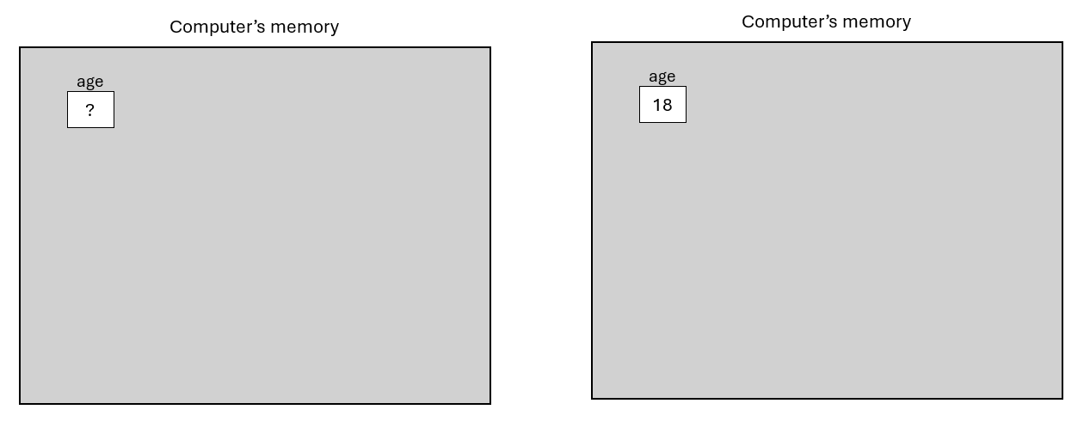
Variables:
Variable declaration
Variable initialization
It is possible to declare and initialize a variable in the same statement by doing: VariableType VariableName = value;
Example: int age = 18;
Notes:
Declarada antes de inicializada
Não inicializada fica com lixo, boa prática atribuir-lhe sempre um valor

Slide 5
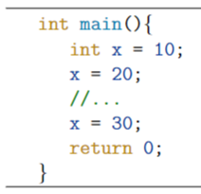
Variables:
The value of a variable can be changed.
Each variable stores at most one value.
Example:
Note: It is not possible to declare a variable with the same name twice (int x = 30; → ERROR).

Slide 6
Variable names:
Variable names must follow some rules:
They can only begin with a letter or an underscore;
They cannot be reserved words;
They cannot contain spaces;
They cannot contain characters other than letters, numbers, or the underscore.
Note: Age ≠ age
Possible | Not possible
Age, house, name | 4real, main, name 2, name!

Slide 7
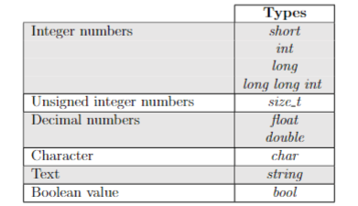
Variable types:
The variable type defines its properties.
To store integer numbers, we use type int and for decimal numbers er use type double.
Is the only date type that is not primitive.

Slide 8
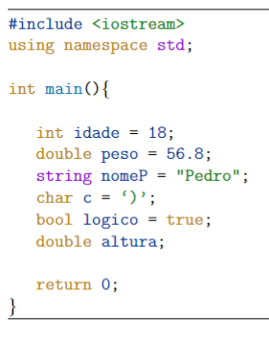
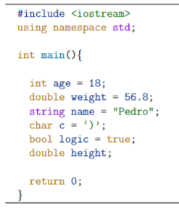
Variable types:
Exemplos de inicialização dos vários tipos de variáveis:
We need to include the package iostream to use the date type string.
The second instruction tell us where the package is included. → Standard (std) library.
Variable declared but not initialized.
Notes:
String aspas e char apostrofe
Caso não fizéssemos o using namespace tínhamos que fazer std::string

Slide 9
Writing to the screen:
It is possible to display information on the screen (variable values, text, numbers, etc.) using the command
cout <<
from the iostream package.
Example:
cout << VariableName;
cout << “Text to print on the screen”;
You can use the cout << command to print any type of data introduced so far.

Slide 10
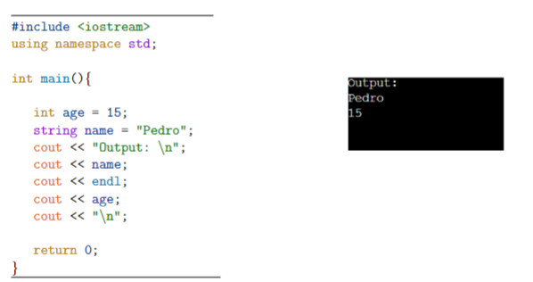
Writing to the screen:
Example:
cout << “Output: \n” << name << endl << age << “\n”;
New line

Slide 11
Reading from the screen:
It is possible to read information from the screen using the command
cin >>
from the iostream package and store it in a variable.
Exemplo: cin >> VariableName;
Variable VariableName must be declared before.
If the entered value does not match the type of the variable VariableName, the cin command will procude an error.

Slide 12
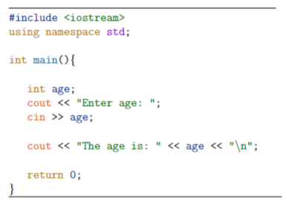


Reading from the screen :
Example:
Waits for the age to be entered.
After being entered, age is displayed on the screen.

Slide 13
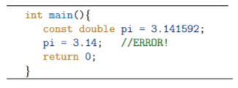
Constants:
A constant variable cannot have its value changed.
To declare a constant variable, add the const keyword before the usual declaration.
Example: const double pi = 3.141592;

Slide 14
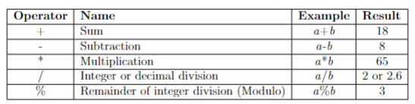
Arithmetic operators:
Similars to the usual mathematical operators.
Example: a = 13 and b = 5
a or b of type double → Operator / is the decimal division.
Operator % is only defined for variables of type int.
The behavior of operators depends on the variable types (for example, the + operator concatenates strings).
Notes:
The behavior of operators depends on the variable types (for example, the + operator concatenates strings).

Slide 15
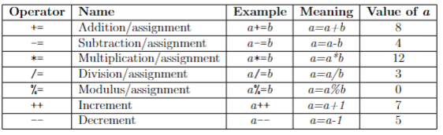
Arithmetic assignment operators:
Change the variable’s value.
Example: a = 6 and b = 2

Slide 16
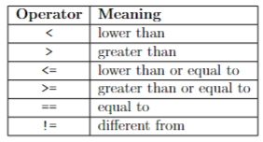
Relational operators:
Compare values and return a bool.
Very Important: Do not confuse the equal operator (==) with the assignment operator (=).

Slide 17

Logical operators:
Compare expressions and return a bool.

