Slide 1




Sociology of Work
Information and communication technologies
Adam Standring, PhD

Slide 2
The Golden Age (c.1880-1945)
Productivity growth (and labour productivity) → high profit rates
Increasing wages and living standards → massification → material goods=social status
Increase in private consumption
Full-employment, welfare state expansion (e.g. NHS)
Consolidation and extension of principles of Taylorism in work organisation
Large-scale → mass production (Fordism, economies of scale) within firms

Slide 3
The Golden Age (c.1880-1945)
The consolidation of the fordist-keynesian employment relationship
- strong labour movement (unions) → fully organised
- employment security
- wage determination: collective agreements → improvement of living conditions
Centralisation of collective bargaining
Minimum wage regulations (state intervention)
Higher balance in class and capital power relations → decline in class conflicts
But… colonialism, gender and race inequalities, wars → ‘cracks’ in the system

Slide 4
Changes in Employment (c.1945-1979)
Development of the service sector
The introduction and diffusion of new technologies
- Implications on the employment structure
from manufacturing industry to service sector: from physical production or distribution of material goods to their design, development, marketing, sale and servicing’ )
- Implications on the occupational structure
increase in intellectual occupations, scientific and technical oriented; highly skilled while low skilled and manual occupations decline
Growth of female employment → the dual breadwinner model
Still heavily segmented: clerical and administrative work, education, health, social and personal services...
New forms of employment: part-time, on-call, temporary, telework

Slide 5
Changes in Work (c.1945-1979)
New learning challenges: life-long learning and flexible occupational trajectories
New (wider) range of skills: technical, social, emotional, relational...
New work values and ethics
Enriching & challenging: personal development
Creative
Team-work oriented; participative
Work-Family Life balance

Slide 6
Changes to Firms and Organizations (c.1945-1979)
Changes in consumer preferences and in product market dynamics:
- From stability to unpredictability...
- From a massive demand to an individualised demand...
Production: flexible but complex (automation, R&D)
New organizational strategies
- outsourcing
- downsizing
- partnerships, networks, joint-ventures
Individualisation/Customisation
Diversification
Quality
Innovation & Design

Slide 7
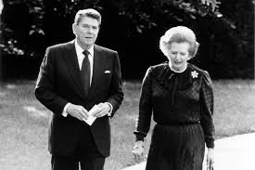
Broader Context – (c.1980-2008)
“Welfare state crisis”: welfare retrenchment
Market de-regulation, including labour markets
Abandonment of a political commitment towards full-employment
- To meet demands for wage and employment flexibility
New social classes and redefinition of new fault lines: gender, race, identity politics
Higher educational attainment, but...
... Greater instability and insecurity

Slide 8

A new society driven by technology?
Post-industrial society (Daniel Bell)
Third wave (Alvin Toffler)
The risk society (Ulrich Beck)
The network society (Castells)
The information society (Masuda)
The knowledge society (Drucker)
The post-modern society (Inglehart)
The post-fordist society (Piore and Sabel)
The new economy

Slide 9



Major issues under debate:
New technologies enhance workers’ skills? More jobs opportunities? Job quality?
Increase participation and autonomy at the workplace? Greater efficiency?
More free time/better work life-balance (a leisure society)?
A more integrated/equal society ? Convergence among societies?
Destroy employment
Deskill workers
Increase centralisation, control over work and reduce workers’ autonomy
Lead to work intensification and psychological stress
Generate new forms of inequality within and among societies

Slide 10
Making sense of the arguments
Technologicaloptimists
Technologicalpessimists
Non-determinists

Slide 11
Technological optimists
- Daniel Bell (1919-2011)
- Alvin Toffler (1928-2016)
- Yoneji Masuda (1905-1995)
Technology will create a new (better!!) society

Slide 12
A post-industrial society
Information: a new commodity and source of power
Universities and R&D institutions → the new ex-libris
New “classes” based on information: the technocrats (who exercise authority through their technical competence) and scientists
Prestige and status = intellectual and scientific knowledge → Class stratification is based on information
Education as a mode of access to power (meritocracy) → homogeneous
Leisure society

Slide 13
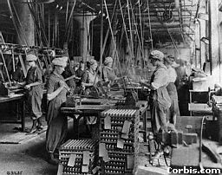
The third wave
First wave: the agrarian revolution and sedentarization
Second wave: industrial revolution and the bureaucratic organization
Third wave:
- Greater individuality, de-massification
- Greater mind-power: a super species
- Electronic cottage: teleworking, return to a more natural environment
- New family forms (de-massification)

Slide 14
As for work...
Smaller scale
Greater discretion and resourcefulness, creativity and less repetitive work
Flat hierarchies, flexibility
The end of subordinated paid work → a new entrepreneurial/business model
Post-employment: workers are no longer employees but service-providing autonomous workers

Slide 15
Did they get it right?
“… it’s worth casting your mind back to the mid-1990s and the arrival of the world wide web. That, too, came with profound assertions of a new utopia, a connected world in which borders, difference and privation would end. “
Alang, N., The Guardian, “No god in the machine: the pitfalls of AI worship” (8.8.2024)
https://www.theguardian.com/news/article/2024/aug/08/no-god-in-the-machine-the-pitfalls-of-ai-worship

Slide 16
Technological pessimists
- Harry Braverman (1920-1976)
Alain Touraine (1925-…)
Evgeny Morozov (1984-…)
Neo-marxist orientation in Sociology of work
A new phase within the capitalist mode of production → Degradation of work

Slide 17
Neo-taylorist forms of organisation and work
Centralisation of decisions
Strong division of labour (dissociation between conception/control and execution)
Deskilling: division of labour is exacerbated work reduced to few, specialized tasks
Intensification of work and labour exploitation
Taylorism "having conquered the factory has moved into the office and shop“ (Kumar, 1978: 210)

Slide 18

Neo-taylorist forms of organisation and work
Technology enables the monitoring in real time of increasingly intensive work
New forms of alienation
Atomization of workers without the bargaining power of units → isolation
Job insecurity
Skill polarization → Widening inequality
knowledge specialists, engineers, programmers and technicians (CORE WORKERS); vs
workers who exercise routine, fragmented and non-skilled tasks (PERIPHERAL WORKERS)

Slide 19
An example of techno-pessimism
https://youtu.be/uhU0hRng-eE?si=sSRjTjptZCuXOXRr

Slide 20
Non-deterministic approaches
- David Lyon (1948-…)
- Manuel Castells (1942-…)
- Christian Stoffaes (1947-…)
Ambivalence (risks and opportunities)
Path uncertainty and heterogeneity: social shaping of technology

Slide 21

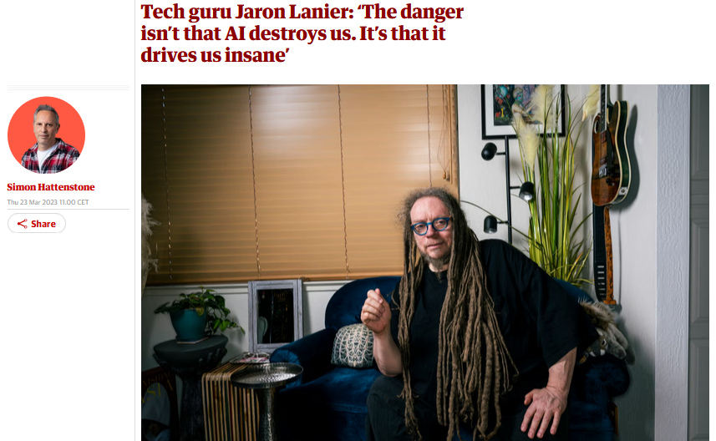
Non-deterministic approaches: one example
“There’s a lot of cool stuff on the internet. I think TikTok is dangerous and should be banned yet I love dance culture on TikTok and it should be cherished.” (…)
“Because it’s controlled by the Chinese, and should there be difficult circumstances there are lots of horrible tactical uses it could be put to. I don’t think it’s an acceptable risk. It’s heartbreaking because a lot of kids love it for perfectly good reasons.”
https://www.theguardian.com/technology/2023/mar/23/tech-guru-jaron-lanier-the-danger-isnt-that-ai-destroys-us-its-that-it-drives-us-insane

Slide 22
Manuel Castells (1947-...)
Technological change as the trigger for a series of transformations in society:
New social structures (network society)
Networks always existed, but technology enables these to more geographically dispersed and generate new kinds of social relationships
New economic structure (global informational capitalism)
Knowledge becoming more important for economic activity in a globalized context
New culture (real virtuality)
Flows substitute places/locales bounded by physical continuity. Sequences are broken and media is integrated (news, shows)

Slide 23
Non-deterministic critique
Technologies are not “autonomous”
They are a social construct and context-dependent
Path dependency
Technology as the starting point to analyse change
Going back to concept of social shaping of technology
Technology
Difusion of ITC
Innovation
Well-being
Inequalities
Values
Virtual reality
Economy
R&D
Professional structure
Economic sectors
Global information
Education
Communities
Inter-culturalism
Source: Castells and Himanen (2002)

Slide 24
Not information society... But societies
“The Silicon Valley model” – a market-dominated informational society;
“The Singapore model” – an authoritarian informational society;
“The Finnish model” – a welfare informational society
Portugal? Proto informational society
Source: Castells and Himanen (2002)

Slide 25
Not information society... But societies
“The Silicon Valley model” – a market-dominated informational society;
Strong economic and technological growth together with high social costs: inequalities, social exclusion and poverty (around 20% below poverty line);
“The Singapore model” – an authoritarian informational society;
Strong economic and technological growth, but some restrictions to individual freedom;
“The Finnish model” – a welfare informational society;
Strong economic and technologic growth, paired with greater equality and social inclusion;
Portugal? Proto-informational society;
Coexistence of traditional and information society; inequalities (permanence of ‘old’ inequalities and emergence of ‘new’ inequalities
Source: Castells and Himanen (2002) The Information Society and the Welfare State: The Finnish Model and Cardoso et al (2015), A Sociedade em Rede em Portugal - Uma Década de Transição, Coimbra, Editora Almedina.

Slide 26
The information age
Information Society
Main tenets
Interconnection
Sources of productivity and power
Production of information
Networks
Processing of information
Transmission of information

Slide 27
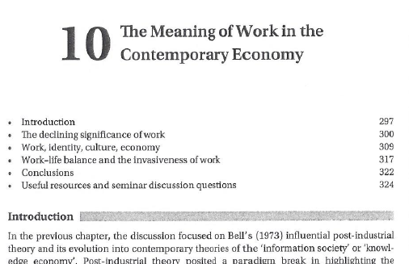
Essential reading:
GRINT, K.; NIXON, D. (2015), “The meaning of work in the Contemporary Economy”, in K. Grint and D. Nixon, The Sociology of Work, London: Polity Press, 4th Edition, pp: 297-304.
The CORE team (2017): The Economy: Economics for a Changing World, UNITs 16.1, 16.2, 16.11, 17.4 to 17.7
(http://www.core-econ.org/the-economy/book/text/0-3-contents.html#contents)

Slide 28

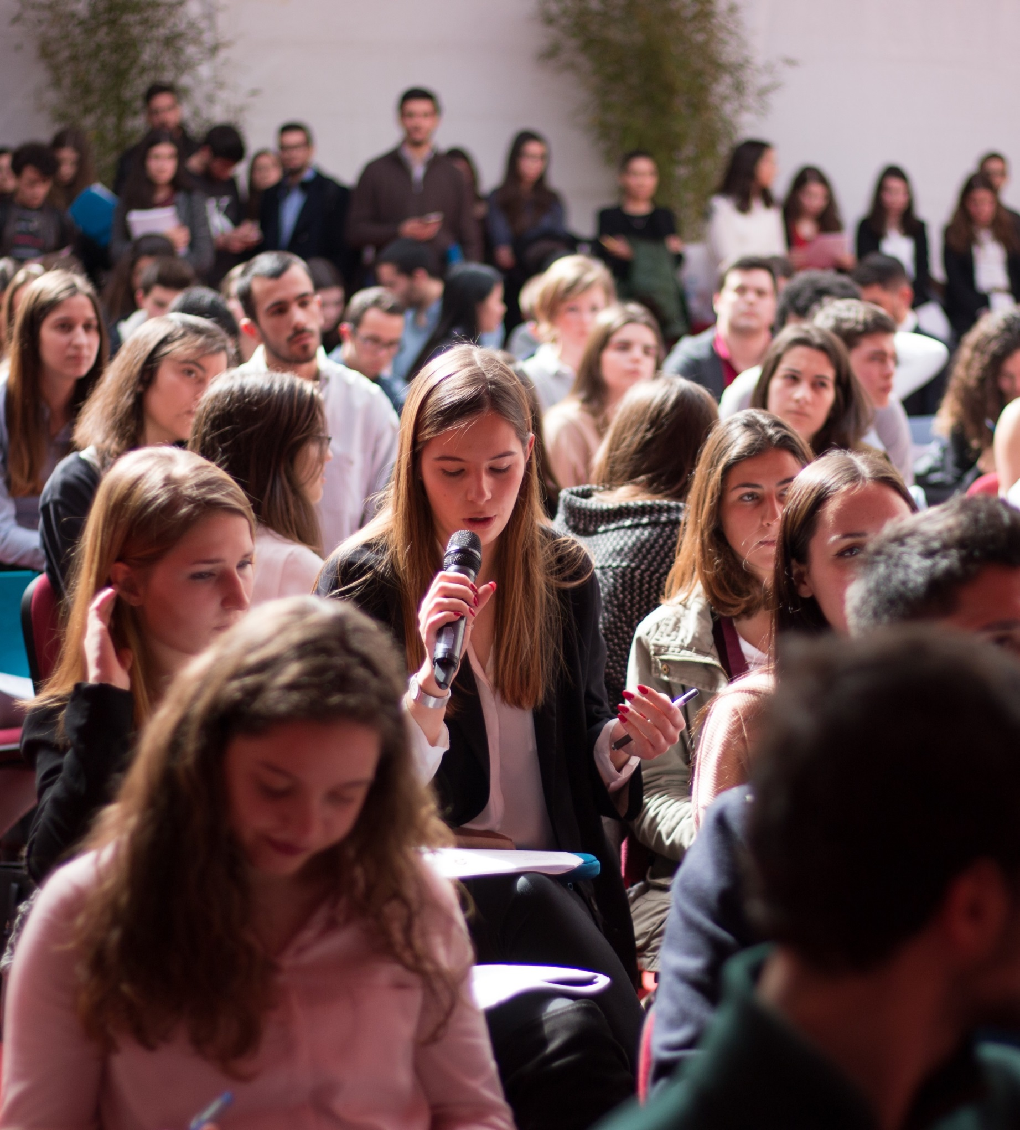
www.iseg.ulisboa.pt

