Slide 1
Intermediate Microeconomics: An Intuitive Approach with Calculus, 1e
Chapter 25 – Oligopoly

Slide 2
Oligopoly Competition
An oligopoly is an industry dominated by a small number of firms that collectively are protected from outside competition by barriers to entry.
Firms in an oligopoly are not price-takers because each firm is large relative to the economic environment.
But such firms are not price-setting monopolies either because they compete with one another.
Instead, through quantity and price choices, such firms strategically interact and realize that they are impacting their industry.
How they compete depends on what the strategic variable is and whether interactions are modelled as simultaneous or sequential.
Timing of Decisions
Strategic Variable
Simultaneous
Sequential
Price
Bertrand Model
Quantity
Cournot Model
Stackelberg Model

Slide 3
Quantity or Price Competition
In this chapter we will assume that the small number of firms sell an identical product. In the next Chapter 26 we extend this to include product differentiation and innovation.
Whether the strategic variable is quantity or prices depends on the context.
In general, price competition is likely in a setting without production capacity constraints: If firms can meet any demand at their chosen price, price competition is more realistic.
Examples may include airlines with empty seats close to departure and supermarkets (selling identical products).
In general, quantity competition is likely in a setting with production capacity constraints: If firms have limited production capacity, they decide on quantity first, and the price adjusts based on total supply.
Examples may include airplane manufacturers and oil extraction.

Slide 4
Bertrand Price Competition
Under Bertrand price competition firms commit to a price and then produce to meet demand at that price.
We assume firms in the oligopoly sell the same product, have the same constant marginal cost, and make simultaneous decisions (for now).
The Nash equilibrium to the price-setting game is then easy to see:
  If firm 2 sets price above MC, firm 1 best-responds by setting its price just below the price set by firm 2 (and thus getting the whole market).
  If firm 2 sets price equal to MC, firm 1 best-responds by also setting its price to MC (and thus splitting the market with firm 2).
  The only way the two firms are best-responding to each other is if both set price equal to MC.
Bertrand price competition therefore results in zero profit for firms and an efficient level of output.
This can also be seen by plotting the best response functions for the two firms, with price as each firm’s strategic variable.

Slide 5
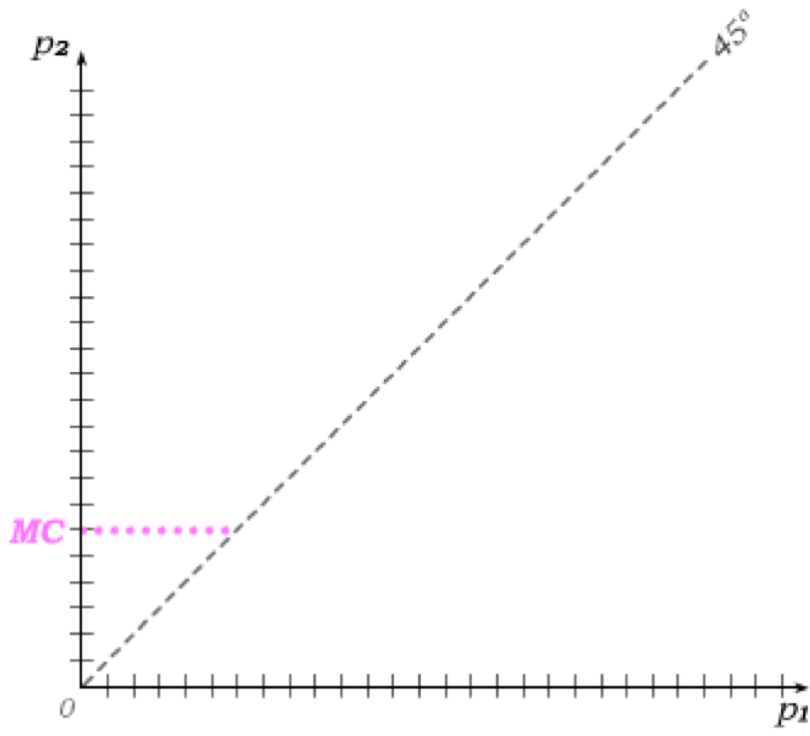
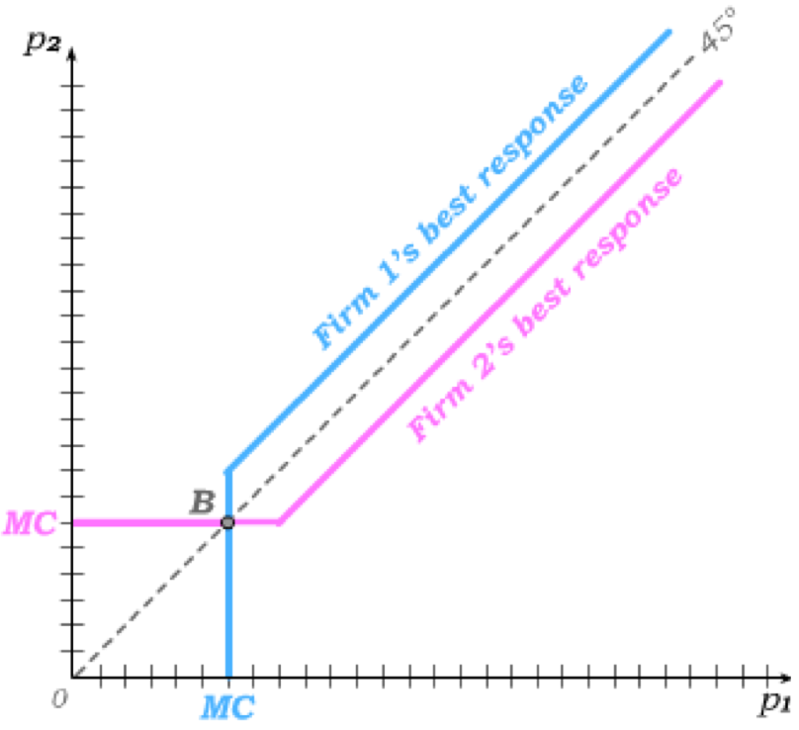
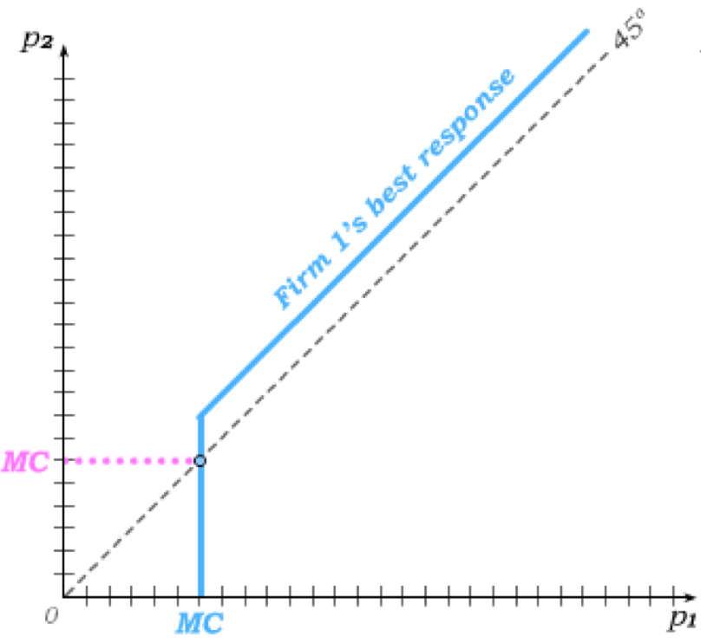
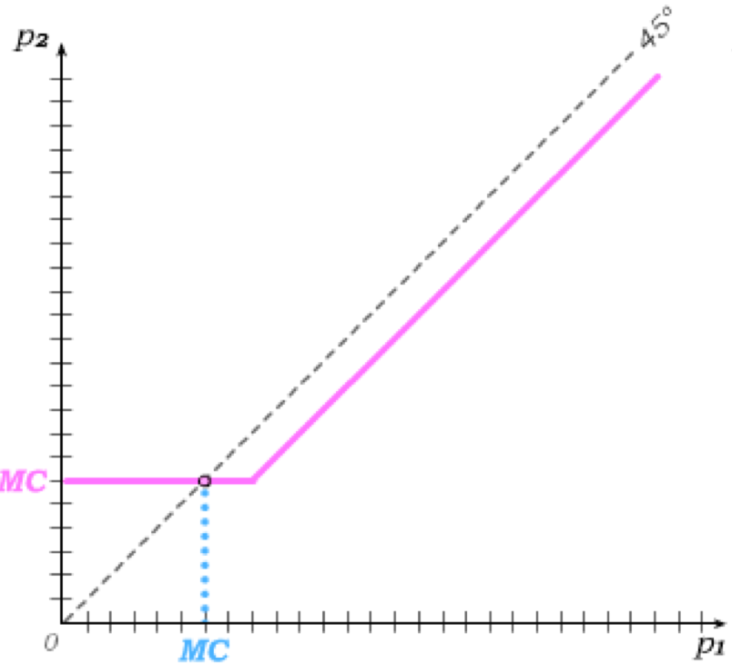
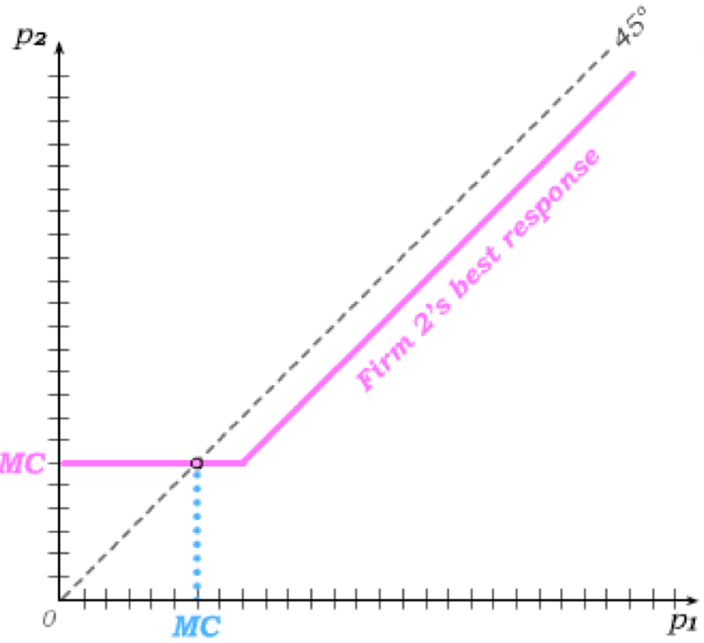
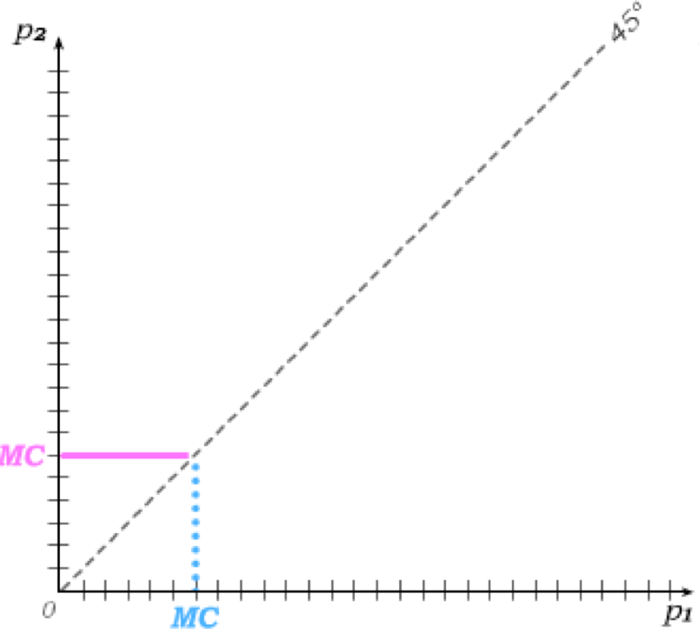
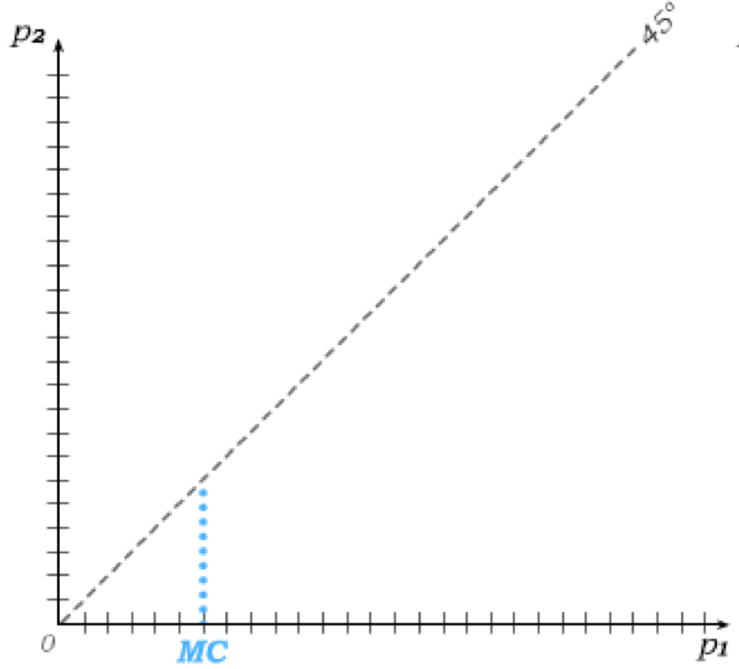
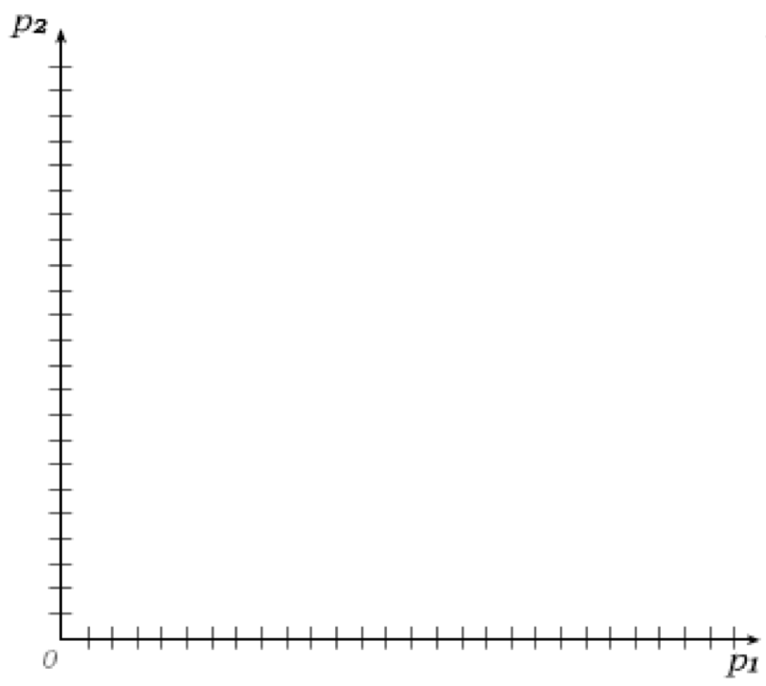
Best Response Functions
Best response functions: plots the best response of one player as a function of strategic choices by the other. Usefull when players have a continuum of actions, like with mixed strategies (in Chapter 24).
If firm 1 sets its price below MC, firm 2 might best-respond by setting its price equal to MC (and simply not producing). But if firm 1 sets its price above MC, firm 2 will best respond by setting its price just below firm 1’s price (and thus getting all consumers).
The same is true for if firm 1’s best response to firm 2’s price.
Recall that the Nash equilibrium is a set of strategies such that every player is playing a best response strategy given the strategies played by others.
The best response functions intersect at B where both firms charge p=MC.
Bertrand Price Competition thus eliminates market power even if there are only two firms in the market.

Slide 6
Bertrand Price Competition
The logic of Bertrand price competition resulting in p=MC does not depend on the number of firms in the market.
It also holds if the firms finitely repeatedly interact, where the subgame-perfect equilibrium logic unravels any attempt to price above MC in earlier stages of the game.
But there are real-world considerations that may cause price-competition to result in p>MC in oligopolies:
1. Infinitely repeated interactions, or, more realistically, settings where firms know each time they meet that they will meet again with some positive probability: Through trigger strategies, p > MC can then emerge.
2. Capacity constraints introduce another strategic variable related to quantity rather than price.
3. Differentiated Products: If firms in the oligopoly produce differentiated products, they can soften price competition and price above MC. This is explored in Chapter 26.

Slide 7
Price vs. Quantity Competition
The striking prediction of the Bertrand model is that full efficiency is restored by moving from one monopoly to two price-competitors.
But the question is whether price is the right strategic variable to consider when thinking about competition within an oligopoly.
In many industries, the more likely strategic variable is quantity. After all, can firms truly produce any quantity demanded given their stated price?
The Cournot model considers the competition of firms when each firm chooses quantity strategically – and price then emerges from the overall quantity produced in the industry. Similar to before, firms sell identical products and have the same constant MC.
Bertrand Model
Cournot Model
quantity then emerges from demand
price then emerges from demand
Firms set price
Firms set quantity
p = MC with just 2 (or more) firms
p > MC, with price falling as the number of firms increases

Slide 8
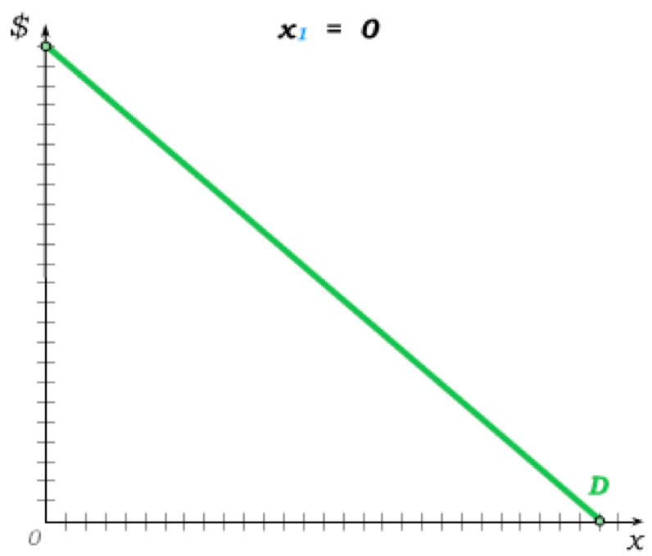
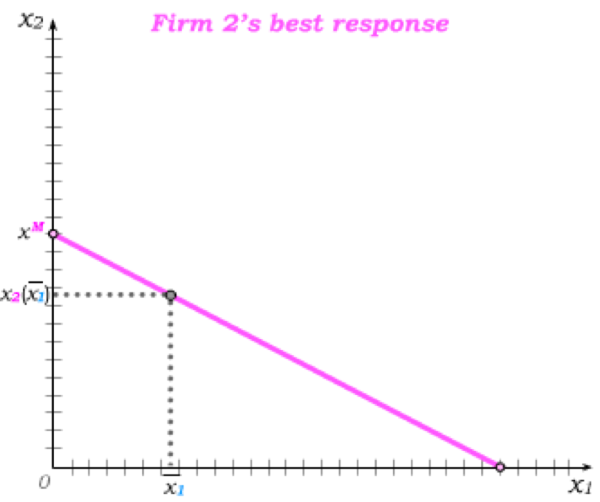
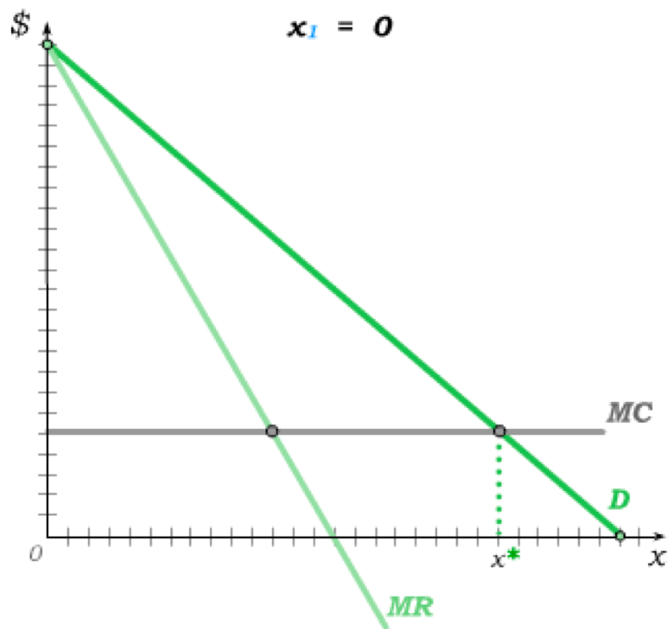
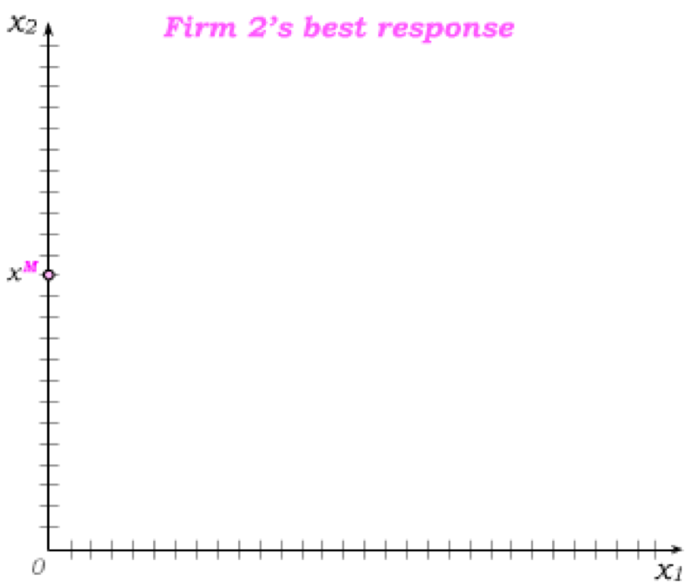
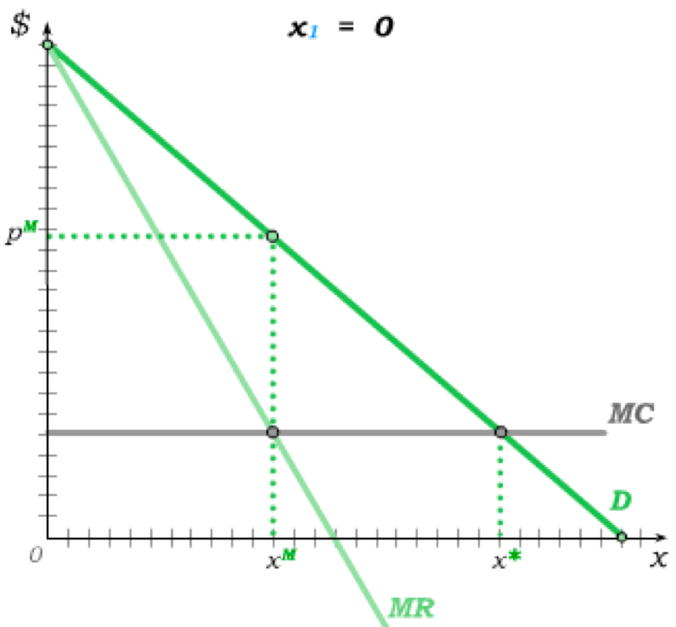
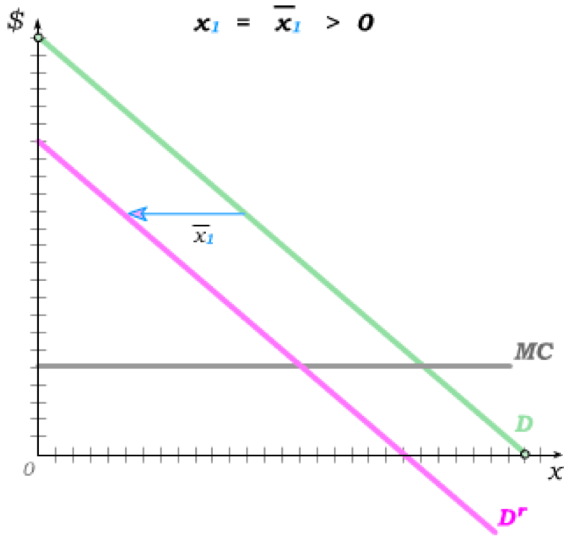
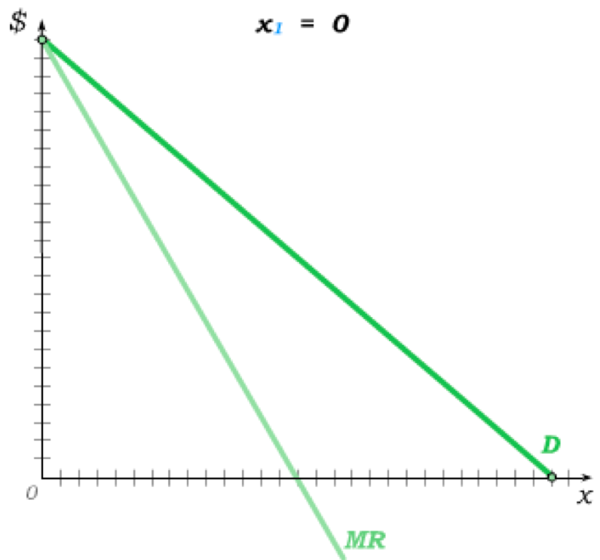
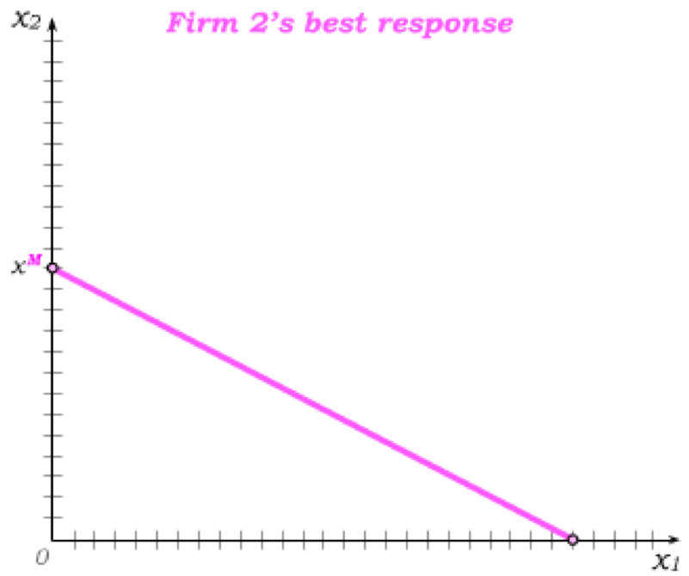
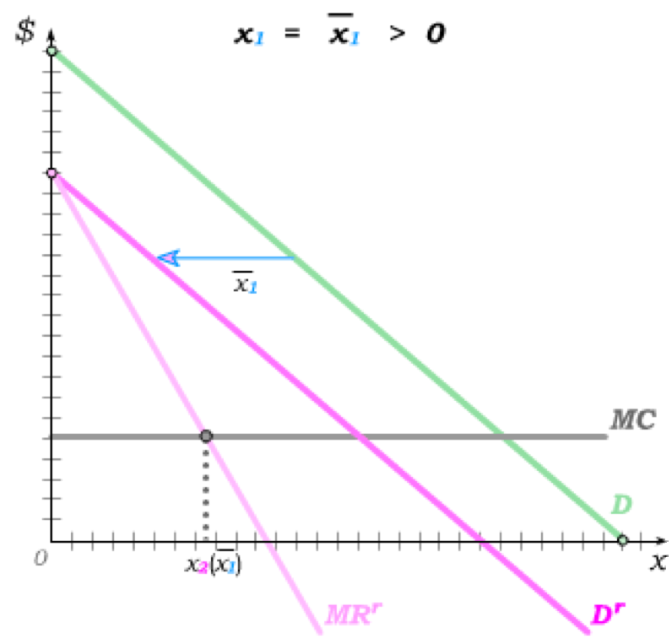
Quantity Best Responses
To find the Cournot Nash equilibrium, we begin by assuming firm 1 sets output to 0, leaving firm 2 to serve the market Demand.
Firm 2 is then a monopolist producing the
monopoly quantity x^{M}
– which is therefore its best response to x₁= 0.
Next, suppose firm 1 sets output to This causes the demand “left over” for firm 2 to shift in from market Demand, giving firm 2’s residual demand D^{r}.
Firm 2’s best response is to produce where MC intersects its new marginal revenue MR^{r}.
€
This best response then lies on its best response function –
which ends at x*, the quantity where MC crosses D.

Slide 9
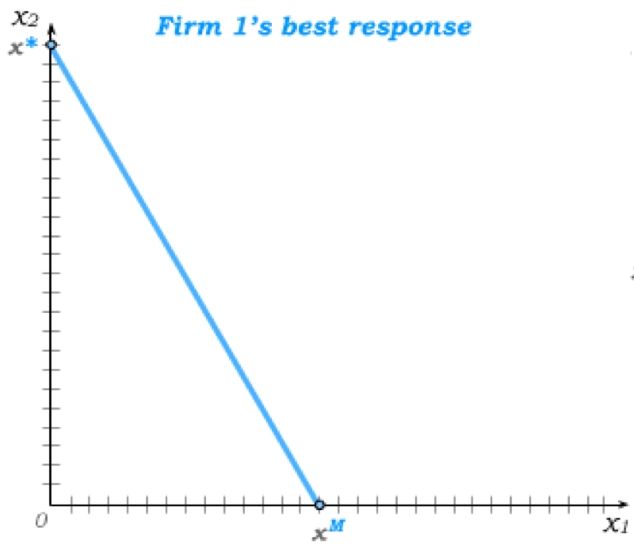
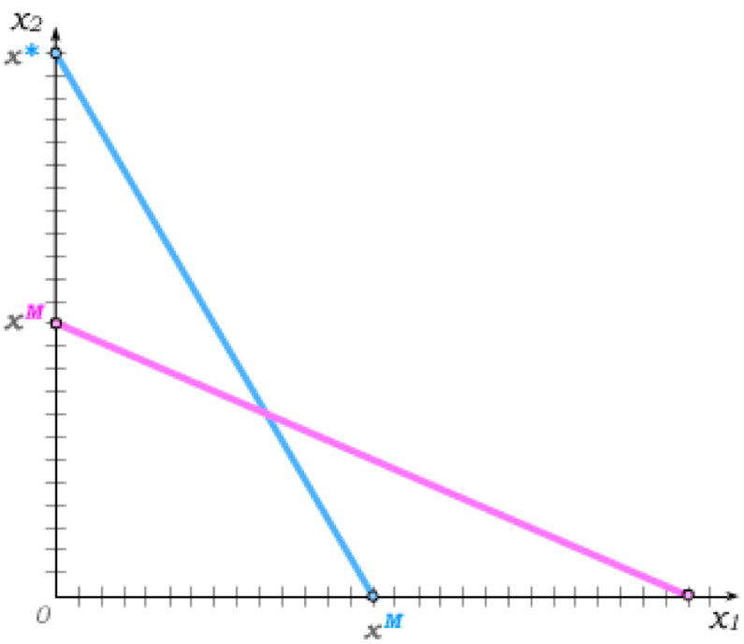
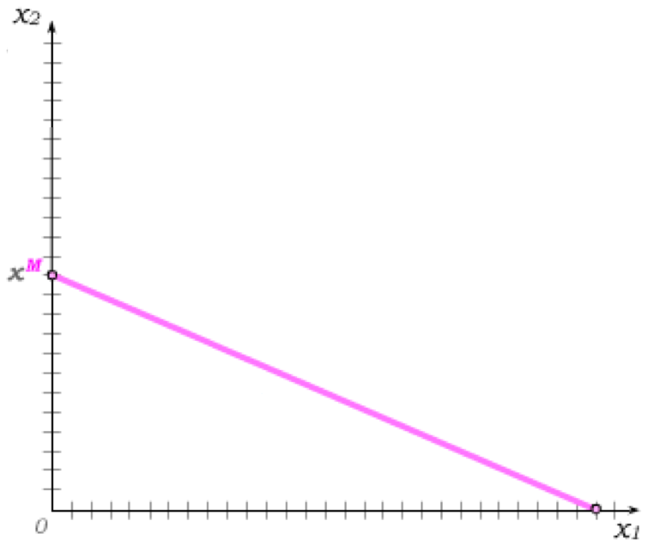
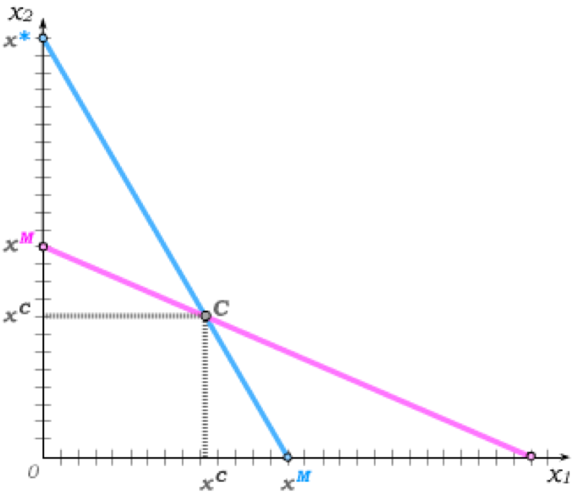
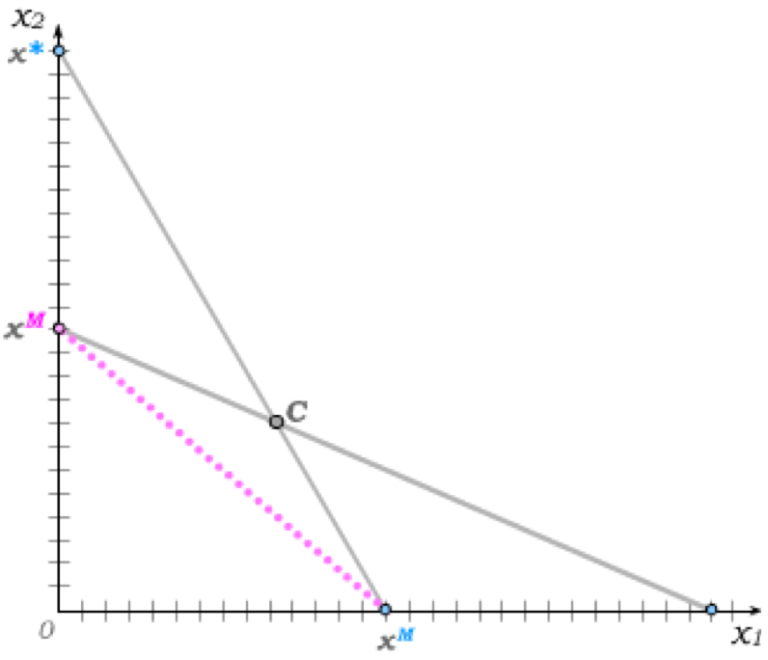
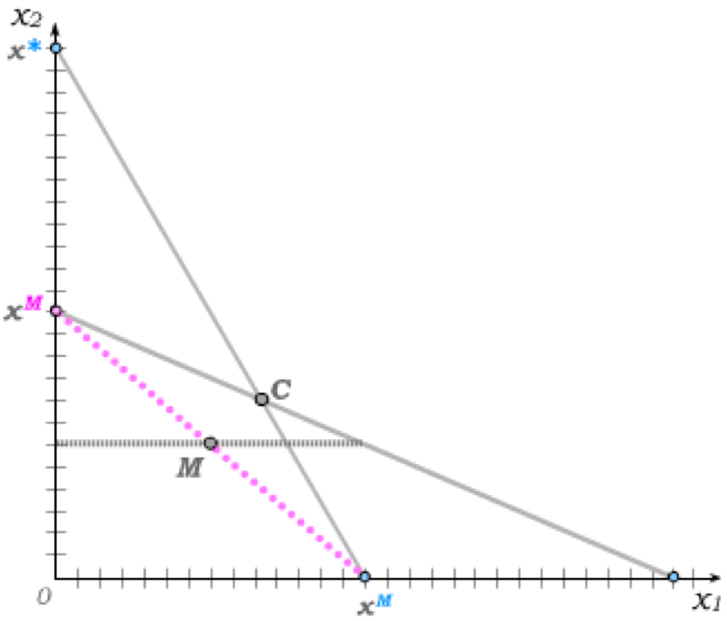
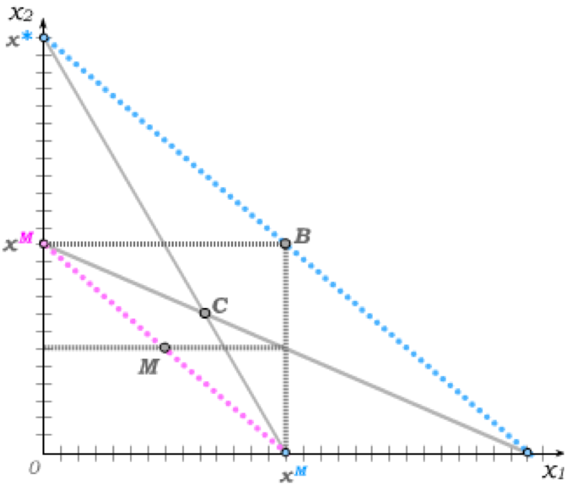
Cournot Equilibrium
Since we assume identical firms, firm 1’s best response function is then the same as firm 2’s,
and the Nash equilibrium again occurs where the two best response functions intersect.
Both firms then produce the Cournot quantity.
We can compare this to the monopoly quantity which would be jointly produced by the two firms anywhere along the magenta dashed line.
The overall Cournot output is then larger than the monopoly output.
But it is smaller than the Bertrand output level where firms produce until p = MC.
Unlike the Bertrand Model, the Cournot Model therefore does not predict a full loss of monopoly power when there are two competitors in the industry.

Slide 10
Sequential Decisions in Oligopolies
Both the Bertrand model and the Cournot model view strategic decisions as being made simultaneously by firms in the oligopoly.
The Bertrand prediction of p = MC does not change if decisions are made sequentially when price is the strategic variable. Can you reason why?
But sequential decisions do change the prediction under quantity competition.
We will introduce 2 types of sequential move, quantity setting models:
Stackelberg Model
Entry-Deterrence Model
Firm 1 sets output first (leader).
Firm 2 observes firm 1’s output and then sets its own (follower).
Firm 1 begins as a monopoly.
Firm 2 observes firm 1’s output and then determines whether to pay a fixed entry cost to enter the industry and compete.

Slide 11
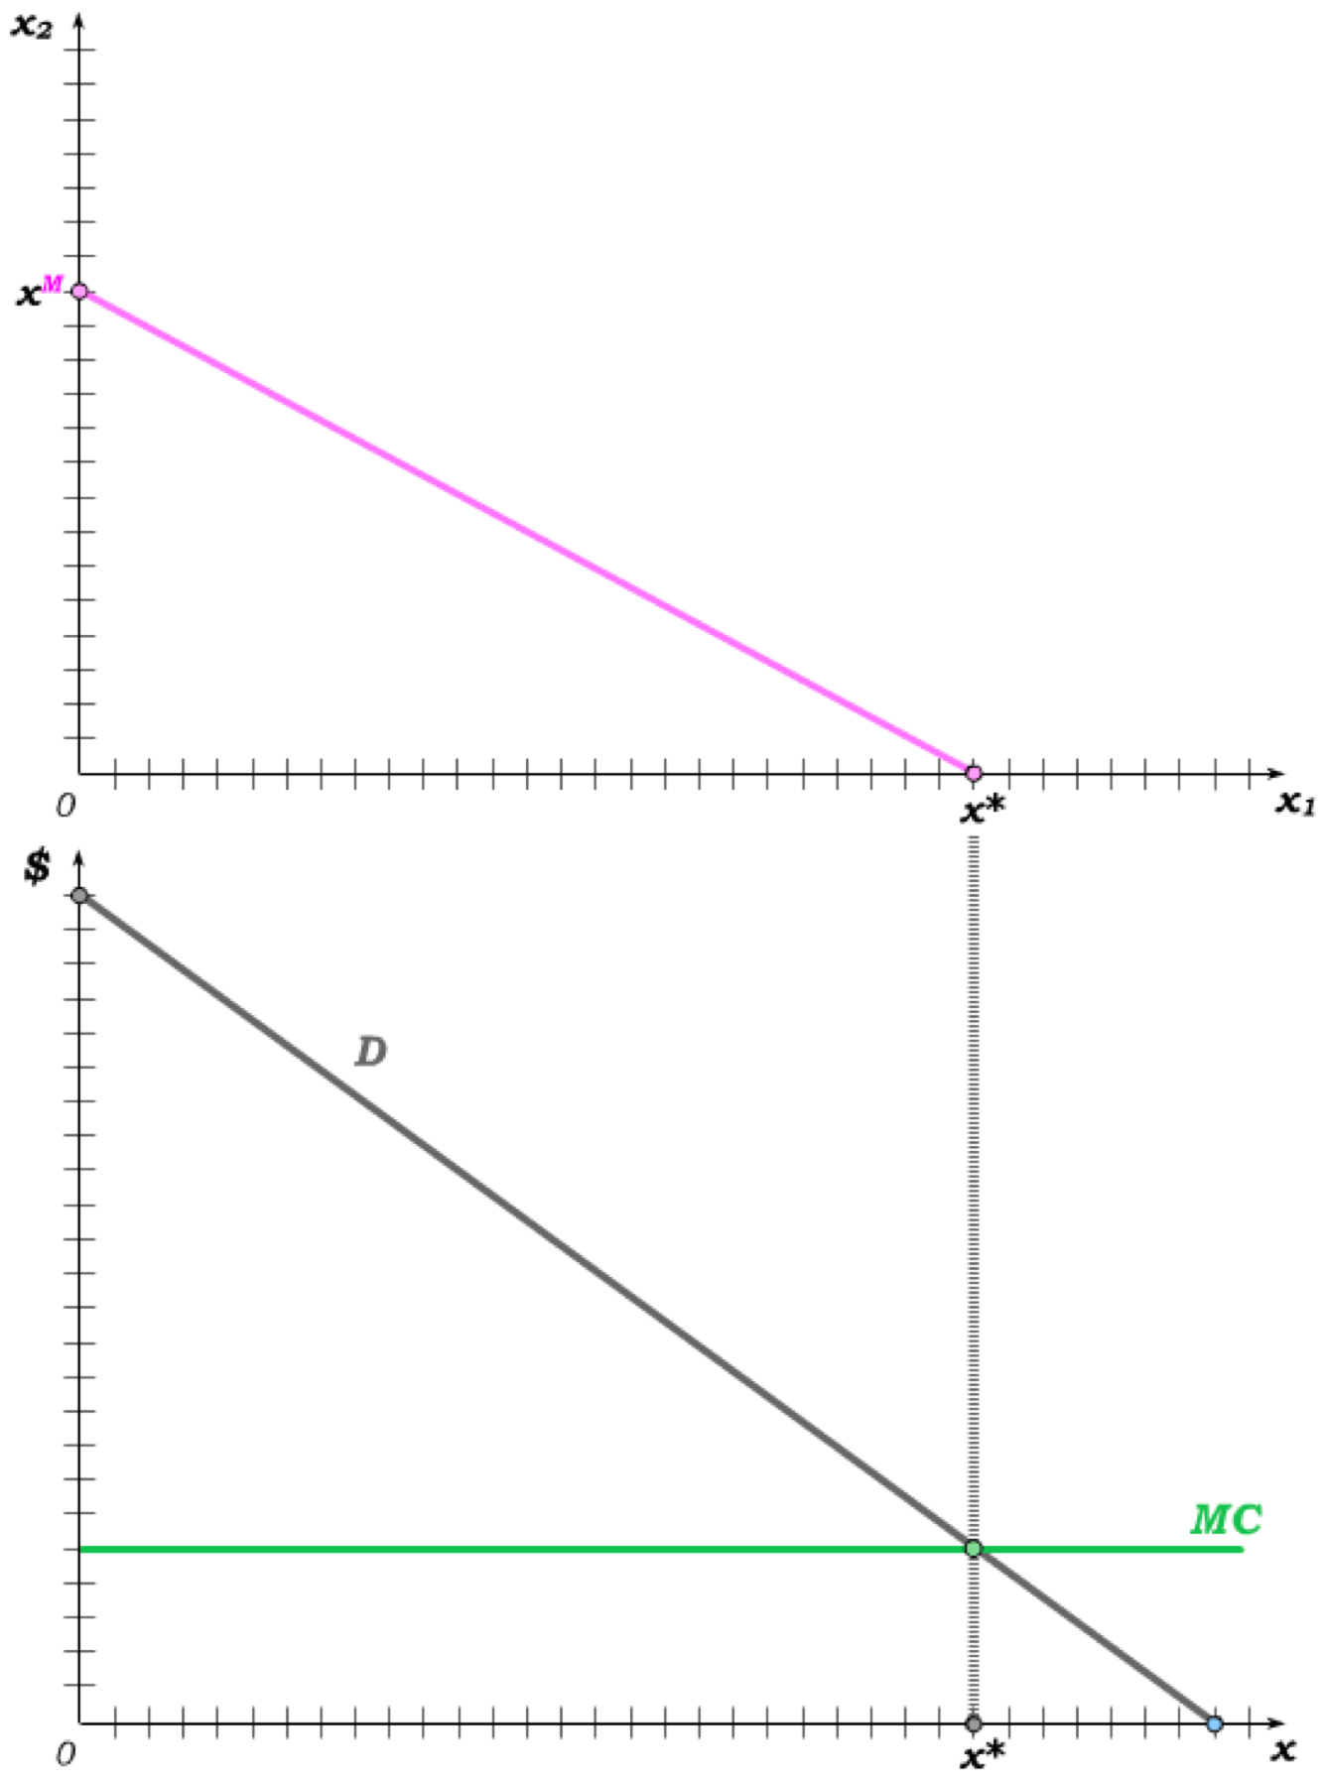
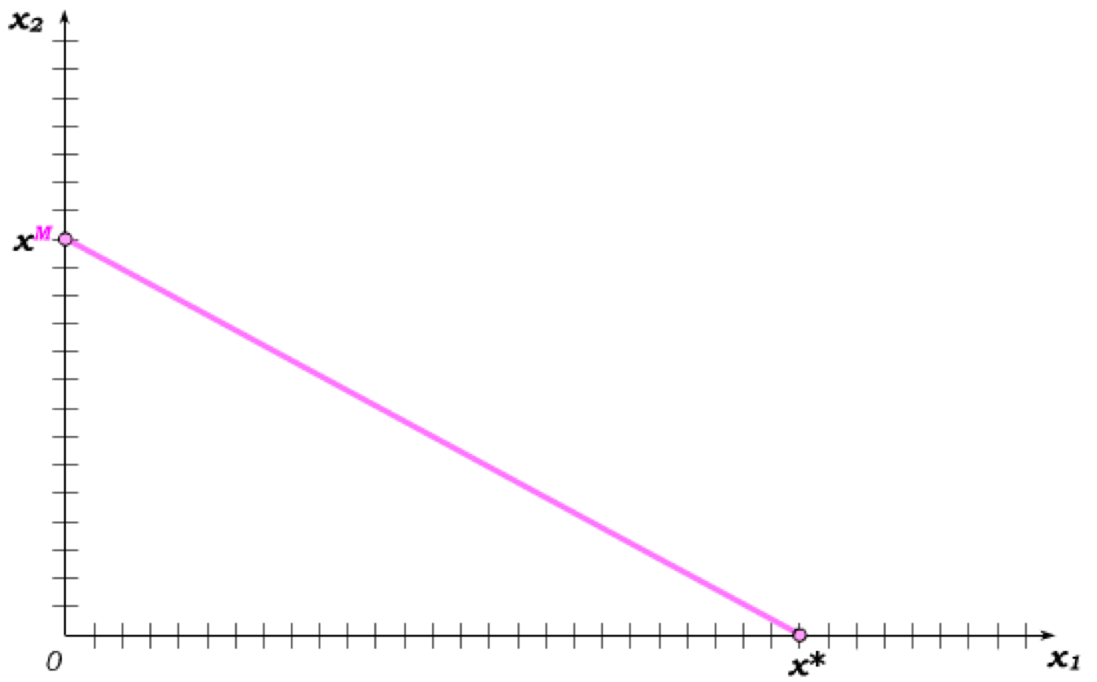
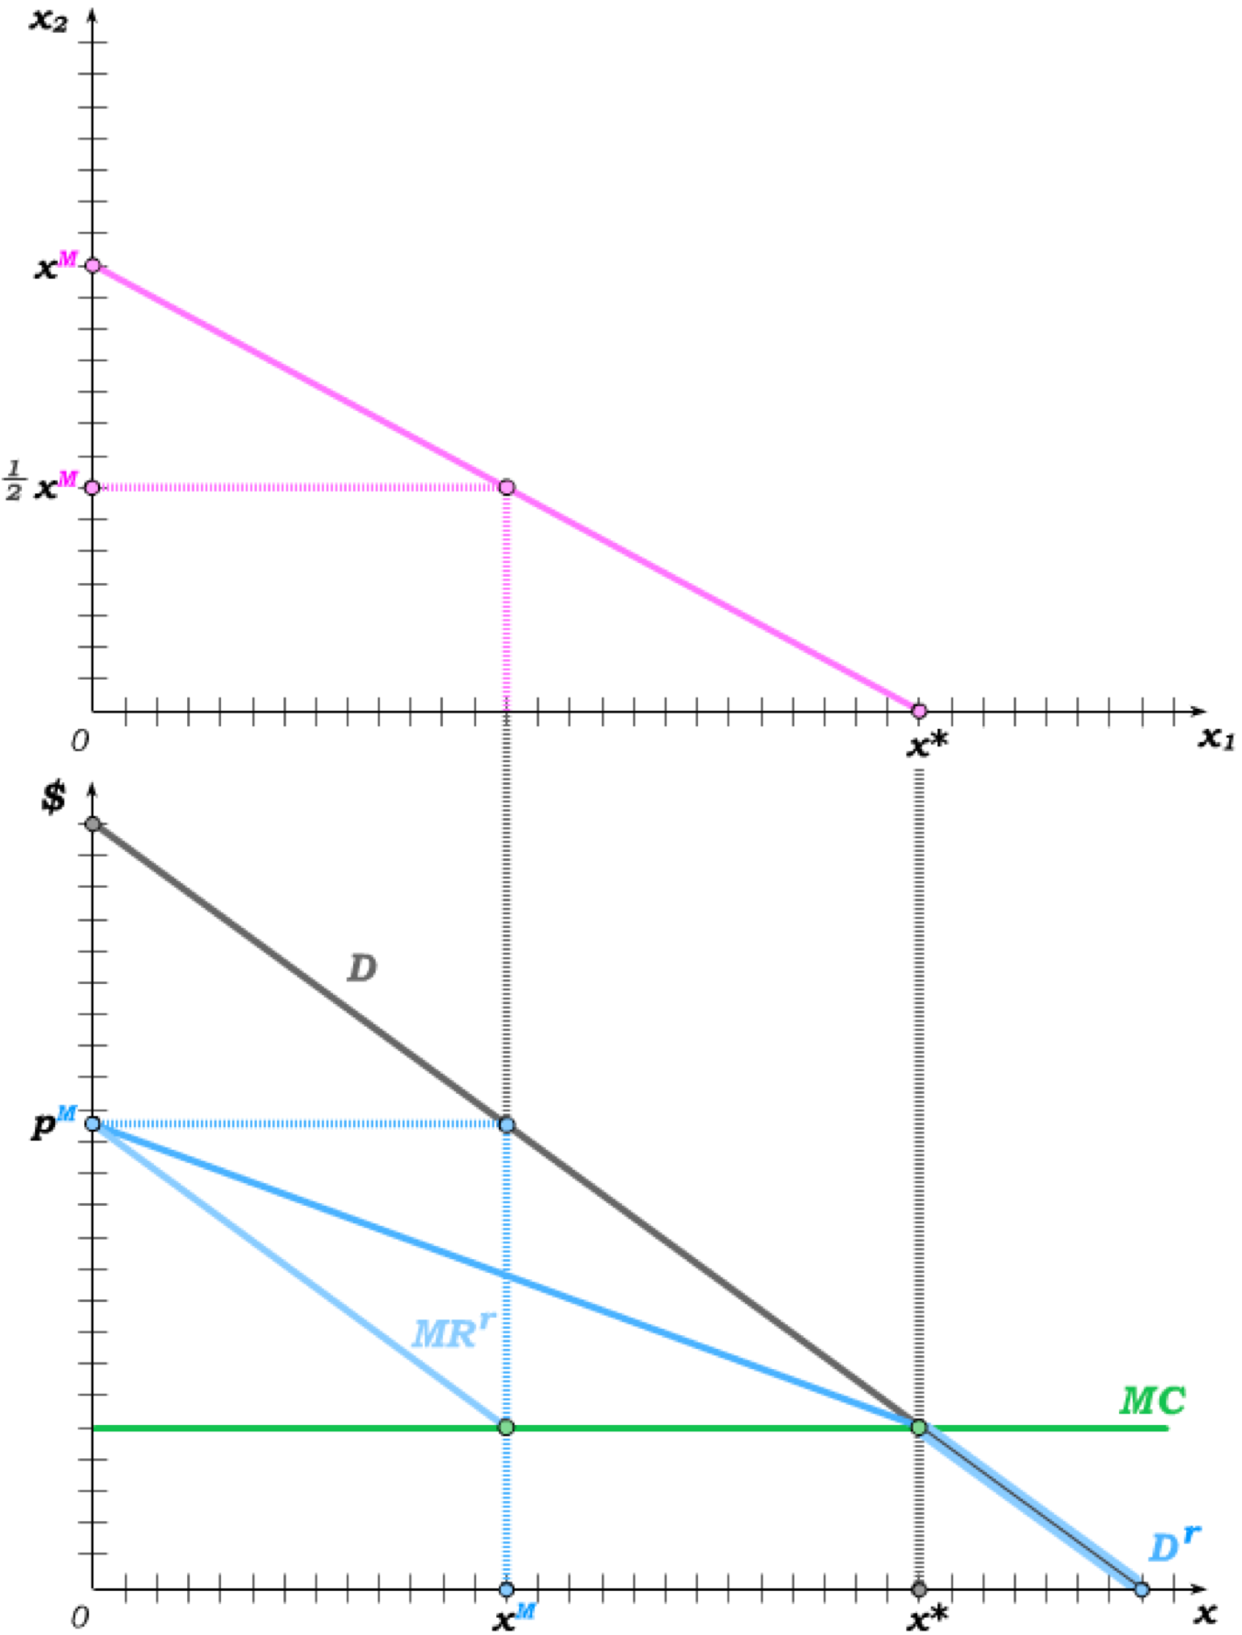
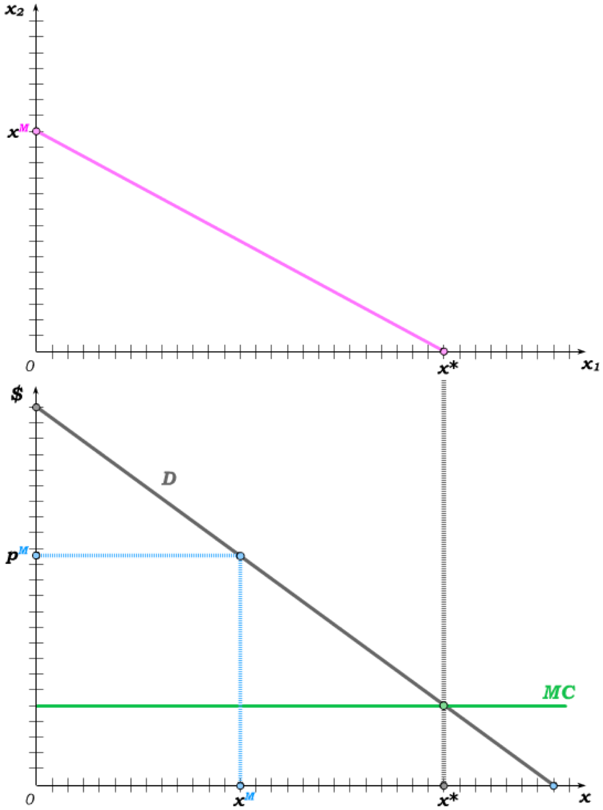
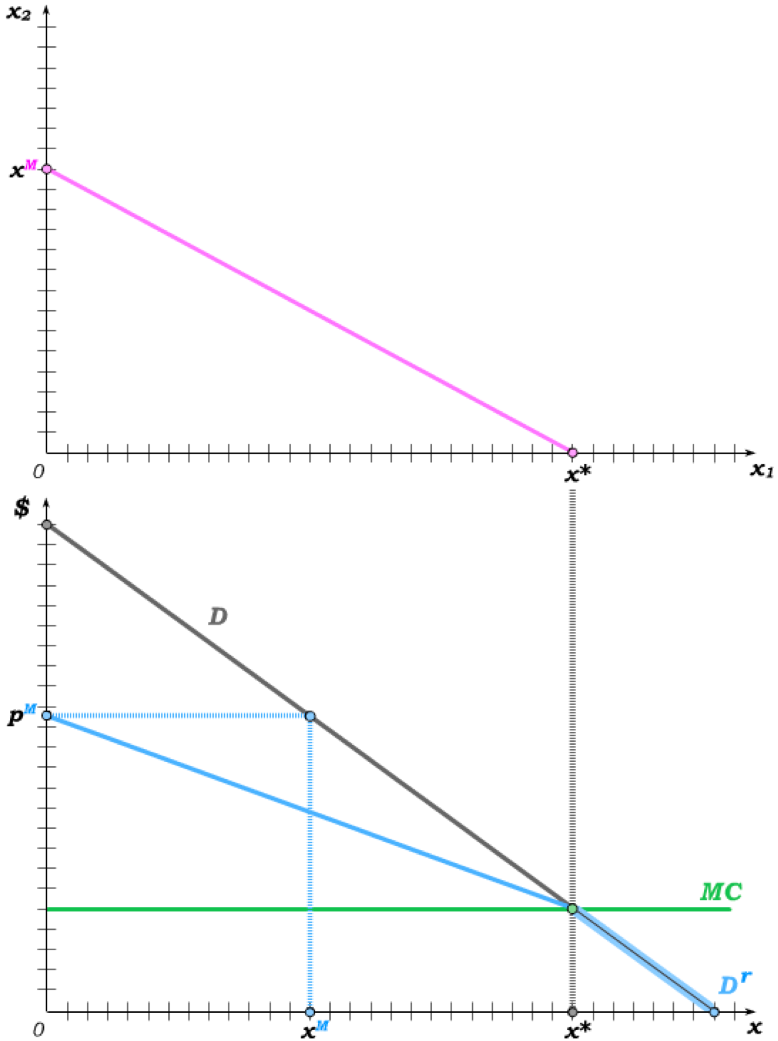
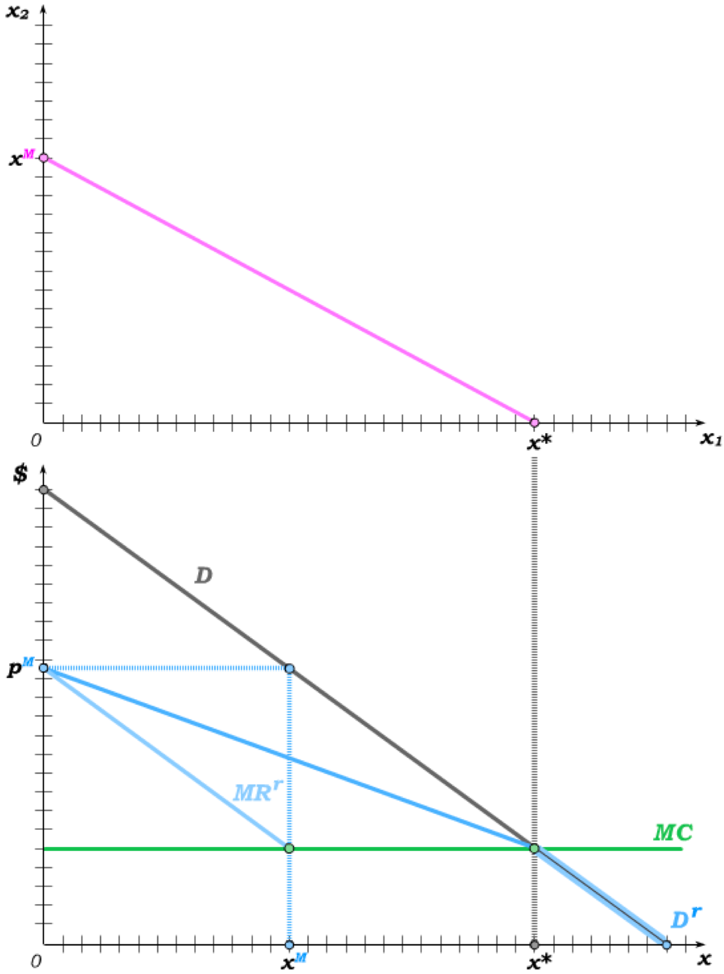

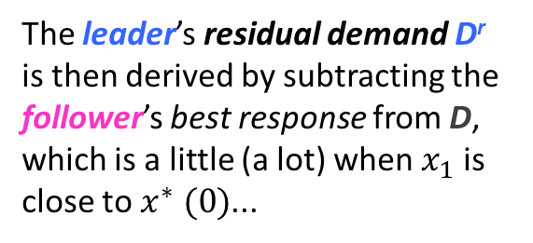
Stackelberg Equilibrium
The Stackelberg Follower knows the leader’s quantity and best-responds in stage 2.
The leader knows this in stage 1 – and thus knows that the entire demand will be hers if she produces x* or more.
She also knows that the follower will produce x^{M} if she produces 0, resulting in an output price of p^{M}.
The leader’s residual demand D^{r} is then derived by subtracting the follower’s best response from D, which is a little (a lot) when $x_{1}$ is close to $x^{∗} (0)$...
€
… giving rise to the leader’s residual demand D^{r} that intersects MC at x^{M}.
The leader produces x^{M} and the follower best-responds with 0.5x^{M}.

Slide 12
Model Predictions Compared
We have seen before that overall output is largest under Bertrand price competition and smallest under a monopoly; i.e.
This implies
Under Stackelberg competition, the leader produces the monopoly quantity and the follower produces half the monopoly quantity.
Thus,
and
S

Slide 13
The Threat of Potential Competition
In our treatment of monopolies, we briefly discussed the possibility that one “invisible” disciplining force on a monopoly is the threat of competition from potential entrants into the market.
An incumbent firm that is the sole firm in the market might then produce more than the monopoly output level in order to reduce price and make it less attractive for a potential entrant to become a real competitor.
We will model this by assuming there is a fixed entry cost that has already been paid by the incumbent firm but would have to be paid by an entrant into the market before she could produce.
For the incumbent firm, this fixed entry cost is thus a sunk cost and does not affect behaviour.
But for the potential entrant, the fixed entry cost is a real cost that has not yet been paid.
We will see that, if fixed entry costs are neither too high nor too low, the incumbent firm may be able to deter entry by setting output above the monopoly level.

Slide 14
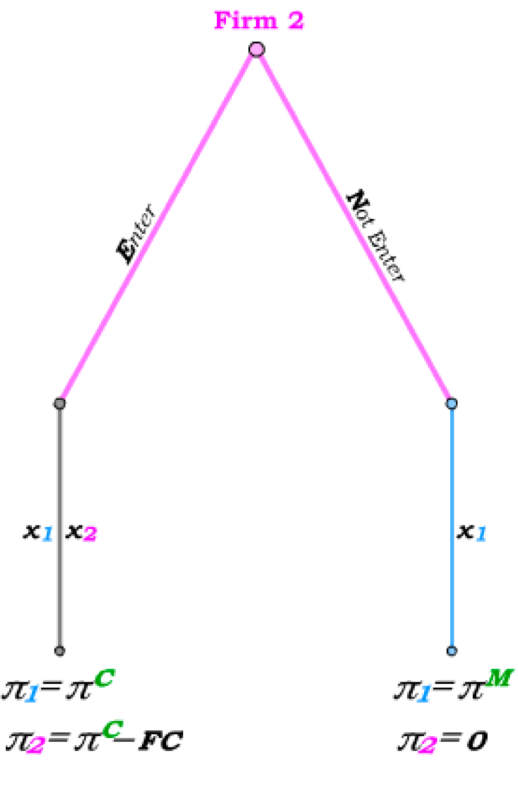
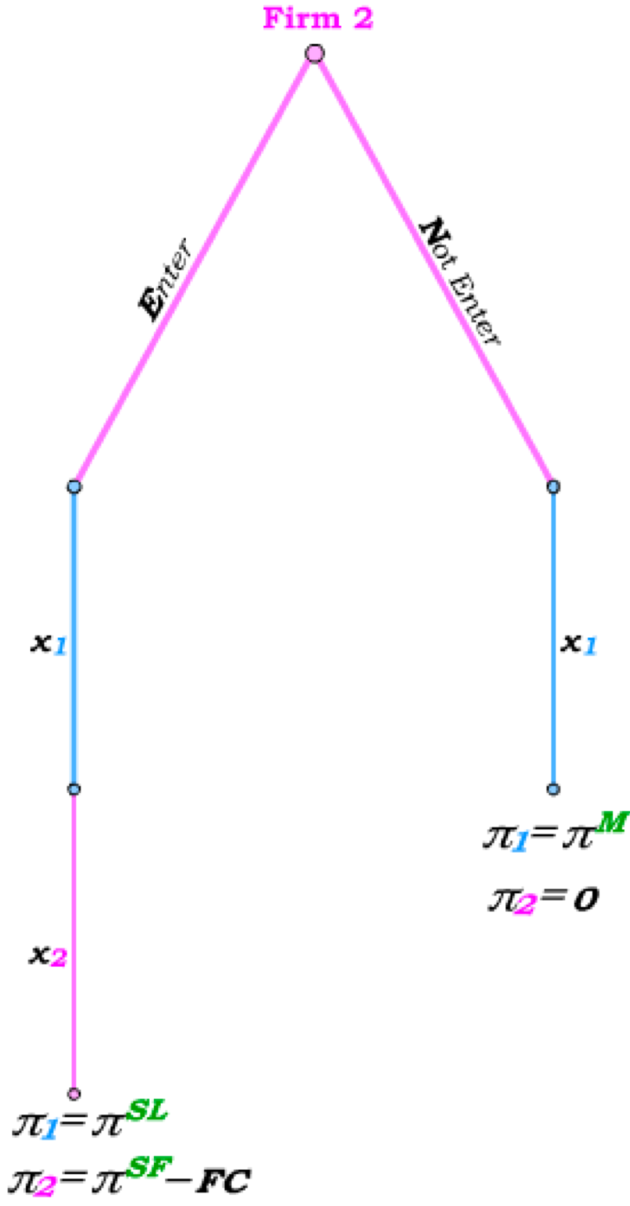
Sequences with No Entry Deterrence
Suppose firm 2 makes its entry decision prior to firm 1’s output decision.
If firm 2 does Not Enter, firm 1 has full monopoly power and thus earns the monopoly profit.
Enter if π^{C} > FC.
Enter if π^{SF} > FC.
If firm 2 does Enter and output is determined simultaneously, the Cournot equilibrium is reached.
If output is instead determined sequentially, we reach the Stackelberg equilibrium.
In both cases, whether or not entry occurs depends only on the size of the fixed entry cost FC. Use backward induction.
In neither case can firm 1 influence firm 2’s entry decision – any threat firm 1 could make would be non-credible.

Slide 15
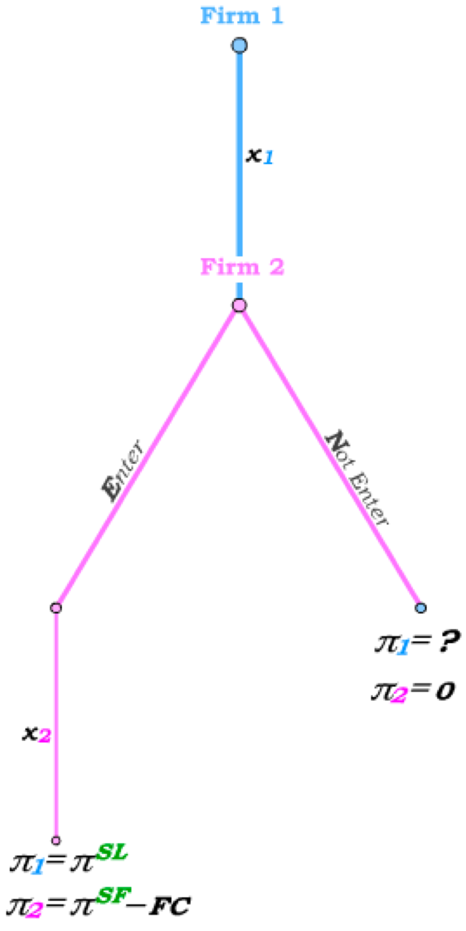
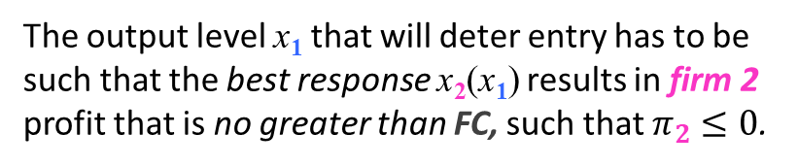
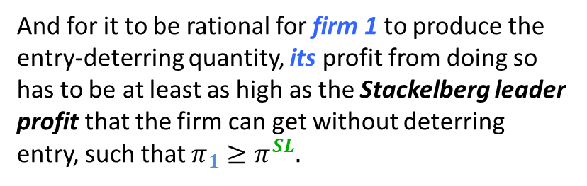
Entry Deterrence
But now suppose that the incumbent firm 1 determines its output prior to firm 2 making its entry decision.
Now firm 1 does not need to threaten – it can simply produce an output level that will deter entry by firm 2.
If firm 2 Enters because firm 1 chooses not to deter entry, firm 1 and firm 2 simply become a Stackelberg leader and follower.
But if firm 1 sets output to deter entry, firm 1’s profit is determined solely by the output level it produced.
The output level x₁ that will deter entry has to be such that the best response x₂(x₁) results in firm 2 profit that is no greater than FC, such that $π_{2}≤0$.
And for it to be rational for firm 1 to produce the entry-deterring quantity, its profit from doing so has to be at least as high as the Stackelberg leader profit that the firm can get without deterring entry, such that $π_{1}≥π^{SL}.$

Slide 16
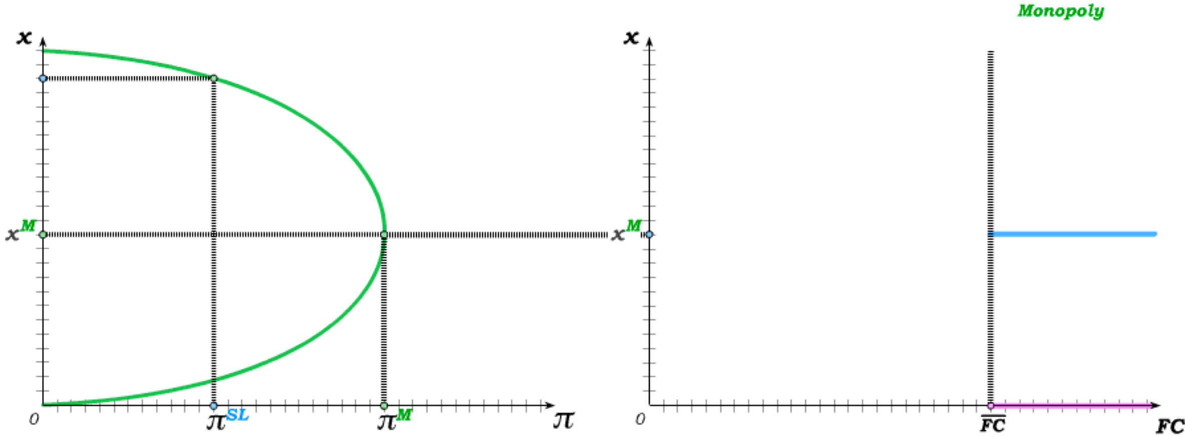
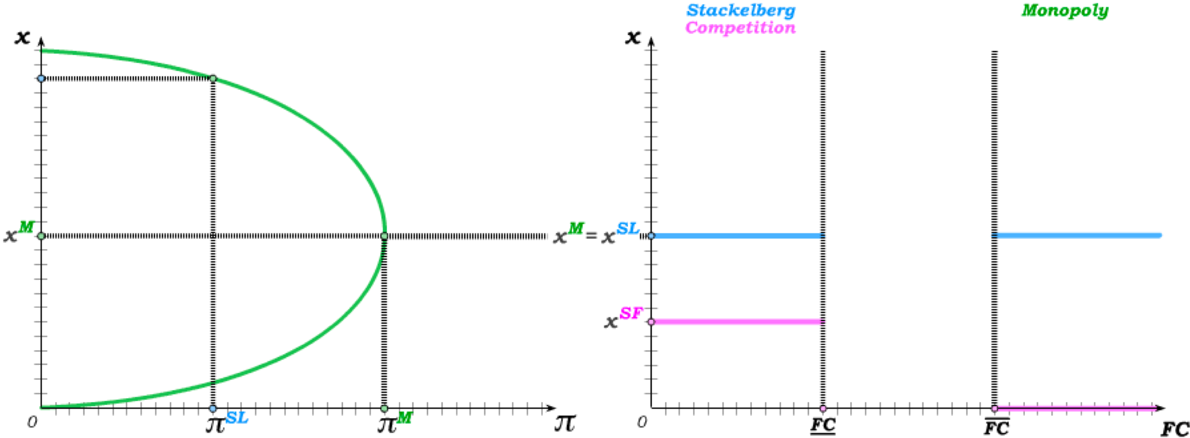
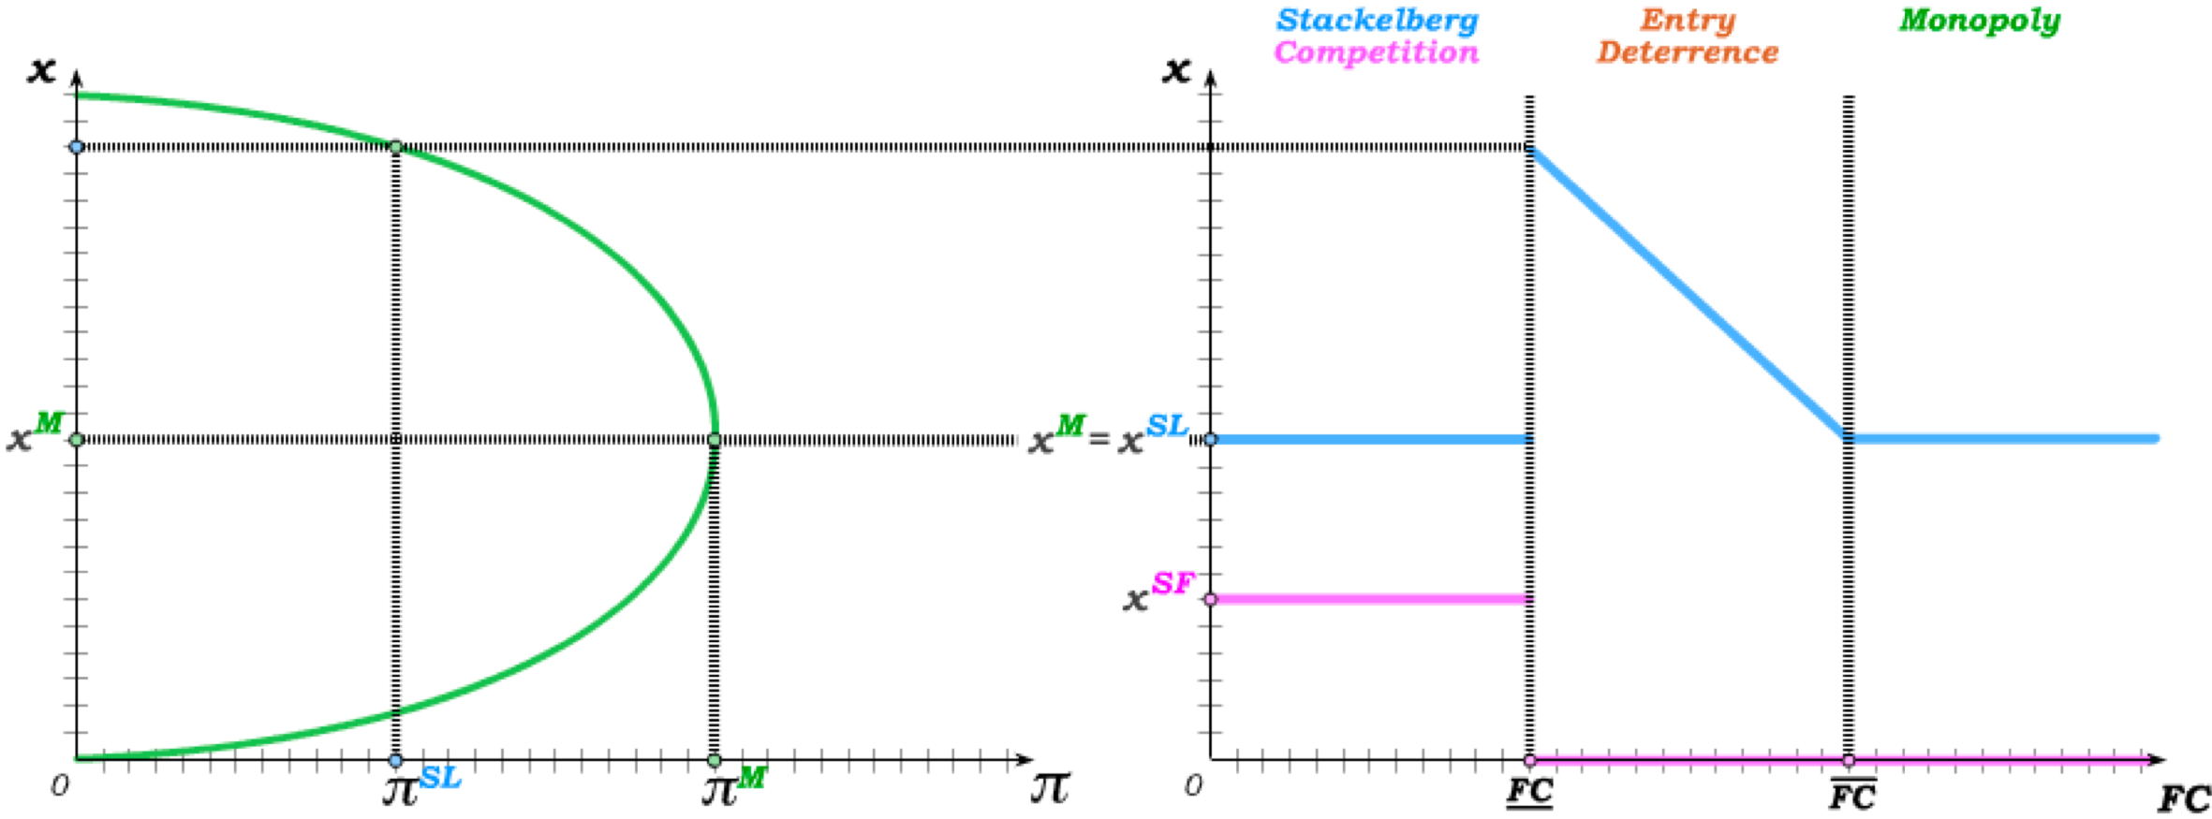
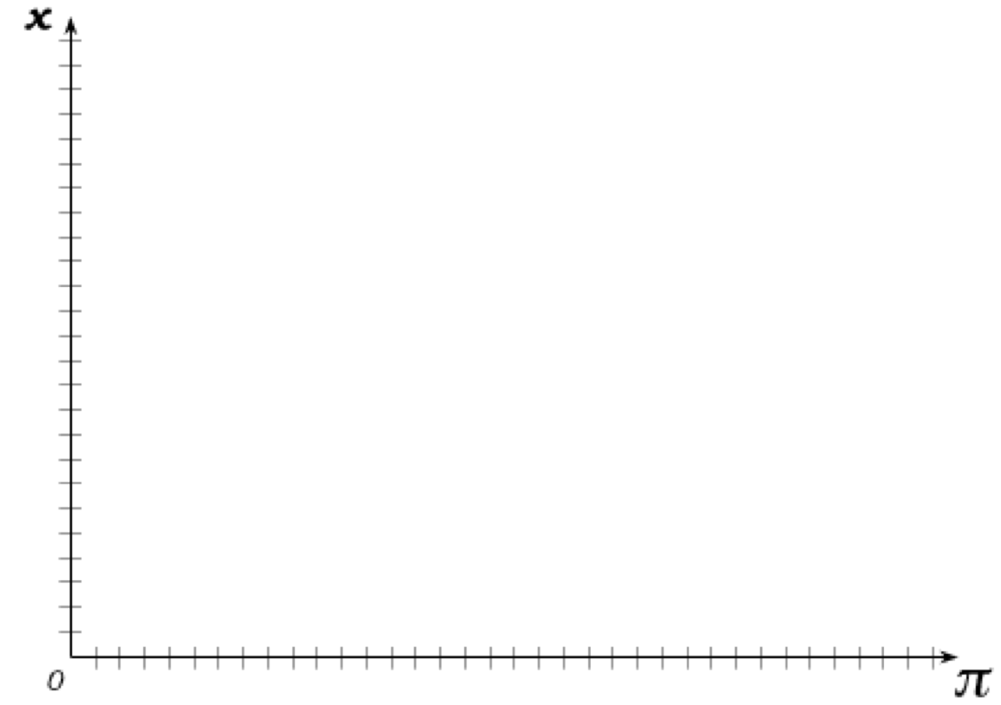
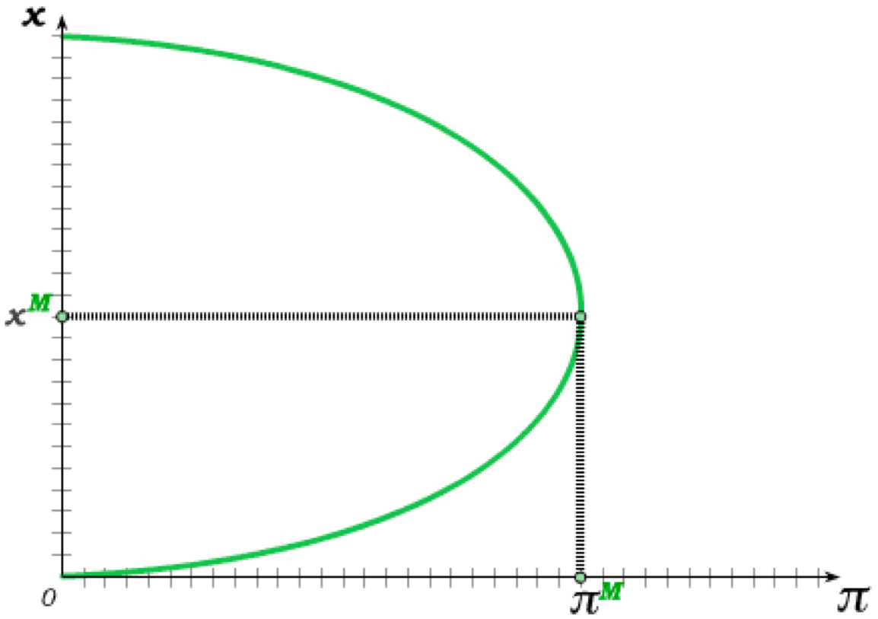
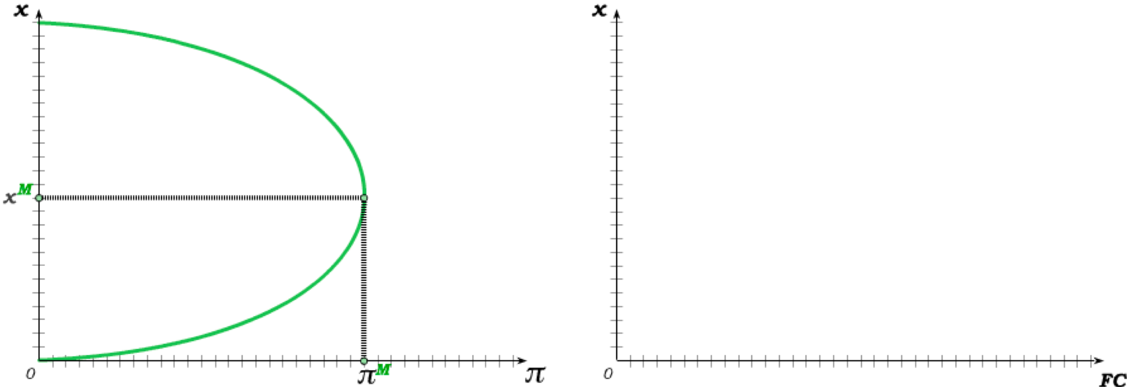
FC that Makes Entry Deterrence Possible
The profit the incumbent firm 1 gets by being the only firm in the market initially increases with output but eventually decreases.
For sufficiently high entry costs FC, firm 2 will not enter even if firm 1 produces x^{M}.
For sufficiently low entry costs FC, firm 2 the entry deterring output level is so high that firm 1 does better by allowing entry and becoming the Stackelberg Leader.
But for entry costs FC that lie in between, firm 1 produces above x^{M} to deter entry.

Slide 17
Cartels and the Prisoner’s Dilemma
Strategically thinking firms in an oligopoly always end up jointly producing more than the monopoly output level.
Since the monopoly output level maximizes profit, oligopoly competition then results in less total profit than what could be achieved if the industry behaved as a monopolist. Without competition both firms would be better off.
A cartel agreement is an agreement to limit overall production in an oligopoly, with each firm assigned a quota of output that it is allowed to produce under the agreement.
Firms in a cartel thus collude with the aim of lowering output in order to raise price.
We will see, however, that each firm in the cartel has an incentive to cheat and produce more than its assigned quota
This results in a “Prisoner’s Dilemma” for the firms in the cartel, with collusion unraveling due to the incentive to cheat.

Slide 18
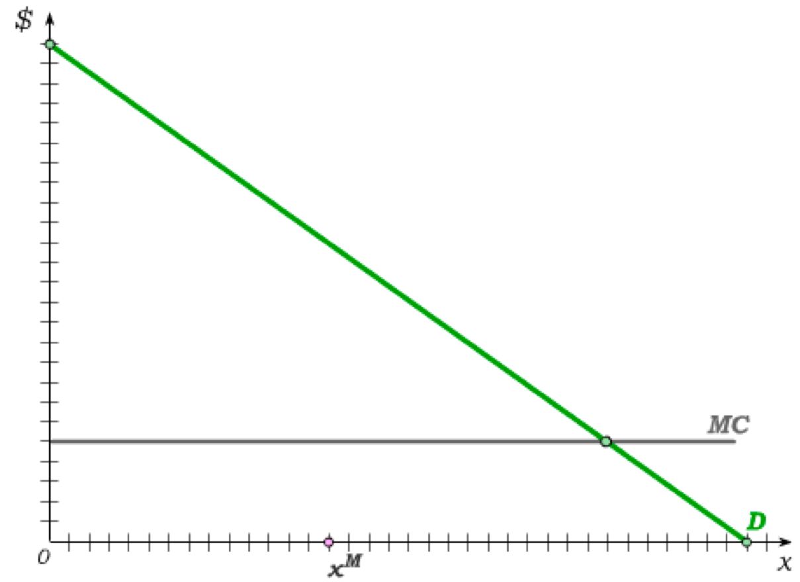
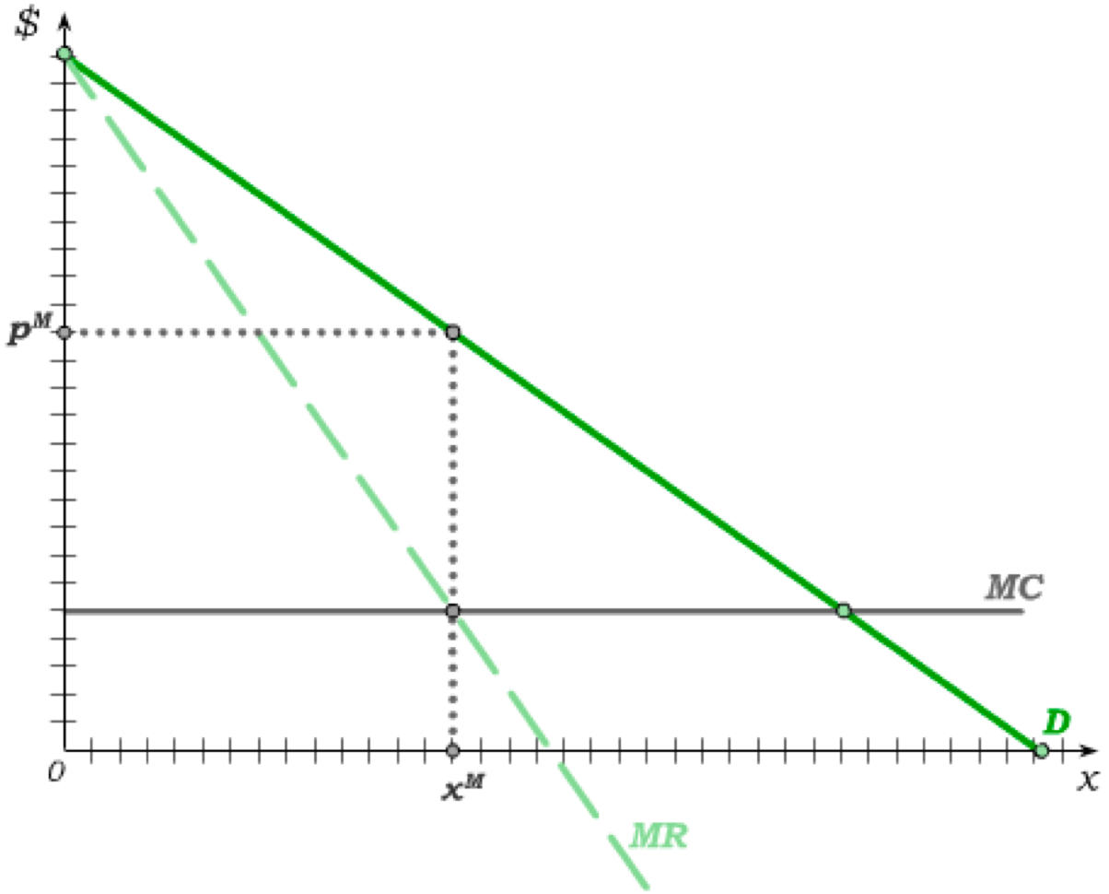
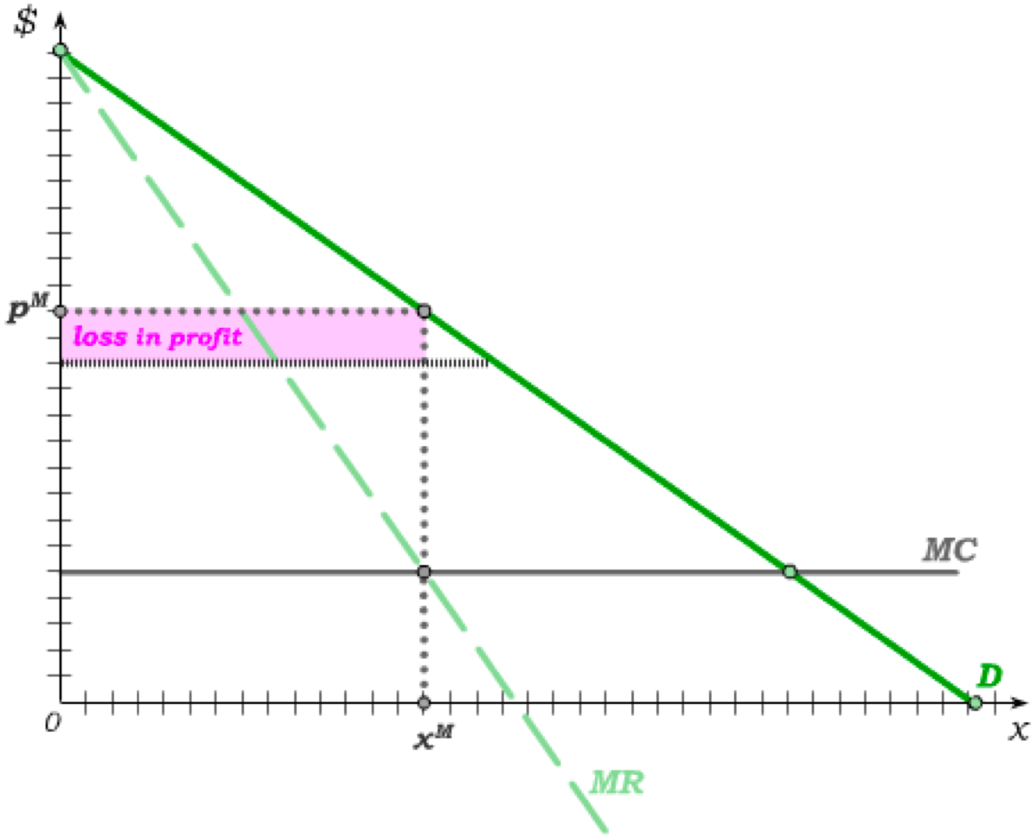
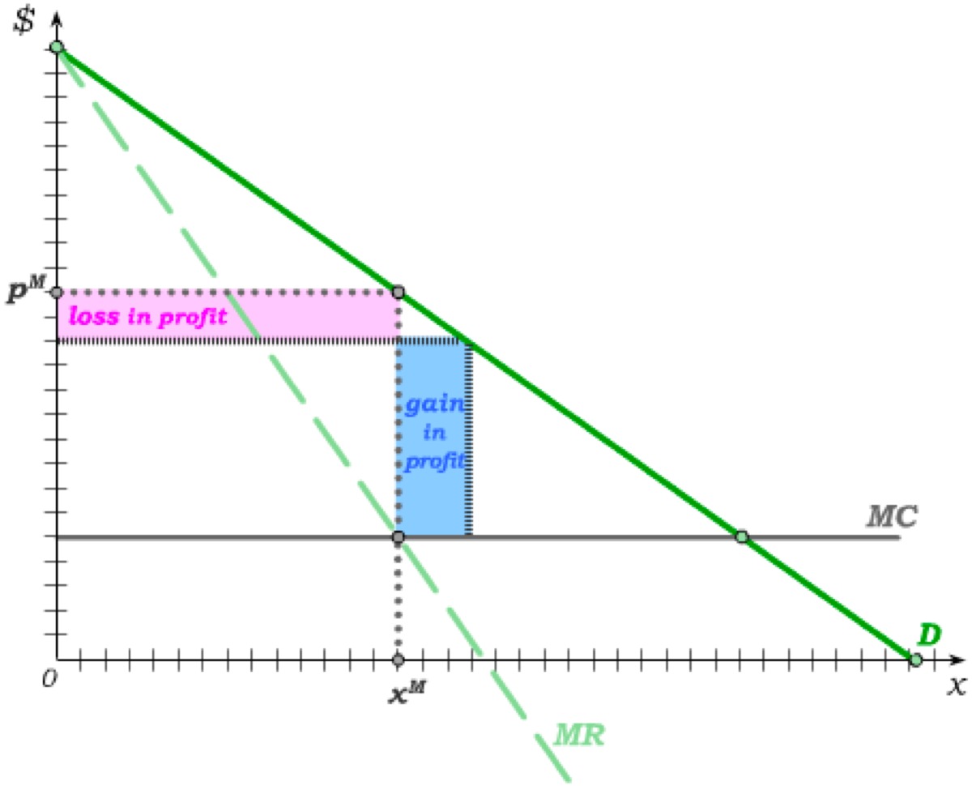
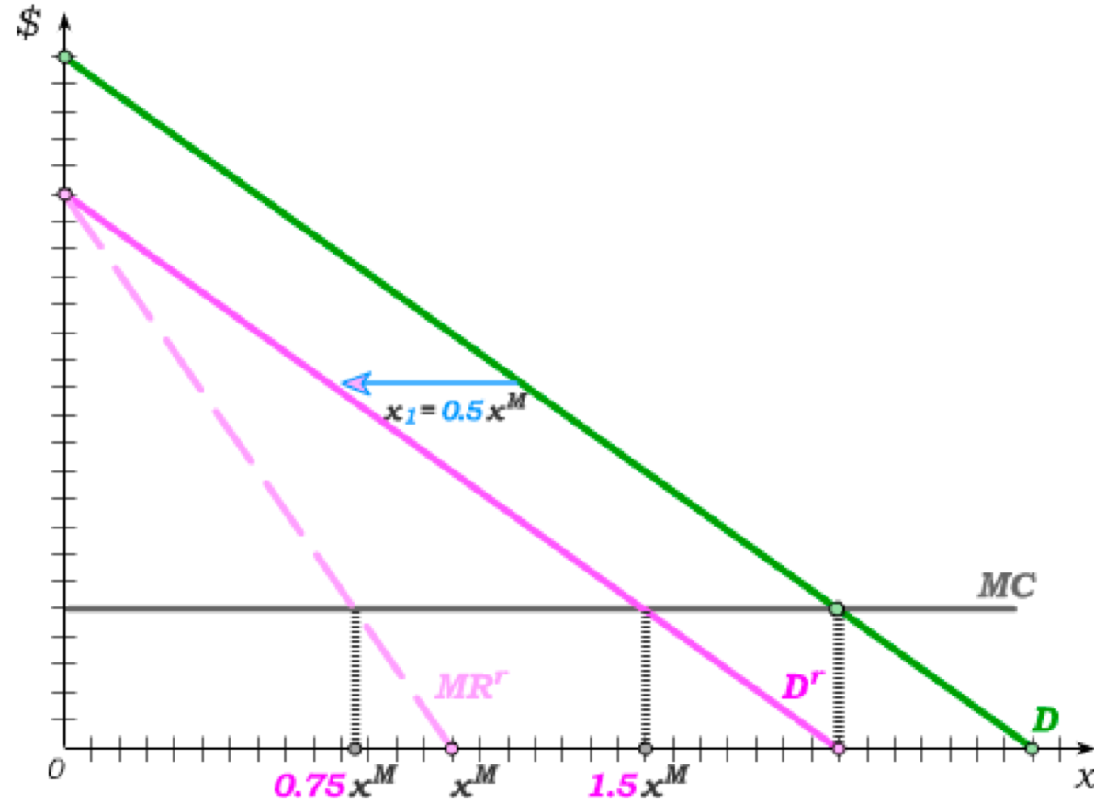
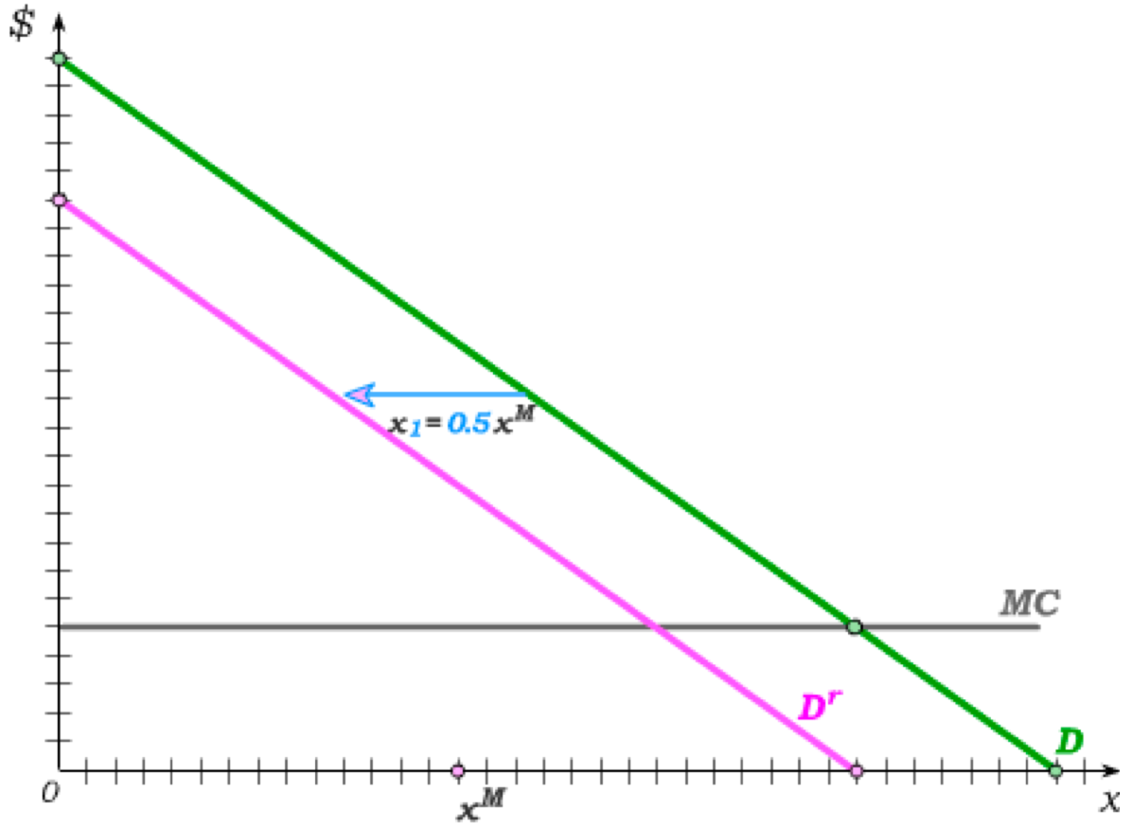
Incentives to Cheat in Cartels
Suppose the two firms in an oligopoly enter into a cartel agreement that has each of them producing half the monopoly quantity x^{M}.
This is the profit-maximizing output level for the
cartel – because the loss in profit from producing one more unit equals the gain in profit.
But if one of the firms in the cartel raises its output, it incurs only half the loss (because its selling half the quantity) while receiving the entire gain.
In fact, if firm 1 abides by the cartel agreement, we can see this incentive arising from firm 2’s residual demand …
€
This results in an incentive to cheat on the cartel agreement.
€
… with firm 2 best-responding by producing 50% more
than what was agreed
to in the cartel
agreement.

Slide 19
Cartels need an Enforcement Mechanism
For the firms in a cartel, colluding is the same as “cooperating”, and cheating (by producing more than the assigned quota) is the same as “not cooperating”.
Since it is always best for a firm in the oligopoly to cheat regardless of what other firms do, cheating (or “not cooperating”) is a dominant strategy.
Just as in any Prisoner’s dilemma, this results in everyone cheating – which, from the firms’ perspective, is inefficient because the firms could increase everyone’s profit by abiding by the cartel agreement.
Without an enforcement mechanism, cartel agreements therefore have a tendency to unravel, with oligopoly competition re-emerging.
Possible Enforcement Mechanisms:
– Trigger strategies in infinitely repeated interactions, or interactions that have a sufficient probability of recurring
– “Mafia” type regulations that change pay offs and “force” firms to abide by cartel quotas

Slide 20
Tutorial exercises
Within-chapter exercises:
  25A.1, 25A.2, 25A.3, 25A.4, 25A.5, 25A.6, 25A.7, 25A.8, 25A.11, 25A.12, 25A.15, 25A.17
End-of-chapter exercises:
  25.1, 25.2, 25.3, 25.5A (challenging)
Extra exercises (see Fenix)
  Open Q.1, Q.4, Q.10

Slide 21

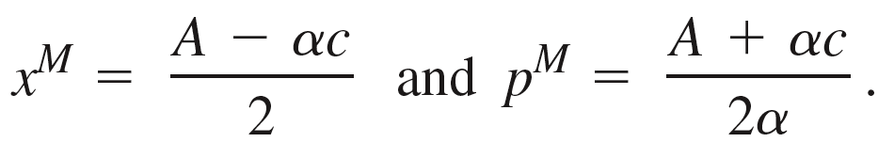

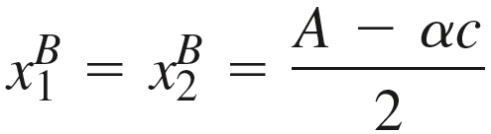

Bertrand Competition
Suppose there are 2 firms in an oligopoly, with both firms facing constant marginal cost c.
Suppose further that consumer demand is given by the function
In our treatment of monopoly (Chapter 23), we derived the monopoly quantity and price chosen by a single firm (assuming no price discrimination) as
Under Bertrand price competition, the Nash equilibrium price charged by both firms is equal to marginal cost MC = c – implying that total output under Bertrand competition is
Assuming each of the two firms produces half the total output, this implies the two Bertrand competitors will produce
at the Bertrand price
Bertrand output is then twice the monopoly output.

Slide 22





Quantity Competition
If the two firms compete by setting output rather than price, firm 2’s output of results in a residual demand function for firm 1 of
Solving for p, this gives the residual demand curve
€
The (residual) marginal revenue curve then has twice the slope, giving us
Setting this equal to MC = c and solving for firm 1 output, we get firm 1’s best response to as

Slide 23








Quantity Best Response Functions
The best response for firm 1 to a quantity produced by firm 2 then holds for any level of firm 2 output, allowing us to write the best response function for firm 1 as
Since firm 2 is identical to firm 1, we similarly can write firm 2’s best response function as
In a Nash equilibrium, firm 2 must be best-responding to firm 1’s actual output; i.e.
This implies , giving us Cournot equilibrium output of

Slide 24

Monopoly, Bertrand and Cournot Compared
Note that, in our example, the total output in the industry is
Thus,
We therefore get the relationship,
which further implies

Slide 25




Cournot Competition with More than 2 Firms
Suppose there are N firms in the oligopoly, with x_{i} denoting firm i’s output and x_{–i} denoting the output levels of all other firms; i.e.
Suppose further that p(x) is the demand curve, and all firms have costs c(x_{i}).
Firm i then takes the output levels of other firms, , as given when solving
The first order condition for this problem is
which can be written as

Slide 26





Cournot Competition with More than 2 Firms
By multiplying the first term in our marginal revenue equation by p/p, we can re-write it in the form if elasticities as
Since we are assuming identical firms, we know that output will be the same for all firms in equilibrium – allowing us to write total output in the industry as and thus writing marginal revenue as
The first order condition of the firm’s profit maximization problem is then
Cournot competition approaches Bertrand competition a the market becomes perfectly competitive!
As the number of firms N increases, the oligopoly price falls –
and as N gets large, price approaches MC.

Slide 27




Stackelberg Competition
Now suppose firm 2 chooses output after observing firm 1’s output.
When determining it’s output, firm 1 knows firm 2’s best response function which we derived for out 2-firm model as
Subtracting this from the market demand function, we then get firm 1’s residual demand function
€
Solving for price, this gives us firm 1’s residual demand curve
The residual marginal revenue curve then has the same intercept but twice the slope; i.e.

Slide 28








Stackelberg Equilibrium
Firm 1 will then produce where its residual MR is equal to MC; i.e.
Monopoly quantity
€
Plugging this into the best response function for firm 2,
Half of the Monopoly quantity

Slide 29
Oligopoly with Asymmetric Information
Now suppose that firm 1’s marginal cost is still c but firm 2 might have either high marginal cost c^{H} or low marginal cost c^{L}.
The probability that firm 2 has high marginal cost c^{H} is ρ.
The Cournot quantity setting game played by the two firms is then a Baysian game of incomplete information.
Such games are modelled in a sequential setting, with the fictional player Nature moving first and assigning either a high cost type or a low cost type to firm 2 prior to the simultaneous quantity setting game.
A strategy for firm 2 (prior to the onset of the game) is then the selection of a quantity x^{H} in the event firm 2 has high costs and a quantity x^{L} in the event it has low costs.
Firm 2 then takes output x₁ as given when choosing its quantity.
And firm 2 takes the strategy (x^{L}, x^{H}) as well as the probability ρ as given when choosing its quantity x₁.
The Cournot equilibrium is reached when the two firms are best-responding to one another (given the beliefs ρ on the part of firm 1).

Slide 30




Oligopoly with Asymmetric Information
Continuing with the demand curve , we can then write firm 1’s optimization problem as
and firm 2’s optimization problem, once its type i has been revealed, as
Solving these in the usual way, we get the best response functions
for firm 1 and
for firm 2.

Slide 31




Oligopoly with Asymmetric Information
Substituting firm 2’s best response functions into firm 1’s and solving for firm 1 output, we get
Firm 1 produces less than it would if it knew firm 2 to be a high cost type, and more than it would if it knew firm 2 to be a low cost type.
Substituting back into firm 2’s best response functions, we get
Because of asymmetric information, firm 2 produces more if high cost and less if low cost (compared to full information).
output in the absence of asymmetric information

Slide 32


Entry Deterrence
In an entry deterrence model, the incumbent firm (firm 1) may set output such that the potential entrant (firm 2) is deterred from entering.
To what extent this will happen depends on how high the fixed entry cost FC is for the potential entrant.
If the FC falls below some level , deterrence is not profitable for firm 1 and the two firms become Stackelberg competitors.
And if FC lies above some level , there is
no need for deterrence and firm 1 can simply behave as a monopoly.

Slide 33






Entry Deterrence
In our model with constant MC of c and market demand of , the monopoly quantity is equal to the Stackelberg leader quantity:
But because firm 2 also produces half the monopoly quantity in the Stackelberg equilibrium, the monopoly price differs from the Stackelberg price, with
and
If the incumbent firm 1 produces the monopoly output, it is then a best response for the entrant firm 2 to enter the market only if the Stackelberg follower profit is no less than FC.
The entrant is indifferent between entering and not entering if
The FC above which there is no need for entry deterrence is then

Slide 34



Entry Deterrence
Next, suppose FC is less than .
Firm 1 knows that firm 2, if it enters, will produce according to its best response function
.
Given the market demand curve , firm 1 can therefore predict, assuming firm 2 enters, the price for any level of output x₁ that it produces:
Firm 1 also knows that firm 2 will not enter if its profit from entering is negative; i.e. if
Substituting firm 2’s best response function x₂(x₁) as well as p(x₁) into this inequality, we can conclude that firm 1 knows firm 2 will enter if

Slide 35







Entry Deterrence
Firm 1 then has a choice:
Either produce a quantity sufficient to deter entry;
or allow entry and produce the Stackelberg leader quantity.
Produce output such that
Implies the Stackelberg leader profit
which implies the lowest entry-deterring output is
Firm 1 will deter entry if
.

Slide 36












Entry Deterrence
Setting , we can solve for the highest quantity that firm 1 is willing to produce to deter entry:
We previously calculated the entry deterrence quantity as
.
Setting , we can then solve for the lowest fixed entry cost for which firm 1 will engage in entry deterrence:
Thus:
implies
implies
implies

Slide 37





Cartels and the Incentive to Cheat
For use with Nechyba, Intermediate Microeconomics © 2018 Cengage EMEA, ISBN: 9781473759008
Under a profit maximizing cartel agreement, a 2-firm oligopoly would
agree to split production of the monopoly quantity.
The two firms might, for instance, agree to produce half of x^{M} each.
The profit for each firm in the cartel would then be
Suppose firm j abides by the agreement but firm i finds its best response quantity.
It would then solve the following optimization problem:
Solving this in the usual way, we get the Deviating quantity which is 50% greater than half the monopoly quantity, with profit

Slide 38


Dynamic Collusion
We would then predict that, in the absence of an enforcement mechanism, a cartel cannot sustain collusion.
But now suppose that the two firms interact an infinite number of times. (This is similar to assuming that there is some probability that the two firms will “meet” again each time that they “meet.”)
We know from our work on infinitely repeated games that subgame perfect Nash equilibria can involve trigger strategies in such settings.
Consider the following such strategy:
Stick by the cartel agreement to produce half the monopoly quantity but revert to the single-period Cournot quantity if the other firm has ever not stuck by the cartel agreement.
Each firm’s profit from both firms playing this strategy (assuming discounting of δ) is

Slide 39





Dynamic Collusion
If firm j plays the trigger strategy but firm i deviates, firm i gets the “deviation profit” once and from then on gets the single period Cournot profit
The profit if deviating from the trigger strategy is then
It is then not profitable to deviate from the trigger strategy if
which holds so long as .
So long as firms don’t discount the future too much, the cartel agreement
can be sustained in an infinitely repeated setting.

