Slide 1




Sociology of Work
The diversity of systems of industrial relations, trends and challenges

Slide 2
Industrial relations: a definition
“Industrial Relations deal with either the relationship between the state and employers and workers organizations or the relation between the occupational organizations themselves.” Int. Labour Organization (ILO)
web of institutionalised relationships between employees and their representatives (trade unions), employers and their representatives (employers’ association), and the state. The relations exist on different levels (national, sector, enterprise) and between different actors. Industrial relations aim to establish rules that will be applied to:
Sectors of activity
Firms and employers
One single firm/employer

Slide 3
A framework for industrial/labour relations (J. Dunlop)
Context
Economy, politics, technology and law
Actors
Employers/managers, workers or their representatives and public bodies (State) that mediate the relationship between the previous actors
Collective bargnaining process (rules for operating this process): e.g. bargaining, arbitration, etc.
Rules
(wages, working times…)
Ideology
Capacity to achieve compromise in some objectives
Creating and administrating these rules/processes is the main objective of the system of industrial relations

Slide 4
Think, pair, share... Give examples of context and ideology (how can they impact?)
Context
Economy, politics, technology and law
Actors
Employers/managers, workers or their representatives and public bodies (State) that mediate the relationship between the previous actors
Collective bargaining process (rules for operating this process): e.g. bargaining, arbitration, etc.
Rules
(wages, working times…)
Ideology
Capacity to achieve compromise in some objectives
Creating and administrating these rules/processes is the main objective of the system of industrial relations

Slide 5
What do Unions Do? (Freeman and Medoff, 1984)
Improving job satisfaction → paradox: unionized workers less satisfied?
Increasing wages and reducing wage inequalities
Unemployment
Advantages of organized industrial relations

Slide 6
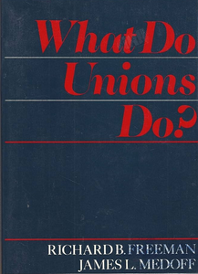
What do unions do? (Freeman and Medoff, 1984)
Improving job satisfaction?
Paradox: unionized workers less satisfied
Union members better equiped to use ‘voice’
Greater expectations
Job satisfaction depends on factors outside control of unions; focusing on wages
Self-selection and reverse causality: unions are stronger in sectors with poor working conditions, dissatisfied workers more likely to join an union
Bargaining-rules and free-riders
Stronger unions → less confrontational work climate → greater satisfaction

Slide 7
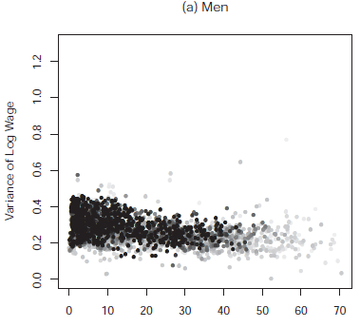
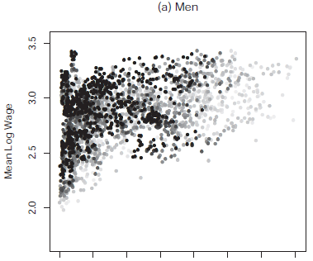
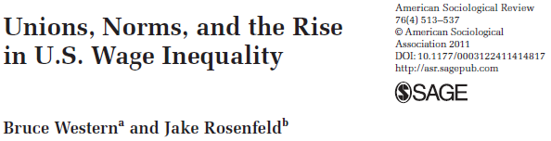
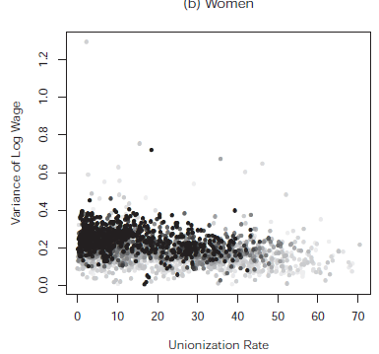
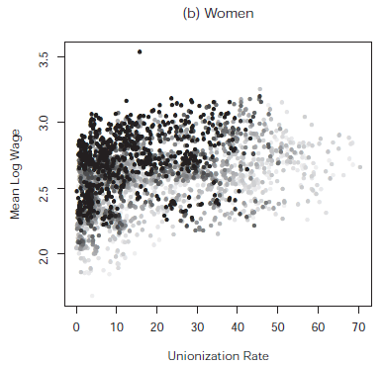
Of unions and wages
Unionization Rates and the Variance of Log Hourly Wages (left) and Mean Log Hourly Wages (right) for Full-Time, Private Sector, Non-union Workers, 1973 to 2007
Unions reduce wage inequality, especially where bargaining processes are centralized
Effect on non-union wages: threat of unionization (US), shapping norms (e.g. Equal pay) and extending collective agreements (e.g. France)
Source: Western and Rosenfeld (2011): Fig. 4 and 5. Points go from grey to black from 1973 to 2007.

Slide 8
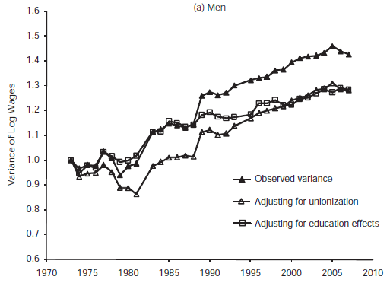
Of unions and wages
Total Variance of Log Hourly Wages, Full-Time, Private Sector 1973 to 2007
Impact on unemployment: temporary increases?
Impact on wage inequality may have inverted “U” shape:
Increasing in t1 (>difference between union and non-union workers) and decreasing in t2 (lower wage demands / concern for unemployment and extension of collective agreement to non-union workers)
Montebello et al (2022) Trade unions and income inequality: Evidence from a panel of European countries, Int Labour Review, https://doi.org/10.1111/ilr.12373
Source: Western and Rosenfeld (2011): Fig. 8. Variances adjust for unionization and education; variances are set to equal 1 in 1973.

Slide 9
Other advantages of organized workers
Internalizing conflicts → concensus building, ‘social peace’
Unions seek legitimacy → shaping public policies
‘Voice’
Mobilizing workers for implementing reforms
Accountability and transparency

Slide 10
Main models of industrial relations
Social-democrat model (Nordic cluster)
Liberal model (Western cluster)
Mediterranean model (Southern cluster)

Slide 11
Social-democrat model
Main principle: compatibility between equity (re-distributive policies) and market
Non-reformist (does not seek to topple capitalism)
Consolidated democracy
Unified and powerful trade unions/confederation of trade unions linked to a strong social-democrat party
Cooperative bargaining/seeking compromise
Centralized and highly regulated collective bargaining process: e.g. collective agreements at sector level
Integration of labour/workers at firm level through mechanisms of information and consultation (e.g. workers’ councils).
High percentage of unionized workers
Source: Cerdeira, M. C. (2014), “Padrões e mudanças nas relações laborais”, in Kovács, Ilona (coord), et al., Temas atuais em Sociologia do Trabalho, Fundação Económicas, Almedina

Slide 12
Social-democrat model
Outcomes:
Trade unions are part of the political process and society
Social dialogue is very much favoured and social partners are key actors in society (incl. public policies)
Bargaining processes extends to other economic and social domains (quantitative and qualitative issues)
Negotiation type: ‘integrative’
Examples:
Sweden, Finland, Norway, Denmark
If you want to know more:
https://nordics.info/show/artikel/trade-unions-in-the-nordic-region

Slide 13
Liberal model
Inspired mostly by the UK model
Most representative example: USA
Particularly after the 80s and influence of neo-liberalism:
Decentralized negotiating bargaining process (at the company/firm level)
Low percentage of unionized workers
Low level of regulation (voluntarist basis or ‘free’ collective bargaining).
The actors lack strong central organisations for co-ordination of interests.
Only occasionally do actors play an influential role in policy-making (by lobbying).
Volunteer
(low regulation and collective barganining)
Economic perspective of the interests of workers (wages and quantitative issues)
Limited intervention (by trade unions) in other social or economic spheres
Capitalism is accepted; not part of a broader (European-wide) socialist/social-democrat process

Slide 14
Mediterranean model
Co-existence of several trade unions/confederations grouped according to ideology (‘pluralism’)
Bargaining relations based on “opposition and conflict”; opposition to the state
Several structures/trade unions represent/compete for the same workers → conflict
intersecting politicised trade union divisions and fragmented labour movement → conflict
Negotiation type: ‘distributive’
Collective agreements at sector and company/firm level
Recent development: Troika intervention decentralized bargaining proccess (e.g. company-level agreements now have priority over sector-wide agreements).

Slide 15
Mediterranean model
Outcomes:
Strong divisions between trade unions: each representing very different visions of change
Conflict-driven negotiations
Bargaining content: minimalist orientation focused on quantitative topics (wages)
High level of regulation but weak effectiveness (gap between formal level and impact).
Examples:
Italy, France, Spain and Portugal

Slide 16
The example of Portugal: collective barganining
Conselho Económico e Social: Economic and Social Council → to promote social dialogue and involve social partners in decision-making process
Comissão Permanente de Concertação Social: Social Concertation Standing Committee
Type of agreements: here
Employees | Employers | State (Ministry of Labour/Employment )
CGTP-IN (Confederação Geral dos Trabalhadores Portugueses – IN) UGT (União Geral de Trabalhadores) | CIP (Conf. Empresarial de Portugal) (mostly industry) CCP (Conf. Com. e Serviços de Portugal) (services) CAP (Conf. Agricultores de Portugal) (agriculture) CTP:(Conf. Turismo Português) (tourism) | DG Employment and Labour Relations (www.dgert.msess.pt/) Authority for Working Conditions (www.act.gov.pt/)

Slide 17
The example of Portugal: representation of workers in companies
Two possibilities:
Union representatives (delegados sindicais) may set up trade unions (comissões sindicais de delegados) and coordination commissions made up of different trade unions (comissões intersindicais de associações sindicais). Exclusive right to sign collective agreements and call for industrial action (strikes)
Workers’ council or committees (comissões de trabalhadores and subcomissões de trabalhadores).
Workers’ councils or committees in European companies: EU-level companies employing at least 1000 workers in all EU Member-States and 150 workers in at least 2 different Member States (each)

Slide 18
Collective Barganining Instruments in Portugal (Instrumentos de Regulamentação Coletiva de Trabalho - IRCT)
Type | Negotiation process | Actors | Scope
Company Agreement (Acordo de Empresa) | Negotiation | One or more trade unions and one employer (company or premisse/facility) | Company/firm or premisse/facility
Collective Agreement (ACT – Acordo Coletivo de Trabalho) | Negotiation | One or more trade unions and several individual employers | Companies/firms that negotiate the agreement
Collective Contract (CCT – Contrato Coletivo de Trabalho) | Negotiation | One or more trade unions and one employer association | Companies/firms and employees in one sector that are members of the associations/trade unions that negotiate the agreement
Accession Agreement (Acordo de Adesão) | Negotiation | Agreement/accession to an instrument negotiated by other trade unions or employer association | Company/firm
Extenson By-law (Portaria de extensão) | By-law by the Ministry of Labour/Employment | Extension to other companies within the same activity/sector | Companies/firms from the same sector or workers in the same profession.
Regulation for Minimum Standards (Regulamento de condições mínimas) | By-law by the Ministry of Labour/Employment | Thecnical commission (e.g. when there are no trade unions) | Companies/firms and employees not convered by other instruments
Compulsory Arbitration Decision (Decisão Arbitragem Obrigatória) | Arbitration | Arbitration Court | Any premisse or company/firm or worker

Slide 19
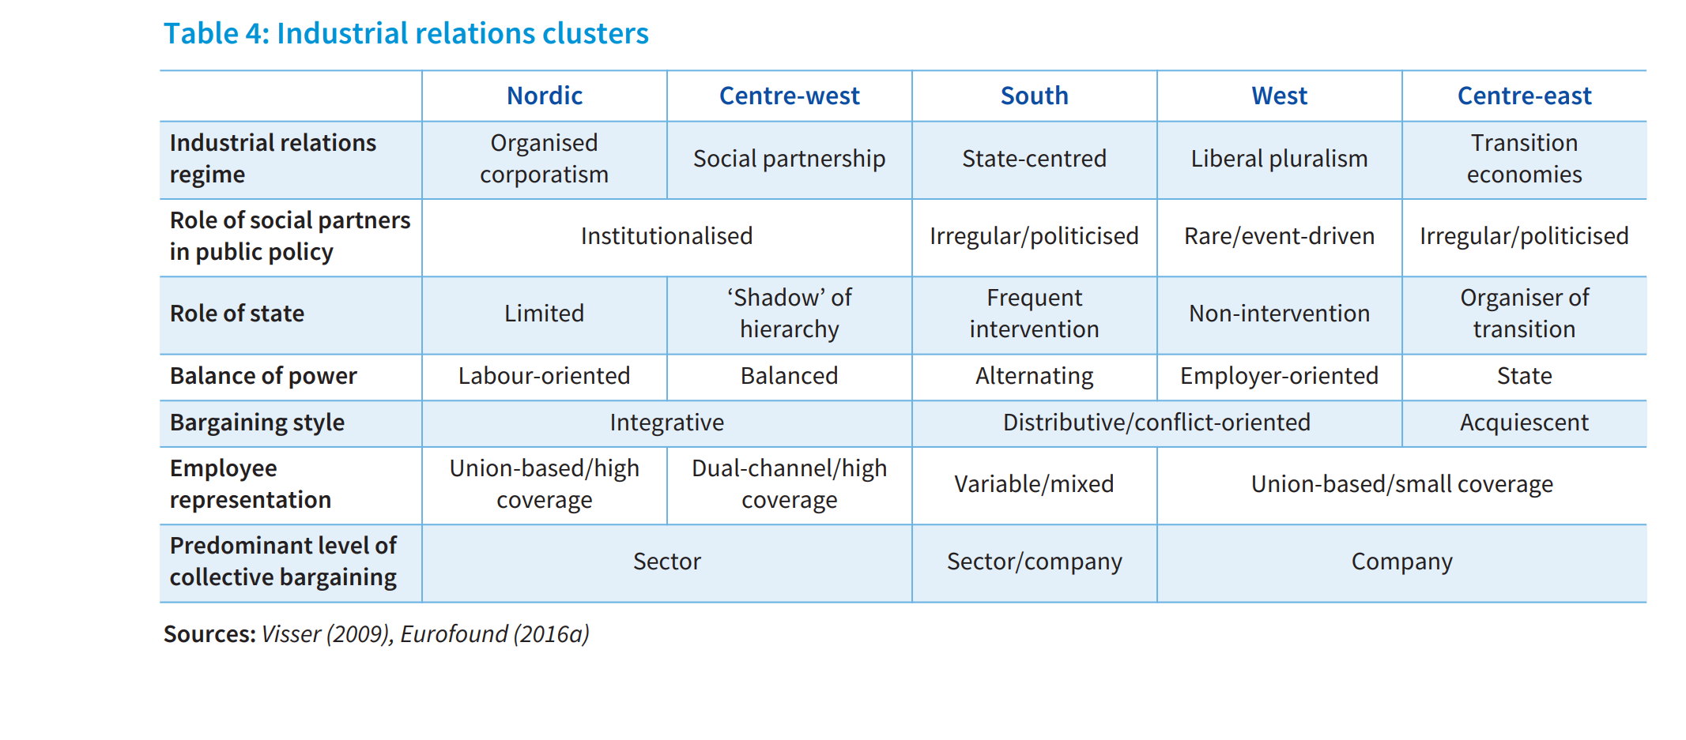
Models of industrial relations (Visser, Eurofound)
Source: Eurofound (2017), Table 4.

Slide 20
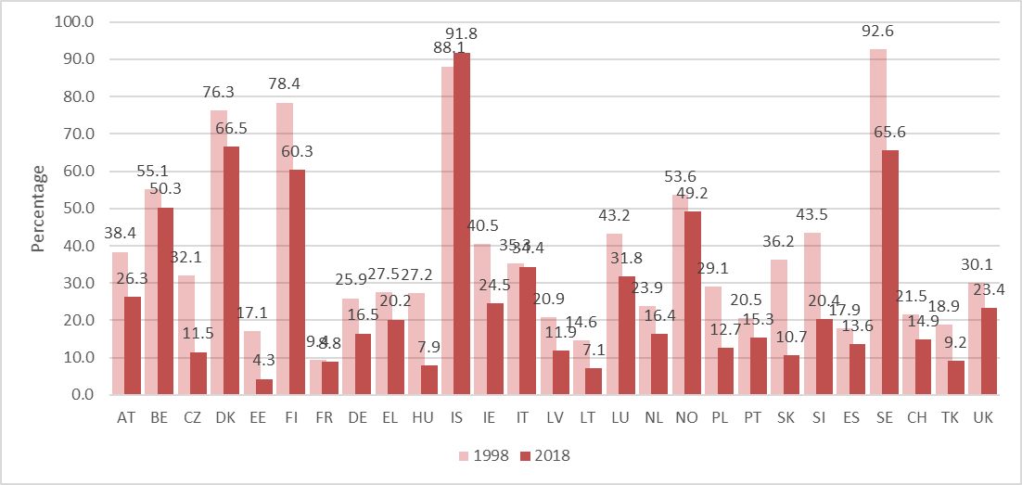
Unionization rates across EU
Percent of unionized employees, per country (1998 and 2018)
Source: OECD Trade Union Dataset. Data for 2018 refers to that year or latest available year.

Slide 21
Think, pair, share: causes for decline in unionization rates
Looking at the previous figure, think of reasons for the decline in unionization (3 minutes)
Hint: some are connected with other points we discussed in the programme of Sociology of Work
Pair with your neighbour and exchange views (3 minutes)
Share them with the class

Slide 22
Causes for the decline of unionization rates
Changing nature of work:
Service vs industrialization;
Atypical forms of work: individualization of working relations, self-employed
De-regulation of the labour market: e.g. troika interventions and austerity
Dealing with a more diverse workforce
Higher unemployment limited mobilization

Slide 23
Negotiation strategies
Distributive
Integrative
Win-lose, zero-sum, competitive and confrontational strategy, emphasis on differences
Win-Win, cooperation and collaboration, problem solving, reciprocity
The negotiators are worried about their results and not concerned with common objectives; distribution of value
Maximizing opportunies for consensus and using up all resources; creation of value
* This typology was initially developed by Walton & McKersie (1965), and later updated by others – cf., Robbins, S. (1998). Organizational Behavior, 8th edition. Prentice-Hall, New Jersey, pp: - 450-453

Slide 24
“Survival game”
You have 50 coins. Use these as a bargaining tool (money) to purchase the resources you need to live. You cannot barter goods; you must negotiate with coins. Write down the coins you spent and received (to whom, from whom) and the resources you purchased.
Each team has one resource (there are 5 in total). All have about equal value.
To “live,” you must use your coins to get at least 4 of the 5 resources. You do not need to possess all the resources at once; you simply need to have at least four at some point during the game. Once a resource is obtained, you have “accessed the resource and satisfied your need.” You can then sell that resource and purchase others.
To win: You must “live” and have the most coins at the end of the game.
Duration: 8 minutes.

Slide 25
“Survival game”
You have 50 coins. Use these as a bargaining tool (money) to purchase the resources you need to live. You cannot barter goods; you must negotiate with coins. Write down the coins you spent and received (to whom, from whom) and the resources you purchased.
Each team has one resource (there are 5 in total). All have about equal value.
To “live,” you must use your coins to get all the 5 resources. You do not need to possess all the resources at once; you simply need to have at least four at some point during the game. Once a resource is obtained, you have “accessed the resource and satisfied your need.” You can then sell that resource and purchase others.
To win: You must “live”.
Duration: 8 minutes.

Slide 26
Looking back at Organisational Modes
Percent of employees by organisational type/class, per country (2000)
 | Discretionary learning organisation | Lean production | Taylorist organisation
Belgium | 38,9 | 25,1 | 13,9
Denmark | 60,0 | 21,9 | 6,8
Germany | 44,3 | 19,6 | 14,3
Greece | 18,7 | 25,6 | 28,0
Italy | 30,0 | 23,6 | 20,9
Spain | 20,1 | 38,8 | 18,5
France | 38,0 | 33,3 | 11,1
Ireland | 24,0 | 37,8 | 20,7
Luxembourg | 42,8 | 25,4 | 11,9
Netherlands | 64,0 | 17,2 | 5,3
Portugal | 26,1 | 28,1 | 23,0
United Kingdom | 34,8 | 40,6 | 10,9
Finland | 47,8 | 27,6 | 12,5
Sweden | 52,6 | 18,5 | 7,1
Austria | 47,5 | 21,5 | 13,1
EU-15 | 39,1 | 28,2 | 13,6
Source: EUROFOUND, 3rd European Working Condition Survey in OECD (2010) Innovative Workplaces, OECD, Paris, p.40

Slide 27
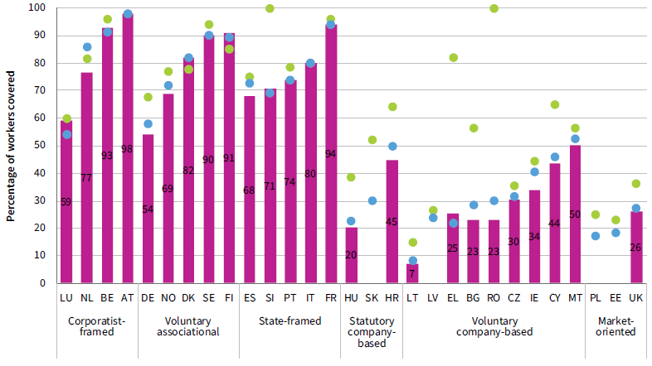
Coverage of collective bargaining in the EU
Collective bargaining coverage rates, 2000, 2014 and 2018
Changing nature of collective bargaining: no longer limited to wages.
Work-life balance, skills and flexibility
Source: Eurofound (2020) Figure 4, based on ICTWSS (database available at: https://www.ictwss.org/downloads)

Slide 28
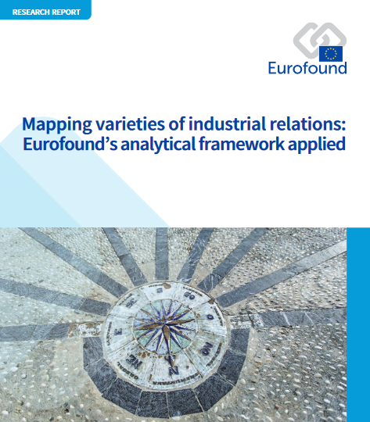
Essential reading:
Western, B. & Rosenfeld, J. (2011), Unions, Norms, and the Rise in U.S. Wage Inequality. American Sociological Review, 76(4) 513–537.
EUROFOUND (2017), Mapping Varieties of Industrial Relations: Eurofound’s Analytical Framework Applied. Publications Office of the European Union, Luxembourg. (Chapter 3)
The CORE team (2017): The Economy: Economics for a Changing World, UNIT 16.9
http://www.core-econ.org/the-economy/book/text/0-3-contents.html#contents

Slide 29


www.iseg.ulisboa.pt

